Slide 1
Project: IEEE P802.15 Working Group for Wireless Personal Area Networks (WPANs)
Submission Title: [Follow up on the CIR bitmap pattern]
Date Submitted: [July, 2023]
Source: [Chenchen Liu, Bin Qian, Lei Huang, David Xun Yang] Company [Huawei Technologies]
Address [Huawei Bantian Base, Longgang District, Shenzhen, 518129 China]
E-Mail:[liuchenchen1@Huawei.com]
Re: [Task Group 4ab: UWB Next Generation]
Abstract: [The mandatory CIR bitmap patterns are listed and the signaling method is discussed]
Purpose: [ ]
Notice: This document has been prepared to assist the IEEE P802.15. It is offered as a basis for discussion and is not binding on the contributing individual(s) or organization(s). The material in this document is subject to change in form and content after further study. The contributor(s) reserve(s) the right to add, amend or withdraw material contained herein.
Release: The contributor acknowledges and accepts that this contribution becomes the property of IEEE and may be made publicly available by P802.15.

Slide 2
Background
To limit the test burden, some mandatory CIR report bitmap patterns are defined:
For each bitmap length M = {32, 64, 128, 256}, two strings of all ones, with equal length L = {16, 32, …, M/2}. The gap options between them are defined as
$G =$ $\left\{\begin{aligned} 0 for L=M/2 \\ \frac{M}{2}−2L+\left\{8,16,….\frac{M}{2}\right\} o.w. \end{aligned}\right.$

Slide 3
Background
The Existing proposal of the CIR Report field of AC IE includes the following parameters：
Observation:
The bits 4-5 is used double times
When bitmap mode=0, the whole length of CIR window is meaningless. So, Bitmap length field can be reused to indicate the length of sub-window of the feedback block in such case.
Bits: 0-1 | 2-3 | 4-5 | 4 | 5 | 6 | 7-16 | 17-18 | 19-23 | 4-64 octets
CIR I/Q number of bits | Bitmap length | Bitmap mode | Process CIR report for Range | Process CIR report for Velocity | Process CIR report for AOA measurement | Bitmap offset | Bitmap sub-window length (present if bitmap mode=0) | Bitmap Gap (present if bitmap mode=0) | Bitmap (present if bitmap mode=1)
Bitmap Mode | Definition
0 | Initiator sets bitmap from predefined bitmaps patterns
1 | Initiator sets bitmap from configs not specified in the predefined subsets.
2 | Responder sets bitmap and reports it.

Slide 4
Proposal: CIR bitmap pattern indication
The parameters of the CIR Report field of AC IE can be modified as follows:
Bitmap /sub-window length field is interpreted depending on the value of Bitmap mode field
When Bitmap mode=0, Bitmap /sub-window length field denotes the bitmap sub-window length, otherwise denotes the bitmap length
The original Bitmap sub-window length field is no longer required
In this case, the Bitmap offset field indicates the start of the first sub-window
Bits: 0-1 | 2-3 | 4-5 | 6 | 7 | 8 | 9-18 | 19-23 | 4-64 octets
CIR I/Q number of bits | Bitmap /sub-window length | Bitmap mode | Process CIR report for Range | Process CIR report for Velocity | Process CIR report for AOA measurement | Bitmap offset | Bitmap Gap | Bitmap (present if bitmap mode=1)

Slide 5
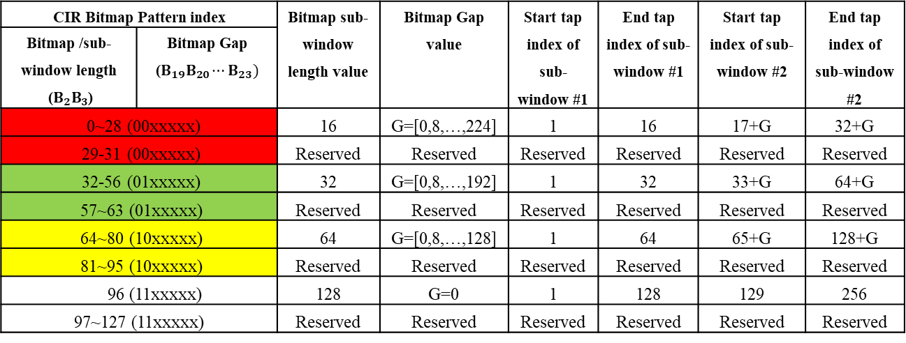
Proposal: CIR bitmap pattern indication
When Bitmap mode=0，the Bitmap length and Bitmap Gap are combined to identify the exact bitmap pattern according to the following table:
CIR Bitmap Pattern index |  | Bitmap sub-window length value | Bitmap Gap value | Start tap index of sub-window #1 | End tap index of sub-window #1 | Start tap index of sub-window #2 | End tap index of sub-window #2
Bitmap /sub-window length ($B_{2}B_{3}$) | Bitmap Gap ($B_{19}B_{20}⋯B_{23})$
0~28 (00xxxxx) |  | 16 | G=[0,8,…,224] | 1 | 16 | 17+G | 32+G
29-31 (00xxxxx) |  | Reserved | Reserved | Reserved | Reserved | Reserved | Reserved
32-56 (01xxxxx) |  | 32 | G=[0,8,…,192] | 1 | 32 | 33+G | 64+G
57~63 (01xxxxx) |  | Reserved | Reserved | Reserved | Reserved | Reserved | Reserved
64~80 (10xxxxx) |  | 64 | G=[0,8,…,128] | 1 | 64 | 65+G | 128+G
81~95 (10xxxxx) |  | Reserved | Reserved | Reserved | Reserved | Reserved | Reserved
96 (11xxxxx) |  | 128 | G=0 | 1 | 128 | 129 | 256
97~127 (11xxxxx) |  | Reserved | Reserved | Reserved | Reserved | Reserved | Reserved

Slide 6
Summary
We propose to modify the CIR Report field of sensing control field of AC IE to save the overhead and fix the bug
Bitmap /sub-window length field is interpreted depending on the value of Bitmap mode field
For Bitmap mode=0, the Bitmap /sub-window length field and Bitmap Gap field are combined to identify the exact bitmap pattern index

Slide 7
References
[1] 15-23-0079-01-04ab-latest-consensus-on-uwb-sensing-for-802-15-4ab
[2] 15-22-0538-04-04ab-proposal-of-sensing-framework
[3] P802.15.4z, Draft Standard for Low-Rate Wireless Networks

