Slide 1
Project: IEEE P802.15 Working Group for Wireless Personal Area Networks (WPANs)
Submission Title: Effect of no-LBT NB on 802.11 devices
Source: Carlos Aldana (Meta), Qiong Wu (Meta), Guoqing Li (Meta), Davide Magrin (Meta), Kumail Haider (Meta), Connor Kennedy (Meta), Claudio da Silva (Meta)
Address : [1 Hacker Way, Menlo Park, CA 94025]
E-Mail: [caldana, qiongwu, guoqingli, davidmagrin, haiderkumail, connork, claudiodasilva (at) meta.com]
Re: Study Group 4ab: UWB Next Generation
Abstract: [This provides experimental and simulation results of how no-LBT NB affects 802.11 devices]
Purpose: [Suggests a way forward to improve coexistence]
Notice: This document has been prepared to assist the IEEE P802.15. It is offered as a basis for discussion and is not binding on the contributing individual(s) or organization(s). The material in this document is subject to change in form and content after further study. The contributor(s) reserve(s) the right to add, amend or withdraw material contained herein.
Release: The contributor acknowledges and accepts that this contribution becomes the property of IEEE and may be made publicly available by P802.15.
Notes:
Jul 12, 2010
Page 1

Slide 2
Technical Guidance
PAR Objective | Proposed Solution (how addressed)
Safeguards so that the high throughput data use cases will not cause significant disruption to low duty-cycle ranging use cases.
Interference mitigation techniques to support higher density and higher traffic use cases
Other coexistence improvement
Backward compatibility with enhanced ranging capable devices (ERDEVs).
Improved link budget and/or reduced air-time
Additional channels and operating frequencies
Improvements to accuracy / precision / reliability and interoperability for high-integrity ranging;
Reduce complexity and power consumption;
Hybrid operation with narrowband signaling to assist UWB; | LBT should be employed by NB as a coexistence mechanism
Enhanced native discovery and connection setup mechanisms;
Sensing capabilities to support presence detection and environment mapping;
Low-power low-latency streaming
higher data-rate streaming allowing at least 50 Mbit/s of throughput.
Support for peer-to-peer, peer-to-multi-peer, and station-to-infrastructure protocols;
Infrastructure synchronization mechanisms.

Slide 3
Background
In 15-23-243, it is suggested to use NB for Data Communications for gate entry applications. We should also consider the effects on other technologies in high device density scenario (e.g., apartment buildings, malls)
In 15-23-119 the effect of NB interference on 802.11 at the PHY level was presented. It was shown that for 20 MHz 802.11 and a 31% duty cycle NB, the SIR > 20 dB for PER to be < 10%.
This work focuses on the effects of NB interference on 802.11 at the MAC level, from a lab measurement and simulation point of view.
We look to answer the following questions:
Is NB (without LBT) a similar neighbor to 802.11 than another 802.11 neighbor?
What NB duty cycle is not acceptable for a no-LBT NB solution?
Would NB with LBT help 802.11?

Slide 4
Background on 802.11 ED and PD Threshold
Energy Detect (ED) Threshold set to -75 dBm/MHz (ETSI EN 303687 and IEEE 802.11 17.3.10.6) : shown by orange circle
Packet Detect (PD) Threshold set to -82 dBm (IEEE 802.11) : shown by purple circle
PD
ED
802.11
802.11ax
Rules for any signal (802.11 or NB) Present
ED threshold of -62 dBm for PRI20
ED threshold of -62 dBm for SEC20
ED threshold of -59 dBm for SEC40
ED threshold of -56 dBm for SEC80

Slide 5
Europe 6 GHz NB vs VLP 802.11 spectrum
NB with 14 dBm EIRP is 15/18/21 dB stronger than VLP 802.11 with 80/160/320 MHz
NB
10 dBm/MHz
Note that skirts associated with NB spectrum not shown and affect many 802.11 sub-carriers
-5 dBm/MHz
80 MHz 802.11
-8 dBm/MHz
160 MHz
802.11
-11 dBm/MHz
320 MHz 802.11

Slide 6
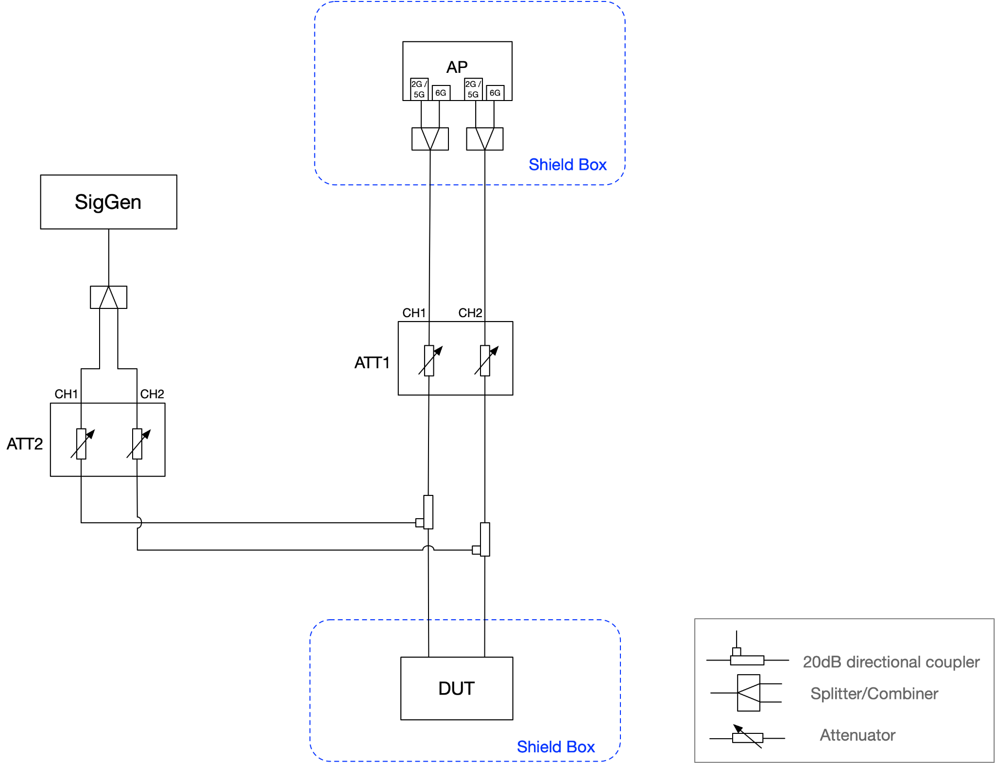
Setup – NB Interferer
SigGen: R&S SMBV100B
802.11 Channel: 5GHz CH36 (160MHz) centered at 5250 MHz (5170-5330 MHz)
Max PHY rate 2.0-2.4 Gbps (depends on guard interval)
802.11 does its own rate adaptation and AMPDU is enabled.
Iperf udp traffic
ATT2 is used to set the NB RX power to the desired level at the DUT and ATT1, called “Attenuation” in following plots is what is swept
NB RX Power is swept from -50 to -90 dBm via ATT2

Slide 7
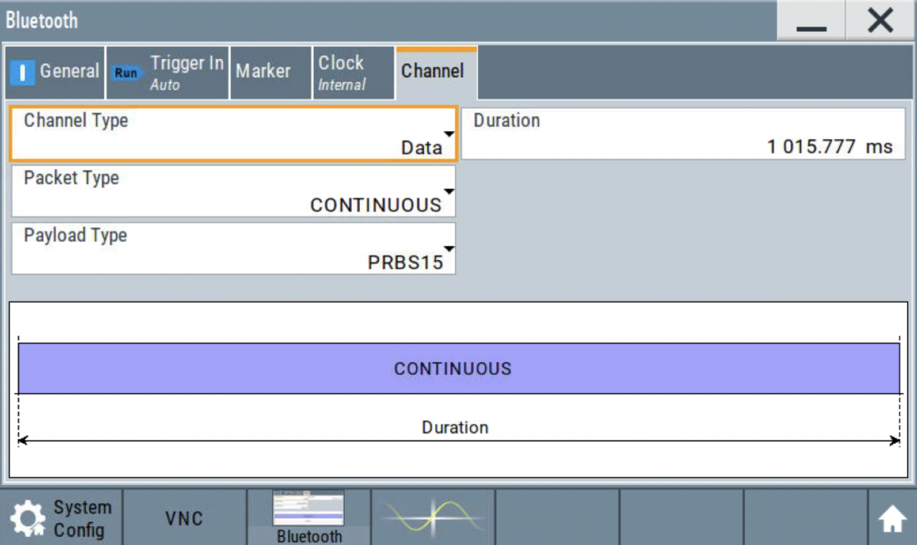
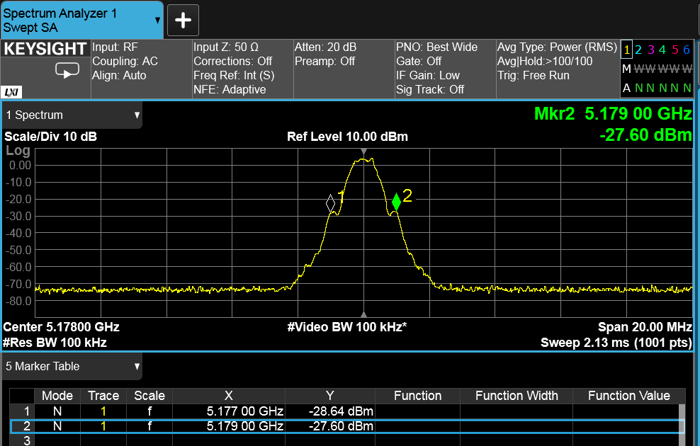
NB Profile 1
Continuous BLE Signal, 2 MHz BW

Slide 8
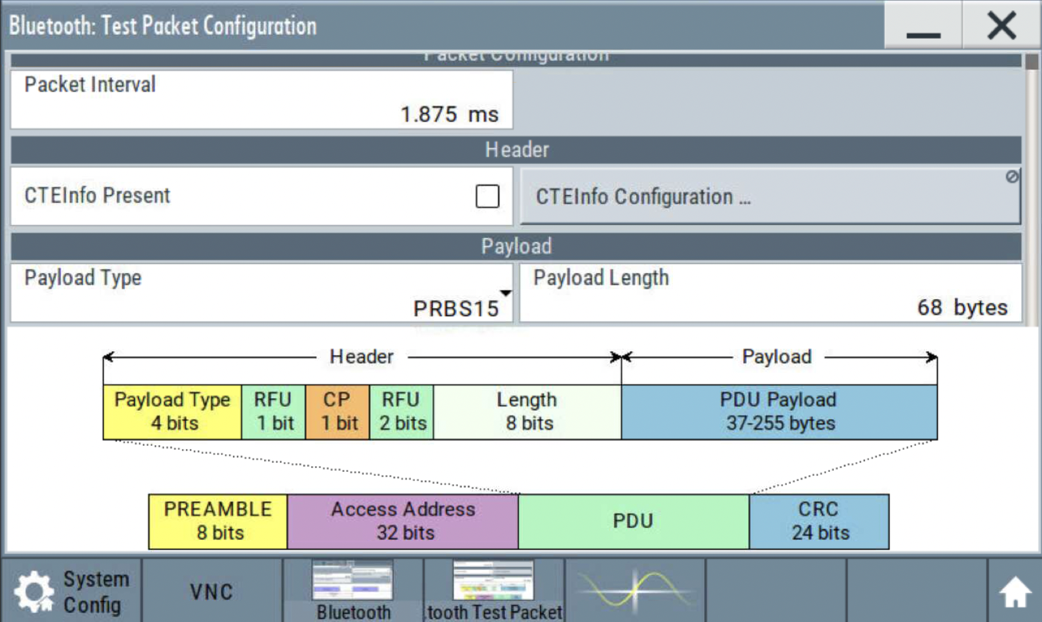
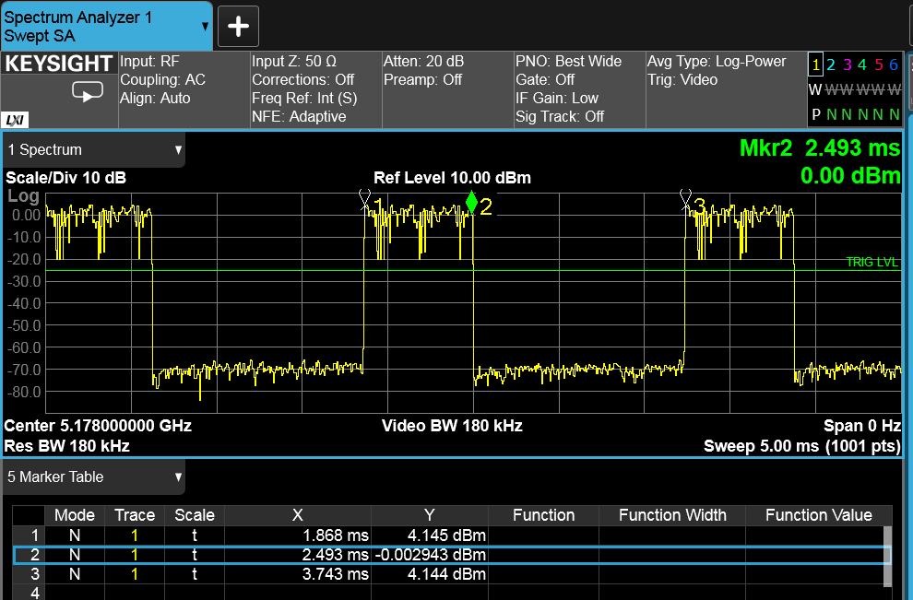
NB Profile 2
BLE with dwell time 625us with a packet interval of 1.875ms, 33.3% duty cycle

Slide 9
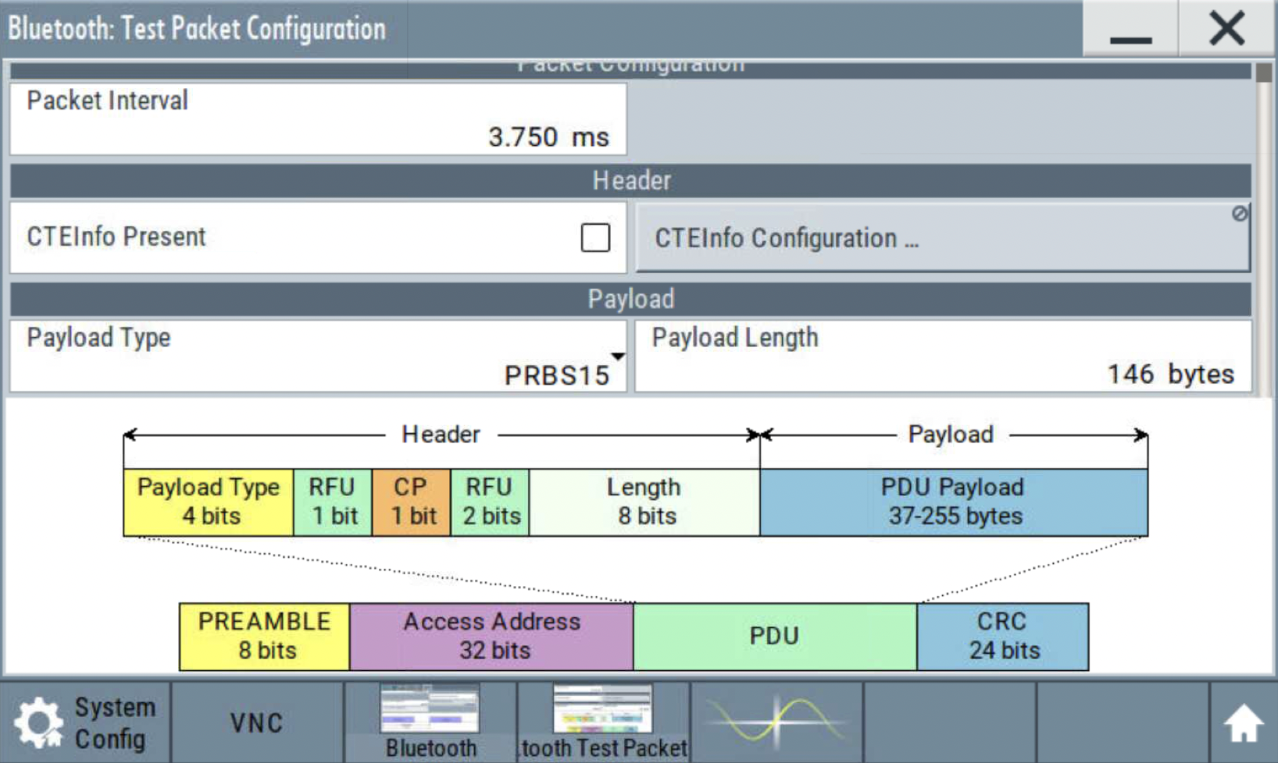
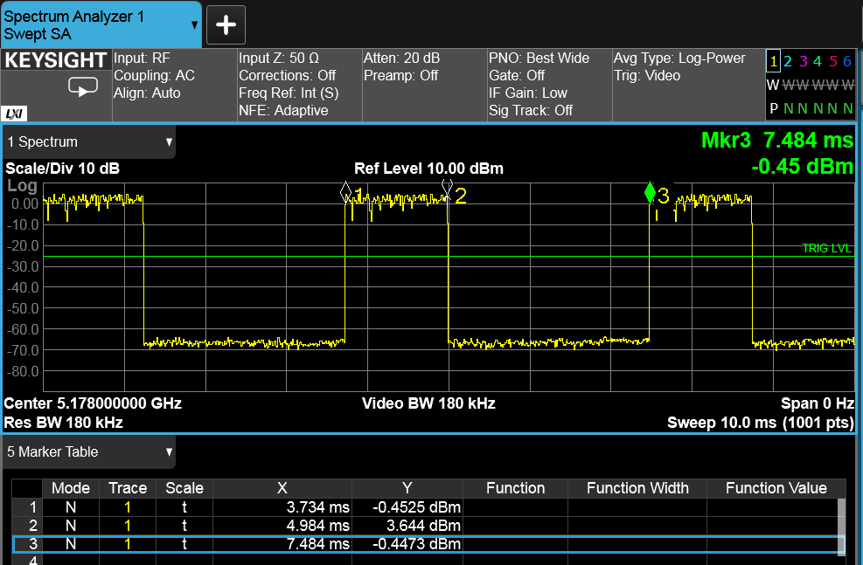
NB Profile 3
BLE with dwell time 1.25ms with a packet interval of 3.75ms, 33.3% duty cycle

Slide 10
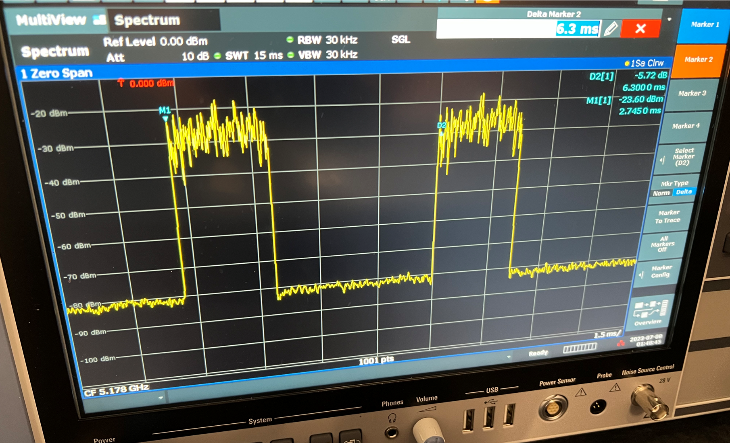
NB Profile 4 (255 bytes)
BLE with dwell time 2.1ms with a packet interval of 6.25ms, 34% duty cycle
Slide 10

Slide 11
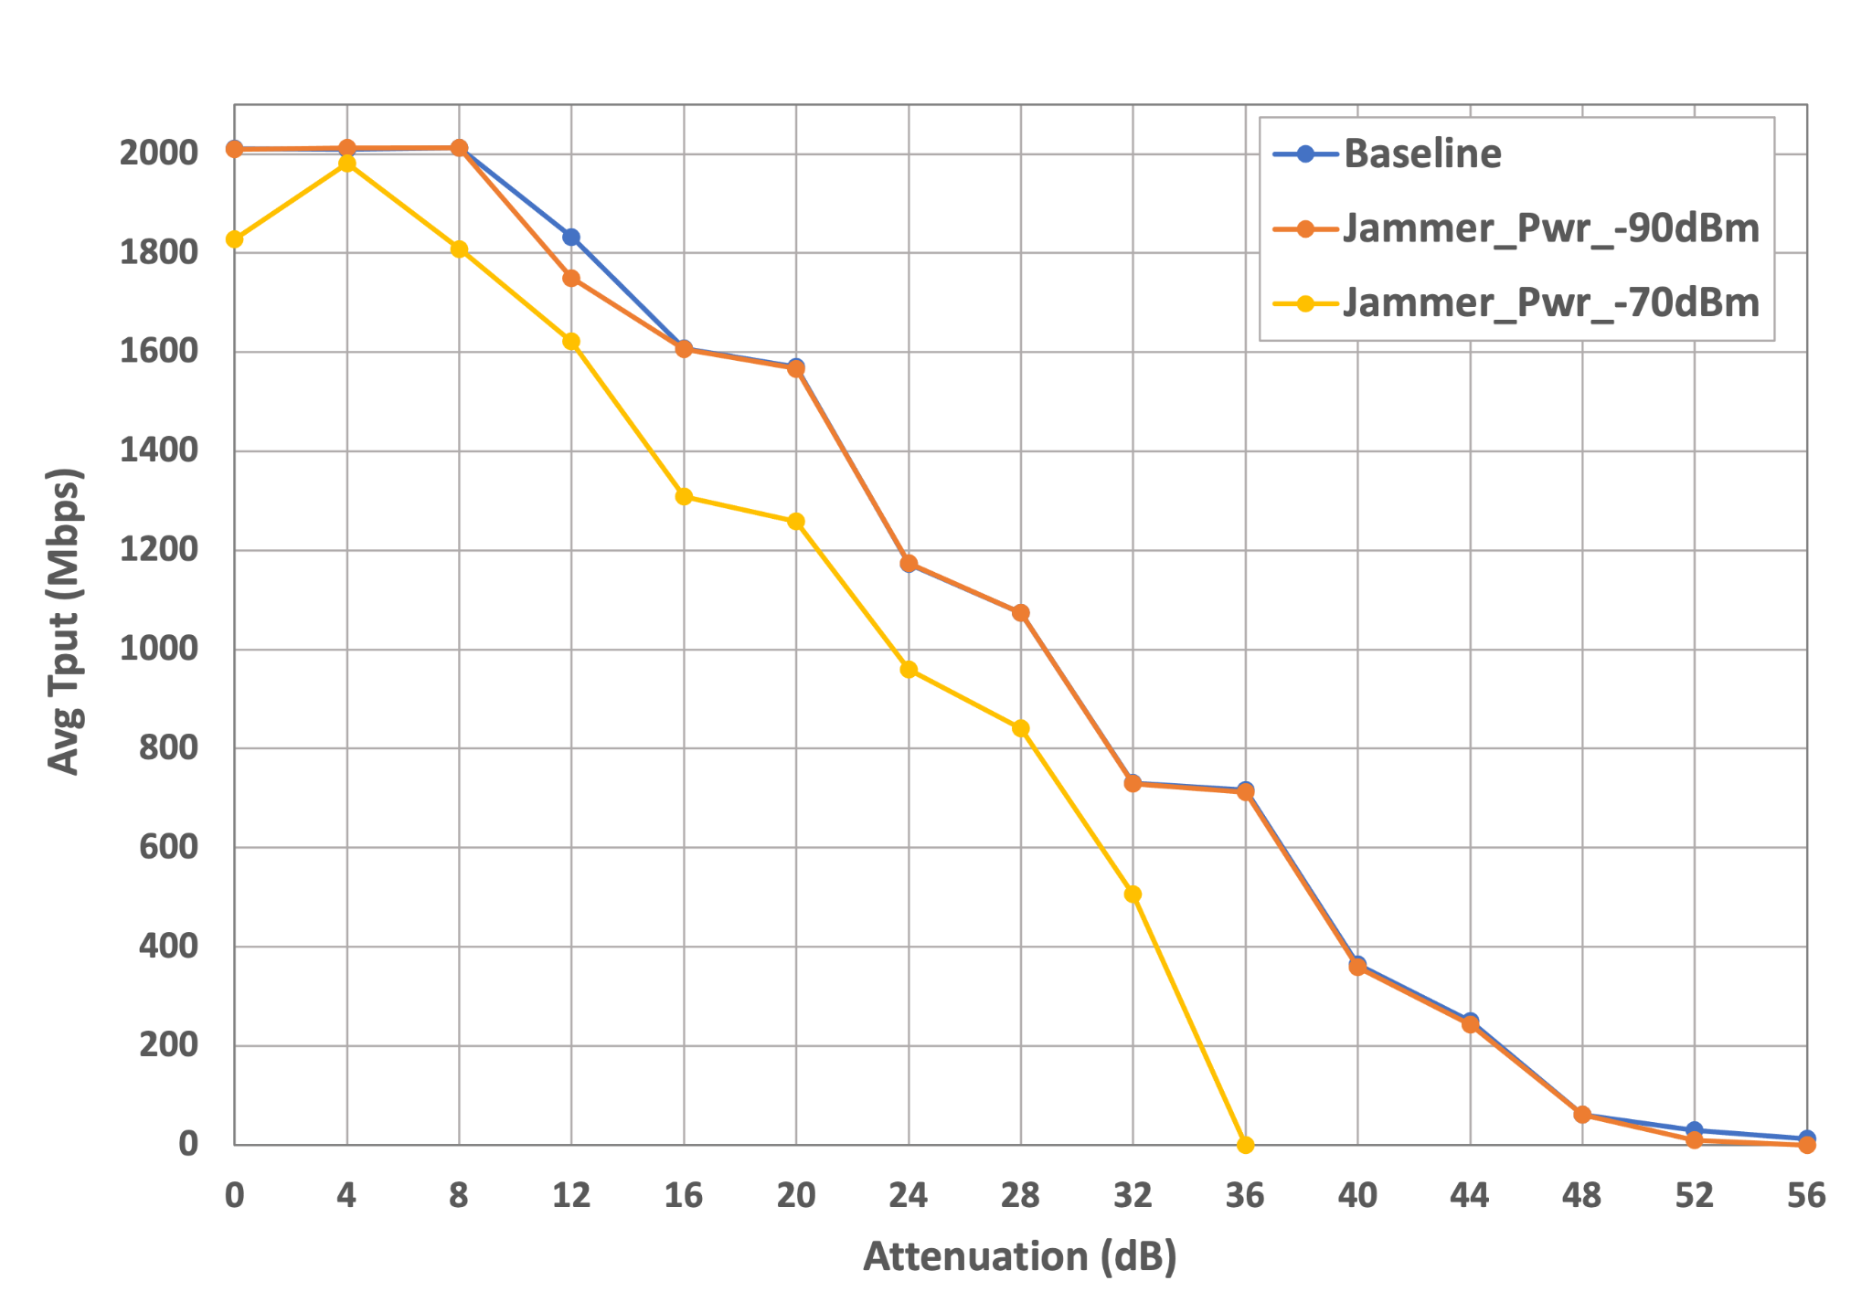
NB Profile 1 at 5178MHz
802.11 throughput is 0 when the NB power is -60dBm or -50dBm. At these interference levels, NB interferer completely prevents DUT from transmitting because 802.11 performs LBT.
Uplink
Attenuation is ATT1 or ATT2?
Note that 0 dB Attenuation is equivalent to -31 dBm RSSI
NOTE:
802.11 throughput is 0 when
NB power is >= -60 dBm

Slide 12
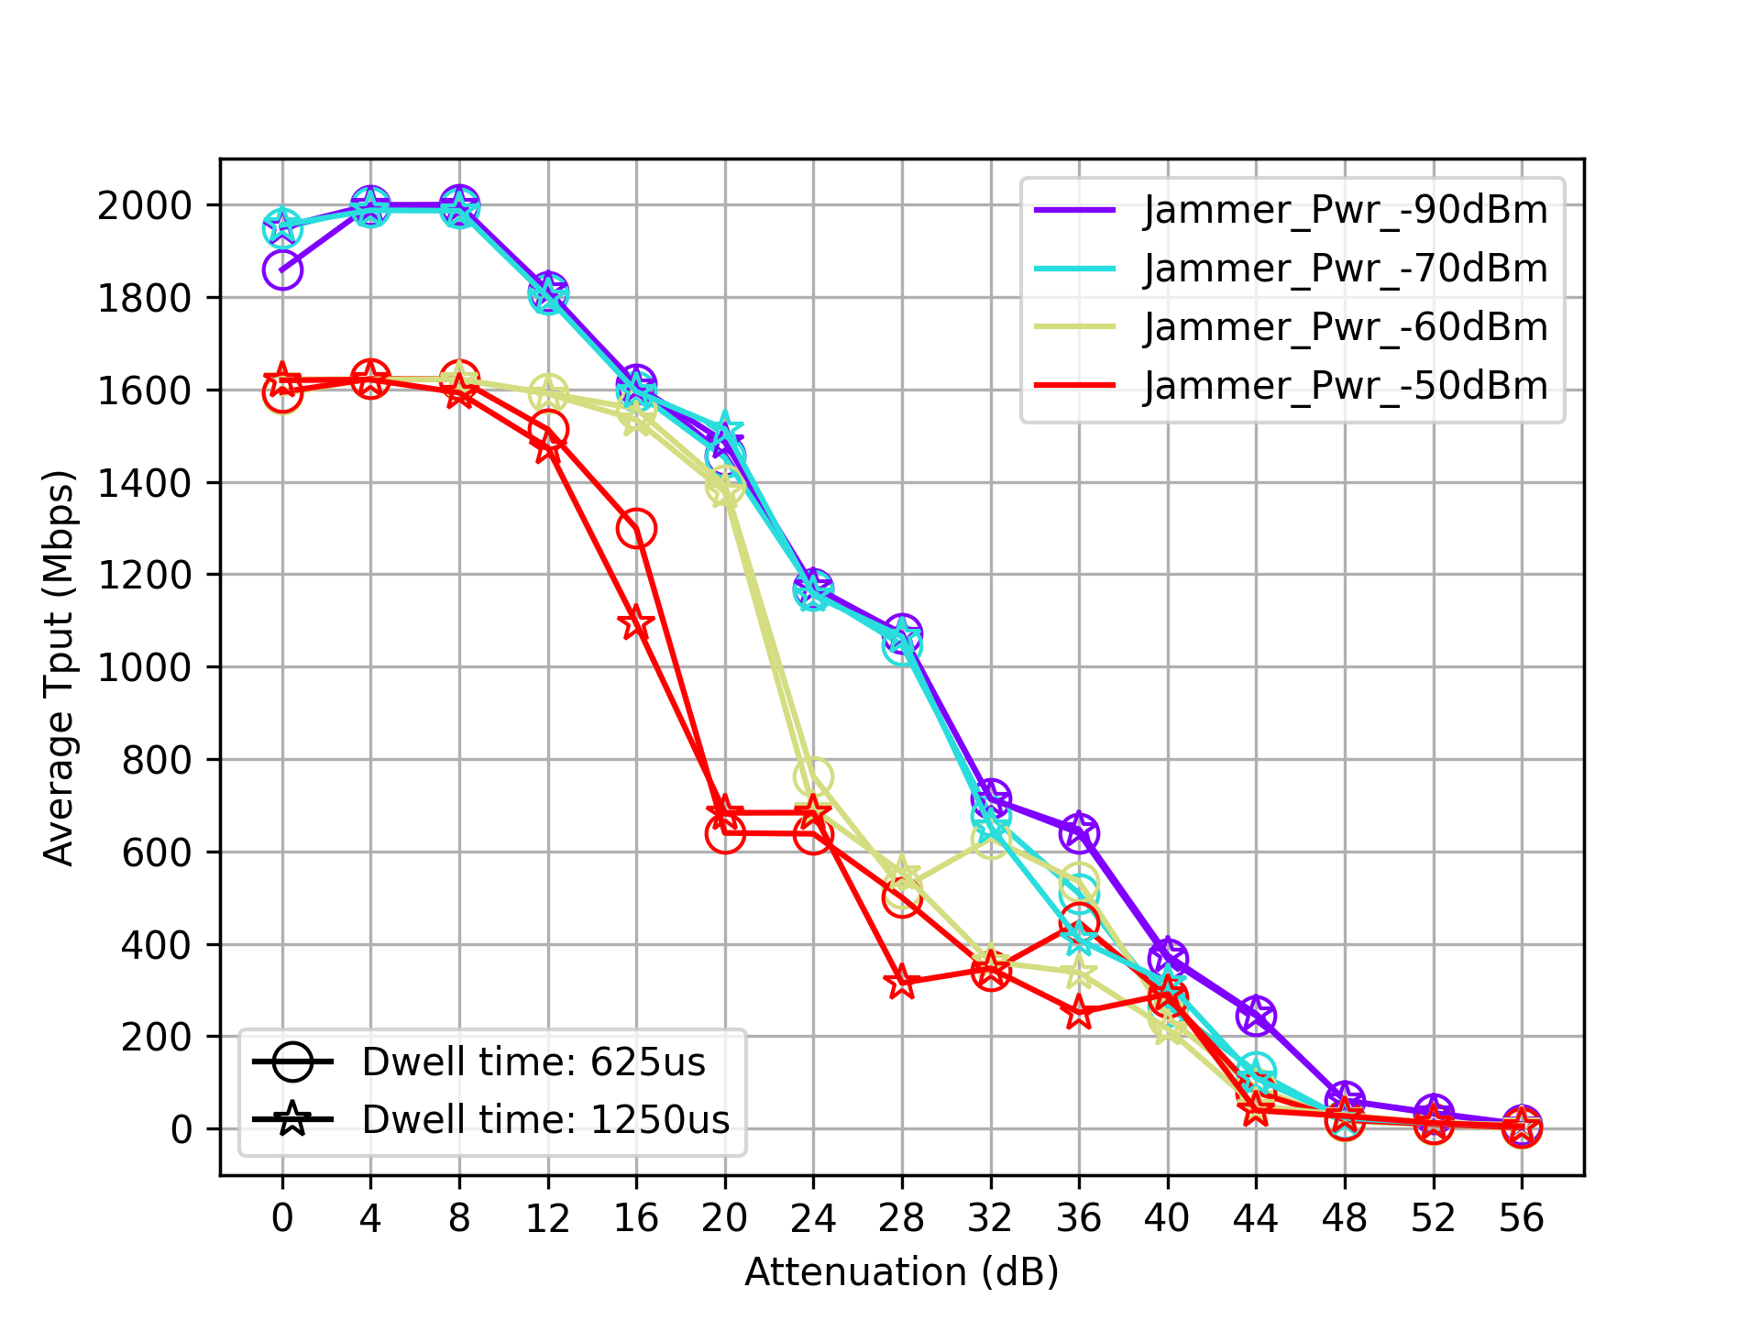
NB Profiles 2 and 3 at 5178MHz
Uplink

Slide 13
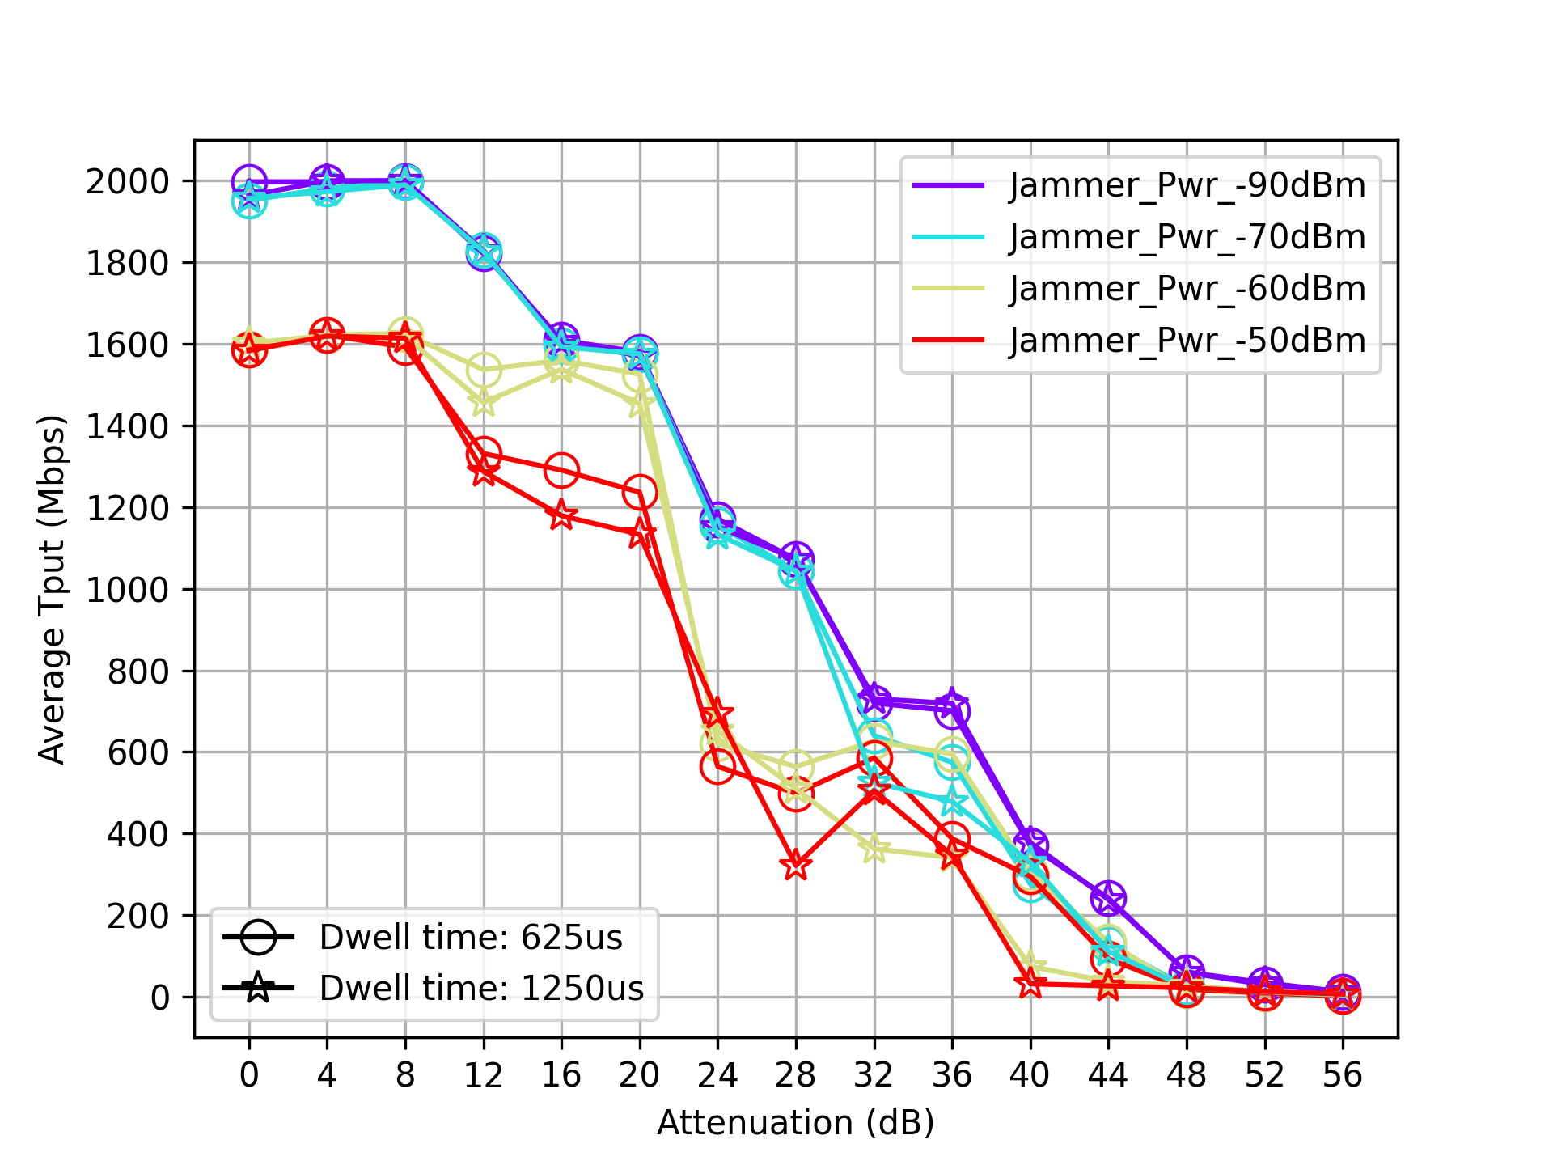
NB Profiles 2 and 3 at 5258MHz
Uplink
Location of NB interferer within the channel does not seem to matter

Slide 14
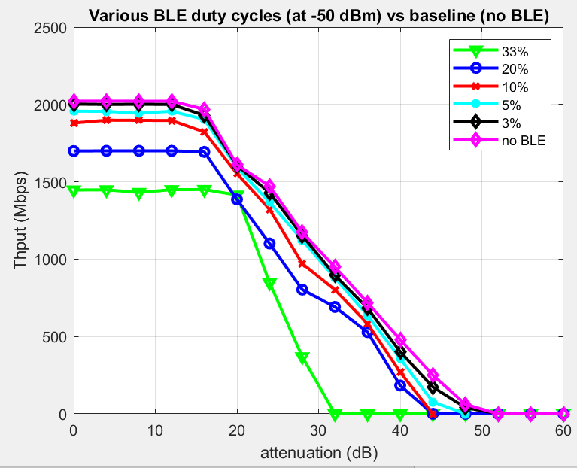
Various BLE Duty Cycles
For 33% duty cycle, we see reduction in peak throughput as well as a large reduction in reach.
There is a small degradation of the peak rate even with 3% duty cycle and sensitivity degradation for 5% duty cycle
NB at 5178 MHz

Slide 15
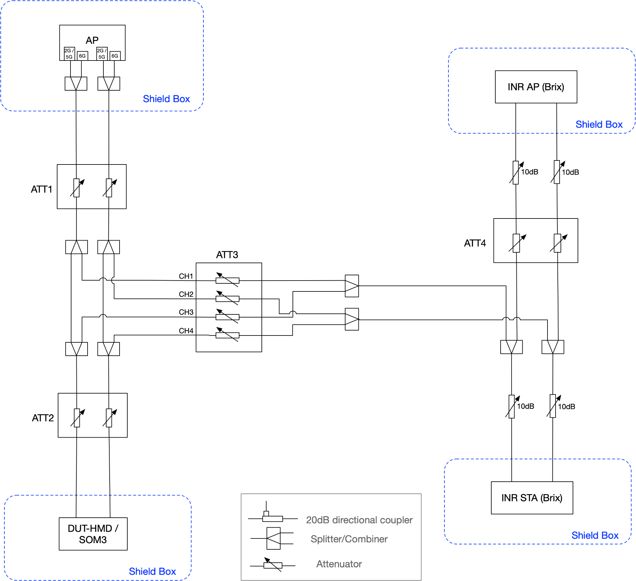
Setup - WiFi Interferer
Desired Link:
802.11 Channel: 5GHz CH36/160MHz
Interference Link:
AP/STA:
802.11 Channel: 5GHz CH36/160MHz
iperf UDP UL 3Mbps
ATT1 is swept for the main link, as before
ATT2 is set to 0
ATT3 controls the interference level

Slide 16
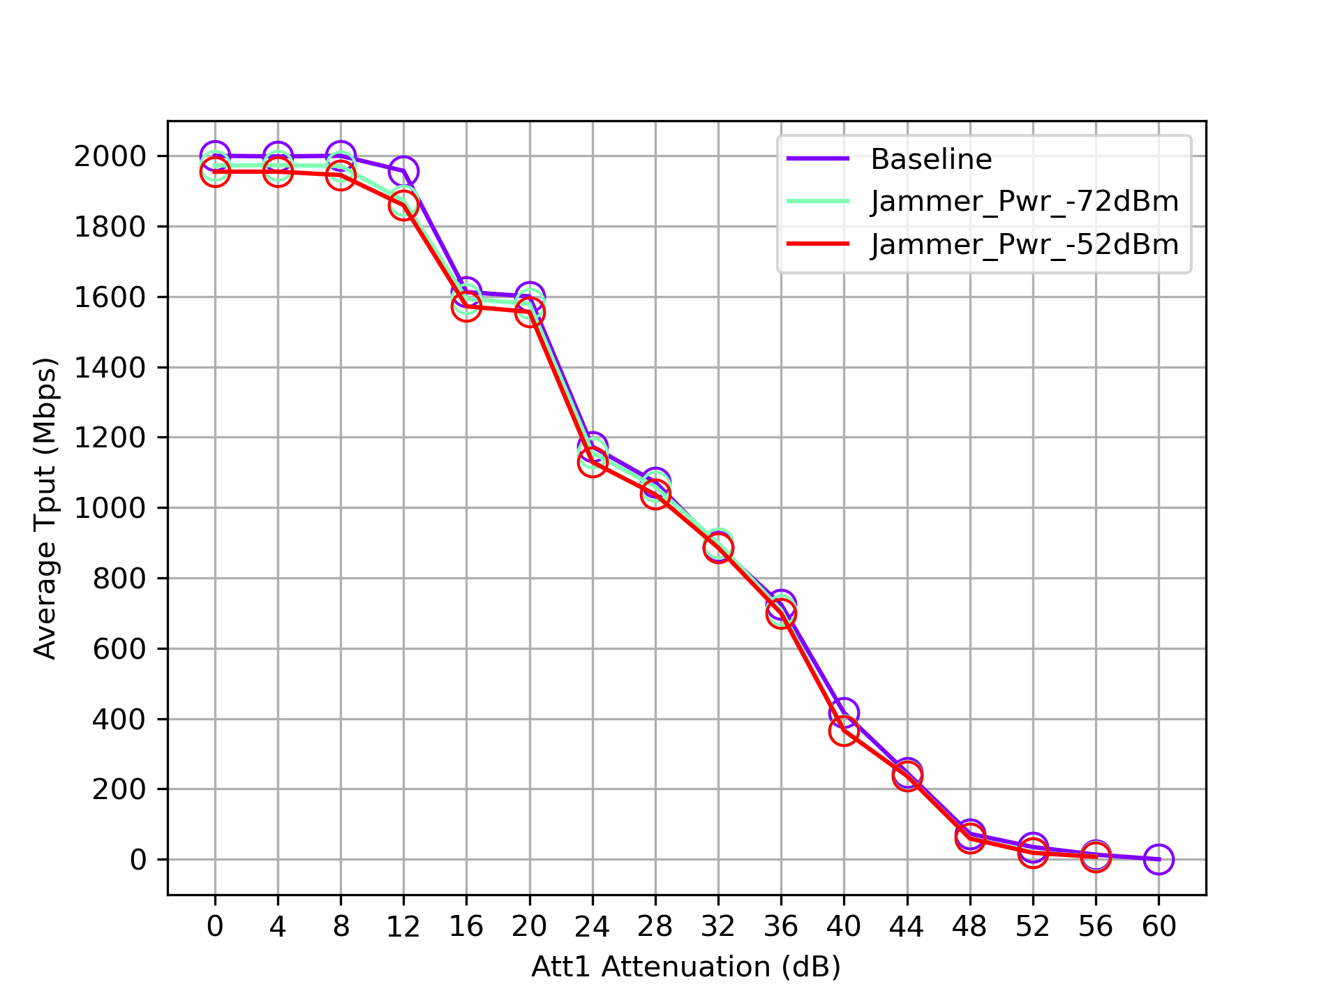
Result - WiFi Interferer
Uplink

Slide 17
Simulation Results for both Throughput and per-packet Latency

Slide 18
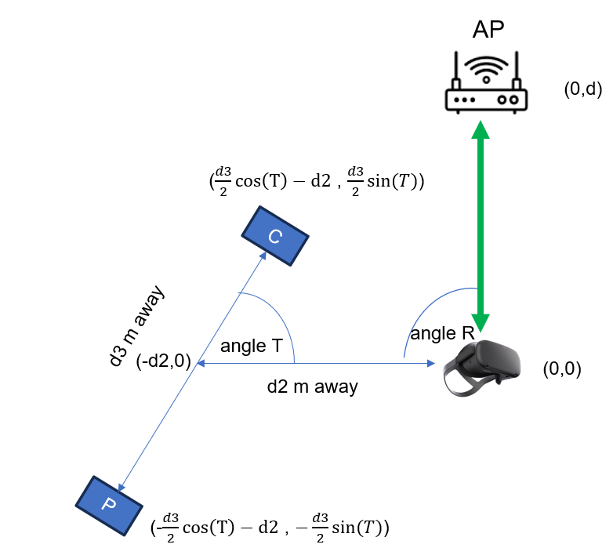
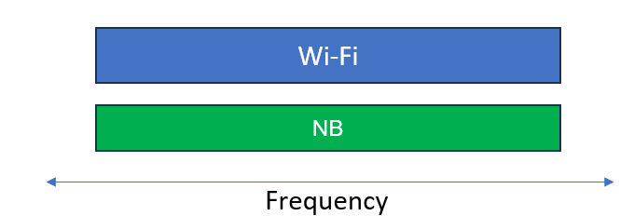
Simple Scenario
802.11 AP and STA d meters away and another set of NB devices, separated by d3 meters, has centroid that is d2 meters away from STA.
C and P are NB devices transmitting in same
frequency as 802.11 devices

Slide 19
Assumptions
Sweep over d while keeping d2=2m, T=R=pi/2 and d3=1m.
802.11
14 dBm at both AP and STA
XR Traffic : 100 Mbps DL @72 Hz and 3 Mbps UL @ 500 Hz
MCS2 with ~55% duty cycle
BW=80 MHz
Traffic type : UDP, AC_BE
0.8s GI, 2x HE-LTF, AMSDU Agg, RTS/CTS off
-62 dBm ED threshold at primary 20 (per 802.11 spec)
Note that -62 dBm in primary 20 is equivalent to -75 dBm/MHz ETSI threshold
NB
14 dBm at both C and P
fc at 802.11 primary channel
-75 dBm/MHz Max ED Threshold value
Fixed duty cycle with 42 byte (416us) NB packet
For 10,5,3,1% duty cycle, data packet size remains fixed but packet interval increases
Enable/Disable NB 80us/416us Ack with 150us/584us IFS
802.11 AWGN Channel model with dbp=5, fc @6.425 GHz
Distances are shown in which 802.11 target throughputs are met
Reduced ED threshold mode : -65 dBm on 802.11 primary 20 (to allow AP/STA to defer to each other at d=14m) and -85 dBm/MHz on NB

Slide 20
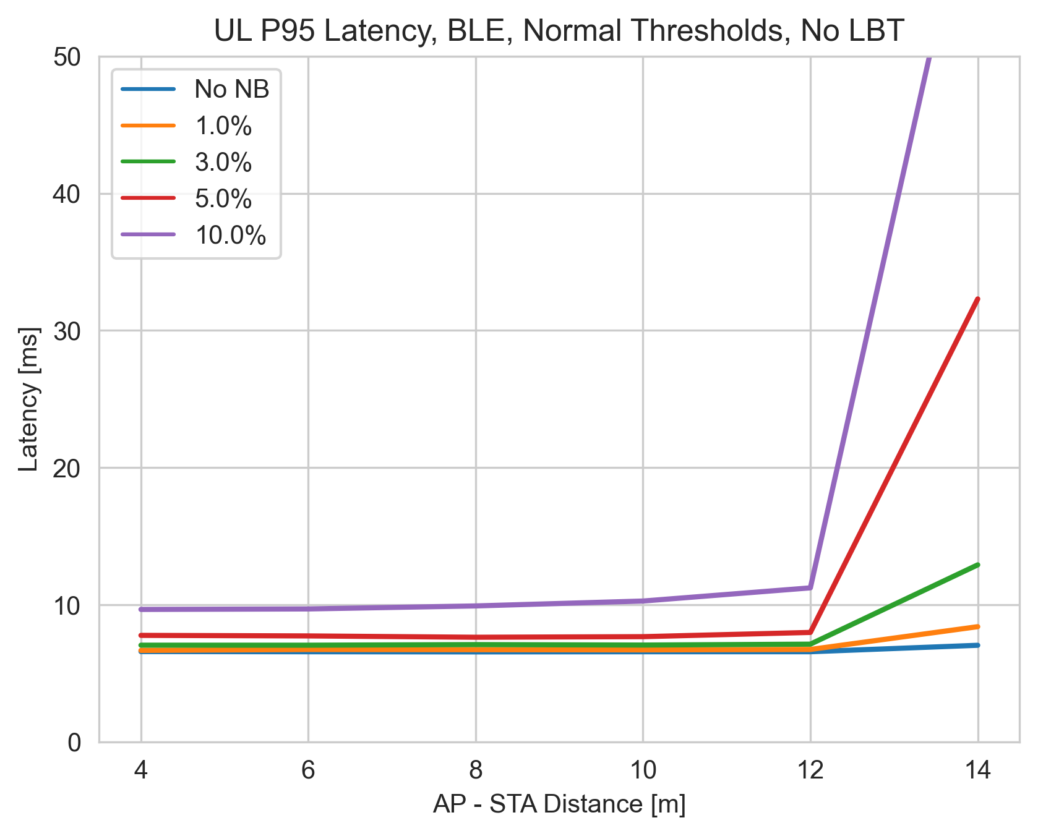
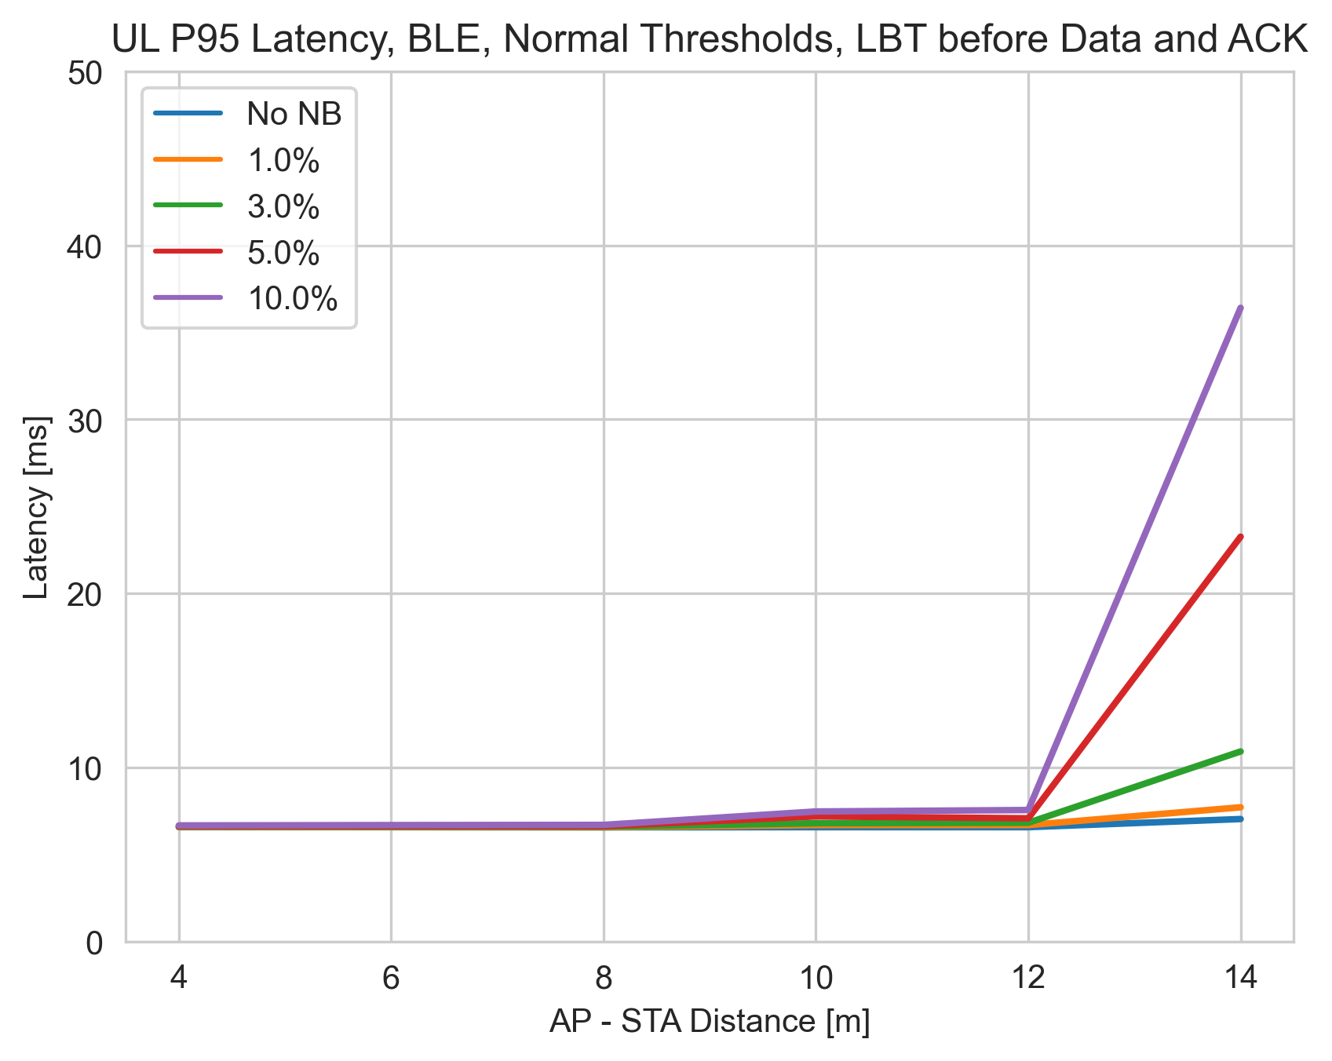
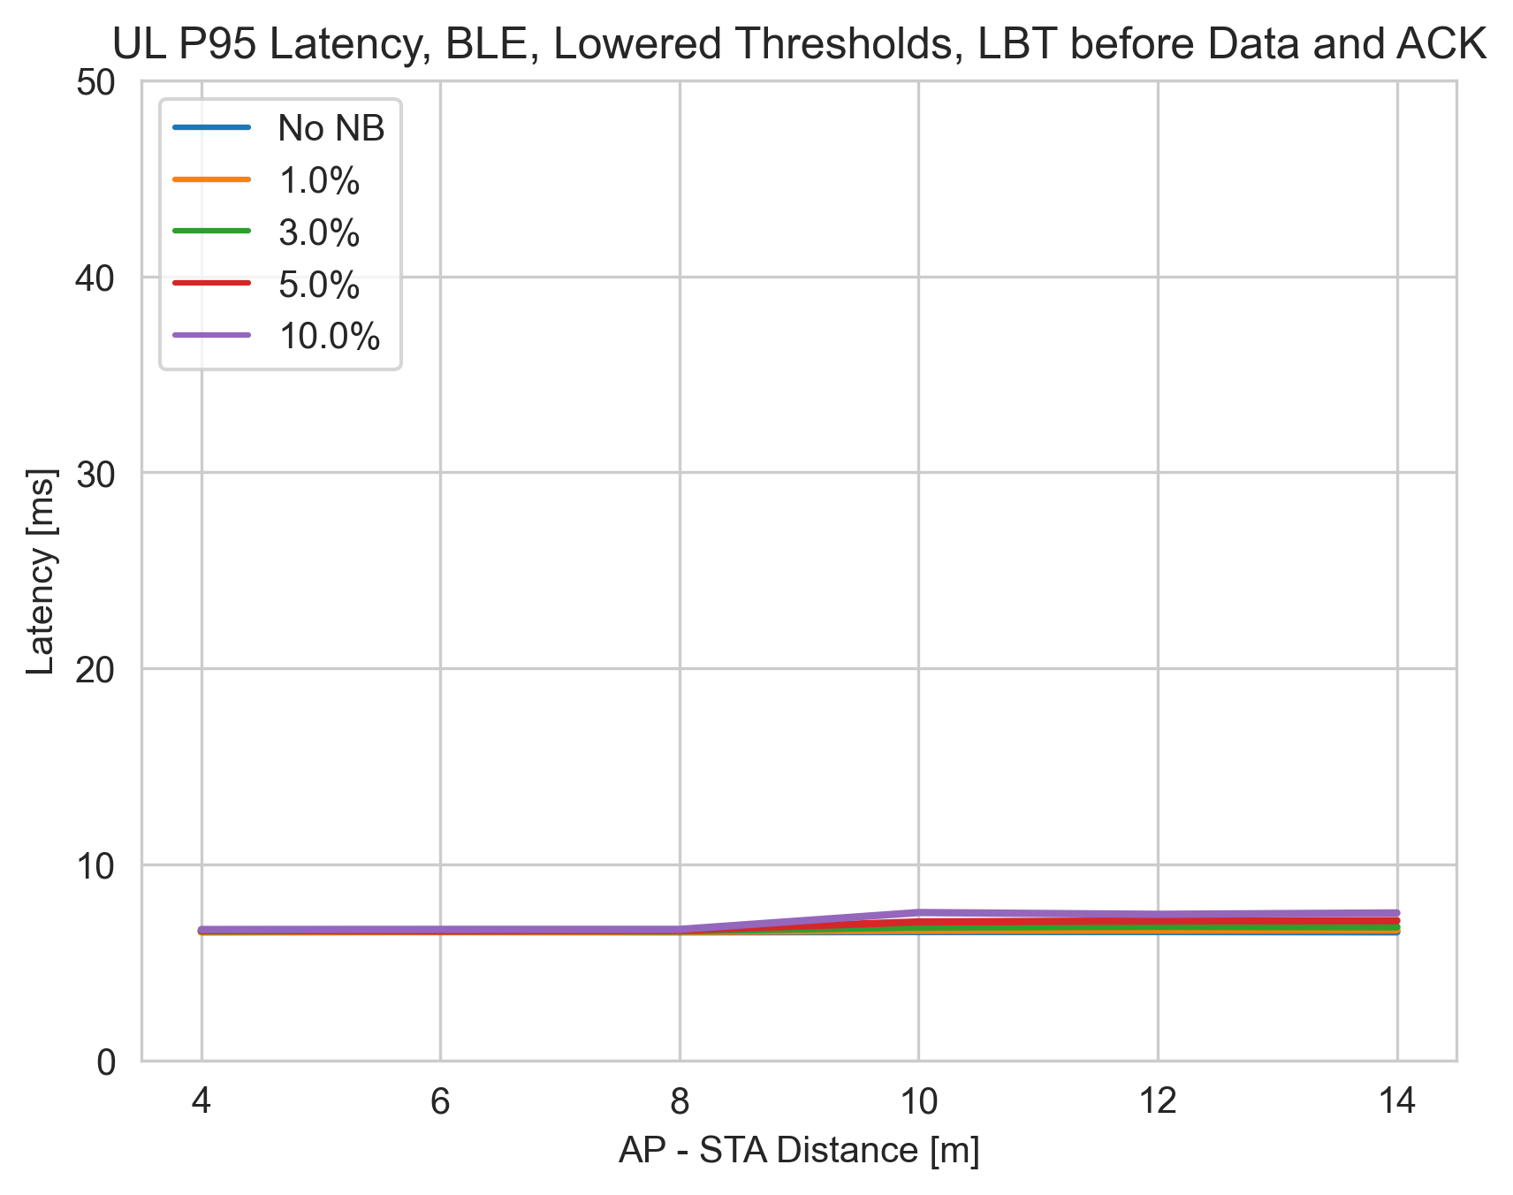
UL Results with MCS=2 (150us IFS), 80 MHz (no LBT vs LBT)
No LBT
Max ED Threshold
Reduced ED Threshold
No LBT
Max ED threshold
Reduced ED threshold
At 14m, AP does not defer to NB C or P nodes, since NB power < -62 dBm
For No LBT, a 3% duty cycle causes ~50% increase in P95 latency
For No LBT, a 10% duty cycle causes unacceptable P95 latency

Slide 21
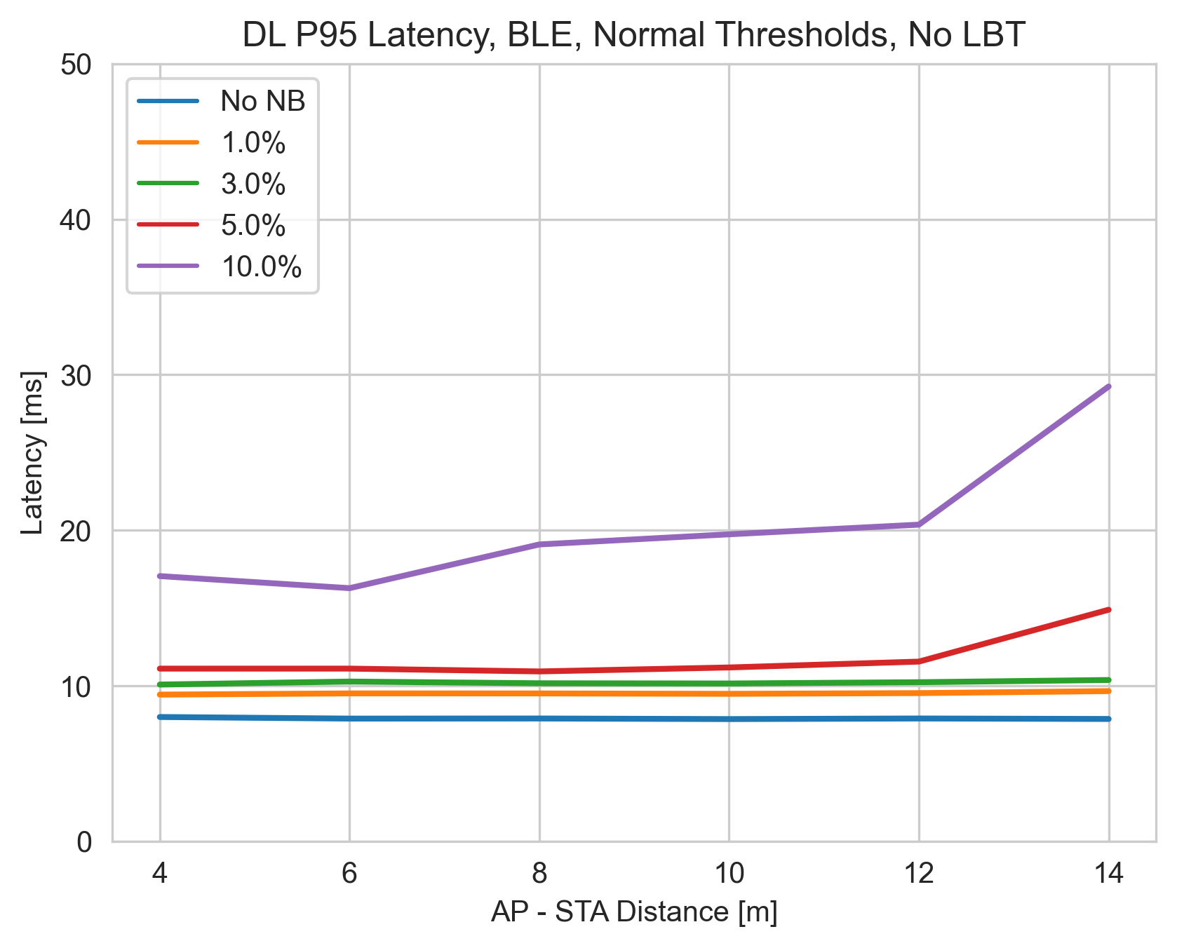
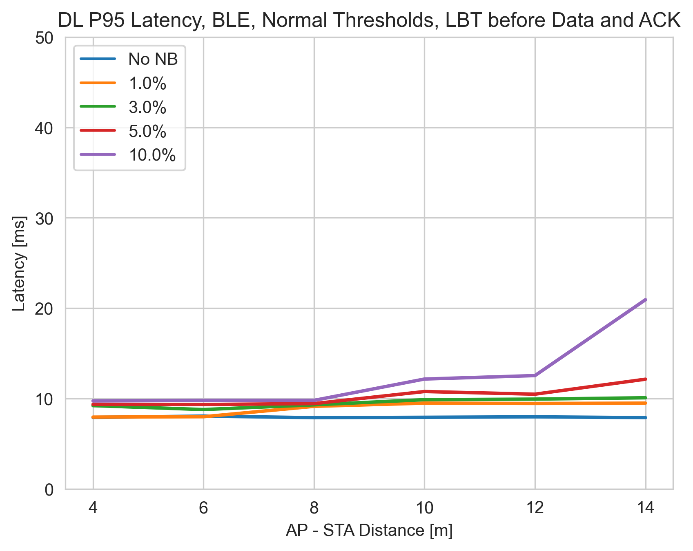
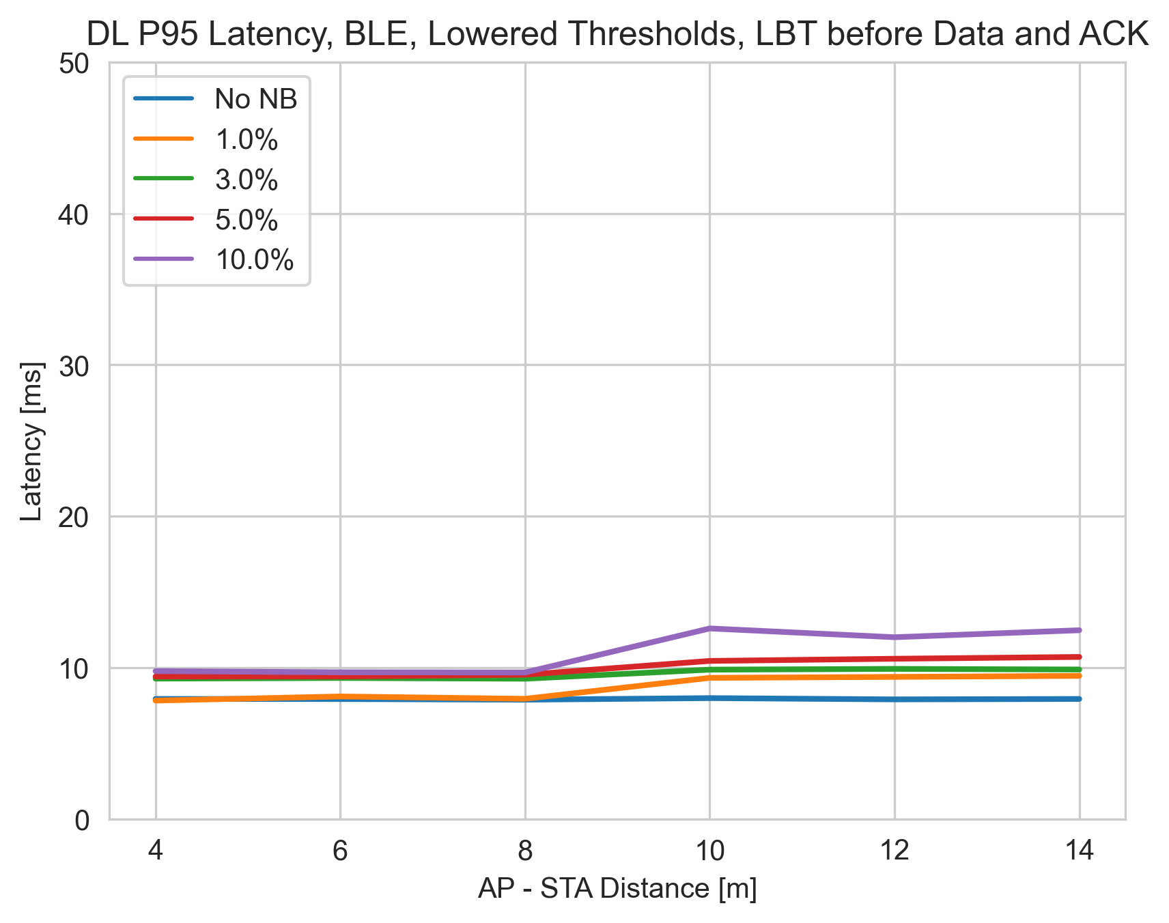
DL Results with MCS=2 (150us IFS), 80 MHz (no LBT vs LBT)
No LBT
Max ED Threshold
Reduced ED Threshold
No LBT
Max ED threshold
Reduced ED threshold
No LBT
Max ED threshold
Reduced ED threshold
For No-LBT, P95 latency for 10% duty cycle is ~3.6x no NB case

Slide 22
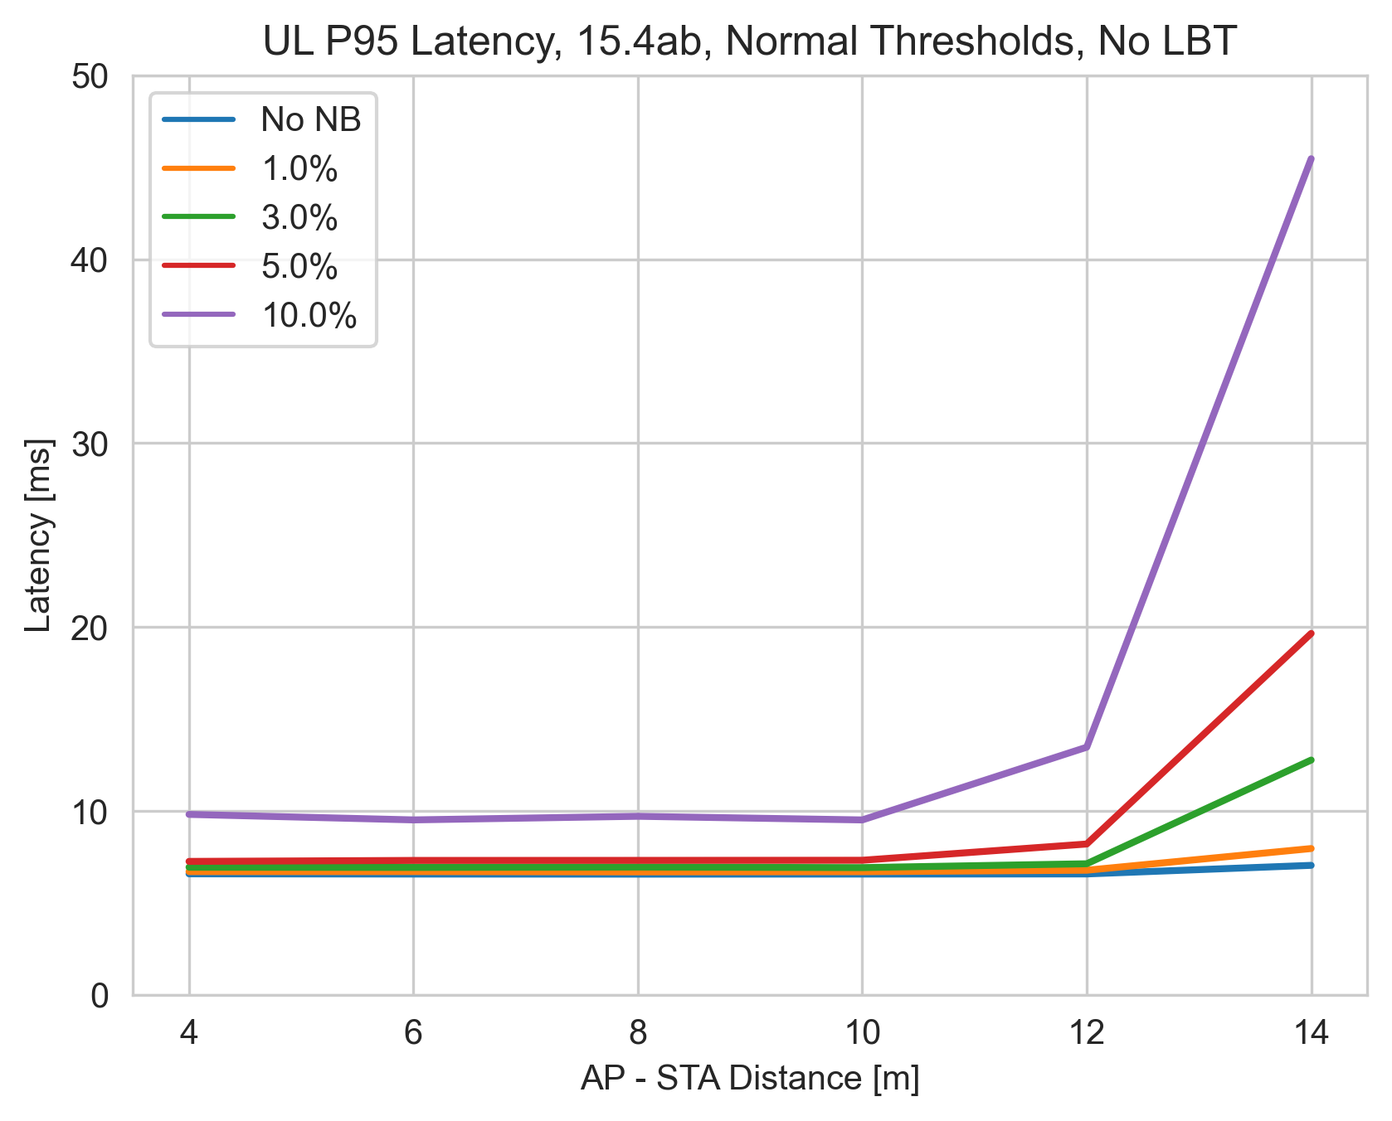
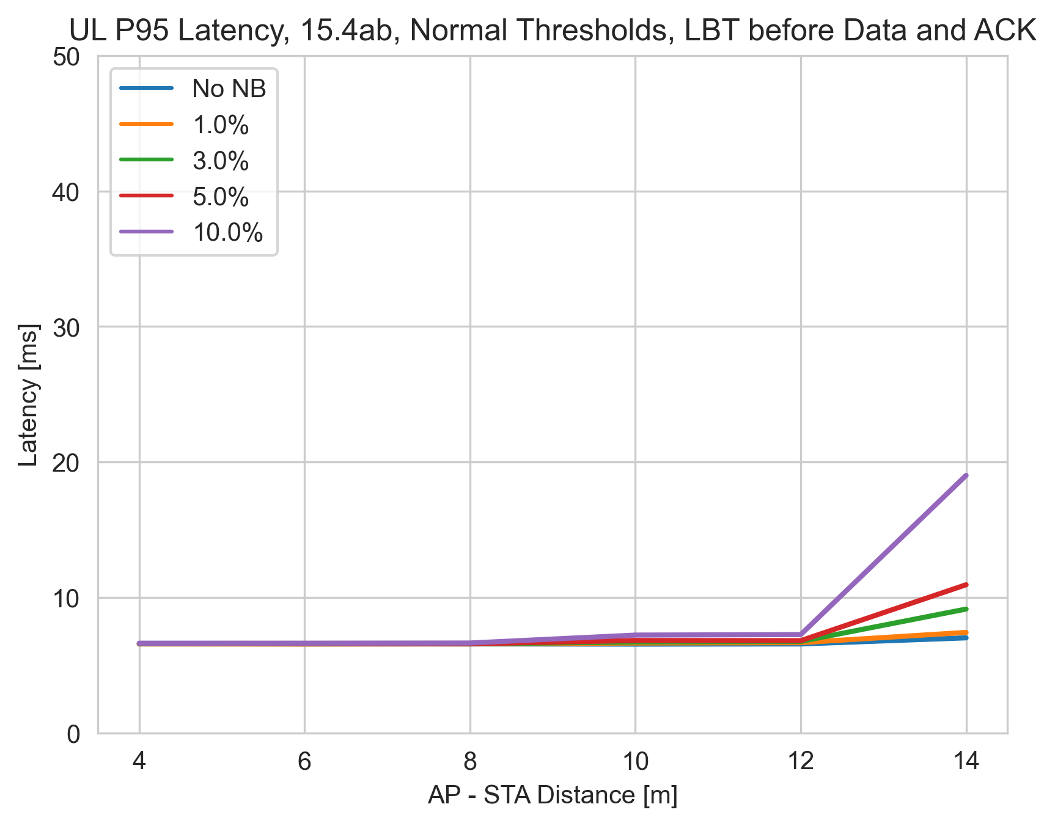
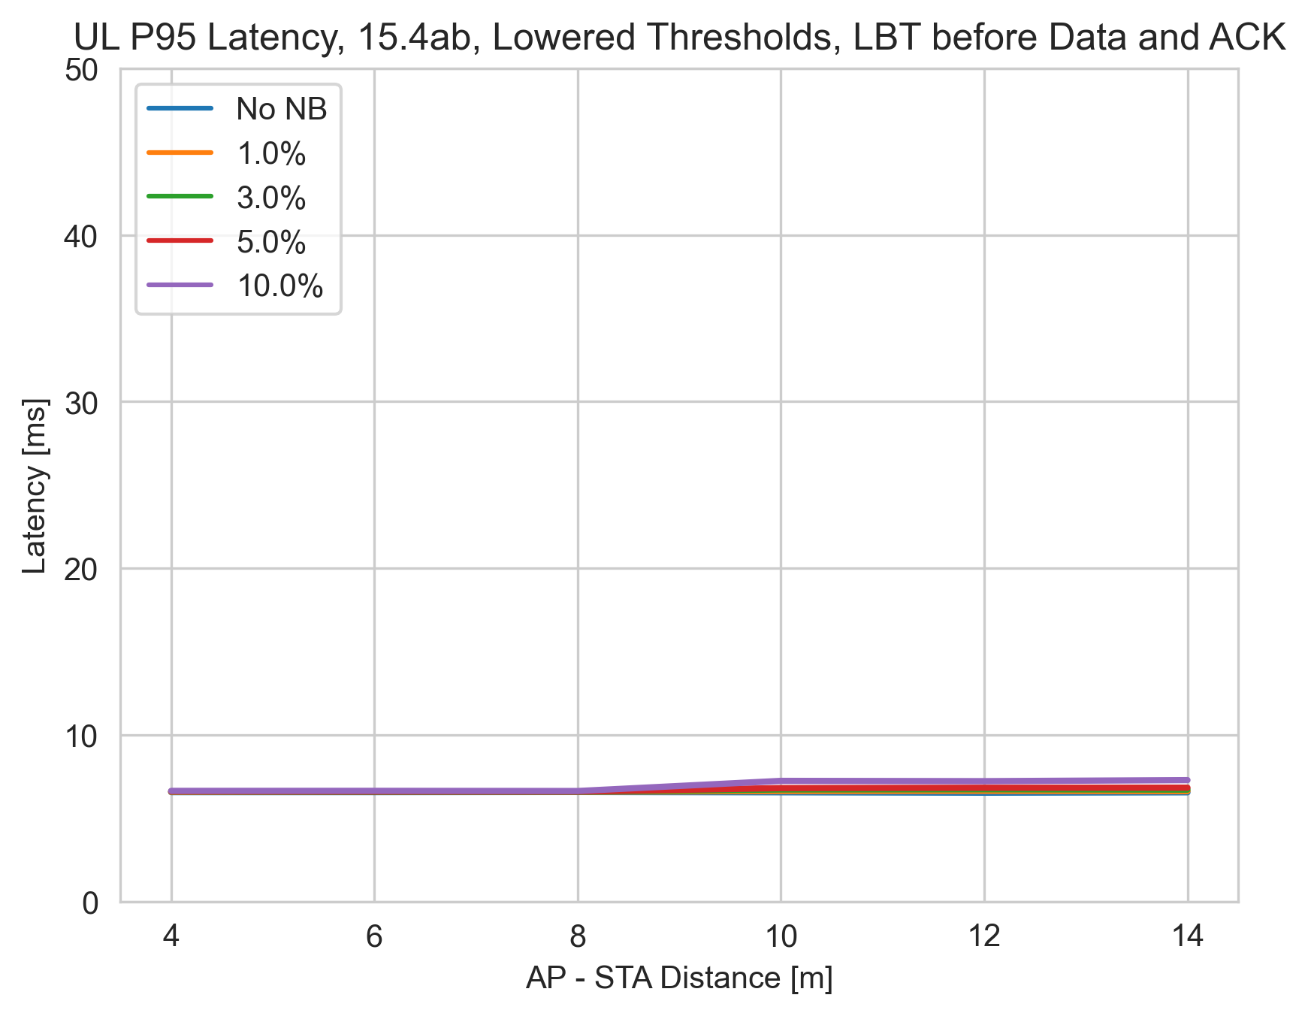
UL Results with MCS=2 (584us IFS), 80 MHz (no LBT vs LBT)
No LBT
Max ED Threshold
Reduced ED Threshold
Max ED threshold
Max ED threshold
Reduced ED threshold
No LBT
Reduced ED threshold
No LBT
For no-LBT, a 3% duty cycle causes ~50% increase in P95 latency
For no-LBT, a 10% duty cycle causes unacceptable P95 latency

Slide 23
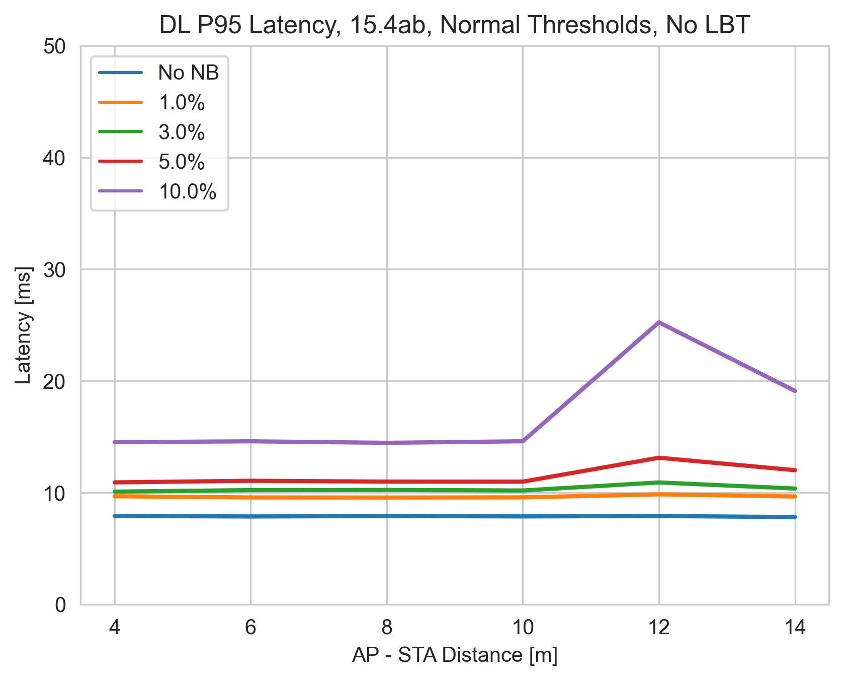
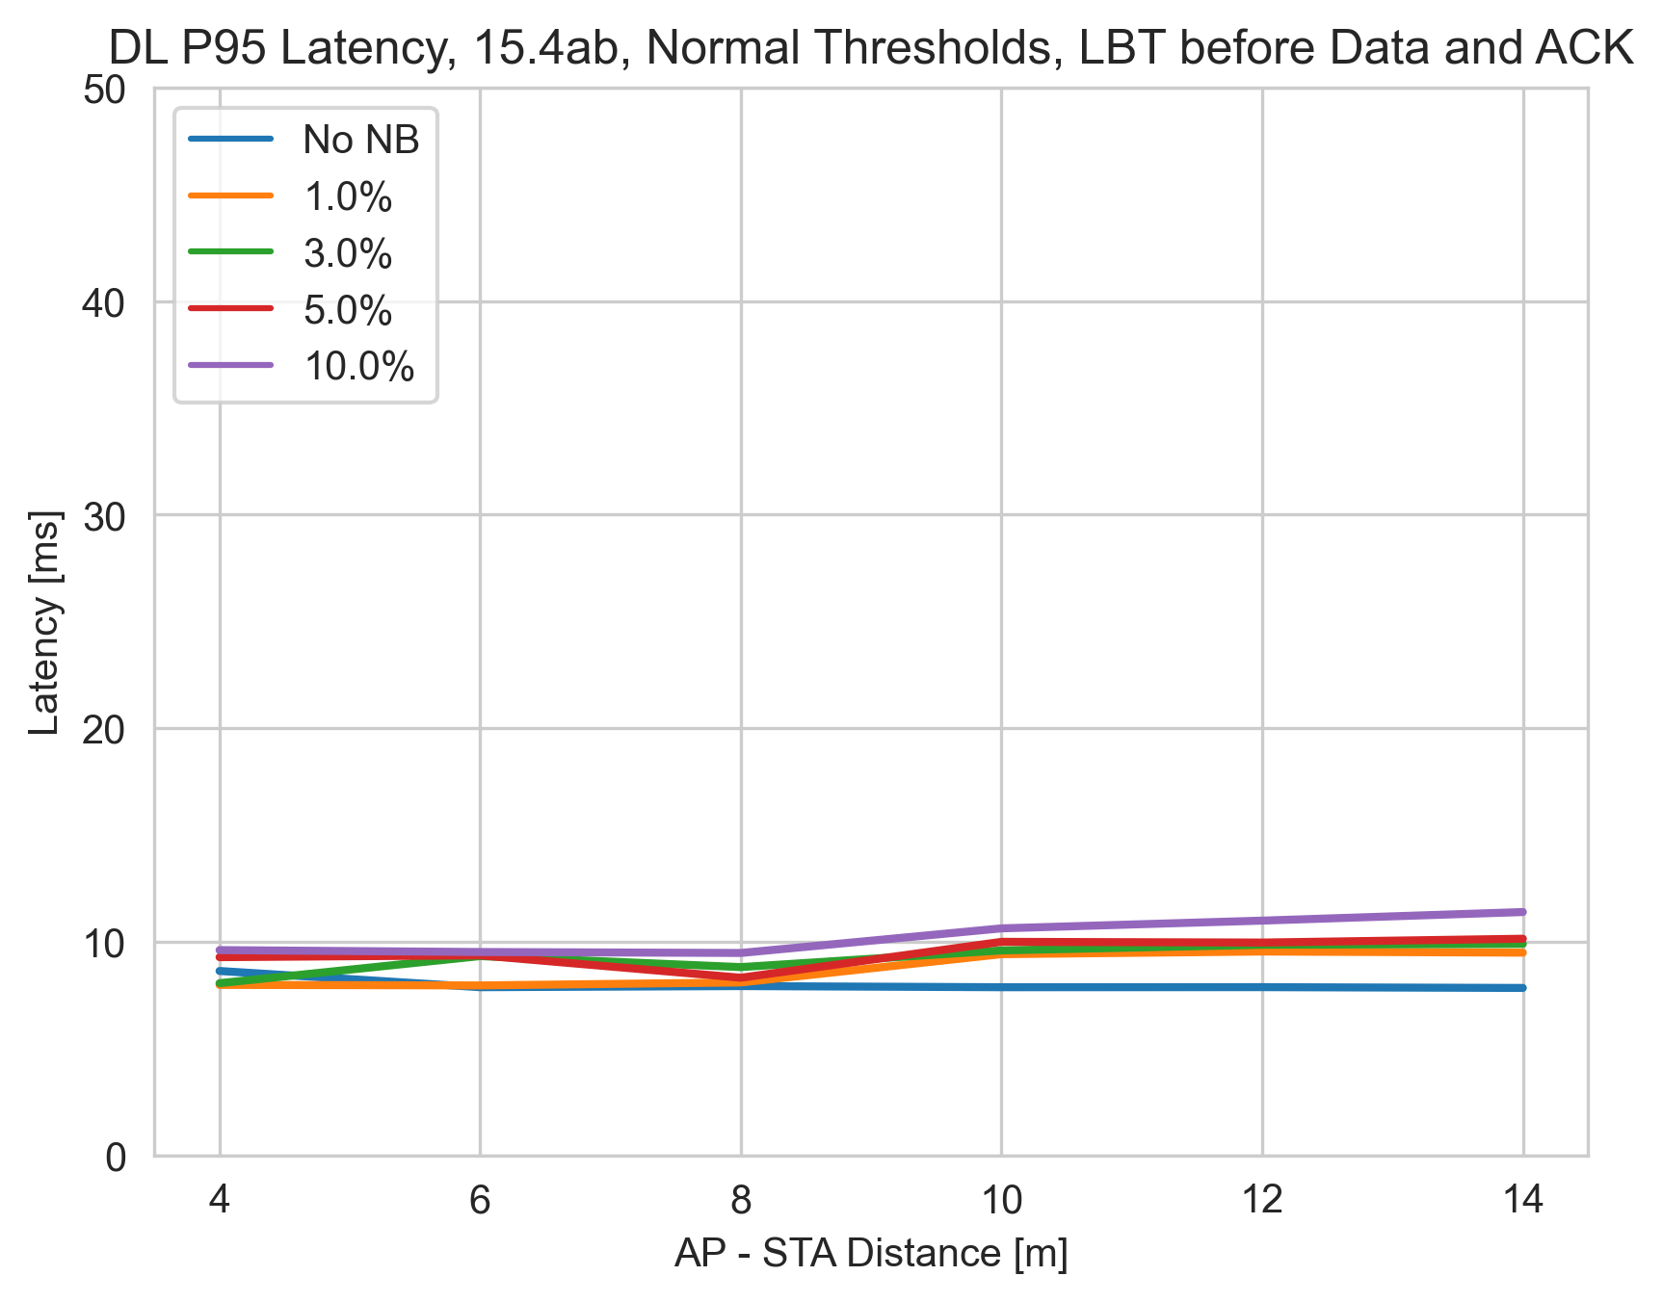
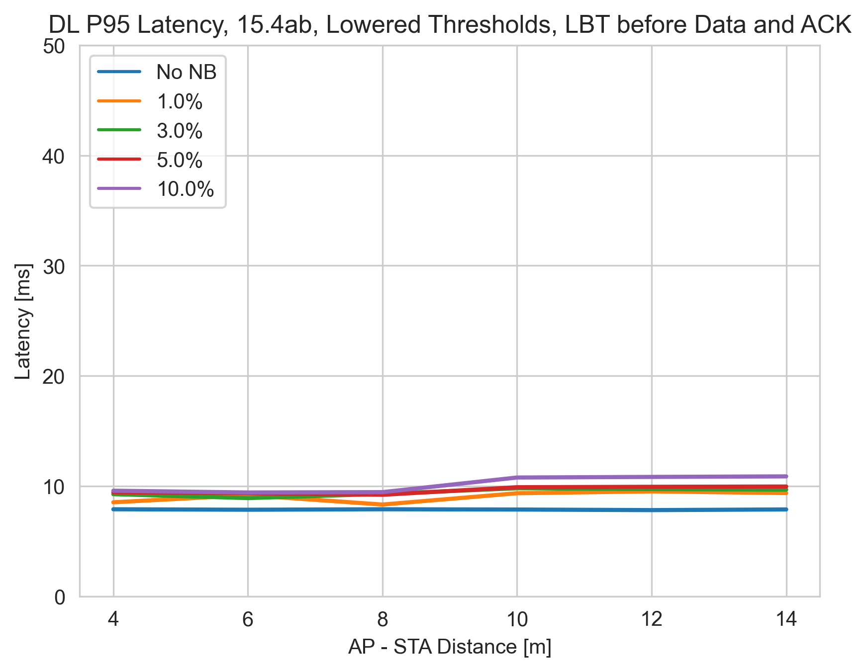
DL Results with MCS=2 (584us IFS), 80 MHz (no LBT vs LBT)
No LBT
Max ED Threshold
Reduced ED Threshold
Max ED threshold
Max ED threshold
Reduced ED threshold
No LBT
Reduced ED threshold
No LBT
At 12m, AP does not defer to NB P node, since NB power < -62 dBm
For No-LBT, P95 latency for 10% duty cycle is ~3x no NB case

Slide 24
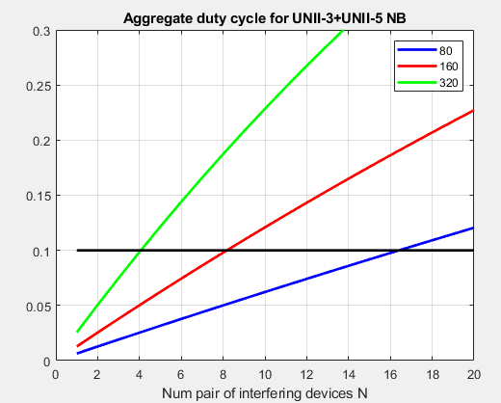
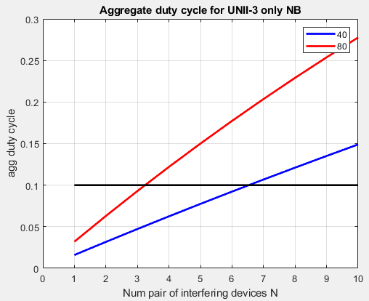
Number of NB Devices and Aggregate Duty cycle
When N pairs of narrowband transmitting UWB devices are using total bandwidth of W MHz, each pair with duty cycle x, the aggregate duty cycle on any B MHz channel is given by 1-(1-x*B/W)^{N}
We can reach ~10% aggregate duty cycle with x=5% duty cycle with 4/8/16 (UNII-3 + UNII-5) NB pair of interfering devices on a single 320/160/80 MHz 802.11 channel.
We can reach ~10% aggregate duty cycle with x=5% duty cycle with 3/6 (UNII-3 only) NB pair of interfering devices on a single 80/40 MHz 802.11 channel.
W=625 MHz
W=125 MHz

Slide 25
Observations
For this scenario, 802.11 latency is more sensitive than 802.11 throughput and smaller IFS value is more detrimental than the larger one.
NB Tx Power control could help improve coexistence
The 802.11 interferer with similar data rates as NB can coexist with 802.11 without significant degradation.
10% aggregate duty cycle can be easily reached with multiple NB interferers
Low NB duty cycle exhibits better coexistence with 802.11 technologies
For the considered scenario, even 3% NB duty cycle causes a ~50% increase in P95 packet latency. A 10% duty cycle causes unacceptable P95 latency.
The use of NB LBT improves 802.11 performance
Effect of NB LBT (or other proposed coex mechanism) on NB performance (throughput and latency) still needs to be assessed

Slide 26
Recommendations
To ensure better co-existence with 802.11, recommendation is for 802.15.4ab to adopt a mandatory coexistence mechanism to ensure adequate performance for both 802.11 and 802.15.4ab.
The mandatory coexistence mechanism can consist of a combination of LBT or other techniques.
Slide 26

Slide 27
Proposed text Change
Current NB text is :
LBT shall be applied to NB channels 50-249 according to regulatory constraints. LBT may be applied to all NB channels 0-249 in the absence of regulatory constraints, for example, to improve QoS and coexistence with other shared spectrum radio, like IEEE 802.11.
Proposed NB text is :
For duty cycle < TBD%, LBT may be applied to all channels 0-249 to improve QoS and coexistence with other shared spectrum radio, like IEEE 802.11. For duty cycle >= TBD%, LBT shall be applied to all channels 0-249.

Slide 28
Appendix

Slide 29
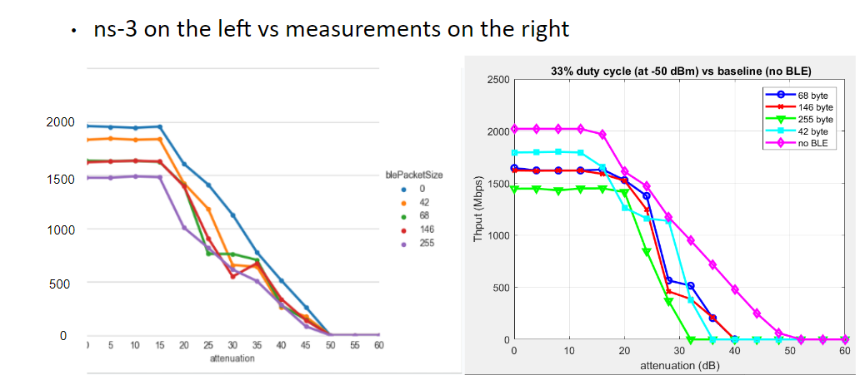
Simulation Calibration

Slide 30
Derivation of Aggregate Duty Cycle
Prob(one channel is occupied) = 1- prob (one channel is free)
=1 – prob (all N devices are not transmitting in that one channel)
=1- (a single device is not transmitting in that one channel)^{N}
= 1- (1-prob(a single device is transmitting on that one channel))^{N}
=1 – (1-x *B/W)^{N} where x is the duty cycle, B is the channel bandwidth and W is the total bandwidth that may be occupied by NB.

Slide 31
Packet configurations for some duty cycle experiments
Duty cycle | Bytes | Packet Interval (ms)
33 | 255 | 6.25
20 | 255 | 10.625
10 | 146 | 12.5
5 | 68 | 12.5
3 | 37 | 12.5

