Slide 1

143rd Session of meetings of the
IEEE 802.15 Working Group for Wireless Specialty Networks (WSN)
Opening Report
May 15-18, 2023
Held in Orlando & Hybrid via Webex

Slide 2
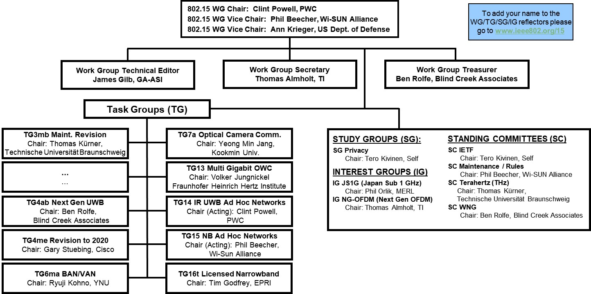
802.15 WG Org. Chart

Slide 3
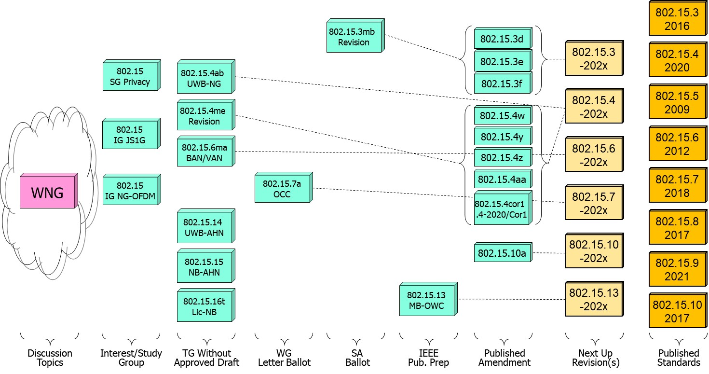
802.15 WG Standards Pipeline

Slide 4
802.15 WG Administrative
Voting members: 133
Nearly voting members: 11
Aspirant voting member: 30
802.15 WG Officer Elections
Clint Powell elected Chair (March 2022)
Phil Beecher elected Vice-Chair (March 2022)
Ann Krieger elected Vice-Chair (Nov. 2022)
Thomas Almholt appointed Secretary (May 2023)
  - Volunteer to setup New WG15 Webpages (pref. using )
  - Volunteer to setup automate voting rights calculator (Visual Basic or Python)

Slide 5
Meeting Slots for 802.15 WG May Interim

Slide 6
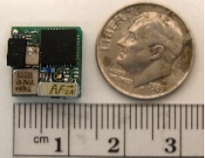

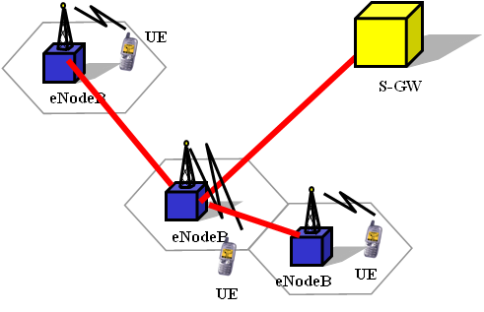

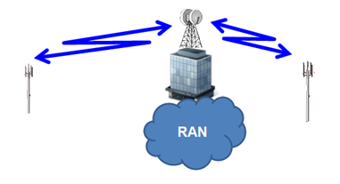







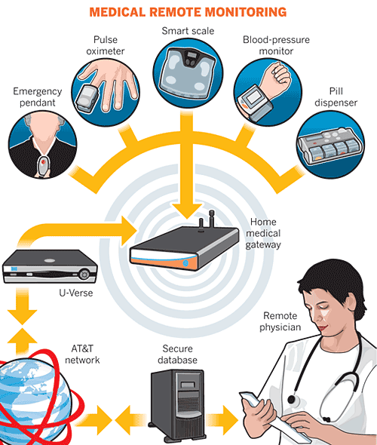
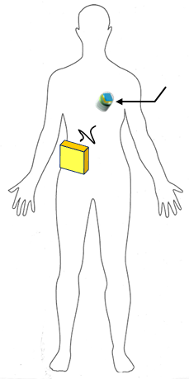



IEEE 802.15 Standards & their Applications
802.15.16
802.15.4
Locating and Tracking
Ultra-low Power Sensors
Automotive
FAN/MAN/RAN
802.15.4
Multi-media networks
&
High Speed
Interconnect
802.15.3
Industrial Networks
802.15.7
802.15.13
Medical
802.15.6
Critical Infrastructure Networks
Consumer Devices
Optical
Communications
Agricultural Sensing
Structural Monitoring
Slide 6

Slide 7
802.15 WG Subgroups/Objectives
TG 3mb – Revision b, Maintenance (mb)
Objective: revision for 802.15.3, extension of the frequency range to 300 GHz and review the 802.1D references and replace them with 802.1Q as appropriate
TG 4ab – Next Generation Ultra WideBand (UWB-NG) amendment
Objective: enhancements to 802.15.4 Ultra Wideband (UWB) physical layers (PHYs) media access control (MAC), and associated ranging techniques while retaining backward compatibility with enhanced ranging capable devices (ERDEVs)
TG 4me – Revision e, Maintenance (me)
Objective: revision to 802.15.4-2020, rolling up amendments 802.15.4w, 802.15.4y, 802.15.4z, and 802.15.4aa and work on errors, omissions, updates, etc.

Slide 8
802.15 WG Subgroups/Objectives
TG 6ma – Revision a, Maintenance (ma)
Objective: enhancements to the BAN Ultra Wideband (UWB) physical layer (PHY) and media access control (MAC) to support enhanced dependability to a human BAN (HBAN) and adds support for vehicle body area networks (VBAN), a coordinator in a vehicle with devices around the vehicular cabin
TG 7a – Optical Camera Communication (OCC)
Objective: high-rate OCC Physical Layer (PHY) using light wavelengths from 10,000 nm to 190 nm delivering data rates up to 100 Mb/s for point-to-point and point-to-multipoint communication

Slide 9
802.15 WG Subgroups/Objectives
TG 13 – Multi-Gigabit/sec Optical Wireless Communication (MG-OWC)
Objective: define OWC specifications to enable high data rate transfer among end points with up to multi-Gigabit throughput and ranges up to 200 m unrestricted line of site targeting support for ceiling-mounted infrastructure serving stationary and mobile devices as well as point-to-point links
TG 14 – Impulse Radio Ultra Wideband Wireless Ad Hoc Networks (UWB-AHN) ---IN HIBERNATION---
Objective: focused on impulse radio (IR) Ultra Wideband (UWB) PHY and MAC providing precision ranging capability that is accurate to the centimeter level by including (via. referencing) the 802.15.4 IR UWB functionality into a simple focused specification
TG 15 – Narrow Band Wireless Ad Hoc Networks (NB-AHN)
---IN HIBERNATION---
Objective: focused on narrow band ad hoc network PHY and MAC by including (via referencing) functionality and features of 802.15.4 into a simple focused specification

Slide 10
802.15 WG Subgroups/Objectives
TG 16t – Licensed Narrowband (Lic-NB)
Objective: specify new PHY in licensed spectrum with channel bandwidths greater than or equal to 5 kHz and less than 100 kHz focusing on spectrum less than 2 GHz.
SG Privacy
Objective: develop PAR and CSD to become a TG
IG JS1G - Japan Sub 1 GHz
Objective: hear presentations and determine interest in forming a Study Group to develop a PAR & CSD for extending the Sub 1 GHz PHY for Japan
IG NG-OFDM - Next Generation OFDM
Objective: hear presentations and determine interest in forming a Study Group to develop a PAR & CSD for extending the OFDM PHY

Slide 11
802.15 WG Subgroups/Objectives
SC Maintenance/Rules
Objective: review errors noted in published standards providing a response/proposal to the 802.15 WG; review the 802.15 WG operations manual and suggest changes to 802.15 WG; review PARs submitted by other WGs
SC IETF – Internet Engineering Task Force standing committee
Objective: provides an 802.15 liaison to IETF for projects associated with 802.15 standards
SC THz – Terahertz (THz)
Objective: follow the developments of THz communications, providing input to the regulatory framework for THz comms. in close cooperation IEEE 802.18 TAG; trigger the start of projects to amend existing and develop new standards for THz comms.
SC WNG – Wireless Next Generation (WNG)
Objective: provides an opportunity to individuals to make technical presentations to the 802.15 WG on new technologies and/or proposals for new projects

Slide 12
Session Objectives May 15-18, 2023
TG 3mb (Revision)
  Prepare motions and package to got to RevCom
TG 4ab (UWB-NG)
  Review initial rough draft baseline
  Identify missing pieces and determine work assignment
TG 4me (Revision)
  Review/resolve comments from informal WG review of merged baseline draft
  Begin developing reorganized structure draft
TG 6ma (Revision)
  Identify pieces of baseline draft
  Review and prepare TG6 Architecture presentation for July mtg.

Slide 13
Session Objectives March 13-16, 2023
TG 7a (OCC)
  Seek WG approval to start next Letter Ballot Recirc
TG 13 (MG-OWC)
  In IEEE Publication Preparation
TG 14 (UWB-AHN) – in hibernation, no meetings
TG 15 (NB-AHN) – in hibernation, no meetings
TG 16t (Lic-NB)
  Continue pre-draft reviews/development
Joint 802.1/802.15
  Internal TG6ma prep mtg. for TG6 Architecture presentation at Joint Mtg. in July
SG PRIVACY
  Hear/discuss proposals while waiting for TG approval

Slide 14
Session Objectives March 13-16, 2023
IG JS1G - Japan Sub 1 GHz
  Hear presentations and determine interest in forming a Study Group
IG NG-OFDM - Next Generation OFDM
  Hear presentations and determine interest in forming a Study Group
SC MAINTENANCE
  Review draft of detailed development process steps checklist
SC IETF
  Discuss IETF activities related to 802/802.15
SC THz – no meetings
SC WNG
  Hearing presentations

