Slide 1
Project: IEEE P802.15 Working Group for Wireless Personal Area Networks (WPANs)
Submission Title: Propagation Simulations of UWB Communication Applications for HBAN and VBAN Use Cases
Date Submitted: January 14th, 2023
Source: Daisuke Anzai, Nagoya Institute of Technology
Address Gokiso-cho, Showa-ku, Nagoya, 466-8555, Japan
Voice: +81-52-735-5389, FAX: +81-52-735-5389, E-Mail: anzai@nitech.ac.jp
Re: In response to call for technical contributions
Abstract: This provides of propagation simulations in UWB communication applications for human passengers BAN (HBAN) and vehicle BAN (VAN) use cases.
Purpose: Material for discussion in P802.15.6a TG corresponding to comments in EC Meeting
Notice: This document has been prepared to assist the IEEE P802.15. It is offered as a basis for discussion and is not binding on the contributing individual(s) or organization(s). The material in this document is subject to change in form and content after further study. The contributor(s) reserve(s) the right to add, amend or withdraw material contained herein.
Release: The contributor acknowledges and accepts that this contribution becomes the property of IEEE and may be made publicly available by P802.15.

Slide 2
Propagation Simulations of UWB Communication Applications for HBAN and VBAN Use Cases
Daisuke Anzai, Sho Asano, Yutaro Aoki
Nagoya Institute of Technology

Slide 3
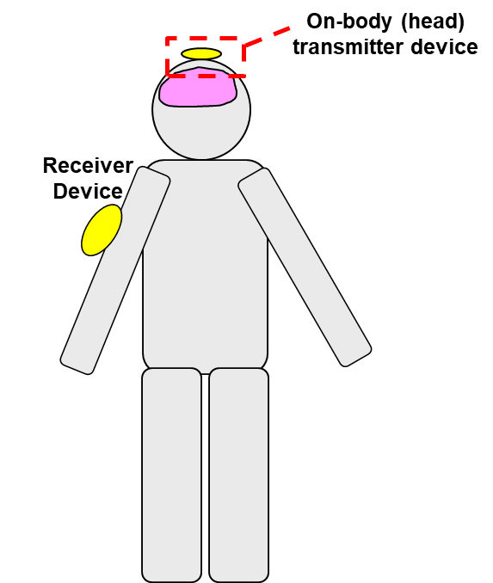
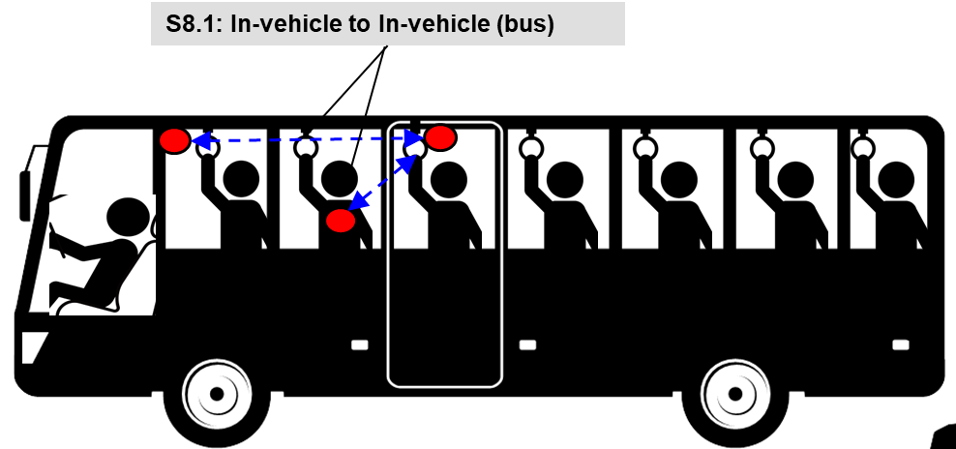
UWB communication applications
Vehicle BAN (VBAN)
Human BAN (HBAN)
Passengers bus model^{[1]}
Brain-computer interface (BCI) model^{[1]}
^{[1]}IEEE 802.15-22-0344-02-006a

Slide 4
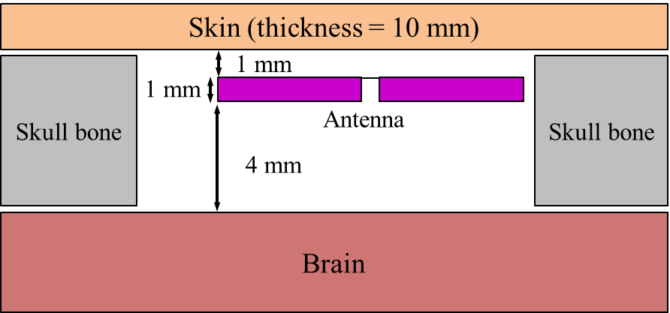
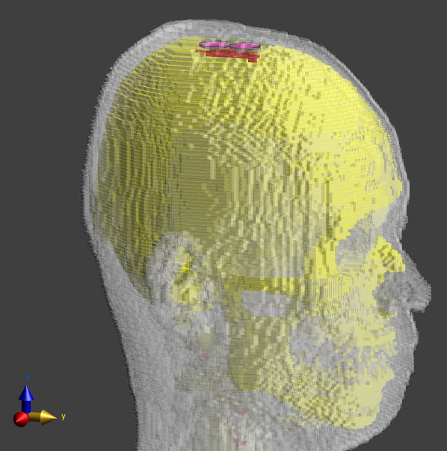
Simulation model for BCI case
(Forward antenna direction)

Slide 5
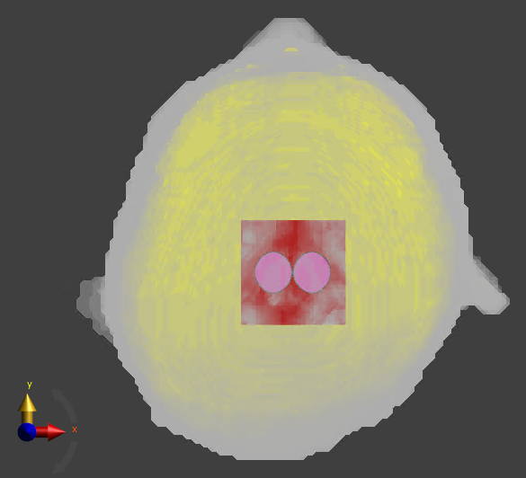
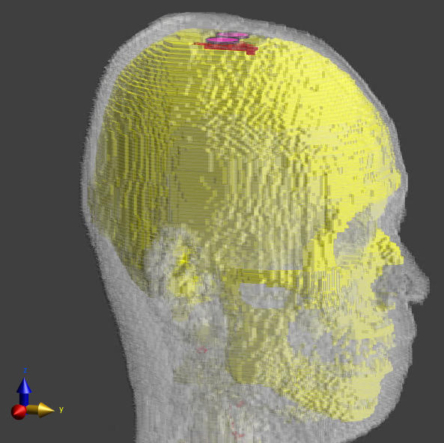
Simulation model for BCI case
(Sideways antenna direction)

Slide 6
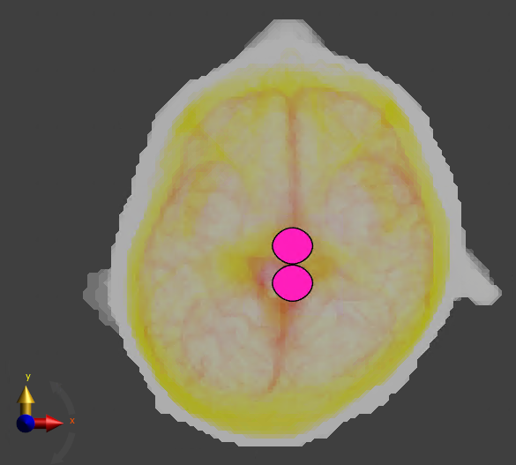
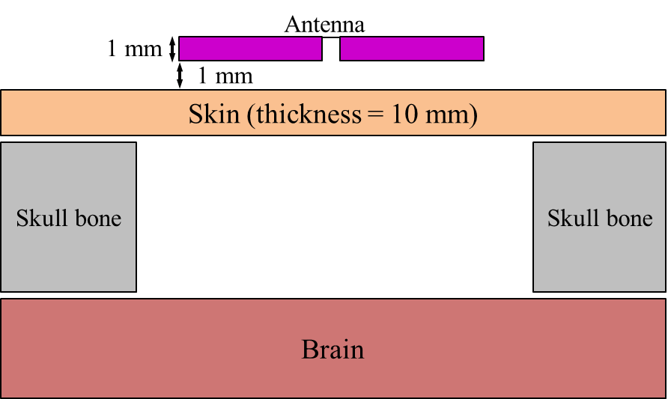
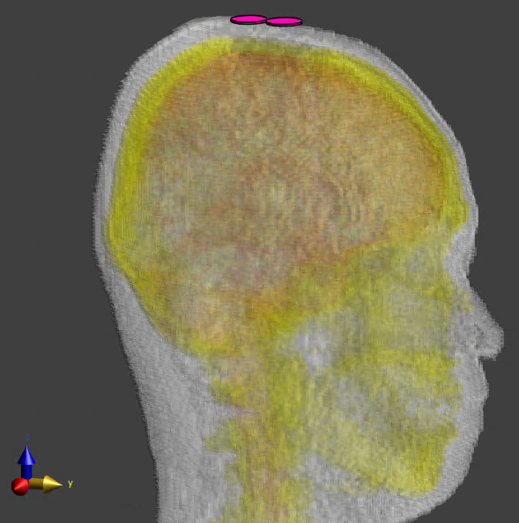
Simulation model for BMI case
(Forward antenna direction)
BMI: Brain Machine Interface

Slide 7

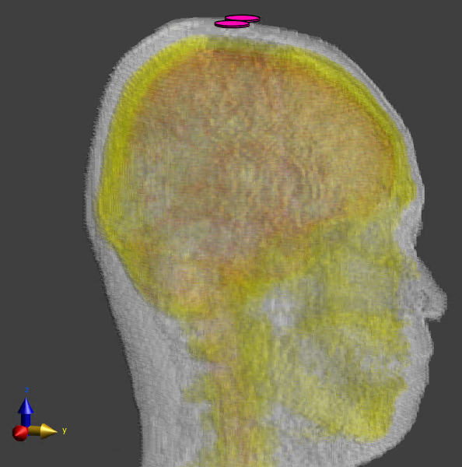
Simulation model for BMI case
(Sideways antenna direction)
BMI: Brain Machine Interface

Slide 8
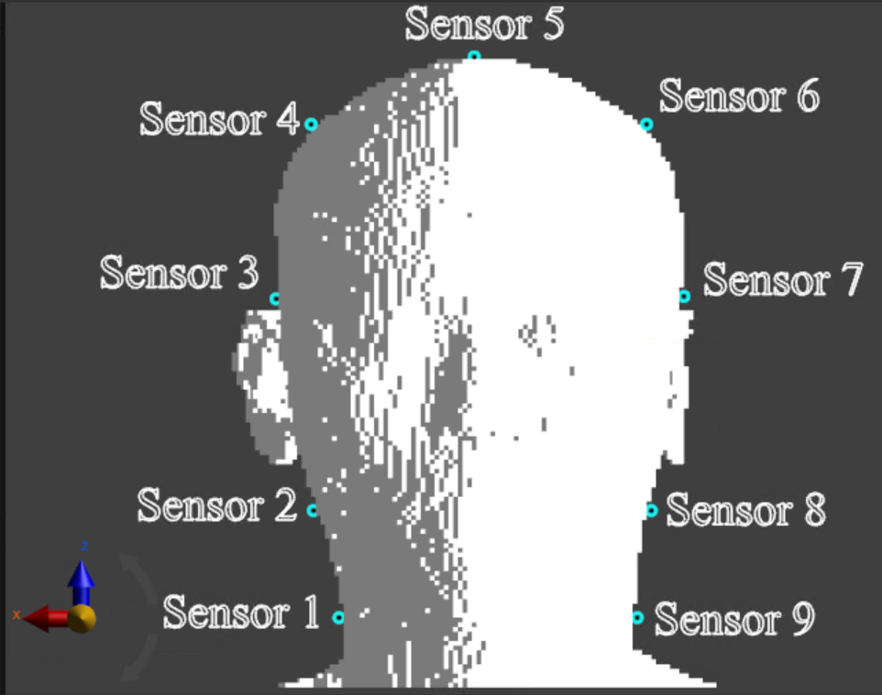
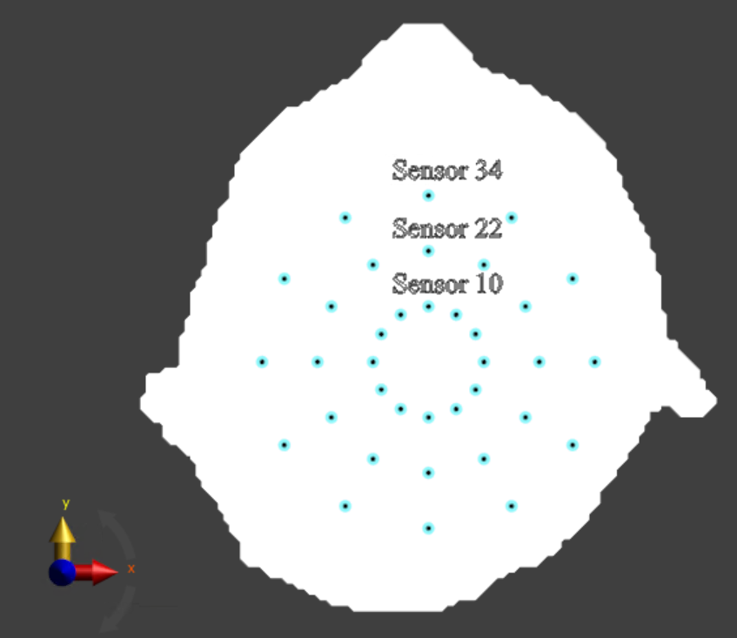
Simulation model (Human head model)

Slide 9
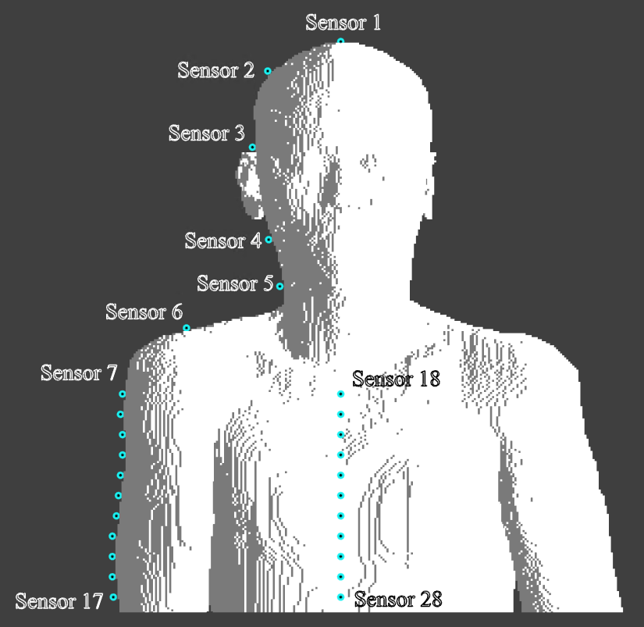
Simulation model (On-body model)
28 receivers were place on the body surface including head, arm, and chest

Slide 10
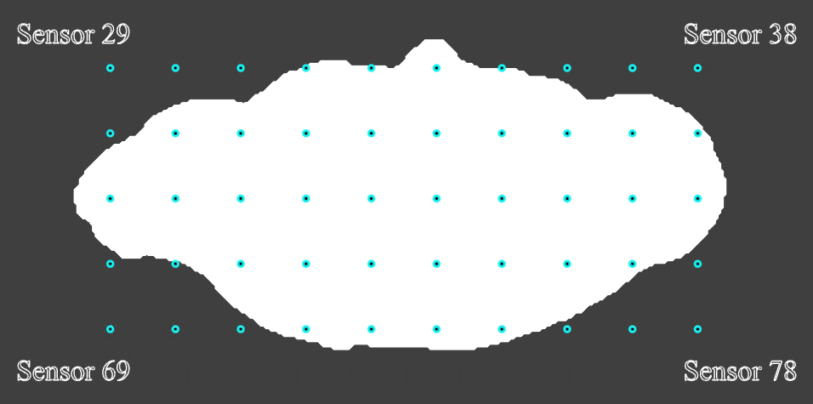
Simulation model (Off-body model)
Top view
50 receivers (#29-#78) were placed at a height of 30 mm above the transmitting antenna (the top of the human head)
The interval of each receiver was set to 5 mm

Slide 11
Summary of channel parameters
(BCI/BMI cases)
Antenna direction | Case | Receiving direction | Receiving antenna position
 |  |  | Whole head (d₀ = 10 mm) |  |  | Scalp (d₀ = 10 mm) |  |  | Arm (d₀ = 100 mm) |  |  | Torso (front) (d₀ = 100 mm) |  |  | Off-body (d₀ = 10 mm)
 |  |  | PL₀ [dB] | n | σ_{s} [dB] | PL₀ [dB] | n | σ_{s} [dB] | PL₀ [dB] | n | σ_{s} [dB] | PL₀ [dB] | n | σ_{s} [dB] | PL₀ [dB] | n | σ_{s} [dB]
Forward | BCI | X | 24.84 | 3.84 | 9.52 | 27.13 | 3.36 | 10.18 | 23.70 | 9.76 | 0.74 | 69.31 | 3.85 | 3.02 | 48.47 | 1.45 | 9.63
 |  | Y | 3.78 | 6.80 | 7.27 | 11.44 | 5.32 | 6.96 | 102.62 | 0.57 | 8.15 | 50.24 | 2.76 | 0.65 | 19.13 | 2.67 | 2.72
 |  | Z | 3.73 | 6.03 | 9.31 | 17.58 | 3.31 | 7.52 | 104.27 | 0.59 | 4.98 | 27.52 | 8.61 | 1.98 | 22.81 | 2.69 | 7.55
 | BMI | X | 32.21 | 2.55 | 12.94 | 33.07 | 2.40 | 14.17 | 60.60 | 2.01 | 1.10 | 70.72 | 5.04 | 2.69 | 40.26 | 1.65 | 6.19
 |  | Y | 10.72 | 5.63 | 8.02 | 14.08 | 4.89 | 7.88 | 90.00 | 0.66 | 10.08 | 59.62 | 3.02 | 0.61 | 23.09 | 2.25 | 3.85
 |  | Z | 13.00 | 4.62 | 8.86 | 18.04 | 3.52 | 8.75 | 87.49 | 0.45 | 5.35 | 32.56 | 9.25 | 1.61 | 22.12 | 2.66 | 5.81
Sideways | BCI | X | 20.37 | 3.80 | 7.47 | 10.97 | 5.63 | 6.89 | 51.42 | 3.14 | 1.13 | 16.68 | 10.59 | 2.42 | 0.05 | 4.95 | 2.66
 |  | Y | 19.60 | 4.96 | 7.59 | 25.39 | 3.86 | 7.31 | 80.65 | 1.99 | 11.42 | 67.02 | 3.72 | 1.80 | 34.94 | 2.74 | 5.65
 |  | Z | 13.36 | 4.54 | 7.09 | 19.77 | 3.34 | 7.03 | 76.35 | 1.85 | 5.12 | 62.07 | 6.87 | 2.61 | 44.11 | 0.56 | 5.84
 | BMI | X | 17.71 | 4.01 | 7.33 | 14.01 | 4.84 | 7.51 | 51.22 | 3.28 | 1.09 | 15.68 | 11.30 | 2.58 | -3.03 | 5.25 | 4.76
 |  | Y | 26.20 | 4.19 | 12.94 | 33.17 | 2.65 | 12.88 | 78.08 | 2.63 | 12.69 | 56.25 | 4.89 | 1.52 | 45.33 | 1.24 | 6.31
 |  | Z | 20.14 | 4.09 | 8.89 | 23.42 | 3.39 | 9.35 | 77.09 | 1.87 | 5.07 | 36.17 | 10.07 | 1.61 | 42.50 | 0.80 | 4.96

Slide 12
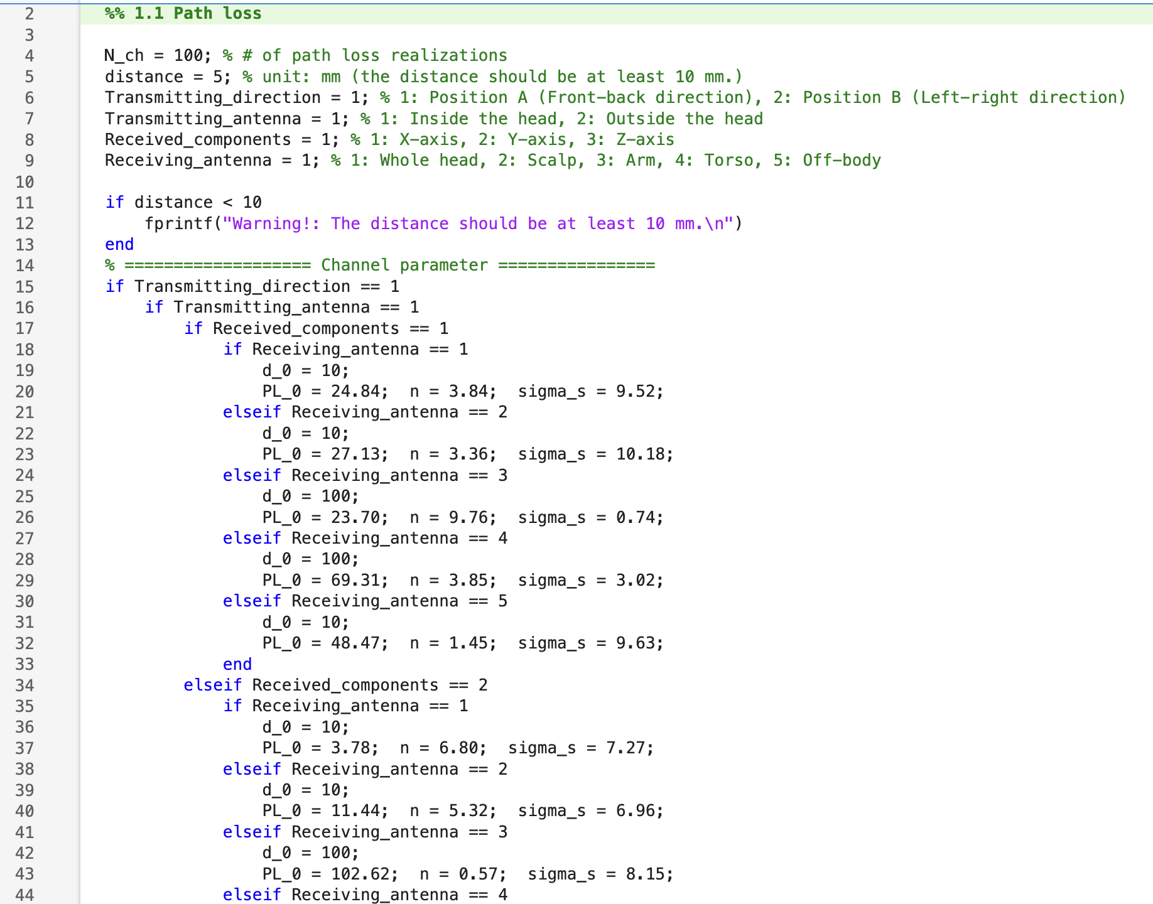
Propagation simulation

Slide 13
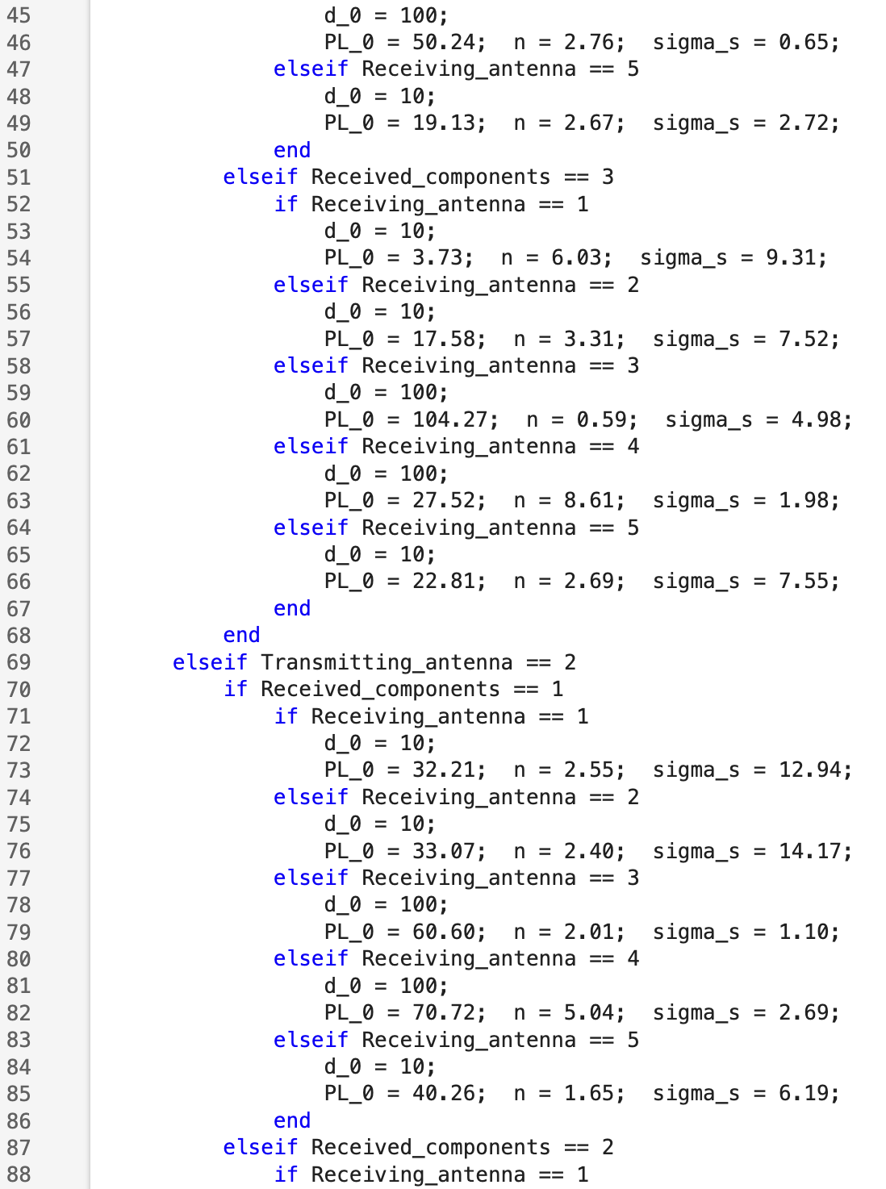
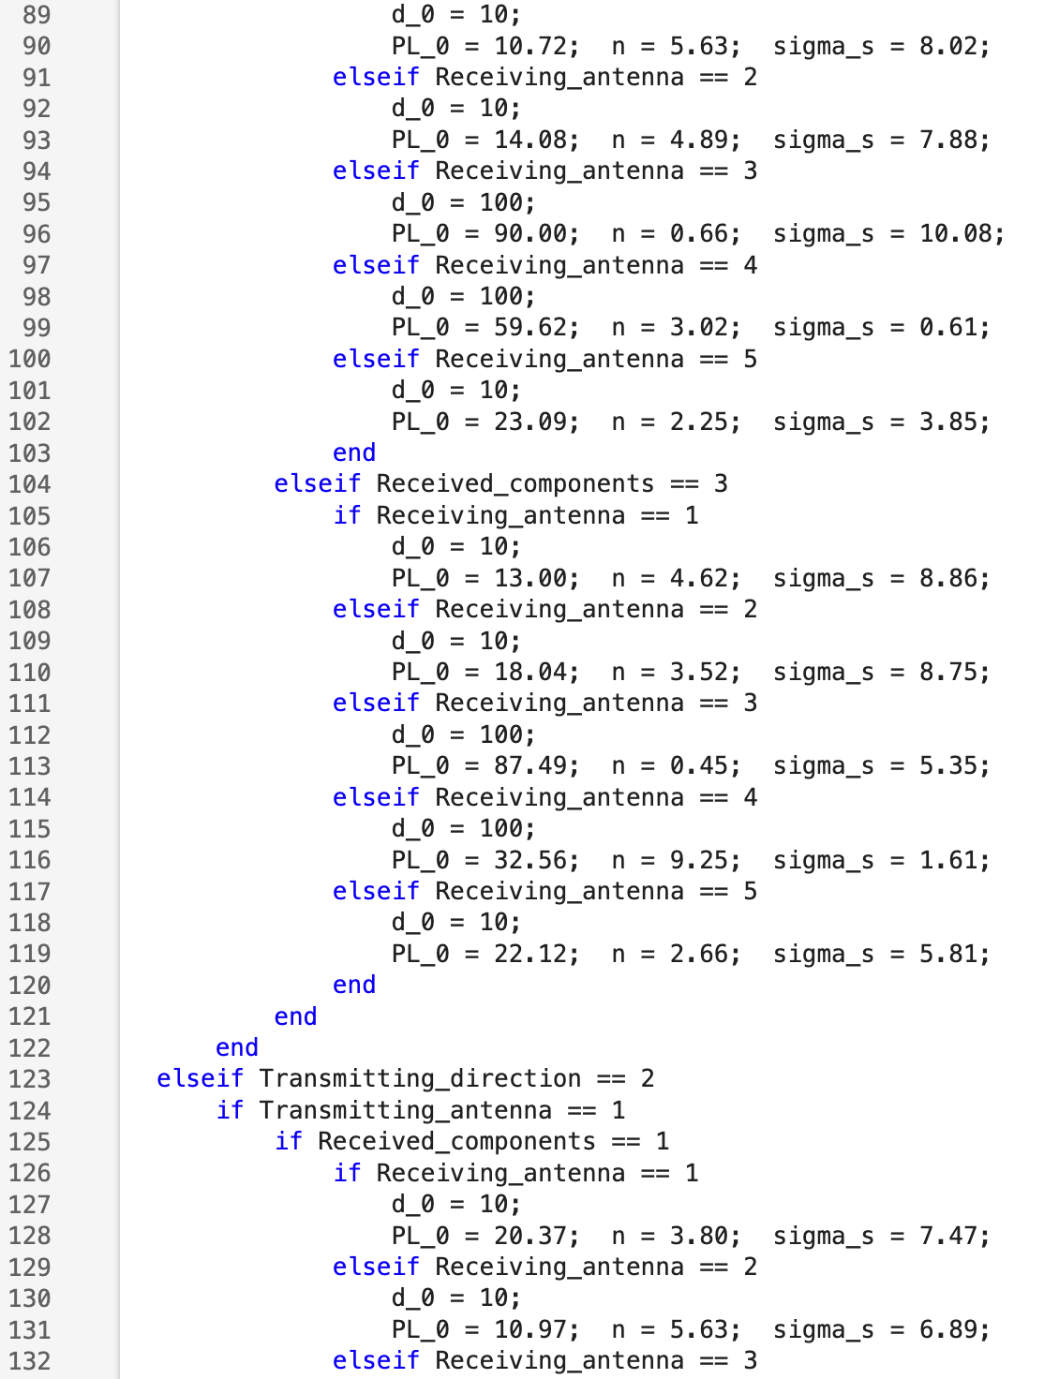
Propagation simulation

Slide 14
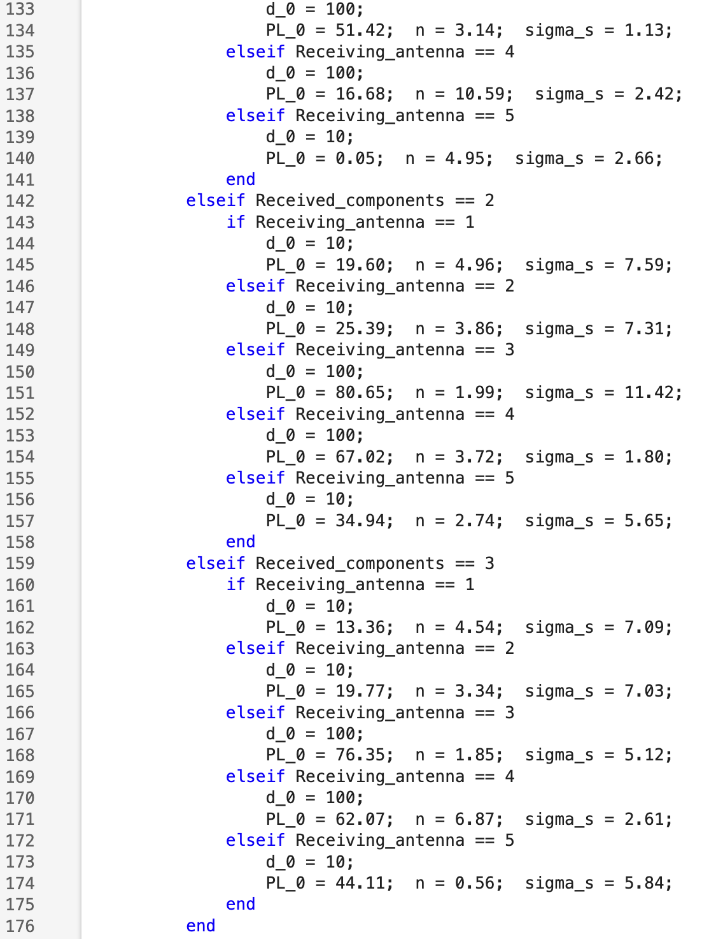
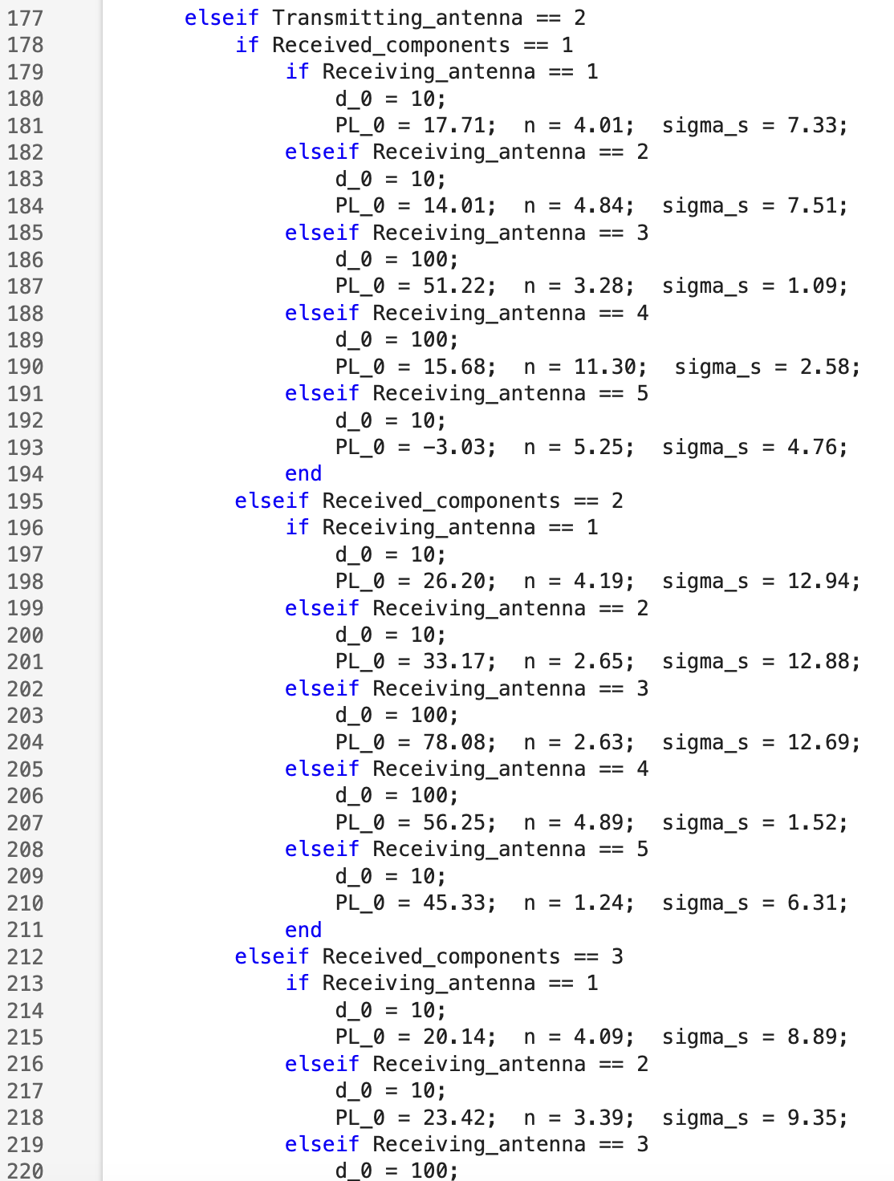
Propagation simulation

Slide 15
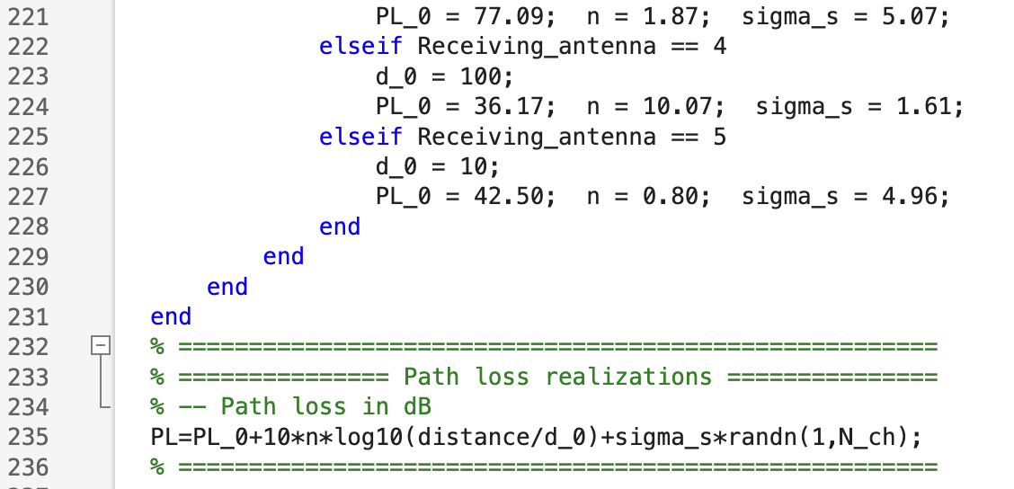
Propagation simulation

Slide 16
References
D. Anzai, I. Balasingham, G. Fischer, J. Wang, “Reliable and High-Speed Implant Ultra-Wideband Communications with Transmit–Receive Diversity,” EAI/Springer Innovations in Communication and Computing, pp. 27-32, March 2020.
Y. Shimizu, D. Anzai, R. C-Santiago, P. A. Floor, I. Balasingham, and J. Wang, “Performance evaluation of an ultra-wideband transmit diversity in a living animal experiment” IEEE Trans. Microw. Theory Tech., vol. 65, no. 7, pp. 2596-2606, July 2017.
D. Anzai, K. Katsu, R. Chavez-Santiago, Q. Wang, D. Plettemeier, J. Wang, and I. Balasingham, “Experimental evaluation of implant UWB-IR transmission with living animal for body area networks,” IEEE Trans. Microw. Theory Tech., vol. 62, no. 1, pp. 183-192, Jan. 2014.
J. Shi, D. Anzai, and J. Wang, “Channel modeling and performance analysis of diversity reception for implant UWB wireless link,” IEICE Trans. Commun., no. E95-B, vol. 10, pp. 3197-3205, Oct. 2012.

