Slide 1
Project: IEEE P802.15 Working Group for Wireless Personal Area Networks (WPANs)
Submission Title: Propagation Characteristics of UWB Communication Applications for Human BAN (HBAN) Use Cases
Date Submitted: January 14th, 2023
Source: Daisuke Anzai, Nagoya Institute of Technology
Address Gokiso-cho, Showa-ku, Nagoya, 466-8555, Japan
Voice: +81-52-735-5389, FAX: +81-52-735-5389, E-Mail: anzai@nitech.ac.jp
Re: In response to call for technical contributions
Abstract: This provides of fundamental propagation characteristics including path loss characteristics for UWB communication applications for BCI use case.
Purpose: Material for discussion in P802.15.6a TG corresponding to comments in EC Meeting
Notice: This document has been prepared to assist the IEEE P802.15. It is offered as a basis for discussion and is not binding on the contributing individual(s) or organization(s). The material in this document is subject to change in form and content after further study. The contributor(s) reserve(s) the right to add, amend or withdraw material contained herein.
Release: The contributor acknowledges and accepts that this contribution becomes the property of IEEE and may be made publicly available by P802.15.

Slide 2
Propagation Characteristics of UWB Communication Applications for Human BAN (HBAN) Use Cases
Daisuke Anzai and Sho Asano
Nagoya Institute of Technology

Slide 3
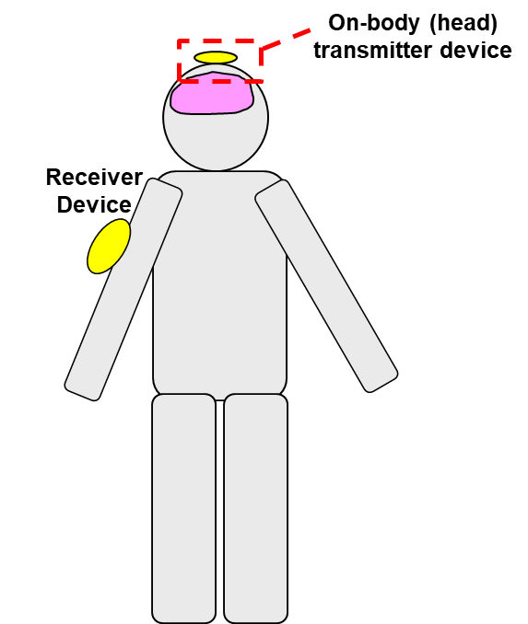
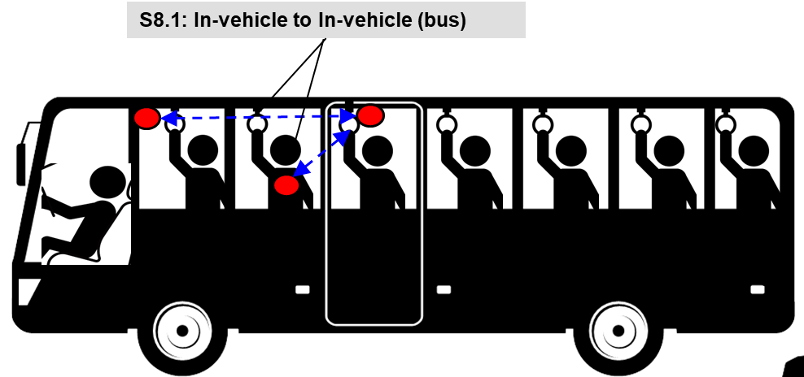
UWB communication applications
Vehicle BAN (VBAN)
Human BAN (HBAN)
Passengers bus model^{[1]}
Brain-computer interface (BCI) model^{[1]}
^{[1]}IEEE 802.15-22-0344-02-006a

Slide 4
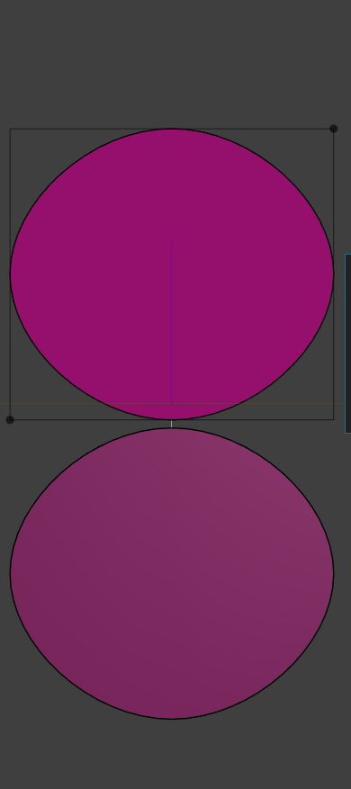
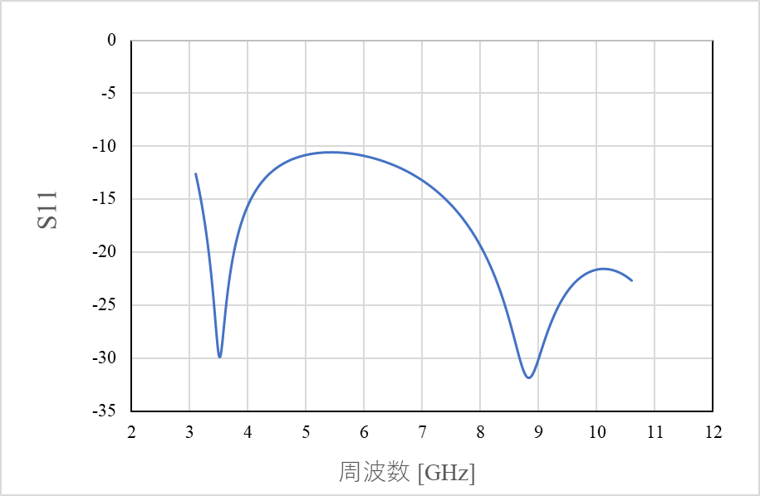
UWB antenna at 3.1 - 10.6 GHz band
20 mm
Frequency: 3.1 – 10.6 GHz
Planar elliptical dipole antenna
Element size: 20 mm x 18 mm x 1 mm
Interval between each element: 0.5 mm
18 mm
|S₁₁| [dB]
Frequency [GHz]

Slide 5
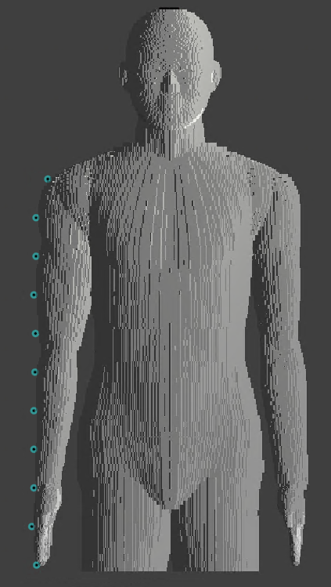



Simulation model
UWB antenna
(transmit antenna)
Frequency: 3.4 – 4.8 GHz
Frequency-dependent finite-different time-domain (FDTD) method
Multi-size voxel model (min. size: 0.5 mm)
Homogeneous human model (Japanese male developed by NICT, Japan)
$$z$$
Transmitted signal waveform
$$x$$
$$y$$

Slide 6
Dielectric constants of human model
Relative permittivity
Conductivity

Slide 7
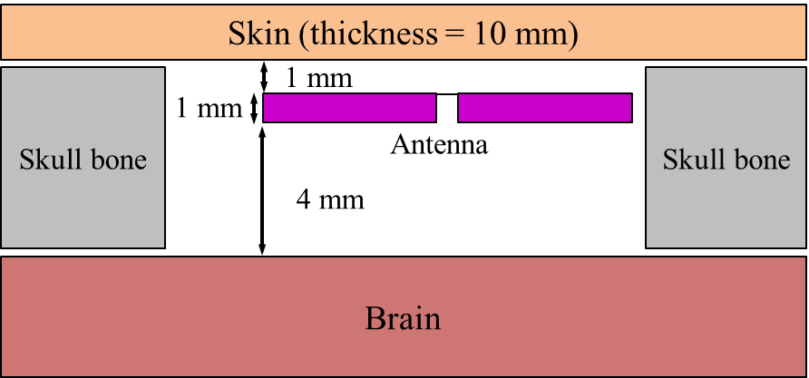
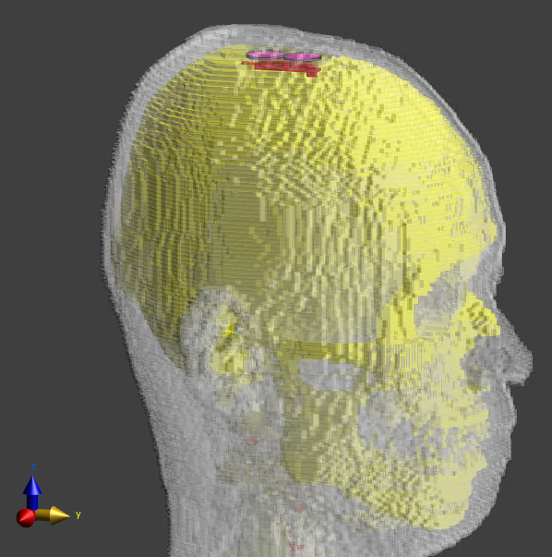
Simulation model for BCI case
(Forward antenna direction)

Slide 8
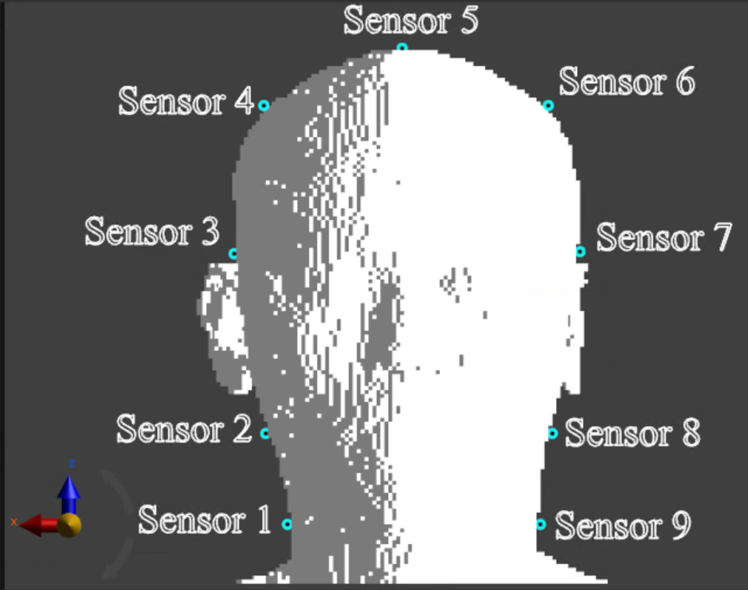
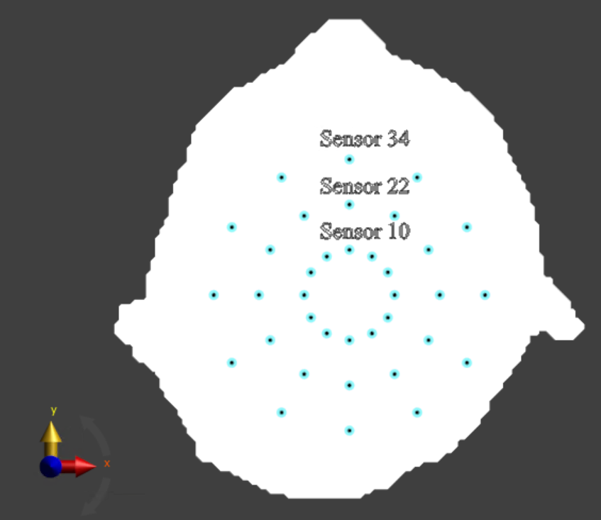
Simulation setup (Human head model)

Slide 9
Path loss characteristics (Sensor #10)

Slide 10
Path loss characteristics (Sensor #22)

Slide 11
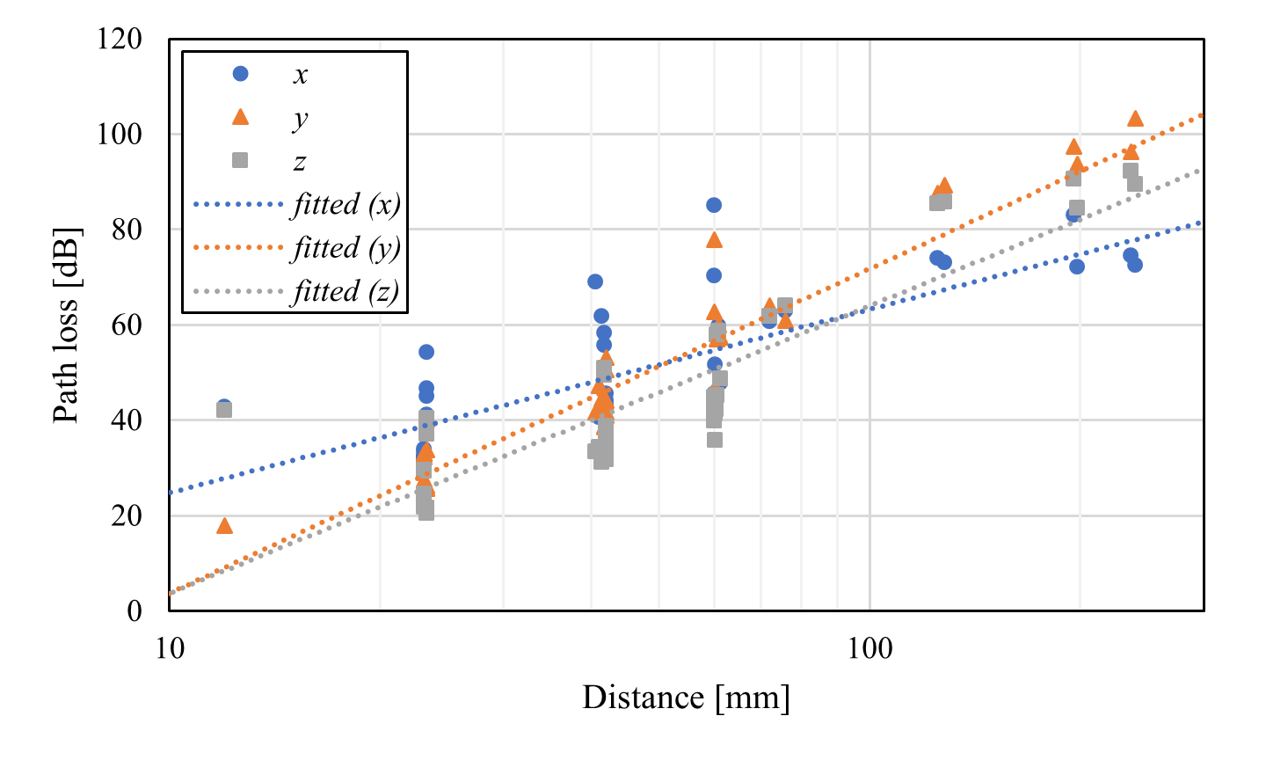

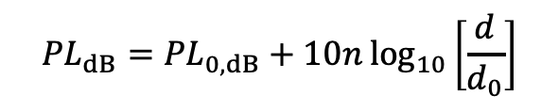
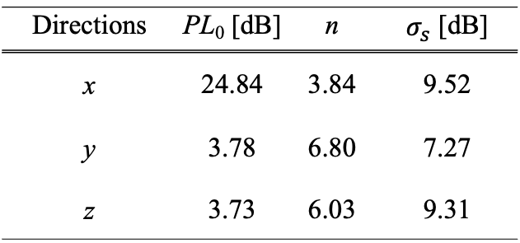
Distance characteristics (Human head, BCI)
$${PL}_{dB}={PL}_{0,dB}+10n\log_{10}\left[\frac{d}{d_{0}}\right]$$
Directions | PL₀ [dB] | n | $σ_{s}$ [dB]
x | 24.84 | 3.84 | 9.52
y | 3.78 | 6.80 | 7.27
z | 3.73 | 6.03 | 9.31
$d_{0}=10$ mm

Slide 12
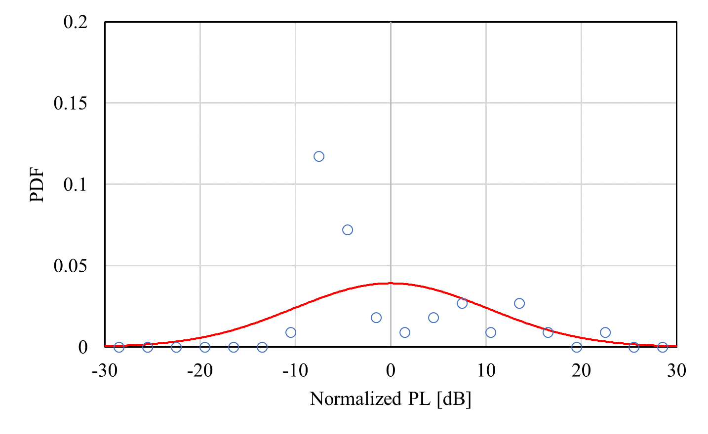
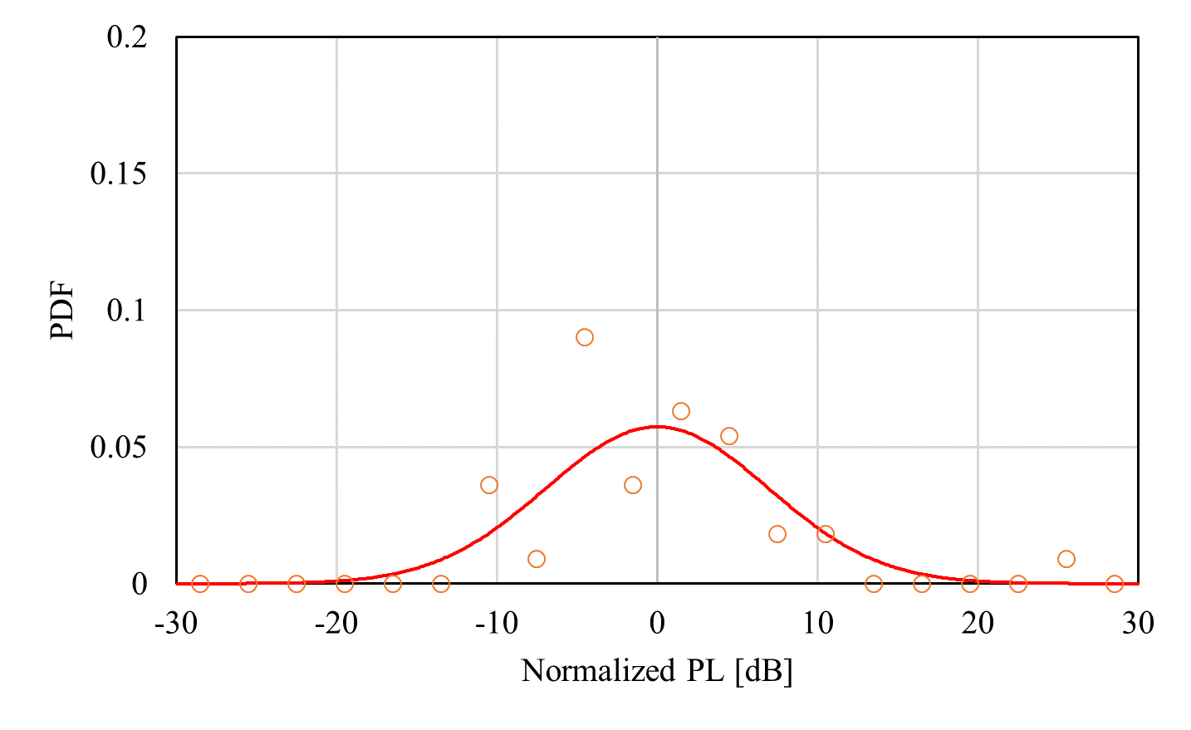
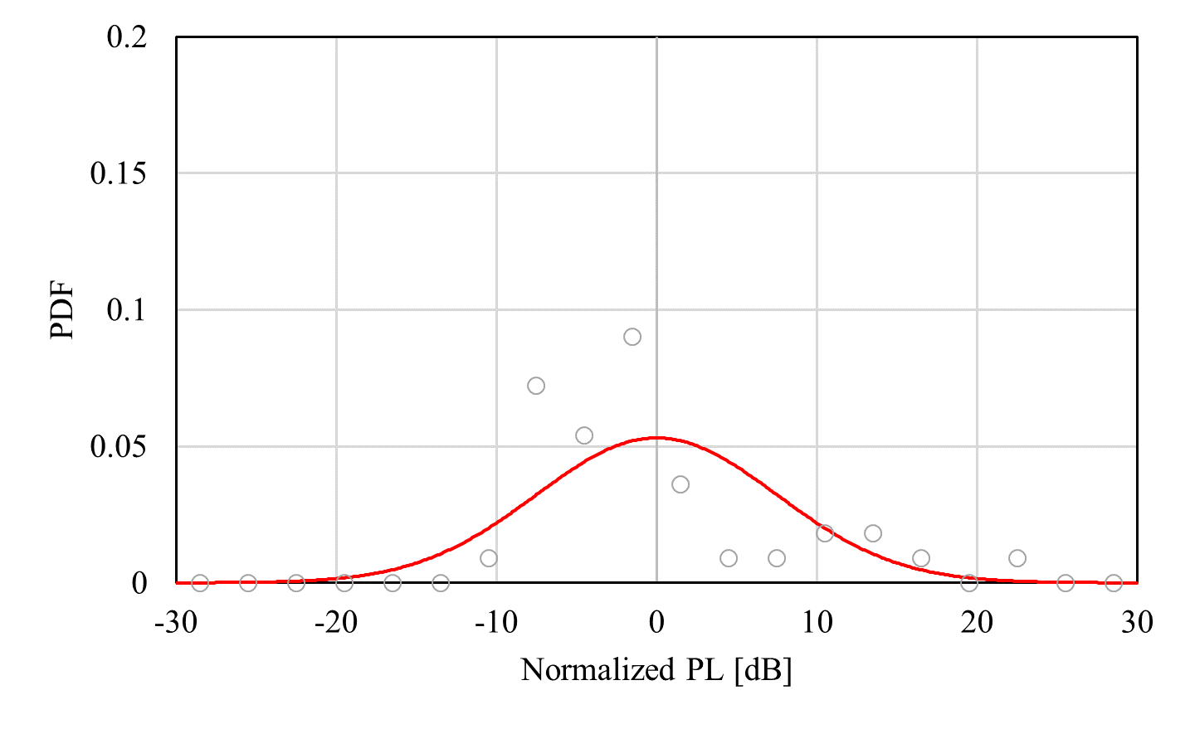



Log-normal distribution
(Human head, BCI)
$x$-direction
$y$-direction
$z$-direction

Slide 13
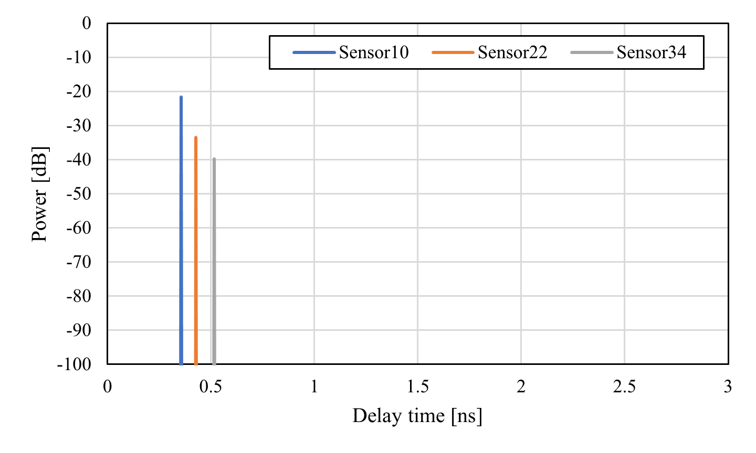
Power delay profile (Human head, BCI)

Slide 14
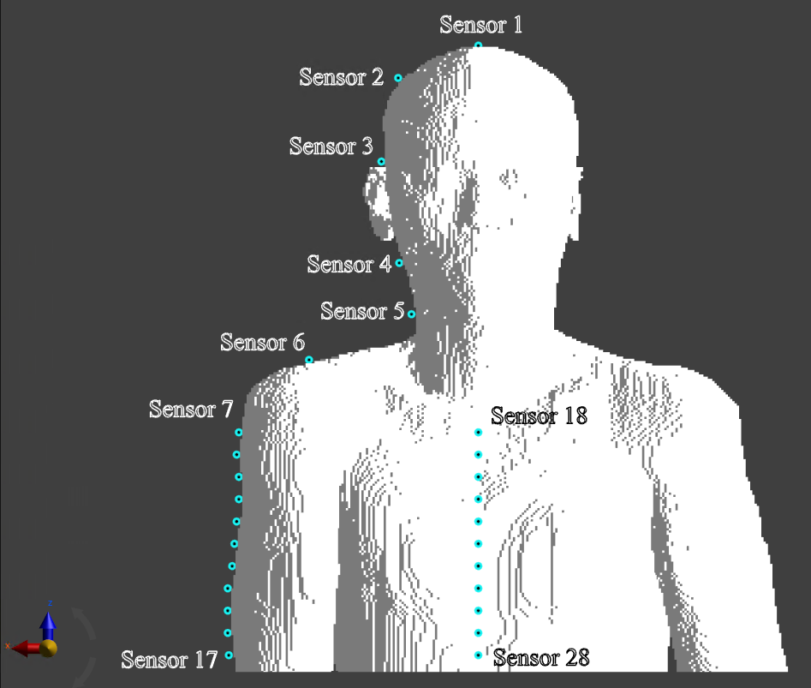
Simulation model (On-body model)
28 receivers were place on the body surface including head, arm, and chest

Slide 15
Path loss characteristics (Sensor #7)

Slide 16
Path loss characteristics (Sensor #18)

Slide 17
Path loss characteristics (Sensor #28)

Slide 18
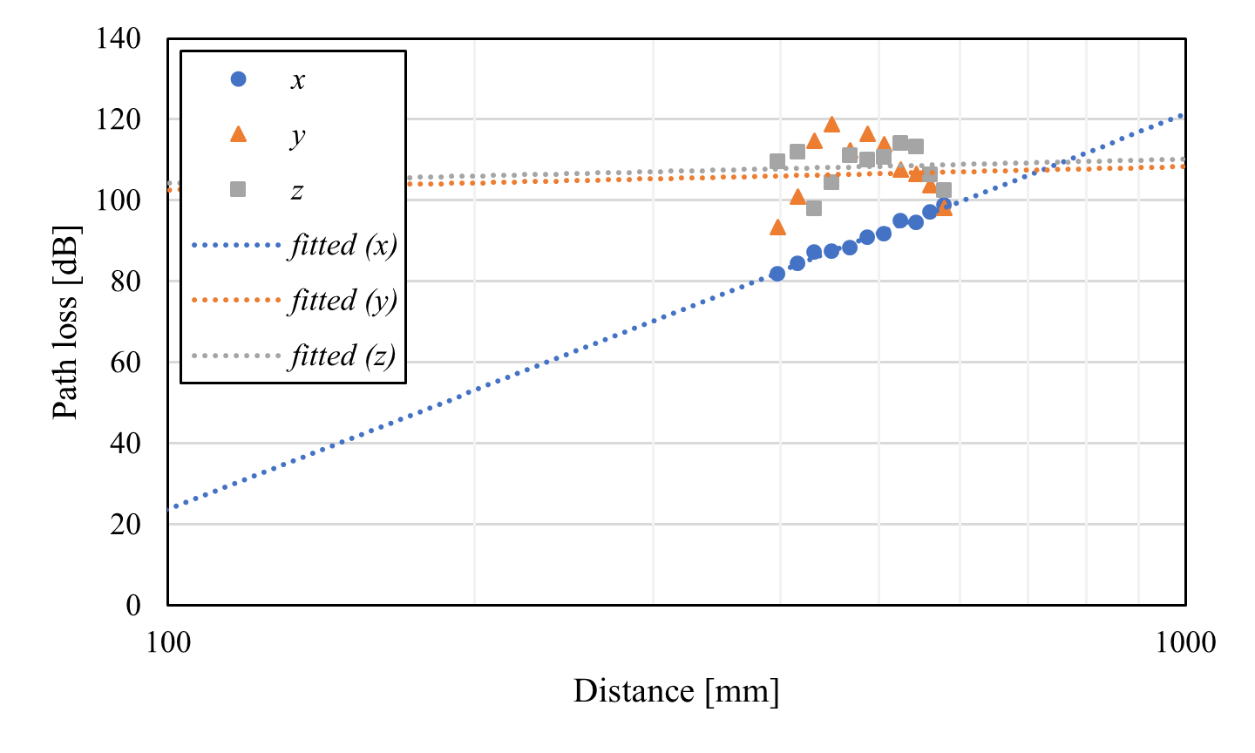
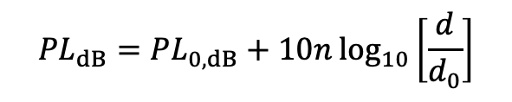
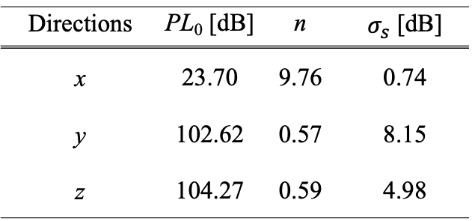

Distance characteristics (Arm, BCI)
$${PL}_{dB}={PL}_{0,dB}+10n\log_{10}\left[\frac{d}{d_{0}}\right]$$
Directions | PL₀ [dB] | n | $σ_{s}$ [dB]
x | 23.70 | 9.76 | 0.74
y | 102.62 | 0.57 | 8.15
z | 104.27 | 0.59 | 4.98
$d_{0}=100$ mm

Slide 19
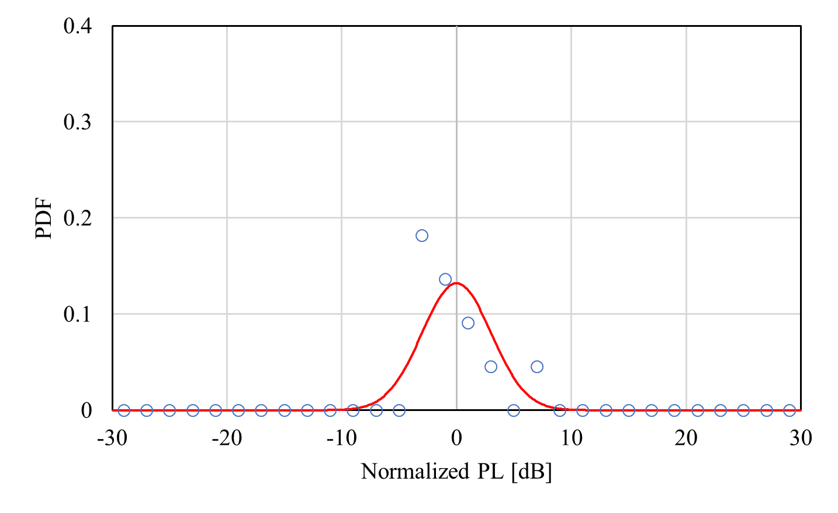
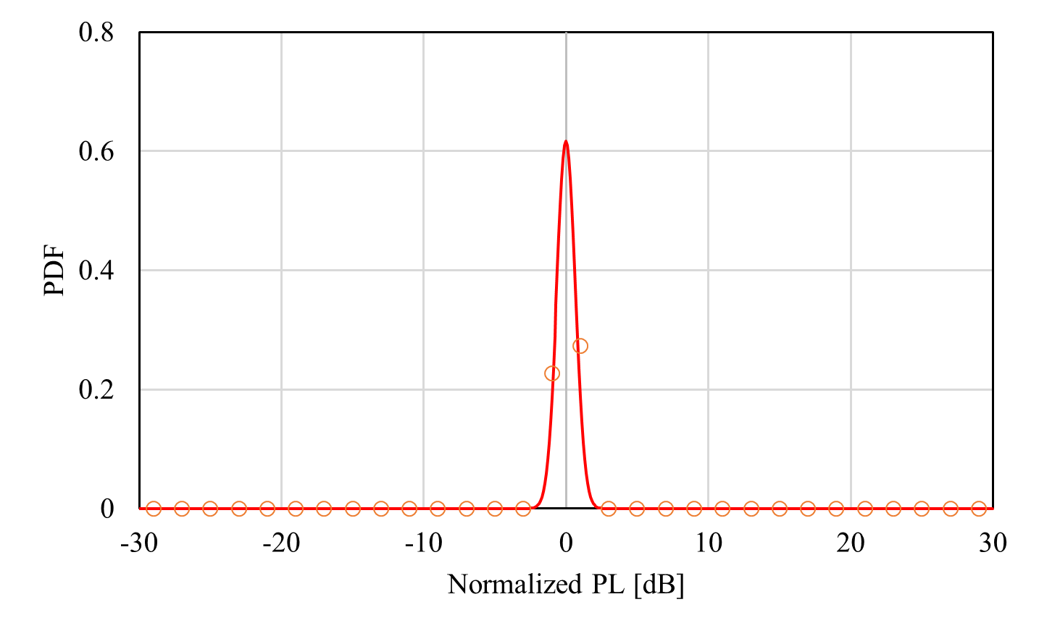
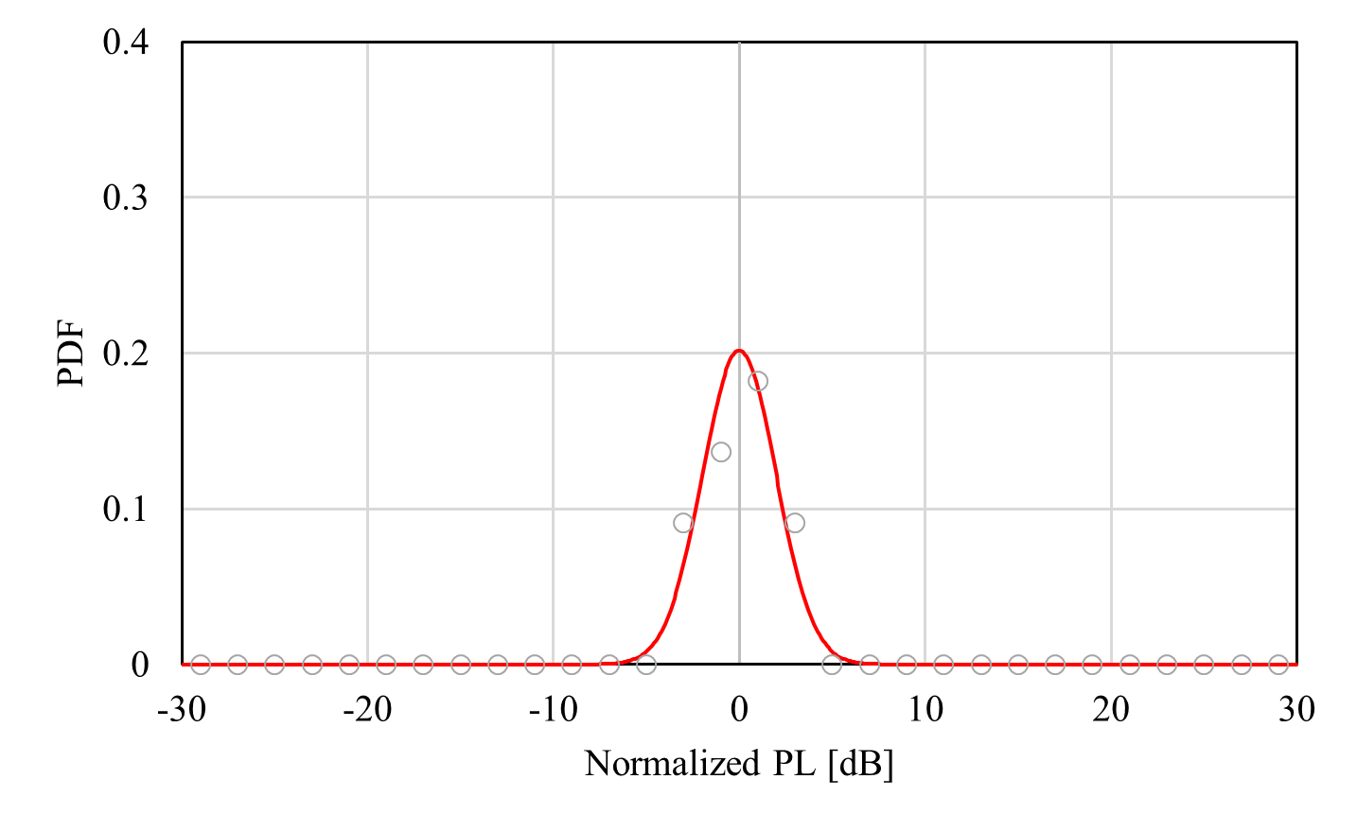


Log-normal distribution
(Front torso, BCI)
$x$-direction
$y$-direction
$z$-direction

Slide 20
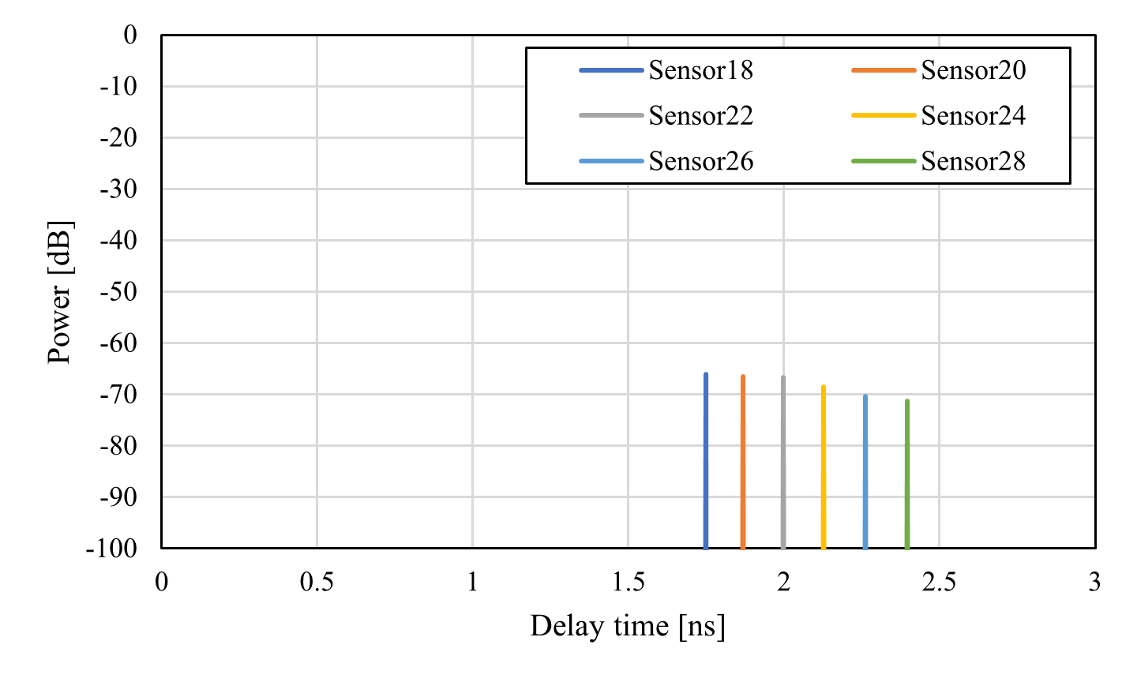
Power delay profile (Front torso, BCI)

Slide 21
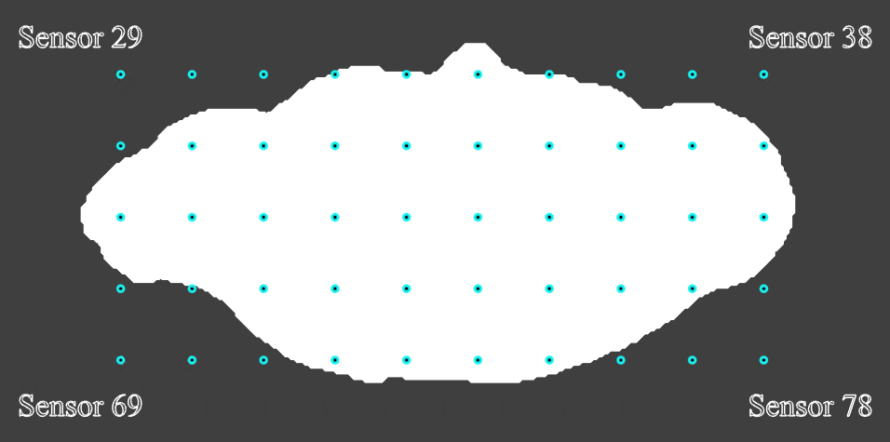
Simulation model (Off-body model)
Top view
50 receivers (#29-#78) were placed at a height of 30 mm above the transmitting antenna (the top of the human head)
The interval of each receiver was set to 5 mm

Slide 22
Path loss characteristics (Sensor #29)

Slide 23
Path loss characteristics (Sensor #78)

Slide 24
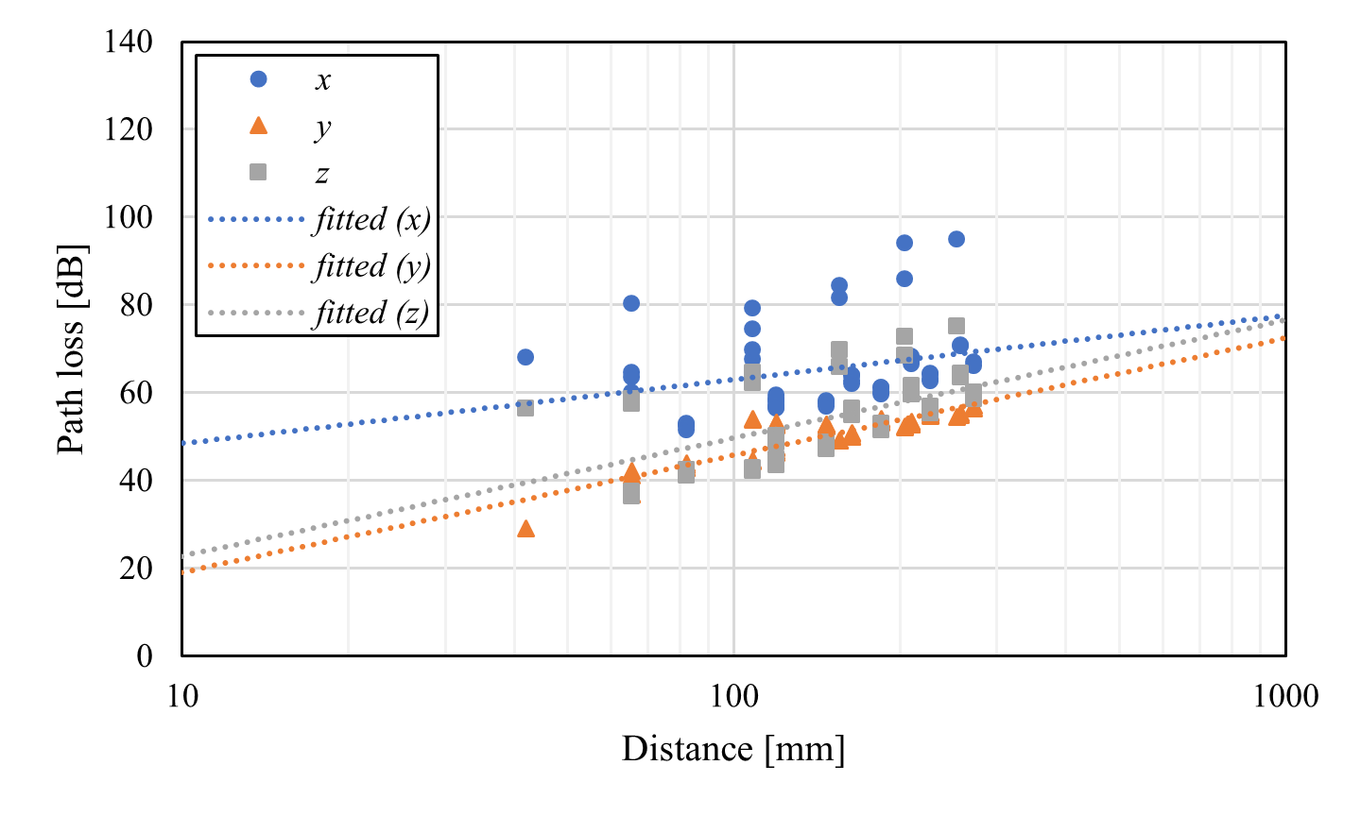

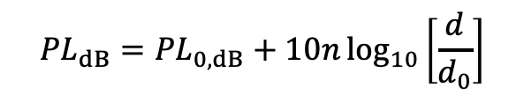
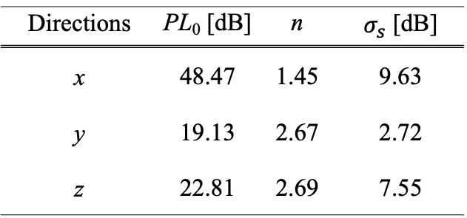
Distance characteristics (Off-body, BCI)
$${PL}_{dB}={PL}_{0,dB}+10n\log_{10}\left[\frac{d}{d_{0}}\right]$$
Directions | PL₀ [dB] | n | $σ_{s}$ [dB]
x | 48.47 | 1.45 | 9.63
y | 19.13 | 2.67 | 2.72
z | 22.81 | 2.69 | 7.55
$d_{0}=10$ mm

Slide 25
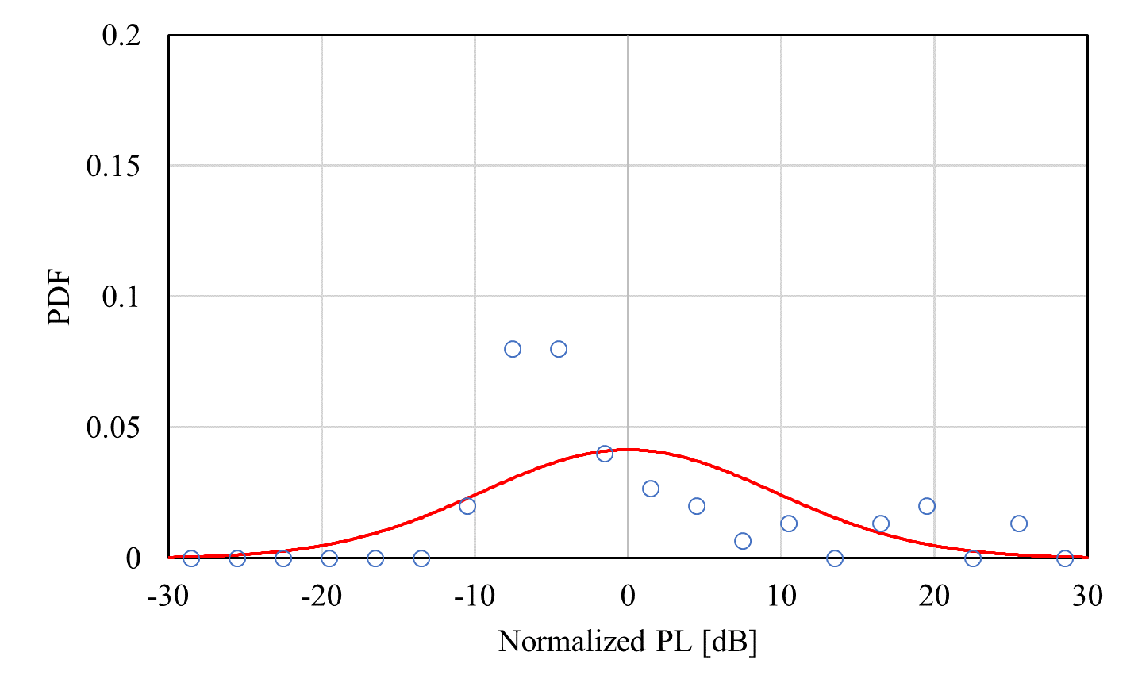
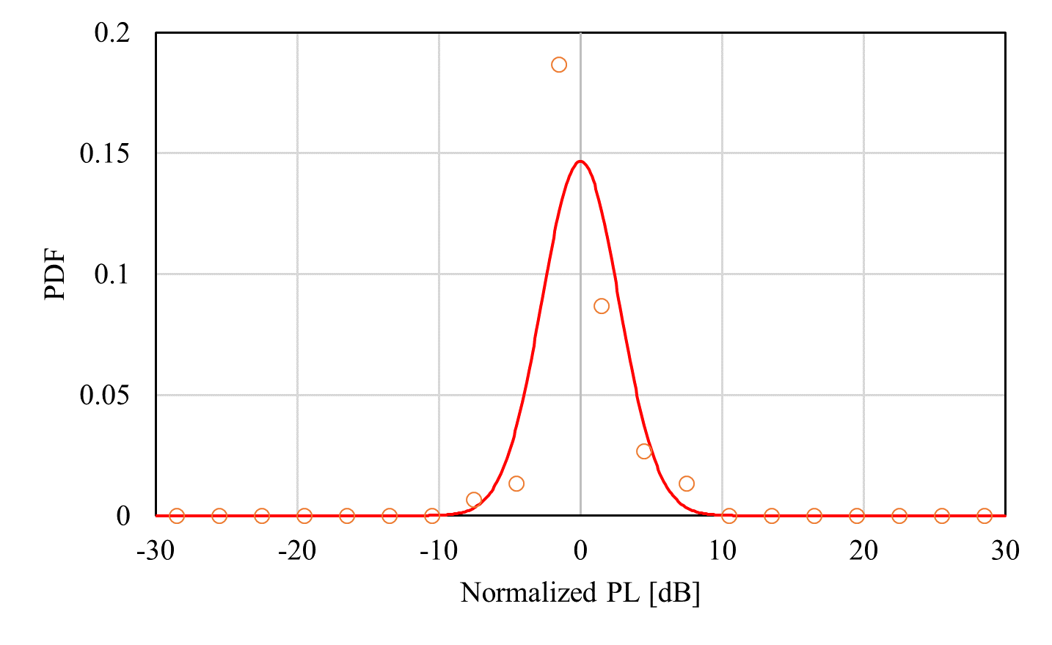
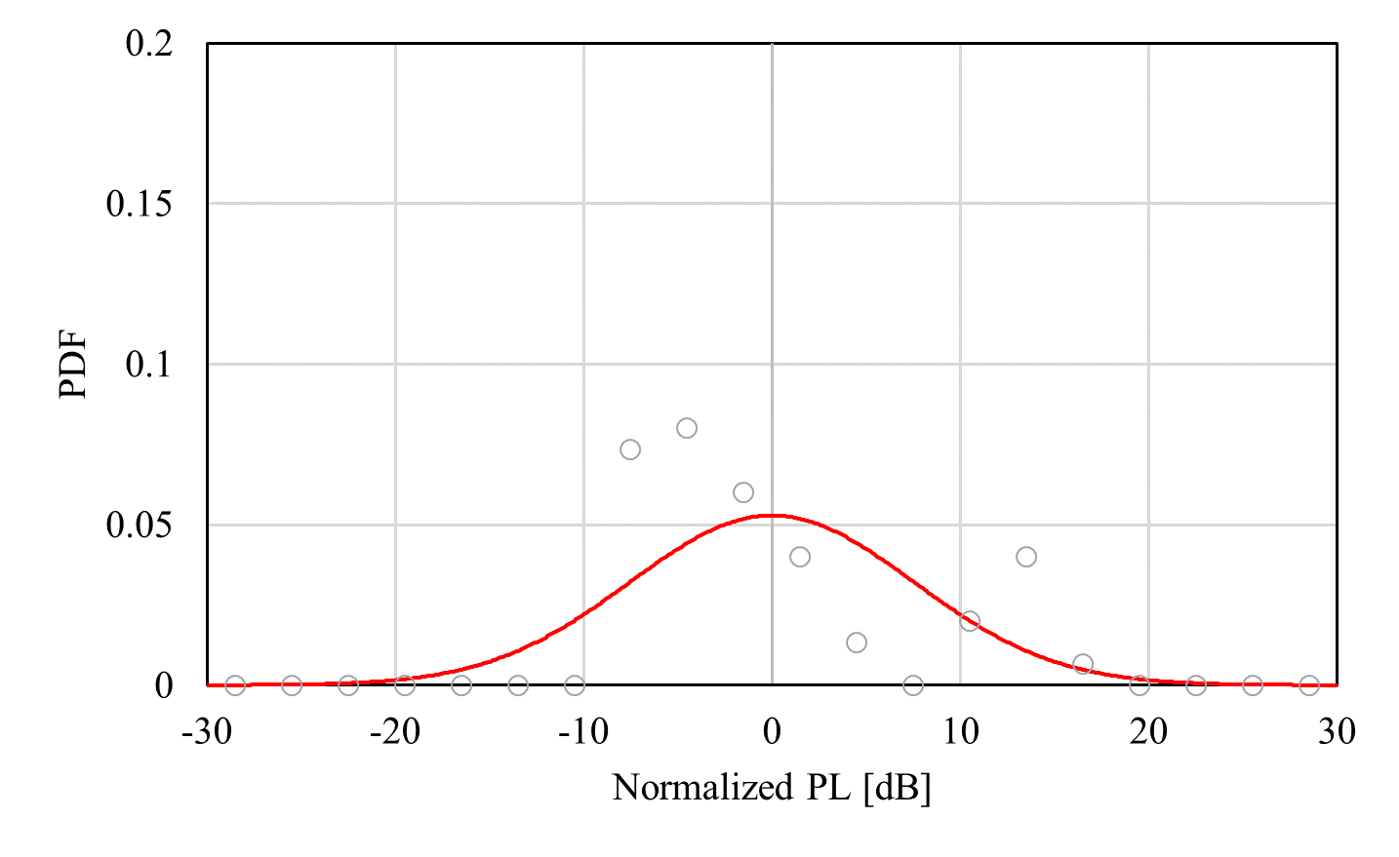
Log-normal distribution
(Off-body, BCI)
$x$-direction
$y$-direction
$z$-direction

Slide 26
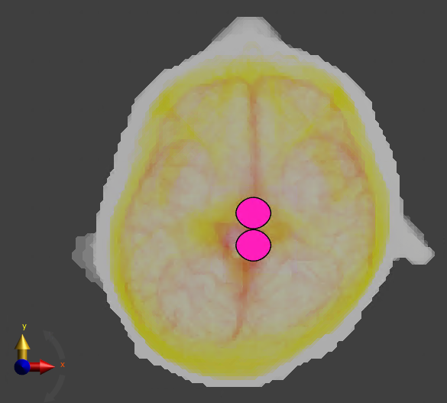
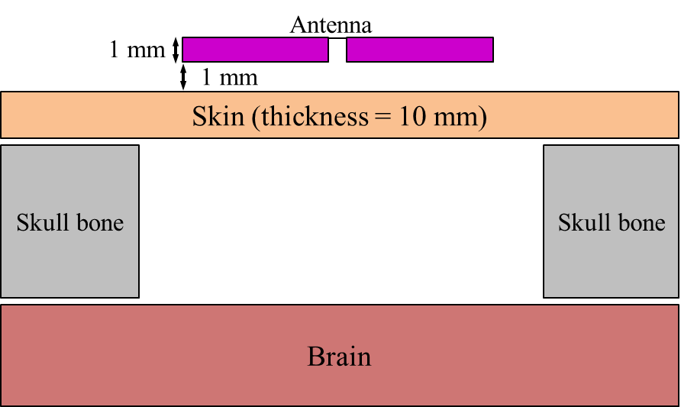
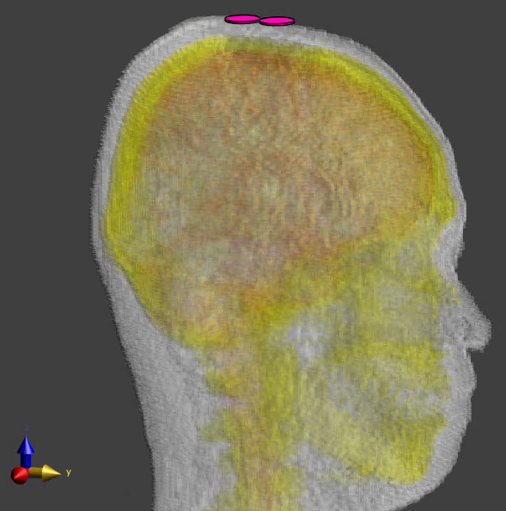
Simulation model for BMI case
(Forward antenna direction)
BMI: Brain Machine Interface

Slide 27
Path loss characteristics (Sensor #10)

Slide 28
Path loss characteristics (Sensor #22)

Slide 29
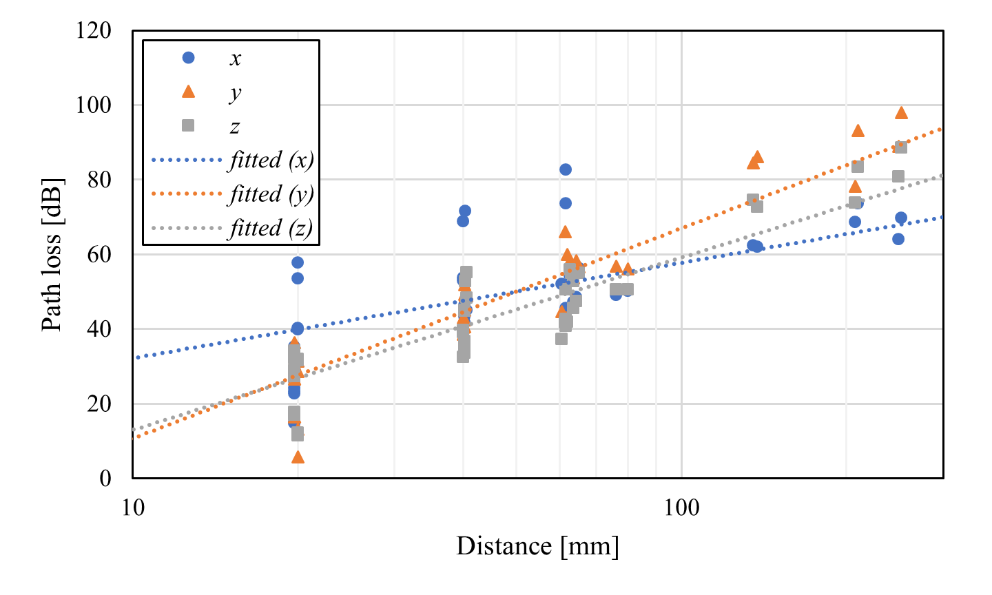
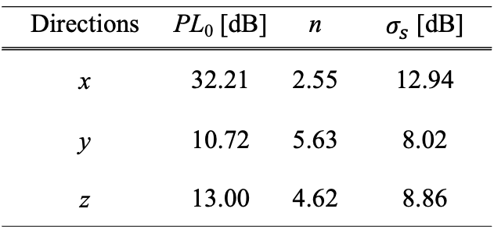
Distance characteristics (Human head, BMI)
$${PL}_{dB}={PL}_{0,dB}+10n\log_{10}\left[\frac{d}{d_{0}}\right]$$
Directions | PL₀ [dB] | n | $σ_{s}$ [dB]
x | 32.21 | 2.55 | 12.94
y | 10.72 | 5.63 | 8.02
z | 13.00 | 4.62 | 8.86
$d_{0}=10$ mm

Slide 30
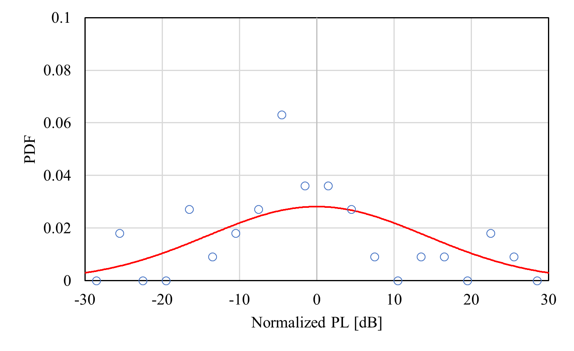
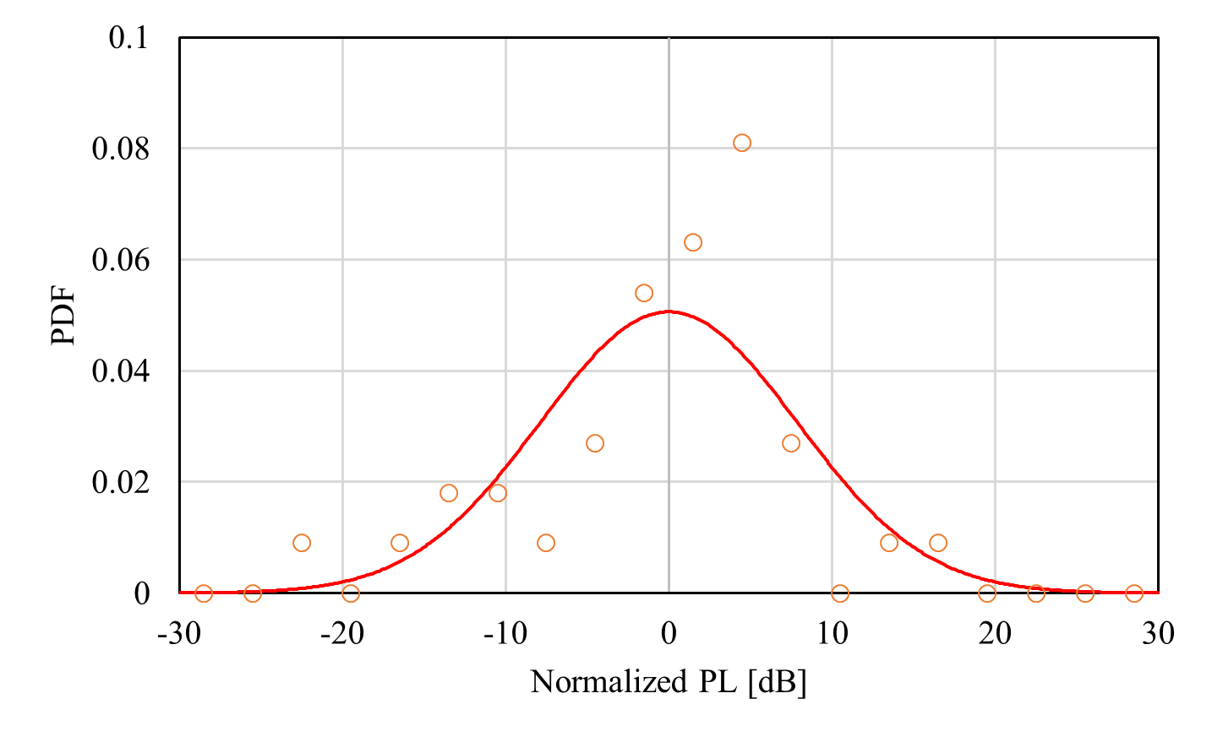
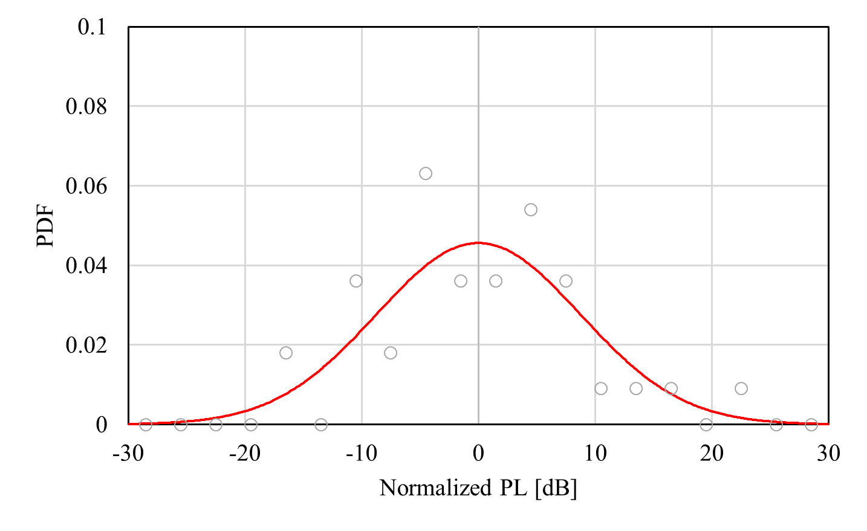
Log-normal distribution
(Human head, BMI)
$x$-direction
$y$-direction
$z$-direction

Slide 31
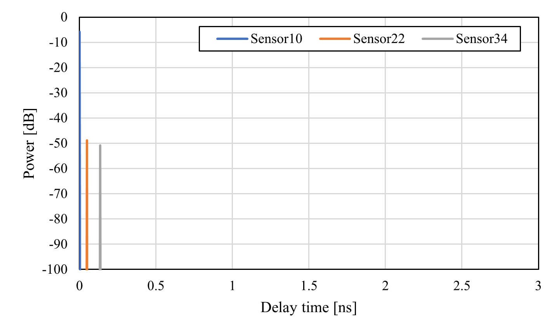
Power delay profile (Human head, BMI)

Slide 32
Simulation model (On-body model, BMI)
28 receivers were place on the body surface including head, arm, and chest

Slide 33
Path loss characteristics (Sensor #7)

Slide 34
Path loss characteristics (Sensor #18)

Slide 35
Path loss characteristics (Sensor #28)

Slide 36
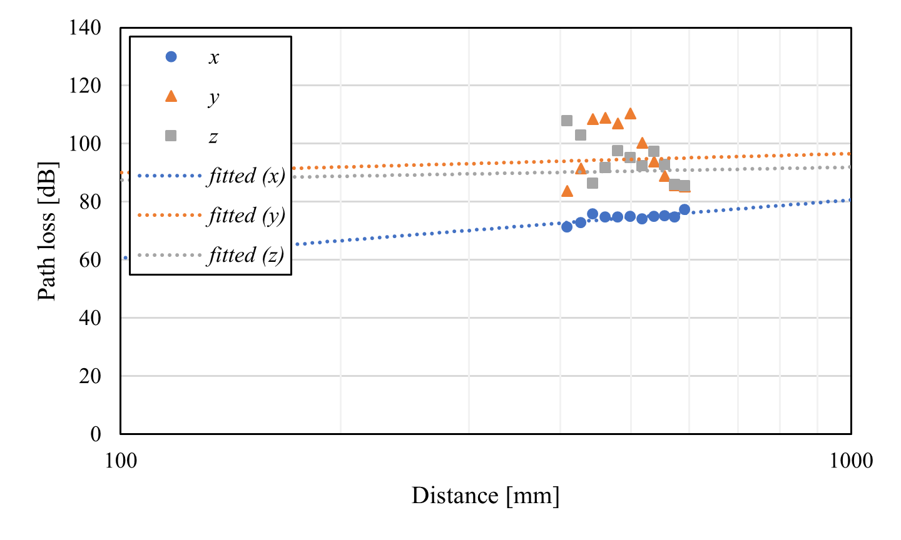
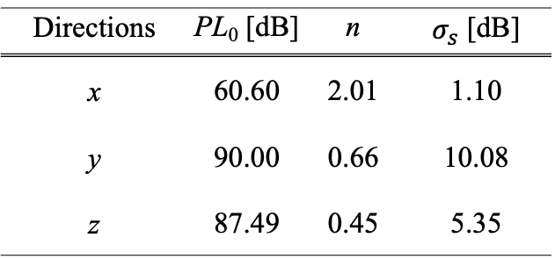
Distance characteristics (Arm, BMI)
$${PL}_{dB}={PL}_{0,dB}+10n\log_{10}\left[\frac{d}{d_{0}}\right]$$
Directions | PL₀ [dB] | n | $σ_{s}$ [dB]
x | 60.60 | 2.01 | 1.10
y | 90.00 | 0.66 | 10.08
z | 87.49 | 0.45 | 5.35
$d_{0}=100$ mm

Slide 37
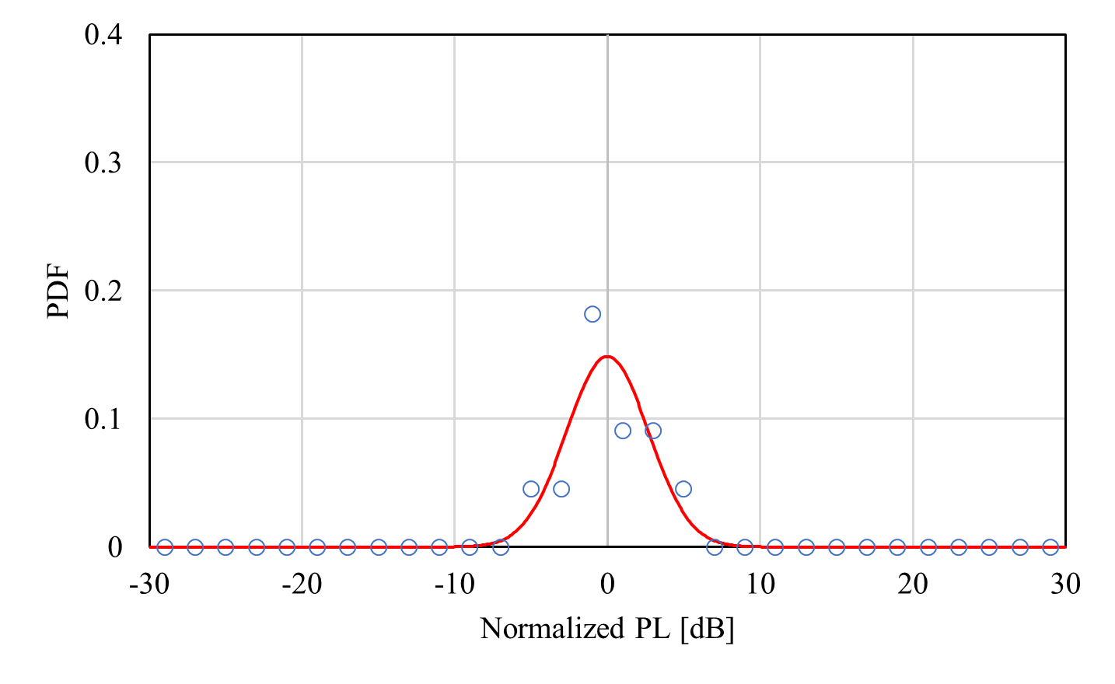

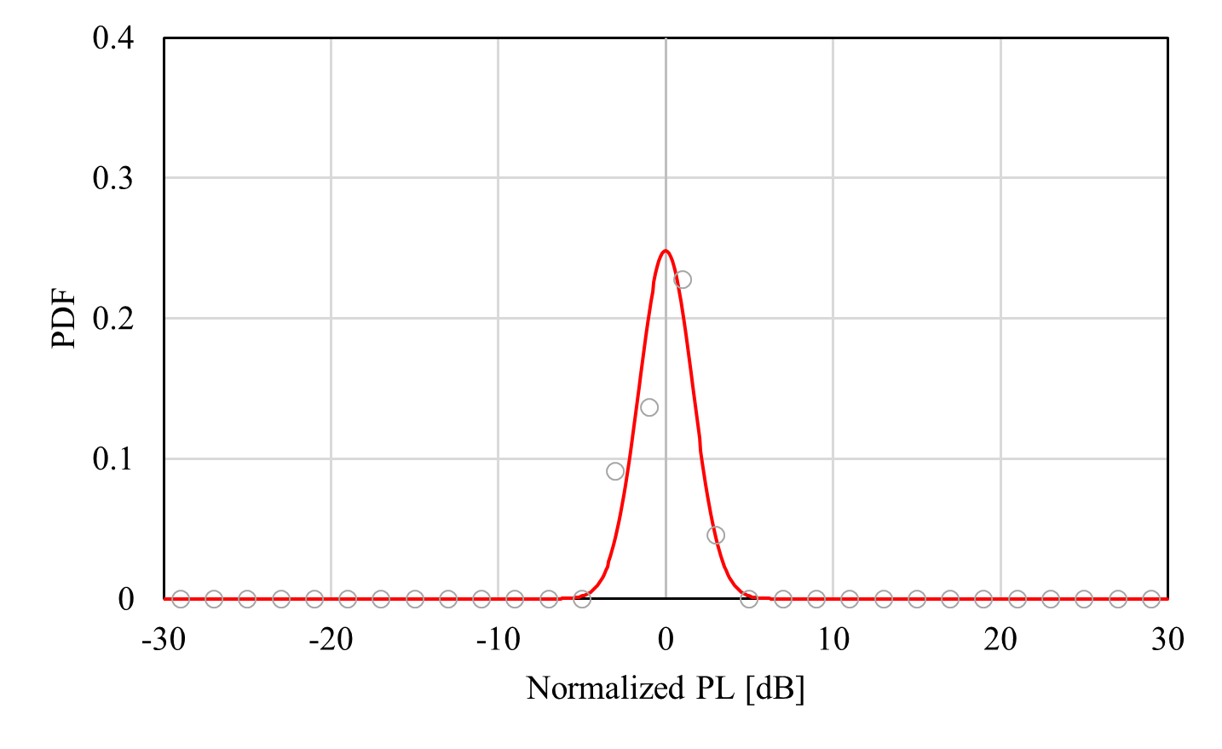

Log-normal distribution
(Front torso, BMI)
$x$-direction
$y$-direction
$z$-direction

Slide 38
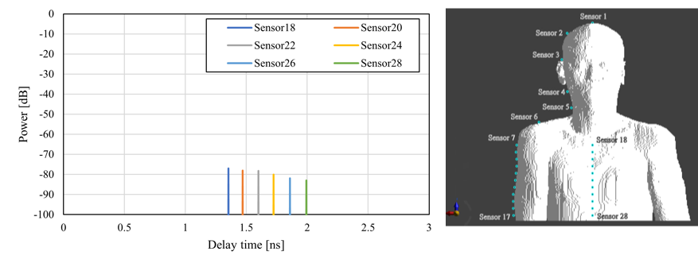
Power delay profile (Front torso, BMI)

Slide 39
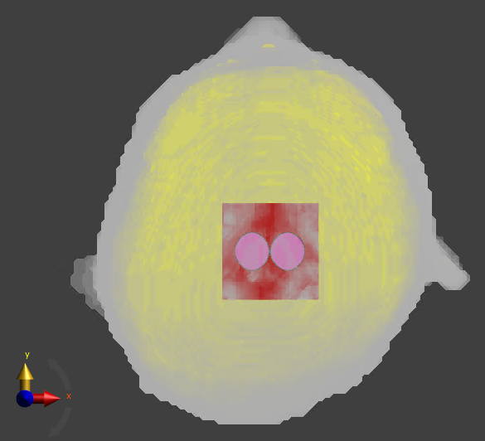
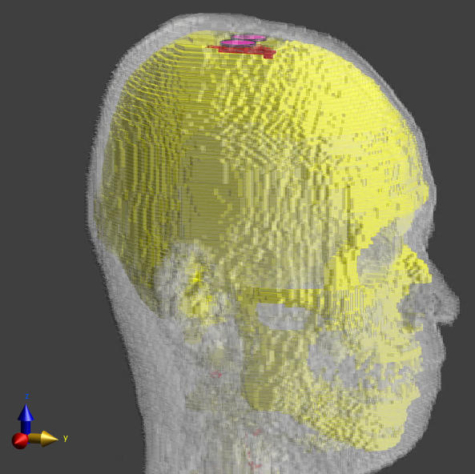
Simulation model for BCI case
(Sideways antenna direction)

Slide 40

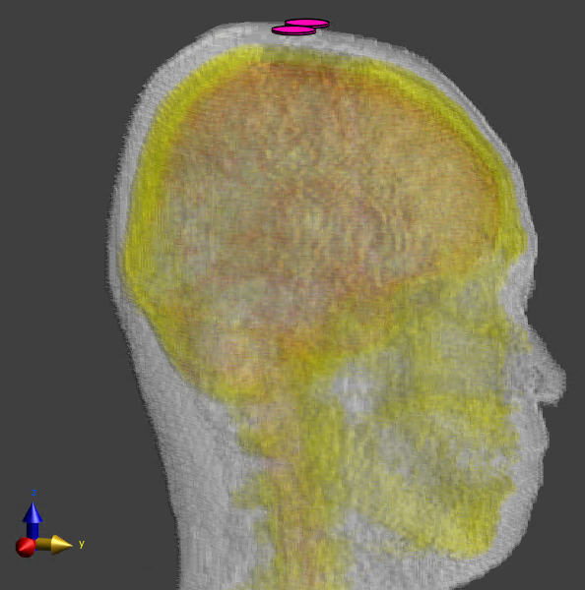
Simulation model for BMI case
(Sideways antenna direction)
BMI: Brain Machine Interface

Slide 41
Summary of channel parameters
Antenna direction | Case | Receiving direction | Receiving antenna position
 |  |  | Whole head (d₀ = 10 mm) |  |  | Scalp (d₀ = 10 mm) |  |  | Arm (d₀ = 100 mm) |  |  | Torso (front) (d₀ = 100 mm) |  |  | Off-body (d₀ = 10 mm)
 |  |  | PL₀ [dB] | n | σ_{s} [dB] | PL₀ [dB] | n | σ_{s} [dB] | PL₀ [dB] | n | σ_{s} [dB] | PL₀ [dB] | n | σ_{s} [dB] | PL₀ [dB] | n | σ_{s} [dB]
Forward | BCI | X | 24.84 | 3.84 | 9.52 | 27.13 | 3.36 | 10.18 | 23.70 | 9.76 | 0.74 | 69.31 | 3.85 | 3.02 | 48.47 | 1.45 | 9.63
 |  | Y | 3.78 | 6.80 | 7.27 | 11.44 | 5.32 | 6.96 | 102.62 | 0.57 | 8.15 | 50.24 | 2.76 | 0.65 | 19.13 | 2.67 | 2.72
 |  | Z | 3.73 | 6.03 | 9.31 | 17.58 | 3.31 | 7.52 | 104.27 | 0.59 | 4.98 | 27.52 | 8.61 | 1.98 | 22.81 | 2.69 | 7.55
 | BMI | X | 32.21 | 2.55 | 12.94 | 33.07 | 2.40 | 14.17 | 60.60 | 2.01 | 1.10 | 70.72 | 5.04 | 2.69 | 40.26 | 1.65 | 6.19
 |  | Y | 10.72 | 5.63 | 8.02 | 14.08 | 4.89 | 7.88 | 90.00 | 0.66 | 10.08 | 59.62 | 3.02 | 0.61 | 23.09 | 2.25 | 3.85
 |  | Z | 13.00 | 4.62 | 8.86 | 18.04 | 3.52 | 8.75 | 87.49 | 0.45 | 5.35 | 32.56 | 9.25 | 1.61 | 22.12 | 2.66 | 5.81
Sideways | BCI | X | 20.37 | 3.80 | 7.47 | 10.97 | 5.63 | 6.89 | 51.42 | 3.14 | 1.13 | 16.68 | 10.59 | 2.42 | 0.05 | 4.95 | 2.66
 |  | Y | 19.60 | 4.96 | 7.59 | 25.39 | 3.86 | 7.31 | 80.65 | 1.99 | 11.42 | 67.02 | 3.72 | 1.80 | 34.94 | 2.74 | 5.65
 |  | Z | 13.36 | 4.54 | 7.09 | 19.77 | 3.34 | 7.03 | 76.35 | 1.85 | 5.12 | 62.07 | 6.87 | 2.61 | 44.11 | 0.56 | 5.84
 | BMI | X | 17.71 | 4.01 | 7.33 | 14.01 | 4.84 | 7.51 | 51.22 | 3.28 | 1.09 | 15.68 | 11.30 | 2.58 | -3.03 | 5.25 | 4.76
 |  | Y | 26.20 | 4.19 | 12.94 | 33.17 | 2.65 | 12.88 | 78.08 | 2.63 | 12.69 | 56.25 | 4.89 | 1.52 | 45.33 | 1.24 | 6.31
 |  | Z | 20.14 | 4.09 | 8.89 | 23.42 | 3.39 | 9.35 | 77.09 | 1.87 | 5.07 | 36.17 | 10.07 | 1.61 | 42.50 | 0.80 | 4.96

Slide 42
Summary and future works
The path loss characteristics were evaluated in HBAN use cases, assuming the receivers were placed on the human head, arm, chest and off the human body
Future works include time-domain analyses such as multipath delay power profile and multipath delay spread

Slide 43
References
D. Anzai, I. Balasingham, G. Fischer, J. Wang, “Reliable and High-Speed Implant Ultra-Wideband Communications with Transmit–Receive Diversity,” EAI/Springer Innovations in Communication and Computing, pp. 27-32, March 2020.
Y. Shimizu, D. Anzai, R. C-Santiago, P. A. Floor, I. Balasingham, and J. Wang, “Performance evaluation of an ultra-wideband transmit diversity in a living animal experiment” IEEE Trans. Microw. Theory Tech., vol. 65, no. 7, pp. 2596-2606, July 2017.
D. Anzai, K. Katsu, R. Chavez-Santiago, Q. Wang, D. Plettemeier, J. Wang, and I. Balasingham, “Experimental evaluation of implant UWB-IR transmission with living animal for body area networks,” IEEE Trans. Microw. Theory Tech., vol. 62, no. 1, pp. 183-192, Jan. 2014.
J. Shi, D. Anzai, and J. Wang, “Channel modeling and performance analysis of diversity reception for implant UWB wireless link,” IEICE Trans. Commun., no. E95-B, vol. 10, pp. 3197-3205, Oct. 2012.

