Slide 1
Project: IEEE P802.15 Working Group for Wireless Personal Area Networks (WPANs)
Submission Title: Propagation Characteristics of UWB Communication Applications for Human BAN (HBAN) Use Cases
Date Submitted: January 14th, 2023
Source: Daisuke Anzai, Nagoya Institute of Technology
Address Gokiso-cho, Showa-ku, Nagoya, 466-8555, Japan
Voice: +81-52-735-5389, FAX: +81-52-735-5389, E-Mail: anzai@nitech.ac.jp
Re: In response to call for technical contributions
Abstract: This provides of fundamental propagation characteristics including path loss characteristics for UWB communication applications for BCI use case.
Purpose: Material for discussion in P802.15.6a TG corresponding to comments in EC Meeting
Notice: This document has been prepared to assist the IEEE P802.15. It is offered as a basis for discussion and is not binding on the contributing individual(s) or organization(s). The material in this document is subject to change in form and content after further study. The contributor(s) reserve(s) the right to add, amend or withdraw material contained herein.
Release: The contributor acknowledges and accepts that this contribution becomes the property of IEEE and may be made publicly available by P802.15.

Slide 2
Propagation Characteristics of UWB Communication Applications for Human BAN (HBAN) Use Cases
Daisuke Anzai
Nagoya Institute of Technology

Slide 3
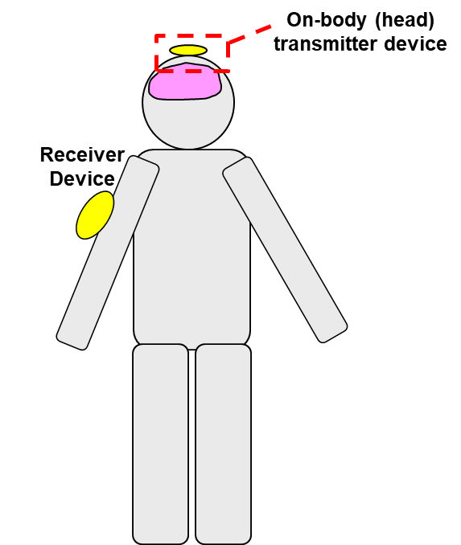
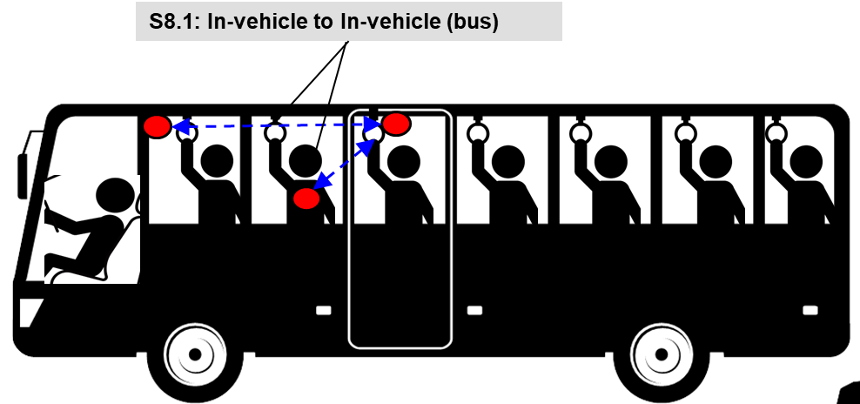
UWB communication applications
Vehicle BAN (VBAN)
Human BAN (HBAN)
Passengers bus model^{[1]}
Brain-computer interface (BCI) model^{[1]}
^{[1]}IEEE 802.15-22-0344-02-006a

Slide 4
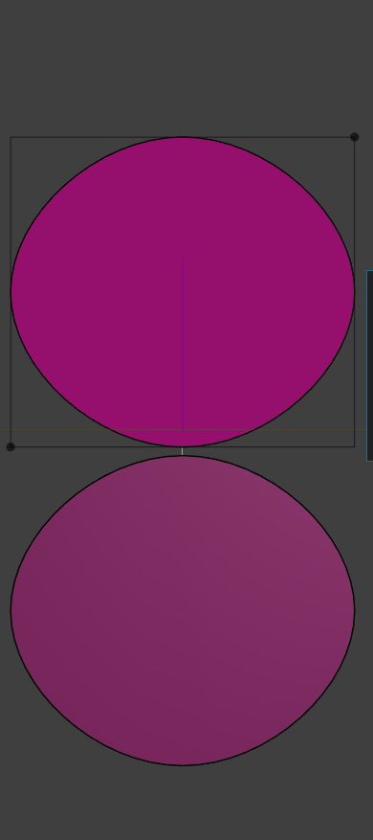
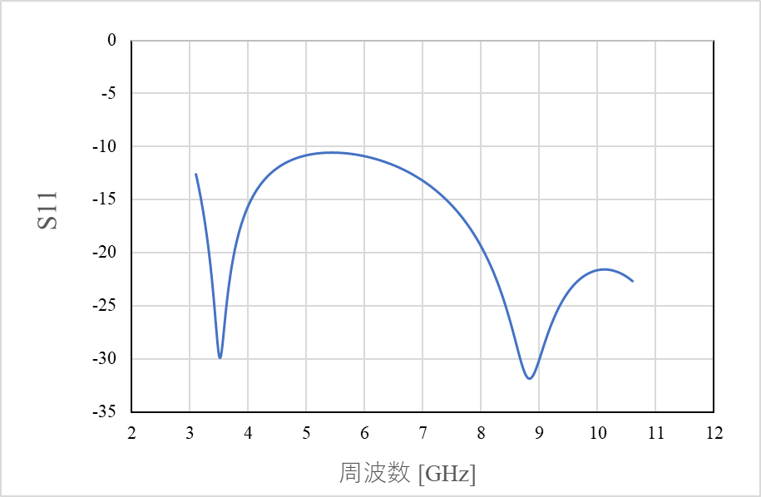
UWB antenna at 3.1 - 10.6 GHz band
20 mm
Frequency: 3.1 – 10.6 GHz
Planar elliptical dipole antenna
Element size: 20 mm x 18 mm x 1 mm
Interval between each element: 0.5 mm
18 mm
|S₁₁| [dB]
Frequency [GHz]

Slide 5
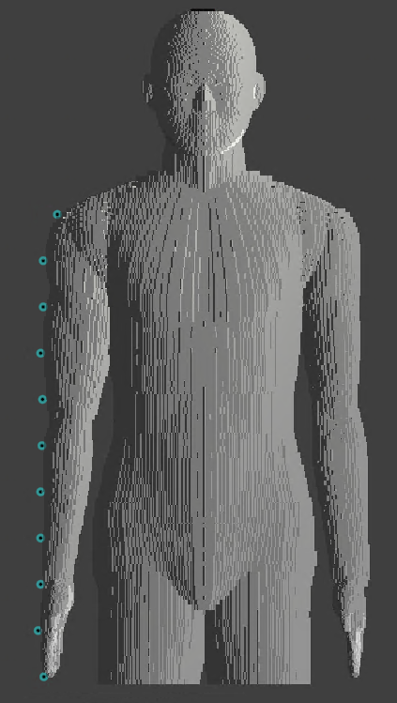



Simulation model
UWB antenna
(transmit antenna)
Frequency: 3.4 – 4.8 GHz
Frequency-dependent finite-different time-domain (FDTD) method
Multi-size voxel model (min. size: 0.5 mm)
Homogeneous human model (Japanese male developed by NICT, Japan)
$$z$$
Transmitted signal waveform
$$x$$
$$y$$

Slide 6
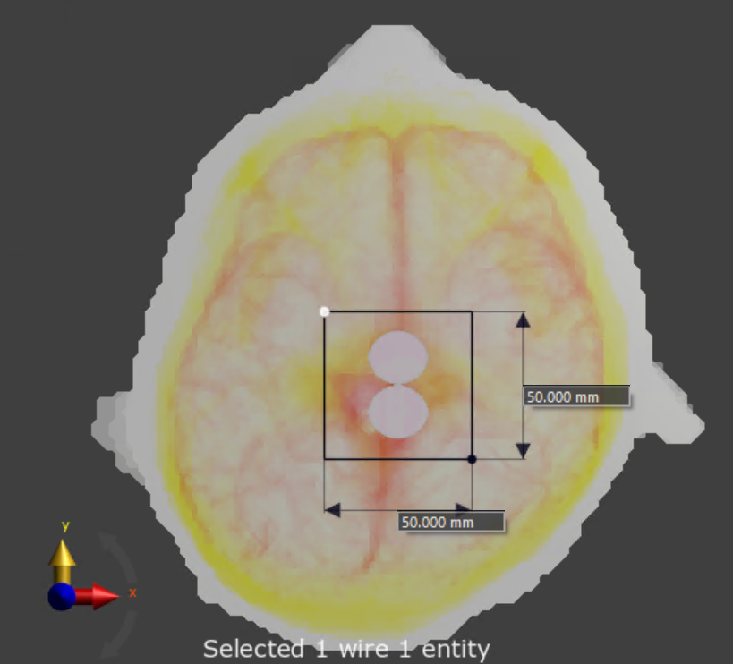
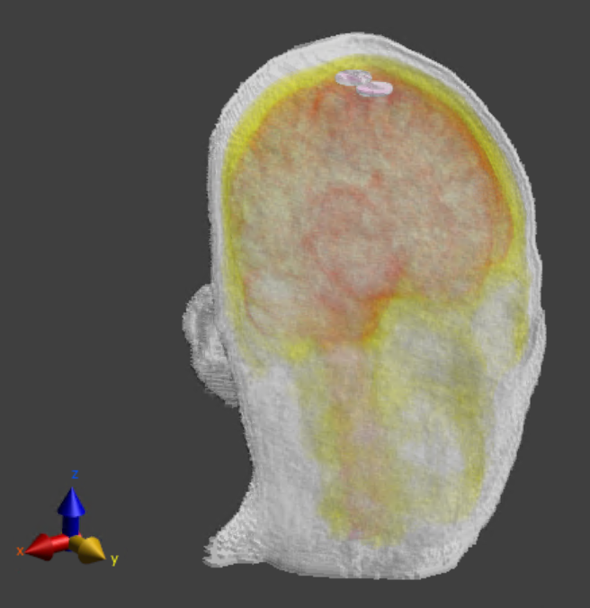
Simulation model
Skin = 10mm
1mm
Skull bone
1mm
Antenna
4mm
Brain

Slide 7
Dielectric constants of human model
Relative permittivity
Conductivity

Slide 8
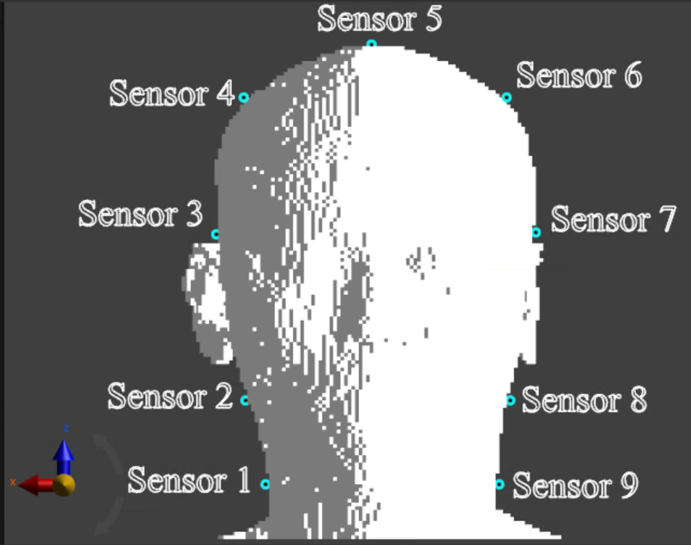
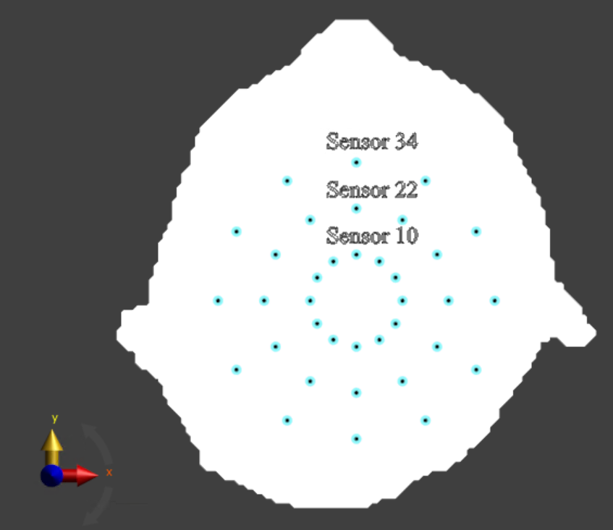
Simulation setup (Human head model)

Slide 9
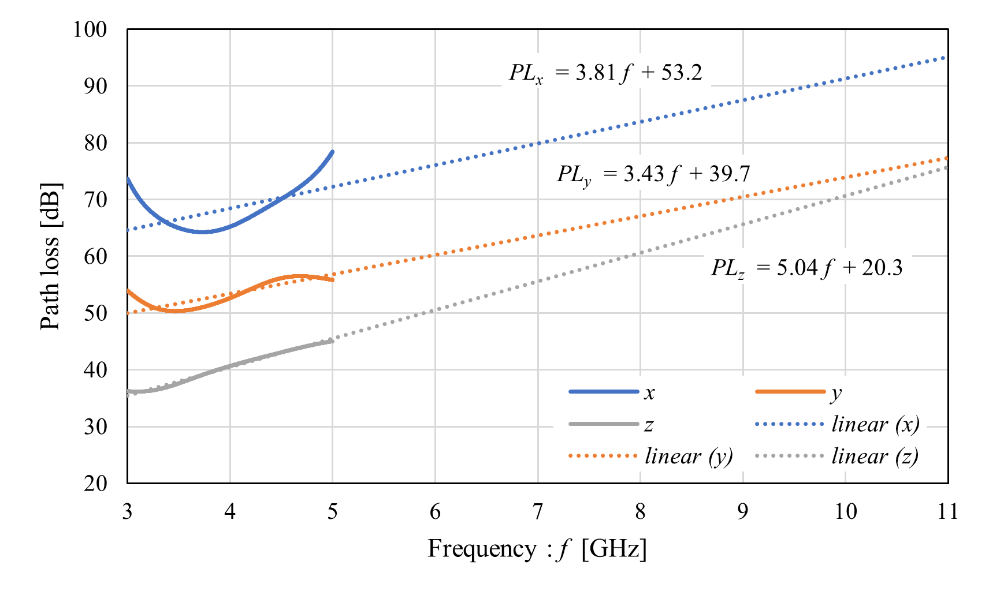
Path loss characteristics (Sensor #10)

Slide 10
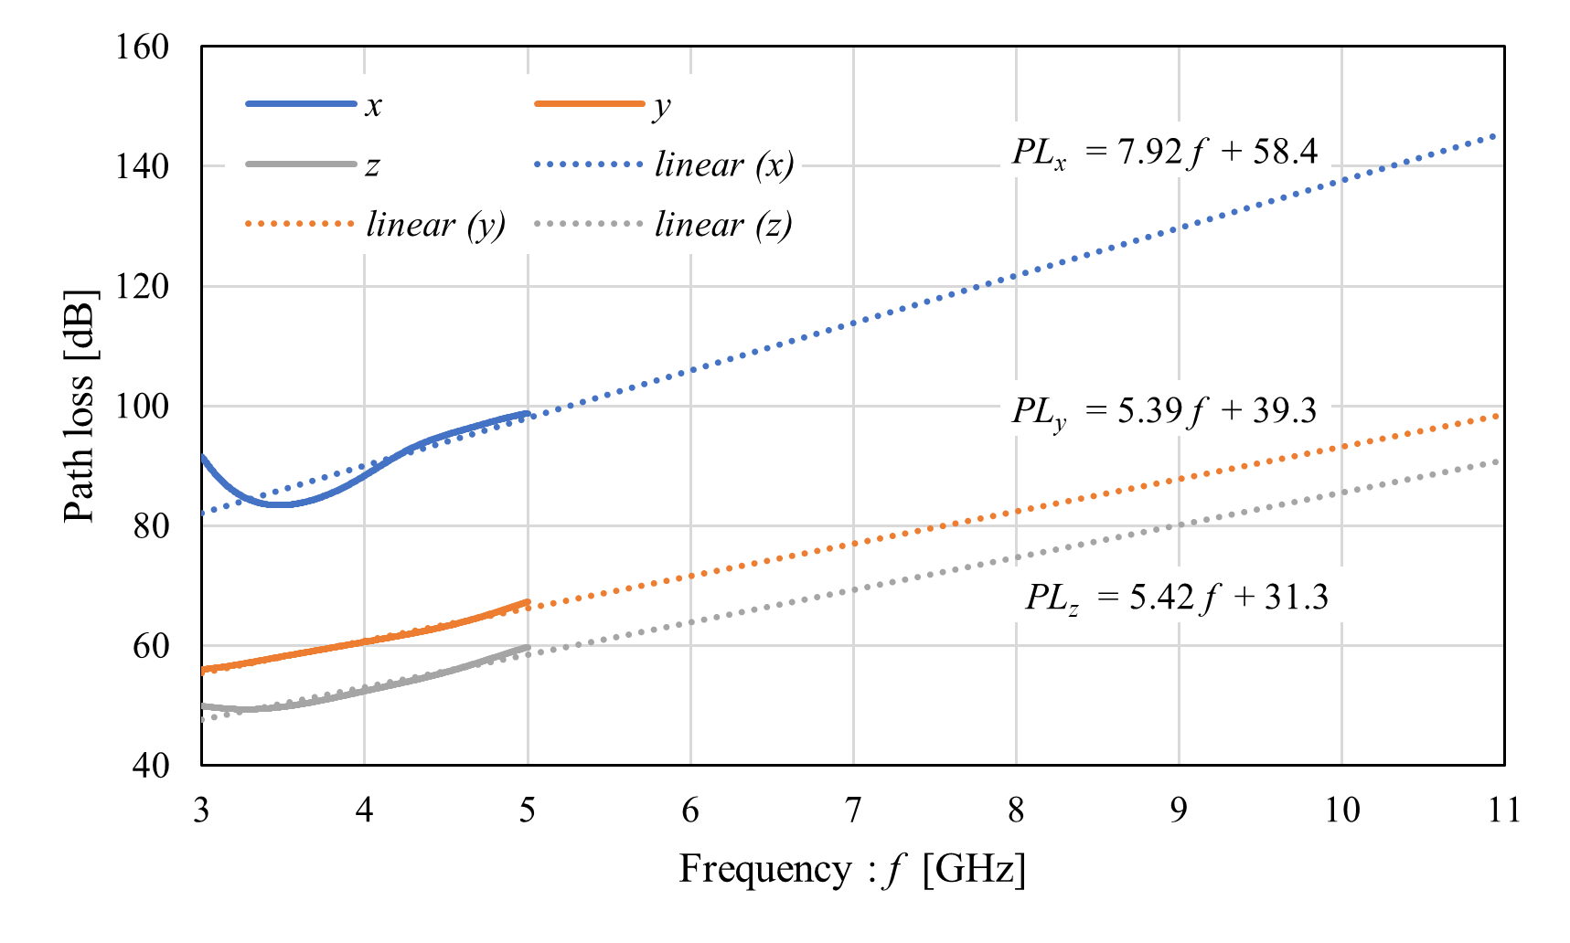
Path loss characteristics (Sensor #22)

Slide 11
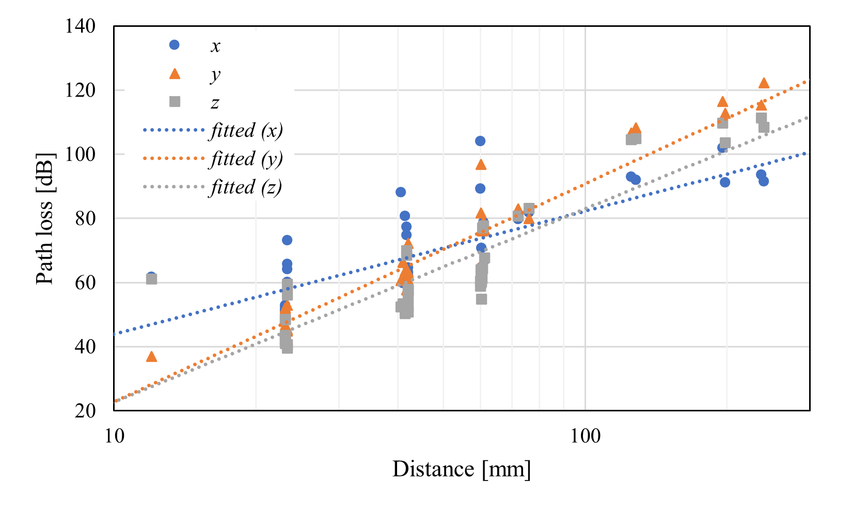
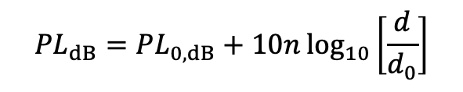

Distance characteristics (human head model)
$${PL}_{dB}={PL}_{0,dB}+10n\log_{10}\left[\frac{d}{d_{0}}\right]$$
Directions | PL₀ [dB] | n
x | 46.9 | 3.84
y | 28.2 | 6.80
z | 27.5 | 6.03
$d_{0}=12$ mm

Slide 12
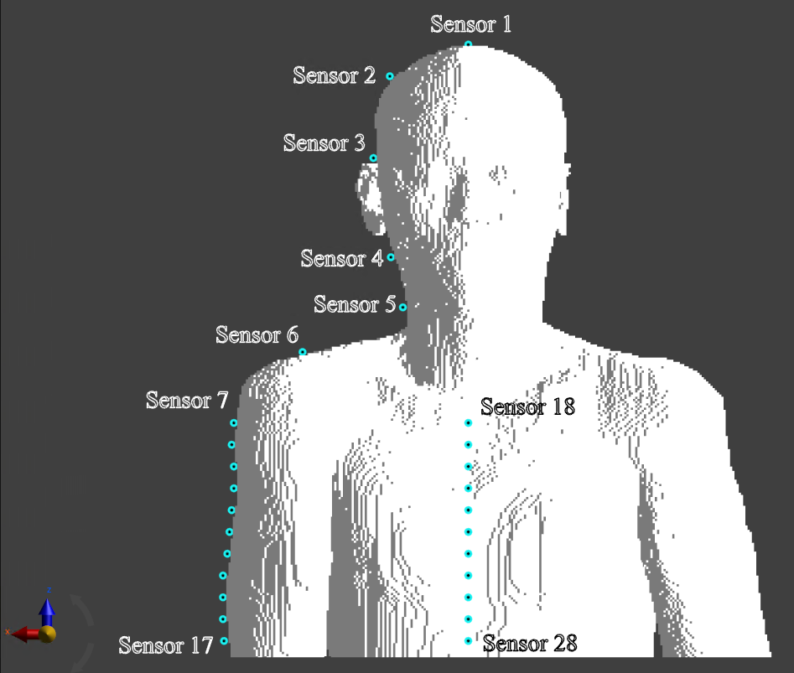
Simulation model (on-body model)
28 receivers were place on the body surface including head, arm, and chest

Slide 13
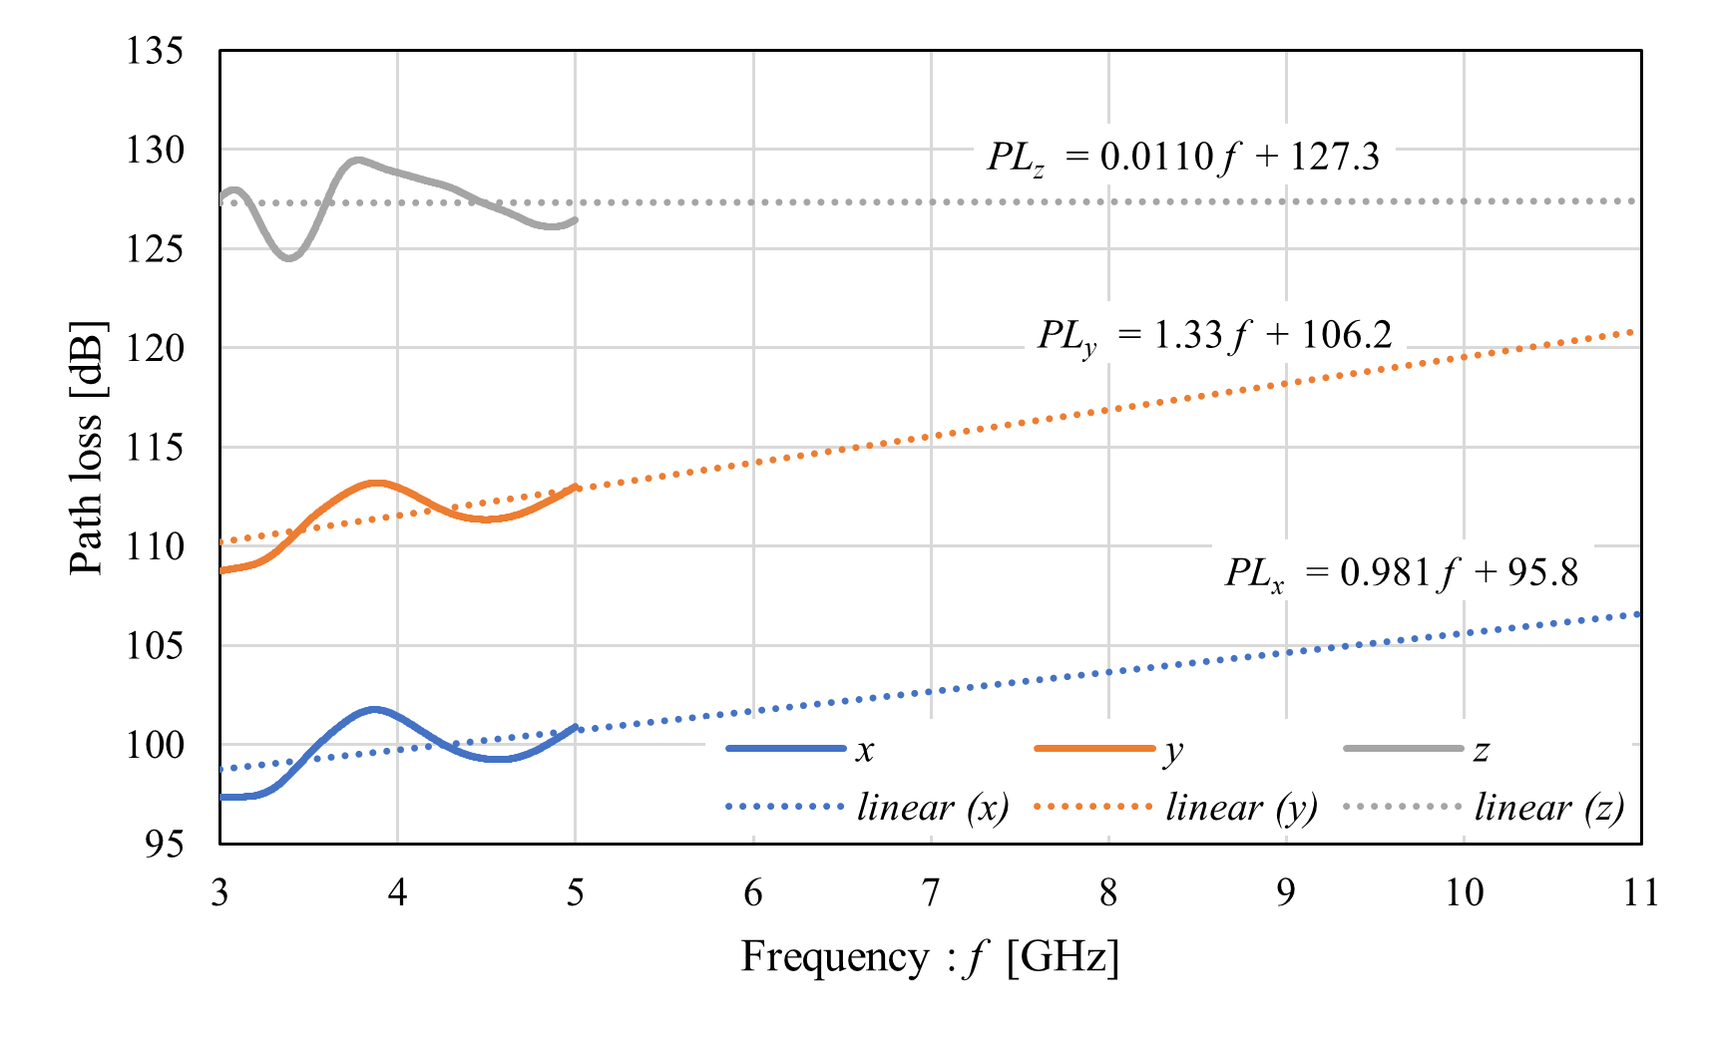
Path loss characteristics (sensor #7)

Slide 14
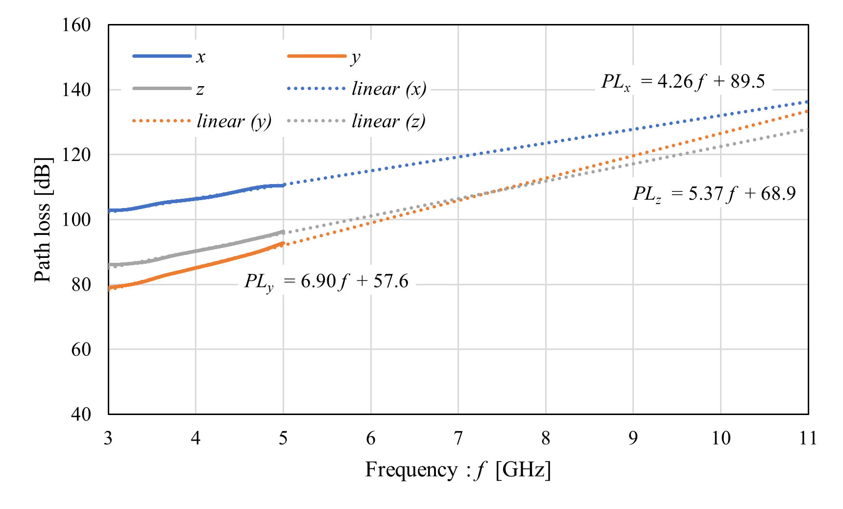
Path loss characteristics (Sensor #18)

Slide 15
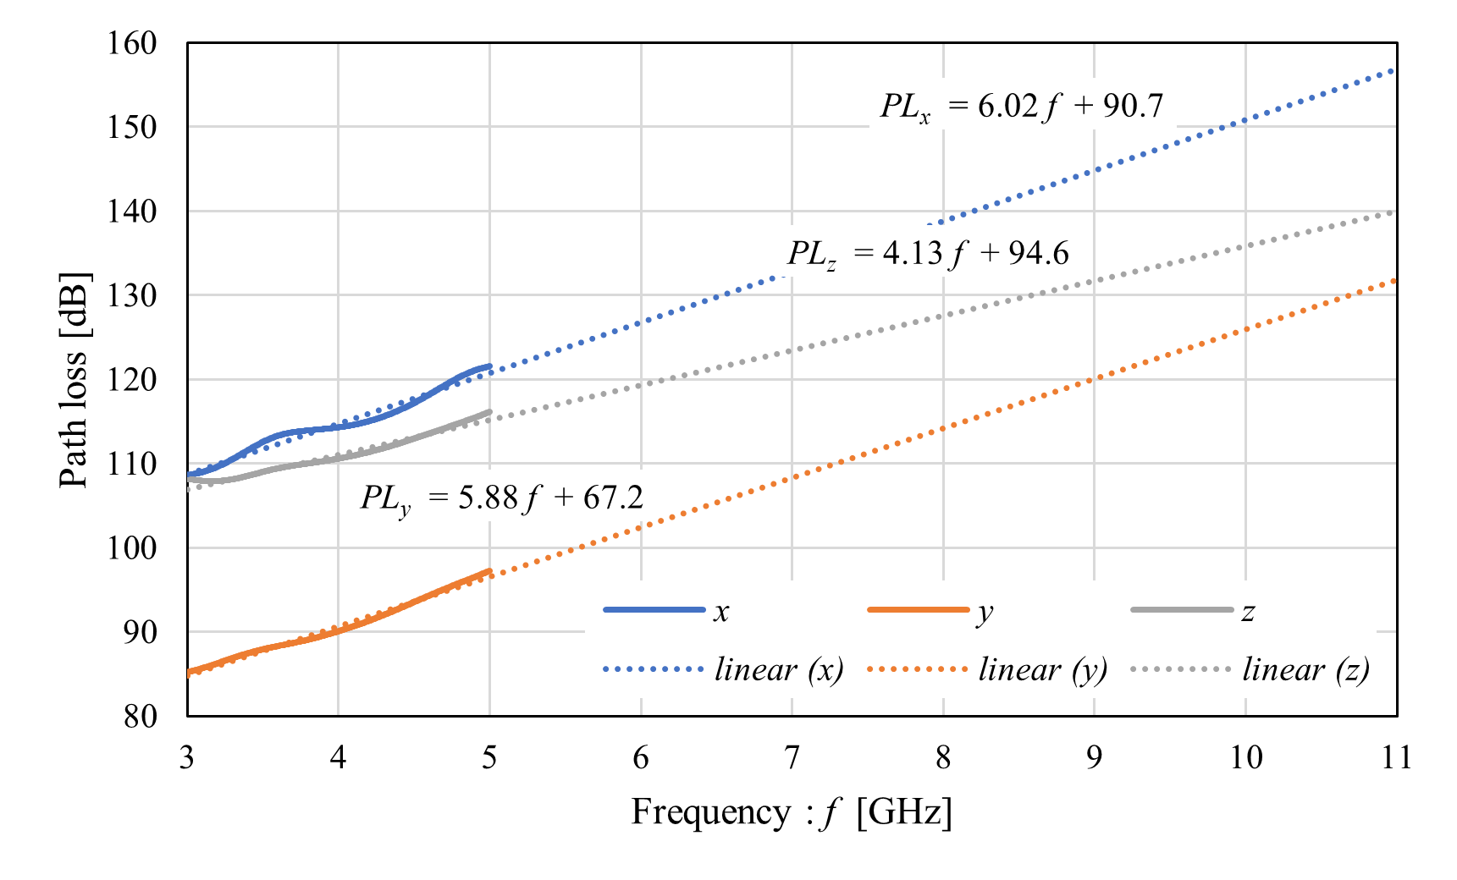
Path loss characteristics (Sensor #28)

Slide 16
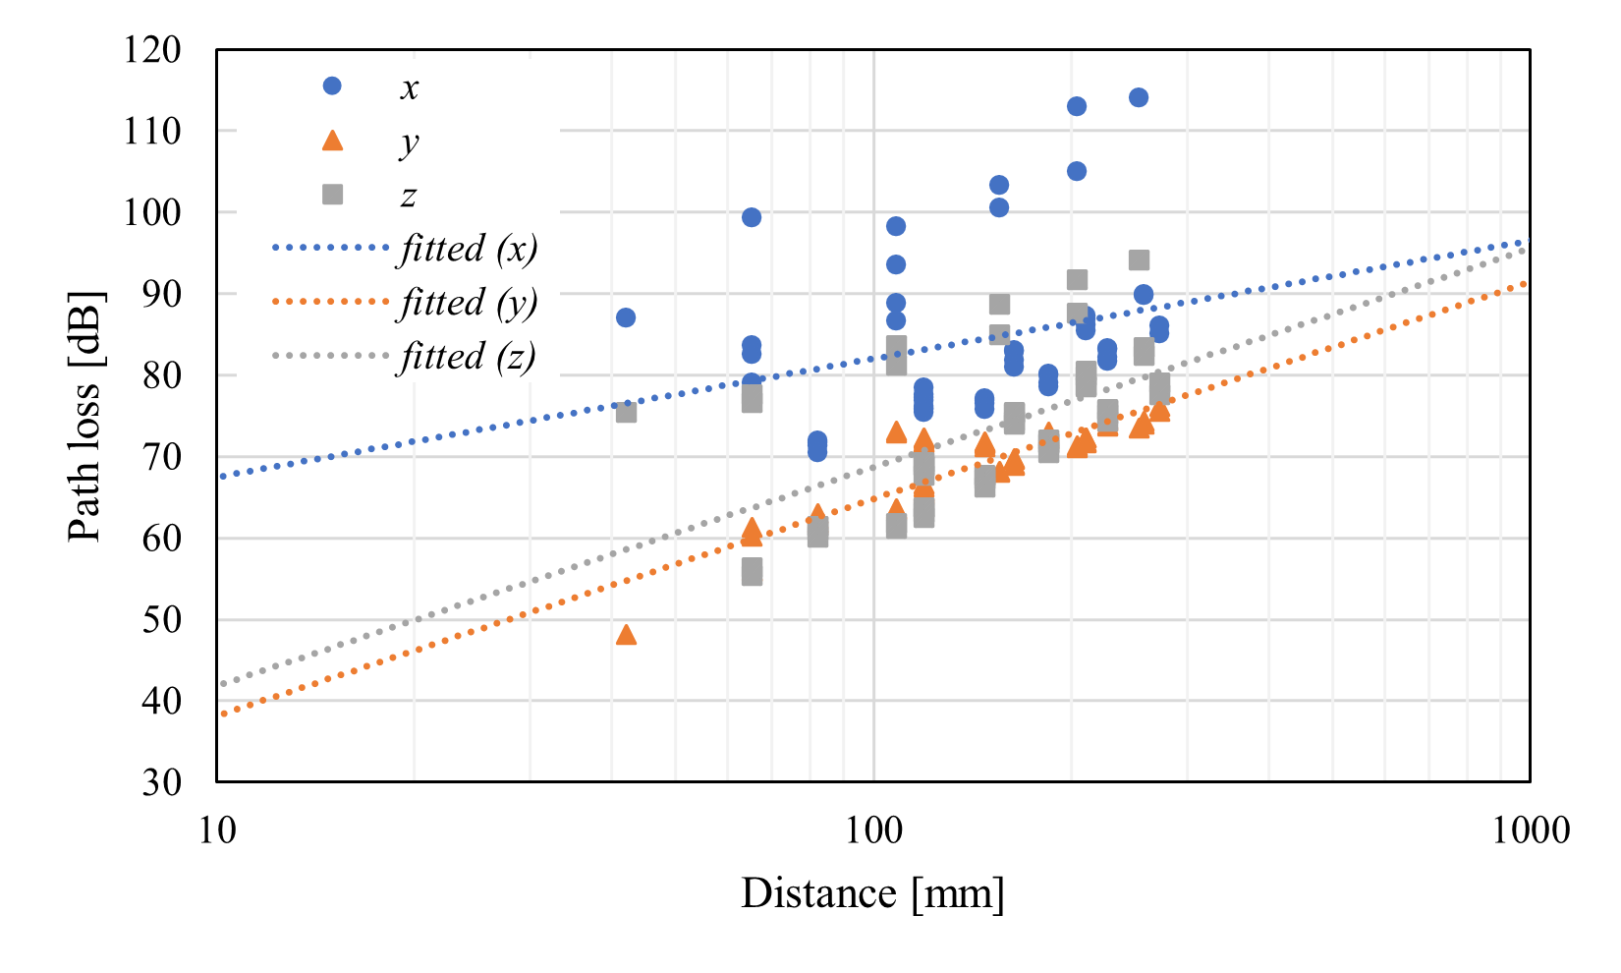
Distance characteristics (on-body model)
$${PL}_{dB}={PL}_{0,dB}+10n\log_{10}\left[\frac{d}{d_{0}}\right]$$
Directions | PL₀ [dB] | n
x | 58.7 | 3.31
y | 49.6 | 3.78
z | 59.1 | 3.55
$d_{0}=12$ mm

Slide 17
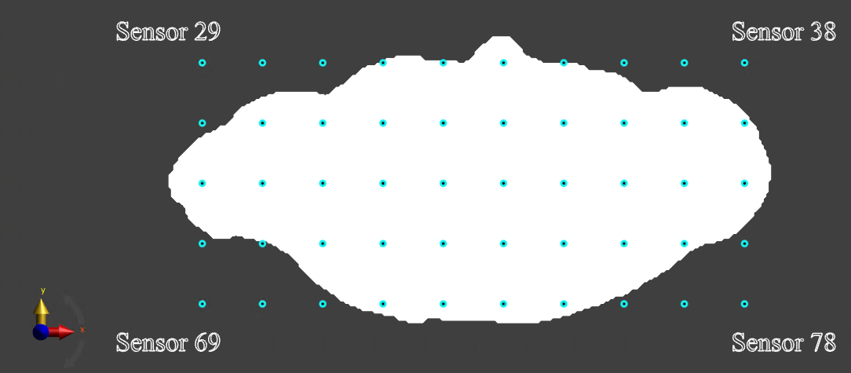
Simulation model (off-body model)
Top view
50 receivers (#29-#78) were placed at a height of 30 mm above the transmitting antenna (the top of the human head)
The interval of each receiver was set to 5 mm

Slide 18
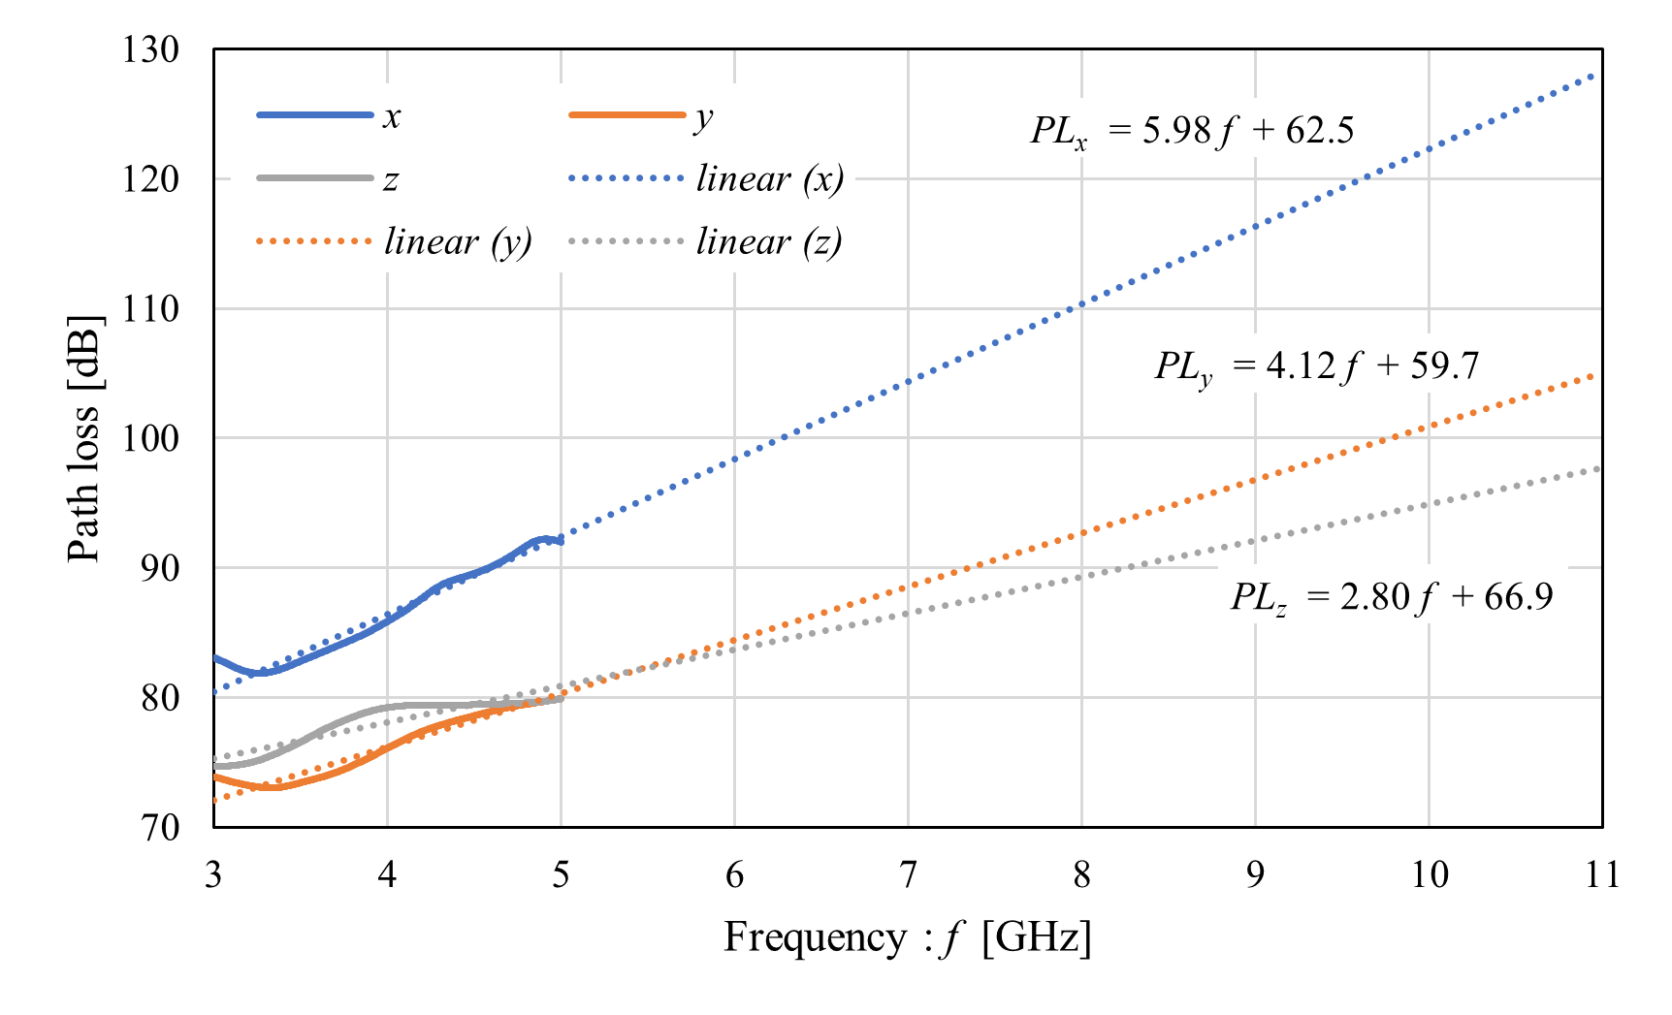
Path loss characteristics (Sensor #29)

Slide 19
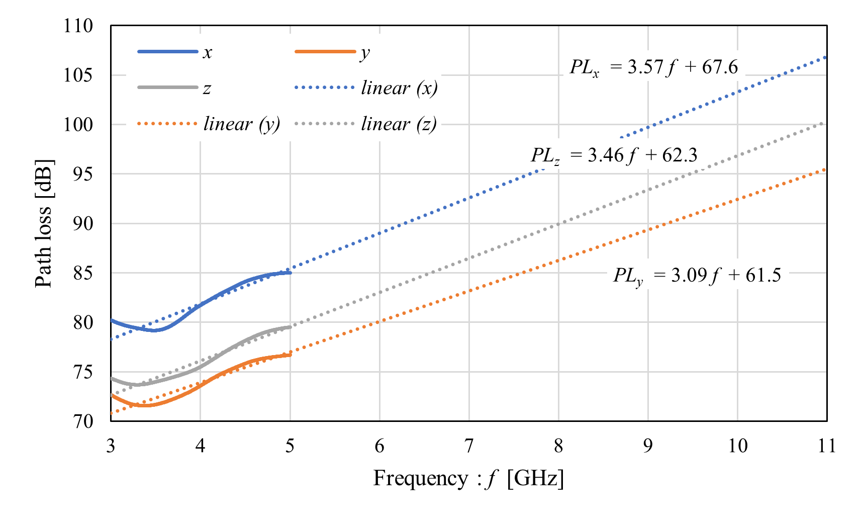
Path loss characteristics (Sensor #29)

Slide 20
Summary and future works
The path loss characteristics were evaluated in BCI use case, assuming the receivers were placed on the human head, arm, chest and off the human body
Future works include time-domain analyses such as multipath delay power profile and multipath delay spread

Slide 21
References
D. Anzai, I. Balasingham, G. Fischer, J. Wang, “Reliable and High-Speed Implant Ultra-Wideband Communications with Transmit–Receive Diversity,” EAI/Springer Innovations in Communication and Computing, pp. 27-32, March 2020.
Y. Shimizu, D. Anzai, R. C-Santiago, P. A. Floor, I. Balasingham, and J. Wang, “Performance evaluation of an ultra-wideband transmit diversity in a living animal experiment” IEEE Trans. Microw. Theory Tech., vol. 65, no. 7, pp. 2596-2606, July 2017.
D. Anzai, K. Katsu, R. Chavez-Santiago, Q. Wang, D. Plettemeier, J. Wang, and I. Balasingham, “Experimental evaluation of implant UWB-IR transmission with living animal for body area networks,” IEEE Trans. Microw. Theory Tech., vol. 62, no. 1, pp. 183-192, Jan. 2014.
J. Shi, D. Anzai, and J. Wang, “Channel modeling and performance analysis of diversity reception for implant UWB wireless link,” IEICE Trans. Commun., no. E95-B, vol. 10, pp. 3197-3205, Oct. 2012.

