Slide 1
Project: IEEE P802.15 Working Group for Wireless Personal Area Networks (WPANs)
Submission Title: Updated Proposal on Channels for Frequency Stitching
Date Submitted: January 18, 2023
Source: Steve Shellhammer, Pooria Pakrooh, Bin Tian, and Koorosh Akhavan (Qualcomm)
E-Mail:{sshellha, ppakrooh, btian, kakhavan}@qti.qualcomm.com
Abstract: We propose channels for Frequency Stitching in RF Sensing.
Notice: This document has been prepared to assist the IEEE P802.15. It is offered as a basis for discussion and is not binding on the authoring individual(s) or organization(s). The material in this document is subject to change in form and content after further study. The authors(s) reserve(s) the right to add, amend or withdraw material contained herein.

Slide 2
PAR Objective | Proposed Solution (how addressed)
Safeguards so that the high throughput data use cases will not cause significant disruption to low duty-cycle ranging use cases
Interference mitigation techniques to support higher density and higher traffic use cases
Other coexistence improvement
Backward compatibility with enhanced ranging capable devices (ERDEVs)
Improved link budget and/or reduced air-time
Additional channels and operating frequencies
Improvements to accuracy / precision / reliability and interoperability for high-integrity ranging
Reduced complexity and power consumption
Hybrid operation with narrowband signaling to assist UWB
Enhanced native discovery and connection setup mechanisms
Sensing capabilities to support presence detection and environment mapping | We propose a channel for Frequency Stitching for RF Sensing.
Low-power low-latency streaming
Higher data-rate streaming allowing at least 50 Mbit/s of throughput
Support for peer-to-peer, peer-to-multi-peer, and station-to-infrastructure protocols
Infrastructure synchronization mechanisms

Slide 3
Background
In [1, 2] Frequency Stitching for RF Sensing was proposed
In [3] a proposal for overlapping channels was proposed
In [4] we proposed to stick with non-overlapping channels and to address Frequency Stitching for RF Sensing can be handled using original channels 4 and 15
There was support for keeping with non-overlapping channels
However, concerned was raised that only allowing Frequency Stitching in Channels 4 and 15 was too restrictive
Here we provide an update proposal on Channels to support Frequency Stitching for RF Sensing

Slide 4
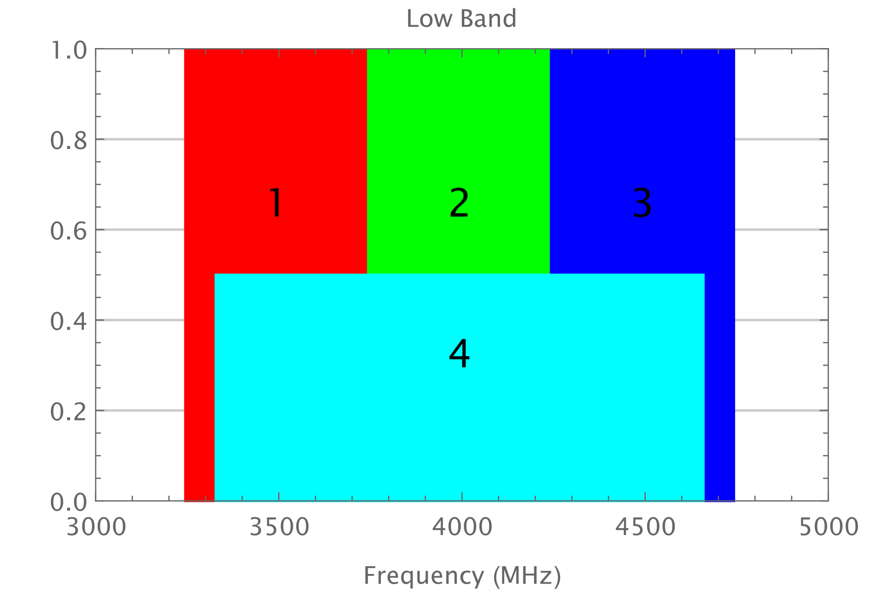
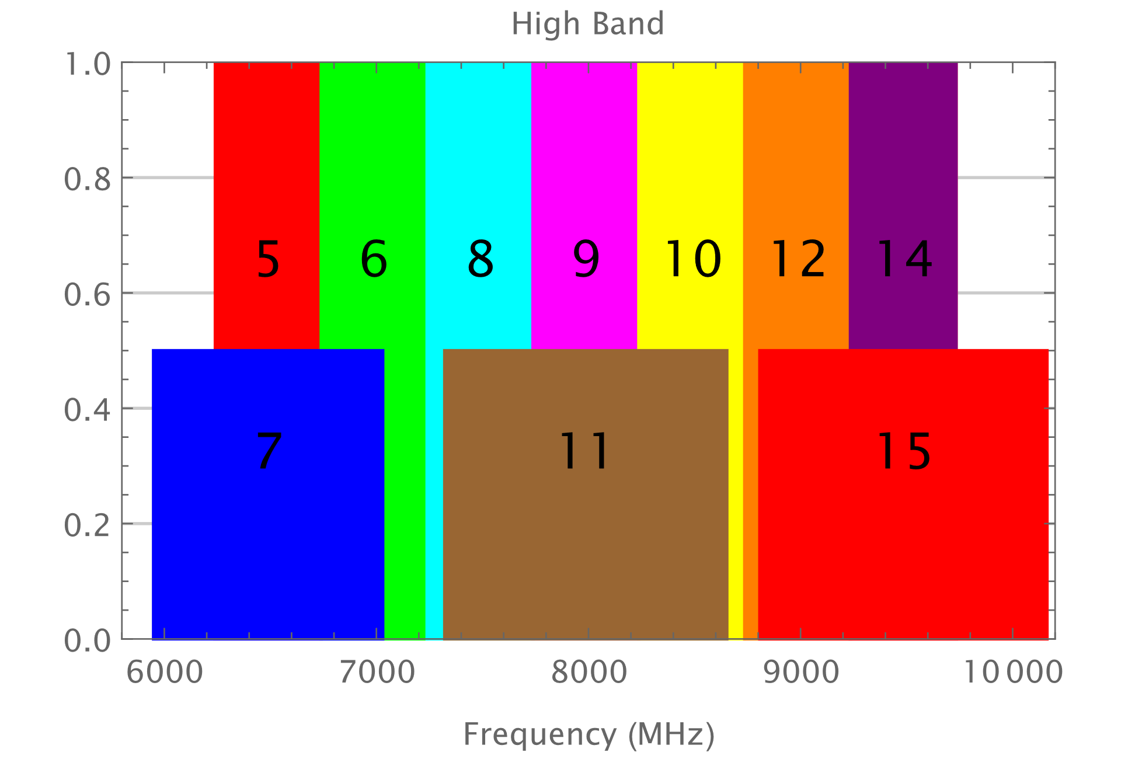
Background (Channels)

Slide 5
Proposal
Include support in the standard for Frequency Stitching for RF Sensing, for bandwidths up to two 499.2 MHz channels
Specify in the standard the set of allowed adjacent 499.2 MHz channels which can be used for Frequency Stitching
We propose excluding pairs-of-channels that include either channel 5 or channel 9
Those channels are specified for several industry use cases
If Frequency Stitching devices was used in those channels, then there would be partially frequency overlapping signals in those channels
There is a concern that these partially overlapping signals could cause harmful interference to the industry use cases specified for those channels

Slide 6
Proposed allowed/disallowed Pairs of 499.2 MHz Channels which can be used for Frequency Stitching
Pairs of 499.2 MHz Channels | Allowed/Disallowed for Frequency Stitching
(1, 2) | Allowed
(2, 3) | Allowed
(5, 6) | Disallowed
(6, 8) | Allowed
(8, 9) | Disallowed
(9, 10) | Disallowed
(10, 12) | Allowed
(12, 14) | Allowed

Slide 7
References
Frank Leong, Wolfgang Küchler, Riku Pirhonen, “Sensing Continued,” IEEE 802.15/22-061r0, January 2022
Frank Leong, Wolfgang Küchler, Riku Pirhonen, “UWB Sensing - Scheduling,” IEEE 802.15/22-422r0, July 2022
Ben Rolfe, “Expanded HRP channel plan,” IEEE 802.15-22/520r1, September 2022
Steve Shellhammer, et. al., “Channels for Frequency Stitching,” IEEE 802.15-22/574r0, November 2022

