Slide 1
Project: IEEE P802.15 Working Group for Wireless Personal Area Networks (WPANs)
Submission Title: Study on interference induced by THz wave scattering from slightly rough surfaces
Date Submitted: 14 November 2022
Source: Tetsuya Kawanishi, Riku Yoshino, Toshiya Yoshida, Waseda University
3-4-1, Okubo, Shinjuku-ku, Tokyo 169-8555, Japan
Voice: +81 3 5286 3386, E-Mail: kawanishi@waseda.jp
Keizo Inagaki, Iwao Hosako, National Institute of Information and Communications Technology (NICT)
4-2-1, Nukui-Kitamachi, Koganei, Tokyo 184-8795, Japan, E-Mail: hosako@nict.go.jp
Re: n/a
Abstract: This document overviews of polarized THz-wave scattering from slightly rough surfaces and its impact on interference. Slightly rough surfaces such as wooden tables and walls would scatter THz waves with particular polarization distribution. The scattered wave would induce interference between short distance THz links.
Purpose: Information document for IEEE 802.15 SC THz
Notice: This document has been prepared to assist the IEEE P802.15. It is offered as a basis for discussion and is not binding on the contributing individual(s) or organization(s). The material in this document is subject to change in form and content after further study. The contributor(s) reserve(s) the right to add, amend or withdraw material contained herein.
Release: The contributor acknowledges and accepts that this contribution becomes the property of IEEE and may be made publicly available by P802.15.

Slide 2
Study on interference induced by THz wave scattering from slightly rough surfaces
November 2022
Tetsuya Kawanishi, Riku Yoshino, Toshiya Yoshida,
Keizo Inagaki and Iwao Hosako
Waseda University, Japan
National Institute of Information and Communications Technology (NICT), Japan

Slide 3
Outline of this contribution
Basics on a model of THz-wave scattering from slightly rough surfaces
Examples of experimental and numerical results
Potential interference induced by scattering

Slide 4
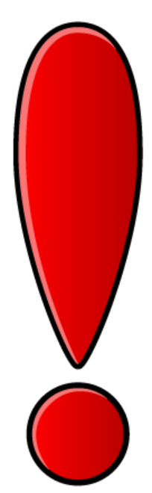




THz-wave scattering from slightly rough surfaces
Microwave
THz-wave
Typical roughness of polished wooden surface is 80 um.
E. Csanády et al., Surface Roughness of Wood. In: Quality of Machined Wood Surfaces, Springer 2015.
Tetsuya Kawanishi, Waseda Univ., et al

Slide 5
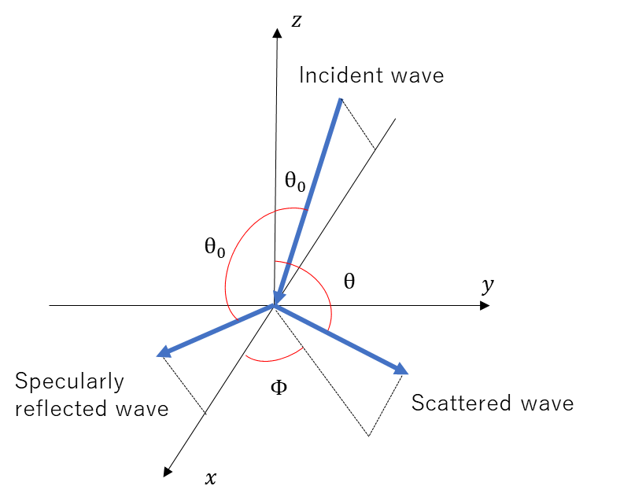
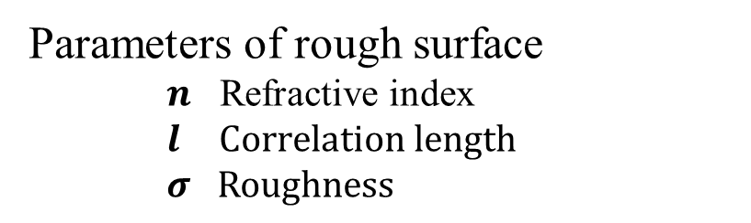
Model of electromagnetic wave scattering
A stochastic functional approach provides mathematical models for EM wave scattering by 2D slightly random surfaces.
Scattering distributions largely depend on polarization.
Wiener kernels offer concise mathematical expressions.
Surfaces are described by Gaussian distribution stochastic functions whose spectra are Gaussian.
Parameters of rough surface
$n$ Refractive index
$l$ $\text{C}\text{orrelation} \text{length}$
$σ \text{R}\text{oughness}$
T. Kawanishi, et al.: “Scattering of electromagnetic wave from a slightly dielectric surface--Yoneda peak and Brewster angle incoherent scattering--,” Waves in Random Media 7 (1997) 351

Slide 6
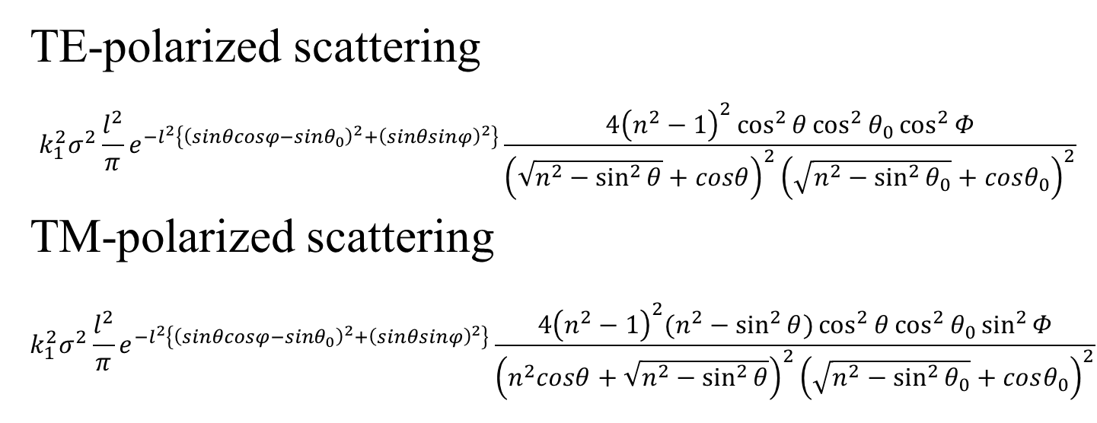

Scattering distribution of
TE polarization incidence
$k1$ Wavenumber in the air
TE-polarized scattering
$$k_{1}^{2}σ^{2}\frac{l^{2}}{π}e^{−l^{2}\left\{{\left(sinθcosφ−sinθ_{0}\right)}^{2}+{\left(sinθsinφ\right)}^{2}\right\}}\frac{4{\left(n^{2}−1\right)}^{2}\cos^{2}{θ}\cos^{2}{θ_{0}}\cos^{2}{Φ}}{{\left(\sqrt{n^{2}−\sin^{2}{θ}}+cosθ\right)}^{2}{\left(\sqrt{n^{2}−\sin^{2}{θ_{0}}}+cosθ_{0}\right)}^{2}}$$
TM-polarized scattering
$$k_{1}^{2}σ^{2}\frac{l^{2}}{π}e^{−l^{2}\left\{{\left(sinθcosφ−sinθ_{0}\right)}^{2}+{\left(sinθsinφ\right)}^{2}\right\}}\frac{4{\left(n^{2}−1\right)}^{2}(n^{2}−\sin^{2}{θ})\cos^{2}{θ}\cos^{2}{θ_{0}}\sin^{2}{Φ}}{{\left(n^{2}cosθ+\sqrt{n^{2}−\sin^{2}{θ}}\right)}^{2}{\left(\sqrt{n^{2}−\sin^{2}{θ_{0}}}+cosθ_{0}\right)}^{2}}$$
R. Yoshino, et al.: “Modeling and evaluation of millimeter wave scattering from minimally rough surfaces on stones,” IEICE ELEX 19 (2022) 20220257.

Slide 7
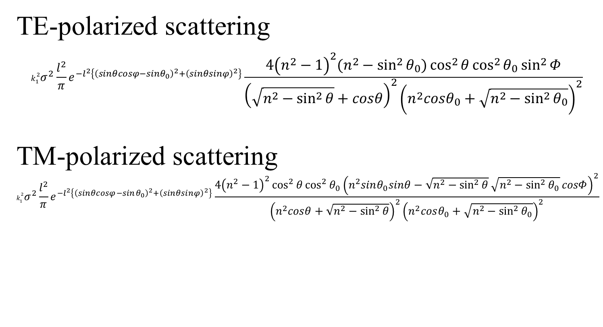
Scattering distribution of
TM polarization incidence
$k1$ Wavenumber in the air
TE-polarized scattering
$$k_{1}^{2}σ^{2}\frac{l^{2}}{π}e^{−l^{2}\left\{{\left(sinθcosφ−sinθ_{0}\right)}^{2}+{\left(sinθsinφ\right)}^{2}\right\}}\frac{4{\left(n^{2}−1\right)}^{2}(n^{2}−\sin^{2}{θ_{0}})\cos^{2}{θ}\cos^{2}{θ_{0}}\sin^{2}{Φ}}{{\left(\sqrt{n^{2}−\sin^{2}{θ}}+cosθ\right)}^{2}{\left(n^{2}cosθ_{0}+\sqrt{n^{2}−\sin^{2}{θ_{0}}}\right)}^{2}}$$
TM-polarized scattering
$$k_{1}^{2}σ^{2}\frac{l^{2}}{π}e^{−l^{2}\left\{{\left(sinθcosφ−sinθ_{0}\right)}^{2}+{\left(sinθsinφ\right)}^{2}\right\}}\frac{4{\left(n^{2}−1\right)}^{2}\cos^{2}{θ}\cos^{2}{θ_{0}}{\left(n^{2}sinθ_{0}sinθ−\sqrt{n^{2}−\sin^{2}{θ}}\sqrt{n^{2}−\sin^{2}{θ_{0}}}cosΦ\right)}^{2}}{{\left(n^{2}cosθ+\sqrt{n^{2}−\sin^{2}{θ}}\right)}^{2}{\left(n^{2}cosθ_{0}+\sqrt{n^{2}−\sin^{2}{θ_{0}}}\right)}^{2}}$$

Slide 8
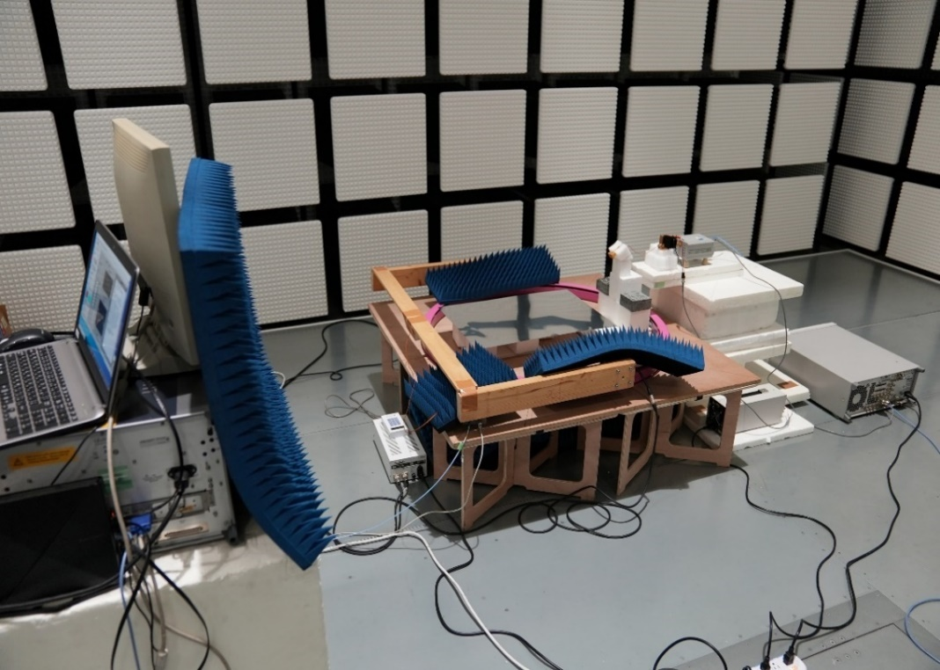
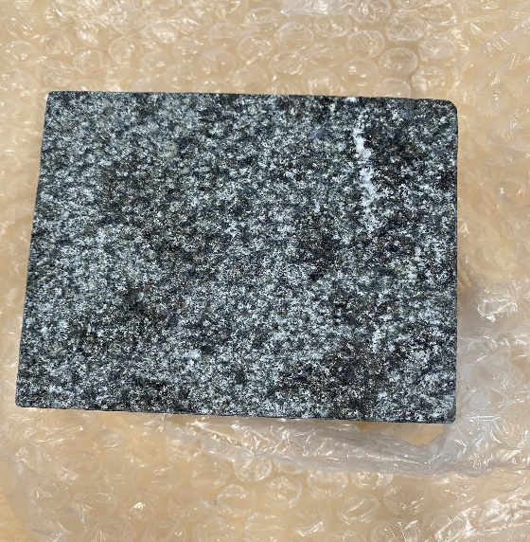
Millimeter-wave scattering measurement
(75-110GHz)
Granite stone (9cm x 9cm)
Tetsuya Kawanishi, Waseda Univ., et al

Slide 9
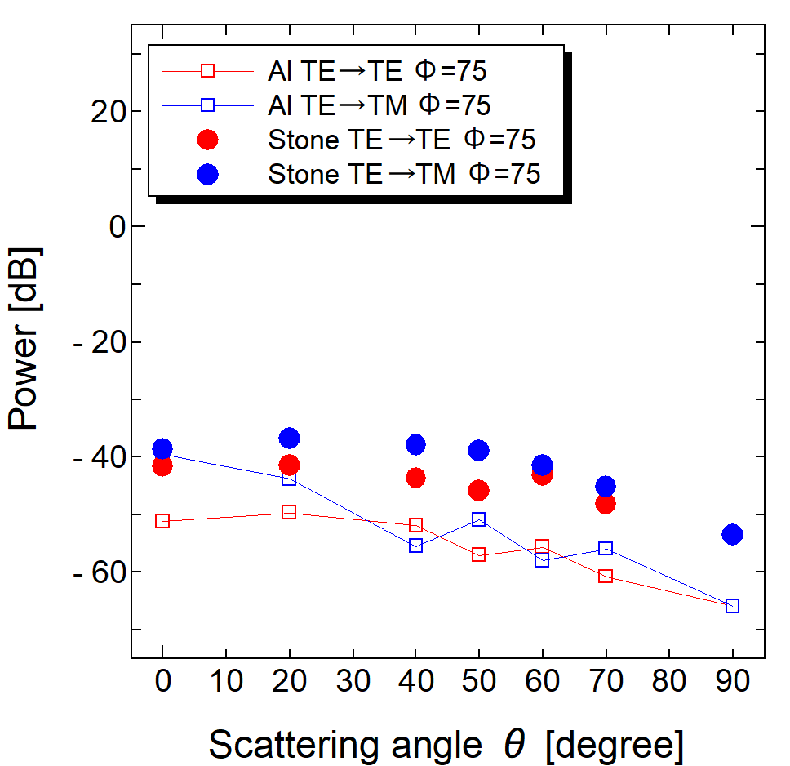
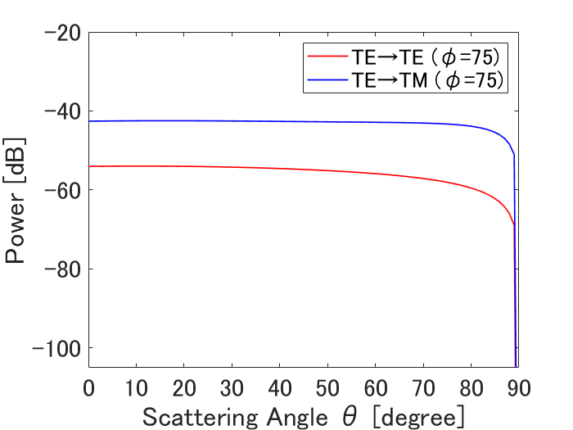
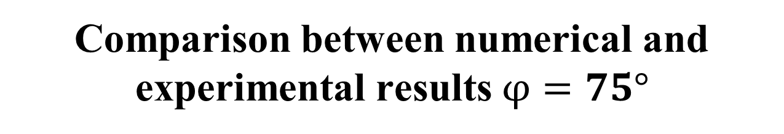
Comparison between numerical and experimental results $φ=75°$
Experiment
Theory
Scattered wave
-36.5dB ~ -56.5dB
-40dB ~ -60dB
Tetsuya Kawanishi, Waseda Univ., et al

Slide 10
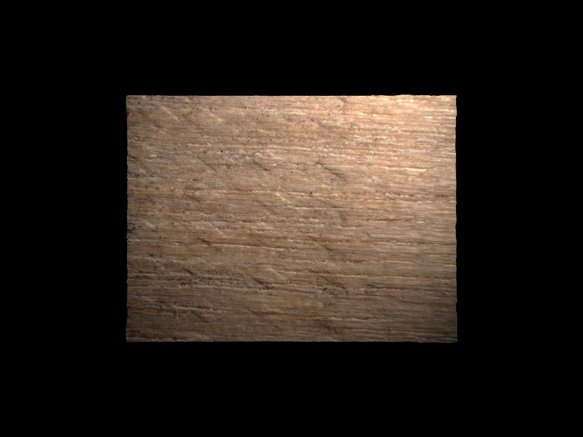
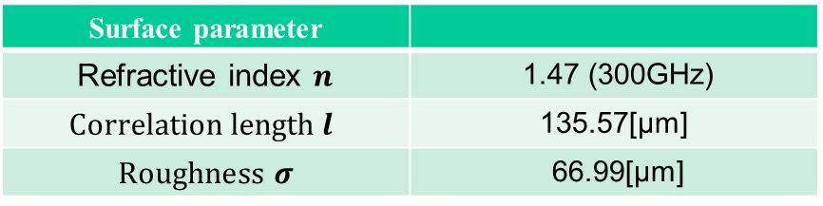
Wooden rough surface sample
Surface parameter
Refractive index $n$ | 1.47 (300GHz)
$$\text{C}\text{orrelation} \text{length} l$$ | 135.57[μm]
$\text{R}\text{oughness}$ $σ$ | 66.99[μm]
Tetsuya Kawanishi, Waseda Univ., et al

Slide 11
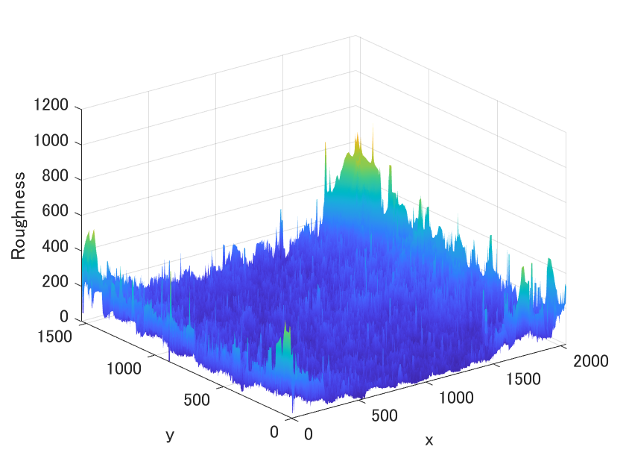
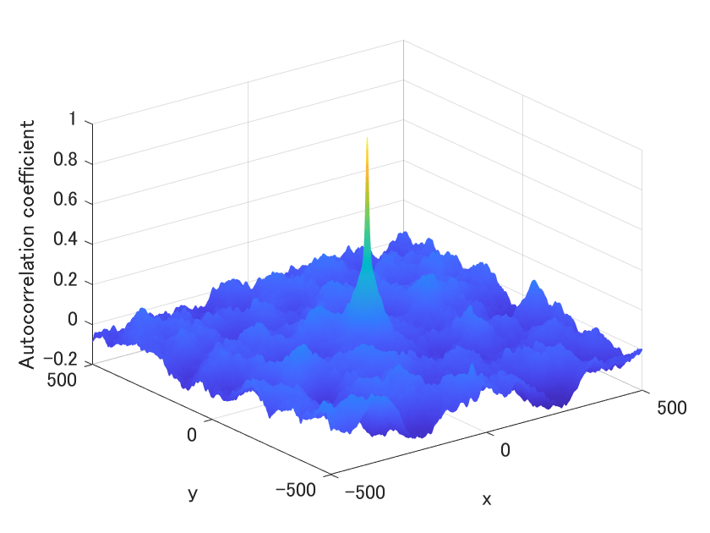
Roughness and correlation length
Tetsuya Kawanishi, Waseda Univ., et al

Slide 12
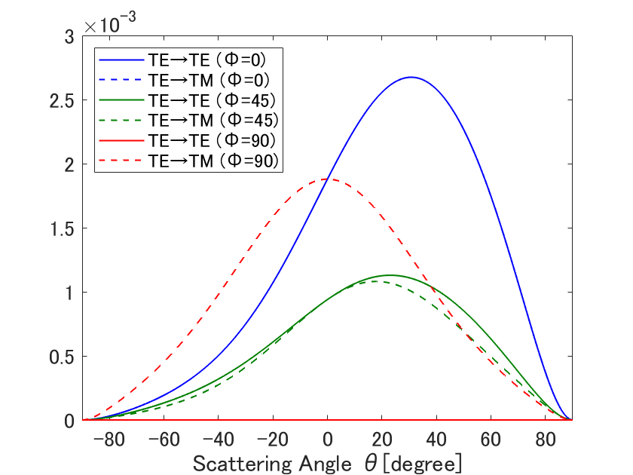
Scattered wave distribution
TE polarized incidence
Tetsuya Kawanishi, Waseda Univ., et al

Slide 13
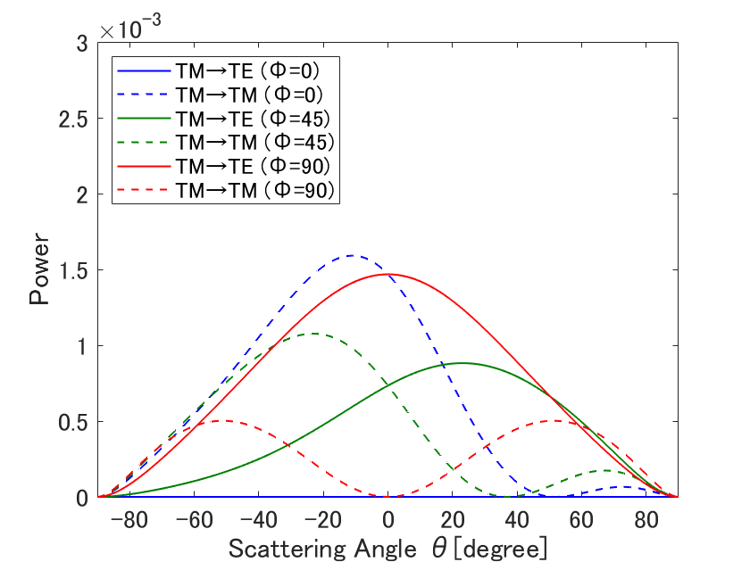
Scattered wave distribution
TM polarized incidence
Tetsuya Kawanishi, Waseda Univ., et al

Slide 14
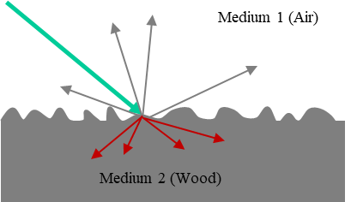
Total scattered wave power
60-degree incidence
TE-polarized incidence 3.63% (-14.4dB)
In Medium 1 TE=>TE 0.57% TE=>TM 0.47%
In Medium 2 TE=>TE 1.82% TE=>TM 0.77%
TM-polarized incidence 4.13% (-13.8dB)
In Medium 1 TM=>TE 0.40% TM=>TM 0.43%
In Medium 2 TM=>TE 1.12% TM=>TM 2.18%
Reflectivity 0.1661
Transmittance 0.8339
(w/o scattering)
Reflectivity 0.0022
Transmittance 0.9978
(w/o scattering)
Tetsuya Kawanishi, Waseda Univ., et al

Slide 15
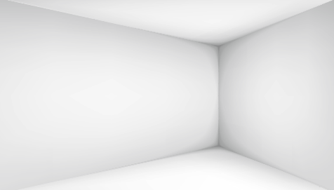


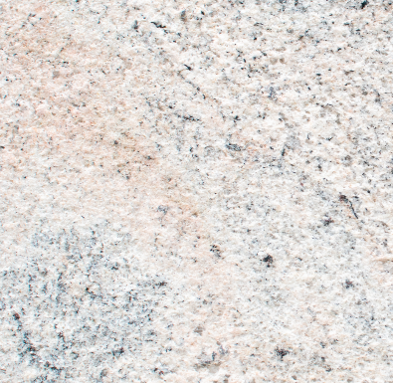
Issues on interference induced by scattering
Short distance THz links close to surfaces would have interference issues caused by scattered waves.
Tetsuya Kawanishi, Waseda Univ., et al
Notes:
The logical step would be to
Design a MPC estimation algorithm and compare how it performs with existing algorithm and our manual approach.
Model the stochastic processes in signal propagation at the band of interest (300 GHz). Also find out the intra-cluster parameters.
Develop channel model suited to THz band propagation

Slide 16
Future works
Study on interference mitigation based on scattering distribution and polarization dependence
  45-deg linear polarization shows asymmetric scattering
Explore materials or surfaces which suppress undesired scattering
T. Kawanishi, et al.: “Polarization characteristics of an electromagnetic wave scattered from a slightly random surface: +45° polarized incidence,” Waves in Random Media 7 (1997) 593
Tetsuya Kawanishi, Waseda Univ., et al
Notes:
The logical step would be to
Design a MPC estimation algorithm and compare how it performs with existing algorithm and our manual approach.
Model the stochastic processes in signal propagation at the band of interest (300 GHz). Also find out the intra-cluster parameters.
Develop channel model suited to THz band propagation

Slide 17
Summary
Stochastic functional approach would be applicable to THz-wave scattering from wood and stone surfaces.
Scattered wave distribution shows large polarization dependence.
Total scattered-wave power from a wood sample was -14dB.
Tetsuya Kawanishi, Waseda Univ., et al
Notes:
With the current dataset and its subsequent analysis the following inferences can be drawn
High K-factor indicates LoS dominant path but as observed from ray-tracing triple bounce path with significant power exists in most of the positions
The impulse like nature of the PDP indicates less number of MPCs per cluster
Further extensive campaign is required to make conclusive statements about the cross-correlation between different large scale parameters

