Slide 1
Project: IEEE P802.15 Working Group for Wireless Personal Area Networks (WPANs)
Submission Title: [Evaluation of IEEE 802.15.6ma Ultra-wideband Physical Layer Utilizing Super Orthogonal Convolutional Code]
Date Submitted: [16 September 2025]
Source: [Kento Takabayashi¹, Ryuji Kohno^{2,3} ] [1;Toyo University, 2;Yokohama National University, 3;YRP International Alliance Institute(YRP-IAI)]
Address [1: 2100 Kujirai, Kawagoe, Saitama, Japan 351-8585, Japan 719-1197,
2; 79-5 Tokiwadai, Hodogaya-ku, Yokohama, Japan 240-8501,
3; YRP1 Blg., 3-4 HikarinoOka, Yokosuka-City, Kanagawa, 239-0847 Japan]
Voice:[1; +81-866-94-2104, 2: +81-90-5408-0611],
Email:[1: takabayashi.kento.xp@gmail.com, 2:kohno@ynu.ac.jp]
Re: []
Abstract: [The performance of an IEEE 802.15.6ma ultra-wideband physical layer utilizing super orthogonal convolutional codes is evaluated. These slides may offer opportunity to discuss on revision for a dependable physical layer technology of a new standard IEEE802.15.6ma.] Purpose: [The discussion will lead definition and requirement of current ongoing research and development on dependable wireless networks.]
Notice: This document has been prepared to assist the IEEE P802.15. It is offered as a basis for discussion and is not binding on the contributing individual(s) or organization(s). The material in this document is subject to change in form and content after further study. The contributor(s) reserve(s) the right to add, amend or withdraw material contained herein. Release: The contributor acknowledges and accepts that this contribution becomes the property of IEEE and may be made publicly available by P802.15.
Notes:
doc.: IEEE 802.15-09-0117-00-0007
<month year>

Slide 2
Evaluation of IEEE 802.15.6ma Ultra-wideband Physical Layer Utilizing Super Orthogonal Convolutional Code
September 2025,
Hybrid Session,
Hilton Waikoloa Village, US
Kento Takabayashi¹, Ryuji Kohno^{2,3}
1. Toyo University, Japan
2. Yokohama National University, Japan
3. YRP International Alliance Institute, Japan

Slide 3
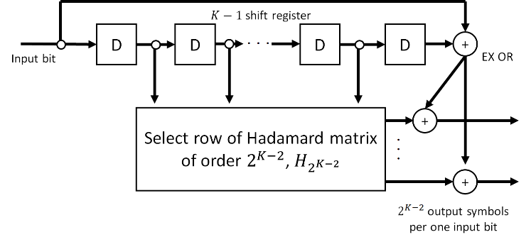
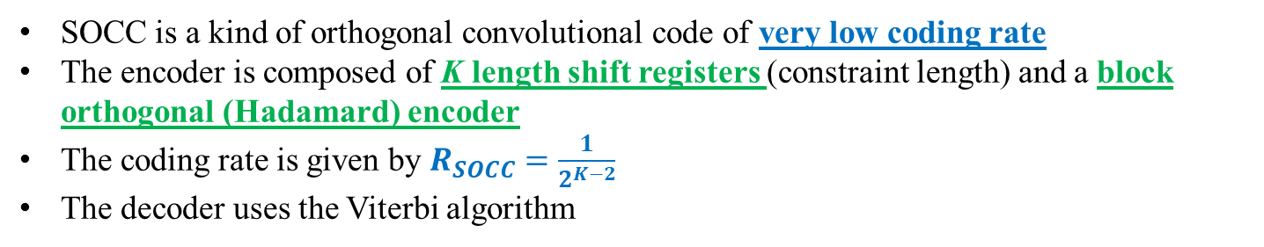
SOCC
Fig. SOCC encoder
SOCC is a kind of orthogonal convolutional code of very low coding rate
The encoder is composed of K length shift registers (constraint length) and a block orthogonal (Hadamard) encoder
The coding rate is given by $R_{SOCC}=\frac{1}{2^{K−2}}$
The decoder uses the Viterbi algorithm
Notes:
The inner (K- 2) bit memories are mapped into one Walsh sequence of length $2^{K−2}$ (two to the power of K-2)
The two outer bits are added to each binary number of the selected Walsh sequence by exclusive OR
One divided by two to the power of K-2
Therefore, SOCCs are considered to be compatible with the UWB, as they use a very wide bandwidth

Slide 4
Classification of Channel and Environment Models for Human and Vehicle Body Area Networks (HBAN&VBAN)
Channel model
※Covered by
IEEE 802.15.6-2012
HBAN model
In-body (Implant)
※
On-body
※
Channel model
With environment
Around body
Outdoor
※Around means;
Desk, WiFi AP in the room etc.
Indoor
※
Home
Implanted BCI model
Office
※
On skull BCI model
Medical (e.g. Hospital)
※
capsule endoscopy
※not covered in 2012
VBAN model
In-vehicle
Engine compartment
Note:
HBAN-model:
-Environment with co-existing systems is not considered.
VBAN model:
Key-less entry system
Localization in-body, on-body
Most dominant model should be defined and separatory defined as Mandatory and Optional.
Cabin
Through Engine compartment and cabin
On-vehicle
Roof
Around vehicle
Side Right/Left/Front/back
Bottom
Static vehicle
Notes:
IEEE802.15.6ma assumes various scenarios for HBAN and VBAN, and the channel model applied varies depending on the scenario
In this presentation, we consider an environment in which on-body to external device communication in HBAN and interference from other systems exist

Slide 5
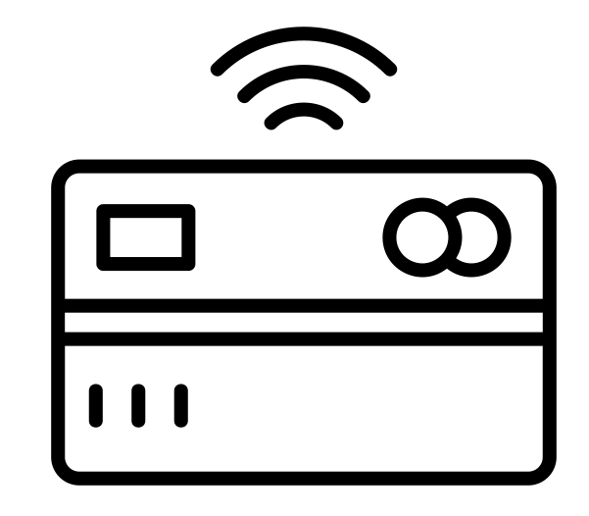
Radio environment
15.6ma
15.6ma
EMI source
15.4z
15.6ma
15.6ma
15.6
15.4ab
15.6ma
On body to an external device channel: IEEE model CM4
Interference from other WBANs and systems: Bit erasure channel
15.4
Notes:
In this presentation, we will assume the area surrounded by the red dotted circle in this figure
The IEEE model CM4 is applied to the on-body to external device channel model, and the bit erasure channel is applied to the interference from other systems

Slide 6
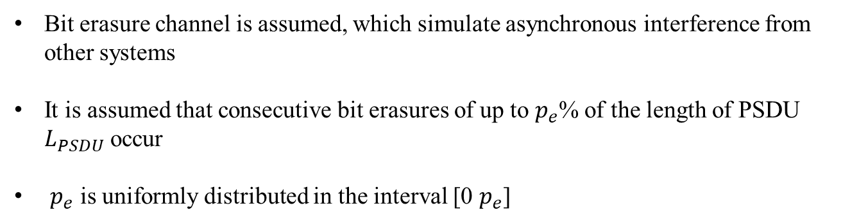
Bit erasure channel
0 1 1 0 0 1 0 0 1・・・0 1 1 1 ✕ ✕ ✕ ✕ ✕ ✕ ・・・0 1 1 0 0 0 1 1
Consecutive bit erasures
Bit erasure channel is assumed, which simulate asynchronous interference from other systems
It is assumed that consecutive bit erasures of up to $p_{e}$% of the length of PSDU $L_{PSDU}$ occur
$p_{e}$ is uniformly distributed in the interval [0 $p_{e}$]
Notes:
For bit erasure channels, the assumptions explained in this slide apply

Slide 7
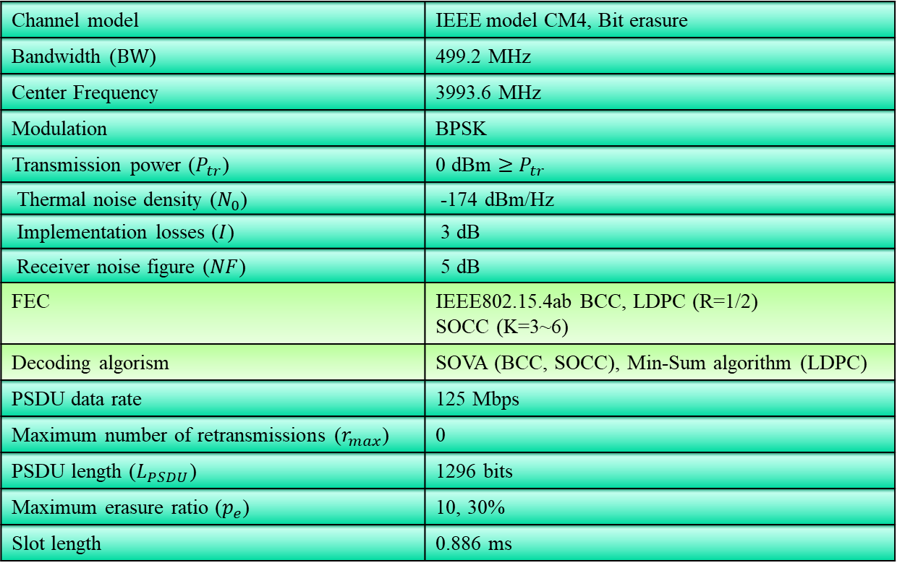
Evaluation
4. Evaluation
Table. Simulation Parameters
Channel model | IEEE model CM4, Bit erasure
Bandwidth ($BW$) | 499.2 MHz
Center Frequency | 3993.6 MHz
Modulation | BPSK
Transmission power ($P_{tr}$) | 0 dBm $≥$ $P_{tr}$
Thermal noise density ($N_{0}$) | -174 dBm/Hz
Implementation losses ($I$) | 3 dB
Receiver noise figure ($NF$) | 5 dB
FEC | IEEE802.15.4ab BCC, LDPC (R=1/2) SOCC (K=3~6)
Decoding algorism | SOVA (BCC, SOCC), Min-Sum algorithm (LDPC)
PSDU data rate | 125 Mbps
Maximum number of retransmissions ($r_{max}$) | 0
PSDU length ($L_{PSDU}$) | 1296 bits
Maximum erasure ratio ($p_{e}$) | 10, 30%
Slot length | 0.886 ms
Notes:
This presentation evaluated several metrices under on body to on body channel model (including multipath fading)

Slide 8
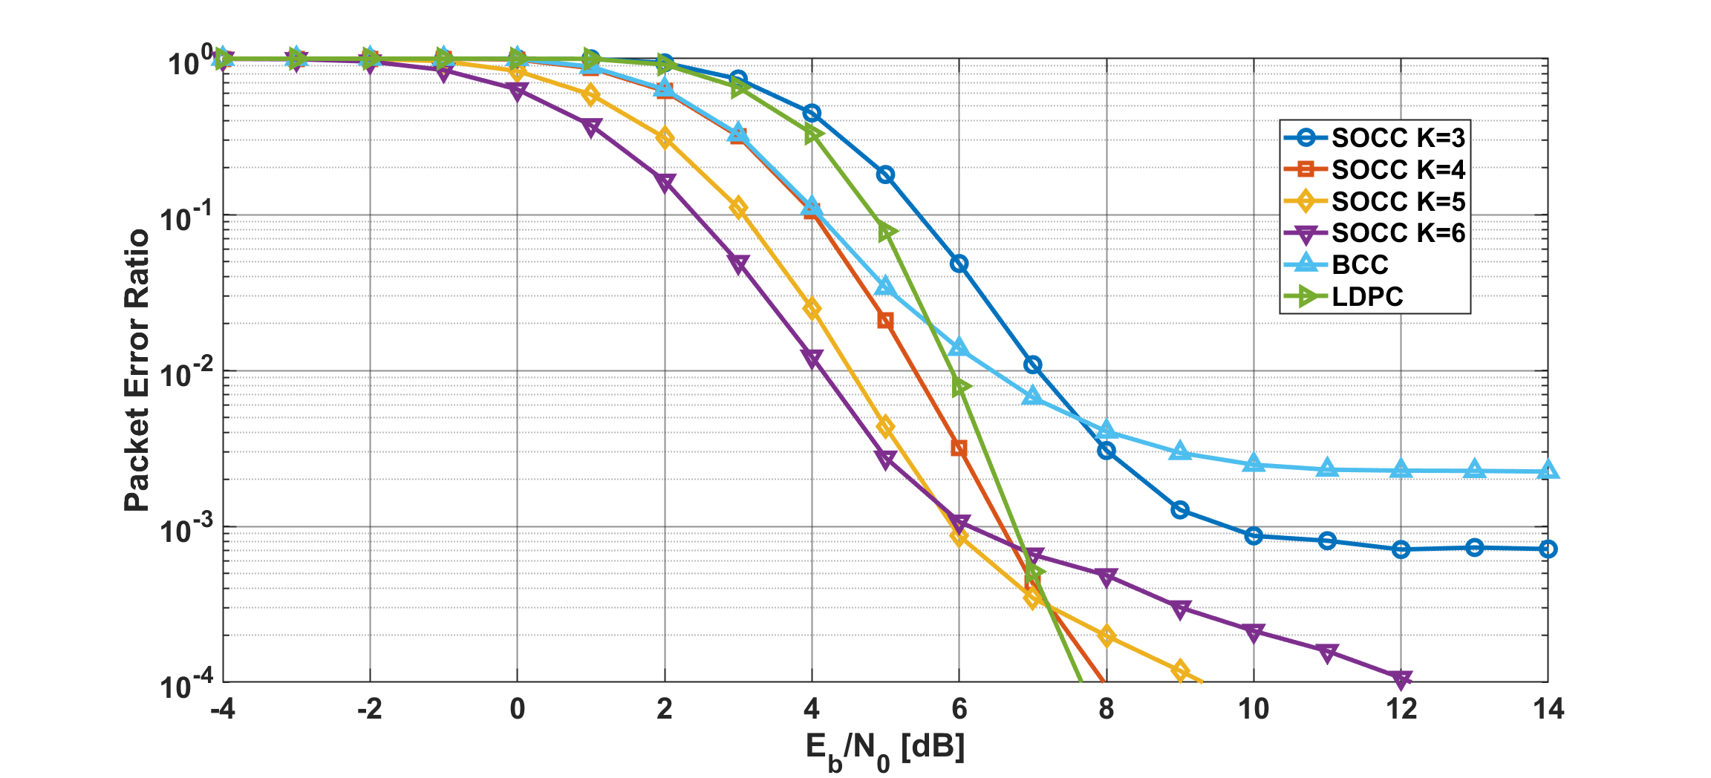
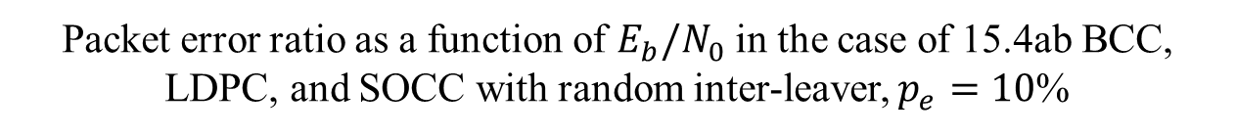
Results
Packet error ratio as a function of $E_{b}/N_{0}$ in the case of 15.4ab BCC, LDPC, and SOCC with random inter-leaver, $p_{e}=10$%
Notes:
First, looking at the case where there is small interference, the PER is below 10^-2 in all cases of BCC, LDPC, and SOCC, so dependability is ensured
Especially, low-rate SOCCs (1/4, 1/8, 1/16) had better in low SNR area

Slide 9
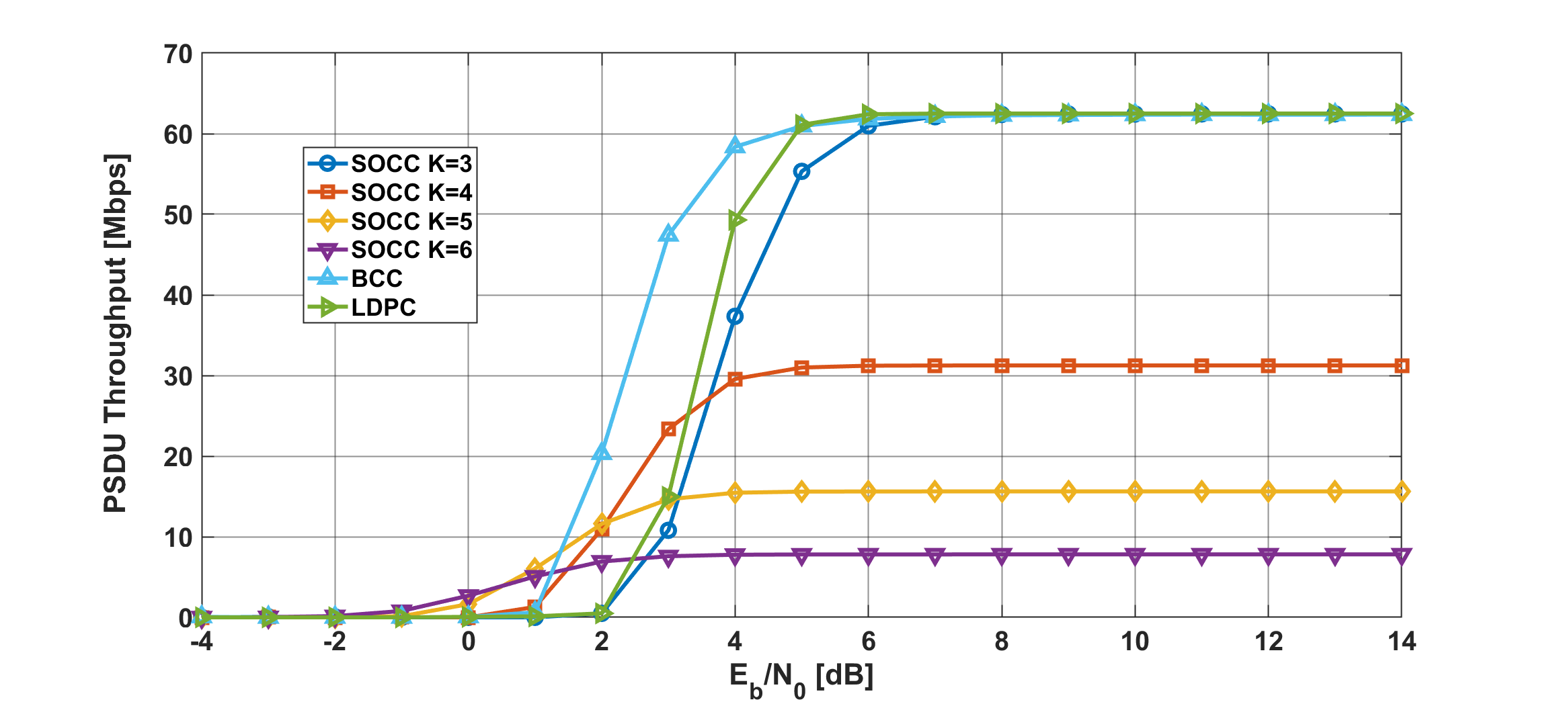

Results
PSDU throughput as a function of $E_{b}/N_{0}$ in the case of 15.4ab BCC, LDPC, and SOCC with random inter-leaver, $p_{e}=10$%
Notes:
Under the same conditions, Low-rate SOCCs had a less PSDU throughput performance than other case, but at least 7.8Mbps or more can be stably achieved

Slide 10
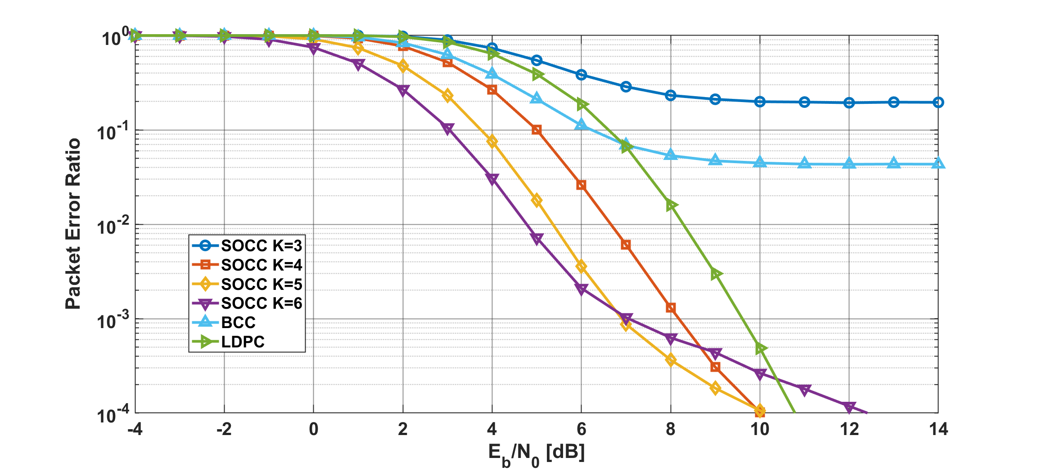
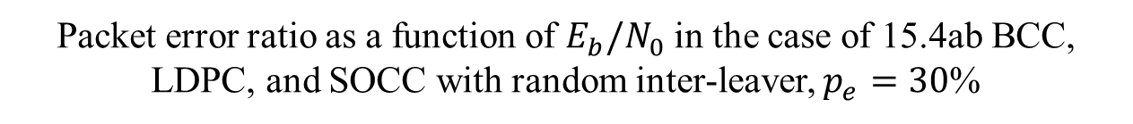
Results
Packet error ratio as a function of $E_{b}/N_{0}$ in the case of 15.4ab BCC, LDPC, and SOCC with random inter-leaver, $p_{e}=30$%
Notes:
Next, in the case of larger interference, BCC and high-rate SOCC could not achieve a PER of 10^-2
On the other hand, LDPC and low-rate SOCCs could achieve that
Especially, low-rate cases (1/4, 1/8, 1/16) had much better in low SNR areas

Slide 11
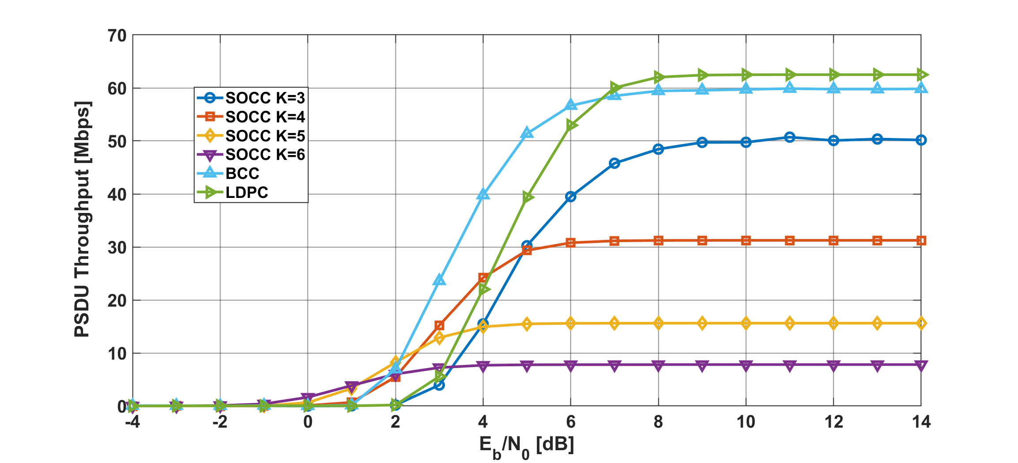

Results
PSDU throughput as a function of $E_{b}/N_{0}$ in the case of 15.4ab BCC, LDPC, and SOCC with random inter-leaver, $p_{e}=30$%
Notes:
In terms of PSDU throughput, the performance of BCC and high coding rate SOCC decreased, but the other methods did not show any significant change

Slide 12
Conclusion
In this presentation, the performance of SOCC when applying an on-body to an external device channel model based on the scenario assumed in IEEE802.15.6ma was evaluated
Low-rate SOCCs had a better PER performance but a less PSDU throughput than other case
  However, at least about 8Mbps or more can be stably achieved
SOCC may be effective in applications that require low latency and dependability
  The above performance can be achieved even without considering retransmission
We also plan to evaluate the performance when applying channel models in other scenarios (Example: VBAN case)

Slide 13
Thank you for your attention ! ! !
* This research was funded by JSPS Grant-in-Aid for Early-Career Scientists Grant Number JP20K14737
13

Slide 14
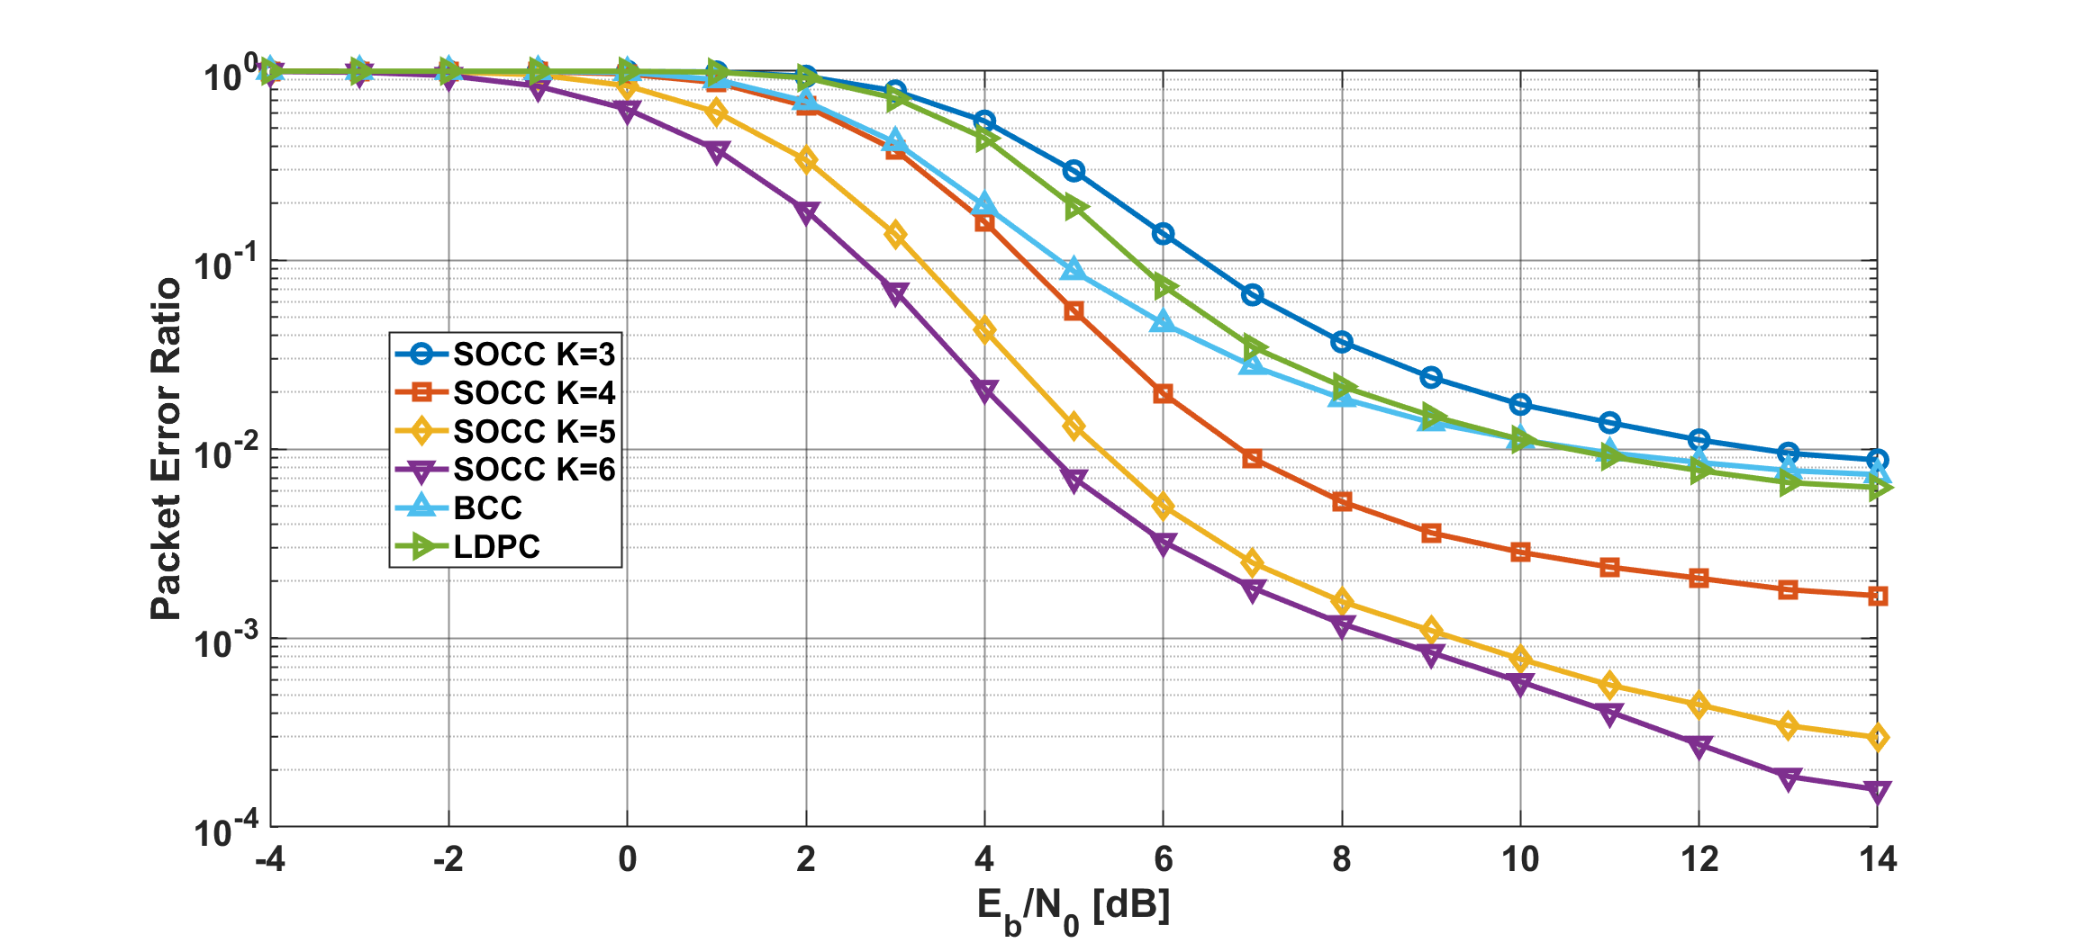
Results
Packet error ratio as a function of $E_{b}/N_{0}$ in the case of 15.4ab BCC, LDPC, and SOCC with random inter-leaver, $p_{e}=10$%
Notes:
First, looking at the case where there is small interference, the PER is below 10^-2 in all cases of BCC, LDPC, and SOCC, so dependability is ensured
Especially, low-rate SOCCs (1/4, 1/8, 1/16) had better in low SNR area

Slide 15
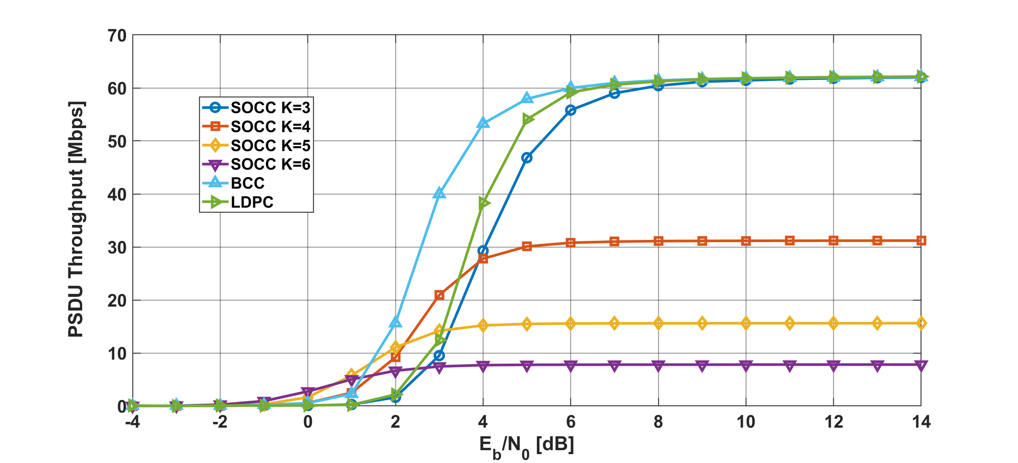
Results
PSDU throughput as a function of $E_{b}/N_{0}$ in the case of 15.4ab BCC, LDPC, and SOCC with random inter-leaver, $p_{e}=10$%
Notes:
Under the same conditions, Low-rate SOCCs had a less PSDU throughput performance than other case, but at least 7.8Mbps or more can be stably achieved

Slide 16
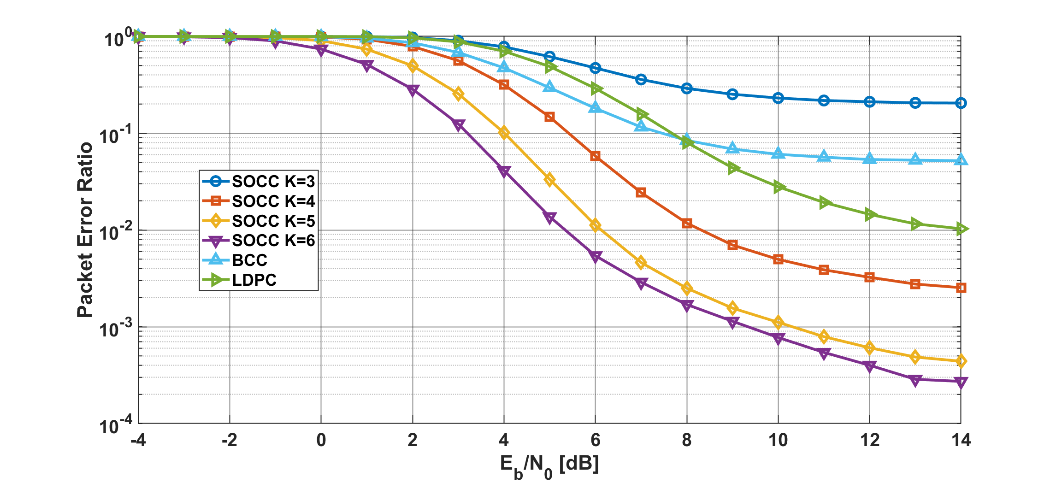
Results
Packet error ratio as a function of $E_{b}/N_{0}$ in the case of 15.4ab BCC, LDPC, and SOCC with random inter-leaver, $p_{e}=30$%
Notes:
Next, in the case of larger interference, BCC and high-rate SOCC could not achieve a PER of 10^-2
On the other hand, LDPC and low-rate SOCCs could achieve that
Especially, low-rate cases (1/4, 1/8, 1/16) had much better in low SNR areas

Slide 17
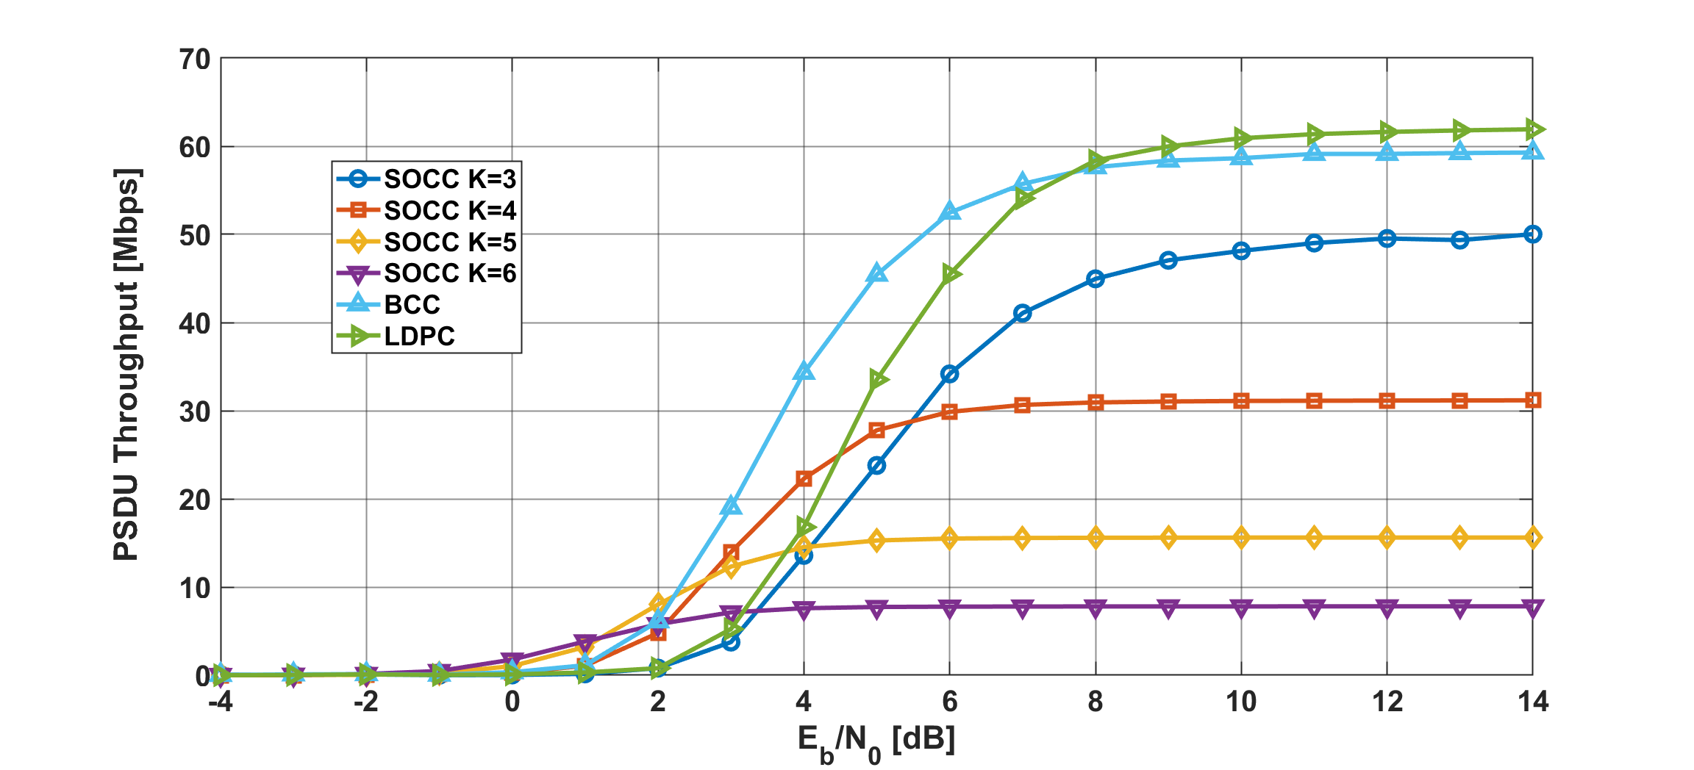
Results
PSDU throughput as a function of $E_{b}/N_{0}$ in the case of 15.4ab BCC, LDPC, and SOCC with random inter-leaver, $p_{e}=30$%
Notes:
In terms of PSDU throughput, the performance of BCC and high coding rate SOCC decreased, but the other methods did not show any significant change

