Slide 1

Lakshmi Thanayankizil PhD
Ready for the Road Ahead: Spectrum Needs and Wi-Fi
IEEE Plenary| 07/13/2022

Slide 2



A changing world.

Slide 3



Zero
Crashes
Zero
Emissions
Zero
Congestion

Slide 4


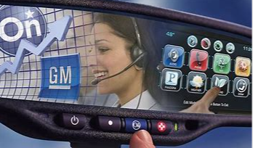
Connected vehicle – 10 years back
Always Connected
Navigation
OnStar

Slide 5
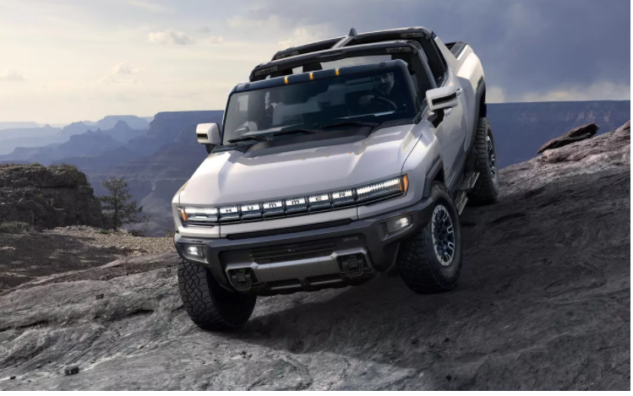



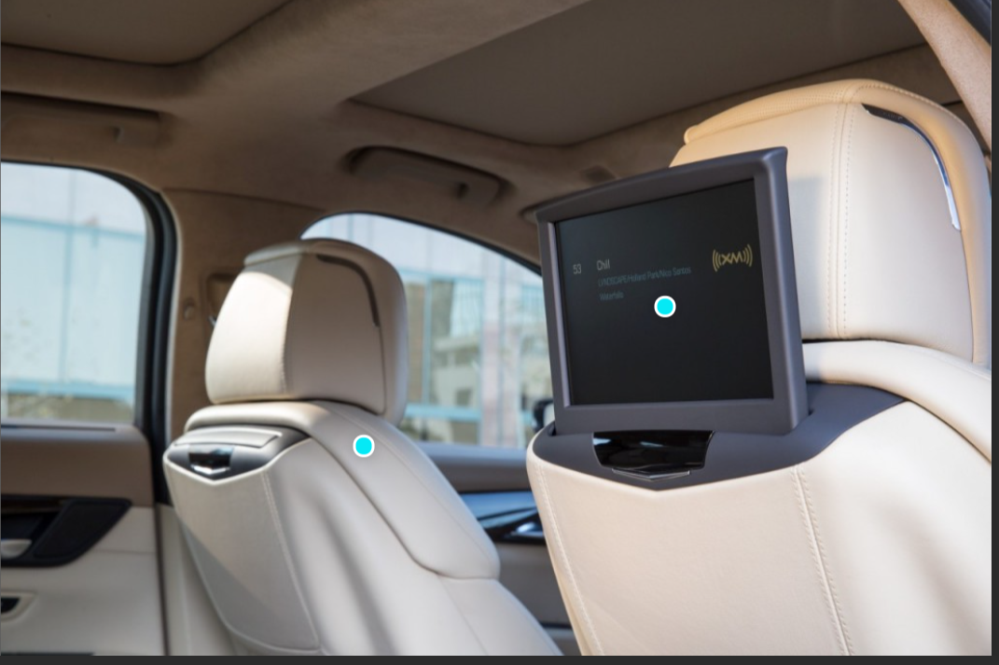

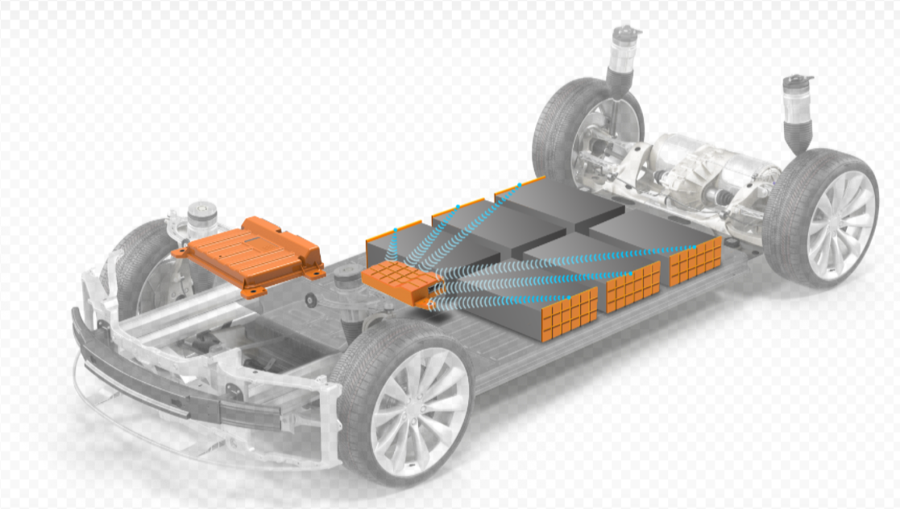


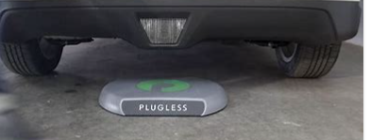

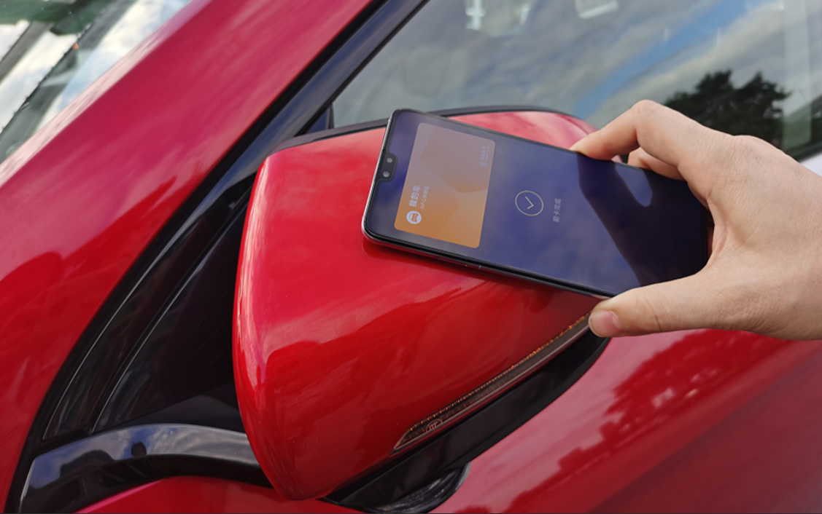
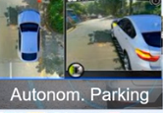
Connected vehicle - today
Seamless Experience
Connected and Protected
Reinventing EV Experience
Safety First
Navigation
Hotspot
Rear Seat
Wireless Battery
Wireless Power Transfer
Vehicle Access

Slide 6
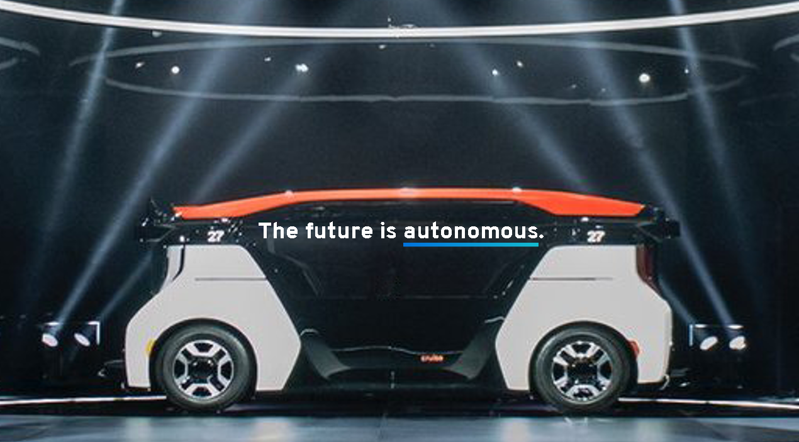
Connected vehicles –road ahead
Unleashing the full potential of connected vehicle requires addressing some of the underlying connectivity challenges

Slide 7
Connected vehicles –KEY Connectivity Issues
Unique Spectrum Coexistence Needs in a Connected Vehicle
Heterogeneous Handover at Vehicle Speeds

Slide 8



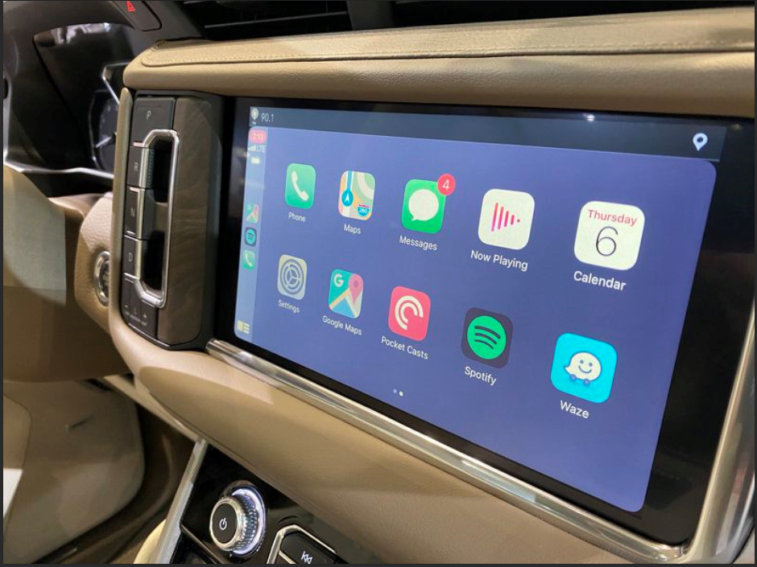

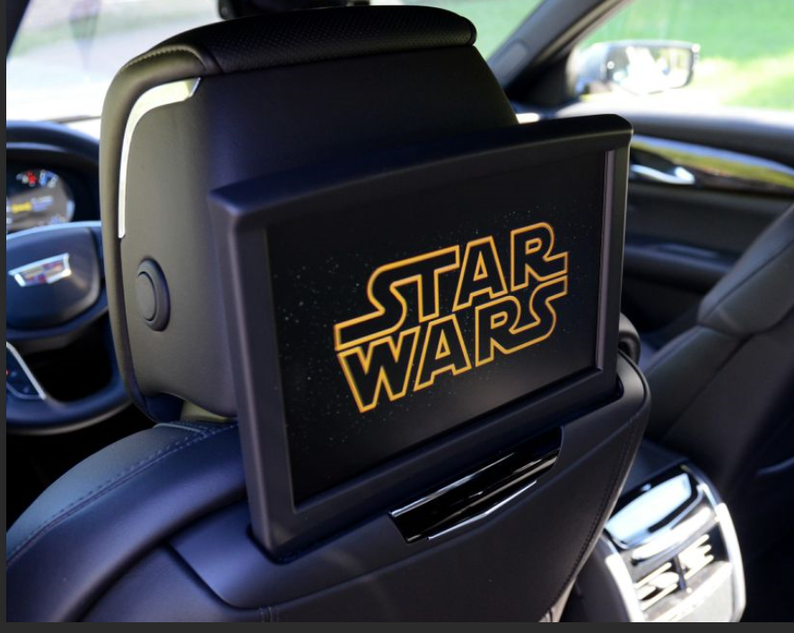
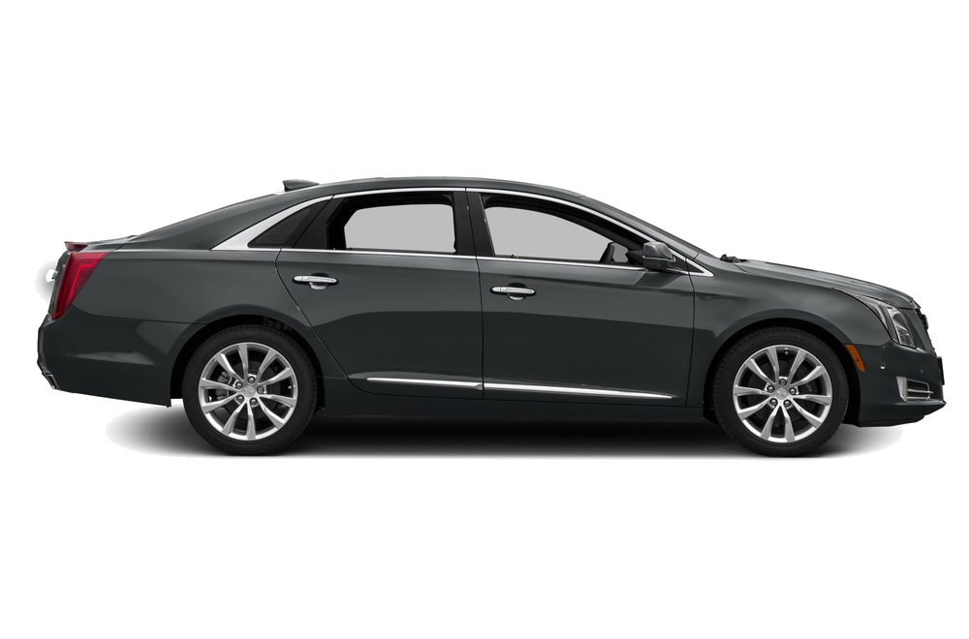

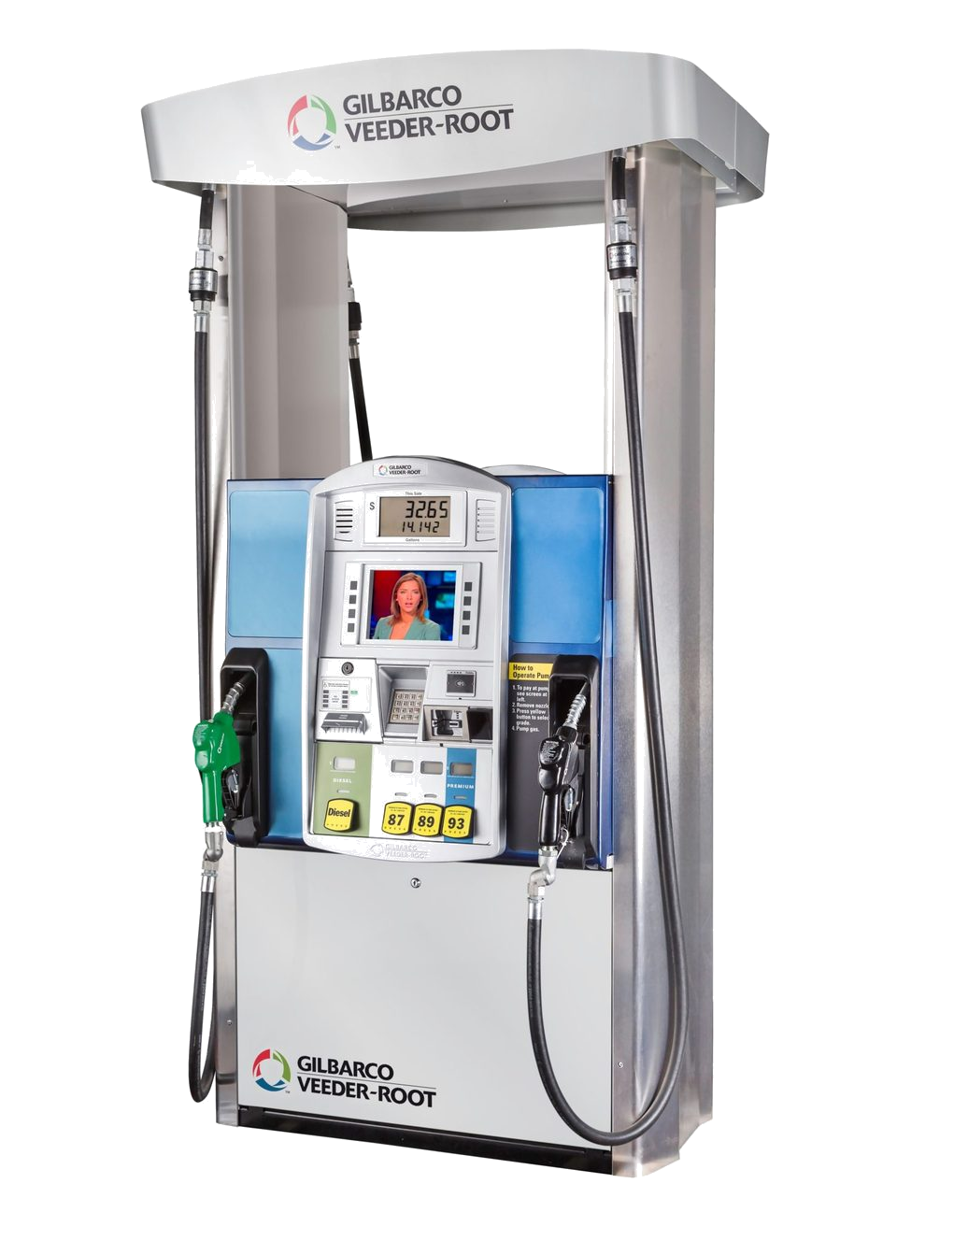
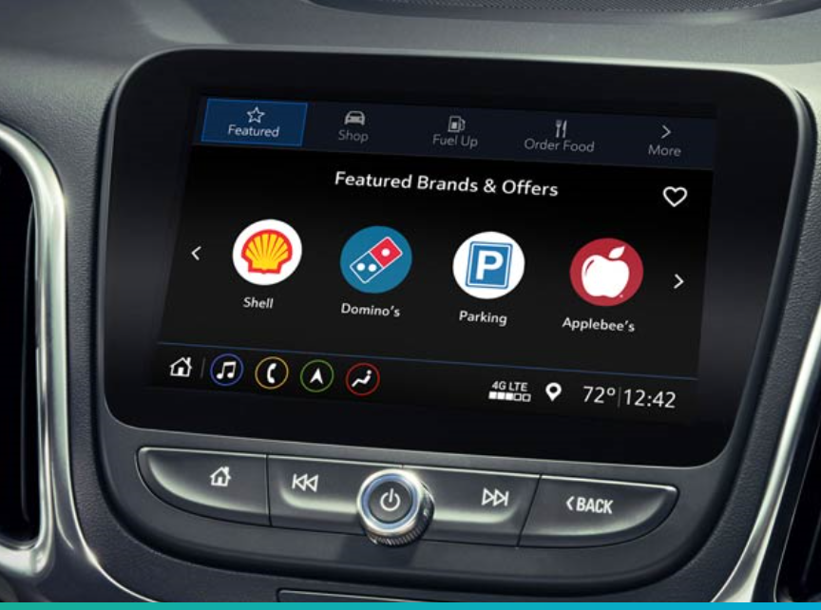

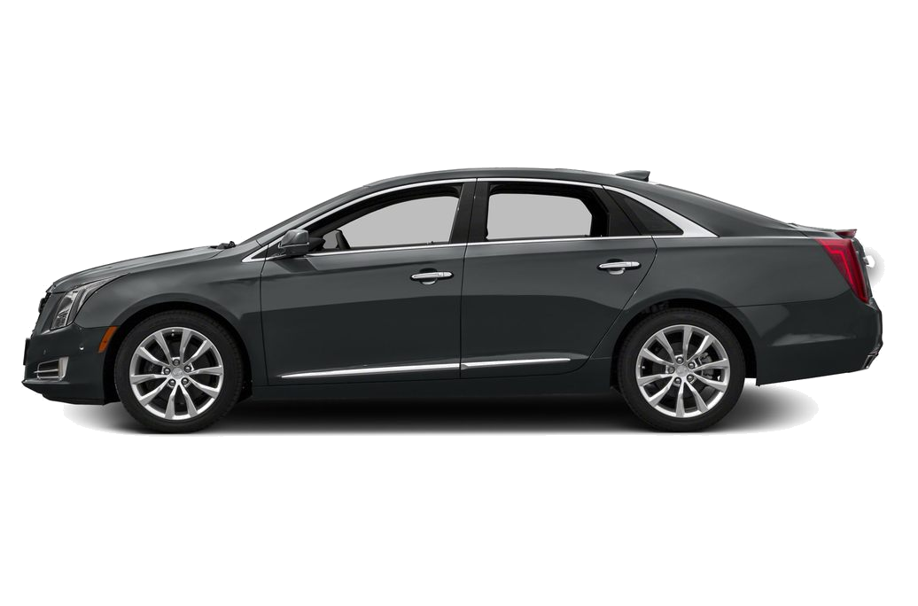
Day in the life of a Connected vehicle

Slide 9
Connected vehicles –KEY Connectivity Issues
Unique Spectrum Needs in a Connected Vehicle
5G and Wi-Fi Convergence at Vehicle Speeds

Slide 10



Connected vehicle – spectrum needs
LTE
Wi-Fi
Wi-Fi
V2V
Wi-Fi
BT/BLE/Zigbee
UWB
2.4 GHz Wi-Fi
5 GHz Wi-Fi
6 GHz Wi-Fi
Unique challenges posed by Connected Vehicle features identifies the need to define new coexistence mechanisms between technologies
Seamless Experience
Connected and Protected
Reinventing EV Experience
Safety First
Navigation
Hotspot
Rear Seat
Wireless Battery
Vehicle Access

Slide 11
Connected vehicles –KEY Connectivity Issues
Unique Spectrum Needs in a Connected Vehicle
5G and Wi-Fi Convergence at Vehicle Speeds

Slide 12
CONNECTED VEHICLE – Heterogeneous Wi-Fi handover needs
Vertical Handover challenging in Vehicular Networks as existing standards do not properly account for Vehicular speeds

Slide 13
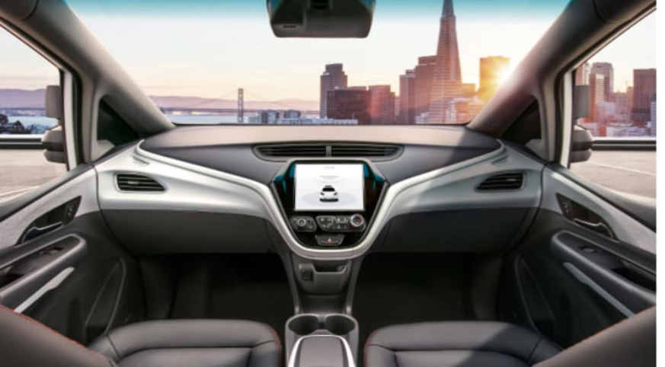

We are at the tipping point…

Slide 14
KEY TRENDS
Positioning
Wi-Fi 7
Open Roaming
UWB
V2I
V2X
6G
5G
Wi-Fi Aware
802.15.4
Leverage new technologies to continue enhancing safety and experience of our customers.

Slide 15


A better world ahead.
Thank you.

