Slide 1
Project: IEEE P802.15 Working Group for Wireless Specialty Networks (WSN)
Submission Title: CIR feedback scheme for UWB sensing - continue
Source: Bin Qian, Xiaohui Peng, Kuan Wu, David Xun Yang (Huawei Technologies)
Address : [Huawei Bantian Base, Longgang District, Shenzhen, 518129 China]
E-Mail: [qianbin14@huawei.com]
Re: Task Group 4ab: UWB Next Generation for 802.15.4
Abstract: [CIR feedback scheme, sensing, UWB]
Purpose:
Notice: This document has been prepared to assist the IEEE P802.15. It is offered as a basis for discussion and is not binding on the contributing individual(s) or organization(s). The material in this document is subject to change in form and content after further study. The contributor(s) reserve(s) the right to add, amend or withdraw material contained herein.
Release: The contributor acknowledges and accepts that this contribution becomes the property of IEEE and may be made publicly available by P802.15.
Notes:
Jul 12, 2010
Page 1

Slide 2
PAR Objective | Proposed Solution (how addressed)
Safeguards so that the high throughput data use cases will not cause significant disruption to low duty-cycle ranging use cases
Interference mitigation techniques to support higher density and higher traffic use cases
Other coexistence improvement
Backward compatibility with enhanced ranging capable devices (ERDEVs)
Improved link budget and/or reduced air-time | The overhead of CIR feedback report is decreased by CIR compression to reduce air-time
Additional channels and operating frequencies
Improvements to accuracy / precision / reliability and interoperability for high-integrity ranging
Reduced complexity and power consumption
Hybrid operation with narrowband signaling to assist UWB | The compressed CIR feedback packet could be transmitted by the narrowband
Enhanced native discovery and connection setup mechanisms
Sensing capabilities to support presence detection and environment mapping | This contribution proposes sensing CIR feedback report
Low-power low-latency streaming
Higher data-rate streaming allowing at least 50 Mbit/s of throughput
Support for peer-to-peer, peer-to-multi-peer, and station-to-infrastructure protocols
Infrastructure synchronization mechanisms

Slide 3
CIR feedback scheme for UWB sensing - continue

Slide 4
Slotted Structure for UWB Sensing
A slotted structure for UWB sensing is proposed in [1]. Here one sensing slot contains at least one snapshot, which is a block of samples corresponding to a sensing packet
The slotted structure enables efficient sensing schedule and coexistence with ranging and data communication

Slide 5
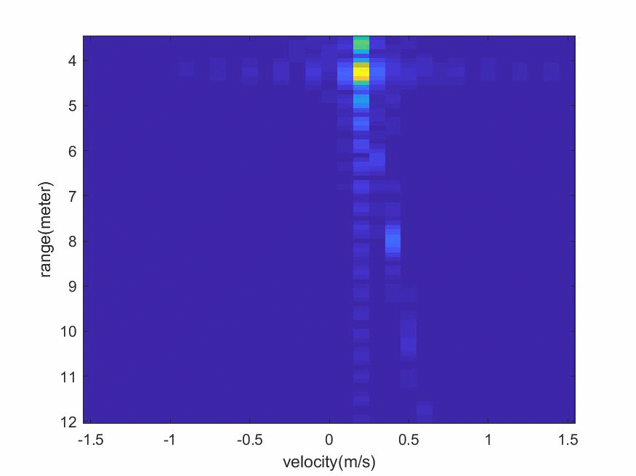
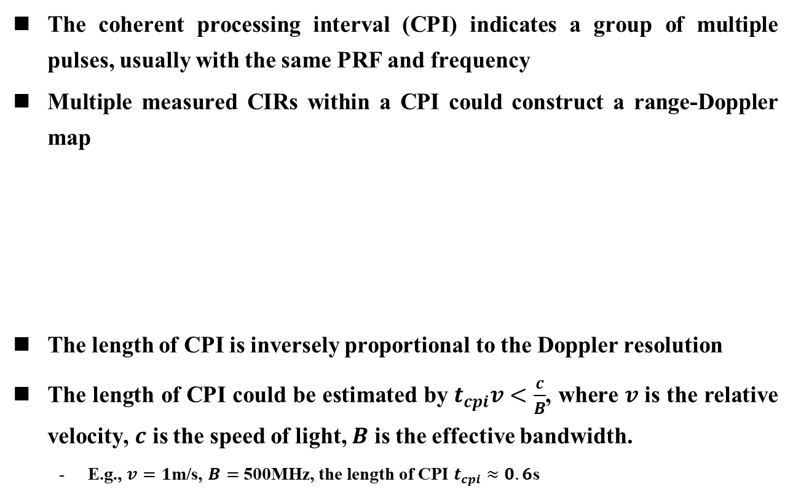
Coherent Processing Interval
The coherent processing interval (CPI) indicates a group of multiple pulses, usually with the same PRF and frequency
Multiple measured CIRs within a CPI could construct a range-Doppler map
The length of CPI is inversely proportional to the Doppler resolution
The length of CPI could be estimated by $t_{cpi}v<\frac{c}{B}$, where $v$ is the relative velocity, $c$ is the speed of light, $B$ is the effective bandwidth.
  E.g., $v=1$m/s, $B=$ 500MHz, the length of CPI $t_{cpi}≈0.6$s

Slide 6
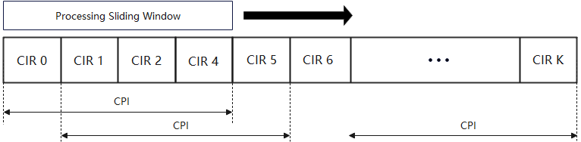
Time Continuous Sensing
To support target tracking, it is designed to perform time continuous sensing
In this scenario, a sliding window is applied such that a range-Doppler map could be generated by each processing

Slide 7
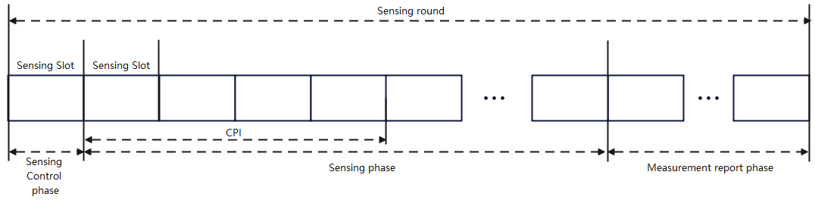
Possible Solutions Enable Time Continuous Sensing
Solution 1a: A lengthened sensing phase structure
  A sensing round could be divided into three phases, where the sensing phase is composed of sensing packets belonging to several CPIs
  Challenge: there exists a large delay the initiator could obtain the CIR report

Slide 8
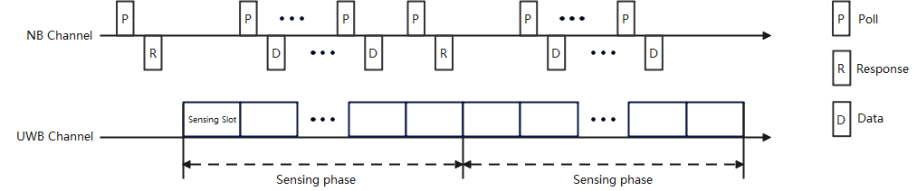
Possible Solutions Enable Time Continuous Sensing
Solution 1b: Narrow band assisted time continuous sensing. The sensing control and measurement report could be performed in the narrow band while the continuous sensing phase could be performed by the UWB. The sensing and measurement report could be overlapped
  Challenge: Need to support simultaneous NB transmission (reception) and UWB transmission (reception)

Slide 9
Sensing CIR Compression
In some scenarios [2], the OTA CIR measurement report is required from the responder to the initiator
The compression of the CIR report is an effective way to reduce the overhead especially the environment is stationary
In [1], we have proposed a CIR report compression method based on the classification of CIR reference information and CIR difference information
The reduction of CIR feedback report overhead is achieved by
  Decreasing the amount of CIR reference information
  Expressing the CIR difference information with less bits

Slide 10
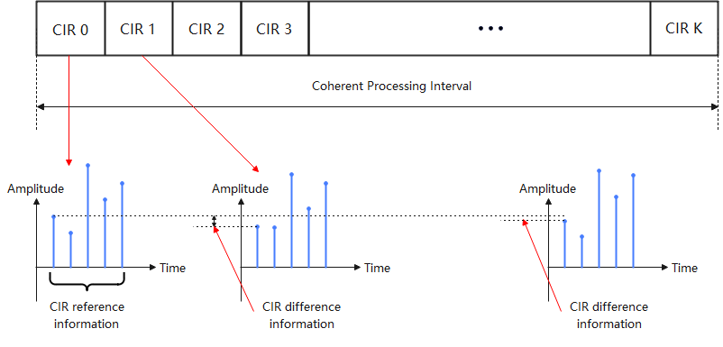
CIR Reference and Difference Information
Select the taps within one snapshot as the CIR reference information and compute the difference between taps with the same delay as the CIR difference information
Since CIR parameters corresponding to the target are changing continuously, the CIR difference information has smaller dynamic range

Slide 11
CIR Difference Information Compression
Approach 1a: The CIR difference information is expressed by less bits, e.g., 12 bits are used for encoding signed I/Q-component each of CIR reference information while 8 bits are used for encoding signed I/Q-component each of CIR difference information
  Packet duration is pre-determined given the number of taps per snapshot and the number of snapshot in the sensing phase
Approach 1b: When the difference between taps with the same delay is larger than a pre-defined threshold, the above difference would be contained in the CIR feedback report. Otherwise, the difference will be neglected. A bit map is used to indicate if the tap difference is included in the CIR feedback report
  Packet duration is varied
  Larger overhead reduction could be achieved

Slide 12
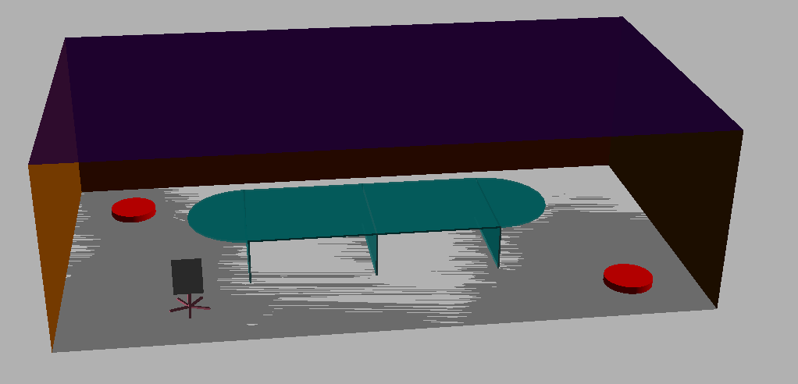
Simulation – Meeting Room
Meeting room size: 10m×5.5m×3m
TX position: [1, 4.5, 1.5] m
RX position: [9, 1, 1.5] m
Target position: [2, 1]m
Target type: chair
Target moving direction: [1, 0, 0] m
Frequency: 8 GHz
Moving speed: 1m/s
TX
RX
50 taps per snapshot, and 10 snapshots in one CIR feedback report
For simplicity, 12 bits for each I/Q when there is no compression
12 bits for each I/Q in CIR reference information and 8 bits for each I/Q in CIR difference information
The threshold of approach 1b is 1e-5
 | No compression | Approach 1a | Approach 1b
Max Quantization Error | 2.2e-5 | 1.8e-5 | 1.85e-5
Feedback Size (Bytes) | 1500 | 1050 | 718
Compression Ratio | 1 | 0.7 | 0.48

Slide 13
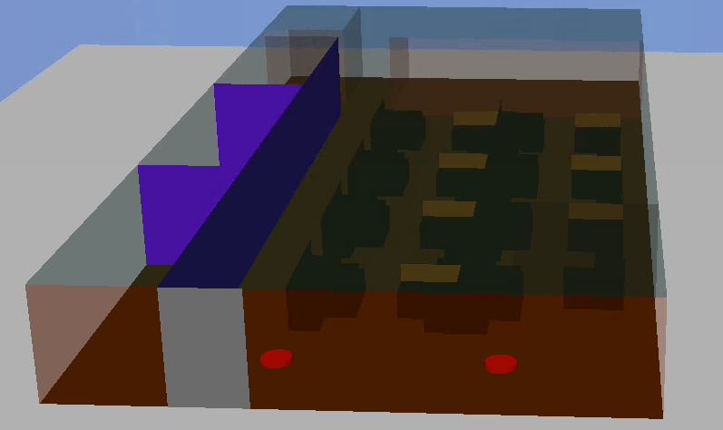

Simulation – Office Room
Office room size: 30m×15m×3m
TX position: [20, 7.5, 2.5] m
RX position: [20, 2, 2.5] m
Target position: [21, 5.5]m
Target type: chair
Target moving direction: [0, -1, 0] m
Frequency: 8 GHz
Moving speed: 1m/s
RX
TX
Moving direction
50 taps per snapshot, and 10 snapshots in one CIR feedback report
For simplicity, 12 bits for each I/Q when there is no compression
12 bits for each I/Q in CIR reference information and 8 bits for each I/Q in CIR difference information
The threshold of approach 1b is 1e-5
 | No compression | Approach 1a | Approach 1b
Max Quantization Error | 2.0e-5 | 1.5e-5 | 1.6e-5
Feedback Size (Bytes) | 1500 | 1050 | 742
Compression Ratio | 1 | 0.7 | 0.49

Slide 14
Summary
In this presentation, some aspects of the CIR feedback scheme are introduced:
  A slotted structure for UWB sensing is preferred
  Time continuous sensing should be further discussed to address the aforementioned challenges
  CIR compression Approach 1b could further reduce the compression ratio

Slide 15
References
Bin Qian, Xiaohui Peng, Mengyao Ma, David Xun Yang, “CIR feedback scheme for UWB sensing,” IEEE 802.15-22-0155-00-04ab, March, 2022.
Pooria Pakrooh, Bin Tian, Steve Shellhammer and Koorosh Akhavan, “UWB sensing scenarios for 802.15.4ab”, Jan, 2022.

