Slide 1
Project: IEEE P802.15 Working Group for Wireless Specialty Networks (WSN)
Submission Title: CIR feedback scheme for UWB sensing
Source: Bin Qian, Xiaohui Peng, Mengyao Ma, David Xun Yang (Huawei Technologies)
Address : [Huawei Bantian Base, Longgang District, Shenzhen, 518129 China]
E-Mail: [qianbin14@huawei.com]
Re: Task Group 4ab: UWB Next Generation for 802.15.4
Abstract: [CIR compression, sensing, UWB]
Purpose:
Notice: This document has been prepared to assist the IEEE P802.15. It is offered as a basis for discussion and is not binding on the contributing individual(s) or organization(s). The material in this document is subject to change in form and content after further study. The contributor(s) reserve(s) the right to add, amend or withdraw material contained herein.
Release: The contributor acknowledges and accepts that this contribution becomes the property of IEEE and may be made publicly available by P802.15.
Notes:
Jul 12, 2010
Page 1

Slide 2
PAR Objective | Proposed Solution (how addressed)
Safeguards so that the high throughput data use cases will not cause significant disruption to low duty-cycle ranging use cases
Interference mitigation techniques to support higher density and higher traffic use cases
Other coexistence improvement
Backward compatibility with enhanced ranging capable devices (ERDEVs)
Improved link budget and/or reduced air-time | The overhead of CIR feedback is decreased by CIR compression to reduce air-time
Additional channels and operating frequencies
Improvements to accuracy / precision / reliability and interoperability for high-integrity ranging
Reduced complexity and power consumption
Hybrid operation with narrowband signaling to assist UWB | The compressed CIR feedback packet could be transmitted by the narrowband
Enhanced native discovery and connection setup mechanisms
Sensing capabilities to support presence detection and environment mapping | This contribution proposes sensing compression and feedback procedure
Low-power low-latency streaming
Higher data-rate streaming allowing at least 50 Mbit/s of throughput
Support for peer-to-peer, peer-to-multi-peer, and station-to-infrastructure protocols
Infrastructure synchronization mechanisms

Slide 3
CIR feedback scheme for UWB sensing

Slide 4
Contents
Recap
Sensing CIR Feedback Procedure
Sensing CIR Compression Simulation
Summary

Slide 5
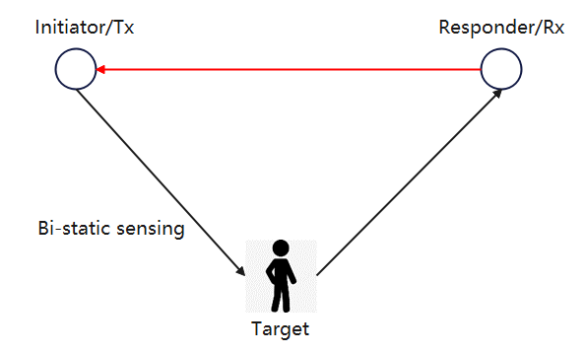
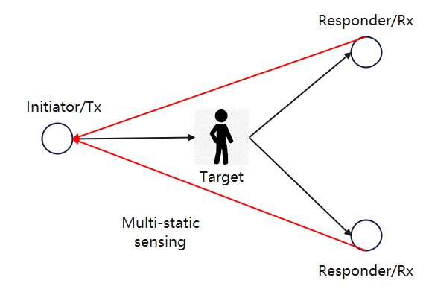

Sensing CIR (Recap)
In a sensing application，the CIR (Channel Impulse Response) is required to extract useful information of the target
When the initiator is the sensing transmitter, the CIR feedback packet is required
Sensing packet
CIR feedback packet
CIR parameters could be compressed
  In the time domain, CIR parameters corresponding to the target are changing continuously and CIR parameters corresponding to the stationary environment are almost fixed
  In the spatial domain, CIR parameters corresponding to different receiver antennas are correlated

Slide 6


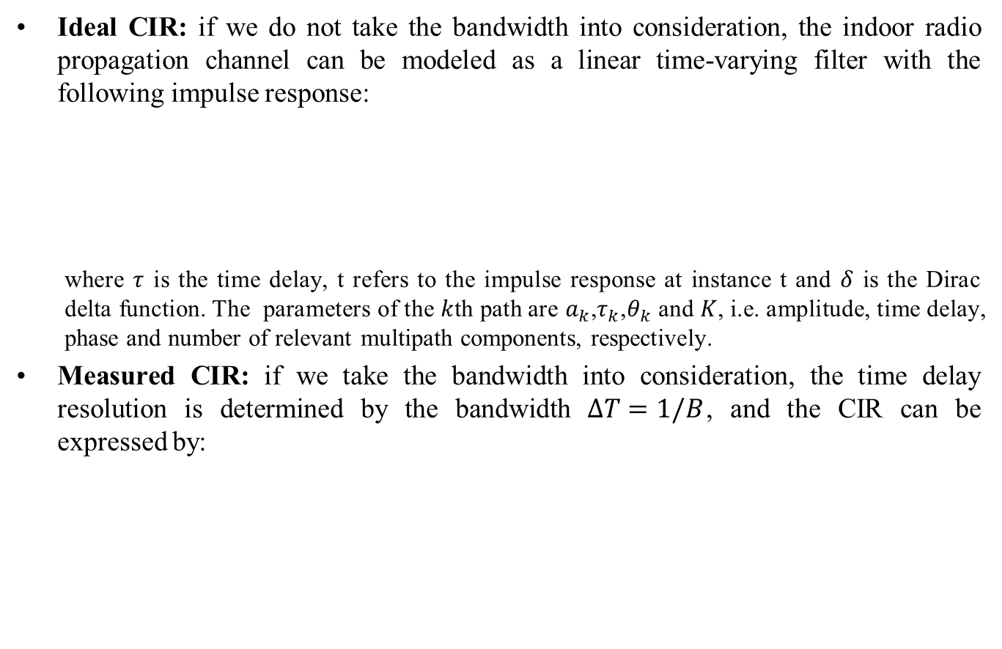










Mathematical Model of CIR (Recap)
Ideal CIR: if we do not take the bandwidth into consideration, the indoor radio propagation channel can be modeled as a linear time-varying filter with the following impulse response:
  where $τ$ is the time delay, t refers to the impulse response at instance t and $δ$ is the Dirac delta function. The parameters of the $k$th path are $a_{k}$,$τ_{k}$,$θ_{k}$ and $K$, i.e. amplitude, time delay, phase and number of relevant multipath components, respectively.
Measured CIR: if we take the bandwidth into consideration, the time delay resolution is determined by the bandwidth $ΔT=1/B$, and the CIR can be expressed by:
$$\left|h(τ) \right|$$
$$h\left(t,τ\right)=\sum_{k=0}^{K−1}{a_{k}\left(t\right)δ\left(τ−τ_{k}\left(t\right)\right)e^{jθ_{k}(t)}}$$
$$τ_{0}$$
$$τ_{2}$$
$$τ_{3}$$
$$τ$$
$$τ_{1}$$
$$\left|h(τ) \right|$$
$$h\left(t,τ\right)=\sum_{k=0}^{K−1}{\left[a_{k}\left(t\right)e^{jθ_{k}(t)}\int_{f_{c}−B/2}^{f_{c}+B/2}{e^{−j2πfτ_{k}(t)}df}\right]}$$
$$ΔT$$
$$τ_{0}$$
$$τ_{2}$$
$$τ_{3}$$
$$τ$$
where $f_{c}$ is the center frequency.
$$τ_{1}$$

Slide 7
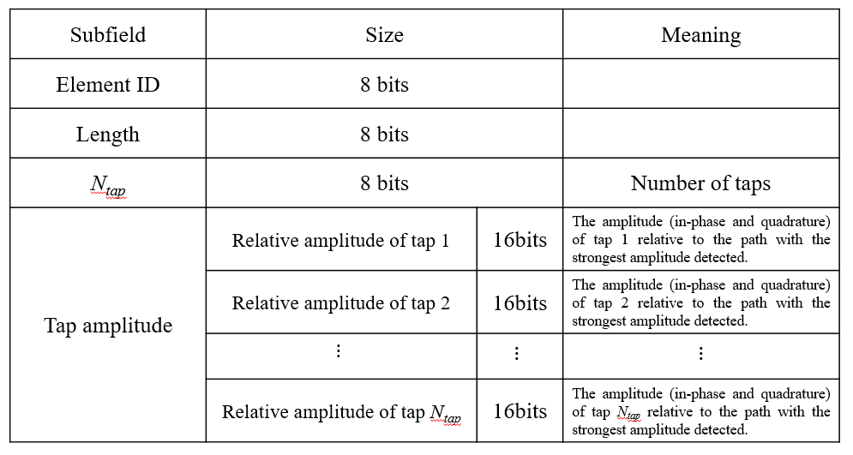
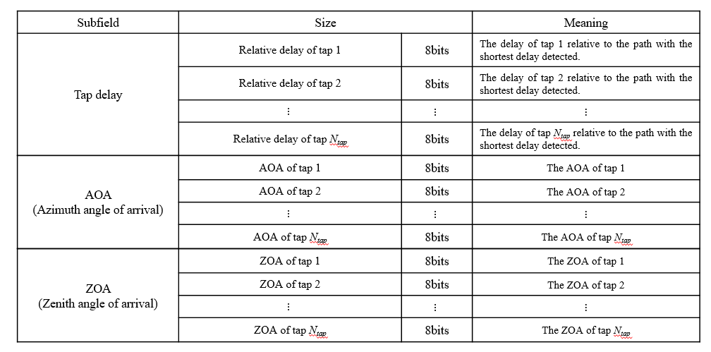
CIR Feedback Report (Recap)
The CIR feedback format in [1] is composed of 4 subfields: tap amplitude, tap delay, AOA and ZOA
The time and spatial correlation is not considered to reduce the CIR overhead

Slide 8
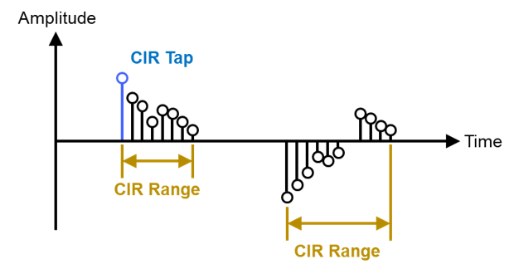
CIR Feedback Report (Recap)
The CIR feedback format in [2] considers multiple CIR ranges
  Within each CIR range, the CIR feedback format contains either I/Q component pairs for each tap with variable field length or delay velocity pairs
  The variable field length for I/Q components indicates different accuracy levels
A window of fixed duration for the CIR measurement report is recommended in [3]

Slide 9
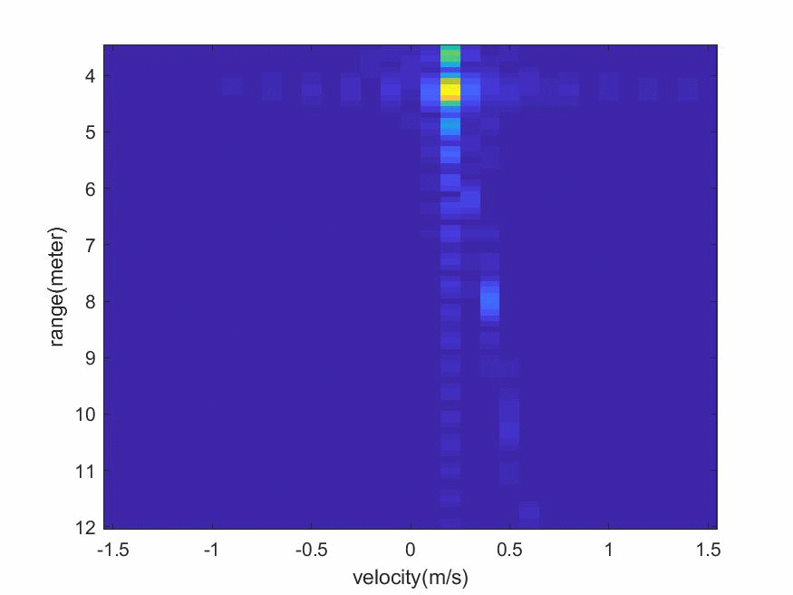
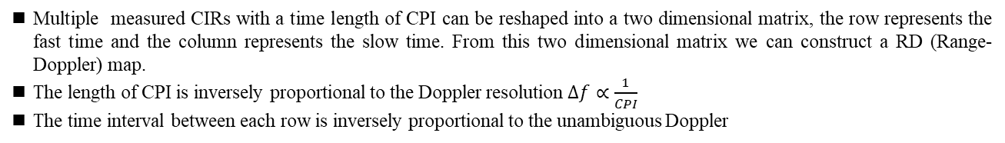
Sensing CIR Feedback Procedure
Pulse 0
Pulse 1
Pulse 2
Pulse 3
Pulse K
…
CIR0
CIR1
CIR2
CIR3
…
CIR_{K}
reshape
CPI (coherent processing interval)
Fast time
1 | 2 | 3 | 4 | 5 | 6 | … | M
Signal processing
RD map
Slow time
Multiple measured CIRs with a time length of CPI can be reshaped into a two dimensional matrix, the row represents the fast time and the column represents the slow time. From this two dimensional matrix we can construct a RD (Range-Doppler) map.
The length of CPI is inversely proportional to the Doppler resolution $Δf∝\frac{1}{CPI}$
The time interval between each row is inversely proportional to the unambiguous Doppler

Slide 10
Sensing CIR Feedback Procedure
A sensing block consists of a whole number of sensing rounds
A sensing round is a period of sufficient duration to complete one entire Range-Doppler map and corresponds to one CPI (coherent processing interval)
Each sensing round is divided into an integer number of sensing slots, where a sensing slot is a time period for the transmission of at least one sensing packet
One sensing slot contains at least one snapshot, which is a block of samples corresponding to a sensing packet

Slide 11
Sensing CIR Feedback Procedure
A sensing round (equivalent to a CPI) is divided into three phases
  Sensing control phase: The first slot of a sensing round in which the controller sends a control message to configure sensing parameters
  sensing phase: A phase in which the initiator(s) sends sensing packets to the responder(s)
  Measurement report phase: A phase in which participating responder(s) feedback the sensing CIR to the initiator(s). The sensing CIR could be reported by a narrow band transmission.

Slide 12
Sensing CIR Feedback Procedure
Taps clustering
  All the taps included in one sensing round could be clustered
  The clustering method is implementation specific, e.g., dynamic range based clustering, K-mean, DBSCAN
CIR reference information
  Within each cluster, a tap is selected as the reference tap. The selection method is implementation specific. The parameter set of all reference taps form the CIR reference information
CIR difference information
  The parameter difference between a reference tap and other taps within each cluster form the CIR difference information
Reduction of CIR feedback overhead is achieved by
  Decreasing the amount of CIR reference information
  Expressing the CIR difference information with less bits

Slide 13
Sensing CIR Feedback Procedure
Approach 1a: Group all the taps in a sensing round based on different I/Q component amplitude ranges into one cluster. Select the tap with the median I/Q component amplitude as the CIR reference information within each cluster
Challenges
  Needs careful selection of the I/Q component amplitude ranges
    Large ranges lead to less room to compress the CIR parameters
    Small ranges lead to increasing clustering complexity
  Disorder taps arrangement
    This requires the indication of delay offsets and snapshot ID, which reduces the advantage of the compression of CIR difference information

Slide 14
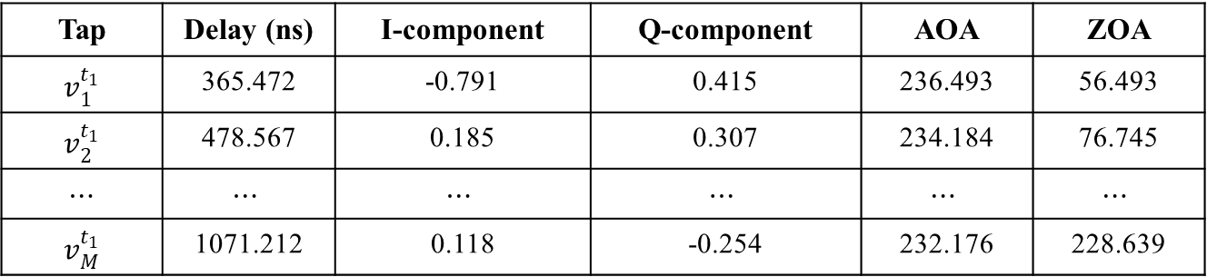
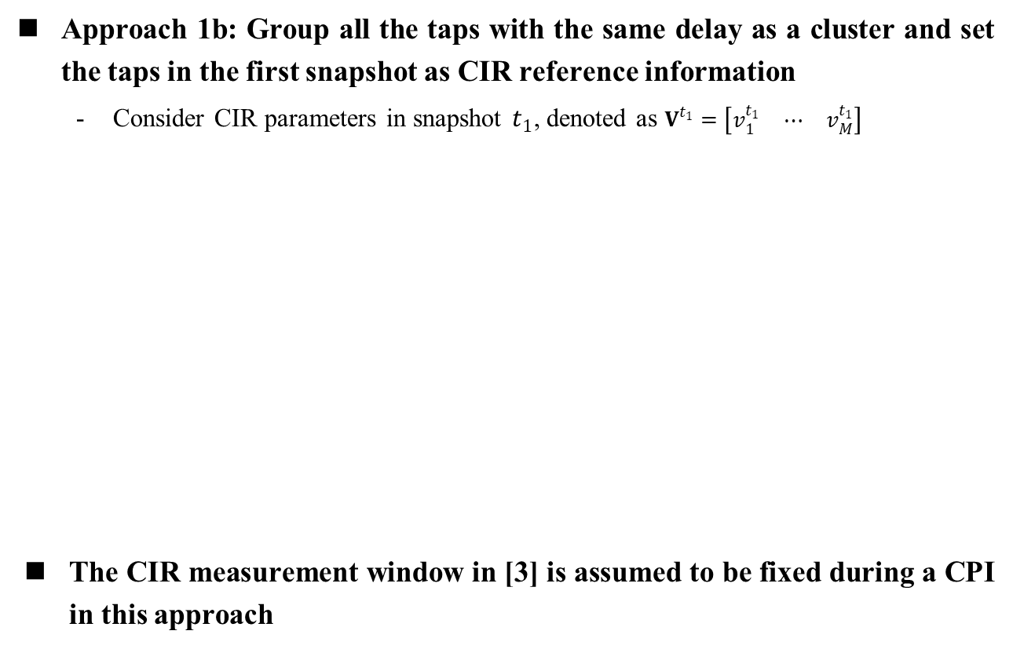


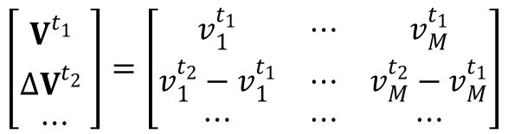
Sensing CIR Feedback Procedure
Approach 1b: Group all the taps with the same delay as a cluster and set the taps in the first snapshot as CIR reference information
  Consider CIR parameters in snapshot $t_{1}$, denoted as $V^{t_{1}}=\left[\begin{matrix}v_{1}^{t_{1}} & ⋯ & v_{M}^{t_{1}}\end{matrix}\right]$
The CIR measurement window in [3] is assumed to be fixed during a CPI in this approach
Tap | Delay (ns) | I-component | Q-component | AOA | ZOA
$$v_{1}^{t_{1}}$$ | 365.472 | -0.791 | 0.415 | 236.493 | 56.493
$$v_{2}^{t_{1}}$$ | 478.567 | 0.185 | 0.307 | 234.184 | 76.745
$$⋯$$ | $$⋯$$ | $$⋯$$ | $$⋯$$ | $$⋯$$ | $$⋯$$
$$v_{M}^{t_{1}}$$ | 1071.212 | 0.118 | -0.254 | 232.176 | 228.639
$$\left[\begin{matrix}V^{t_{1}^{}} \\ ∆V^{t_{2}^{}} \\ ⋯\end{matrix}\right]=\left[\begin{matrix}v_{1}^{t_{1}} & ⋯ & v_{M}^{t_{1}} \\ v_{1}^{t_{2}}−v_{1}^{t_{1}} & ⋯ & v_{M}^{t_{2}}−v_{M}^{t_{1}} \\ ⋯ & ⋯ & ⋯\end{matrix}\right]$$
$$→$$
CIR reference information
$$→$$
CIR difference information

Slide 15
Sensing CIR Feedback Procedure
CIR Update Indicator field
  Transmitted in the sensing control phase to indicate the presence and content of the measurement report phase
  If target is moving fast, the CIR reference information could be updated frequently
  If target is moving slowly, the CIR reference information could be stored for a longer period
CIR Update Indicator field value b1 b0 | Description
00 | CIR difference information only
01 | Both CIR reference information and CIR difference information
10 | No CIR feedback in this sensing round
11 | Reserved

Slide 16
Sensing CIR Feedback Procedure
CIR Feedback field
  Transmitted in the measurement report phase
  Snapshot Number: the number of snapshots contained in this CIR feedback packet
  AOA and ZOA Present: 1 indicates the presence of AOA and ZOA in the CIR Information field, or not present when 0
  Compression Mode: 1 indicates that compression is used, or not used when 0
  CIR Reference Information Present: 1 indicates the presence of CIR reference information in the CIR Information field, or not present when 0
Bits: 0-7 | 8-10 | 11 | 12 | 13 | 14-15 | Octets: variable
Snapshot Number | Receiver Antenna Number | AOA and ZOA Present | Compression Mode | CIR Reference Information Present | Reserved | CIR Information

Slide 17
Sensing CIR Feedback Procedure
CIR Information field contains CIR reference information and CIR difference information
  When Compression Mode is 0, the report format in [1] could be used
  When Compression Mode is 1, less bits are used by the CIR difference information to reduce the overhead of the CIR information field, taking the following table as an example
 | CIR Reference Information Size (Bits) |  | CIR Difference Information Size (Bits) |  | Description
Tap | I-Component | 16 | I-Component Difference | 12 | Signed integer, scaled to pre-agreed level
 | Q-Component | 16 | Q-Component Difference | 12
 | Delay | 8 | Delay Difference | 6
 | AOA | 8 | AOA Difference | 6
 | ZOA | 8 | ZOA Difference | 6

Slide 18
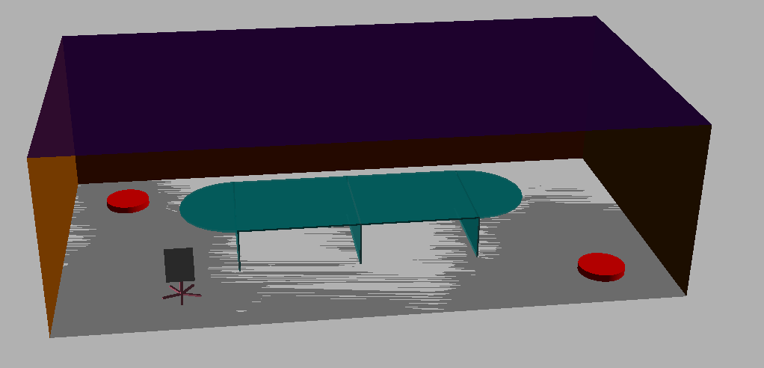
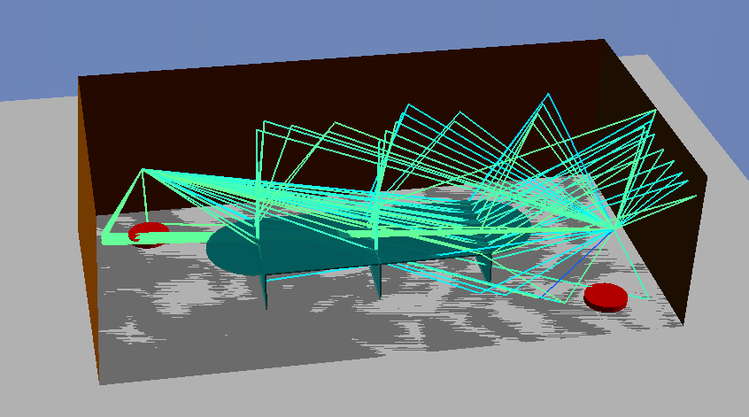
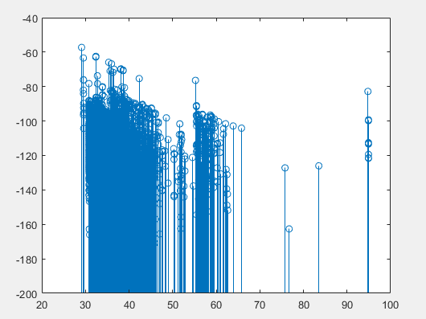

Simulation – Meeting Room
Meeting room size: 10m×5.5m×3m
TX position: [1, 4.5, 1.5] m
RX position: [9, 1, 1.5] m
Target position: [2, 1]m
Target type: chair
Target moving direction: [1, 0, 0] m
Frequency: 8 GHz
Moving speed: 1m/s
TX
RX
Moving direction
TX
RX
Most of the rays are static, only target-related rays are changing continuously over time
We can compress the CIR in time domain to reduce the CIR transmission overhead

Slide 19

Simulation – Meeting Room
$d_{spread}$: 0~30m
Sampling rate: 499.2 MHz
Snapshot number in the sensing phase: 20 (1 is used for CIR reference information)
Dynamic range: > 100dB
Approach 1b is utilized
Compression can reduce the overhead without degrading the quantization accuracy
Quantization accuracy is not sensitive to the number of snapshots within a sensing round

Slide 20
Simulation – Meeting Room
50 taps at chip rate can cover sensing range spread close to 30m per snapshot
For simplicity, we assume 16 bits for each I/Q when there is no compression
Scheme 1 (similar maximum quantization error as the no compression case): 16 bits for CIR reference I/Q, 12 bits for CIR difference I/Q
Scheme 2 (maximum quantization error is about 1e-5 but larger than the no compression case): 16 bits for CIR reference I/Q, 8 bits for CIR difference I/Q
 | Feedback Size Per tap (Bytes) |  | Feedback Size of 10 Snapshots (Bytes) |  | Feedback Size of 20 Snapshots (Bytes)
No Compression | 4 |  | 2000 |  | 4000
Scheme 1 | Reference Info. Size | Difference Info. Size | Size | Compression ratio | Size | Compression Ratio
 | 4 | 3 | 1550 | 0.775 | 3050 | 0.7625
Scheme 2 | Reference Info. Size | Difference Info. Size | Size | Compression ratio | Size | Compression Ratio
 | 4 | 2 | 1100 | 0.55 | 2100 | 0.525

Slide 21
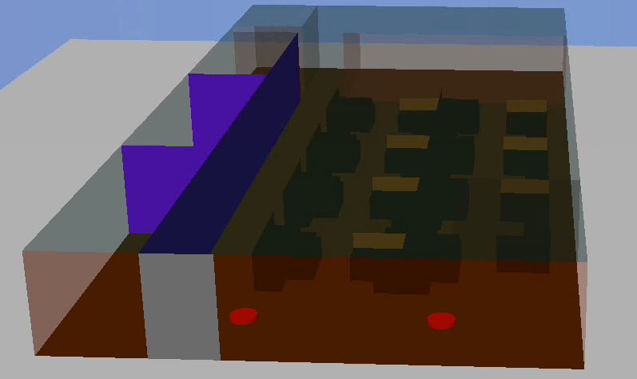
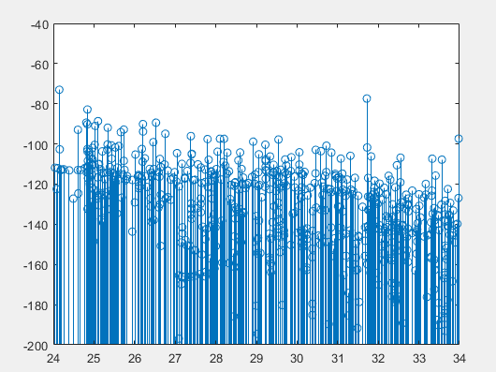
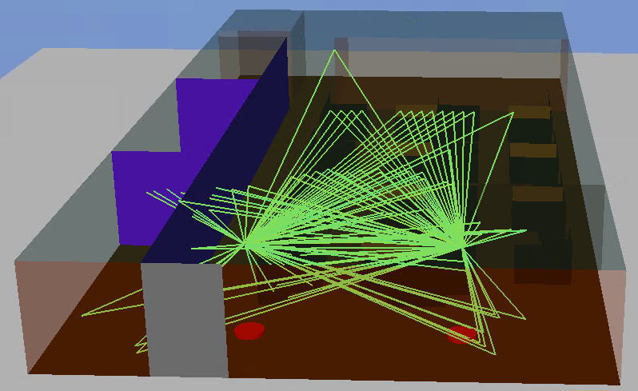
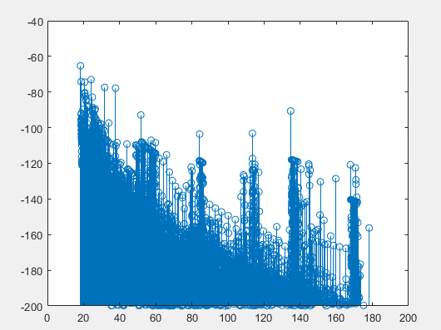
Simulation – Office Room
Office room size: 30m×15m×3m
TX position: [20, 7.5, 2.5] m
RX position: [20, 2, 2.5] m
Target position: [21, 5.5]m
Target type: chair
Target moving direction: [0, -1, 0] m
Frequency: 8 GHz
Moving speed: 1m/s
RX
TX
Moving direction
Moving direction
TX
RX
Most of the rays are static, only target-related rays are changing continuously over time
We can compress the CIR in time domain to reduce the CIR transmission overhead

Slide 22

Simulation – Office Room
$d_{spread}$: 0~60m
Sampling rate: 499.2 MHz
Snapshot number in the sensing phase: 20 (1 is used for CIR reference information)
Dynamic range: 100dB
Approach 1b is utilized
Compression can reduce the overhead without degrading the quantization accuracy
Quantization accuracy is not sensitive to the number of snapshot within a sensing round
Similar compression ratio can be achieved as the meeting room scenario

Slide 23
Summary
In this presentation, some aspects of CIR feedback in UWB sensing are introduced:
  According to the sensing signal processing procedure and the existing ranging procedure in 802.15.4z, we established a sensing procedure
  The CIR can be divided into CIR reference information and CIR difference information to reduce the CIR feedback overhead, approach 1b is recommended
  The simulation results show that the proposed scheme provides a good balance between the quantization accuracy and the CIR feedback overhead

Slide 24
References
Xiaohui Peng, David Xun Yang, Chenchen Liu, Rani Keren, Kuan Wu, “CIR feedback for UWB sensing,” IEEE 802.15-21/570r0, November 2021.
Frank Leong, Wolfgang Kuchler, and Riku pirhonen, “Sensing - Continued”, IEEE 802.15-22-0061-00-4ab, January 2022.
Pooria Pakrooh, Bin Tian, Steve Shellhammer and Koorosh Akhavan, “Link budget analysis and CIR reporting for UWB RF sensing”, IEEE 802.15-22-0066-02-04ab, January 2022.

