Slide 1
PHY Layer Design Considerations for ieee802.16t March 07-2022

Slide 2
Key SRD PHY Layer Requirements
Support operation in paired and unpaired continuous/non continuous licensed bands:
Paired spectrum example: AAR- 900 MHz
Paired spectrum with small separation example: AMTS band
Unpaired spectrum example: AAR-160 MHz
Non continuous spectrum example: ATCS band
Support partition of continuous licensed bands into multiple channels:
Partitioning of the bands between multiple organizations
Smooth migration of legacy deployments
Frequency reuse
Link budget/coverage considerations
Support operation in Private Land Mobile Radio (PLMR) bands (e.g., RR160 MHz) is required. This includes:
Support of common PLMR channel bandwidth: 6.25, 12.5, 25 and 50 kHz
Support special PLMR channel bandwidth: 5, 7.5 and 15 kHz
Support aggregation of multiple adjacent and non-adjacent PLMR channels to enable higher throughput services.
The specification will support simultaneous remote operation over one or more aggregated (adjacent or non-adjacent) subchannels of bandwidth as low as 5 kHz.
The specification will support base station operation over any one or more sub-channels. The base station may support aggregation of multiple subchannels such that the total bandwidth in the sector is not limited to 100 KHz.

Slide 3
Partitioning of a Non-Continuous Channel into Continuous Sub-Channel Groups

Slide 4
Partitioning of a Non-Continuous Channel into Continuous and Non-Continuous Sub-Channel Groups

Slide 5
Partitioning of a Continuous Channel

Slide 6
Peak to Average Power Ratio (PAPR) Analysis

Slide 7
Peak to Average Power Ratio (PAPR)
.
PAPR is the ratio of peak power to the average power of a signal. The signal average power and peak power are measured over a window and the ratio is expressed in units of dB.
Where E{|s|^2} denotes the mean value.

Slide 8
PAPR Computation
Generate the time domain signal by populating the appropriate subcarriers, followed by IFFT(Inverse Fast Fourier Transform) and CP(Cyclic Prefix) addition for a total of 10 slots. 1 slot corresponds to 6 symbols for OFDM (as per ieee802.16s AMC 1X6) and 54 symbols for an alternative single carrier system.
Obtain the PAPR of the above generated signal using the formula:
The above two steps are repeated for a total of 1000 iterations and the PAPR value corresponding to each iteration is stored.
From the 1000 PAPR values, generate the Complementary Cumulative Distribution Function (CCDF) plot.
Note the PAPR value (say x) at which the CCDF takes the value of 0.01. This means 1% of the time or 10 out of the 1000 obtained PAPR values (corresponding to each iteration) is greater than the value x.
This probabilistic value x is considered as the final PAPR.

Slide 9
High PAPR Impact
The Power Amplifier (PA) should maintain linearity at the peak power value, i.e., the PA is selected based on peak TX power. When the PAPR is high, the efficiency of the PA at the average power is low.
The maximum pathloss that can be accommodated by the link is determined by the average power. As such, the maximum pathloss/range is reduced by PAPR. The higher the PAPR, the lower the maximum pathloss.
In the received path, the received signal gain is adjusted to occupy the maximum range of the ADC. The ADC needs to accommodate the signal peaks and as a result, when the PAPR is high, the average bit resolution for a given ADC is lower. This results in higher quantization noise.
Similarly on the TX side, the DAC average bit resolution is lower and as a result, the ACLR performance is lower.

Slide 10
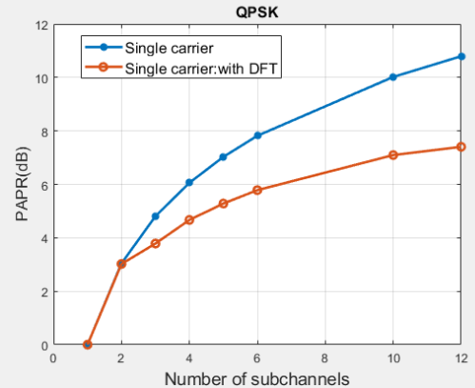
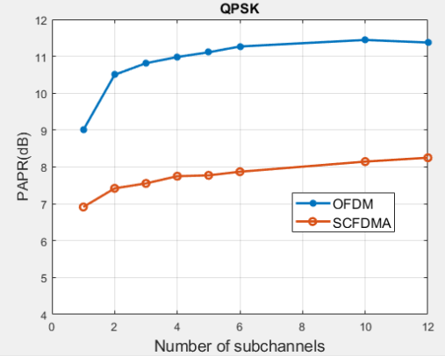
PAPR vs Number of Subchannels : QPSK
Single carrier : 1 subchannel corresponds to 1 subcarrier
OFDM and SCFDMA : 1 subchannel corresponds to 9 subcarriers

Slide 11
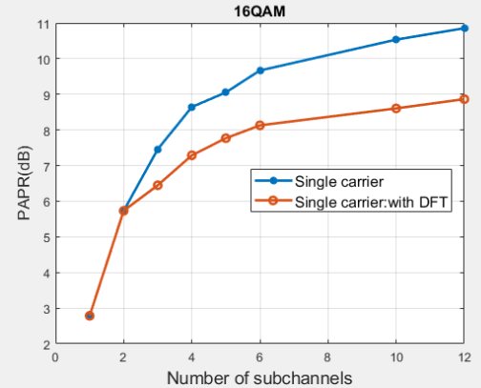
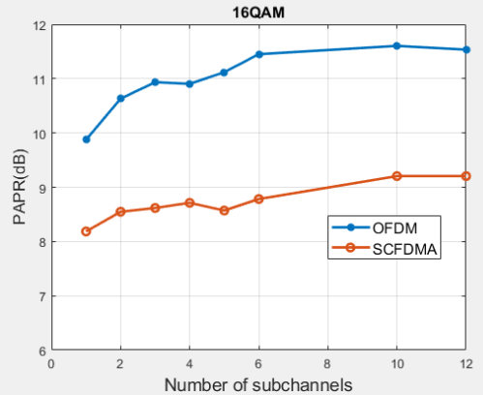
PAPR vs Number of Subchannels : 16QAM
Single carrier : 1 subchannel corresponds to 1 subcarrier
OFDM and SCFDMA : 1 subchannel corresponds to 9 subcarriers

Slide 12
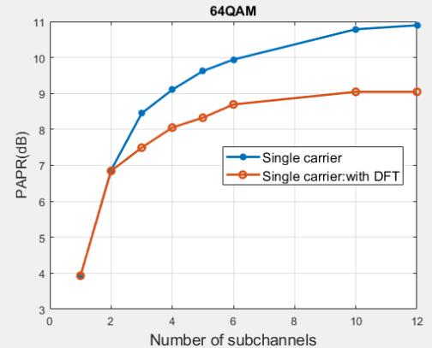
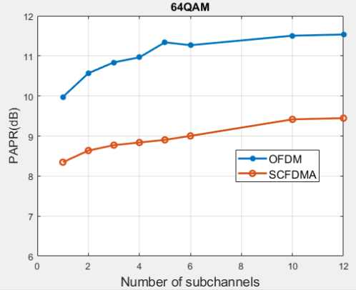
PAPR vs Number of Subchannels : 64QAM
Single carrier : 1 subchannel corresponds to 1 subcarrier
OFDM and SCFDMA : 1 subchannel corresponds to 9 subcarriers

Slide 13
In Band Rejection (IBR) Filter

Slide 14
IBR Filter
In a non adjacent channel scenario, the received signal passband consists of the in-band wanted active channels and in band interferers which cannot be filtered out by the RF front end.
The IBR is an arbitrary frequency response FIR filter used to attenuate the in-band interferers.
The frequency response of the filter is derived from the active subchannels bitmap in the radio configuration.
The flexibility of the filter allows to operate with any combination of the subchannels.
IBR filter performance goal: ACR/in-band blocker > 60 dB @ 16 bit ADC

Slide 15
IBR Filter Example for 12 Subchannels (Alternate Active Sub-Channels
Red – Blocked subchannel
White – Active subchannel

Slide 16
In-Band Rejection Filter

Slide 17
Non-Adjacent Channel Aggregation Schemes
Divide an entire band into equal bandwidth sub-channels (as per SDD)
The subchannels are orthogonal/they don’t interfere with each other
Simple OFDM based DL and UL implementation
No frequency gap needed between subchannels
An In Band Rejection (IBR) filter can be used
It is desirable to minimize the number of subcarriers in order to minimize PAPR. When multiple subchannels are aggregated, the PAPR will be reduced if a single subcarrier is used. This leads to consider the following modified scheme.
Partition an entire band into multiple (non equal) bandwidth subchannels. All subchannel bandwidths used have an integer multiple relationship
The motivation for this scheme is to reduce the number of subcarriers per subchannel group to minimize PAPR.
No subchannel orthogonality. Interference between active subchannels is reduced as the gap between the sub-channels increases.
Receiver processing increases as it needs to perform multiple FFTs based on number of different bandwidths used.
The integer multiple relationship allows for the use of the IBR filter.

Slide 18
Degradation of Orthogonality when using Non-Equal Bandwidth Subchannels

Slide 19
Orthogonality Degradation With Two Channel Bandwidths
Δf2 = 3*Δf1

Slide 20
Two Subcarrier Spacing, 12.5 kHz and 25 kHz : Scenario # 1
16
15
14
13
12
11
10
9
8
7
6
5
4
3
2
1
8
7
6
5
4
3
2
1
Frequency
Frequency
12.5 kHz
Subcarrier spacing each
25 kHz
Subcarrier spacing each
Used
subcarrier
available
subcarrier
guard
subcarrier
Symbol duration = 1/12.5k​
16 pt IFFT, 2 samples CP​
Symbols
Symbol duration = 1/25k​
8 pt IFFT, 1 sample CP​
Symbols

Slide 21
WAVEFORM GENERATION FOR DIFFERENT SUBCARRIER SPACINGS (SCS)
QPSK MOD SYMBOLS
MAPPING TO RESOURCE GRID 12.5 kHz SCS
FORM 1 SUBFRAME WORTH SAMPLES
USER 1 DATA
12.5 kHz SCS
16 POINT IFFT AND 2 SAMPLES CP
Tx WAVE
QPSK MOD SYMBOLS
MAPPING TO RESOURCE GRID 25 kHz SCS
8 POINT IFFT AND 1 SAMPLE CP
FORM 1 SUBFRAME WORTH SAMPLES
USER 2 DATA
25 kHz SCS
* Note : While mapping to resource grid, the occupied 12.5 kHz and 25 kHz subcarriers should not overlap in frequency domain

Slide 22
Matlab Simulation for Mixed 12.5 KHz and 25 KHz Channel bandwidth – Scenario #1
Subcarrier spacing:
Two subcarrier spacing of 12.5 KHz and 25 KHz
The subcarriers do not overlap in the frequency domain as shown in slide 11
The TX time domain waveform is generated as per the block diagram in slide 12
A total of 16 subchannels of which the central 12 can be occupied and the rest of them are guard are considered for the 12.5 kHz subcarrier spacing
A total of 8 subchannels of which the central 6 can be populated and the rest of them are guard are considered for the 25 kHz subcarrier spacing.
The waveform is demodulated and the EVM of the received constellation is calculated.
The decoded bits are also compared against the TX bits.

Slide 23
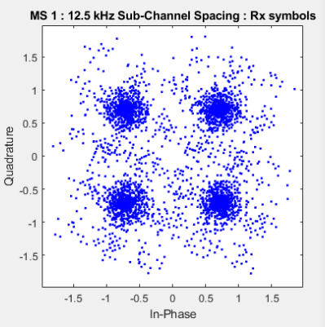
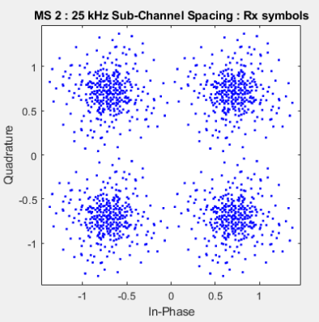
CASE 1 : No Guard Band Between the Two Sub-Channel Spacing
12.5 kHz SCS : Total 16 subchannels : 3 to 8 occupied
EVM : 31.96 % (-9.90 dB), 1.25% bits in error
25 kHz SCS : Total 8 subchannels : 5 to 7 occupied
EVM : 31.29 % (-9.81 dB), Bits decoded correctly

Slide 24
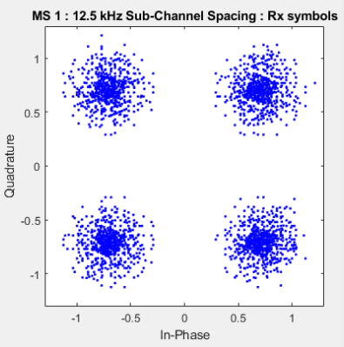
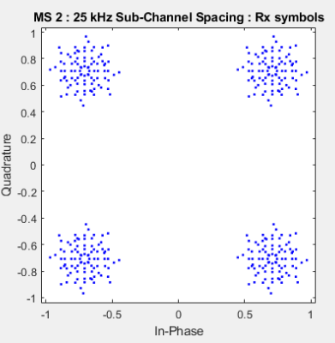
CASE 2 : 1 subchannel of 12.5 kHz as guard band
12.5 kHz SCS : Total 16 subchannels : 3 to 7 occupied
EVM : 19.07 % (-14.39 dB)
Bits decoded correctly
25 kHz SCS : Total 8 subchannels : 4 to 6 occupied
EVM : 15.42 % (-16.23 dB)
Bits decoded correctly

Slide 25
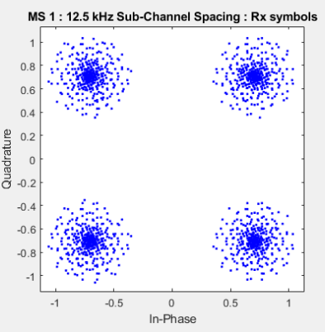
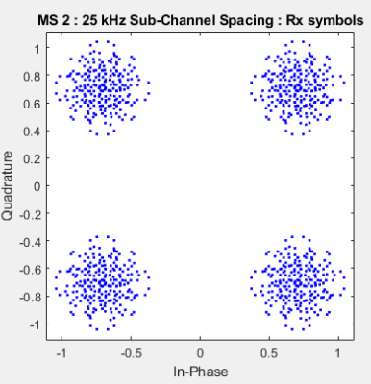
CASE 3 : 1 subchannel of 25 kHz as guard band
12.5 kHz SCS : Total 16 subchannels : 3 to 8 occupied
EVM : 15.42% (-16.23 dB)
Bits decoded correctly
25 kHz SCS : Total 8 subchannels : 6 to 7 occupied
EVM : 18.95% (-14.44 dB)
Bits decoded correctly

Slide 26
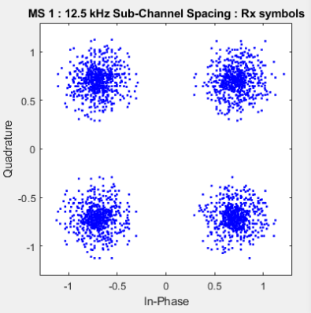
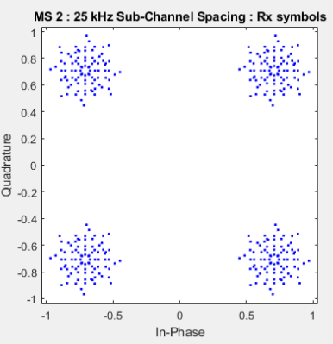
CASE 4 : 2 subchannels of 12.5 kHz as guard band
12.5 kHz SCS : Total 16 subchannels : 3 to 6 occupied
EVM : 18.74% (-14.55 dB)
Bits decoded correctly
25 kHz SCS : Total 8 subchannels : 5 to 7 occupied
EVM : 15.54% (-16.17 dB)
Bits decoded correctly

Slide 27
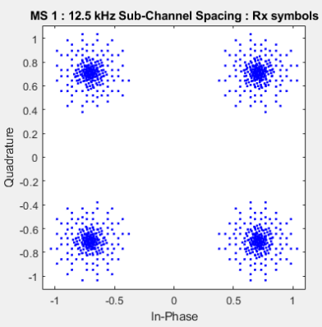
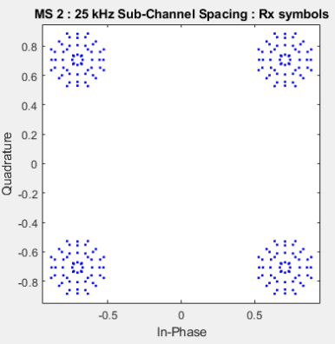
CASE 5 : 2 subchannels of 12.5 kHz and 1 subchannel of 25 kHz as guard band
12.5 kHz SCS : Total 16 subchannels : 3 to 6 occupied
EVM : 13.29% (-17.53 dB)
Bits decoded correctly
25 kHz SCS : Total 8 subchannels : 6 to 7 occupied
EVM : 13.37% (-17.47 dB)
Bits decoded correctly

Slide 28
Two Subcarrier Spacing, 12.5 kHz and 25 kHz : Scenario # 2
256
:
226
225
224
223
:
:
:
:
34
33
32
:
2
1
128:
113
112
:
:
17
16 :
1
Frequency
Frequency
12.5 kHz
Subcarrier spacing each
25 kHz
Subcarrier spacing each
Occupied
subcarrier
guard
subcarrier
Symbol duration = 1/12.5k​
256 pt IFFT, 32 samples CP​
Symbol duration = 1/25k​
128 pt IFFT, 16 samples CP​
Symbols
Symbols

Slide 29
Matlab Simulation for Mixed 12.5 KHz and 25 KHz Channel bandwidth – Scenario #2
Subcarrier spacing:
Two subcarrier spacing of 12.5 KHz and 25 KHz
The subcarriers do not overlap in the frequency domain
The TX time domain waveform is generated as per the block diagram in the slide 12
A total of 256 subchannels for the 12.5 kHz subcarrier spacing as shown in slide 20.
A total of 128 subchannels for the 25 kHz subcarrier spacing as shown in slide 20.
The waveform is demodulated and the EVM of the received constellation is calculated.
The decoded bits are also compared against the TX bits.

Slide 30
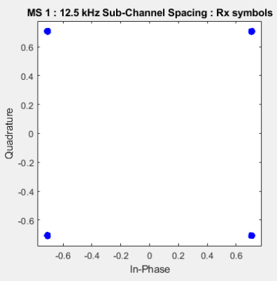
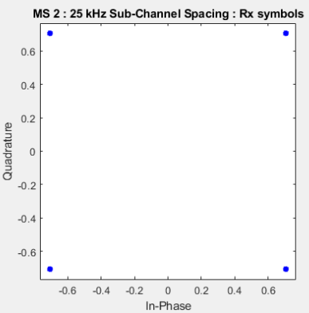
CASE 1 : large guard band ( 105 subchannels of 12.5 kHz SCS) : without noise
12.5 kHz SCS : Total 256 subchannels : 20 to 23 occupied , EVM : 0.88% (-41.15 dB)
Bits decoded correctly
25 kHz SCS : Total 128 subchannels : 65 to 66 occupied
EVM : 0.78% (-42.10 dB)
Bits decoded correctly

Slide 31
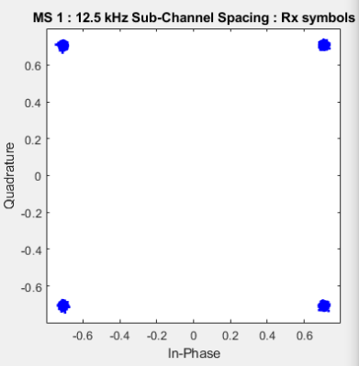
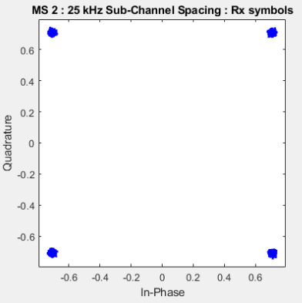
CASE 1 : large guard band ( 105 subchannels of 12.5 kHz SCS) : 40 dB Tx vector SNR
12.5 kHz SCS : Total 256 subchannels : 20 to 23 occupied , EVM : 1.32% (-37.57 dB), SNR : 37.57 dB
Bits decoded correctly
25 kHz SCS : Total 128 subchannels : 65 to 66 occupied
EVM : 1.25%(-38.04 dB), SNR : 38.04 dB
Bits decoded correctly

Slide 32
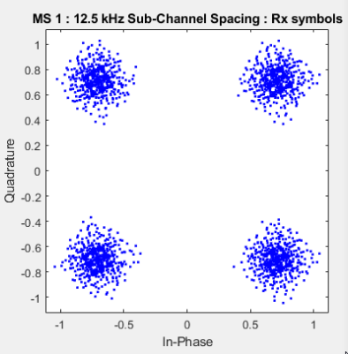
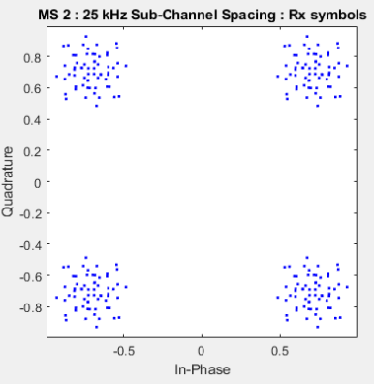
CASE 2 : Small Guard Band (3 subchannels of 12.5 kHz SCS) : without noise
12.5 kHz SCS : Total 256 subchannels : 123 to 126 occupied , EVM : 14.32% (-16.87 dB)
Bits decoded correctly
25 kHz SCS : Total 128 subchannels : 65 to 66 occupied
EVM : 14.69% (-16.66 dB)
Bits decoded correctly

Slide 33
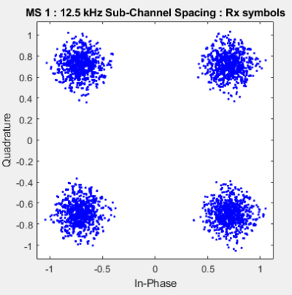
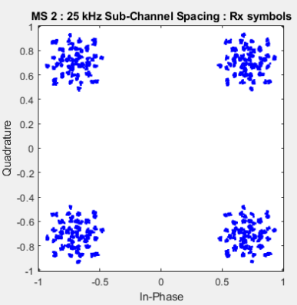
CASE 2 : BANDWIDTH PARTS : small guard band (3 subchannels of 12.5 kHz SCS) : 40 dB Tx vector SNR
12.5 kHz SCS : Total 256 subchannels : 123 to 126 occupied , EVM : 14.35% (-16.86 dB), SNR : 16.87 dB
Bits decoded correctly
25 kHz SCS : Total 128 subchannels : 65 to 66 occupied
EVM : 14.72%(-16.64), SNR : 16.66 dB
Bits decoded correctly

Slide 34
Matlab Simulation for Two Channel Bandwidths (12.5 KHz and 25 KHz) with IBR
Two subcarrier spacings of 12.5 kHz and 25 kHz are considered and the subcarriers are populated such that they do not overlap in the frequency domain.
Tx time domain waveform is generated
An IBR filter is applied to the Tx waveform corresponding to each of the subcarrier spacing, before adding them to generate the final waveform.
The waveform is demodulated and the EVM of the received constellation is calculated.
The decoded bits are also compared against the TX bits.

Slide 35
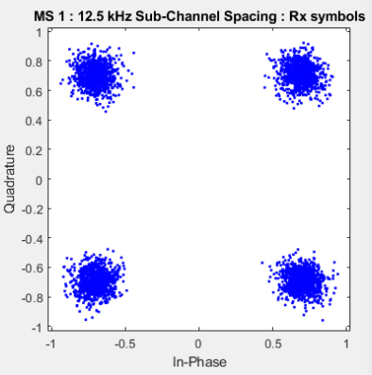
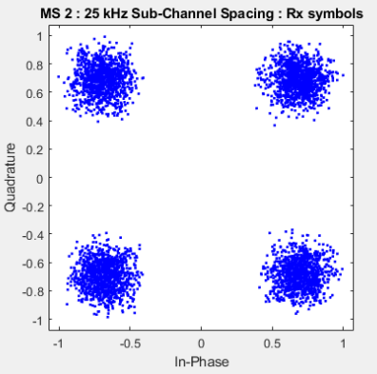
Small Guard Band (3 Subchannels of 12.5 kHz SCS) with IBR filter: without noise
12.5 kHz SCS: Total 256 subchannels, 123 to 126occupied EVM: 9.93% (-20.06 dB), bits decoded correctly
25 kHz SCS: Total 128 subchannels, 65 to 66 occupied
EVM: 14.75% (-16.62 dB), bits decoded correctly

Slide 36
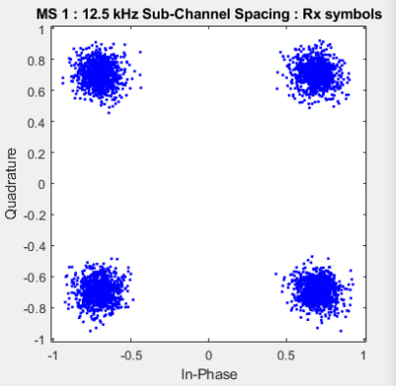
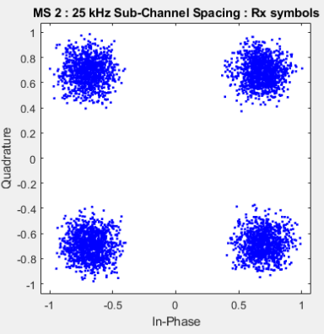
Small guard band (3 subchannels of 12.5 kHz SCS) with IBR filter : 40 dB Tx vector SNR
12.5 kHz SCS: Total 256 subchannels, 123 to 126 occupied
EVM: 9.97% (-20.02 dB), SNR: 19.91 dB, bits decoded correctly
25 kHz SCS: Total 128 subchannels, 65 to 66 occupied
EVM: 14.79% (-16.60 dB), SNR: 16.36 dB, bits decoded correctly

Slide 37
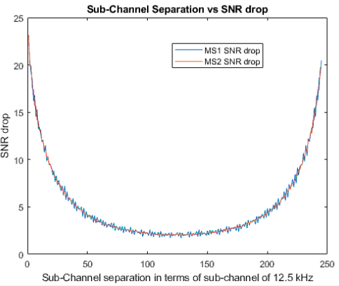
SNR Drop vs Guard Band for Two Bandwidths (12.5 KHz & 25 KHz) Without IBR
40 dB Tx vector SNR
MS1 : 12.5 kHz subcarrier spacing
: 256 subchannels
MS2 : 25 kHz subcarrier spacing
: 128 subchannels
MS2 is fixed to the left most subchannels (2,3) and the allocation of MS1 is varied starting from (8:11) to the rightmost subchannels

Slide 38
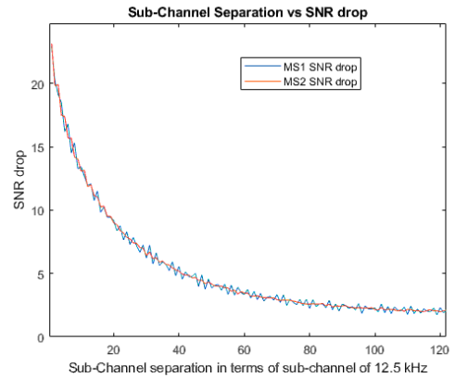
SNR Separation VS Guard Band (zoomed in figure of previous slide)
40 dB Tx vector SNR
MS1 : 12.5 kHz subcarrier spacing
: 256 subchannels
MS2 : 25 kHz subcarrier spacing
: 128 subchannels
MS2 is fixed to the left most subchannels (2,3) and the allocation of MS1 is varied starting from (8:11) to the rightmost subchannel

