Slide 1
Project: IEEE P802.15 Working Group for Wireless Specialty Networks (WSN)
Submission Title: TG 15.4ab Agenda and Meeting Slides
Date Submitted: February 8th, 2022
Source: Benjamin A. Rolfe (Blind Creek Associates)
Contact:
Voice: +1 408 395 7207, E-Mail: ben.rolfe @ ieee.org
Re: Task Group 4ab: 802.15.4 UWB Next Generation
Abstract: Teleconference (WebEx) Agenda and Meeting Slides
Purpose: Emulate organization, encourage participation and make further progress
Notice: This document has been prepared to assist the IEEE P802.15. It is offered as a basis for discussion and is not binding on the contributing individual(s) or organization(s). The material in this document is subject to change in form and content after further study. The contributor(s) reserve(s) the right to add, amend or withdraw material contained herein.
Release: The contributor acknowledges and accepts that this contribution becomes the property of IEEE and may be made publicly available by P802.15.
Notes:
Jul 12, 2010
Page 1

Slide 2
Task Group 15.4ab Next Generation UWB Amendment
Teleconference / Virtual Meeting
February 8th, 2022

Slide 3
Task Group Rules
Discussion: Everyone present is welcome
Straw polls: Everyone present may vote
Formal motions: WG voters
To make, second and vote
Patent policy for PAR activities applies
All the usual rules of conduct
Please identify yourself on first contact with name and affiliation

Slide 4
IEEE-SA Patent, Copyright, and Participation Policies
See: https://grouper.ieee.org/groups/802/sapolicies.shtml
IEEE-SA Patent Slides for Standards Development Meetings (.pdf)
https://development.standards.ieee.org/myproject/Public/mytools/mob/slideset.pdf
IEEE-SA Standards Board Patent Committee (PatCom) home page
https://standards.ieee.org/content/ieee-standards/en/about/sasb/patcom/index.html
IEEE-SA Participation Policy meeting slide set - individual method (.pdf)
https://standards.ieee.org/content/dam/ieee-standards/standards/web/documents/other/Participant-Behavior-Individual-Method.pdf
Working Group Copyright Materials
https://standards.ieee.org/ipr/copyright-materials.html
https://standards.ieee.org/content/dam/ieee-standards/standards/web/documents/other/ieee-sa-copyright-policy-2019.pdf

Slide 5
IEEE 802 Ground Rules
Respect … give it, get it
NO product pitches
NO corporate pitches
NO prices
NO restrictive notices – (no confidentially notices in email)
Presentations must be openly available

Slide 6
Proposed Agenda
Opening and meet ing preamble
Recap and Reminders
TGD Presentation Table
Technical discussions from January
Discussion on link budgets
Sensing discussion
Other deferred discussions
Next steps
Any other Business

Slide 7
Recap

Slide 8
5.2.b Scope of the project (As approved):
This amendment enhances the Ultra Wideband (UWB) physical layers (PHYs) medium access control (MAC), and associated ranging techniques while retaining backward compatibility with enhanced ranging capable devices (ERDEVs). Areas of enhancement include:
additional coding, preamble and modulation schemes to additional coding, preamble and modulation schemes to support improved link budget and/or reduced air-time relative to IEEE Std 802.15.4 UWB;
additional channels and operating frequencies;
interference mitigation techniques to support greater device density and higher traffic use cases relative to the IEEE Std 802.15.4 UWB;
improvements to accuracy, precision and reliability and interoperability for high-integrity ranging; schemes to reduce complexity and power consumption;
definitions for tightly coupled hybrid operation with narrowband signaling to assist UWB;
enhanced native discovery and connection setup mechanisms;
sensing capabilities to support presence detection and environment mapping;
and mechanisms supporting low-power low-latency streaming as well as high data-rate streaming allowing at least 50 Mb/s of throughput.
Support for peer-to-peer, peer-to-multi-peer, and station-to-infrastructure protocols are in scope, as are infrastructure synchronization mechanisms. This amendment includes safeguards so that the high throughput data use cases do not cause significant disruption to low duty-cycle ranging use cases.
https://development.standards.ieee.org/myproject-web/app#viewpar/9081

Slide 9
Session Summary
Objectives:
Hear technical contributions and develop technical content for TFD
Accomplished via:
Seven (7) Task Group meetings
Two (2) Joint Task Group meetings
TG 4ab+TG14+TG15
TG 4ab+TG14+TG6a

Slide 10
List of Technical Presentations, TG41b
Title | Doc # and Link
TG4ab Presentations by TGD Categories | 15-21-0638-00
Mac Layer Considerations for UWB Data Streaming | 15-22-0047-01
Waveform Design for UWB Sensing | 15-22-0040-04
UWB Sensing Scenarios for 802 15 4ab | 15-22-0012-01
Channel Coding Considerations for 802 15 4ab | 15-22-0050-00
UWB And NB Link Budget Comparison | 15-22-0051-01
Sensing Continued | 15-22-0061-00
Pilot NB Radio for Assisting UWB Channel Access | 15-22-0065-00
Link Budget Analysis and CIR Reporting for UWB RF Sensing | 15-22-0066-00
Potentials of Narrowband Assisted UWB | 15-22-0064-00
The Capacity and Accuracy Optimization for DL-TDoA of UWB | 15-22-0070-00
Proposal For Extending Nb UWB for Secure Ranging | 15-22-0076-00
Link budget analysis for NBA-MMS | 15-22-0074-00
TDMA scheme enabling industrial DL-TDoA and UL-TDoA scenarios | 15-22-0077-00
UWB Sensing Concepts | 15-22-0083-01
Integrity Protection to Support Secure Ranging n IR-UWB | 15-22-0072-00
A method to evaluate the quality of ToF measurement for IR-UWB | 15-22-0073-00
NBA-MMS-UWB MAC Follow-up | 15-22-0080-00
Link budget UWB vs NB | 15-22-0094-01

Slide 11
Joint Meeting Links
Joint Meeting with TG14, TG15 and TG4ab
Title | Doc # and Link
Joint .6a .4ab .14 Meeting Slides Plenary Nov 2021 | 15-21-0596-00
Joint Meeting with TG6a, TG4ab and TG14
Title | Doc # and Link
Dynamic Channel and Environmental Modeling Scheme for BANs on TG15.6a | 15-22-0023-00
Measurement based BAN channel model for XR applications : Part I | 15-22-0062-01
Snapshot of TG4ab PHY topics Jan 2022 | 15-22-0038-01
MAC Bridging for Time-Sensitive Networking of 802.15.6a | 15-22-0024-01

Slide 12
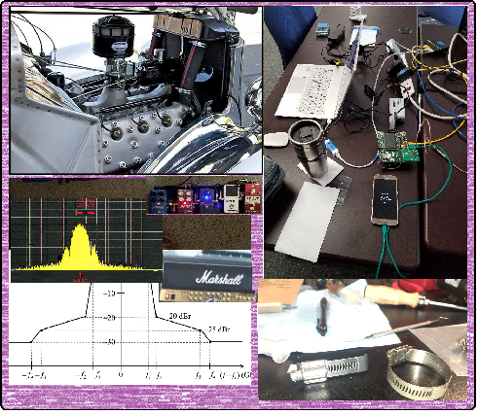
Technical Discussion

Slide 13
Next Steps

Slide 14
Collaboration Potential
Areas for collaboration and convergence based on discussions and presentations:
Sensing
Monostatic and multi-static techniques
Control and Communication
NB-UWB hybrid
PHY selection criteria
Channel plans
MAC support
UWB power saving
Improved integrity mechanisms
Coexistence considerations and mechanisms

Slide 15
Teleconference Schedule
 |  |  | Feb-22
Sun | Mon | Tue | Wed | Thr | Fri | Sat
 |  | 1 | 2 | 3 | 4 | 5
6 | 7 | 8 | 9 | 10 | 11 | 12
13 | 14 | 15 | 16 | 17 | 18 | 19
20 | 21 | 22 | 23 | 24 | 25 | 26
27 | 28
Usual pattern:
Frequency: Bi-weekly
Phase: Tuesday
Time: 09:00 ET (06:00 PT)
Offset: First call Feb 8th^{th}
[skip week following the plenary]
Duration: 1 hour.
Next
 |  |  | Mar-22
Sun | Mon | Tue | Wed | Thr | Fri | Sat
 |  | 1 | 2 | 3 | 4 | 5
6 | 7 | 8 | 9 | 10 | 11 | 12
13 | 14 | 15 | 16 | 17 | 18 | 19
20 | 21 | 22 | 23 | 24 | 25 | 26
27 | 28 | 29 | 30 | 31
March Plenary

Slide 16
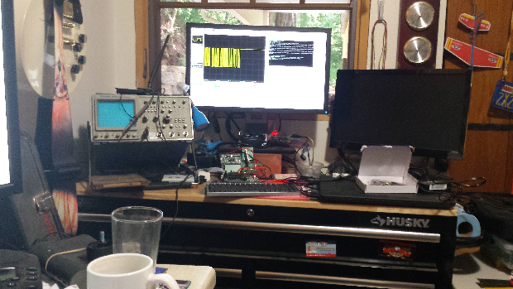
Other Business

Slide 17
Adjourned Thanks

