Slide 1
Project: IEEE P802.15 Working Group for Wireless Specialty Networks (WSN)
Submission Title: Task Group 15.4ab January Closing Report
Date Submitted: January 25, 2021
Source: Benjamin A. Rolfe (Blind Creek Associates)
Contact:
Voice: +1 408 395 7207, E-Mail: ben.rolfe @ ieee.org
Re: Task Group 4ab: UWB Next Generation for 802.15.4
Abstract: Task Group 15.4ab January Interim Session Closing Report
Purpose: Report project progress to the working group
Notice: This document has been prepared to assist the IEEE P802.15. It is offered as a basis for discussion and is not binding on the contributing individual(s) or organization(s). The material in this document is subject to change in form and content after further study. The contributor(s) reserve(s) the right to add, amend or withdraw material contained herein.
Release: The contributor acknowledges and accepts that this contribution becomes the property of IEEE and may be made publicly available by P802.15.
Notes:
Jul 12, 2010
Page 1

Slide 2
Task Group 15.4ab Next Generation UWB Amendment
Closing Report

Slide 3
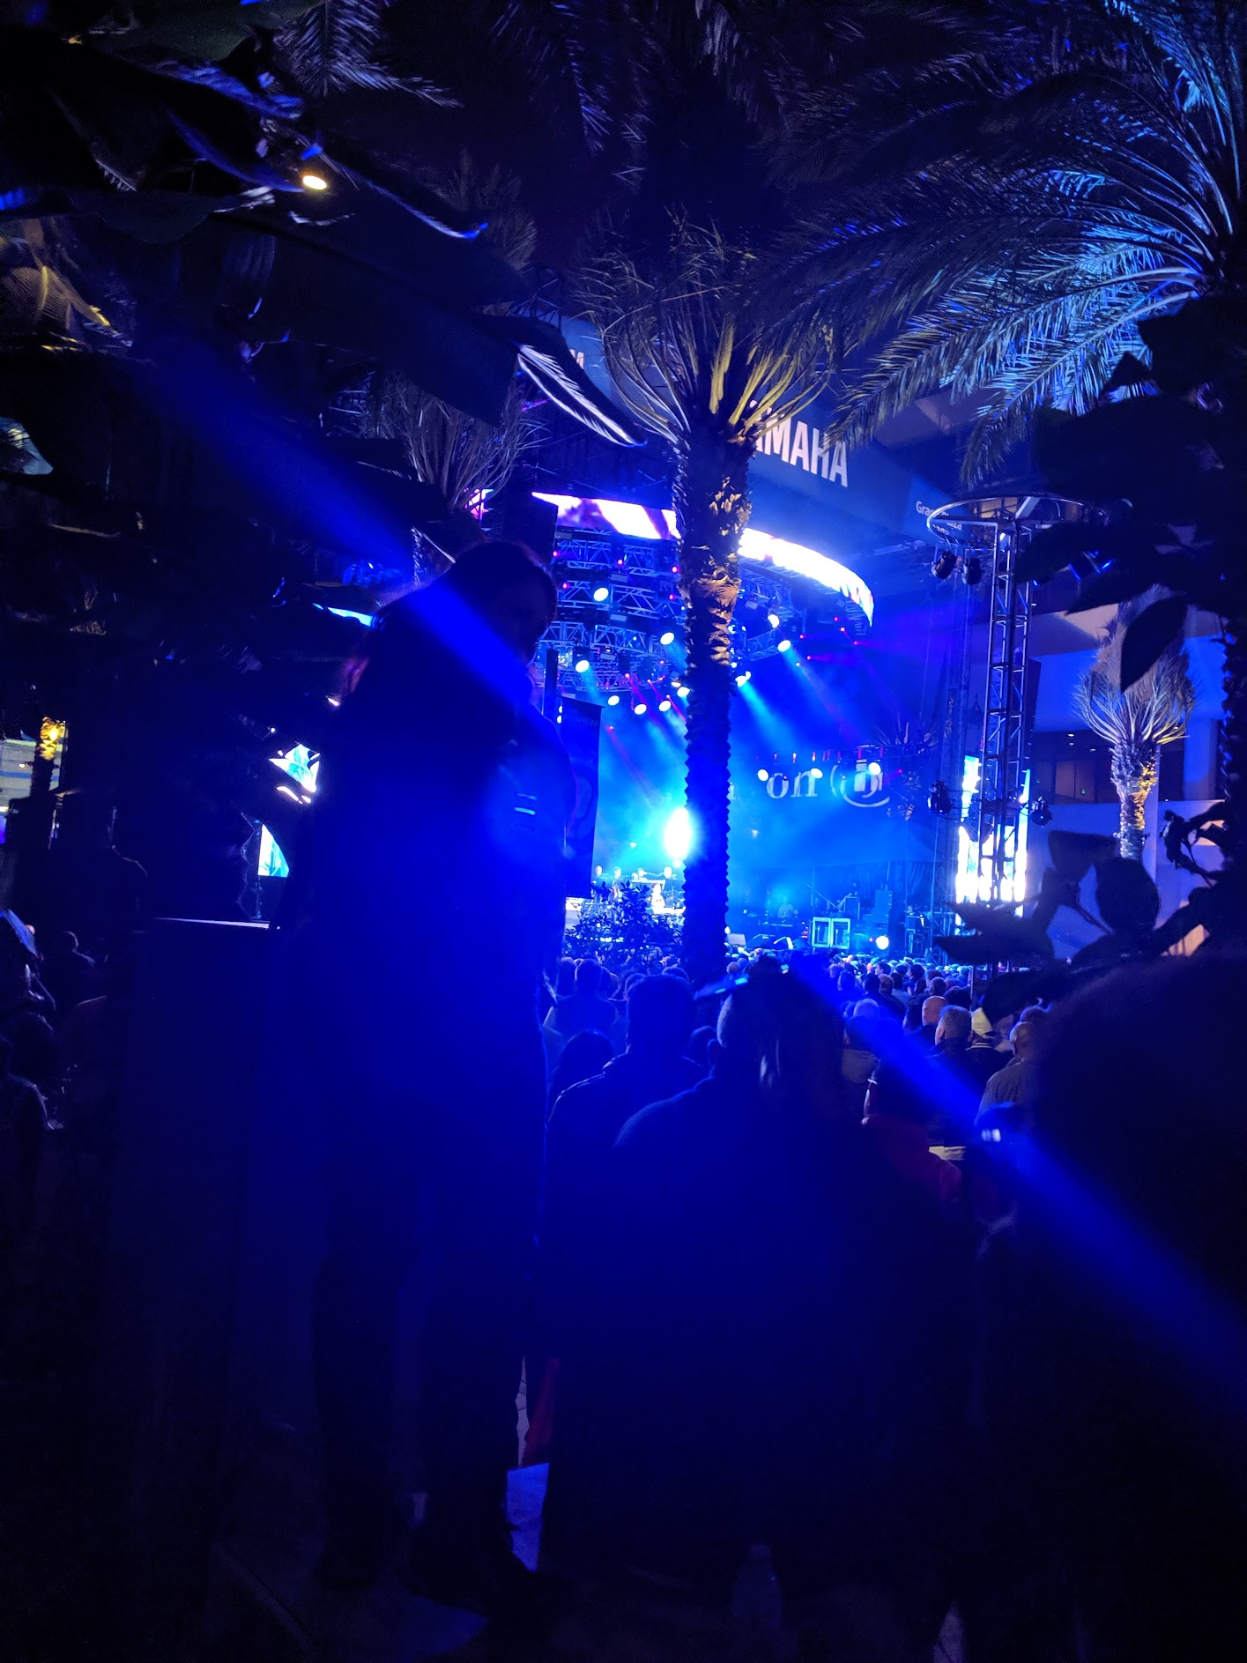
Task Group 15.4ab Virtual Interim January 2022
January 18th through January 26th 2022

Slide 4
5.2.b Scope of the project (As approved):
This amendment enhances the Ultra Wideband (UWB) physical layers (PHYs) medium access control (MAC), and associated ranging techniques while retaining backward compatibility with enhanced ranging capable devices (ERDEVs). Areas of enhancement include:
additional coding, preamble and modulation schemes to additional coding, preamble and modulation schemes to support improved link budget and/or reduced air-time relative to IEEE Std 802.15.4 UWB;
additional channels and operating frequencies;
interference mitigation techniques to support greater device density and higher traffic use cases relative to the IEEE Std 802.15.4 UWB;
improvements to accuracy, precision and reliability and interoperability for high-integrity ranging; schemes to reduce complexity and power consumption;
definitions for tightly coupled hybrid operation with narrowband signaling to assist UWB;
enhanced native discovery and connection setup mechanisms;
sensing capabilities to support presence detection and environment mapping;
and mechanisms supporting low-power low-latency streaming as well as high data-rate streaming allowing at least 50 Mb/s of throughput.
Support for peer-to-peer, peer-to-multi-peer, and station-to-infrastructure protocols are in scope, as are infrastructure synchronization mechanisms. This amendment includes safeguards so that the high throughput data use cases do not cause significant disruption to low duty-cycle ranging use cases.
https://development.standards.ieee.org/myproject-web/app#viewpar/9081

Slide 5
Session Summary
Objectives:
Hear technical contributions and develop technical content for TFD
Accomplished via:
Seven (7) Task Group meetings
Two (2) Joint Task Group meetings
TG 4ab+TG14+TG15
TG 4ab+TG14+TG6a

Slide 6
January Agenda
https://mentor.ieee.org/802.15/dcn/21/15-21-0644-09-04ab-tg-4ab-agenda-jan-2022.xlsx
 |  | Wednesday | Friday | Tuesday |  | Wednesday |  | Thursday |  | Friday |  |  | Sunday | Monday |  | Tuesday |  | Wednesday
EST | PST | 12-Jan | 14-Jan | 18-Jan |  | 19-Jan |  | 20-Jan |  | 21-Jan |  | UTC | 23-Jan | 24-Jan |  | 25-Jan |  | 26-Jan |  | JST
5:00 | 2:00 |  |  |  |  |  |  |  |  |  |  | 10:00 |  |  |  |  |  |  |  | 19:00
6:00 | 3:00 |  |  |  |  |  |  |  |  |  |  | 11:00 |  |  |  |  |  |  |  | 20:00
7:00 | 4:00 |  |  |  |  | TG13 | AM0 | TG13 | AM0 | AM0 | AM0 | 12:00 |  | TG13 | Joint 3ma/THz | TG13 | AM0 |  |  | 21:00
8:00 | 5:00 |  |  |  |  |  |  |  |  |  |  | 13:00 |  |  |  |  |  |  |  | 22:00
9:00 | 6:00 |  |  | WG Opening Meeting |  | TG7a | TG6a | TG7a | TG6a | Joint 6a/4ab/14 | Joint 3ma/THz | 14:00 |  | TG7a | TG4ab | TG7a | TG6a | WG Closing Meeting |  | 23:00
10:00 | 7:00 | 802.15 CAC |  |  |  |  |  |  |  |  |  | 15:00 |  |  |  |  |  |  |  | 0:00
11:00 | 8:00 |  |  | SC Maint |  | Joint 802.15/802.1 |  | SC WNG |  | TG4ab | AM2 | 16:00 |  | AM2 | AM2 | SC IETF |  |  |  | 1:00
12:00 | 9:00 |  |  |  |  |  |  |  |  |  |  | 17:00 |  |  |  |  |  |  |  | 2:00
13:00 | 10:00 |  |  | TG15 | TG16t | TG15 | PM1 | Joint 14/15/4ab | PM1 | PM1 | PM1 | 18:00 |  | TG15 | TG16t | TG4ab | PM1 |  |  | 3:00
14:00 | 11:00 |  |  |  |  |  |  |  |  |  |  | 19:00 |  |  |  |  |  |  |  | 4:00
15:00 | 12:00 |  |  | TG4aa | PM2 | TG4cor1 | PM2 | TG14 | PM2 | PM2 | PM2 | 20:00 |  | TG14 | PM2 | TG4cor1 | PM2 |  |  | 5:00
16:00 | 13:00 |  |  |  |  |  |  |  |  |  |  | 21:00 |  |  |  |  |  |  |  | 6:00
17:00 | 14:00 |  |  | EV1 | EV1 | TG4ab | EV1 | TG4ab | EV1 | EV1 | EV1 | 22:00 |  | EV1 | TG4ab | EV1 | EV1 |  |  | 7:00
18:00 | 15:00 |  |  |  |  |  |  |  |  |  |  | 23:00 |  |  |  |  |  |  |  | 8:00
19:00 | 16:00 |  |  | EV2 | EV2 | EV2 | EV2 | EV2 | EV2 | EV2 | EV2 | 0:00 |  | EV2 | TG4ab | EV2 | EV2 |  |  | 9:00
20:00 | 17:00 |  |  |  |  |  |  |  |  |  |  | 1:00 |  |  |  |  |  |  |  | 10:00
21:00 | 18:00 |  |  |  |  |  |  |  |  |  |  | 2:00 |  |  |  |  |  |  |  | 11:00
22:00 | 19:00 |  |  |  |  |  |  |  |  |  |  | 3:00 |  |  |  |  |  |  |  | 12:00
23:00 | 20:00 |  |  |  |  |  |  |  |  |  |  | 4:00 |  |  |  |  |  |  |  | 13:00

Slide 7
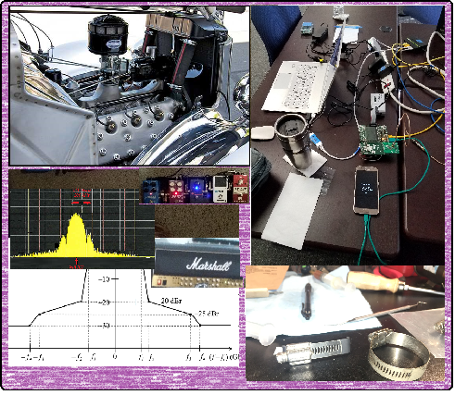
Technical Contributions

Slide 8
List of Technical Presentations, TG41b
Title | Doc # and Link
TG4ab Presentations by TGD Categories | 15-21-0638-00
Mac Layer Considerations for UWB Data Streaming | 15-22-0047-01
Waveform Design for UWB Sensing | 15-22-0040-04
UWB Sensing Scenarios for 802 15 4ab | 15-22-0012-01
Channel Coding Considerations for 802 15 4ab | 15-22-0050-00
UWB And NB Link Budget Comparison | 15-22-0051-01
Sensing Continued | 15-22-0061-00
Pilot NB Radio for Assisting UWB Channel Access | 15-22-0065-00
Link Budget Analysis and CIR Reporting for UWB RF Sensing | 15-22-0066-00
Potentials of Narrowband Assisted UWB | 15-22-0064-00
The Capacity and Accuracy Optimization for DL-TDoA of UWB | 15-22-0070-00
Proposal For Extending Nb UWB for Secure Ranging | 15-22-0076-00
Link budget analysis for NBA-MMS | 15-22-0074-00
TDMA scheme enabling industrial DL-TDoA and UL-TDoA scenarios | 15-22-0077-00
UWB Sensing Concepts | 15-22-0083-01
Integrity Protection to Support Secure Ranging n IR-UWB | 15-22-0072-00
A method to evaluate the quality of ToF measurement for IR-UWB | 15-22-0073-00
NBA-MMS-UWB MAC Follow-up | 15-22-0080-00

Slide 9
Joint Meeting Links
Joint Meeting with TG14, TG15 and TG4ab
Title | Doc # and Link
Joint .6a .4ab .14 Meeting Slides Plenary Nov 2021 | 15-21-0596-00
Joint Meeting with TG6a, TG4ab and TG14
Title | Doc # and Link
Dynamic Channel and Environmental Modeling Scheme for BANs on TG15.6a | 15-22-0023-00
Measurement based BAN channel model for XR applications : Part I | 15-22-0062-01
Snapshot of TG4ab PHY topics Jan 2022 | 15-22-0038-01
MAC Bridging for Time-Sensitive Networking of 802.15.6a | 15-22-0024-01

Slide 10
Next Steps

Slide 11
Proposed Project Schedule (baseline)
Proposed project schedule | Nov-21 | Dec-21 | Jan-22 | Feb-22 | Mar-22 | Apr-22 | May-22 | Jun-22 | Jul-22 | Aug-22 | Sep-22 | Oct-22 | Nov-22 | Dec-22 | Jan-23 | Feb-23 | Mar-23 | Apr-23 | May-23 | Jun-23 | Jul-23 | Aug-23 | Sep-23 | Oct-23 | Nov-23 | Dec-23 | Jan-24 | Feb-24 | Mar-24 | Apr-24 | May-24 | Jun-24 | Jul-24 | Aug-24 | Sep-24 | Oct-24 | Nov-24
Call for proposals
Hear and evaluate proposals
Cut-off for new proposals, PHY
Cut-off for new proposals, MAC
Integrate poposals/contributions into TFD
Develop draft from TFD
Draft 0
TG draft review and revision
Working group pre-ballot review
Pre-ballot review and comment resolution
First letter ballot |  |  |  |  |  |  |  |  |  |  |  |  |  |  |  |  | LB
LB Comment Resolution
WG Recirculatoin |  |  |  |  |  |  |  |  |  |  |  |  |  |  |  |  |  |  |  |  | LB-R
Comment resolution, 1st recirc
Conditional approval for SA ballot
WG Recirculatoin |  |  |  |  |  |  |  |  |  |  |  |  |  |  |  |  |  |  |  |  |  |  | LB-R
Comment resolution, 2nd recirc and final recirc
First SA ballot |  |  |  |  |  |  |  |  |  |  |  |  |  |  |  |  |  |  |  |  |  |  |  |  | SA
Comment resolution, first SA ballot
SA Resirculation |  |  |  |  |  |  |  |  |  |  |  |  |  |  |  |  |  |  |  |  |  |  |  |  |  |  |  | SA-R
Comment resolution, SA recirculation
SA Resirculation |  |  |  |  |  |  |  |  |  |  |  |  |  |  |  |  |  |  |  |  |  |  |  |  |  |  |  |  |  |  | SA-R
Comment resolution, 2nd SA recirc
Conditional or unconditional approval to RevCom |  |  |  |  |  |  |  |  |  |  |  |  |  |  |  |  |  |  |  |  |  |  |  |  |  |  |  |  | ?? |  |  |  | ??
Optional 3rd SA recirc if needed |  |  |  |  |  |  |  |  |  |  |  |  |  |  |  |  |  |  |  |  |  |  |  |  |  |  |  |  |  |  |  |  | SA-R
RevCom meets |  |  |  |  |  |  |  |  |  |  |  |  |  |  |  |  |  |  |  |  |  |  |  |  |  |  |  |  |  |  |  |  |  | ` |  |  |  | `
As Presented in November
We are here
Notes: SASB/RevCom schdule for 2024 a guess

Slide 12
Schedule Major Milestones
Working Milestones
√
Call for proposals | November 2021
Cut-off for new features (high level feature set), PHY | May 2022
Cut-off for new features (high level feature set), MAC | July 2022
Draft 0 | September 2022 [Discuss]
TG draft review and revision complete | November 2022
Working group pre-ballot review complete | January 2022 (before meeting)
First letter ballot | March 2023 (following meeting)
Conditional approval for SA ballot | July 2023 [questionable]
WG balloting complete | November 2023
First SA ballot | November 2023 (post meeting)
SA Balloting complete | June/July 2024
Conditional or unconditional approval to RevCom | March or July 2024
RevCom meets | September or October 2024

Slide 13
Teleconference Schedule
 |  |  | Feb-22
Sun | Mon | Tue | Wed | Thr | Fri | Sat
 |  | 1 | 2 | 3 | 4 | 5
6 | 7 | 8 | 9 | 10 | 11 | 12
13 | 14 | 15 | 16 | 17 | 18 | 19
20 | 21 | 22 | 23 | 24 | 25 | 26
27 | 28
Usual pattern:
Frequency: Bi-weekly
Phase: Tuesday
Time: 09:00 ET (06:00 PT)
Offset: First call Feb 8th^{th}
[skip week following the plenary]
Duration: 1 hour.
 |  |  | Mar-22
Sun | Mon | Tue | Wed | Thr | Fri | Sat
 |  | 1 | 2 | 3 | 4 | 5
6 | 7 | 8 | 9 | 10 | 11 | 12
13 | 14 | 15 | 16 | 17 | 18 | 19
20 | 21 | 22 | 23 | 24 | 25 | 26
27 | 28 | 29 | 30 | 31

Slide 14
Thanks!

