Slide 1
Project: IEEE P802.15 Working Group for Wireless Personal Area Networks (WPANs)
Submission Title: Link budget analysis for narrowband assisted multi-millisecond UWB
Date Submitted: 24 January, 2022
Source: Ersen Ekrem, Shang-Te Yang, Ido Bettesh, and Moche Cohen (Apple Inc.)
Address: One Apple Park Way, Cupertino, CA 95104, USA
E-Mail: ersenek@gmail.com
Abstract: Link budget analysis of narrowband assisted UWB system.
Purpose: Illustrate how narrowband assisted UWB system can have improved link budget.
Notice: This document has been prepared to assist the IEEE P802.15. It is offered as a basis for discussion and is not binding on the authoring individual(s) or organization(s). The material in this document is subject to change in form and content after further study. The authors(s) reserve(s) the right to add, amend or withdraw material contained herein.

Slide 2
PAR Objective | Proposed Solution (how addressed)
Safeguards so that the high throughput data use cases will not cause significant disruption to low duty-cycle ranging use cases
Interference mitigation techniques to support higher density and higher traffic use cases
Other coexistence improvement
Backward compatibility with enhanced ranging capable devices (ERDEVs)
Improved link budget and/or reduced air-time | Use coordinated PHY signaling (NB and UWB) to improve link budget and/or to reduce air-time
Additional channels and operating frequencies
Improvements to accuracy / precision / reliability and interoperability for high-integrity ranging
Reduced complexity and power consumption | Off-loading of functionality to lower-complexity/power NB PHY helps reduce complexity of “heavier” UWB sub-system
Hybrid operation with narrowband signaling to assist UWB | Exploit tightly coupled concurrent operation of NB to help UWB
Enhanced native discovery and connection setup mechanisms
Sensing capabilities to support presence detection and environment mapping
Low-power low-latency streaming
Higher data-rate streaming allowing at least 50 Mbit/s of throughput
Support for peer-to-peer, peer-to-multi-peer, and station-to-infrastructure protocols
Infrastructure synchronization mechanisms

Slide 3
NBA-MMS UWB: A refresher from July 2021
A synergistic interplay between NB and UWB:
Tight coupling between radios leading to link budget improvement
Tight coupling between NB and UWB radios:
NB will provide UWB precise timing and frequency offsets to assist in acquisition
NB will own data exchange on behalf of UWB (status signaling, etc.)
Link budget improvement:
UWB will have preamble-only packets (no SFD, no data)
There will be multiple fragments separated by 1 ms for further link budget boost

Slide 4
A comparison of O-QPSK and UWB BPRF ND
For LOS AWGN channel, the difference is ~ 25 dB
UWB HPRF ND packet link budget is almost identical
UWB BPRF/HPRF data packet (@ 6.8 Mbps) ~ 8 dB worse link budget

Slide 5
Tx Power Regulations
UNII-3 band is universally available except Japan
UNII-5, 6, 7, 8 are also of interest depending on the regulatory process

Slide 6
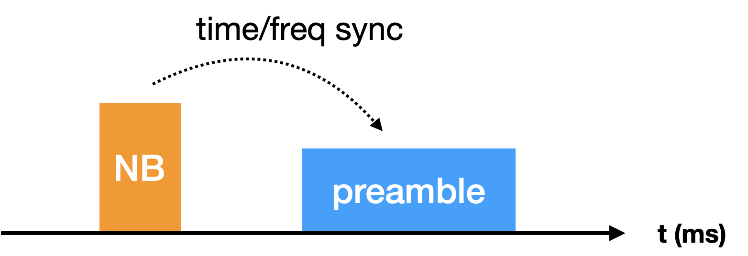
Narrowband assisted UWB
SNR loss < 0.04 dB on PRF 62.4 MHZ, 139.5 usec packet:
Entire preamble could be used to produce a CIR and hence for ToF estimation

Slide 7
A comparison of O-QPSK, UWB BPRF ND and NBA-UWB
Given that NBA UWB can use the entire packet for ToF, NBA-UWB has ~9 dB better link budget:
For NBA-UWB, 62.4 MHz 139.5 usec packet is used.

Slide 8
How about fading?
“TGn Channel Models”, IEEE 802.11-03/940r4, Vinko Erceg et. al. has channel model suggestions for 5 GHz band where UNII-3 is located.
These are used for WiFi performance characterization.
Model A (optional, should not be used for system performance comparisons), flat fading model with 0 ns rms delay spread (one tap at 0 ns delay model). This model can be used for stressing system performance, occurs small percentage of time (locations).
==> Let’s use single tap Rayleigh fading as the worst case scenario.

Slide 9
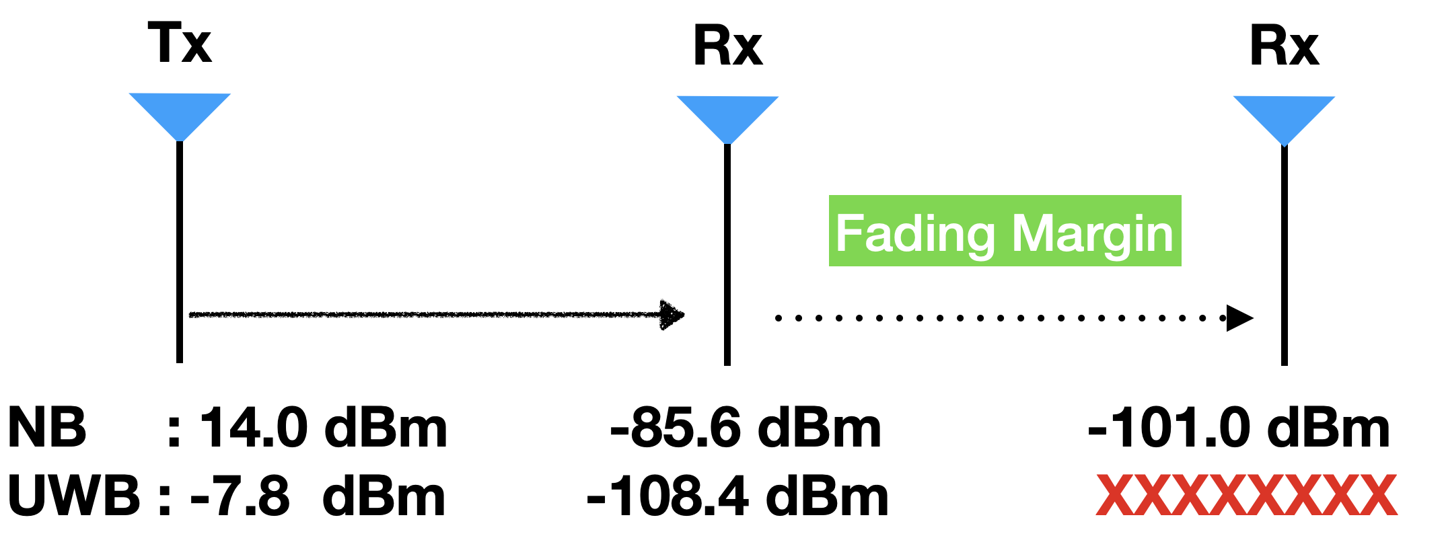
Worst case fading performance
O-QPSK has ~15 dB margin for fading that is sufficient for an ~1 % outage probability
Even in the presence of fading, NBA-MMS link budget is 9 dB better than BPRF-ND!

Slide 10
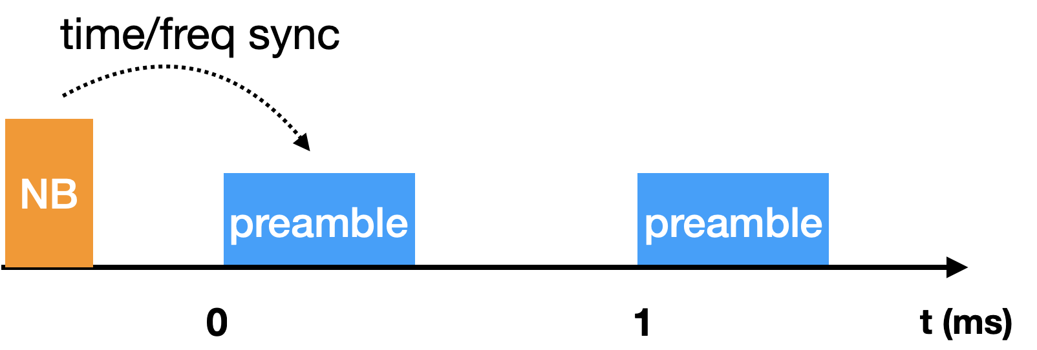
Multi-millisecond integration
O-QPSK provides initial timing and frequency estimate to UWB:
O-QPSK is assumed to be at -113 dBm (at its sensitivity).
UWB does freq. tracking over multi-millisecond and coherently integrates the fragments.
4 ms and 8 ms integrations provide ~6 and ~8.5 dB sens. improvement.

Slide 11
A comparison of O-QPSK, BPRF ND and NBA-UWB…
18 dB link budget improvement with multi-millisecond integration!

Slide 12
Multi-millisecond integration under fading
Link budget improvement persists under Rayleigh fading
Spatial diversity neutralizes the fading impediment

Slide 13
Multi-millisecond integration under fading
~17 dB link budget improvement with multi-millisecond integration under fading

Slide 14
Conclusions
Narrowband assisted UWB can increase the link budget by
offloading acquisition and data transfer to narrowband
enabling coherent multi-millisecond integration
The former brings ~10 dB improvement and the latter can provide beyond 17 dB improvement
O-QPSK on UNII-3 with the most stringent power regulation has enough fading margin to materialize these gains!

