Slide 1
Project: IEEE P802.15 Working Group for Wireless Specialty Networks (WSN)
Submission Title: November 2021 WNG Closing Report
Date Submitted: 17 November 2021
Source: Benjamin A. Rolfe (Blind Creek Associates)
Contact:
Voice: +1 408 395 7207, E-Mail: ben.rolfe @ ieee.org
Re: Wireless Next Generation Standing Committee
Abstract: Agenda and Meeting Slides for the November WNG meeting
Purpose: Report to the working group activates during the plenary session
Notice: This document has been prepared to assist the IEEE P802.15. It is offered as a basis for discussion and is not binding on the contributing individual(s) or organization(s). The material in this document is subject to change in form and content after further study. The contributor(s) reserve(s) the right to add, amend or withdraw material contained herein.
Release: The contributor acknowledges and accepts that this contribution becomes the property of IEEE and may be made publicly available by P802.15.
Notes:
Jul 12, 2010
Page 1

Slide 2
November 2021 Plenary
Virtual Session
Closing Report

Slide 3
Agenda 10 November 2021
Opening and Meeting Reminders
Presentations
TG 12 concepts and future (Kinney)
802 Next Gen collaboration (Rolfe)
Any other business
Reminders and announcements
Adjourn

Slide 4
The usual question
What do you propose the Working Group do next?
15.12 – Pat Kinney to present further in January WNG
Ben Rolfe to continue in the 802 NextGen collaboration

Slide 5
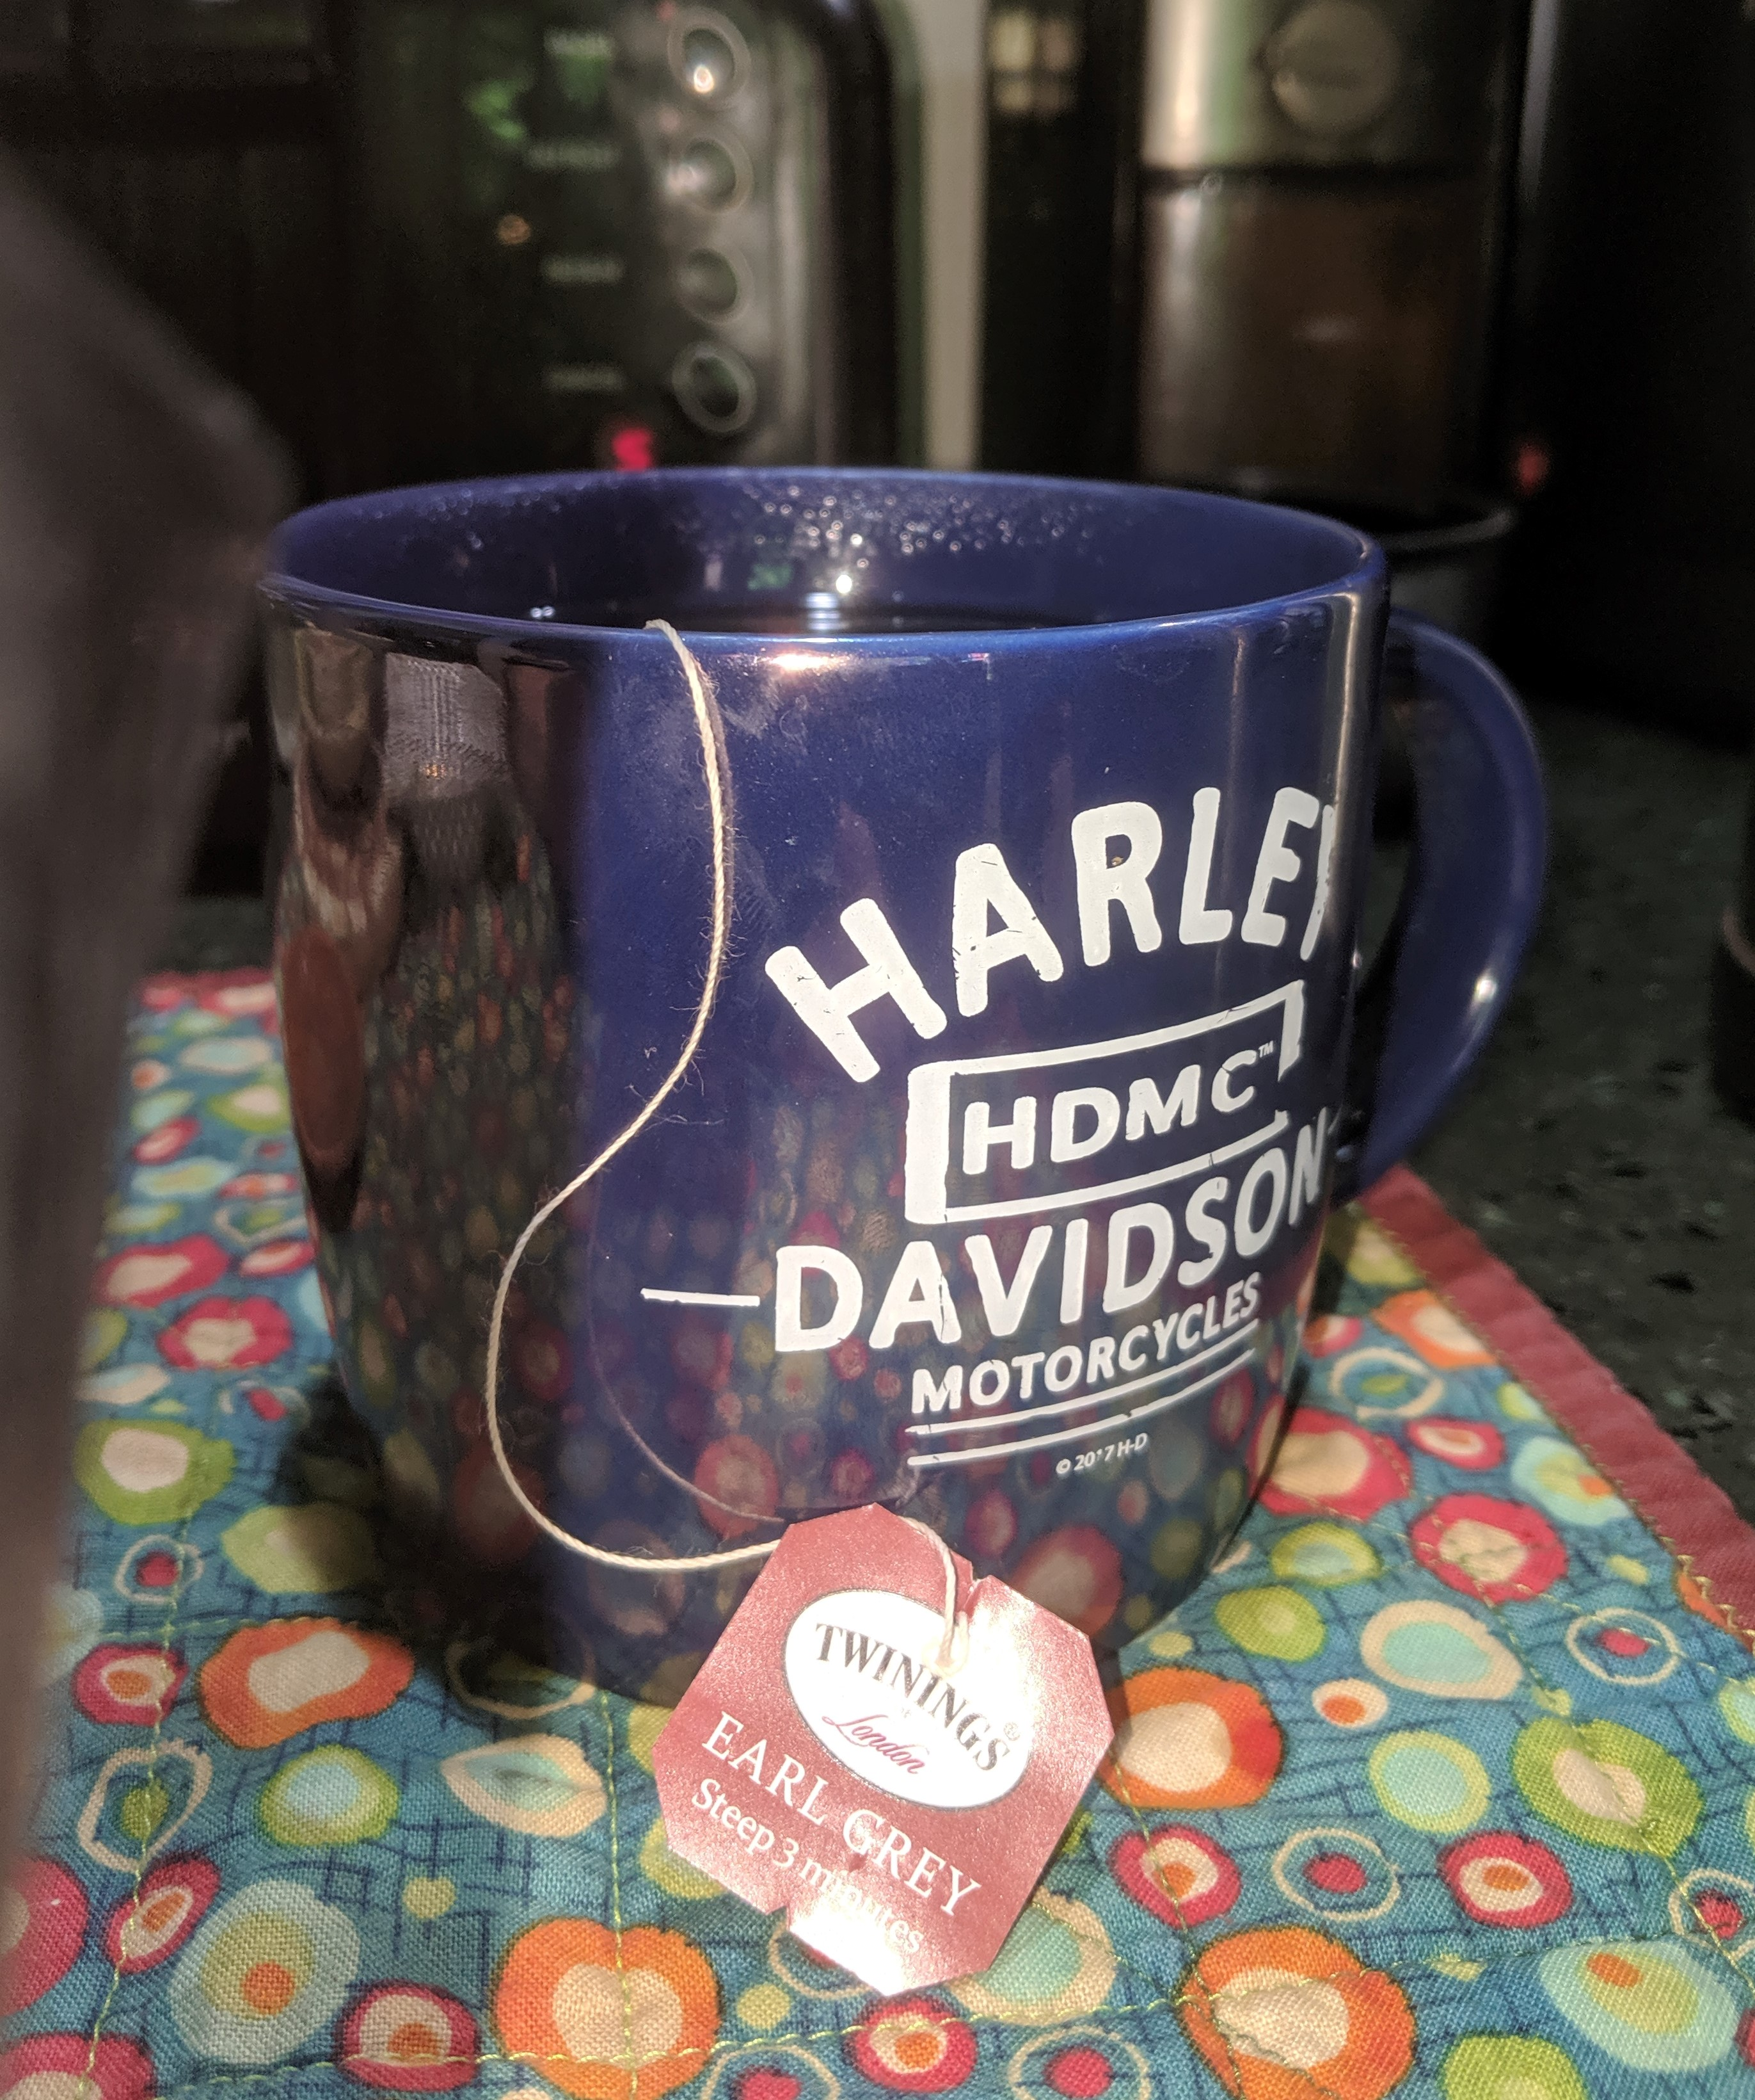
Thank You

