Slide 1
Project: IEEE P802.15 Working Group for Wireless Personal Area Networks (WPANs)
Submission Title: A Study on Data-Driven Advanced Symbol Modulation
Date Submitted: 11 November 2021
Source: Ahmet Serdar Tan, InterDigital Europe
Address: 64 Great Eastern St, InterDigital Europe, London, UK, EC2A 3QR
Voice:+44 20 3922 1792, E-Mail:ahmetserdar.tan@interdigital.com
Re: n/a
Abstract: This talk will focus on the performance of AI/ML based symbol modulation/demodulation, end-to-end architecture that includes trainable symbol modulation, a scalable DNN to cover any M-ary modulation and new signalling procedures required for practical training and inference procedures.
Purpose: Information of the Technical Advisory Group THz
Notice: This document has been prepared to assist the IEEE P802.15. It is offered as a basis for discussion and is not binding on the contributing individual(s) or organization(s). The material in this document is subject to change in form and content after further study. The contributor(s) reserve(s) the right to add, amend or withdraw material contained herein.
Release: The contributor acknowledges and accepts that this contribution becomes the property of IEEE and may be made publicly available by P802.15.

Slide 2
Symbol Modulation in Standards
In existing wireless standards, 3GPP 5G NR, and IEEE standards such as 802.15.3d and IEEE 802.11ax use QAM based modulations.
QAM is known to be optimal for AWGN.
3GPP 5G NR ^{[1]}
    Up to 256 QAM
IEEE 802.15.3d ^{[2]}
    Up to 64 QAM
IEEE 802.11ax ^{[3]}
    Up to 1024 QAM

Slide 3
Impairments and Noise in THz Wireless Communications ^{[4][5]}
Additive White Gaussian Noise (AWGN).
Phase noise caused by fluctuations in the phase of oscillators.
RF HW related impairments due to frequency multiplier and power amplifiers.
As the frequency increases, non-linearities depending on the input signal may become dominant.

Slide 4
Motivation
As the transmission frequencies target THz bands and RF hardware become more demanding, non-linear distortions start to become dominant.
However, traditional modulation schemes are not designed to handle non-linear impairments.
AI/ML at the PHY layer of wireless communications has the potential to adapt rapid-time varying channel conditions and non-linear impairments.
In this contribution, we consider architectures and signalling for autoencoder based symbol modulation.

Slide 5
Traditional Symbol Modulation
Traditional symbols modulation is a look-up table based scheme.
Symbol modulators convert a group of encoded bits to complex symbols that represent the in-phase and quadrature components of the baseband signal.
Symbol demodulators convert the received baseband complex signals to group of bits that are fed into the channel decoder.
Traditional fixed modulation types do not adapt to the specifics of channel conditions or RF impairments.
Symbols with higher/lower energy may experience different levels of impairments for higher frequencies.

Slide 6
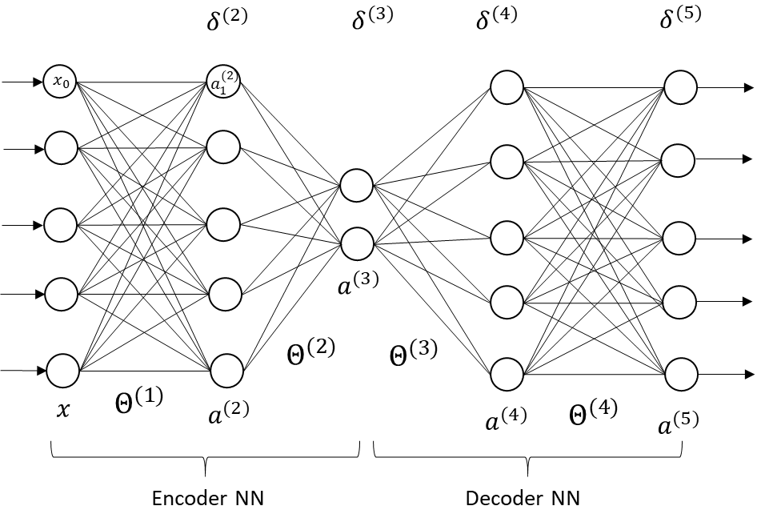
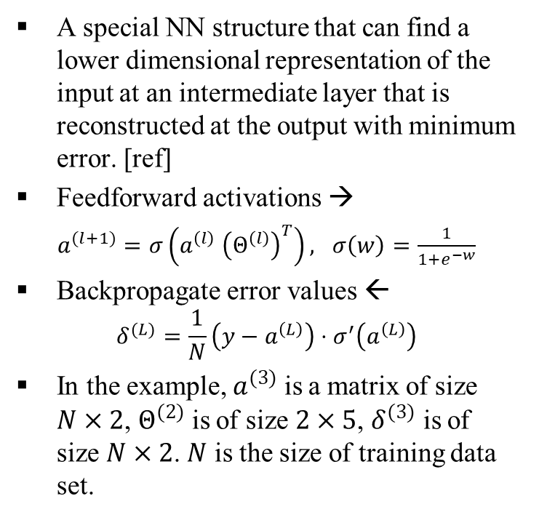
Autoencoder Neural Networks
A special NN structure that can find a lower dimensional representation of the input at an intermediate layer that is reconstructed at the output with minimum error. [ref]
Feedforward activations →
$a^{(l+1)}=σ\left(a^{\left(l\right)} {\left(Θ^{\left(l\right)}\right)}^{T}\right), σ\left(w\right)=\frac{1}{1+e^{−w}}$
Backpropagate error values ←
$$δ^{(L)}=\frac{1}{N}\left(y−a^{\left(L\right)}\right)⋅σ^{′}\left(a^{\left(L\right)}\right)$$
In the example, $a^{(3)}$ is a matrix of size $N×2$, $Θ^{(2)}$ is of size $2×5$, $δ^{(3)}$ is of size $N×2$. $N$ is the size of training data set.

Slide 7
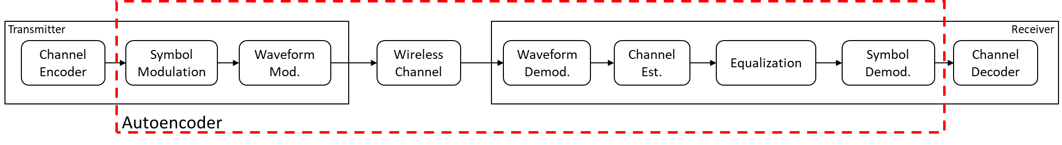
Autoencoder Based Symbol Modulation
We assume the block-by-block methodology where modulation/demodulation blocks are trainable and constitute an autoencoder pair ^{[6]}.
Other blocks and wireless channel in between are non-trainable blocks and may act as a source of noise/impairments.
Constellations learned using the autoencoders in the PHY layer is dependent on the wireless channel properties and other impairments.
Replacing symbol mod/demod with autoencoders is shown to improve the bit error rate performance (BER) of the PHY layer ^{[7]}.

Slide 8
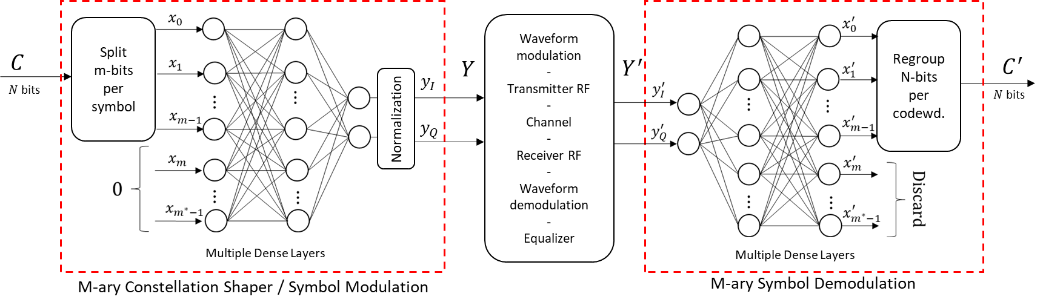
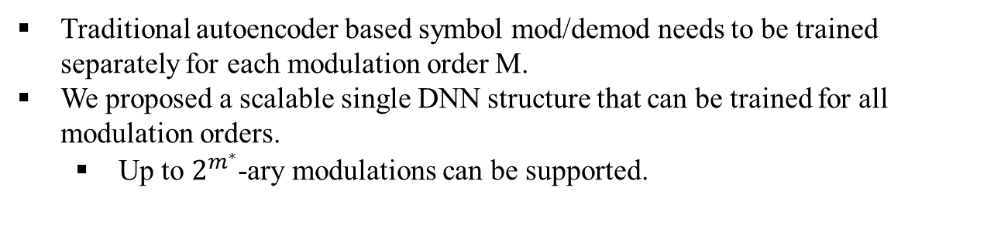
Solution 1: DNN Architecture for Symbol Modulation
Traditional autoencoder based symbol mod/demod needs to be trained separately for each modulation order M.
We proposed a scalable single DNN structure that can be trained for all modulation orders.
  Up to $2^{m^{∗}}$-ary modulations can be supported.

Slide 9
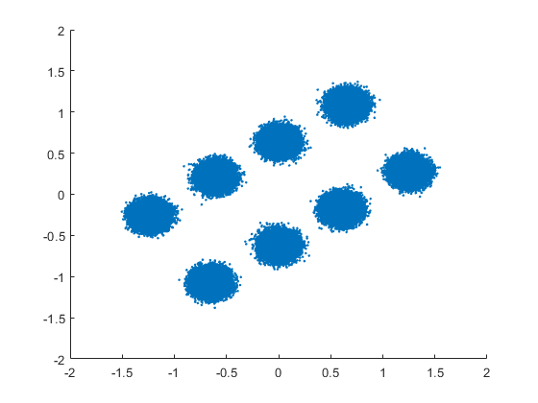
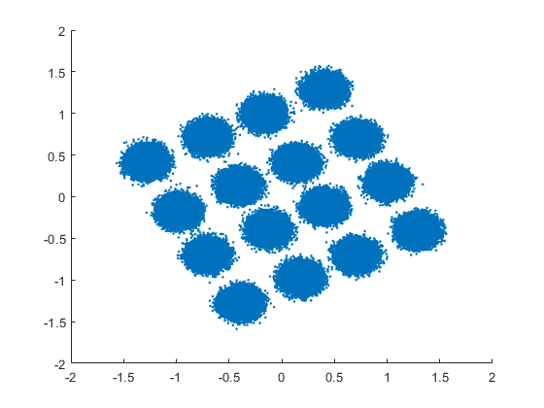
Study 1: Autoencoder Designed Constellations under AWGN
Noise Model: AWGN, $m^{∗}=6$, $r=x+n$where $n\sim N\left(0,P_{n}\right)$
Received symbols

Slide 10
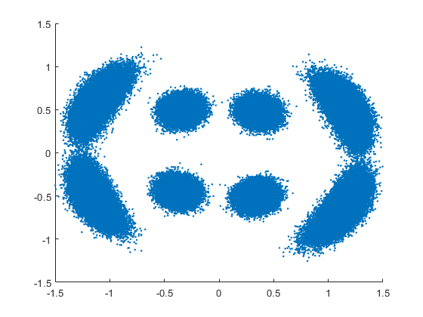
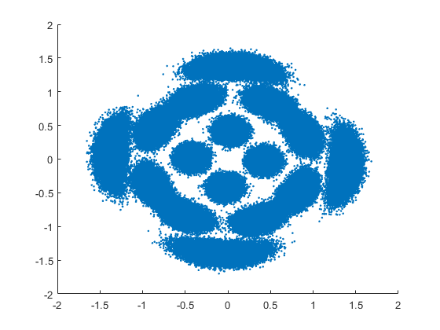
Study 2: Autoencoder Designed Constellations under AWGN + PN
Noise Model: AWGN + non-linear phase noise
$r=x⋅e^{−jψ}+n$, where $ψ\sim N\left(0,α{\left\|x\right\|}^{2}\right)$ and $n\sim N\left(0,P_{n}\right)$
Received symbols

Slide 11
Solution 2: Signalling for Online Training
Training process of the autoencoder NNs can be performed offline or online.
However, offline training may not reflect the channel conditions specific to a UE.
Offline trained NN weights can be used as initialization for online training.
The structure of the offline trained NN for different channels constitute a codebook for NN parameters that is shared between BS and UEs.
BS can select the initial NN to be used for the UE and additional training can be performed.
An example codebook of NN parameters

Slide 12
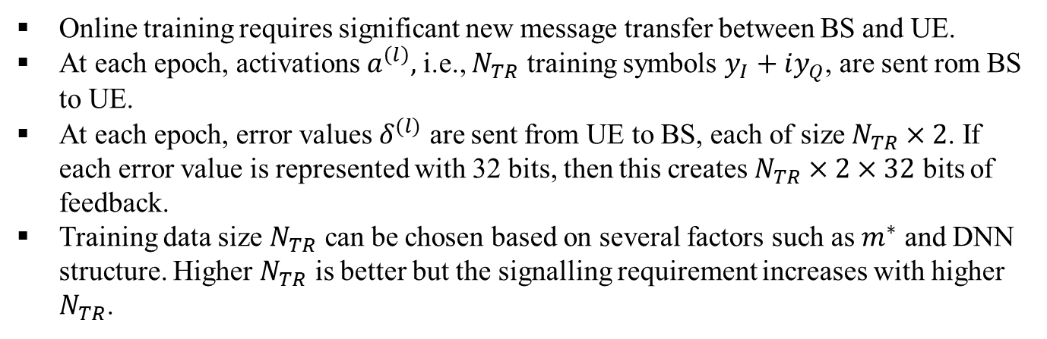

Solution 2: Signalling for Online Training
Online training requires significant new message transfer between BS and UE.
At each epoch, activations $a^{\left(l\right)},$ i.e., $N_{TR}$ training symbols $y_{I}+iy_{Q}$, are sent rom BS to UE.
At each epoch, error values $δ^{(l)}$ are sent from UE to BS, each of size $N_{TR}×2$. If each error value is represented with 32 bits, then this creates $N_{TR}×2×32$ bits of feedback.
Training data size $N_{TR}$ can be chosen based on several factors such as $m^{∗}$ and DNN structure. Higher $N_{TR}$ is better but the signalling requirement increases with higher $N_{TR}$.
Feedforward: Training symbols ($y_{I},y_{Q}$) (activations $a^{\left(l\right)}$)
BS
UE
Backpropagation: Error signals ($δ^{(l)}$)

Slide 13
Conclusion
The physical layer (PHY) blocks designed under linearity and Gaussian noise assumptions may fall short of satisfying the requirements of next generation networks.
AI/ML based advanced symbol modulation can bring substantial gains in terms of bit error rate and throughput under non-linear and UE specific impairments.
Autoencoders are promising candidates to replace PHY blocks.
Significant signalling is required to enable online training for PHY blocks.
Future work can include incorporating different noise models for THz bands and analysis of signalling overhead (i.e. training) and performance trade-offs.

Slide 14
REFERENCES
[1] 3GPP TS 38.211, NR; Physical channels and modulation
[2] Petrov, Vitaly, Thomas Kurner, and Iwao Hosako. "IEEE 802.15. 3d: First standardization efforts for sub-terahertz band communications toward 6G." IEEE Communications Magazine 58.11 (2020): 28-33.
[3] https://standards.ieee.org/standard/802_11ax-2021.html
[4] Bicais, Simon, and Jean-Baptiste Dore. "Phase noise model selection for sub-THz communications." 2019 IEEE Global Communications Conference (GLOBECOM). IEEE, 2019.
[5] Ramadan, Yahia R., Hlaing Minn, and Mahmoud E. Abdelgelil. "Precompensation and system parameters estimation for low-cost nonlinear tera-hertz transmitters in the presence of I/Q imbalance." IEEE Access 6 (2018): 51814-51833.
[6] Timothy J. O'Shea, Jakob Hoydis, “An Introduction to Deep Learning for the Physical Layer”, https://arxiv.org/abs/1702.00832
[7] Sebastian Cammerer, Fayçal Ait Aoudia, Sebastian Dörner, Maximilian Stark, Jakob Hoydis, Stephan ten Brink, “Trainable Communication Systems: Concepts and Prototypes”, https://arxiv.org/abs/1911.13055

