Slide 1
Project: IEEE P802.15 Working Group for Wireless Specialty Networks (WSN)
Submission Title: SG4ab September Interim Session Slides
Date Submitted: September 8, 2021
Source: Benjamin A. Rolfe (Blind Creek Associates)
Contact:
Voice: +1 408 395 7207, E-Mail: ben.rolfe @ ieee.org
Re: Study Group 4ab: UWB Next Generation
Abstract: Interim Session Slides
Purpose: Reinforce the illusion of organization
Notice: This document has been prepared to assist the IEEE P802.15. It is offered as a basis for discussion and is not binding on the contributing individual(s) or organization(s). The material in this document is subject to change in form and content after further study. The contributor(s) reserve(s) the right to add, amend or withdraw material contained herein.
Release: The contributor acknowledges and accepts that this contribution becomes the property of IEEE and may be made publicly available by P802.15.
Notes:
Jul 12, 2010
Page 1

Slide 2
Study Group 15.4ab Next Generation UWB Amendment
Objective: enhancements to 802.15.4 Ultra Wideband (UWB) physical layers (PHYs) medium access control (MAC) and associated ranging techniques while retaining backward compatibility with enhanced ranging capable devices (ERDEVs).

Slide 3
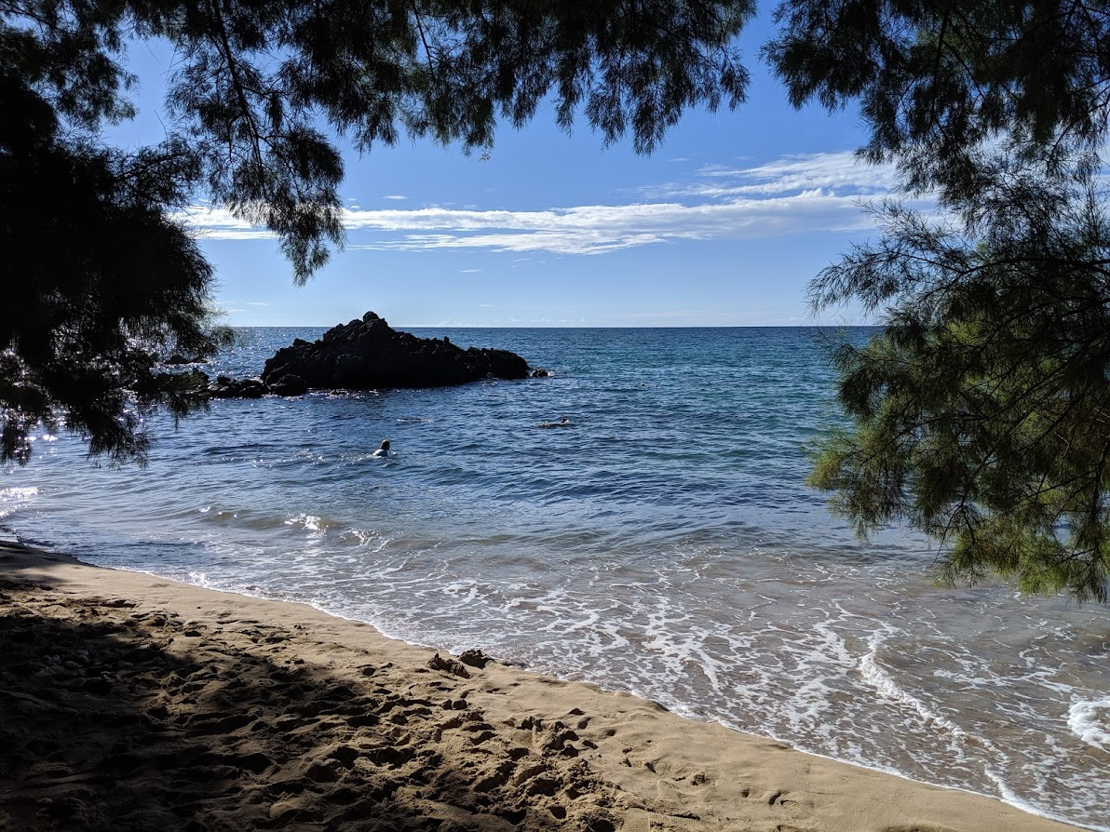
Virtual Wireless Interim Session, September 2021
September 15th through September 21st 2021

Slide 4
802.15 Study Group Meetings
Pre-PAR Activity Rules
Study Group voting: everyone present can vote
Identify yourself and affiliation on first contact
Reminder: Individual Participation

Slide 5
IEEE-SA Patent, Copyright, and Participation Policies
See: https://grouper.ieee.org/groups/802/sapolicies.shtml
IEEE-SA Patent Slides for Pre-PAR Meetings:
https://development.standards.ieee.org/myproject/Public/mytools/mob/preparslides.pdf
IEEE-SA Participation Slides for Pre-PAR Meetings:
https://standards.ieee.org/content/dam/ieee-standards/standards/web/documents/other/Participant-Behavior-Individual-Method.pdf
Copyright:
https://standards.ieee.org/content/dam/ieee-standards/standards/web/documents/other/ieee-sa-copyright-policy-2019.pdf

Slide 6
Task Group Rules
PAR has been submitted
So we will abide by the rules that apply to a PAR activity also:
https://mentor.ieee.org/myproject/Public/mytools/mob/slideset.pdf

Slide 7
IEEE 802 Ground Rules
Respect … give it, get it
NO product pitches
NO corporate pitches
NO prices
NO restrictive notices – (no confidentially notices in email)
Presentations must be openly available

Slide 8
5.2.b Scope of the project (As submitted to NesCom):
This amendment enhances the Ultra Wideband (UWB) physical layers (PHYs) medium access control (MAC) and associated ranging techniques while retaining backward compatibility with enhanced ranging capable devices (ERDEVs).
Areas of enhancement include:
additional coding, preamble and modulation schemes to support improved link budget and/or reduced air-time relative to IEEE Std 802.15.4 UWB;
additional channels and operating frequencies; interference mitigation techniques to support greater device density and higher traffic use cases relative to the IEEE Std 802.15.4 UWB;
improvements to accuracy, precision and reliability and interoperability for high-integrity ranging;
schemes to reduce complexity and power consumption;
definitions for tightly coupled hybrid operation with narrowband signaling to assist UWB;
enhanced native discovery and connection setup mechanisms;
sensing capabilities to support presence detection and environment mapping;
and mechanisms supporting low-power low-latency streaming as well as high data-rate streaming allowing at least 50 Mbit/s of throughput.

Slide 9
Proposed Agenda
See document 15-21-0433

Slide 10
September Interim
 |  | Wednesday | Friday | Tuesday |  | Wednesday |  | Thursday |  | Friday |  |  | Sunday | Monday |  | Tuesday |  | Wednesday
EDT | PDT | 8-Sep | 10-Sep | 14-Sep |  | 15-Sep |  | 16-Sep |  | 17-Sep |  | UTC | 19-Sep | 20-Sep |  | 21-Sep |  | 22-Sep |  | JST
5:00 | 2:00 |  |  |  |  |  |  |  |  |  |  | 9:00 |  |  |  |  |  |  |  | 18:00
6:00 | 3:00 |  |  |  |  |  |  |  |  |  |  | 10:00 |  |  |  |  |  |  |  | 19:00
7:00 | 4:00 |  |  |  |  |  |  |  |  |  |  | 11:00 |  |  |  |  |  |  |  | 20:00
8:00 | 5:00 |  |  |  |  |  |  |  |  |  |  | 12:00 |  |  |  |  |  |  |  | 21:00
9:00 | 6:00 |  | 802 Wireless Opening | WG Opening Meeting |  | TG7a | SG6a | TG7a | SG3ma | SG4ab | SC THz | 13:00 |  | TG7a | SG3ma | TG7a | SG6a | WG Closing Meeting |  | 22:00
10:00 | 7:00 | 802.15 CAC |  |  |  |  |  |  |  |  |  | 14:00 |  |  |  |  |  |  |  | 23:00
11:00 | 8:00 |  |  | SC IETF | Joint 13/7a | SC WNG |  | SC Maint |  | SG15 | TG7a | 15:00 |  | Joint 6a/4ab/14 | AM2 | SG15 | AM2 |  |  | 0:00
12:00 | 9:00 |  |  |  |  |  |  |  |  |  |  | 16:00 |  |  |  |  |  |  |  | 1:00
13:00 | 10:00 |  |  | TG16t | PM1 | TG13 | PM1 | TG13 | Joint 14/15/4ab | SG4ab | PM1 | 17:00 |  | TG4cor1 | PM1 | TG13 | PM1 |  |  | 2:00
14:00 | 11:00 |  |  |  |  |  |  |  |  |  |  | 18:00 |  |  |  |  |  |  |  | 3:00
15:00 | 12:00 | 802 Wireless Chairs mtg |  | SG15 | PM2 | PM2 | PM2 | PM2 | PM2 | SG14 | PM2 | 19:00 |  | SG14 | PM2 | SG14 | TG16t |  |  | 4:00
16:00 | 13:00 |  |  |  |  |  |  |  |  |  |  | 20:00 |  |  |  |  |  |  |  | 5:00
17:00 | 14:00 |  |  | EV1 | EV1 | TG4cor1 | SG4ab | TG4aa | SG4ab | EV1 | EV1 | 21:00 |  | TG4aa | EV1 | TG4cor1 | SG4ab |  |  | 6:00
18:00 | 15:00 |  |  |  |  |  |  |  |  |  |  | 22:00 |  |  |  |  |  |  |  | 7:00
19:00 | 16:00 |  |  | EV2 | EV2 | EV2 | EV2 | SG6a | EV2 | EV2 | EV2 | 23:00 |  | EV2 | EV2 | EV2 | EV2 |  |  | 8:00
20:00 | 17:00 |  |  |  |  |  |  |  |  |  |  | 0:00 |  |  |  |  |  |  |  | 9:00
21:00 | 18:00 |  |  |  |  |  |  |  |  |  |  | 1:00 |  |  |  |  |  |  |  | 10:00
22:00 | 19:00 |  |  |  |  |  |  |  |  |  |  | 2:00 |  |  |  |  |  |  |  | 11:00
23:00 | 20:00 |  |  |  |  |  |  |  |  |  |  | 3:00 |  |  |  |  |  |  |  | 12:00
 |  | Required mtg slots
 |  | Extra credit slots
SG4ab
Joint

Slide 11
Session Objectives
Review and Refine the TGD
Review and Refine technical framework document Outline
Hear technical contributions
Review and Refine next steps

Slide 12
General Announcements
November plenary to be VIRTUAL
WG15 E-Pol result: 4 yes, 25 no
Overall (all 802 groups that polled): less than 50% yes
January Interim to be VIRTUAL
Poll results: Overall (all 802 wireless groups that polled): Less than 50%
Joint Session with COR1 TG
Possible errors in 15.4z have been identified

Slide 13
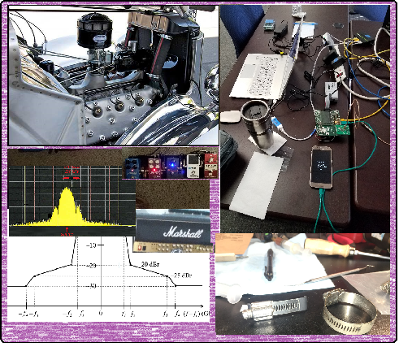
Technical Contributions

Slide 14
List of presentations
TBD

Slide 15
Next Steps

Slide 16
Teleconference Schedule Discussion
Proposal:
Frequency: Bi-weekly
Phase: Tuesday
Time: 10:00 ET (07:00 PT)
Offset: First call August 3rd
Duration: 1 hour.
Week | Time (ET)
Now: | [Sept Interim]
August 3 | 10:00 ET
August 17 | 10:00 ET
August 31 | 10:00 ET
Sept 14: | Sept Interim
We are Here
NEXT

Slide 17
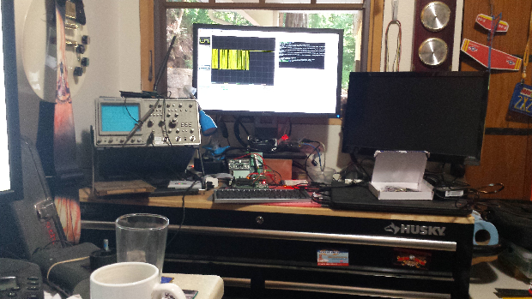
Other Business

Slide 18
Adjourned Thanks

