Slide 1
Project: IEEE P802.15 Working Group for Wireless Personal Area Networks (WPANs)
Submission Title: SG4ab May Interim Closing Report
Date Submitted: May 11, 2021
Source: Benjamin A. Rolfe (Blind Creek Associates)
Contact:
Voice: <deprecated>, E-Mail: ben.rolfe @ ieee.org
Re: Study Group 4ab: UWB Next Generation
Abstract: May Interim Meetings Closing Report
Purpose: Achieve the illusion of organization and promote getting work done
Notice: This document has been prepared to assist the IEEE P802.15. It is offered as a basis for discussion and is not binding on the contributing individual(s) or organization(s). The material in this document is subject to change in form and content after further study. The contributor(s) reserve(s) the right to add, amend or withdraw material contained herein.
Release: The contributor acknowledges and accepts that this contribution becomes the property of IEEE and may be made publicly available by P802.15.
Notes:
Jul 12, 2010
Page 1

Slide 2
802.15.4ab Study Group Meeting
Virtual Meeting May 12th through 18th, 2021

Slide 3
Agenda
Agenda: Document # 15-21-0250-08
 |  | 131th IEEE 802.15 WSN MEETING VIA WEBEX Study Group 15.4ab - Next Generation UWB Summary of Agenda | EST
1 | Wednesday PM2: | Opening, Review, Technical Presentations | 3:00 PM
2 | Thursday PM1: | Technical Presentations, Technical Guidance Framework | 1:00 PM
3 | Monday AM2 | Coordination with SGs (Joint w/15.14 & 15.15) | 11:00 AM
4 | Monday PM2: | Technical Presentations, TCD Discussion | 3:00 PM
5 | Tuesday AM2: | TCD, Call For Contributions, next steps, wrap-up | 11:00 AM

Slide 4
Meeting Documents
Document | Link
SG 15.4ab Agenda May 2021 Interim | 15-21-0250-08
SG15.4ab Meeting Slides May 2021 | 15-21-0266-01

Slide 5
Meeting Goals
Review and reaffirm the proposed PAR and CSD.
Further consideration of use cases and technical requirements and characteristics
Heard and discussed technical contributions
Discussed technical framework and produce a technical guidance document
Produce a call for contributions
Coordinate with other Study Groups

Slide 6
Re-affirmed PAR and CSD approved by TG and WG in March
PAR
Document: 15-21-0126-01
CSD
Document: 15-21-0047-05

Slide 7
Study Group Motion
SG Motion: Request that the PAR and CSD contained in documents [15-21-0126-01] and [15-21-0047-05], respectively, be approved for submission to the WG for its approval and that the EC be requested to forward the PAR to NesCom
Moved: Clint Powel
Second: Phil Beecher
Discussion: None
Result: Motion carried by unanimous consent

Slide 8
Working Group Motion
WG Motion: Request that the PAR and CSD contained in documents [15-21-0126-01] and [15-21-0047-05], respectively, be approved for submission to the WG for its approval and that the EC be requested to forward the PAR to NesCom. The 802.15 working group chair and technical editor are authorized to make additional modifications to the PAR and CSD as needed to reflect EC discussion at its closing meeting.
Moved: Benjamin Rolfe
Second: Clint Powell

Slide 9
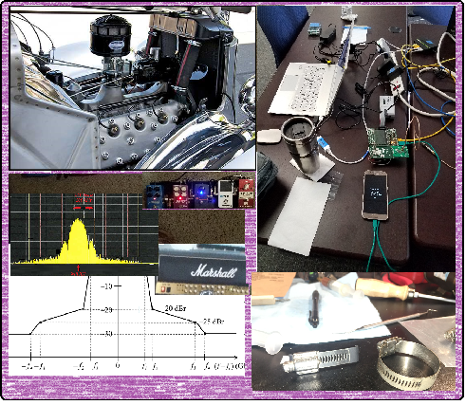
Technical Contributions

Slide 10
Contributions
Meeting | Title | Link
Wednesday | 15.4ab Technical Guidance Framework | 15-21-0268-00
Thursday | UWB for data streaming use cases - suitable features overview | 15-21-0277-00
Thursday | Some UAS Use Cases for UWB | 15-21-0272-00
Thursday | Receiver Requirements for Realistic Interference Scenarios | 15-21-0276-00
Thursday | Objectives Checklist Table | 15-21-0280-00
Monday | Coupling between NB and UWB | 15-21-0289-00
Monday | Opportunities for improved UWB/NB coordination | 15-21-0292-00
Monday | Input to tech requirements for the NG UWB project | 15-21-0294-00
Tuesday | 15.4ab Technical Guidance Doc | 15-21-0297-01

Slide 11
Next Steps

Slide 12
Next Steps
EC Process:
Submit for review (June 8th)
Comments received and resolved in July
EC and WG Review Schedule:
08 Jun 2021 | PAR Announcement
14 Jul 2021 | Submit comments against PARs / ICAIDs
21 Jul 2021 | Post responses to submitted comments against PARs / ICAIDs
23 Jul 2021 | 802 EC Closing Mtg (Consider PARs / ICAIDs)
Call for Contributions to be issued following this meeting
Technical guidance document refine as needed
Bi-weekly teleconferences (see schedule)
Prepare for July meeting

Slide 13
Call for Contributions
Study Group 15.4ab requests technical contributions to further the development of recommendations for technical content of the proposed amendment. Contribution guidance is provided in the Technical Guidance Document (TGD), DCN #15-21-0297 (https://mentor.ieee.org/802.15/dcn/21/15-21-0297-01-04ab-15-4ab-technical-guidance-doc.docx)
Contributions may include but are not limited to the areas covered in the draft Project Authorization Request (PAR) and the TGD. Contributions may include further technical considerations, use case descriptions and requirements and background information supporting development of the amendment.
Contributions on analysis of coexistence and proposed methods to enhance coexistence are strongly encouraged.
Schedule:
Contributions to be considered on bi-weekly conference calls commencing June 1: Please advise chair of request for agenda time ahead of the call.
Contributions to be considered at the July Plenary: Please advise chair as early as possible prior to the meeting. Requests one week prior to the meeting appreciated.
Agenda time priority: Queued First In, First choice of time slot

Slide 14
Teleconference Schedule Discussion
We are Here
Week | Time (ET)
Now: | [May Interim]
June 1 | 10:00 ET
June 15 | 10:00 ET
June 29 | 10:00 ET
July 13: | July Plenary
NEXT
Frequency: Bi-weekly
Phase: Tuesday
Time: 10:00 ET (07:00 PT)
Duration: 1 hour.

Slide 15
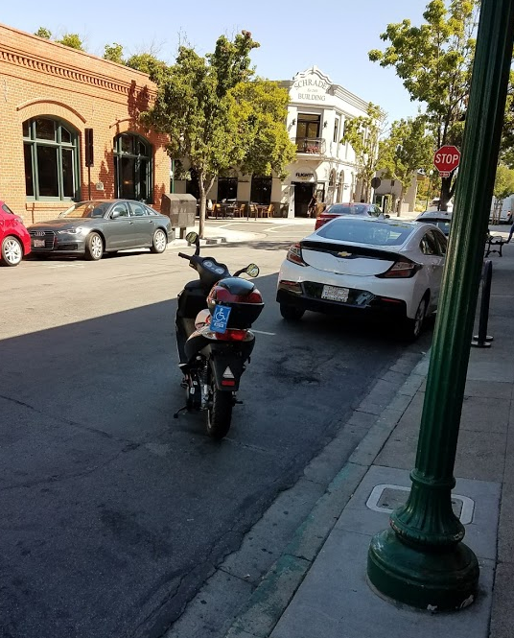
Donec iterum conveniant
(Until we met again)

