Slide 1
Project: IEEE P802.15 Working Group for Wireless Personal Area Networks (WPANs)
Submission Title: [TG4aa JRE Proposed comment resolution for CID 18]
Date Submitted: [13th May,2021]
Source: [Kiyoshi Fukui] Company [Oki Electric Industry Co., Ltd. ]
Address [2-6-8 Bingomachi, Chuo-ku, Osaka, Japan]
Voice[+81-6-6260-0700], FAX: [+81-6-6260-0770], E-Mail:[fukui535@oki.com]
Re: [] Abstract: [This document contains the proposal for the draft amendment] Purpose: [information]
Notice: This document has been prepared to assist the IEEE P802.15. It is offered as a basis for discussion and is not binding on the contributing individual(s) or organization(s). The material in this document is subject to change in form and content after further study. The contributor(s) reserve(s) the right to add, amend or withdraw material contained herein.
Release: The contributor acknowledges and accepts that this contribution becomes the property of IEEE and may be made publicly available by P802.15.

Slide 2
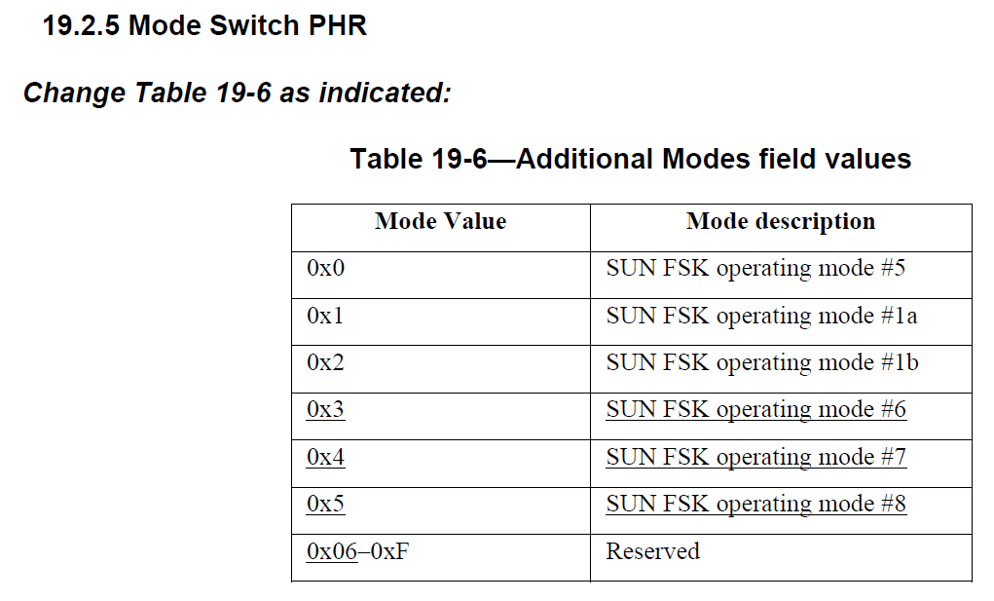
Reference CID 18 of the consolidated comments(15-21-0241-04aa)
Comments:
The added paragraph does not allow using Mode switch with operating modes #6, #7, or #8 as there is no bits defined in the mode switch mode field value for modes 6-8, table 19-5 and 19-6 only include modes 1-5 and 1a and 2b.
Proposed Change:
Change the sentence to say “Modes #6, #7, or #8 cannot be used with mode switch.”
Proposed Resolution
Referred to 15-20-0396-00, modification to Table19-6 was originally proposed and initially included in P802.15.4aa D02. However it was accidentally removed in the later revision of P802.15.4aa. So modification to Table19-6 is required for new operating mode.as shown below

