Slide 1
Project: IEEE P802.15 Working Group for Wireless Specialty Networks
Submission Title: SG15.6a Channel and Environmental Models Including EMC/EMI of Human and Vehicle Body Area Networks(HBAN and VBAN)
Date Submitted: September 21st , 2021
Source: Takumi Kobayashi, Minsoo Kim, Marco Hernandez, Ryuji Kohno
Company: (1)Yokohama National University (2) YRP International Alliance Institute
Address: (1)79-5 Tokiwadai, Hodogaya-ku, Yokohama, 240-8501 Japan,
(2) YRP1 Blg., 3-4 HikarinoOka, Yokosuka-City, Kanagawa, 239-0847 Japan
Voice:[+81-90-5408-0611] E-Mail:[minsoo@minsookim.com, kobayashi-takumi-ch@ynu.ac.jp, marco.hernandez@ieee.org, kohno@ynu.ac.jp, Kohno@yrp-iai.jp]
Re: In response to call for technical contributions
Abstract: This provides how channel and environmental model should be defined and developed for human body area network(HBAN) and vehicle body area network(VBAN) for amendment of IEEE802.15.6-2012 for wireless medical body area network(BAN) with enhanced dependability.
Purpose: Material for discussion in P802.15.6a SG corresponding to comments in EC Meeting
Notice: This document has been prepared to assist the IEEE P802.15. It is offered as a basis for discussion and is not binding on the contributing individual(s) or organization(s). The material in this document is subject to change in form and content after further study. The contributor(s) reserve(s) the right to add, amend or withdraw material contained herein.
Release: The contributor acknowledges and accepts that this contribution becomes the property of IEEE and may be made publicly available by P802.15.

Slide 2
SG15.6a Channel and Environmental Models of Human and Vehicle Body Area Networks (HBAN and VBAN)Including EMC/EMI Issues
Takumi Kobayashi ^{(1,2)}, Marco Hernandez ⁽²⁾, Minsoo Kim ⁽²⁾, Ryuji Kohno^{(1,2)}
⁽¹⁾YNU, ⁽²⁾YRP-IAI

Slide 3
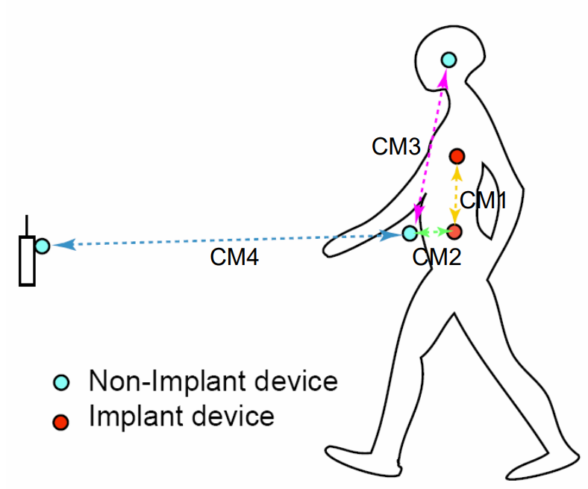
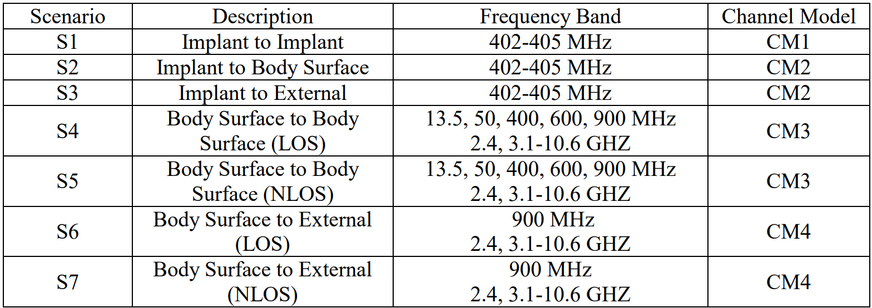
Channel models and scenarios in IEEE802.15.6-2012
IEEE P802.15-08-0780-12-0006-TG6
IEEE 802.15.6-2012 channel models considered
Fading ( Small scale/ large scale)
Path loss
Shadowing
Power delay profile
In-body (implant)
On-body (body surface)
CM1, 2, 3, 4
Scenario 1, to Scenario 7. (S1 – S7)

Slide 4
Classification of Channel and Environment Models for Human and Vehicle Body Area Networks (HBAN&VBAN)
Channel model
※Covered by
IEEE 802.15.6-2012
HBAN model
In-body (Implant)
※
On-body
※
Around body
Outdoor
※Around meaning;
Desk, WiFi AP in the room etc.
Channel model
With environment
※not covered yet
Indoor
※
Home
Office
※
Medical (e.g. Hospital)
※
VBAN model
In-vehicle
Engine room
Cabin
Note:
HBAN-model:
-Environment with co-existing systems is not considered.
VBAN model:
Key-less entry system
Localization in-body, on-body
Most dominant model should be defined and separatory defined as Mandatory and Optional.
※mandatory
Through engine room and cabin
On-vehicle
Roof
Around vehicle
Side Right/Left/Front/back
※mandatory
Bottom
Static vehicle
※mandatory
Moving vehicle

Slide 5
Channel and Environmental Models
Environment model
※will be defined in this amendment
Channel model
Environment model
Channel model
Path loss
Reflection
Multipath
Fading
LOS / NLOS model
White Gaussian noise
Interference from co-existing wireless systems
e.g. Bluetooth, IEEE 802.11, IEEE 802.15.4 etc.
Interference from the other BANs.
Interference from the other electric systems, devices and components (Electro-magnetic interference; EMI from electric motors, spark plugs in vehicles, etc.
Electro-magnetic compatibility; EMC. Possibility to affect to the other systems and human body.
VBAN ⬄ HBAN interference
VBAN and HBAN ⬄ Vehicle control and human body impacts.
Colored noise (Impulse noise, spike noise, ignition noise etc.)
Time-varying channel and interference modeling (Statistic, non-static, pseudo static model)
※IEEE802.15.6-2012
Other wireless systems
EMI EMC
Colored noise
Time-varying modeling
※mandatory
※optional
※mandatory
※mandatory
※Comments in May 2021.
※optional
or
?
※mandatory
or
?
※optional
※mandatory
※mandatory
※optional

Slide 6
Various Interference in Coexistence
＊ IEEE 802.11a (wi-fi) （5GHz） overlaps
UWB-WBAN
IEEE 802.15.6
User “B”
Other BAN
Other UWB system.
e.g. IEEE 802.15.4-2020
IEEE 802.15.4z
Other UWB-BAN
user ？
interference
user ？
Other NB-BAN
interference
User “A”.
A wants to connect to “B”.
user ？
Inter-user interference
“IUI”
Inter-system interference
Inter-BAN interference
“IBI”
“ISI”
Interference from a system using
the same standard.
Interference from a system using
overlapped frequency
VBAN ⬄ HBAN interference
Unknown signal.
EMI / EMC issues
Known signal.
Pre-knowledge can be used to mitigation

Slide 7
Automotive Systems and EMC
The inclusion of new technologies in automotive systems has resulted in
new challenges across the radio spectrum

Slide 8
Today’s electronic and electric systems in vehicles contain many more active
components than in the past.
Those components and assemblies may emit electromagnetic (EM) noise, or be exposed to external sources of energy/EM noise, resulting in unanticipated changes in systems operation (vehicle’s control, on-board radio equipment)
Wireless/radio equipment: cellular communications, Wi-Fi, Bluetooth, NFC,
automotive radar, sensors, infotainment, GPS, etc.
Assemblies include high speed digital circuits that may be radiating EM noise.

Slide 9
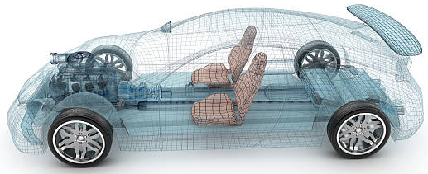
Environment Model in Vehicle
Engine/Motor room environment model
Engine/motor diagnostic sensor and controller
Air pressure sensor, wheel health sensor and controller
Transmission monitoring sensor and controller
Cabin environment sensor (temperature, brightness, humidity etc.)
Sheet sensor, health care sensors for driver
Sheet sensor, health care sensors for passenger
Cabin room environment model
Note:
Various type of car/vehicles
Bus, Bulldozer, Heavy construction equipment needed each different sensors.
4
2
5
1
3
6
https://media.istockphoto.com/photos/transparent-car-design-wire-model3d-illustration-my-own-car-design-picture-id594040008?k=6&m=594040008&s=612x612&w=0&h=XE8LiBjpM51aB4pH2CFt6-MT6IvALRPnlxPcac0RXhg=

Slide 10
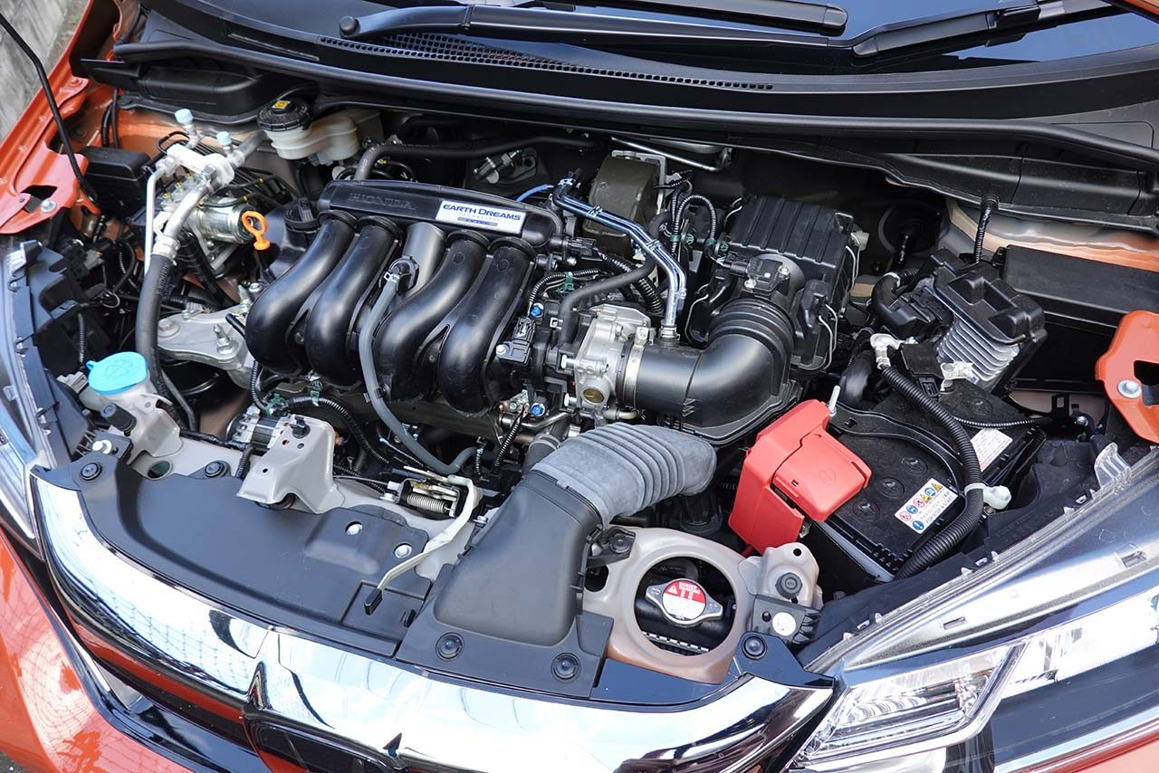
Engine/Motor Room Environment
Many metallic components
Components existing in densely
Ignition noise, motor noise
Larger path-loss than free propagation
A lot of reflection of RF signal
Electro-magnetic interference, EMI issues
Especially EV
https://www.as-web.jp/car/575374/attachment/03a_sub_dsc01273
Ignition coil
Spark plug
Electric generator
Electric motor
High current battery and cable

Slide 11
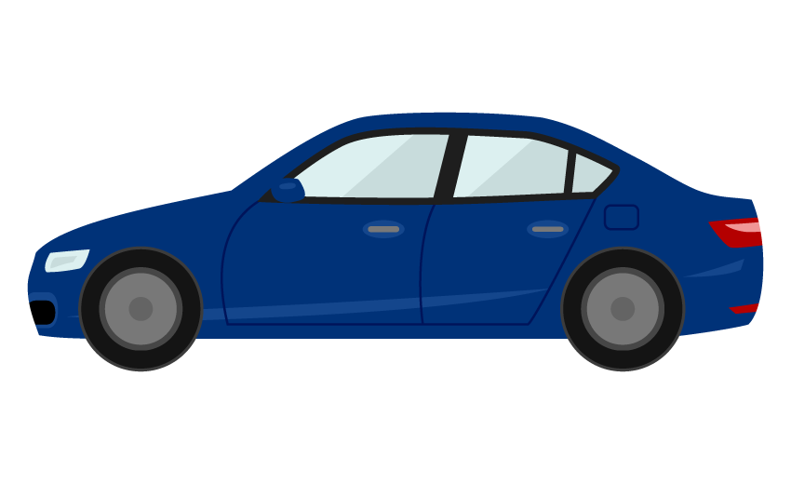
Electromagnetic Environment
Front object CCD camera
Rear object monitor CCD camera
Lane departure system
Night vision
Blind spot detection
Front airbag sensors
Nighttime pedestrian warning
Rear camera
Cross traffic alert
Drowsiness sensos
Rear object laser radar
Front object laser radar
Side airbag SRS
Tire pressure sensor
Tire pressure sensor
Automatic brake actuator
Steering angle sensor
Central computer
Wheel speed sensor
Wheel speed sensor
Active park assist
Adaptive cruise control
Nighttime pedestrian warning IR sensor
Sensors, monitors and vehicle controlling systems in modern vehicle

Slide 12
Electric and hybrid vehicle environment
Wheel motor
High current cables
High capacity Li-ion batteries
Motor controller / inverter
Battery charge and discharge controller
Electric generator
etc….
Motor controller / inverter
Brake controller
Central computer
Battery charge and discharge controller
Sensors, cameras, etc….
Vehicle control systems and sensors are electronically sensitive system in general.
Those systems should be protected from EMI from HBAN and VBAN and guaranteed EMC.
Power electronics systems and its circuits radiate EM wave which causes colored noise EMI.
VBAN and HBAN should be protected from such EMI.

Slide 13
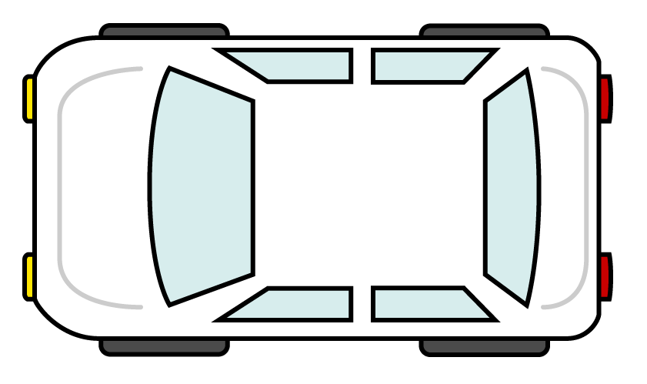
EMC model
Source
Path
Sink
Sources of EM near and far field: may be off board and on board sources
Path: radiated or conducted
Sink: intended receiver or unintended receiver
Camera application
Radar application
Engine control application
Camera application
Multimedia application
Head unit
Dashboard application
rear seat entertainment
Body control applicaition
Radar application
Camera application
Camera application

Slide 14
Vehicle Original Equipment Manufacturer (OEM) practice is to address
EMC/EMI at the component and system design phase. Moreover, the
resolution of EMC/EMI issues must take in high volume and complex
manufacturing process with the Goal to balance EMC/EMI requirements
with market-based vehicle usage, as in our case HBAN and VBAN.
15.6a does not intend to address all these items and issues.
We would like to use the knowledge base on these issues:
EMI is been categorized into four areas: conducted & radiated
emissions, and conducted & radiated susceptibility; with
their specific compliance standards and limits

Slide 15
OEMs design EMC-proof circuits and components for immunity, with the ultimate goal to achieve certification of the vehicle to relevant standards, including EMC/EMI.
So far we have been relaying on international standards for EMC/EMI environments for on-board and off-board sources in internal combustion vehicles, electric vehicle and hybrid-electric vehicles.
CISPR 25 v4 , SAE J551/1, ECE R10 r5, Nissan NDS02
We may add support from Japanese automotive industry and/or others
for testing EMC/EMI over UWB systems in-vehicles based on CISPR 25,
SAE J551/1 or relevant Standards.

Slide 16
Cabin Room Environment
A lot of metallic components
Human being moves in the cabin room
Ignition noise, motor noise
Larger path-loss than free propagation
Human body absolve RF energy. Dynamic path loss issue and safety issue for passengers should be considered.
Even smaller effect than engine room environment, electro-magnetic interference should be considered.
Note:
Noise and interference through the glass windows cannot be ignored.
Interference from BT/WiFi/ cellular / ETC (Electric toll correction system), car navigation system should be considered.

Slide 17
On Vehicle Environment
Around roof
・mostly free propagation can be applicable except reflection on the metallic roof
Note:
・open car
・in-door roof<=in body
Side
mostly free propagation can be applicable
Between right hand side and the left, front and back, NLOS model should be applied. (Glass window)
Note:
・key-less entry system
https://illust8.com/contents/2559
Bottom
Reflection at the body bottom and the ground should be considered.
=> maybe ignorable.
=> Depends on pavement

Slide 18
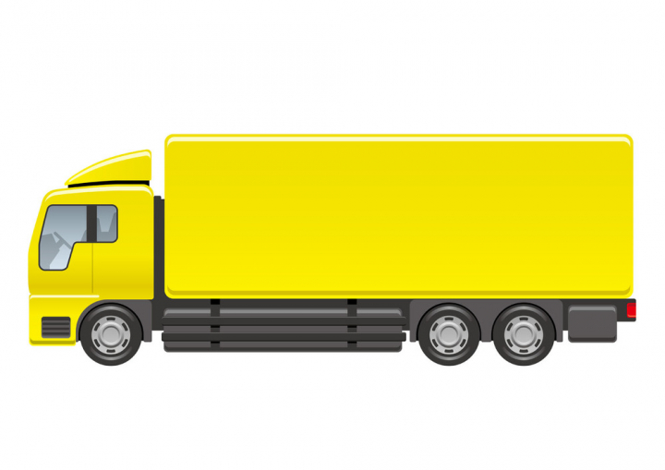
Environment models that can be applicable against different type of vehicles
Cabin
Engine
Cabin
Engine
Different
Size;
Structure;...etc.
https://nohat.cc/f/heavy-truck-illustration-isolated-on-a-white-background/comvecteezy328938-201908251309.html
Categories:
Categorize several type of vehicle like “for passengers”, “bus”, “small cargo”, “middle cargo”, “Large cargo” and “special purpose vehicles” such as a construction machines and build models for various categories.
Policy:
IEEE 802.15.6a defines several common environment models against most dominant use cases as mandatory models.

Slide 19


Channel and Environment Model Categories
Mandatory / optional
In-vehicle body
On-vehicle body
Around vehicle body
Most dominant case
CM-V1 / EM-V1
CM-V2 / EM-V2
CM-V3 / EM-V3
Without motor
channel / Environment
channel / Environment
channel / Environment
Small / medium size vehicle
With motor
channel / Environment
channel / Environment
channel / Environment
or
channel / Environment
channel / Environment
channel / Environment
https://frame-illust.com/?p=8372
Large / long size vehicle
channel / Environment
channel / Environment
channel / Environment
https://illust8.com/contents/5097
Special purpose vehicle

Slide 20
In-Vehicle Body Model Categories
Mandatory / optional
Through engine room and cabin
Engine room
Cabin
Most dominant case
CM-V1 / EM-V1
Without motor
Channel / Environment
Channel / Environment
channel / Environment
Small / medium size vehicle
With motor
Channel / Environment
channel / Environment
Channel / Environment
Channel / Environment
channel / Environment
Channel / Environment
Large / long size vehicle
Channel / Environment
channel / Environment
Channel / Environment
https://illust8.com/contents/5097
Special purpose vehicle

Slide 21
On-Vehicle Body Model Categories
Side Right/Left/
Front/Back
Mandatory / optional
Roof
Bottom
Most dominant case
Without motor
CM-V2 / EM-V2
Channel / Environment
Channel / Environment
channel / Environment
Small / medium size vehicle
With motor
Channel / Environment
channel / Environment
Channel / Environment
or
Channel / Environment
channel / Environment
Channel / Environment
Large / long size vehicle
Channel / Environment
channel / Environment
Channel / Environment
https://illust8.com/contents/5097
Special purpose vehicle

Slide 22
Around Vehicle Body Model Categories
Mandatory / optional
Static vehicle
Moving vehicle
Most dominant case
CM-V3 / EM-V3
Without motor
Channel / Environment
channel / Environment
Small / medium size vehicle
With motor
channel / Environment
Channel / Environment
or
channel / Environment
Channel / Environment
Large / long size vehicle
channel / Environment
Channel / Environment
https://illust8.com/contents/5097
Special purpose vehicle

Slide 23
Inter Vehicle (Vehicle to Vehicle) Model Categories
Mandatory / optional
Without motor
With motor
Most dominant case
Without motor
CM-V4 / EM-V4
Channel / Environment
Channel / Environment
Channel / Environment
channel / Environment
Small / medium size vehicle
With motor
Channel / Environment
Channel / Environment
channel / Environment
Channel / Environment
or
Channel / Environment
Channel / Environment
channel / Environment
Channel / Environment
Large / long size vehicle
Channel / Environment
Channel / Environment
channel / Environment
Channel / Environment
https://illust8.com/contents/5097
Special purpose vehicle

Slide 24

Use case : In-vehicle
(Small & Medium vehicle)
HBAN(1): For vehicle driver
Health care sensors (ECG, Hart-rate, Body temp. etc.)
HBAN(2): For passenger
Health care sensors (ECG, Hart-rate, Body temp. etc.)
VBAN(1):
For vehicle sensing & control
Collision avoidance radar, wheel angle sensor, pressure sensor, rear monitor camera, ECU etc.
VBAN(2):
For entertainment purpose
Audio & video, smart phone, tablet PC, etc.
General purpose radios
Cellar phone, wireless devices using WiFi, Bluetooth and NFC etc.
EMI sources
Motors, ignition plugs,
Various electric systems

Slide 25
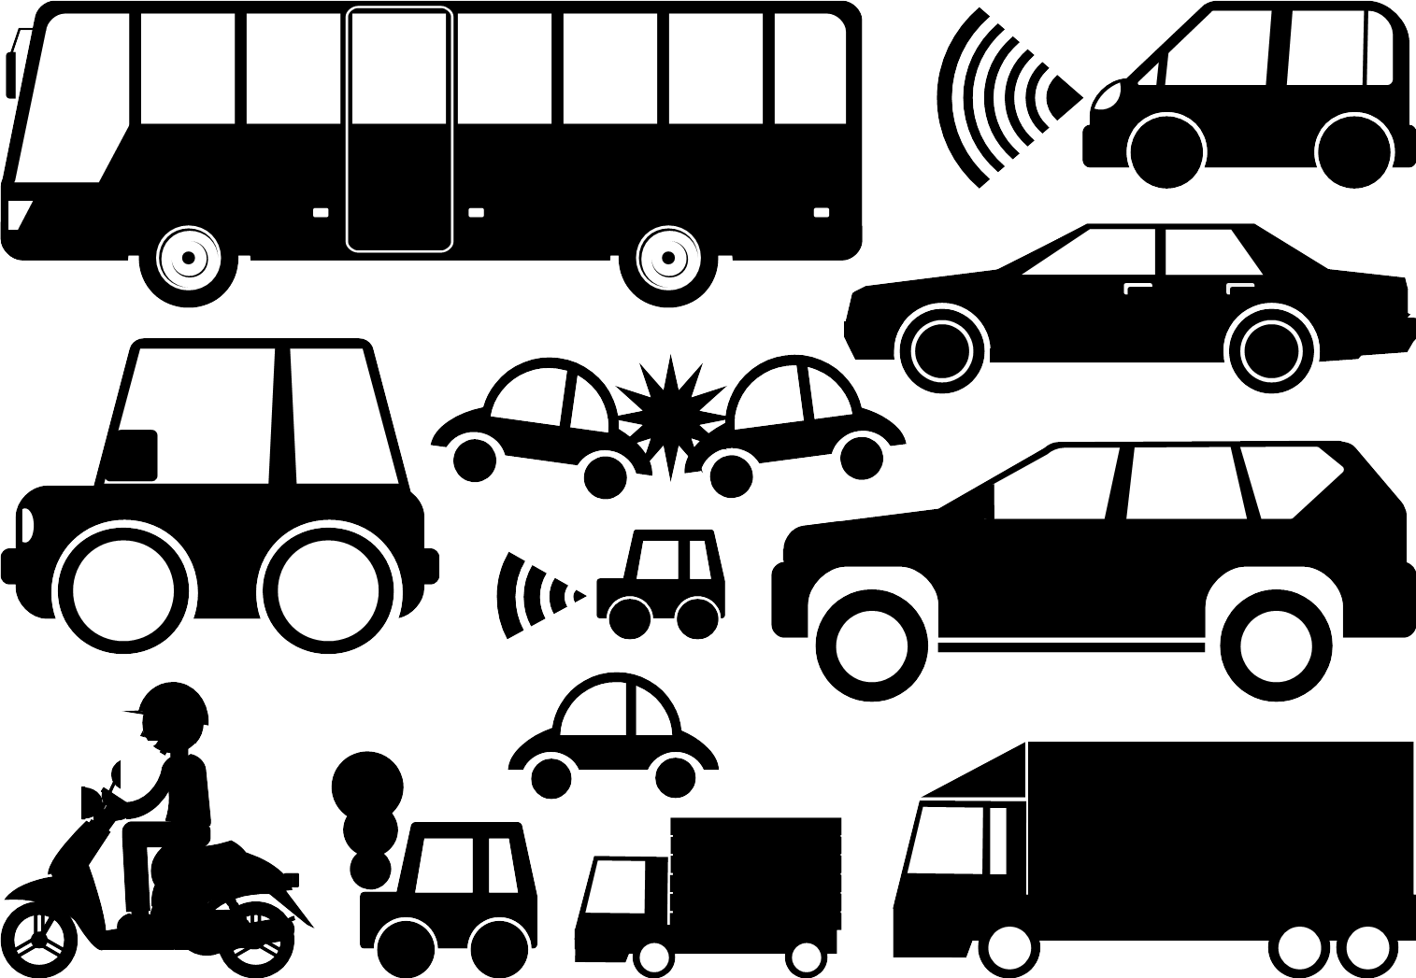
Use case : In-vehicle
(Large & long vehicle)
Cargo vehicle (Truck)
HBAN: For vehicle driver
Health care sensors (ECG, Hart-rate, Body temp. etc.)
VBAN(1):
For vehicle sensing & control
[S/M vehicle model] + payload weight sensor, center-of-gravity position sensor, more cameras and radars.
Wireless signal Propagates long distance
VBAN(2):
For entertainment purpose
Audio & video, smart phone, tablet PC, etc.
EMI sources
&
General purpose radios
Similar condition as [S/M size vehicle]
Longer distance than [S/M vehicle model]

Slide 26
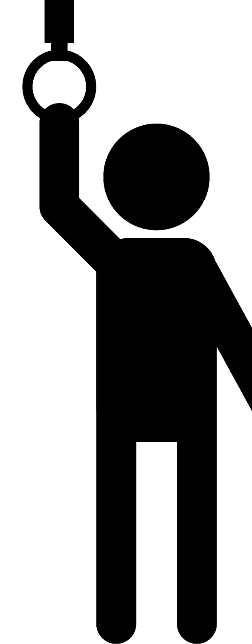
Use case : In-vehicle
(Large & long vehicle)
Passenger vehicle (BUS)
HBAN: For vehicle driver
Health care sensors (ECG, Hart-rate, Body temp. etc.)
HBAN(1~several dozens): For passenger
Health care sensors (ECG, Hart-rate, Body temp. etc.) as well as [S/M size vehicle] model. However, number of HBAN in the same vehicle is match more.
VBAN(1):
For vehicle sensing & control
VBAN(2):
For entertainment purpose
Similar condition as [Cargo vehicle]
General purpose radios
&
EMI sources

Slide 27

Use case : In-vehicle
(Special purpose vehicle)
Passenger vehicle (BUS)
HBAN: For vehicle driver
Health care sensors (ECG, Hart-rate, Body temp. etc.)
VBAN(1):
For vehicle sensing & control
Load sensor, arm angle sensor, posture sensor,
oil pressure sensor, engine temperature sensor,
over-load sensor, rear and side cameras etc.
EMI sources
&
General purpose radios
Similar condition as [Cargo vehicle]

Slide 28

Use case : On-vehicle
Key-less entry system and relay attack avoidance
Around-vehicle environment
Anchor node device
on-vehicle environment
Anchor node device
Smart key
https://illust8.com/contents/2559

Slide 29
Use case : In-vehicle
Elderly driver’s accident avoidance
HBAN(1): For vehicle driver
Health condition monitoring, Seizure and sudden death detection
HBAN(2): For passenger
Health condition monitoring, ride comfort monitoring
VBAN(1):
For vehicle sensing & control
Emergency vehicle control and braking while driver ’s health problem happens
VBAN(2):
For entertainment purpose
Emergency call to rescue, ambulance teams and police station
General purpose radios
Emergency call to rescue, ambulance teams and police station on cellular network

Slide 30
Current channel models in std.802.15.6
Senario | Description | Freqency band | Channel Model
S1 | Implant to Implant | 402-405 MHz | CM1
S2 | Implant to Body Surface | 402-405 MHz | CM2
S3 | Implant to External | 402-405 MHz | CM2
S4 | Body Surface to Body Surface (LOS) | 13.5, 50, 400, 600, 900 MHz 2.4, 3.1-10.6 GHZ | CM3
S5 | Body Surface to Body Surface (NLOS) | 13.5, 50, 400, 600, 900 MHz 2.4, 3.1-10.6 GHZ | CM3
S6 | Body Surface to External (LOS) | 900 MHz 2.4, 3.1-10.6 GHZ | CM4
S7 | Body Surface to External (NLOS) | 900 MHz 2.4, 3.1-10.6 GHZ | CM4

Slide 31
Extension for this amendment
Scenario | Description | Frequency band | Channel Model | Environmental Model
VS1 | In-vehicle to In-vehicle | UWB band
VS2 | In-vehicle to On-vehicle | UWB band
VS3 | In-vehicle to Around | UWB band
VS4 | On-vehicle to On-vehicle (LOS) | UWB band
VS5 | On-vehicle to On-vehicle Surface (NLOS) | UWB band
VS6 | On-vehicle to On-vehicle to Around vehicle (LOS) | UWB band
VS7 | On-vehicle to Around vehicle (NLOS) | UWB band

Slide 32
Channel and Environmenta models between VBAN and HBAN
On-vehicle to On vehicle(LOS)
On-vehicle to On Body
On-body to On-body
In-Vehicle to On-body

Slide 33
Models for VBAN
HBAN-1
Models for HBAN
VBAN
Models for VBAN
HBAN-2
Models between HBAN and VBAN

Slide 34
Summary
Environment model which has wider meaning than channel model has been proposed.
Environment model including not only channel characteristics but also including interference, colored noise, EMC and human impact issues.
Environment models has been categorized against several typical vehicle categories.
Most dominant environment models in individual categories were assigned as "Mandatory".

