Slide 1
Project: IEEE P802.15 Working Group for Wireless Personal Area Networks (WPANs)
Submission Title: Consideration of OCC for Intelligent Transportation System (ITS)
Date Submitted: January 2021
Source: Huy Nguyen, Yeong Min Jang [Kookmin University].
Contact: +82-2-910-5068 E-Mail: yjang@kookmin.ac.kr
Re:
Abstract: Consideration of OCC for Intelligent Transportation System (ITS)
Purpose: To discuss about the need for applying OCC for Intelligent Transportation System (ITS)
Notice: This document has been prepared to assist the IEEE P802.15. It is offered as a basis for discussion and is not binding on the contributing individual(s) or organization(s). The material in this document is subject to change in form and content after further study. The contributor(s) reserve(s) the right to add, amend or withdraw material contained herein.
Release: The contributor acknowledges and accepts that this contribution becomes the property of IEEE and may be made publicly available by P802.15.

Slide 2
Consideration of OCC for Intelligent Transportation System (ITS)

Slide 3
Introduction
An intelligent transportation system (ITS) is an advanced application which aims to provide innovative services relating to different modes of transport and traffic management.
Advantages of ITS:
Secure, safe and comfortable movement of drivers
Reduce delay time and congestion
Increase convenience for drivers
Parking information and guidance

Slide 4
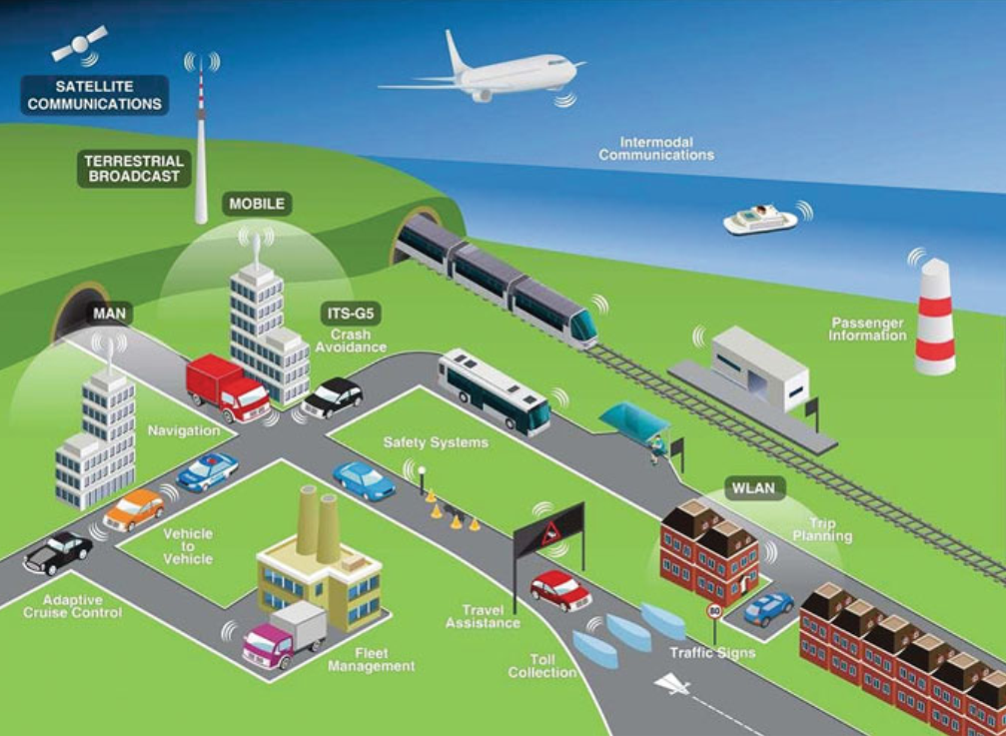
Intelligent Transportation Systems (ITS) Scenario
ITS scenario
Information from vehicles and road side can be transmitted to a server for central fusion and processing.
These data can be used to detect events such as road works, traffic jam, approaching emergency vehicle, etc.
Such data are processed in order to produce driving recommendation dedicated to drivers and transmitted to another vehicles by wireless communication.

Slide 5
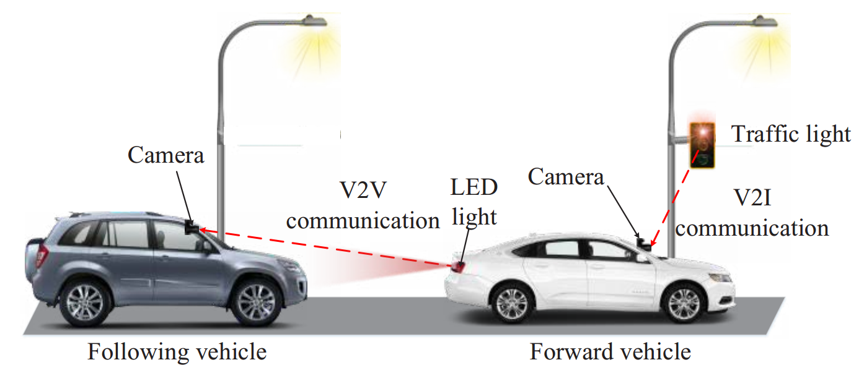
Scenario of V2V communication using OCC
Scenario of V2V communication using OCC
OCC uses vehicle backlight LED lights or traffic lights as Tx and camera in the vehicle as Rx. Here, the Tx transmit the vehicles status (speed, safety information, emergency message, and etc.) or the traffic condition.
The receiver can be a single or multiple of image sensor which receives the transmitted information from the Tx.

Slide 6
OCC in Intelligent Transportation Systems (ITS)
Overview of OCC-based ITS communication
The ITS infrastructure and the ITS ad-hoc network are designed to accommodate and implement ITS services and applications.
They are interconnected and connected to public access, private access, and local data networks.

