Slide 1
Project: IEEE P802.15 Working Group for Wireless Personal Area Networks (WPANs)
Submission Title: [Technical Proposal for TG4aa JRE]
Date Submitted: [3 November, 2020]
Source: [Hiroshi Harada, Ryota Okumura] Company [Kyoto University]
Address [Yoshidahonmachi, Sakyo-ku, Kyoto 606-8501 Japan]
Voice:[+81-75-753-5318], FAX: [], E-Mail:[hiroshi.harada@i.kyoto-u.ac.jp]
Re: []
Abstract: [This document includes Technical Contributions toward the development the amendment of IEEE Std 802.15.4-2020]
Purpose: [Technical Proposal for TG4aa JRE.]
Notice: This document has been prepared to assist the IEEE P802.15. It is offered as a basis for discussion and is not binding on the contributing individual(s) or organization(s). The material in this document is subject to change in form and content after further study. The contributor(s) reserve(s) the right to add, amend or withdraw material contained herein.
Release: The contributor acknowledges and accepts that this contribution becomes the property of IEEE and may be made publicly available by P802.15.

Slide 2
Current SUN FSK options for Japan in IEEE 802.15.4
Frequency band (MHz) | Parameter | Operating mode
 |  | #1 | #2 | #3 | #4
920-928 MHz | Data rate (kb/s) | 50 | 100 | 200 | 400
 | Modulation | 2-FSK | 2-FSK | 2-FSK | 4-FSK
 | Modulation index | 1.0 | 1.0 | 1.0 | 0.33
 | Channel spacing (kHz) | 200 | 400 | 600 | 600
 | Standard | 802.15.4-2020
Slide 2

Slide 3
Proposal
Frequency band (MHz) | Parameter | Operating mode
 |  | #1 | #2 | #3 | #4 | #XX | #XX | #XX | #XX
920-928 MHz | Data rate (kb/s) | 50 | 100 | 200 | 400 | 400 | 600 | 600 | 800
 | Modulation | 2-FSK | 2-FSK | 2-FSK | 4-FSK | 2-FSK | 2-FSK | 4-FSK | 4-FSK
 | Modulation index | 1.0 | 1.0 | 1.0 | 0.33 | 0.5 | 0.4 | 0.5 | 0.33
 | Channel spacing (kHz) | 200 | 400 | 600 | 600 | 200 * N 1≦N≦5 [2] | 200 * N 1≦N≦5 [2] | 200 * N 1≦N≦5 [2] | 200 * N 1≦N≦5 [2]
 | Standard | 802.15.4-2020 [1] |  |  |  | Proposed
Note: N is integer number

Slide 4
Feasibility Study [3][4]

Slide 5
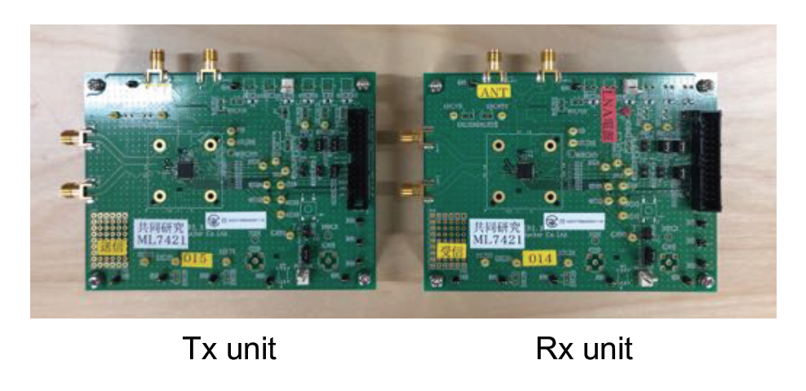
High-speed FSK Transmission Scheme
Prototype IC and evaluation board
  Support data rates from 50 kbps to 600 kbps by 2-FSK
  Support IEEE 802.15.4-compliant FEC
  Certified by a certification body in Japan
    Meet the requirements of ARIB STD-T108 under the proposed parameters
Prototype IC

Slide 6
High-speed FSK Transmission Scheme
Static characteristics of IC
  External LNA: improve transmission quality
  PER and average RSSI calculated by PC from 1,000 transmitted packets
  Input power to receiver: power at the input of the LNA
Input power to receiver

Slide 7
High-speed FSK Transmission Scheme
Static characteristics of IC
Parameters | Values
Modulation Scheme | 2-GFSK
CH Frequency | 926.9 MHz | 927.0 MHz
Data Rate | 100 kbps | 300 kbps | 600 kbps
Modulation Index | 1.0 | 0.5 | 0.4
Preamble Length | 15 octets
Payload Length | 250 octets
FEC | OFF, ON
Encoding Scheme | RSC
Decoding Scheme | Viterbi (Hard decision)
Interleaver | ON
CRC | 16 bits
Inter-packet Time | 0.35 s

Slide 8
High-speed FSK Transmission Scheme
Target PER = 10%
Static characteristics of IC
Data Rate (kbps) | Required Input Power (dBm)
100 | –105.6
300 | –99.7
600 | –98.6
7.0 dB
  600 kbps achieved with a deterioration of 7.0 dB
  FEC improvement: 2.4 dB
  600 kbps w/ FEC is better than 300 kbps w/o FEC
Feasibility of proposed high-speed FSK scheme
LNA gain: about 12 dB
Possibility of using FEC to improve transmission quality

Slide 9

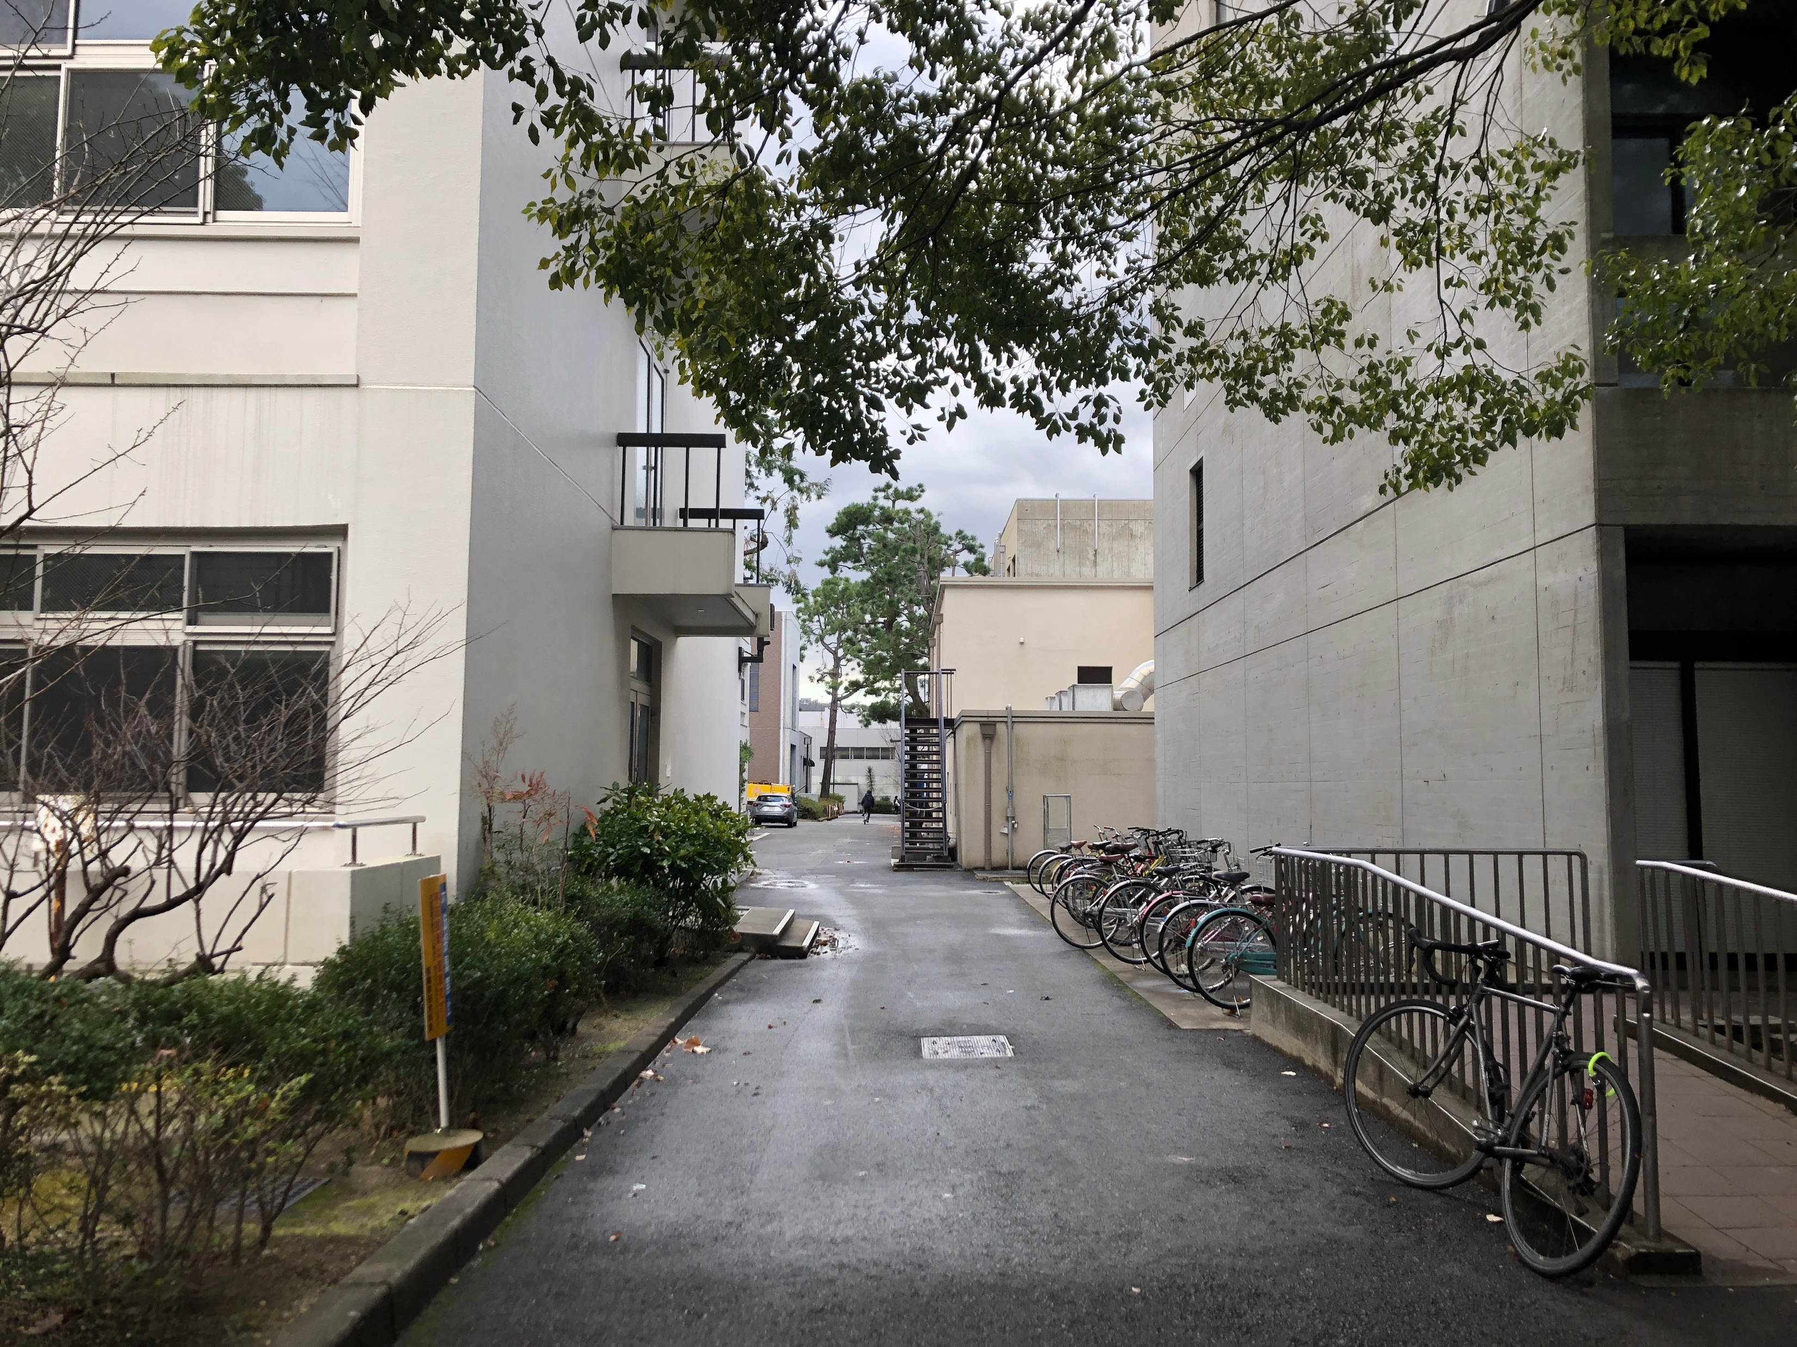
Field Experiment with High-speed FSK
Measurement field
  Typical urban environment assuming smart metering system
  Transmitter is fixed while receiver keeps moving along different routes
Route A (mostly LoS)
Route B (mostly NLoS)

Slide 10
Field Experiment with High-speed FSK
Radio stations
SAW: Surface acoustic wave
GPS: Global position system
Transmitter (concentrator)
  Antenna height: 4.5 m
  Transmission power: 20 mW
Receiver (smart meter device)
  Antenna height: 1.1 m
  SAW filter: remove signals from out bands
  GPS loggers: log location information of receiver while moving

Slide 11
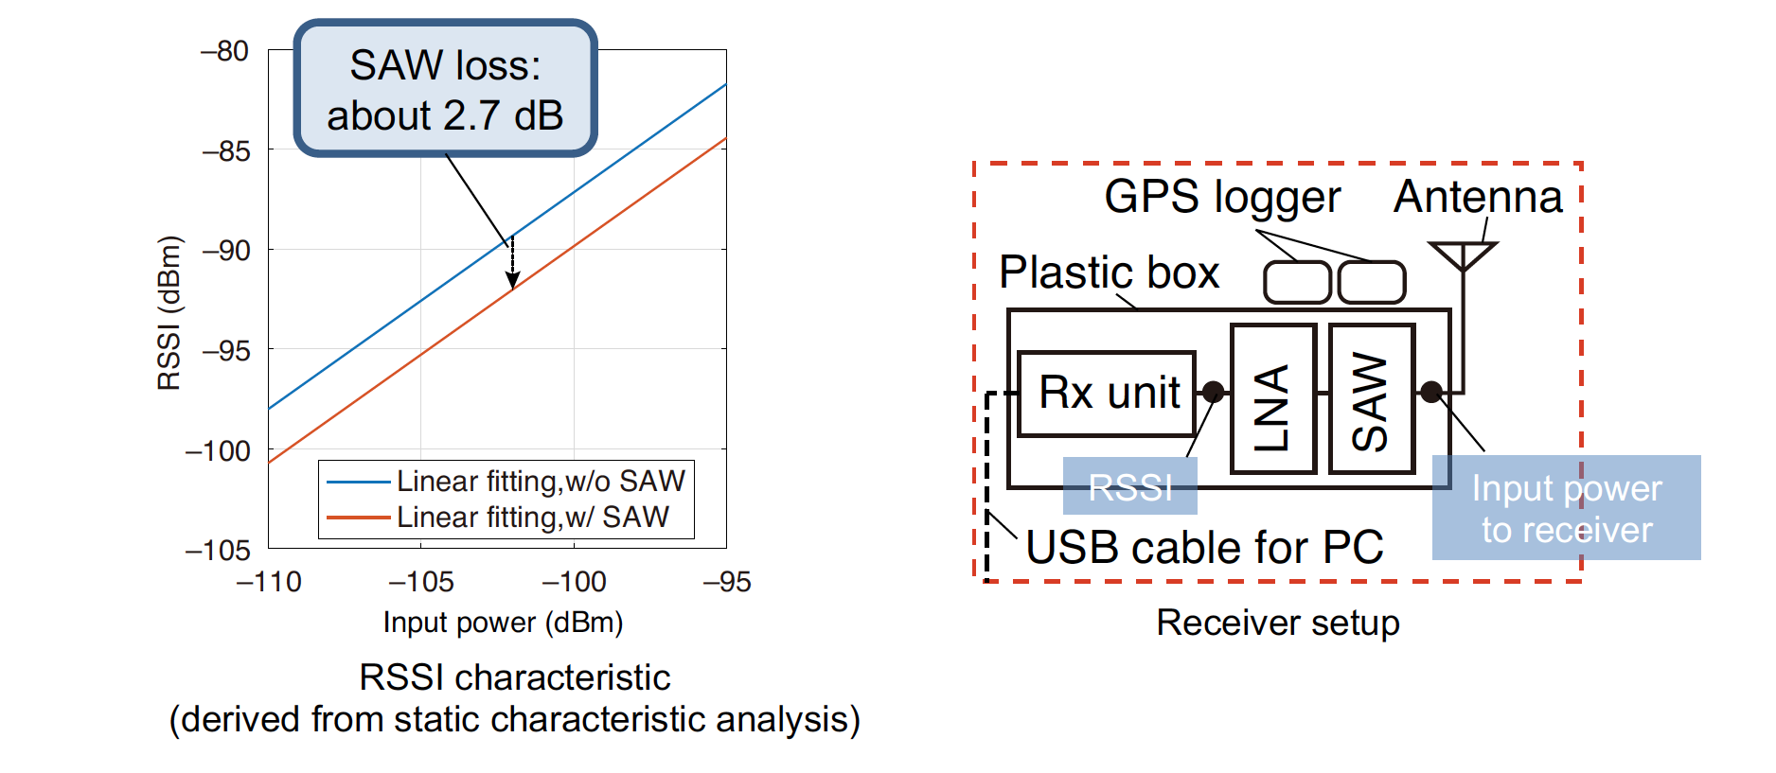
Field Experiment with High-speed FSK
Average input power to receiver
  Input power to receiver: power at the input of the SAW filter
  Average value: calculated from 51 packets before and after

Slide 12
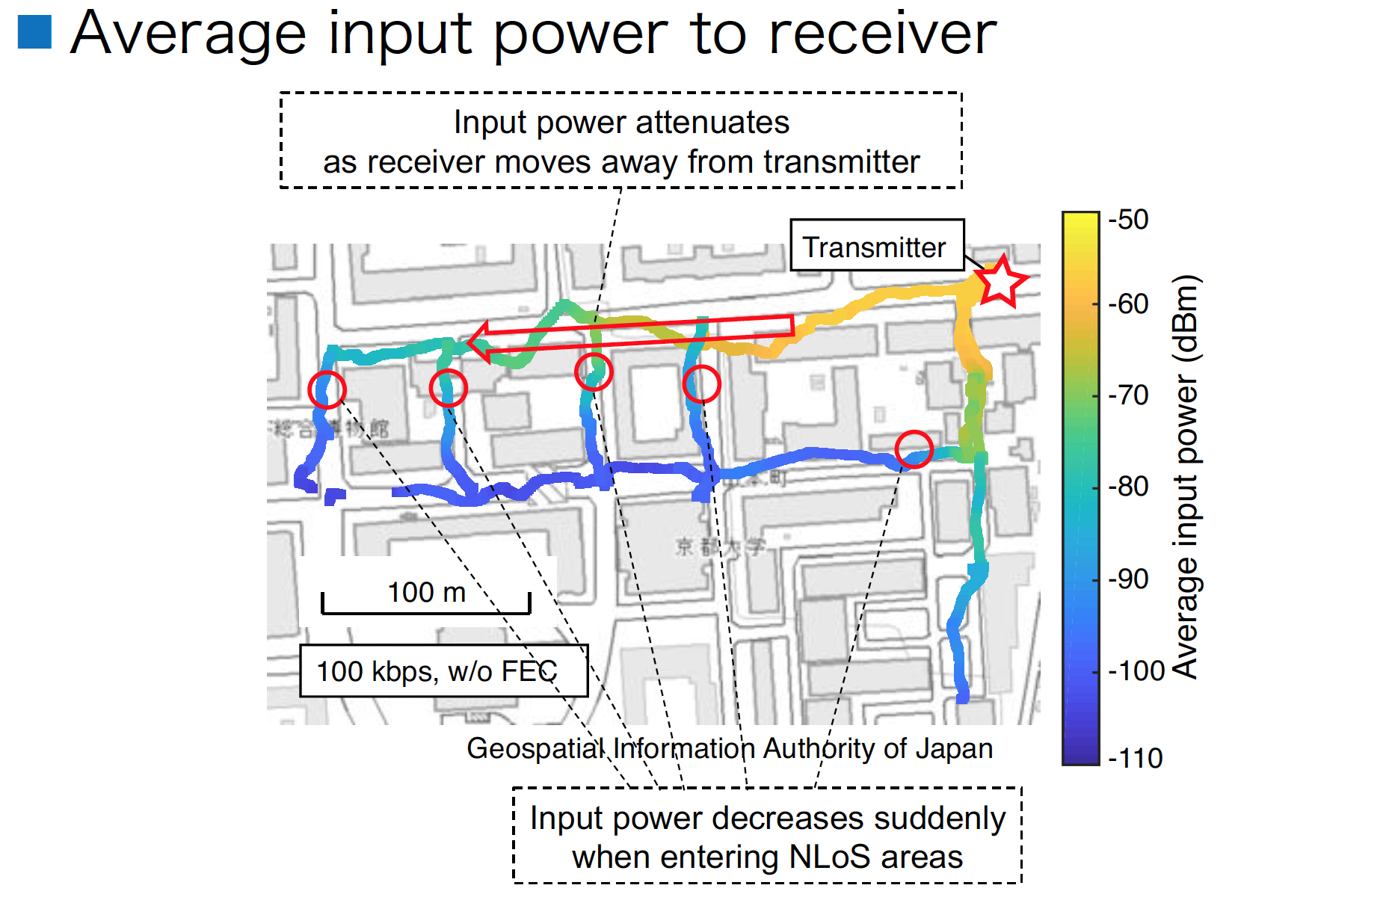
Field Experiment with High-speed FSK
Average input power to receiver

Slide 13
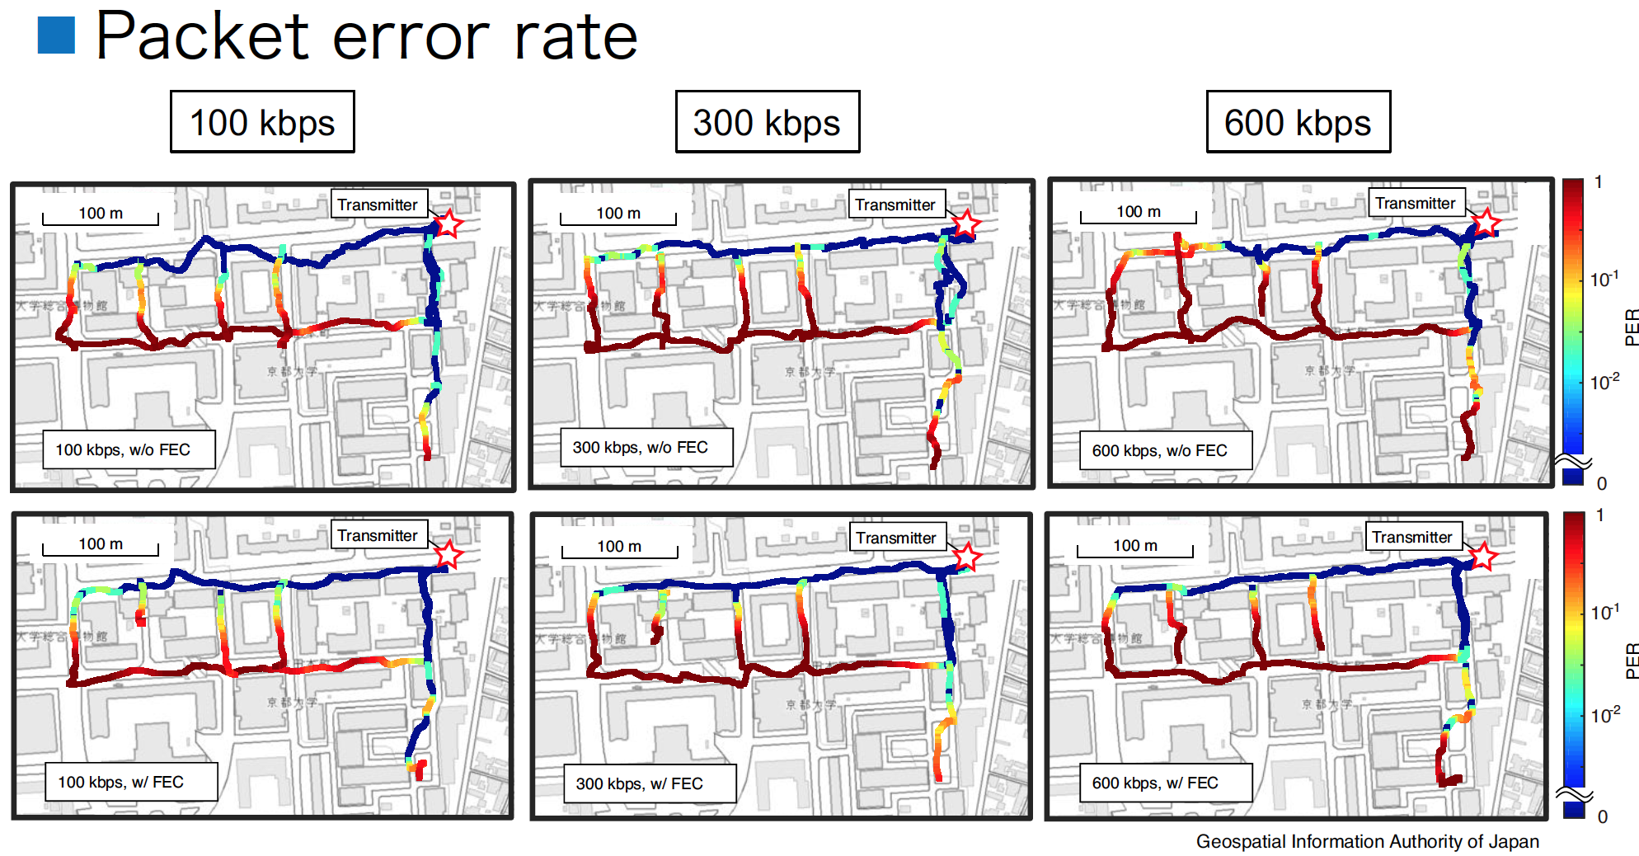
Field Experiment with High-speed FSK
Packet error rate

Slide 14
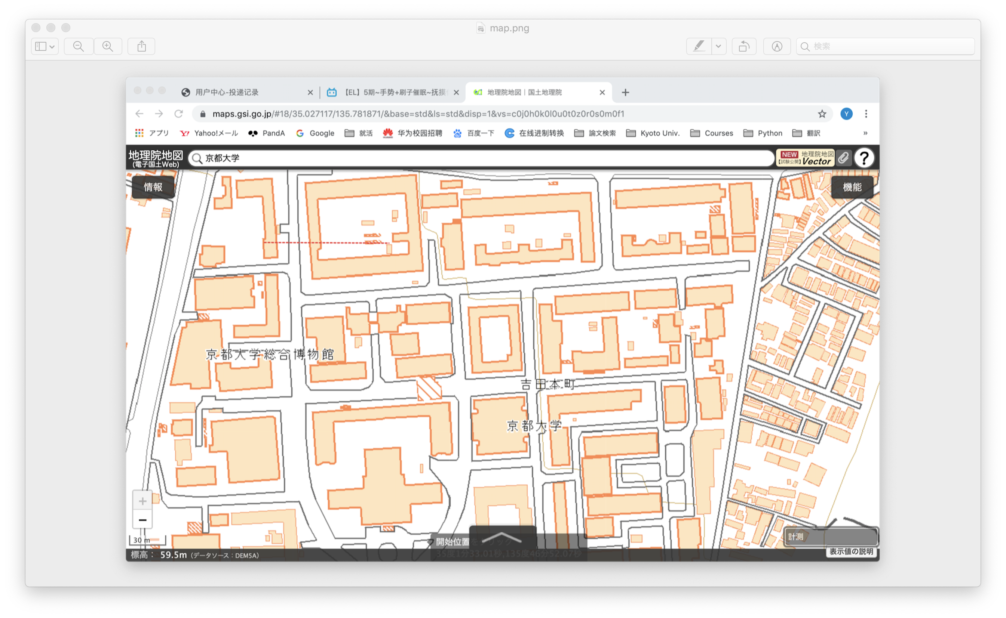
Field Experiment with High-speed FSK
Packet error rate (for distance)
320 m
200 m

Slide 15
Field Experiment with High-speed FSK
Communication distance
  High-speed FSK is applicable with a shorter communication distance
  On an LoS road without obvious obstacles, 600 kbps achieves 250 m communication distance
  The communication distance of 600 kbps is sufficient in a massive and dense network using multi-hop communication
Data Rate (kbps) | Communication Distance (m)
 | Route A (LoS) | Route B (NLoS)
100 | > 320 | 150
300 | > 320 | 120
600 | 250 | 100
Communication Distance
The shortest distance where PER exceeds 10%

Slide 16
Simulation Study
on Channel Spacing [5][6]

Slide 17
Wi-SUN FAN with High-speed FSK
Channel arrangement on performing frequency hopping (FH)
  In general, the channel spacing defined in IEEE 802.15.4 is equal to the channel width
    e.g. the channel spacing in existing FSK (100 kbps) in Japan is defined as 400kHz
    “Channel width”: sum of bundled unit channels to make up one channel
Channel Spacing: 400 kHz (Operating Mode #2)
Channel Spacing: 1,000 kHz (N=5)
Similar channel allocation

Slide 18
Problem of Adopting High-speed FSK and FH
Larger occupied bandwidth
  FAN with High-speed FSK performing FH (7 channels) occupies most of the available bandwidth in the 920 MHz-band (7.6 MHz)
  FAN with High-speed FSK performing FH has poor compatibility with the existing system design using the existing FSK
×2.5

Slide 19
Proposed Channel Spacing
Smaller channel spacing in high-speed FSK (N<5)
  Smaller N reduces occupied bandwidth
  Case of N=2 has an affinity with the existing system design
Reduce by half
(Case of N=2)

Slide 20
Proposed Channel Spacing
Smaller channel spacing in high-speed FSK (N<5)
  Enough interference avoidance performance can be expected
    Interference from neighboring channels becomes larger
    But shorter packet by high-speed FSK makes easy to avoid interference in the time domain

Slide 21
Simulation Model
  Each router independently generates packets according to the Poisson distribution
    𝜆 : mean packet generation rate
  A node whose 𝑛 is one less than own 𝑛 on a straight line toward BR is selected as a relay node
    𝑛 : predetermined number of transfers toward BR
total of
144 routers

Slide 22
Simulation Parameters
Parameters | Values
Modulation scheme | 2-GFSK
Data rate | 100kbps or 600kbps
Modulation index | 1.0 (100kbps), 0.4 (600kbps)
Gaussian filter BT | Tx: 0.5, Rx: 0.5
Channel model | AWGN
Payload size | 256bytes
Header size | 108bytes
ACK frame size | 38bytes
Number of Routers | 144
BR height | 5m
Router height | 0m
Attenuation constant | 3
Transmit power | 13dBm
CCA threshold | –80dBm
Parameters | Values
Target number of packets | 1.0×10⁴
Packet generation rate | From 5.0×10^{–3} to 1.0×10^{–1} (s^{–1})
Number of active channels | 1 or 7
Channel function | DH1CF
Unicast dwell interval | 100ms
Channel spacing | 400kHz (100kbps), 400kHz or 1MHz (600kbps)
LIFS | 1ms
CCA duration | 0.13ms
Unit backoff period | 1.13ms
RX to TX TurnaroundTime | 1ms
ACK waiting duration | 5ms (100kbps), 2.5ms (600kbps)
Minimum backoff exponent | 3
Maximum backoff exponent | 5
Maximum number of backoff | 4
Maximum number of retransmission | 3

Slide 23
System Throughput
  Sufficient throughput even in the high-speed FSK with the smaller channel spacing
max 26.1 kbps
600 kbps, 1,000 kHz spacing (N=5)
max 25.2 kbps
600 kbps, 400 kHz spacing (N=2)
max 10.5 kbps
100 kbps, 400 kHz spacing
×2.4
Proposed smaller channel spacing achieves 2.4 times maximum system throughput (Case of N=2) compared to existing FSK with FH

Slide 24
Reference
[1] IEEE, “IEEE 802.15.4-2020,” July 2020.
[2] ARIB, “ARIB STD-T108 920MHz-BAND TELEMETER, TELECONTROLAND DATA TRANSMISSION RADIO EQUIPMENT ver 1.3,” Apr. 2019.
[3] Y. Xiang, R. Okumura, K. Mizutani, and H. Harada, “Field Experiment of IEEE 802.15.4 Based High-Speed FSK Transmission Scheme,” IEICE Technical Report, Jan. 2020.
[4] Y. Xiang, R. Okumura, K. Mizutani, and H. Harada, “Data Rate Enhancement for IEEE 802.15. 4 Based FSK Transmission Scheme,” 2020 IEEE 6th World Forum on Internet of Things, Jun. 2020.
[5] H. Ochiai, K. Mizutani, R. Okumura, K. Mizutani, and H. Harada, “A Highly Dense Frequency Hopping for High-speed Wi-SUN FAN Network,” IEICE Technical Report, Jan. 2020.
[6] H. Ochiai, K. Mizutani, R. Okumura, K. Mizutani, and H. Harada, “A High-speed Wi-SUN FAN Network by Highly-Dense Frequency Hopping,” Proc. IEEE Vehicular Technology Conference , Nov. 2020 (to be appeared).

