Slide 1
Project: IEEE P802.15 Working Group for Wireless Personal Area Networks (WPANs)
Submission Title: [Technical Proposal for TG4aa JRE]
Date Submitted: [26 October, 2020]
Source: [Hiroshi Harada, Ryota Okumura] Company [Kyoto University]
Address [Yoshidahonmachi, Sakyo-ku, Kyoto 606-8501 Japan]
Voice:[+81-75-753-5318], FAX: [], E-Mail:[hiroshi.harada@i.kyoto-u.ac.jp]
Re: []
Abstract: [This document includes Technical Contributions toward the development the amendment of IEEE Std 802.15.4-2020]
Purpose: [Technical Proposal for TG4aa JRE.]
Notice: This document has been prepared to assist the IEEE P802.15. It is offered as a basis for discussion and is not binding on the contributing individual(s) or organization(s). The material in this document is subject to change in form and content after further study. The contributor(s) reserve(s) the right to add, amend or withdraw material contained herein.
Release: The contributor acknowledges and accepts that this contribution becomes the property of IEEE and may be made publicly available by P802.15.

Slide 2
Current SUN FSK options for Japan in IEEE 802.15.4
Frequency band (MHz) | Parameter | Operating mode
 |  | #1 | #2 | #3 | #4
920-928 MHz | Data rate (kb/s) | 50 | 100 | 200 | 400
 | Modulation | 2-FSK | 2-FSK | 2-FSK | 4-FSK
 | Modulation index | 1.0 | 1.0 | 1.0 | 0.33
 | Channel spacing (kHz) | 200 | 400 | 600 | 600
 | Standard | 802.15.4-2020
Slide 2

Slide 3
Proposal
Frequency band (MHz) | Parameter | Operating mode
 |  | #1 | #2 | #3 | #4 | #XX | #XX | #XX | #XX
920-928 MHz | Data rate (kb/s) | 50 | 100 | 200 | 400 | 400 | 600 | 600 | 800
 | Modulation | 2-FSK | 2-FSK | 2-FSK | 4-FSK | 2-FSK | 2-FSK | 4-FSK | 4-FSK
 | Modulation index | 1.0 | 1.0 | 1.0 | 0.33 | 0.5 | 0.4 | 0.5 | 0.33
 | Channel spacing (kHz) | 200 | 400 | 600 | 600 | 200 * N 1≦N≦5 [2] | 200 * N 1≦N≦5 [2] | 200 * N 1≦N≦5 [2] | 200 * N 1≦N≦5 [2]
 | Standard | 802.15.4-2020 [1] |  |  |  | Proposed
Note: N is integer number

Slide 4
Feasibility Study [3]

Slide 5
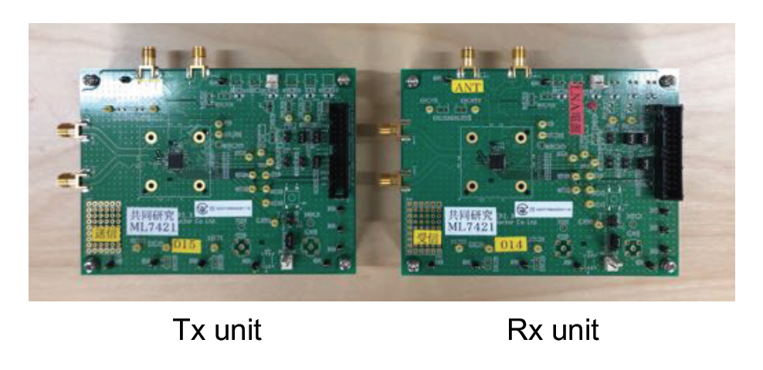
High-speed FSK Transmission Scheme
Prototype IC and evaluation board
  Support data rates from 50 kbps to 600 kbps by 2-FSK
  Support IEEE 802.15.4-compliant FEC
  Certified by a certification body in Japan
    Meet the requirements of ARIB STD-T108 under the proposed parameters
Prototype IC

Slide 6
High-speed FSK Transmission Scheme
Static characteristics of IC
  External LNA: improve transmission quality
  PER and average RSSI calculated by PC from 1,000 transmitted packets
  Input power to receiver: power at the input of the LNA
Input power to receiver

Slide 7
High-speed FSK Transmission Scheme
Static characteristics of IC
Parameters | Values
Modulation Scheme | 2-GFSK
CH Frequency | 926.9 MHz | 927.0 MHz
Data Rate | 100 kbps | 300 kbps | 600 kbps
Modulation Index | 1.0 | 0.5 | 0.4
Preamble Length | 15 octets
Payload Length | 250 octets
FEC | OFF, ON
Encoding Scheme | RSC
Decoding Scheme | Viterbi (Hard decision)
Interleaver | ON
CRC | 16 bits
Inter-packet Time | 0.35 s

Slide 8
High-speed FSK Transmission Scheme
Target PER = 10%
Static characteristics of IC
Data Rate (kbps) | Required Input Power (dBm)
100 | –105.6
300 | –99.7
600 | –98.6
7.0 dB
  600 kbps achieved with a deterioration of 7.0 dB
  FEC improvement: 2.4 dB
  600 kbps w/ FEC is better than 300 kbps w/o FEC
Feasibility of proposed high-speed FSK scheme
LNA gain: about 12 dB
Possibility of using FEC to improve transmission quality

Slide 9

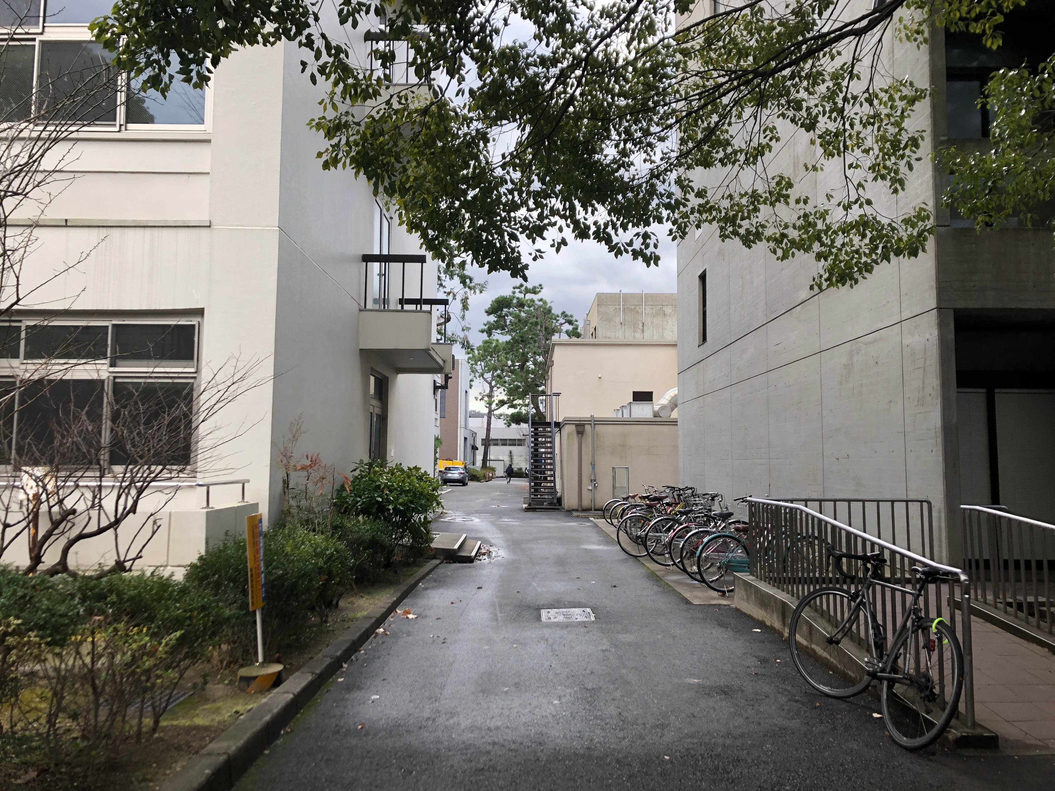
Field Experiment with High-speed FSK
Measurement field
  Typical urban environment assuming smart metering system
  Transmitter is fixed while receiver keeps moving along different routes
Route A (mostly LoS)
Route B (mostly NLoS)

Slide 10
Field Experiment with High-speed FSK
Radio stations
SAW: Surface acoustic wave
GPS: Global position system
Transmitter (concentrator)
  Antenna height: 4.5 m
  Transmission power: 20 mW
Receiver (smart meter device)
  Antenna height: 1.1 m
  SAW filter: remove signals from out bands
  GPS loggers: log location information of receiver while moving

Slide 11
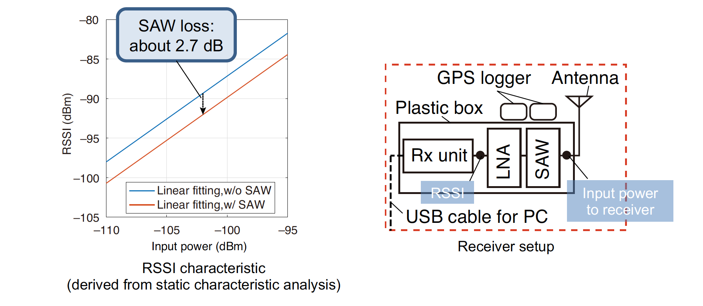
Field Experiment with High-speed FSK
Average input power to receiver
  Input power to receiver: power at the input of the SAW filter
  Average value: calculated from 51 packets before and after

Slide 12
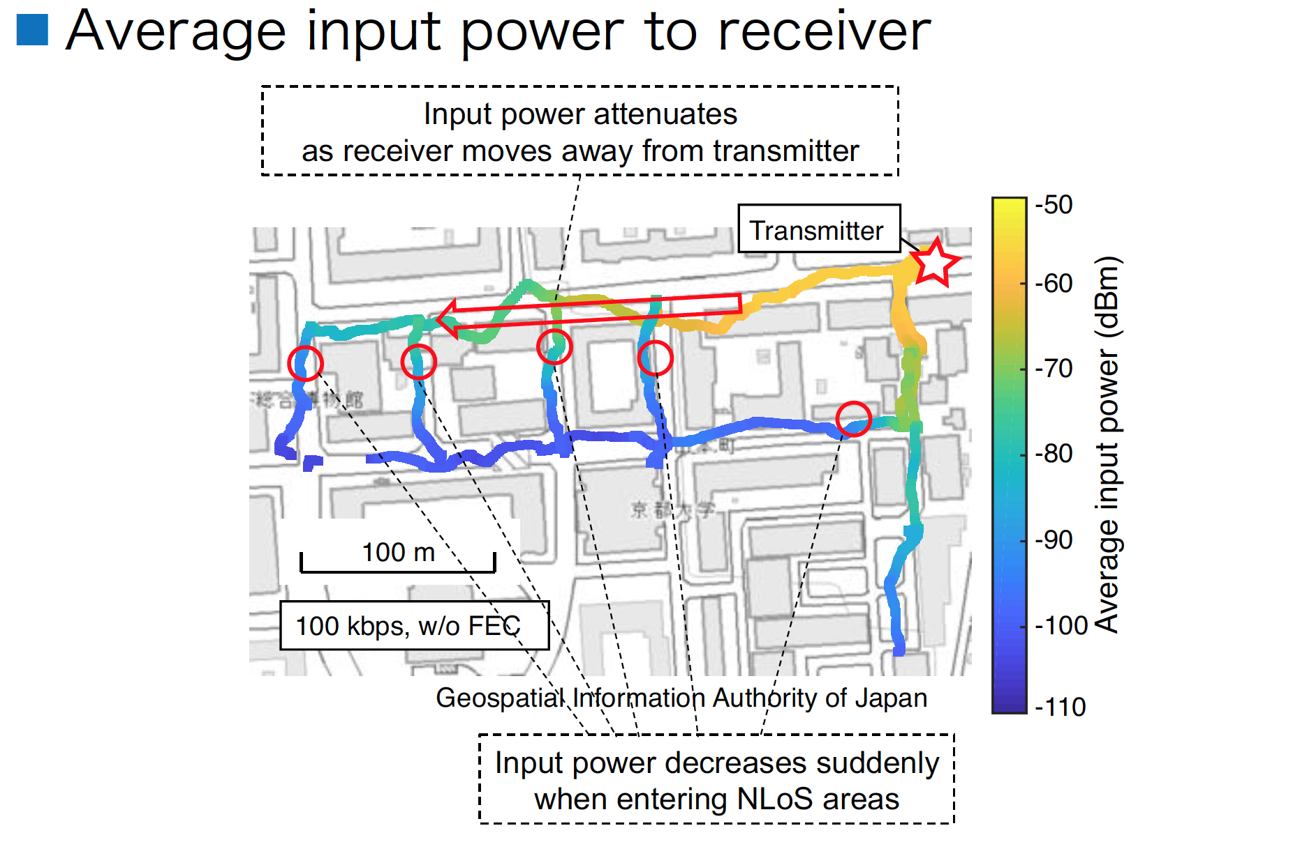
Field Experiment with High-speed FSK
Average input power to receiver

Slide 13
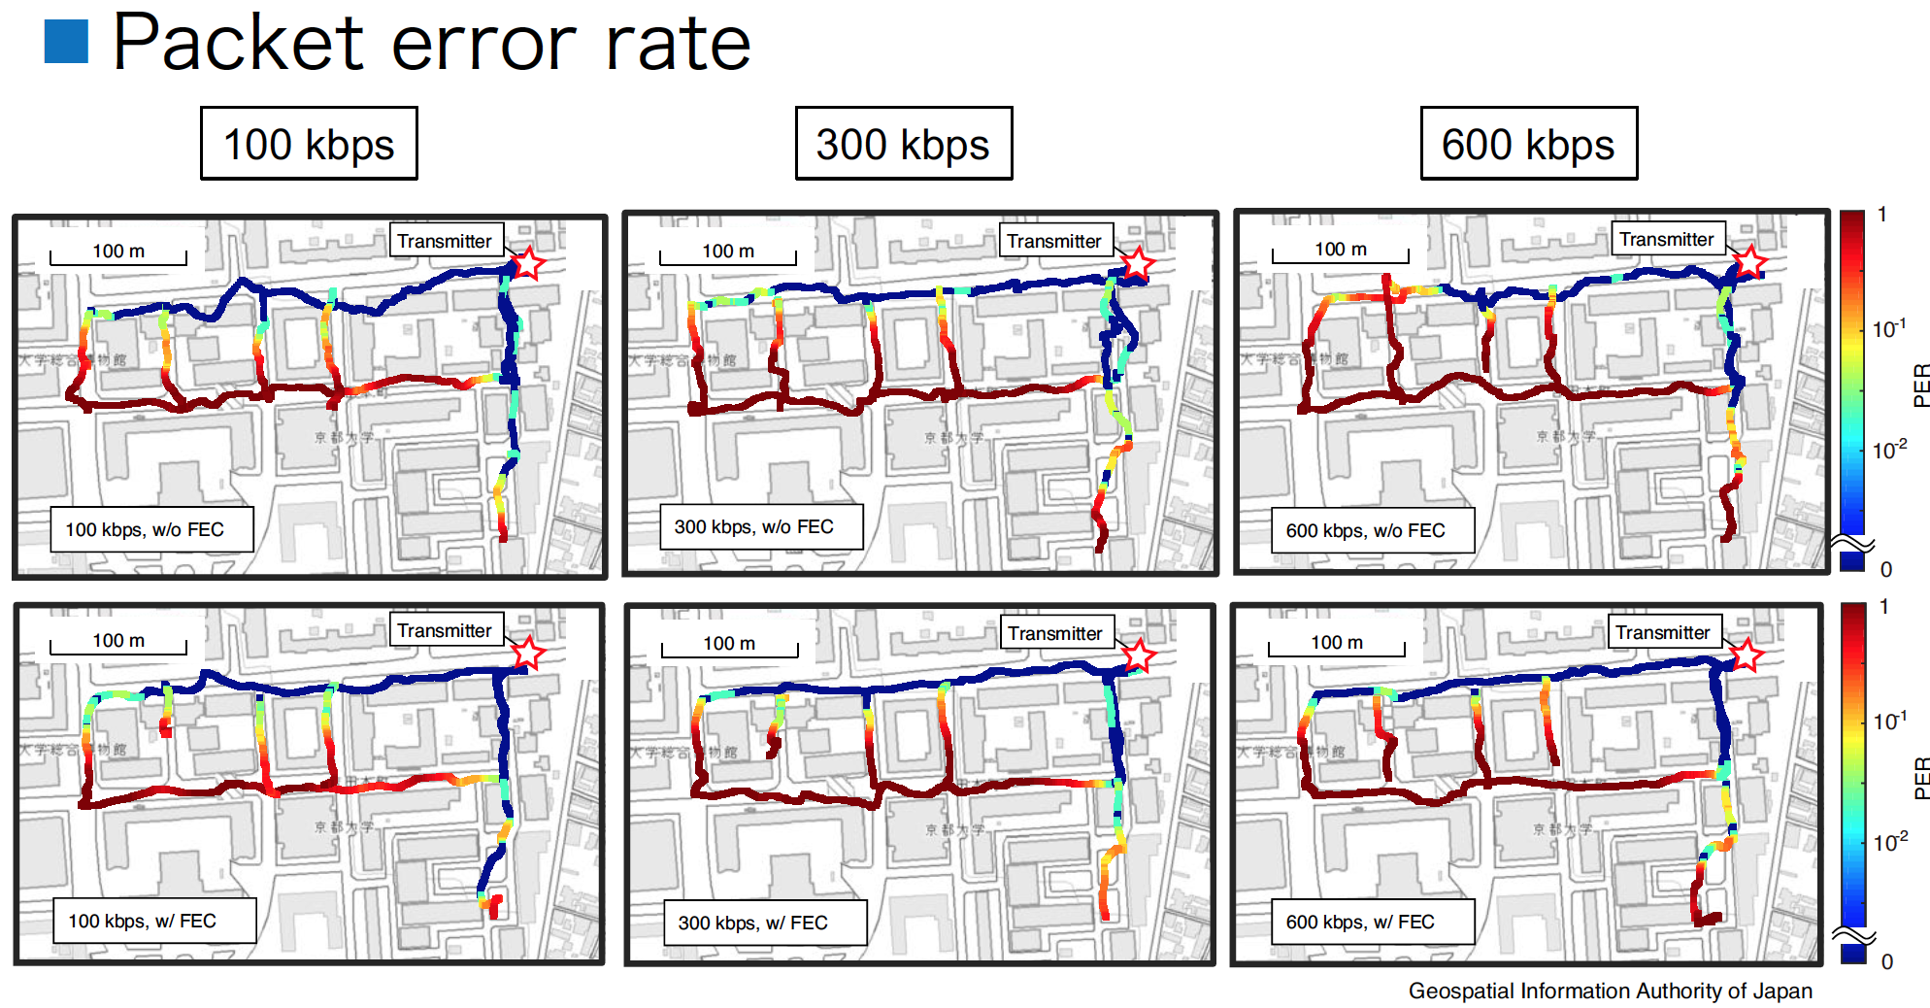
Field Experiment with High-speed FSK
Packet error rate

Slide 14
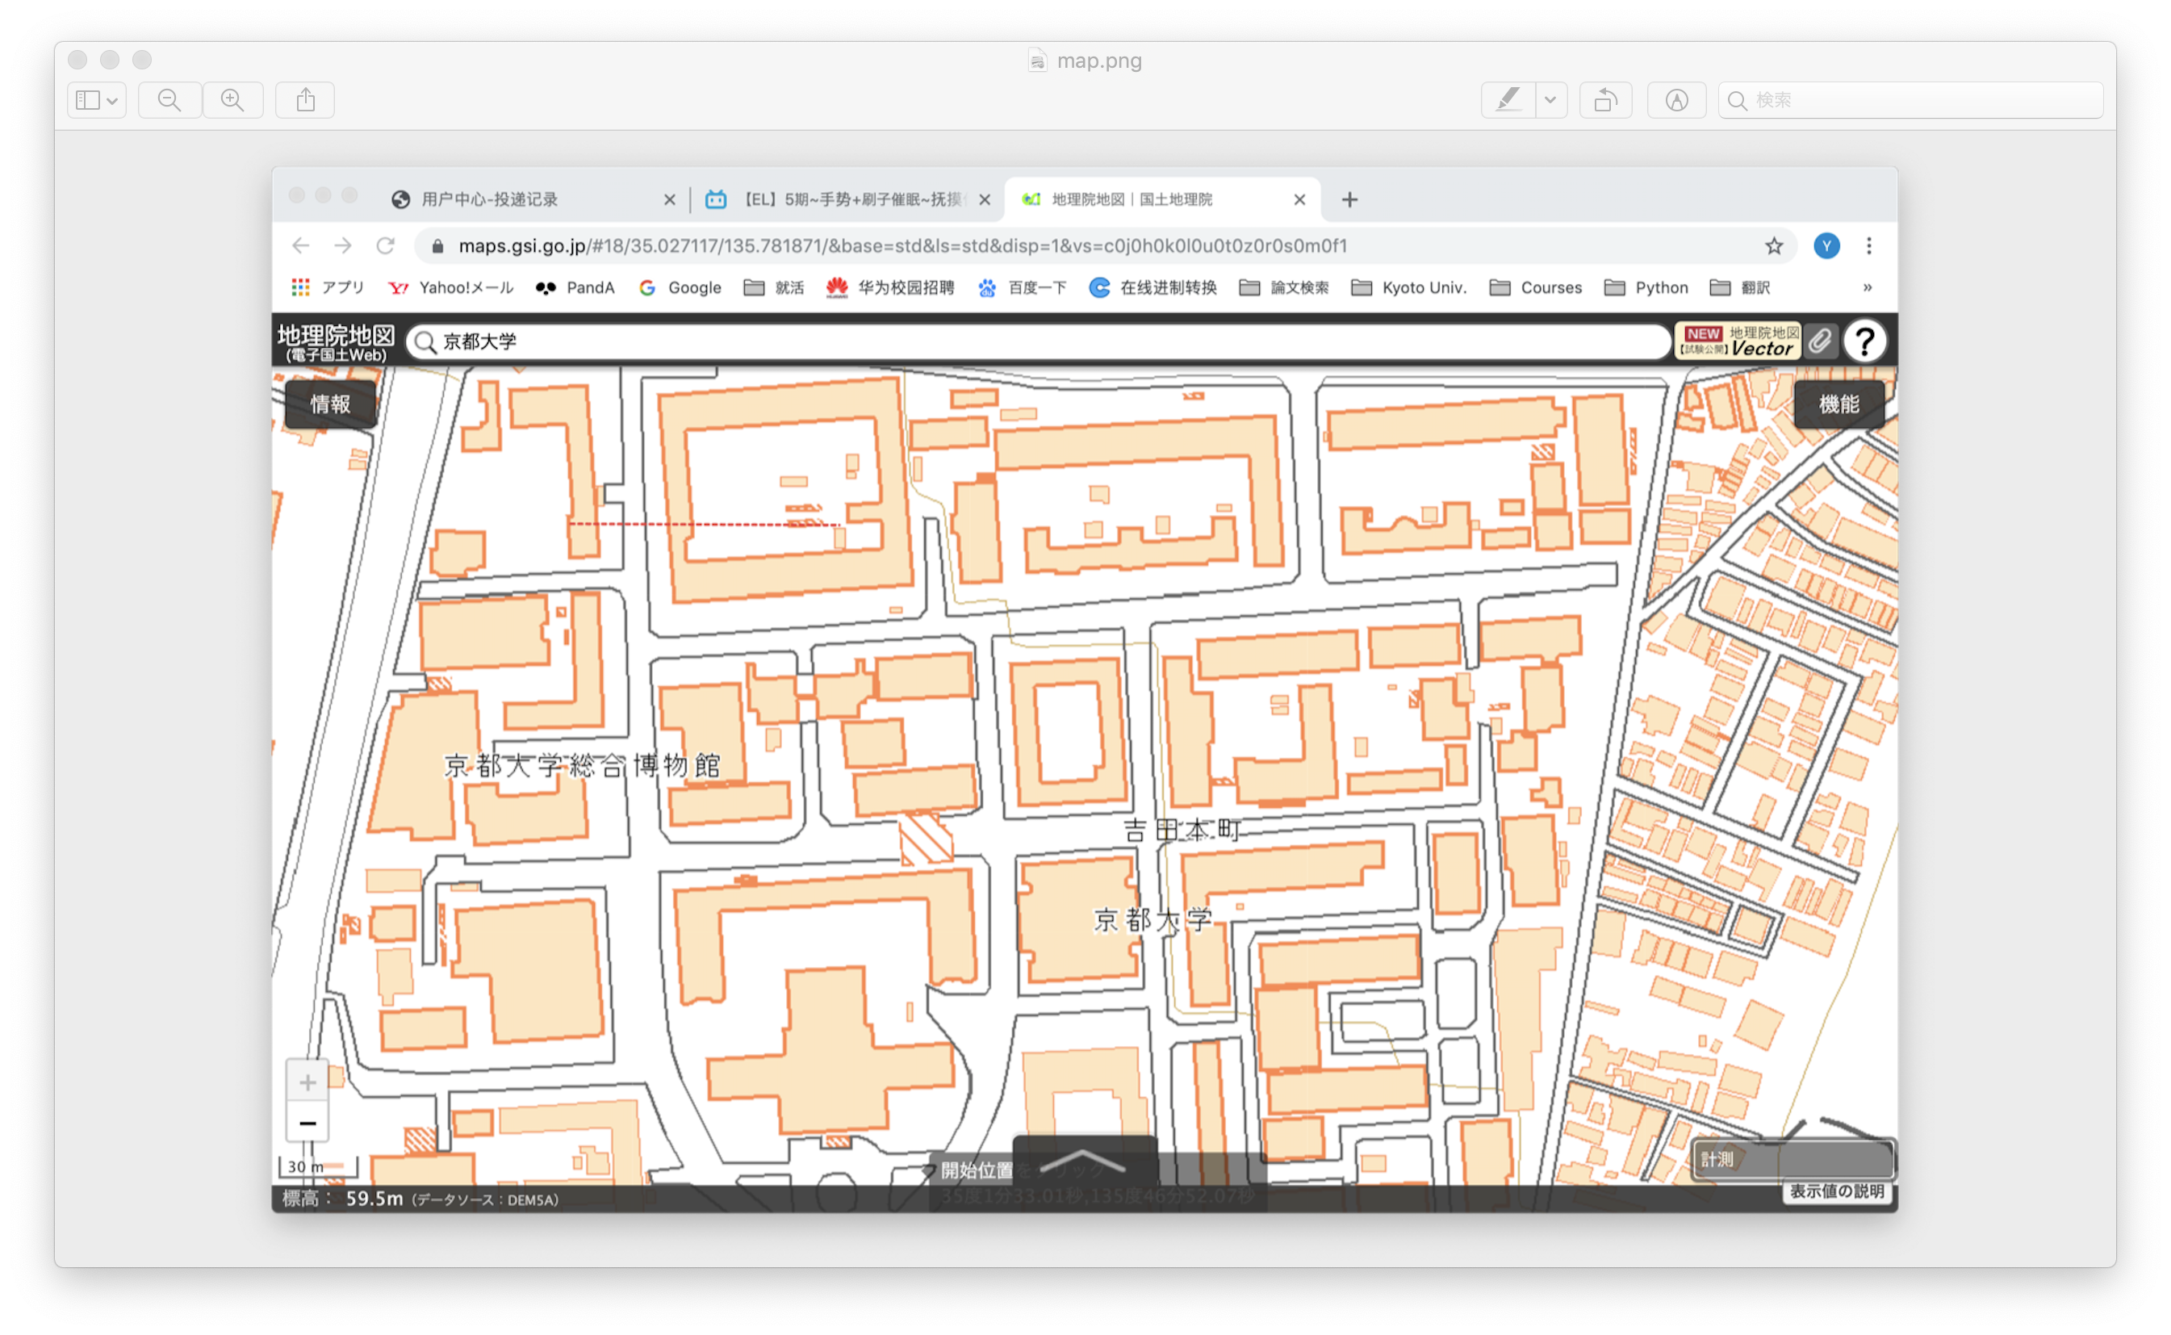
Field Experiment with High-speed FSK
Packet error rate (for distance)
320 m
200 m

Slide 15
Field Experiment with High-speed FSK
Communication distance
  High-speed FSK is applicable with a shorter communication distance
  On an LoS road without obvious obstacles, 600 kbps achieves 250 m
  The communication distance of 600 kbps is sufficient in a massive and dense network using multi-hop communication
Data Rate (kbps) | Communication Distance (m)
 | Route A (LoS) | Route B (NLoS)
100 | > 320 | 150
300 | > 320 | 120
600 | 250 | 100
Communication Distance
The shortest distance where PER exceeds 10%

Slide 16
Reference
[1] IEEE, “IEEE 802.15.4-2020,” July 2020.
[2] ARIB, “ARIB STD-T108 920MHz-BAND TELEMETER, TELECONTROLAND DATA TRANSMISSION RADIO EQUIPMENT ver 1.3,” Apr. 2019.
[3] Y. Xiang, R. Okumura, K. Mizutani, and H. Harada, “Field Experiment of IEEE 802.15.4 Based High-Speed FSK Transmission Scheme,” IEICE Technical Report, Jan. 2020.

