Slide 1
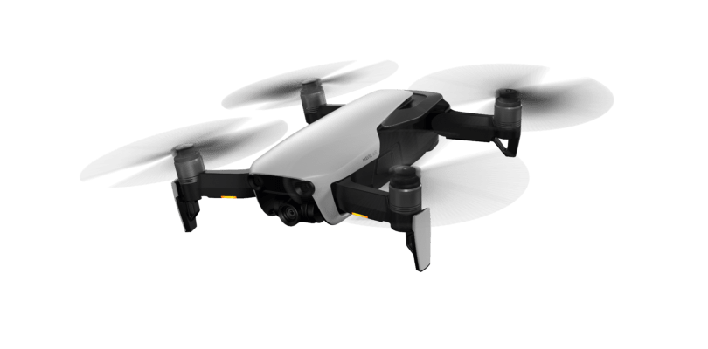
AURA Network Systems Next Generation Nationwide Air-to-Ground Communications Network Use Case
Doc.802.15-20-0059-00-016t
Michael Gagne – AURA Network Systems

Slide 2
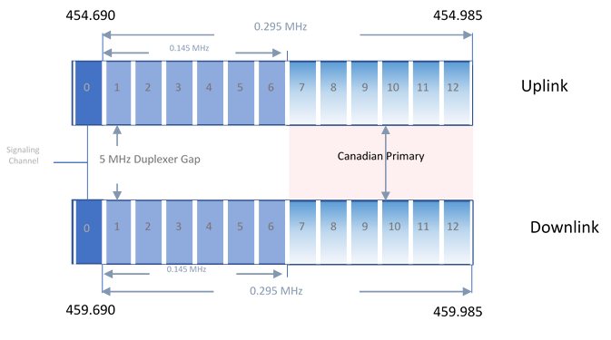
1. Introduction / Band Plan
Doc.802.15-20-0059-00-016t
Title 47 – Telecommunications
Part 22 – Public Mobile Service
Subpart G –Air-Ground Radiotelephone Service
General Aviation
Individual Site License
Signal Channel (20KHz) and Traffic Channel (20KHz)
325KHz Paired (650KHz total)
497 Mile Co-Channel Protection
217 Mile Service Area
Power Requirements
Ground Min 50 Watts, Max 100 Watts ERP
Mobile Min 4 Watts, Max 25 Watts ERP
Spectrum utilization allows for spectrum to be used as a block
Michael Gagne – AURA Network Systems

Slide 3
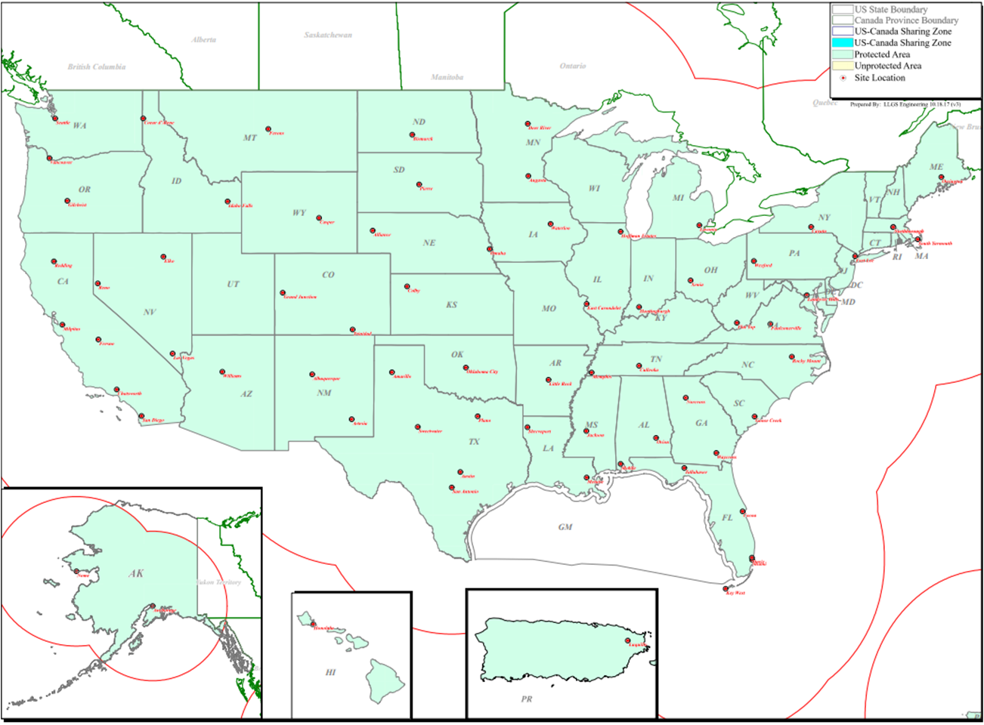
2. Site Licenses
Doc.802.15-20-0059-00-016t
67 licenses cover 69 transmitter locations
Secures all spectrum nationwide
Including Alaska, Puerto Rico and Hawaii
The 450 MHz spectrum has strong propagation characteristics
Operation permitted at all elevation
Michael Gagne – AURA Network Systems

Slide 4
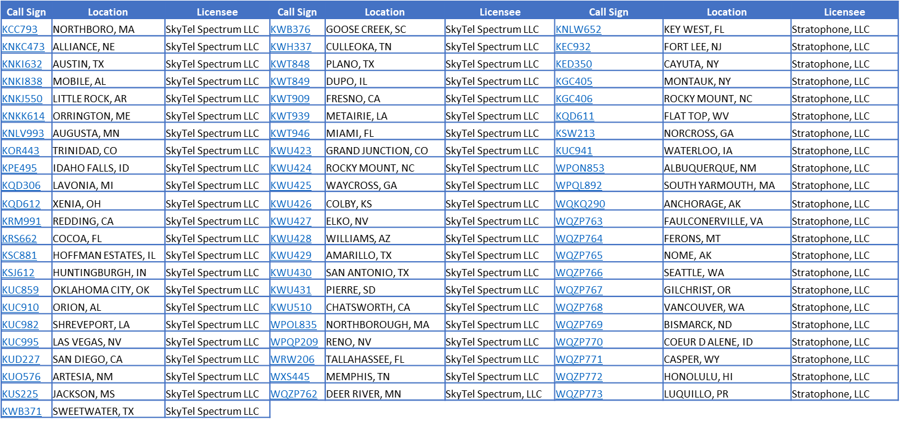
2. Site Licenses
Doc.802.15-20-0059-00-016t
Licensee of 67 General Aviation Air-Ground Radiotelephone Service licenses that together cover the entire United States and its territories, including Alaska, Hawaii and Puerto Rico
The 67 licenses cover 69 transmitter site locations
Michael Gagne – AURA Network Systems

Slide 5
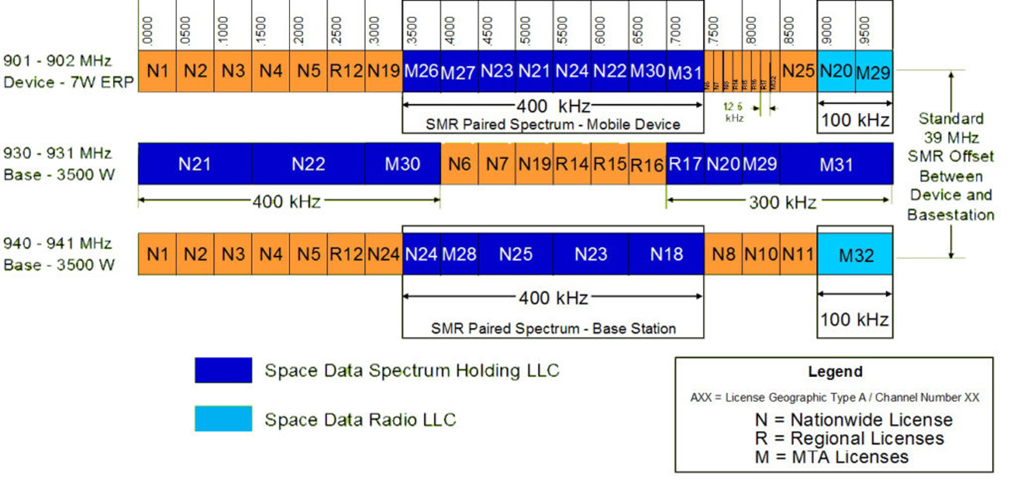
2. Site Licenses
Doc.802.15-20-0059-00-016t
TX - 12.5KHz 7W ERP
RX - 50KHz 3500 W ERP
Not Aviation - Alternative Use
Michael Gagne – AURA Network Systems

Slide 6
3. Critical Aviation and Unmanned Systems
Doc.802.15-20-0059-00-016t
Regulatory
Managed under the FAA General Aviation Office
Commercial Beyond Visual Line of Site (BVLOS)
Part 107 – Visual Line of Site below 400’, not over people
Part 87 - Pilots
Part 90 – Certified Aviation
Part 135 – Cargo for Hire/HEMS
RTCA SC-228
Working Group 1 – Detect and Avoid
Working Group 2 – Command Non-Payload Communications
ASTM F38
Small UAS
2018 FAA Reauthorization Act Section 373 (October 2019)
UAS Spectrum Availability
L – Band (960-1164MHz)
Congested FAA, Military Use
No Service Rules
C – Band (5031-5090MHz)
Unencumbered
No Service Rules
Regulatory
FCC Technological Advisory Counsel (TAC)
Unmanned Aircraft System – Working Group (UAS-WG)
UAS CNPC Capacity on 450MHz (650KHz)
Pilot to UAS Communication is done as needed to re-task Autopilot
UAS to Pilot Communication is streaming data at 5kbps or less
315KHz of return link spectrum offers 630kbps with a 2 b/Hz spectral efficiency
Over 50 simultaneous UAS per site
802.16 based/Slim LTE/Other Air Interface
UAS benefits to 450MHz spectrum
FCC Designated Aviation Spectrum
Aviation Service Rules
Nationwide Footprint
Low cost of deployment
Large coverage area
Highly Reliable
Great Anchor Spectrum for higher bands to add capacity
Available today
Michael Gagne – AURA Network Systems

Slide 7
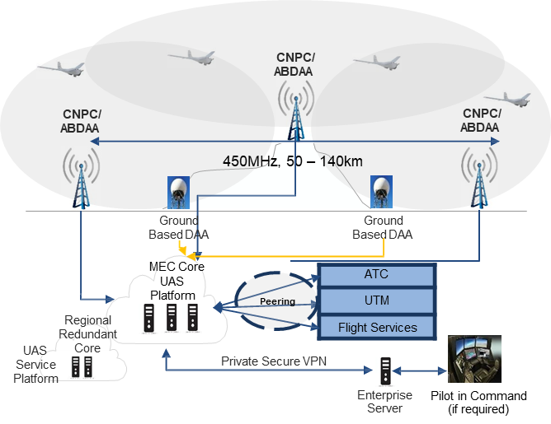
4. Air Interface Requirements and Use
Doc.802.15-20-0059-00-016t
Spectrum Utilization
Spectrum efficiency of 2 bits/Hz or better
Spectrum Bandwidth size of 15KHz Min to 325KHz Max
Sub-carrier size of 5 KHz Minimum
Physical sectorization of spectrum to increase Reuse and Capacity
Mobility
Handovers
Doppler (Speed of Sound)
Elevation from Ground to 60,000 feet
Distance up to 200 Miles
Remote dynamic power control
Performance
Availability, Reliability, Continuity, and Integrity
How many 9’s.
RTCA Standards still in development
Latency – Base to Remote of less than 50ms
Data
Messages delivered from Remote to Base at 1 Message per Second
Message size from 5kb to 100kb
Messages delivered from Base to Remote as needed
Message size from 20kb to 1mb
Michael Gagne – AURA Network Systems

