Slide 1
DCN 15-19-0542-01-0vat
Project: IEEE P802.15 IG VAT
Submission Title: CNN models to detect multiple LEDs for multilateral OCC.
Date Submitted: November 2019
Source: Md. Shahjalal, Moh. Khalid Hasan, Md. Faisal Ahmed, and Yeong Min Jang [Kookmin University].
Contact: +82-2-910-5068 E-Mail: yjang@kookmin.ac.kr
Re:
Abstract: Developing multilateral optical camera communication using smartphone camera.
Purpose: To achieve convolutional neural network model based multi-LED detection technique for OCCC
Notice: This document has been prepared to assist the IEEE P802.15. It is offered as a basis for discussion and is not binding on the contributing individual(s) or organization(s). The material in this document is subject to change in form and content after further study. The contributor(s) reserve(s) the right to add, amend or withdraw material contained herein.
Release: The contributor acknowledges and accepts that this contribution becomes the property of IEEE and may be made publicly available by P802.15.

Slide 2
Introduction
DCN 15-19-0542-01-0vat
Computer vision tasks include methods for acquiring, processing, analyzing and understanding digital images, and extraction of high-dimensional data from the real world.
Real-time computer vision can be performed using open source computer vision (OpenCV) programming library. OpenCV has vast application areas such as facial recognition system, human-computer interaction, object identification, mobile robotics, motion tracking, augmented reality.
A brief overview of the DNN based object detection techniques has been provided. These are computationally complex and requires high performance GPUs.

Slide 3
DCN 15-19-0542-01-0vat
Object detection techniques
Faster R-CNN
Faster R-CNN [1] is the third version of R-CNN where R stands for region. The previous two versions (R-CNN & Fast R-CNN) uses selective search which is much slow and time-consuming process affecting the performance of the network. Whereas, Faster RCNN uses region proposal networks (RPN) to predict where an object lies. The predicted region proposals are then reshaped using a region-of-interest (RoI) pooling layer which is then used to classify the image within the proposed region and predict the offset values for the bounding boxes
Mask R-CNN
Mask R-CNN [2] is the extension of Faster RCNN method in which a segmentation mask is added on each RoI along with the bounding boxes. This additional segments facilities the wide use cases. The inference time requires for Mask R-CNN is within 350-200 ms.

Slide 4
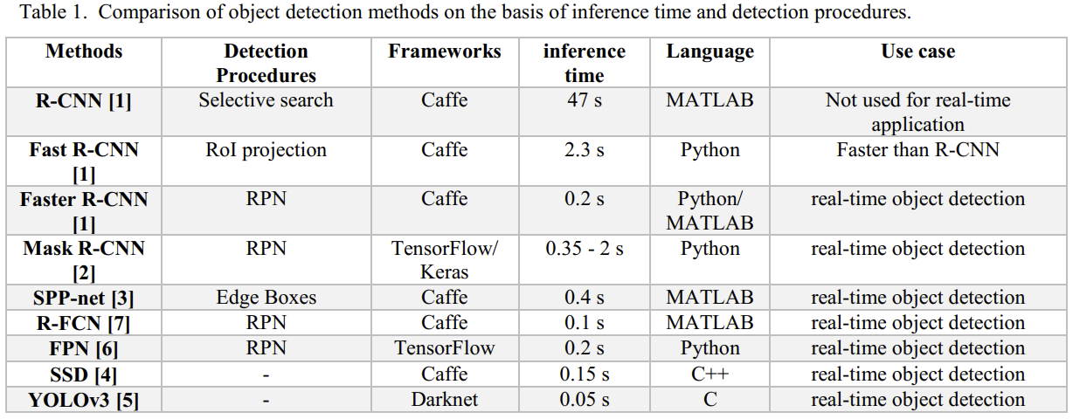
DCN 15-19-0542-01-0vat
Object detection techniques

Slide 5
DCN 15-19-0542-01-0vat
Object detection techniques
YOLOv3
YOLOv3 [5] is a completely different way of object detection where it passes the whole image only once same as SSD. In this process the image is divided into a grid of cells which depends on the size of the input image. Each cell is responsible for predicting the number of boxes in the image. Then confidence of prediction is made for each boxes and boxes of lower values are eliminated by using non-maximum suppression technique.
SPP-net
Spatial Pyramid Pooling network (SPP-net) [3] can generate a fixed-length representation regardless of image size/scale. In this system the feature maps of convolution layer are feed into a spatial pyramid pooling layer and it finally represent fixed length outputs to fully-connected layers. Average time of 100 random VOC images using GPU for SPP-net 5- scale version is about 382 ms.

Slide 6
DCN 15-19-0542-01-0vat
Object detection techniques
SSD
Single-shot multi-box detector (SSD) is a simple and faster than you only look once (YOLO) even more accurate. This feature eliminates proposal generation and resampling stages and encapsulates in a single detector which makes it simple for training and inference. In [4] shows 74.3% mAP for 300-by- 300 input on VOC2007 test at 59 fps.
FPN
In feature pyramid networks (FPN) a single-scale image of an arbitrary size is used as input and proportionally sized feature maps are taken as outputs. This method introduces small extra cost by the extra layers in the FPN, but has a lighter weight head FPN is proposed in [6] and they test the performance on RPN and Fast R-CNN. They achieved 0.165 s inference time per image for FPNbased Fast R-CNN on NVIDIA M40 GPU for ResNet-50.

Slide 7
References
DCN 15-19-0542-01-0vat
[1] S. Ren, K. He, R. Girshick, and J. Sun, “Faster R-CNN: Towards real-time object detection with region proposal networks,” in Proc. 28th Int. Conf. Neural Inf. Process. Syst., 2015, pp. 91–99.
[2] K. He, G. Gkioxari, P. Dollar, and R. Girshick. “Mask r-cnn,” arXiv:1703.06870, 2017.
[3] K. He, X. Zhang, S. Ren, and J. Sun, “Spatial pyramid pooling in deep convolutional networks for visual recognition,” in Proc. Eur. Conf. Comput. Vis., 2014, pp. 346–361.
[4] W. Liu, D. Anguelov, D. Erhan, C. Szegedy, and S. Reed, “SSD: Single shot multibox detector,” arXiv:1512.02325, 2015.
[5] J. Redmon and A. Farhadi. “Yolov3: An incremental improvement,” arXiv preprint arXiv:1804.02767, 2018.
[6] T.-Y. Lin, P. Dollar, R. Girshick, K. He, B. Hariharan, and ´S. Belongie. “Feature pyramid networks for object detection,” In CVPR, 2017.
[7] J. Dai, Y. Li, K. He, and J. Sun, “R-FCN: Object detection via region-based fully convolutional networks,” arXiv:1605.06409, 2016.

