Slide 1
Project: IEEE P802.15 Interest Group for Wireless Personal Area Networks (WPANs)
Submission Title: Consideration for interference factor to OCC system using RoI signaling technique
Date Submitted: November 2019
Source: Huy Nguyen, and Yeong Min Jang [Kookmin University].
Contact: +82-2-910-5068 E-Mail: yjang@kookmin.ac.kr
Re:
Abstract: This document discusses about the effects of another light in environment(sunlight, another light of vehicle…) to OCC system
Purpose: To evaluate the impacts of environment to RoI signaling technique.
Notice: This document has been prepared to assist the IEEE P802.15. It is offered as a basis for discussion and is not binding on the contributing individual(s) or organization(s). The material in this document is subject to change in form and content after further study. The contributor(s) reserve(s) the right to add, amend or withdraw material contained herein.
Release: The contributor acknowledges and accepts that this contribution becomes the property of IEEE and may be made publicly available by P802.15.

Slide 2
Consideration for effects of mobility for OCC system using hybrid waveform

Slide 3
Introduction
Communication technology based on radio frequency(RF) has shown tremendous growth and advantages since decades ago.
The use of visible light spectrum to transmit data is studied by many researchers in the world. Optical Camera Communication(OCC) is strong candidates using visible light for V2X communication.
To track and differentiate interested light-sources among others (including the sun/stars and ambient lights, building lamps, etc.), RoI-signaling mode is indispensable to the OCC system operating in a challenging condition.
However, in the real environment, there are many challenges for this system need to consider carefully.

Slide 4
Technical Requirement in the using visible light to transmit data
Transmitter:
Non-flicker
Real-time
Dimming support
Receiver:
Enable to use with all camera in the market (Rolling Shutter Camera, Global Camera)
Image sensor with high density of image pixels

Slide 5
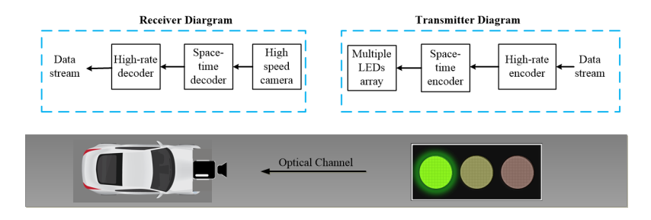
Infrastructure-to-vehicular reference architecture using traffic lights and high-speed camera.
Infrastructure-to-vehicular reference architecture using traffic lights and high-speed camera.[1]

Slide 6
Consideration for interference factor to OCC system using RoI signaling technique
Sunlight: the sunlight is one of factor to effect the performance of system. The received signal in Rx is attenuated because of the sunlight.
Other sources:
Decorative lights
The light of other vehicle make noise at Rx.
➔ We need Equalization Channel at Rx to reduce the inference factor.

Slide 7
References
[1] T. Nguyen et al., “Current Status and Performance Analysis of Optical Camera Communication Technologies for 5G Networks”, IEEE Access, vol. 5, March 2017, pp. 4574-4594.

