Slide 1
Project: IEEE P802.15 Working Group for Wireless Personal Area Networks (WPANs)
Submission Title: VLC based automatic Doorlock control for car parking sheds
Date Submitted: November 2019
Source: Jaesang Cha (VTASK Co., Ltd), Jungdo Han, Jinyoung Choi (SNUST), Nugmanov Said (SNUST), Jinyoung Kim (Kwangwoon Univ.), Sung Hoon Yoon, Kilsoo Lee (Kogen Corp.), Sooyoung Chang (SYCA), Minwoo Lee (SNUST)
Address: Contact Information: +82-2-970-6431, FAX: +82-2-970-6123, E-Mail: chajs@seoultech.ac.kr
Re:
Abstract: This documents introduce the V2I OWC Link design consideration for VAT. This proposed OWC technology used to automatic doorlock control solution using Car head/tail light connected on vehicles. This VAT solution can be used to operate on the application services like ITS, ADAS, IoT/IoL, etc. on road condition. Also this can be used for LEDIT, Digital Signage with connected information services etc.
Purpose: To provided concept models of OWC technology solution for Vehicular Assistant Technology (VAT) Interest Group
Notice: This document has been prepared to assist the IEEE P802.15. It is offered as a basis for discussion and is not binding on the contributing individual(s) or organization(s). The material in this document is subject to change in form and content after further study. The contributor(s) reserve(s) the right to add, amend or withdraw material contained herein.
Release: The contributor acknowledges and accepts that this contribution becomes the property of IEEE and may be made publicly available by P802.15.
Slide 1

Slide 2
Contents
Needs for VLC based Automatic Doorlock Control
VLC based Automatic Doorlock Control for Car Parking Sheds
Conclusion
Slide 2

Slide 3
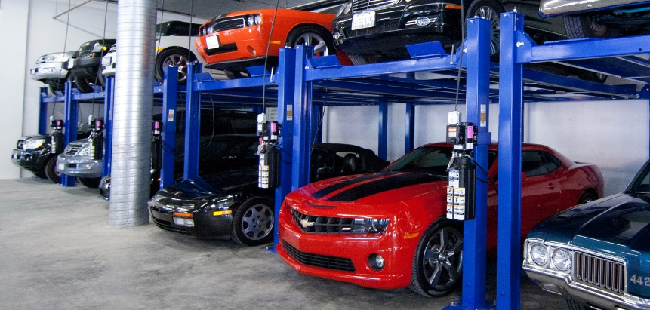
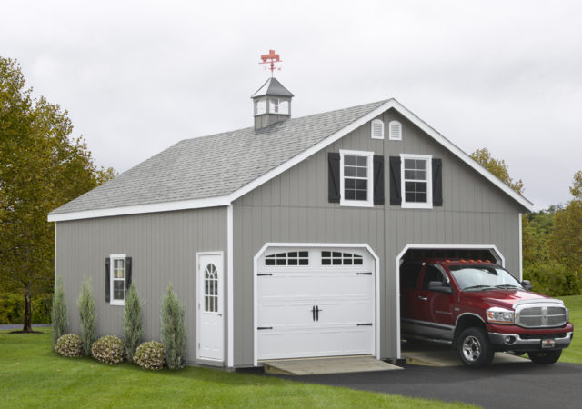
Needs for VLC based Automatic Doorlock Control
Needs
Currently, people using private or public garages are using doorlocks to allow vehicle access.
This causes the driver to get out of the car, enter a personal password in the door lock, and then confirm that the switchgear is opened and then get back in the car.
In addition, if a security medium such as a card key is lost, a problem may occur that prevents entry into the garage.
Basic Concept
The module for visible light communication is installed in the door lock installed for opening and closing the door in a private or public garage.
Install a transmission module for visible light communication on the front or rear headlights installed in the vehicle.
The front / rear headlights transmit visible light data through the light source, which can be received in the garage to identify the user.
Google
< Various Car Sheds >
Slide 3

Slide 4
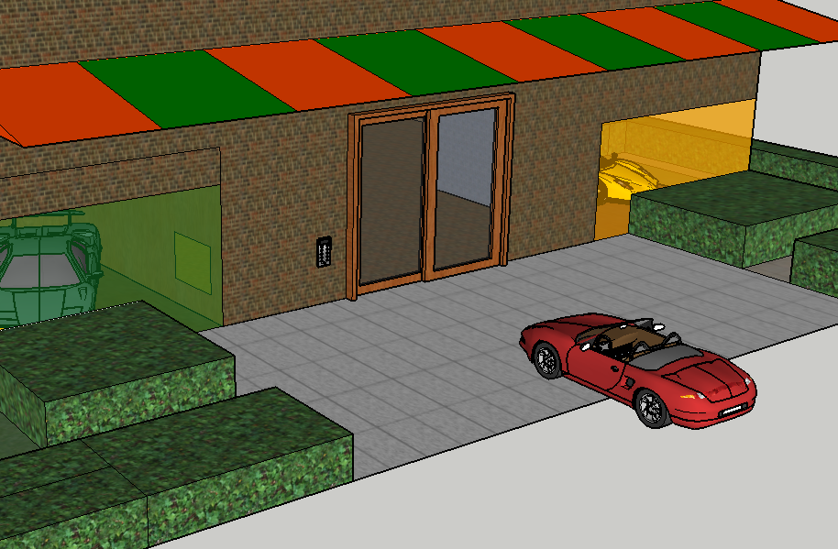
VLC based Automatic Doorlock Control for Car Parking Sheds
VLC based Automatic Doorlock Control for Car Parking Sheds
Tx : Car Head/Tail Light
Rx : Camera or PD built in Doorlock
Day-Night Communication Mode
Modulations :
OOK, VPPM, Offset-VPWM, Multilevel PPM, Inverted PPM, Subcarrier PPM, DSSS SIK etc.
Data Rate : 1K ~ 1Mb/s
Supported LoS (Line of Sight)
Available Distance : 2m ~ 20m
Rx
Doorlock
Sending Micro User Data
via VLC
< VLC Link for Automatic Doorlock Control >
Slide 4

Slide 5
Conclusion
Proposed VLC based Automatic Doorlock Control for Car Parking Sheds
Utilize the VLC links between Car Head/Tail Light and PD/Camera built in a doorlock
The proposed technology uses sending data about user recognition data based on VLC.
This research may contribute to the study of automatic doorlock
Slide 5

