Slide 1
Project: IEEE P802.15 Working Group for Wireless Personal Area Networks (WPANs)
Submission Title: OWC Link to Improve Warehouse Crane Productivity and Accuracy for Logistics System
Date Submitted: November 2019
Source: Jaesang Cha (VTASK Co., Ltd), Juphil Cho (Kunsan National Univ.), Sangwoon Lee (Namseoul Univ.), Nugmanov Said, Li Vadim, Jungdo Han (SNUST), Daeyoon Cha (VTASK Co., Ltd), Hwang Hyeonseok (Seoil Un.v.), Jinyoung Kim (Kwangwoon Univ.), YoungMin Kim (Welfrun Co., Ltd), Hyejeong Cho (RIZM), Timur Khudaybergenov (SNUST), Deokgun Woo (SNUST), Minwoo Lee(SNUST)
Address: Contact Information: +82-2-970-6431, FAX: +82-2-970-6123, E-Mail: chajs@seoultech.ac.kr
Re:
Abstract: This documents introduce the V2I VLC link design consideration for VAT. This proposed VLC data link model V2I optical wireless communication between living vehicle and parking area lighting infrastructures to part the movable smart house in respective positions. This solution is introduced as a part of the smart city development to manage living vehicles in a public area.
Purpose: To provided concept models of VLC Link solution for Vehicular Assistant Technology (VAT) Interest Group
Notice: This document has been prepared to assist the IEEE P802.15. It is offered as a basis for discussion and is not binding on the contributing individual(s) or organization(s). The material in this document is subject to change in form and content after further study. The contributor(s) reserve(s) the right to add, amend or withdraw material contained herein.
Release: The contributor acknowledges and accepts that this contribution becomes the property of IEEE and may be made publicly available by P802.15.
Slide 1

Slide 2
Contents
Needs for Increasing the accuracy and productivity of Warehouse Crane
OWC Link to Improve Warehouse Crane Productivity
Conclusion
Slide 2

Slide 3
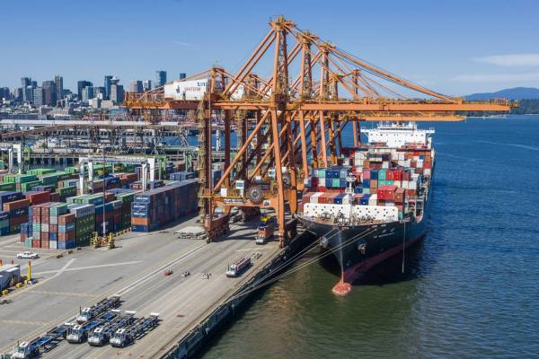
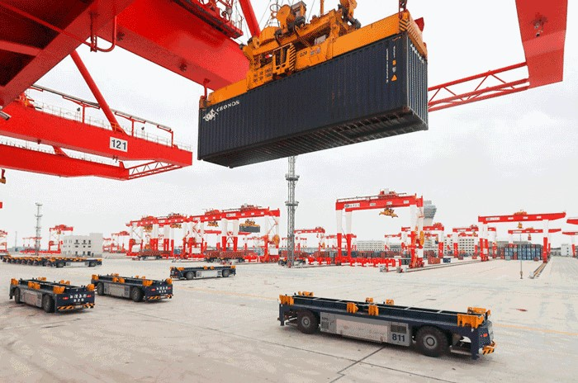
Increase the accuracy and productivity of Warehouse Crane
Needs
Automated port warehouses are safer than conventional ones. The number of human-related disruptions falls, and performance becomes more predictable.
Cargo ships maybe unloaded by several cranes, for increasing productivity AGV should determine which crane unloads which container
Basic concept
For loading or unloading freighter ship the crane is used. For big ships for increasing the speed of loading/unloading several cranes are used.
AGVs which are transporting the container share with crane the information about container, so AGV/Crane knows where to load or deliver the container.
Uses the lighting Infrastructure and Camera Installed on the crane, AGV or warehouse infrastructures to enable IoT/IoL Connectivity link between AGVs
Google
< Crane and AGV carrier >
Slide 3

Slide 4
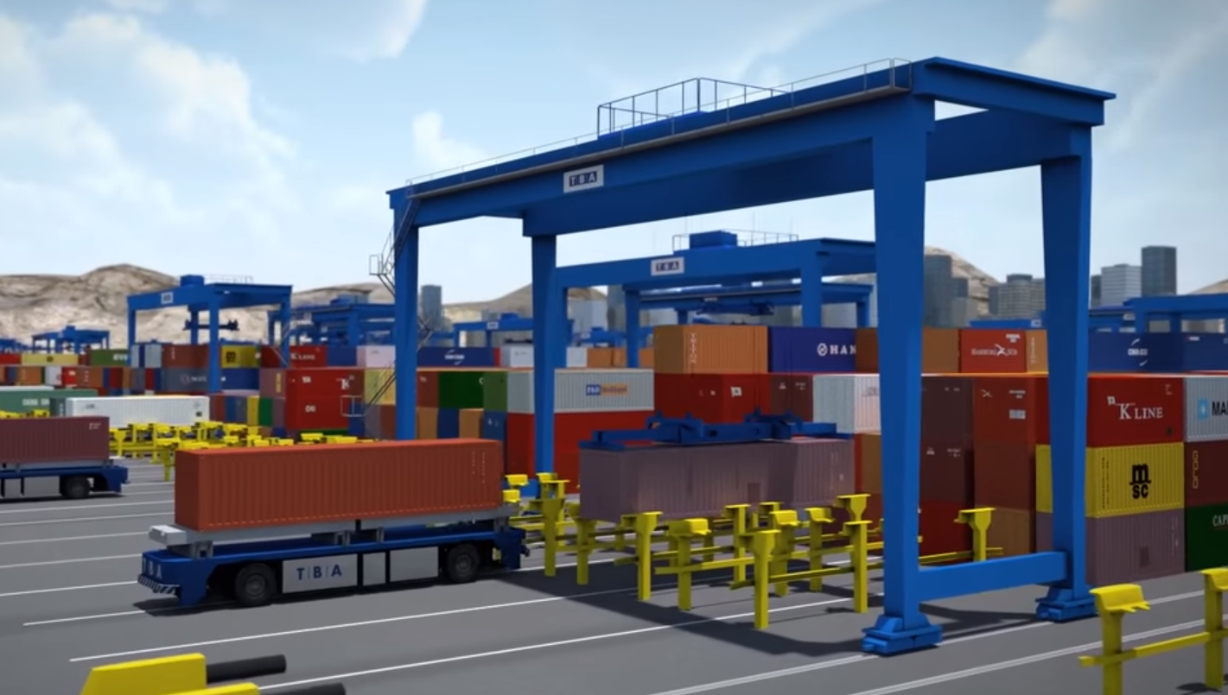
OWC Link to Improve Warehouse Crane Productivity and Accuracy
VLC/OWC communication link for Warehouse AGV solution
Tx : Lighting of AGV or 2D Color Coded Package Distribution LED Labels
Rx : CMOS Camera or PD Installed in the AGV
Day-Night Communication Mode
Modulations
Color Code, QR-Code, VTASC, OOK, Offset-VPWM, Multilevel PPM, Inverted PPM, Subcarrier PPM, DSSS SIK etc.
Data Rate : 1K ~ 5Mb/s
Supported LoS (Line of Sight)
Available Distance : 5m ~ 200m
VLC Link
< OWC Link between Warehouse Crane to increase the accuracy and productivity >
※ AGV for transportation goods in the warehouse uses decoded information with connected cloud server via IoT/IoL Technology.
※ Use the Lighting or LED Labels to transmit information about type of goods, weight and etc.
Slide 4

Slide 5
Conclusion
Proposed the OWC Link for Warehouse Crane to increase the accuracy and productivity Solution for Smart Warehouse.
Uses the Lighting and Camera System installed in the Warehouse crane
In this proposed goods transportation automation, LED lightning, CMOS Camera/PD installed in the warehouse crane and crane as a transceiver to share the transported container information.
Slide 5

