Slide 1
Project: IEEE P802.15 Working Group for Wireless Personal Area Networks (WPANs)
Submission Title: OWC Enabled crane for getting information of container through Optical Wireless Link
Date Submitted: November 2019
Source: Jaesang Cha, Li Vadim, Deokgun Woo, Jungdo Han (SNUST), Kaewon Choi (SKKU), Sooyoung Chang (SYCA), Minwoo Lee (SNUST)
Address: Contact Information: +82-2-970-6431, FAX: +82-2-970-6123, E-Mail: chajs@seoultech.ac.kr
Re:
Abstract: This documents introduce the V2I Optical Wireless link design consideration for automatic crane of logistic. This proposed optical wireless link used to assist crane to decide what kind of container is it and where to put this container. This solution is introduced for crane of logistics in the automation of logistics.
Purpose: To provided concept models of Optical Wireless Link for Vehicular Assistant Technology (VAT) Interest Group
Notice: This document has been prepared to assist the IEEE P802.15. It is offered as a basis for discussion and is not binding on the contributing individual(s) or organization(s). The material in this document is subject to change in form and content after further study. The contributor(s) reserve(s) the right to add, amend or withdraw material contained herein.
Release: The contributor acknowledges and accepts that this contribution becomes the property of IEEE and may be made publicly available by P802.15.
Slide 1

Slide 2
Contents
Needs for automatic crane of Logistics Service with AI management
Optical Wireless Link for automatic crane of Logistics Service
Conclusion
Slide 2

Slide 3
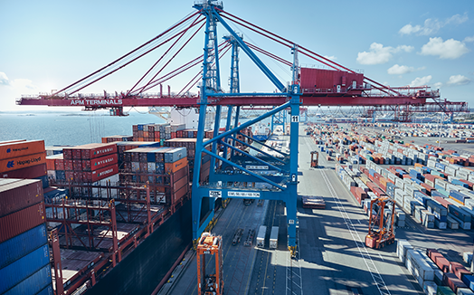
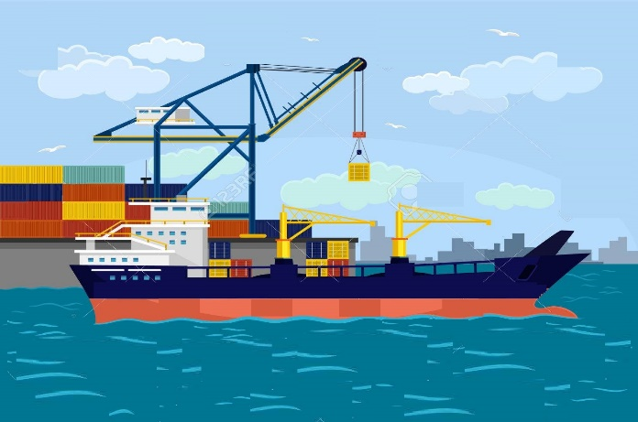
Needs for future automatic crane of Logistics Service with AI management
Needs
Efficient automated crane solution is the key for future smart automatic crane with AI based management.
Automated Guided Vehicles (AGV) have been proved to be an one of the most important technologies used in logistics service.
Automatic decision is a key feature in autonomous vehicle development.
Need to automatically decide which kind of container is it and where to put it by OWC and color code.
Basic concept
Uses the color code contained with data of container and OWC to define the type of container and where to put it for automatic management.
Use the Camera installed on the crane to receive information of container with color code to decide automatically where to put.
Google
< Crane Usage in Logistics >
Slide 3

Slide 4
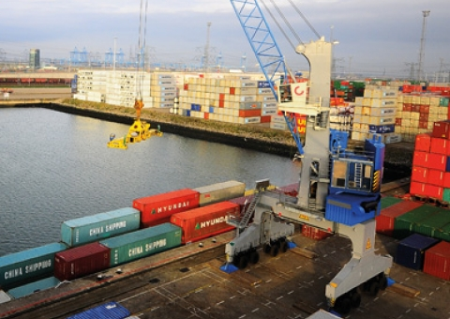
Optical Wireless Link for Logistics Service
OWC communication link for automatic crane solution
Tx : Lighting of crane or 2D Color Coded Package Distribution LED Tag
Rx : CMOS Camera Installed in the AGV
Day-Night Communication Mode
Modulations
VTASC, SS2DC, Quick-QR Code, 2D Color Code
OOK, Offset-VPWM, Multilevel PPM, Inverted PPM, Subcarrier PPM, DSSS SIK etc.
Data Rate : 1K ~ 5Mb/s
Supported LoS (Line of Sight)
Available Distance : 5m ~ 50m
OWC Link
< Optical Wireless Communication Link for automatic crane solution >
※ Automatic crane used for moving containers to the appropriate place uses the optical wireless decoded information to decide what kind of container is it and where to put it.
※ Use color code Tags to transmit information about container content, type of goods, weight and etc.
Slide 4

Slide 5
Conclusion
Proposed the IoT/IoL Enabled automatic crane through Optical Wireless Link to make crane automation more automatic for smart crane of logistic management.
Uses the color code attached on the container and Camera System installed on the crane to get information from container.
In this proposed optical wireless link, the Color coded LED Tag attached on the container as a Transmitter and CMOS Camera installed on the crane as a receiver to share information of container.
Slide 5

