Slide 1
Project: IEEE P802.15 Working Group for Wireless Personal Area Networks (WPANs)
Submission Title: LiFi / CamCom technology solutions to operate smart car parking indoor
Date Submitted: September 2019
Source: Seongkwon Kim, Jaesang Cha, Pham Minh Trung, Jungdo Han (SNUST), Sangwoon Lee (Namseoul Univ.), Hyeongho Lee (Netvision Telecom Inc., Korea Univ.), Jinyoung Kim (Kwangwoon Univ.), Jeonggon Kim (Korea Polytechnic Univ.), Sooyoung Chang (SYCA), Minwoo Lee (SNUST)
Address: Contact Information: +82-2-970-6431, FAX: +82-2-970-6123, E-Mail: chajs@seoultech.ac.kr
Re:
Abstract: This document introduces the use of street light to operate the city bus system automatically. The bus will automatically stop at the bus stop, the location and real time of the bus will be sent to users accurately and quickly.
Purpose: To provided concept models of Light Communication based IoT/IoL Relay Link solution for Vehicular Assistant Technology (VAT) Interest Group
Notice: This document has been prepared to assist the IEEE P802.15. It is offered as a basis for discussion and is not binding on the contributing individual(s) or organization(s). The material in this document is subject to change in form and content after further study. The contributor(s) reserve(s) the right to add, amend or withdraw material contained herein.
Release: The contributor acknowledges and accepts that this contribution becomes the property of IEEE and may be made publicly available by P802.15.
Slide 1

Slide 2
Contents
Help smart buses move smart, accurate automatically and quickly
Operation principle of smart bus is based on Lifi / Camcom
Conclusion
Slide 2

Slide 3
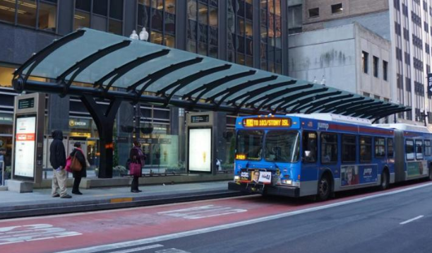
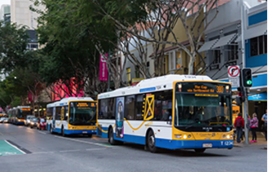
Help smart buses move smart, accurate automatically and quickly
Needs
A smart city is a city where traffic systems are automatically operated. Especially, public transports are operated automatically such as buses, trams, etc. The cars will move, stop and pick up passengers completely automatically without needing to human support.
The real-time and location of the bus should be updated continuously to send information to the electronic boards at bus stops or information applications on the internet for users to update the time as well. like the location where the bus is moving.
Basic Concept
LiFi software / CamCom technology solution to operate smart bus efficiently. Use street lights installed on both sides of the road. The light emitted from the street light will contain the coordinates, time and corresponding information. The cameras installed on the bus when receiving the street light will analyze the beam and send location, time information to the information control stations and request the car to stop as required.
< The bus picks up guests at the bus stop>
< The bus is moving in the city >
Slide 3

Slide 4
Operation principle of smart airport is based on Lifi / Camcom
Control room (Send information to cloud)
Send signal to other bus by light
LiFi/CamCom Link
Tx : LED Lighting Systems
Rx : PD / Camera
Day-Night Communication Mode
Modulations :
OOK, Offset-VPWM, Multilevel PPM, Inverted PPM, Subcarrier PPM, DSSS SIK etc.
Data Rate : 1K ~ 1Mb/s
Supported LoS (Line of Sight)
Available Distance : 2m ~ 200m
Send information to Control room
Signal contain bus location information, bus stop location, real time….
Send request to bus
100100101010
Camera
Signal contain bus location information, bus stop location, real time ….
1001001010101010
100100101010
Camera
Receive stop signal request from LED at bus stop
< VLC Link through Street Lighting System for Operating city bus>
Using street lights to transmit and receive information from the bus to the control center, the control center will update and send back the coordinates of the vehicles, stops, the number of passengers on the vehicle, Real-time vehicle up data storage center. This information will be sent to electronic boards at bus stops or information applications that users can access.
Slide 4

Slide 5
Conclusion
Proposing smart bus operation solution with LiFi / CamCom technology.
Use the lighting system from both sides of the road through LiFi / CamCom technology to connect buses and connect buses to the central control room and bus stops.
Reduce labor costs, automate systems and operate systems accurately and optimally
Slide 5

