Slide 1
Project: IEEE P802.15 Working Group for Wireless Personal Area Networks (WPANs)
Submission Title: Optical Wireless Networked Edge Computing Build-In Logistics Autonomous vehicles For Indoor Hospital Logistic Services
Date Submitted: September 2019
Source: Jaesang Cha (SNUST), Sangwoon Lee (Namseoul Univ.), Jintae Kim (Fivetek Co., Ltd.), Sooyoung Chang (SYCA), Vinayagam Mariappan (SNUST)
Address: Contact Information: +82-2-970-6431, FAX: +82-2-970-6123, E-Mail: chajs@seoultech.ac.kr
Re:
Abstract: This documents introduce the V2X optical wireless network link design consideration for VAT. This proposed optical wireless network connectivity link model for Autonomous vehicles to be used in indoor hospital logistical services. This solution is introduced as a part of the healthcare facility infrastructure automation to logistics services inside the hospital environment.
Purpose: To provided concept models of optical wireless network link solution for Vehicular Assistant Technology (VAT) Interest Group
Notice: This document has been prepared to assist the IEEE P802.15. It is offered as a basis for discussion and is not binding on the contributing individual(s) or organization(s). The material in this document is subject to change in form and content after further study. The contributor(s) reserve(s) the right to add, amend or withdraw material contained herein.
Release: The contributor acknowledges and accepts that this contribution becomes the property of IEEE and may be made publicly available by P802.15.
Slide 1

Slide 2
Contents
Needs for Logistics Autonomous vehicles In Healthcare Infrastructures
Optical Wireless Networked Edge Computing Build-In Autonomous vehicles For Hospitals
Conclusion
Slide 2

Slide 3
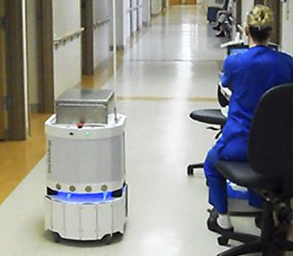
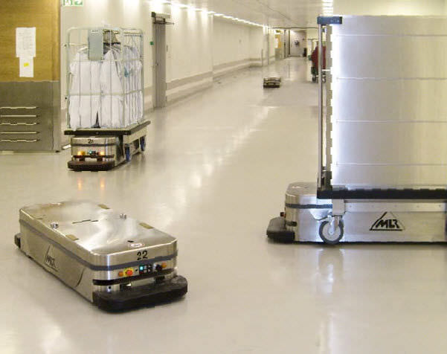
Needs for Logistics Autonomous vehicles In Healthcare Infrastructures
Needs
  Demand for mobile robots and their use in hospitals has increased due to changes in demographic trends and medical cost control.
  Targeted to healthcare segment, the autonomous vehicles can be used in a healthcare setting to move materials throughout a hospital like bulk material, pharmacy medicines, laboratories samples, food, dirty dishes, bed laundry, medical wastes, biomedical instruments.
  autonomous vehicles based automation in hospitals helps free hospital employees to spend the time directly on patient care.
  Medical equipment maybe very sensitive to RF signal and required alternative connectivity method for autonomous vehicles with infrastructures.
Basic Concept
  Uses the lighting infrastructure to enable optical wireless connectivity link for autonomous vehicles in healthcare automation.
  Hospitals lighting infrastructure uses the to transmit position and package related information and camera installed on autonomous vehicles work as a receiver to decode the location and hospital package information to move packages to respective location.
Google
  < Autonomous Vehicles Usage Scenario in Hospital >
Slide 3

Slide 4
Optical Wireless Networked Edge Computing Build-In Autonomous vehicles For Hospitals
Optical Wireless Networked for Indoor Hospital Logistics Automation
  Tx : Hospital and Autonomous vehicles Lighting Infrastructure
  Rx : CMOS Camera Installed in the Hospital and Autonomous vehicles
  Day-Night Communication Mode
  Modulations
    VTASC, SS2DC Color Code, QR-Code, VTASC,
    OOK, Offset-VPWM, PPM, DSSS SIK etc.
  Data Rate : 1K ~ 5Mb/s
  Supported LoS (Line of Sight)
  Available Distance : 5m ~ 200m
  < Optical Wireless Networked Edge Computing Build-In Autonomous Vehicles >
※ Autonomous vehicles used logistics in the hospital uses camera to decode the information and analyze the data using edge computing technology and connected cloud server through optical wireless network link.
※ Use the hospitals LED lighting infrastructure to transmit location information about type of logistics Things with ID, destination, Delivery times, and etc.
Slide 4

Slide 5
Conclusion
Proposed the Optical Wireless Networked Edge Computing Build-In Autonomous vehicles For Indoor Hospital Logistic Services to automate the healthcare application.
Uses the lighting installed and camera system installed in the hospital and Autonomous vehicles
In this proposed hospital logistic automation, the lighting infrastructure and the 2D Color coded LED Labels attached on logistics items act as a optical transmitter and CMOS camera installed in the Autonomous vehicles as a receiver with edge computing technology to process and take action according to data received from luminaries.
Slide 5

