Slide 1
IEEE 802.15.4 (SUN) Use Cases for consideration
Authors:
Date: 2019-07-16
Notice: This document has been prepared to assist IEEE 802.19. It is offered as a basis for discussion and is not binding on the contributing individual(s) or organization(s). The material in this document is subject to change in form and content after further study. The contributor(s) reserve(s) the right to add, amend or withdraw material contained herein.

Slide 2
Introduction
Overview of 802.15.4 (SUN) sub-GHz Use cases

Slide 3
Scenarios
Smart utilities:
Advanced Metering Infrastructure (AMI), Peak Load Management, Distribution Automation, EV charging stations, Gas and Water metering, leak detection
Smart cities:
Street lighting, smart parking, traffic and transport systems, environmental sensing, infrastructure management,
Smart home:
Smart thermostats, air conditioning, heating, energy usage displays and health and well-being applications
Other M2M:
Agriculture, structural health monitoring (e.g. bridges, buildings, etc.), monitoring and asset management

Slide 4
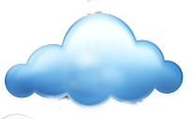
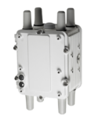








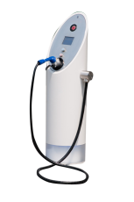
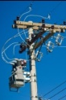




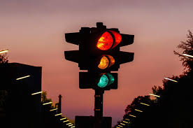
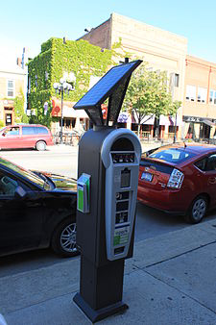
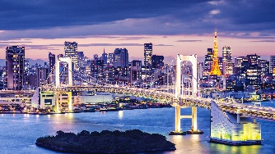



Reproduced with permission of Wi-SUN Alliance 2019
Field Area Network Architecture
Network Operations Center
WAN
Public or Private WAN Backhaul
Cellular
Private Network
Fiber/Ethernet
FAN
Wi-SUN FAN RF Mesh
Wi-SUN FAN RF Mesh
Wi-SUN FAN RF Mesh
Advanced Meter Infrastructure
EV Charging Infrastructure
Distribution Automation
Direct Load Control
SCADA
Distributed Generation
Outdoor
Lighting
Traffic management
Parking
Structural health
Agriculture

Slide 5
Current Status in Japan
Smart meter deployments in Japan: https://www.meti.go.jp/committee/summary/0004668/pdf/015_03_00.pdf
Smart Meter to HEMS controller connection uses 802.15.4 FSK at 920 – 928MHz - adopted by all Japan Utilities (together with plc)
AMI connection – most Japanese Utilities have chosen Wireless Mesh using 802.15.4 FSK at 920 – 928MHz
> 65 million smart meters scheduled for deployment in Japan by 2023
> 20 million smart meters already deployed by TEPCO

