Slide 1
Project: IEEE P802.15 Working Group for Wireless Personal Area Networks (WPANs)
Submission Title: OWC Enabled Independent Sensor Monitoring Vehicle for Remote Sensing
Date Submitted: July 2019
Source: Jaesang Cha (SNUST), Jintae Kim (Fivetek Co., Ltd.), Sooyoung Chang (SYCA), Vinayagam Mariappan (SNUST)
Address: Contact Information: +82-2-970-6431, FAX: +82-2-970-6123, E-Mail: chajs@seoultech.ac.kr
Re:
Abstract: This documents introduce the OWC data link design consideration for VAT. The proposed OWC data link model proposed to introduce the possibility of using light communication for transmission environment sensor monitoring data installed on trailer vehicle using lighting device network infrastructure. Also the proposed VAT solution can operate on the application services like ITS, ADAS, IoT/IoL, etc. on road condition.
Purpose: To provided concept models of OWC link solution for Vehicular Assistant Technology (VAT) Interest Group
Notice: This document has been prepared to assist the IEEE P802.15. It is offered as a basis for discussion and is not binding on the contributing individual(s) or organization(s). The material in this document is subject to change in form and content after further study. The contributor(s) reserve(s) the right to add, amend or withdraw material contained herein.
Release: The contributor acknowledges and accepts that this contribution becomes the property of IEEE and may be made publicly available by P802.15.
Slide 1

Slide 2
Contents
Needs for Remote Environment Monitoring Solution
OWC Enabled Remote Sensor Monitoring Vehicle
Conclusion
Slide 2

Slide 3
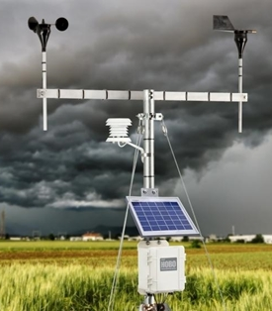
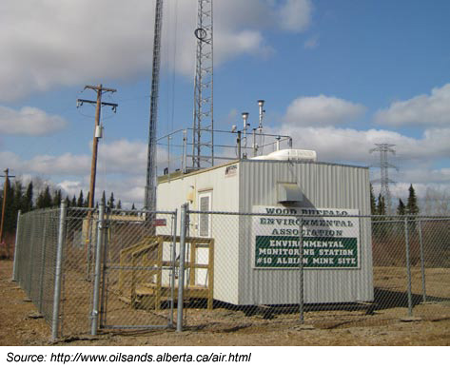
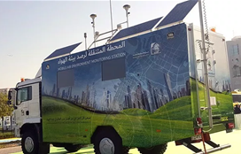
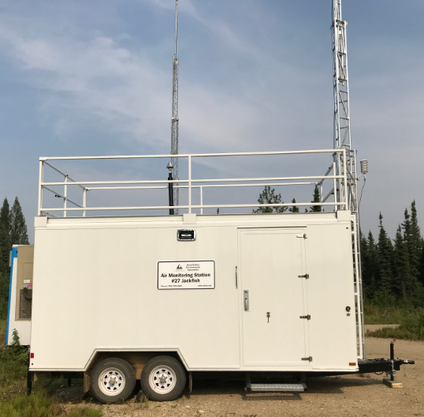
Needs for Remote Environment Monitoring Solution
Needs
Environment Monitoring is an important factor to consider due to environmental pollution.
Remote Monitoring Stations can be installed in any areas with extreme weather conditions and without communication infrastructure.
Remote Monitoring Stations should be high-speed, cheapest, and easy-to-install transmission technology.
Basic concepts
Uses optical wireless communication for transmission data from environment monitoring sensor trailer to the center.
Provides data transmission between monitoring station and weather center with no needs to existing communication infrastructure.
The data transmission is weather independent.
Google
< Remote Environment Monitoring Stations >
Slide 3

Slide 4
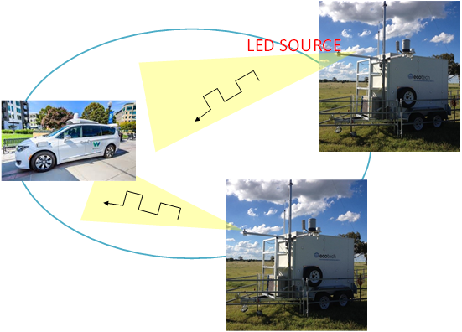
OWC Enabled Remote Sensor Monitoring Vehicle
OWC Transmission for Remote Sensing Data Link
Tx : LED Light
Rx : Photodiode or Camera Installed on Miniwan or Track
Modulations :
OOK, VPPM, Offset-VPWM, Multilevel PPM, Inverted PPM, Subcarrier PPM, DSSS SIK etc.
Day-Night Communication Mode
Data Rate : 1K ~ 1Mb/s
Supported LoS (Line of Sight)
Available Distance : 500m around
< OWC Enable Independent Remote Sensing System >
Slide 4

Slide 5
Conclusion
Proposed the OWC Enabled Independent Sensor Monitoring Vehicle for Remote Sensing
Uses the LED light source installed on the portable sensor monitoring trailer and PD / Camera as the transceiver and receiver respectively
Proposed solution can be utilized as a part of a complex of environment monitoring system, etc.
Slide 5

