Slide 1
Project: IEEE P802.15 Working Group for Wireless Personal Area Networks (WPANs)
Submission Title: LiFi/CamCom Technology for Finding Sunken Ship Using Water Drone
Date Submitted: July 2019
Source: Jaesang Cha (SNUST), Hyeongho Lee (Netvision Telecom Inc., Korea Univ.), Yoonkwan Kim (The Catholic Univ.), Minseok Oh (Kyonggi Univ.),Sangwoon Lee (Namseoul Univ.), Jinyoung Kim (Kwangwoon Univ.), SeongKweon Kim(SNUST), Yong Ik Yoon (Sookmyung Women's University), Jeonggon Kim (Korea Polytechnic Univ.), Chanhyeong Chung (RAPA), Sooyoung Chang (SYCA),Vinayagam Mariappan (SNUST)
Address: Contact Information: +82-2-970-6431, FAX: +82-2-970-6123, E-Mail: chajs@seoultech.ac.kr
Re:
Abstract: This documents introduce the V2X LiFi/CamCom Link design consideration for VAT. The LiFi/CamCom Technology proposed to assist finding sunken ships in the sea using water drones. This VAT solution also used to operate on the application services like ITS, ADAS, IoT/IoL, etc. on road condition.
Purpose: To provided concept models of Light Communication based LiFi/CamCom solution for Vehicular Assistant Technology (VAT) Interest Group
Notice: This document has been prepared to assist the IEEE P802.15. It is offered as a basis for discussion and is not binding on the contributing individual(s) or organization(s). The material in this document is subject to change in form and content after further study. The contributor(s) reserve(s) the right to add, amend or withdraw material contained herein.
Release: The contributor acknowledges and accepts that this contribution becomes the property of IEEE and may be made publicly available by P802.15.
Slide 1

Slide 2
Contents
Needs for Assistive Solution to Find Sunken Ships
Water Drone with LiFi/CamCom Technology to Find Sunken Ships
Conclusion
Slide 2

Slide 3
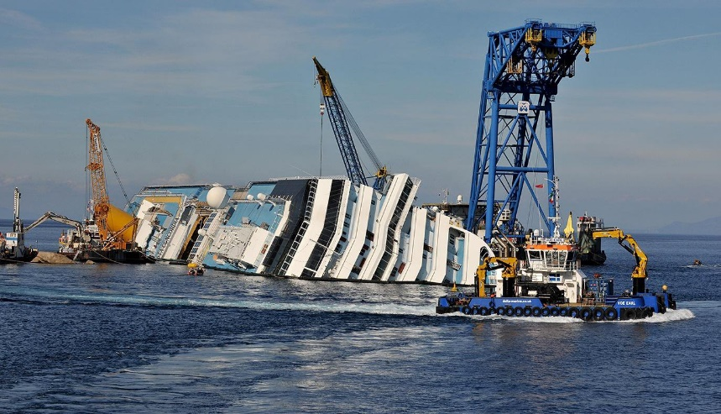
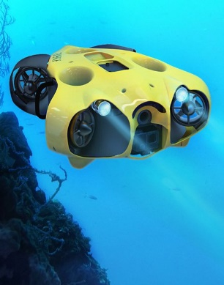
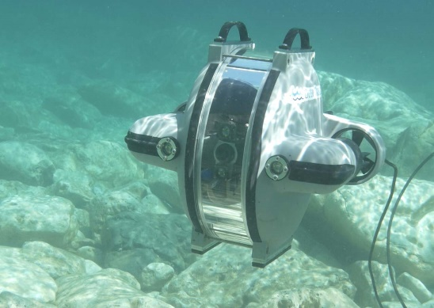
Needs for Assistive Solution to Find Sunken Ships
Needs
The sea side transportation technology and the sea side security system is improved constantly and trying to decrease the possibility of the seaside accidents
The sea side accidents recue operations are difficult process in the deep sea water due to limited divers, bad weather or seaside condition.
Too difficult to finding the location of the ship in deep underwater.
To resolve this problem, we can use an water drone with light communication technology to find the location of the ship sunken ships
The rescue underwater drone can send the visual present condition of the sunken ship to the rescue ship or the crane vessel.
Basic Concept
The underwater drone can easily find a sunken ship by using the headlights and capture visual information using the built-in camera and send to the rescue ship using LiFi/CamCom Technology.
The visual and location information’s are transmitted to the rescue ship using the taillight or headlight .
The rescue ship can receive data by using installed photo detector or camera and progress the rescue operation.
GOOGLE
< Sunken Ship and Rescue Operation >
GOOGLE
< Underwater Drone >
Slide 3

Slide 4
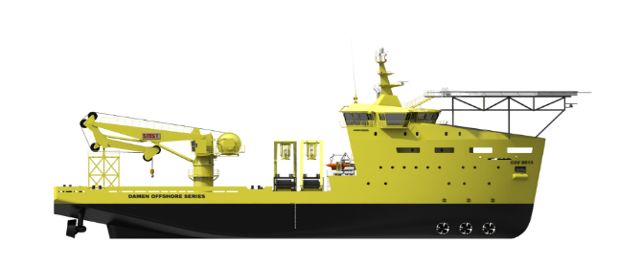
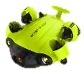
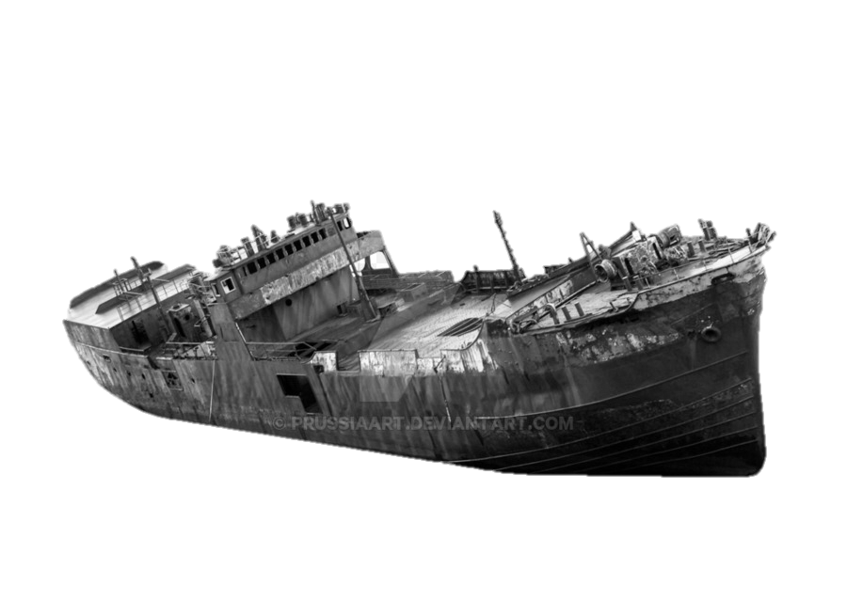
Water Drone with LiFi/CamCom Technology to Find Sunken Ships
Crane Vessel
LiFi/CamCom Technology for Assisting to Find Sunken Ships
Tx : Drone Head/Tail Lights
Rx : Camera / Photo detector Built-in on a Ship
Day-Night Communication Mode
Modulations :
OOK, VPPM, Offset-VPWM, Multilevel PPM, Inverted PPM, Subcarrier PPM, DSSS SIK etc.
Data Rate : 1K ~ 1Mb/s
Supported LoS (Line of Sight)
Available Distance : 2m ~ 20m
100100101
Water Drone
※ This technology enables to assist the rescue operation by finding the sunken ship location with LiFi/CamCom Technology.
Sunken Vessel
< Underwater Drone with LiFi/CamCom Technology in Rescue Operation >
Slide 4

Slide 5
Conclusion
Proposed the solution to find the sunken ship using underwater drone with LiFi/CamCom Technology.
Proposed system uses the head/tail lights of the water drones and the photo detector / camera installed in the rescue ships to enable LiFi/CamCom Link for communications
Used to find a place of the sunken ship and inform to crane vessels using LiFi/CamCom technology, which can reduce time to find the ship and fast rescue of the people who is stuck in the ship.
Slide 5

