Slide 1
Project: IEEE P802.15 Working Group for Wireless Personal Area Networks (WPANs)
Submission Title: LiFi/CamCom Technology for Coastline Zones Monitoring Using Drone
Date Submitted: May 2019
Source: Jaesang Cha (SNUST), Seoungkyun Kim (SNUST), Hyeongho Lee (Netvision Telecom Inc., Korea Univ.), Yoonkwan Kim (The Catholic Univ.), Minseok Oh (Kyonggi Univ.),Sangwoon Lee (Namseoul Univ.), Jinyoung Kim (Kwangwoon Univ.), Jeonggon Kim (Korea Polytechnic Univ.), Chanhyeong Chung (RAPA), Sooyoung Chang (SYCA),Vinayagam Mariappan (SNUST)
Address: Contact Information: +82-2-970-6431, FAX: +82-2-970-6123, E-Mail: chajs@seoultech.ac.kr
Re:
Abstract: This documents introduce the V2V LiFi/CamCom Link design consideration for VAT. This proposed LiFi/CamCom Technology is used to detect the illegal ships by the lighting system and cameras installed in the drones and water vehicles. This VAT to operate on the application services like ITS, IoT/IoL, etc. on road condition.
Purpose: To provided concept models of Light Communication based LiFi/CamCom solution for Vehicular Assistant Technology (VAT) Interest Group
Notice: This document has been prepared to assist the IEEE P802.15. It is offered as a basis for discussion and is not binding on the contributing individual(s) or organization(s). The material in this document is subject to change in form and content after further study. The contributor(s) reserve(s) the right to add, amend or withdraw material contained herein.
Release: The contributor acknowledges and accepts that this contribution becomes the property of IEEE and may be made publicly available by P802.15.
Slide 1

Slide 2
Contents
Needs for Coastline Zones Monitoring
LiFi / CamCom Technology for Coastline Zones Monitoring Using Drones
Conclusion
Slide 2

Slide 3
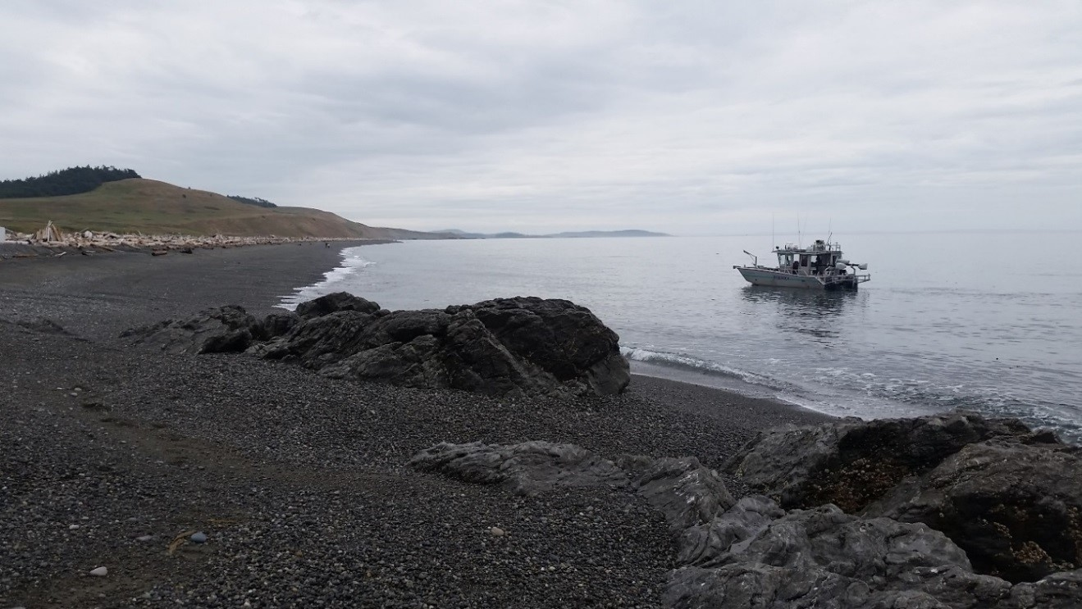
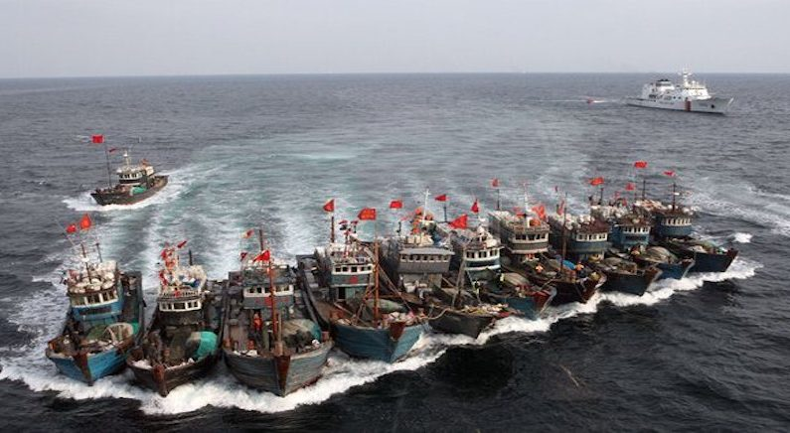
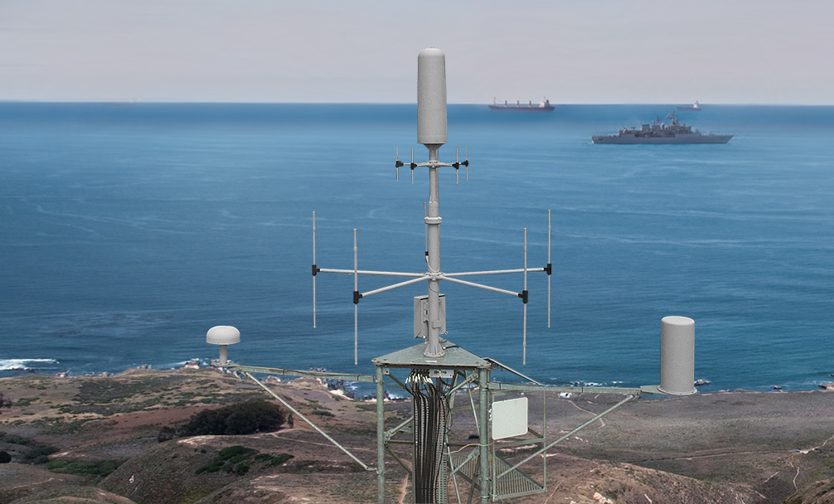
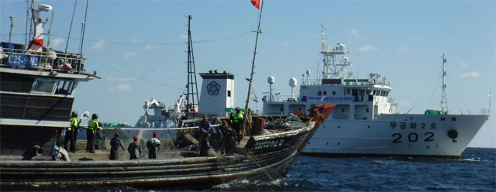
Needs for Coastline Zones Monitoring
Needs
Today, several countries have suffered from pirate and illegal ships like other country fishing ships.
On the character of the coastline zone, it is difficult for the coast guard to find a place where a pirate and illegal ship exists in the coastal zones.
To solve this problem, we can use of drones for finding and tracking pirate and illegal ships.
Basic Concept
Use a drone to detect the pirate and illegal ships as well as a send the location data and details of the ships to the coast guard vehicle using Visible light communication technologies.
The Lighting System in Drone used as Transmitter and camera built on the coast guard ship is used as a receiver to decode the information from the drone.
Using the offered system, the coast guard can reduce the time spend for reconnaissance and protect the native people working at the sea.
< Water Vehicles in Coastline Zones Scenario >
Google
Slide 3

Slide 4
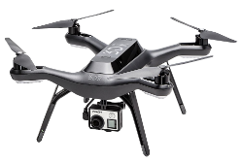
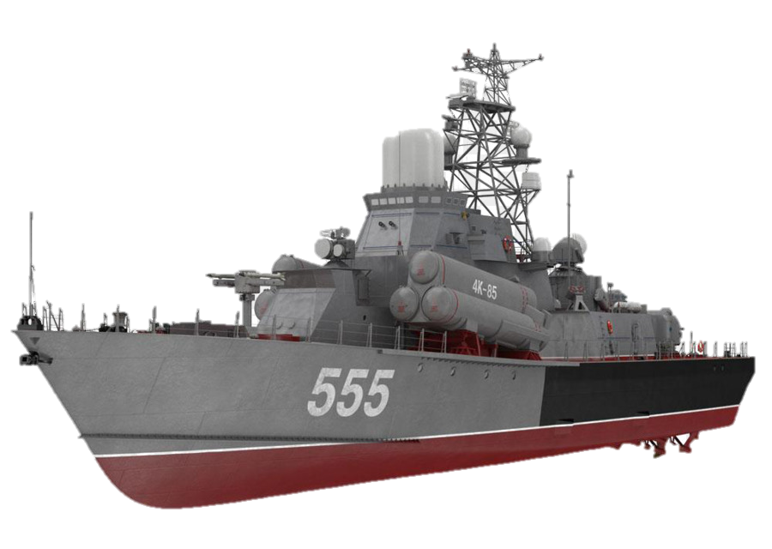
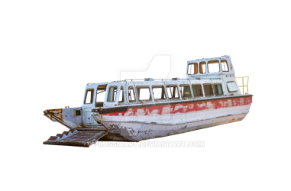
LiFi / CamCom Technology for Coastline Zones Monitoring Using Drones
Tx: Drone
LiFi/CamCom Technology for Coastline Zones Monitoring Using Drone
Tx : Drone Lighting System
Rx : Camera Built on Coast Guard Ship
Day-Night Communication Mode
Modulations :
OOK, VPPM, Offset-VPWM, Multilevel PPM, Inverted PPM, Subcarrier PPM, DSSS SIK etc.
Data Rate : 1K ~ 1Mb/s
Supported LoS (Line of Sight)
Available Distance : 2m~200m
Find & Trace the Ships
100100101
Ship location, Image, and so on..
Rx: Camera
Coast Guard Ship
Illegal Ship
< LiFi/CamCom Technology for Coastline Zone Monitoring >
※ Use the Drone to transmit location data of an ships and the camera built on the coast guard ship to receive the data from the Drone.
※ The Drone will keep tracking the illegal ship until it will leave the Coastline Zones.
Slide 4

Slide 5
Conclusion
Proposed the solution of LiFi/CamCom Technology for Coastline Zones Monitoring Using Drone
Proposed system uses the lighting system and the camera built in the Drones and ships to enable LiFi/CamCom Link for communication.
Used to inform a place where the ships exist in the coastline by using LiFi/CamCom technology, which can reduce time to find the ships and protect native people on the seashore area.
Slide 5

