Slide 1
Project: IEEE P802.15 Working Group for Wireless Personal Area Networks (WPANs)
Submission Title: IoT/IoL Relay Link for Highway Emergency Warning Signal
Date Submitted: May 2019
Source: Jaesang Cha (SNUST), Li Vadim(SNUST), Seongjhin Choi (SNUST), Jaesoo Kim (SNUST), Jonghoon Lee (SNUST), Jintae Kim (Fivetek Co., Ltd.), Sungdoo Kang (Feelux Co., Ltd.), Changsoo Lee (L&S LED Co., Ltd.), Sangil Lim (Signtelecom Co. Ltd.), Sooyoung Chang (SYCA), Vinayagam Mariappan (SNUST)
Address: Contact Information: +82-2-970-6431, FAX: +82-2-970-6123, E-Mail: chajs@seoultech.ac.kr
Re:
Abstract: This documents introduce the V2X IoT/IoL Relay Link design consideration for VAT. This proposed IoT/IoL Relay Link used for the emergency warning signal in highways. This VAT solution can be used to operate on the application services like ITS, ADAS, etc. on road condition. The proposed solution prevent the multiple vehicle accidents on the highway since milliseconds delay is really important in emergency situations for immediate drivers reactions.
Purpose: To provided concept models of IoT/IoL relay link solution for Vehicular Assistant Technology (VAT) Interest Group
Notice: This document has been prepared to assist the IEEE P802.15. It is offered as a basis for discussion and is not binding on the contributing individual(s) or organization(s). The material in this document is subject to change in form and content after further study. The contributor(s) reserve(s) the right to add, amend or withdraw material contained herein.
Release: The contributor acknowledges and accepts that this contribution becomes the property of IEEE and may be made publicly available by P802.15.
Slide 1

Slide 2
Contents
Needs for Highway Emergency Warning Signal
IoT/IoL Relay Link for Highway Emergency Warning Signal
Conclusion
Slide 2

Slide 3
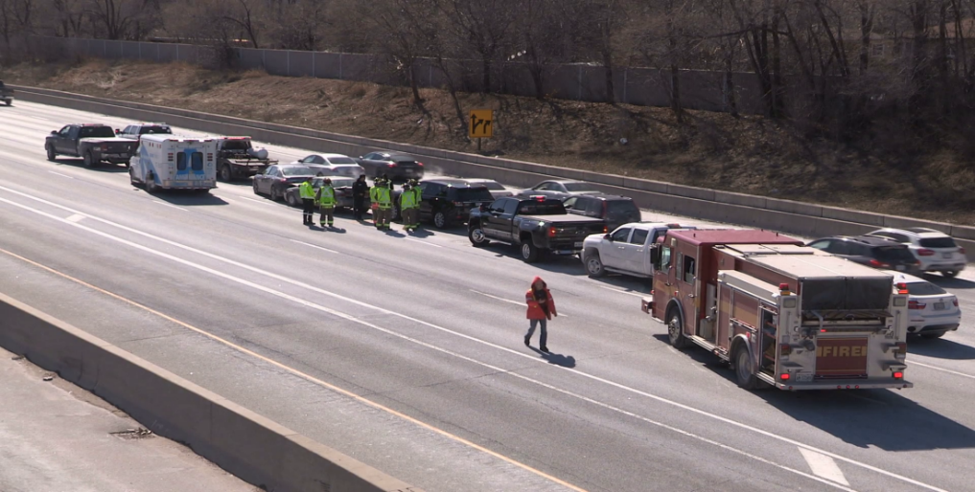
Needs for Highway Emergency Warning Signal
Needs
Highway are built for convenient long distance transportation.
The speed of the vehicles in highway is very high and the vehicles are from the cars to heavy vehicles.
If there is accident on the highway, the following vehicles also becoming part of the accident.
Since when any accidents happened in highway, the following vehicles does not know the exact situation of the accidents and can not react instantly due to the high traveling speed of the vehicle in the highway.
Needs the highway infrastructures to notify the accident scenario ahead of vehicle approaching accidental location and this will reduce the multiple vehicle accident on the highway.
Basic Concept
Uses the Highway Lighting System connected with Highway Monitoring CCTV Camera and the Camera connected on the vehicle to enable IoT/IoL Link to broadcast the highway emergency warning signal to avoid multiple vehicle accident.
The Highway Lighting System with Camera used as a IoT/IoL Relay Link to forward the highway emergency warning signal to broadcast everywhere in the Highway.
< Group of Car Accidents Scenario in Highway >
Google
Slide 3

Slide 4
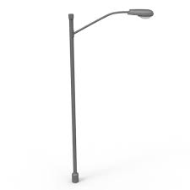
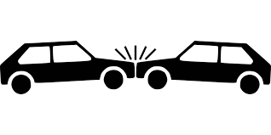
IoT/IoL Relay Link for Highway Emergency Warning Signal
Camera recognizes car accident and send alarm to other street light
IoT/IoL Relay Link
IoT/IoL Link
camera
VLC
< IoT/IoL Link for Emergency Warning in Highways >
IoT/IoL Link for Emergency Warning Signal
Tx : Highway Lighting System
Rx : Camera Built on a Car and CCTV Camera on Highway Lighting System
Day-Night Communication Mode
Modulations :
OOK, Offset-VPWM, Multilevel PPM, Inverted PPM, Subcarrier PPM, DSSS SIK etc.
Data Rate : 1K ~ 1Mb/s
Supported LoS (Line of Sight)
Available Distance : 2m ~ 200m
※ Highway Lighting System with Camera used as a IoT/IoL Relay Link to forward the highway emergency warning signal to broadcast everywhere in the Highway.
※ Reduces the multiple vehicle accident on the highway and ease the Driving in Emergency Situation.
Slide 4

Slide 5
Conclusion
Proposed the IoT/IoL Relay Link for Emergency Warning Signal broadcasting in Highways.
Utilize the Lighting System connected with CCTV Camera and camera installed in the car to enable IoT/IoL Link to notify emergency warning signal like accidental situation, fire on tunnels, etc., on the highway.
Reduce the multiple vehicle accident and provide safe journey in the highways.
Slide 5

