Slide 1
Project: IEEE P802.15 Working Group for Wireless Personal Area Networks (WPANs)
Submission Title: IoT/IoL Technology of Secure Payment for Self-Driving Vehicle
Date Submitted: January 2019
Source: Jaesang Cha (SNUST), Minwoo Lee (SNUST), Hyeongho Lee (Netvision Telecom Inc., Korea Univ.), Yoonkwan Kim (The Catholic Univ.), Minseok Oh (Kyonggi Univ.), Jinyong Choi (Shinhan Bank), Jintae Kim (Fivetek Co., Ltd.), Sungdoo Kang (Feelux Co., Ltd.), Changsoo Lee (L&S LED Co., Ltd.), Kirak Jung (Namuga Co. Ltd.), Sooyoung Chang (SYCA), Vinayagam Mariappan (SNUST)
Address: Contact Information: +82-2-970-6431, FAX: +82-2-970-6123, E-Mail: chajs@seoultech.ac.kr
Re:
Abstract: This documents introduce the IoT/IoL Communication Link design consideration for VAT. This proposed IoT/IoL technology used for secure payment for self-driving vehicle using build in illumination devices in vehicle. This VAT to operate on the application services like ITS, ADAS, etc.
Purpose: To provided concept models of light communication based IoT/IoL solution for Vehicular Assistant Technology (VAT) Interest Group.
Notice: This document has been prepared to assist the IEEE P802.15. It is offered as a basis for discussion and is not binding on the contributing individual(s) or organization(s). The material in this document is subject to change in form and content after further study. The contributor(s) reserve(s) the right to add, amend or withdraw material contained herein.
Release: The contributor acknowledges and accepts that this contribution becomes the property of IEEE and may be made publicly available by P802.15.
Slide 1

Slide 2
Contents
Need of IoT/IoL Technology for Secure Payment
IoT/IoL Technology of Secure Payment for Self-Driving Vehicle
Conclusion
Slide 2

Slide 3
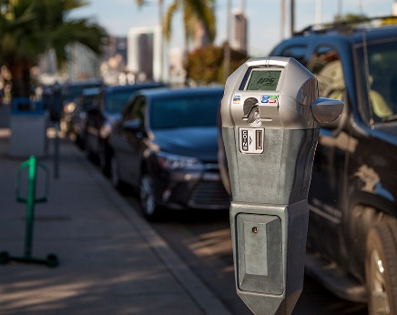
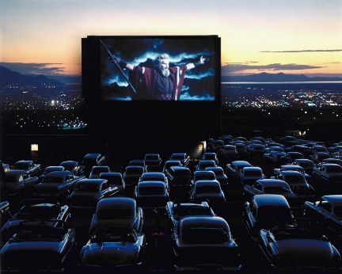
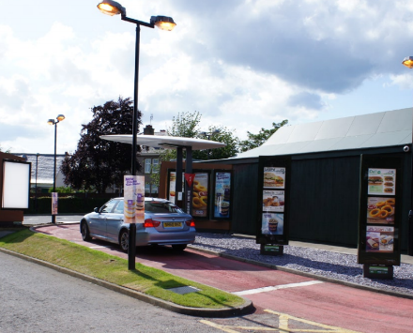
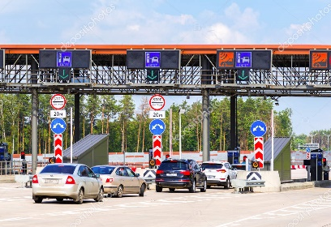
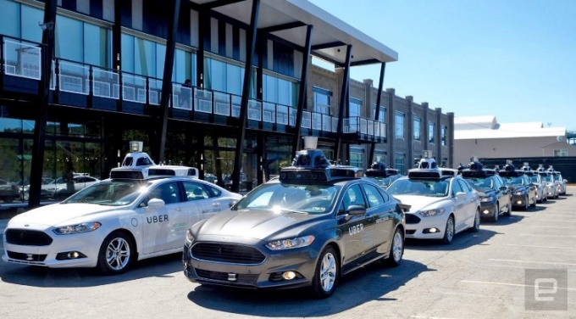
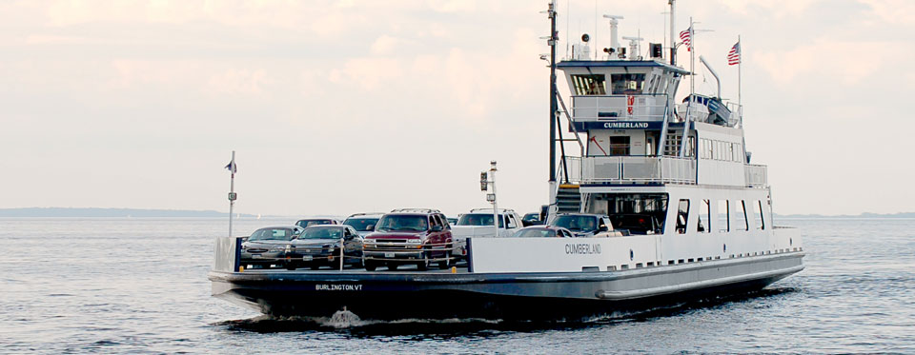
Need for IoT/IoL Technology of Secure Payment
Needs
  Smart payment is widely spread in everyday life.
  In many areas using of infrastructure requires payment or fee: parking, drive-in areas, drive-trough shopping, using of speedways, ferry crossing etc.
  The secure payment for infrastructure usage, which will be convenient for both driver and self-driving vehicle, is necessary.
Basic Concept
  Uses of built in car illumination system and camera for OWC between car and terminal.
  Provides data exchange of: bank or card account, fee/price, authorization of infrastructure usage.
  Security is provided due to limited light propagation – only within sight
GOOGLE
  < Self-Driving Vehicle >
GOOGLE
  < Paid Infrastructure Service Examples >
Slide 3

Slide 4
IoT/IoL Technology of Secure Payment for Self-Driving Vehicle
  < IoT/IoL based secure payment for self-driving vehicle >
IoT / IoL Data transmission
  Tx : LED illumination
  Rx : Camera / Image Sensor
  Modulations
    OOK, VPPM, Inverted PPM, Color Code, DSSS SIK etc.
  Data Rate : 1K ~ 1Mb/s
  Supported LoS (Line of Sight)
  Available Distance : 2m ~ 20m
Optical wireless communication works on short distance with stability, precision, high sensitivity high speed.
Directional light propagation makes theft of personal data to third parties very complicated.
Implementation of OWC receiver and transceiver into existing car with illumination makes this technology cost effective
Can be used for car under driver control also, making payment more fast and secure
Slide 4

Slide 5
Conclusion
Proposed the technology of Secure Payment for Self-driving vehicle.
Uses built in light illumination as a Transmitter and camera as a receiver to provide data communication between vehicle and paying terminal.
Secure payment process by avoiding data theft due to short and directional light propagation - only within sight.
Slide 5

