Slide 1
Project: IEEE P802.15 Interest Group for Wireless Personal Area Networks (WPANs)
Submission Title: Increasing communication range in OWC/OCC system for V2V/V2I
Date Submitted: January 2019
Source: Minh Duc Thieu, Yeong Min Jang [Kookmin University].
Contact: +82-2-910-5068 E-Mail: yjang@kookmin.ac.kr
Re:
Abstract: A summary of potential problem for increasing communication distance in OWC/OCC system for V2X
Purpose: To summary challenges of increasing communication range in OWC/OCC system for V2X
Notice: This document has been prepared to assist the IEEE P802.15. It is offered as a basis for discussion and is not binding on the contributing individual(s) or organization(s). The material in this document is subject to change in form and content after further study. The contributor(s) reserve(s) the right to add, amend or withdraw material contained herein.
Release: The contributor acknowledges and accepts that this contribution becomes the property of IEEE and may be made publicly available by P802.15.

Slide 2
A summary of increasing communication range challenges in OWC/OCC system for V2V/V2I

Slide 3
Introduction
Communication range is one of the main challenge in communication systems using OWC/OCC.
The longer communication distance, the lower SNR levels and therefore, power signals are lower at the receiver side.
However, the distances between vehicle-to-vehicle should adhere to the minimum safe distance for safety purpose. Thus, the communication distance for V2V communication systems should match these minimum distances to guarantee safety in transportation.

Slide 4
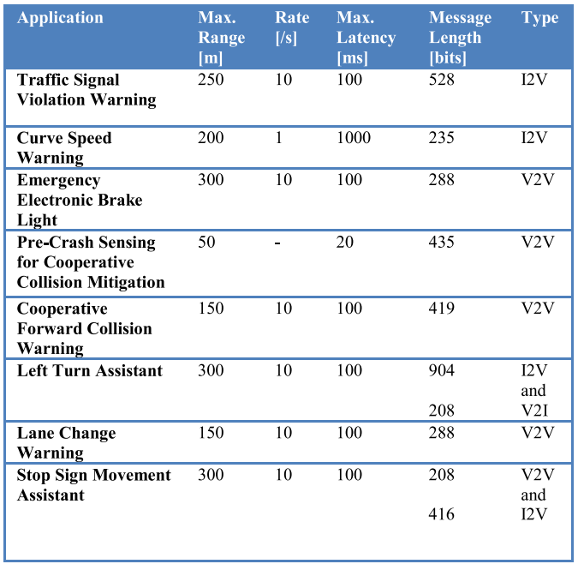
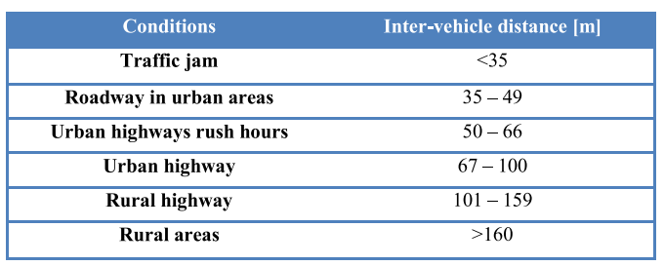
Challenges of increasing communication distance (1)
Summarizes the requirements imposed by the VSCC* for the eight most important communication-based vehicle traffic applications.
*VSCC: the Vehicle Safety Communications Consortium
Inter-vehicle distance in different traffic conditions [1]
The high priority safety application [1]

Slide 5
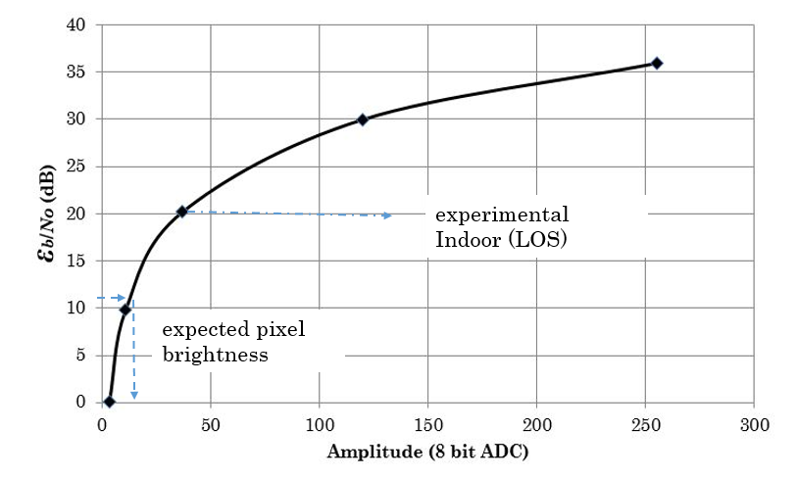
Challenges of increasing communication distance (2)
In far communication distance condition, the SNR level should be adapt to the requirement of receiver side to decode data from signal light intensity.
Bigger than 10 dB Eb/No is the expected value (more than enough) for any system with any modulation scheme to achieve desired BER (such as 10-5).
The communication distance may depends on the power of light sources, modulation schemes, focal length of cameras, etc.
Pixel amplitude vs Pixel SNR

Slide 6
References
[1] Alin-Mihai Cailean, Mihai Dimian, "Current Challenges for Visible Light Communications Usage in Vehicle Applications: A Survey," IEEE Communication Surveys & Tutorials, vol. 19, no. 4, pp. 2681-2703, 2017.

