Slide 1
Project: IEEE P802.15 Working Group for Wireless Personal Area Networks (WPANs)
Submission Title: [MAC Proposal for 802.15.4w Standard]
Date Submitted: [6 July, 2018]
Source: [Jin-Taek Lim, Kunmin Yeo, Youngnam Han] Company: [Korea Advanced Institute of Science and Technology]
Address: [717, N1 Bldg., 291, Daehak-ro, Yuseong-gu, Daejeon, Republic of Korea]
Voice:[+82-10-4736-8940], E-Mail:[jtyim@kaist.ac.kr]
Re: []
Abstract: [This presentation represents KAIST’s proposal for the P802.15.4w MAC standard, emphasizing the need for a low energy consumption.]
Purpose: [Response to IEEE P802.15.4w Low Power Wide Area Call for Proposals]
Notice: This document has been prepared to assist the IEEE P802.15. It is offered as a basis for discussion and is not binding on the contributing individual(s) or organization(s). The material in this document is subject to change in form and content after further study. The contributor(s) reserve(s) the right to add, amend or withdraw material contained herein.
Release: The contributor acknowledges and accepts that this contribution becomes the property of IEEE and may be made publicly available by P802.15.
Jin-Taek Lim, Kunmin Yeo, Youngnam Han, KAIST

Slide 2
MAC Proposal for 802.15.4w Standard
Jin-Taek Lim°, Ph.D candidate Kunmin Yeo*, Principal Researcher Youngnam Han°, Professor
°Korea Advanced Institute of Science and Technology (KAIST)
*Electronics and Telecommunications Research Institute (ETRI)
Phone: +82-10-4736-8940
jtyim@kaist.ac.kr
Jin-Taek Lim, Kunmin Yeo, Youngnam Han, KAIST
Notes:
Hello everyone.
I am Jin-Taek Lim, a doctoral student from KAIST in Korea.
It is an honor to present to you today.
I will tell you today is a proposal for MAC for 802.15.4w.

Slide 3
15.4w is Different!
LPWA is a major market application that needs to be addressed.
Requirements differ from those of other WPANs
Uplink-based traffic
More emphasis on longer battery life and lower cost.
Less emphasis on message latency, channel capacity, and QoS.
Support for larger space and device numbers.
Fixed location.
Because the requirements are different, the network design should be changed
Jin-Taek Lim, Kunmin Yeo, Youngnam Han, KAIST
Notes:
As you all know, 15.4 focuses on the lpwa environment.
Therefore, the requirement differs from the existing WPAN.
First, it focuses on increasing the lifetime of devices and lowering chip complexity with the goal of low power and low cost.
Also, applications using lwpa do not require high data rates and are tolerant of message delays.
It is also expected that most of the devices will be in fixed form in a very large space.
Therefore, the design of the network must change under these completely different requirements.

Slide 4
Not all devices will be energy-critical!
Full-function device (FFD, coordinator)
Candidates for FFD : Smart vehicle, Outlet device
Rich in energy capacity
Reduced-function device (RFD, simple device)
Candidates for RFD : Battery-based sensors
Poor in energy capacity
The transfer protocol of a device without energy restrictions does not have to be suitable energy-saving only!
Jin-Taek Lim, Kunmin Yeo, Youngnam Han, KAIST
Notes:
Before we make this proposal, we have noticed that all devices of lpwa are not the same condition.
While most devices are energy-limited devices with battery-based energy, smart cars or devices that use outlets can be energy-free.
We will call the former RFD and the latter FFD.
We thought that it will not be efficient in terms of overall energy to match the transmission protocol of all devices to low power protocol despite the availability of energy-conscious devices.

Slide 5
Contention-free/based protocols
Contention-free
(cons) Energy consumption ↑
Exchange of signaling, maintaining the connection
More suitable when there is more data to send
Suitable for FFD
(pros) Transmission reliability ↑
collision-free
Latency from waiting time if crowded
Contention-based
(pros) Energy consumption ↓
More suitable when less data to send
Suitable for RFD
(cons) Transmission reliability ↓
Latency from retransmission(collisions) if crowded
Jin-Taek Lim, Kunmin Yeo, Youngnam Han, KAIST
Notes:
As you know, there are two major types of transport protocols.
One is a contention-free transport protocol, which is typically done through scheduling.
Therefore, additional signal exchange for additional scheduling and signal exchange for maintaining the connection are typically more energy consuming.
This scheduling scheme is advantageous because it does not cause collision between packets in terms of stability, but it is not suitable to one packet transmission every once in a while.
On the other hand, the case of contention-base is different.
For example, pure ALOHA simply selects the transmission channel and time at random in a given contention window, so there is no need to sense channels or to exchange transmission-related signaling.
Therefore, energy consumption is obviously small.
However, in such a case, as the number of devices increases, collision between packets can not be avoided and transmission safety becomes poor.
Taking the characteristics of these two protocols together, we find that contention-free is suitable for FFDs that operate as a relay, and contention-based for general RFDs.
Both have different bases where delays occur when the devices are too crowded.
In case of contention-free, it is caused by waiting time. In case of contention-based, it is caused by retransmission due to collision.

Slide 6
15.4w network topology proposal
6
20
14
5
Waste of energy in FFD
12
11
4
5
GW
2
7
8
6
13
9
FFD
1
0
4
RFD
7
2
1
3
9
3
22
10
6
20
Overflow energy of FFD contributes to more reliable connections
Saving the energy of RFDs
Increase of latency
12
14
5
11
GW
7
4
5
2
8
6
13
9
1
FFD
0
4
RFD
7
2
1
3
9
3
22
10
Since CB and CF share common resource, GW need to control it by considering the probability that a packet is delivered and the probability of meeting a delay bound.
Jin-Taek Lim, Kunmin Yeo, Youngnam Han, KAIST
Notes:
On this page, we can compare the protocol that uses FFD as a relay and not the protocol.
The red circle represents RD, the yellow circle represents FFD, and the green circle represents GW.
Black solid lines indicate transmission using a contention-based protocol, and blue solid lines indicate transmission using a contention-free protocol.
As mentioned earlier, energy-free FFD simply uses the CB protocol is not an efficient use.
Rather, it is better to combine packets of RFDs closer to FFD than GW and communicate packets with GW through scheduling in two respects.
First, there is a low transmission power consumption of the RFD, and second, there is a more stable transmission gain through the CF communication.
However, the second advantage, stable transmission can be a disadvantage that the delay due to the waiting time can be increased when the number of the devices is large.
This waiting time also depends on the amount of resources distributed to the CF.
Therefore, the performance of the proposed system depends on the division of resources between CB and CF, and its optimal point is determined by the delay boundary of the app and the number of RFD, FFD, and so on.

Slide 7
Procedures of proposed FFD-assisted network
A “Collecting Device” (Gateway, GW) sends beacon.
FFD sends its beacon at the same period as GW’s beacon.
RFD receives beacons and controls power based on the signal strength of the nearest beacon.
If there is FFD or GW nearby, energy consumption is reduced! (Energy saving!)
The RFD does not need to know whether its packets are relayed or not (Simple!)
RFD sends its packet which includes the overhead (RFD’s ID)
FFD receives packets in surrounding RFDs, decodes and its information in the queue
FFD re-modulates the information in the queue according to channel quality between FFD and GW and sends it through scheduling with GW
Packet should include the new overhead for scheduling
Jin-Taek Lim, Kunmin Yeo, Youngnam Han, KAIST
Notes:
The detailed procedure of each device is as follows.
First, the GW periodically sends a beacon signal at all times.
The FFD receives the beacon from the GW based on the rich energy and transmits its beacon according to the period.
RFD will wake up from sleep and detect beacons around if there are packets to send.
Then, the RFD transmits the packet using the pure aloha method by adjusting the power of the packet to be transmitted based on the strongest beacon signal of the surroundings.
The advantages that arise in this case are energy saving, as well as the fact that the RFD itself can be very simple because it does not need to know if its packets are relayed in the RFD.
Of course, the RFD packet should have its own ID information in overhead so that it knows who the contents of this packet belong to.
FFD does not attempt to transmit on the contention-based window, but collects packets of RFD that attempt to transmit on the perimeter like GW.
Then, these packets are decoded and stacked with the overhead information of the packets in the order of arrival in the queues.
In the contention-free window period, re-modulates the information of the queues in the slots allocated from the GW and transmits them.

Slide 8
Network Frame Proposal
CF period
CB period
Beacon packet
Information for CF and CB period
Division of CF and CB period should be variable depending on
How many FFDs are in topology
How many RFDs are in topology and their delay bounds
GW
Beacon
Beacon
FFD
Beacon
Beacon
RFD 1
RFD 2
Jin-Taek Lim, Kunmin Yeo, Youngnam Han, KAIST
Notes:
This procedure is illustrated in the following figure.
The GW spurts the beacon periodically and receives packets for each protocol during the specified CF period and CB period.
EFD sends packets during the CF period and receives packets from the ECD during the CB period.
Each ECD transmits packets in the CB period with a pure aloha for the strongest beacon signal in the periphery.
The GW beacon packet must contain the distribution information of CF and CB, and such distribution information must affect overall performance.

Slide 9
MAC Packet Proposal
Proposal to include new information for CF/CB division optimization
Latency bound information
Transmission time information
Number of retransmissions performed in CB protocol
Software implementation in GW:
Statistics evaluation for packet delay violation
Evaluation of CB/CF allocation and send it to a beacon
Jin-Taek Lim, Kunmin Yeo, Youngnam Han, KAIST
Notes:
The division of CF and CB is adjusted by statistically analyzing the incoming packets in the GW.
At this time, in order to analyze the performance due to the introduction of FFD and CF, it is necessary to consider that packets become useless due to latency in addition to packet loss due to collision.
For this purpose, the MAC packet needs to know the delay limit information of this packet, the time of the first transmission attempt, and the number of retransmissions in the CB protocol.
GW can statistically determine the overall performance of the current system and adjust the division of CB and CF for better performance.
Detailed algorithms for this are left as implementation problems.

Slide 10
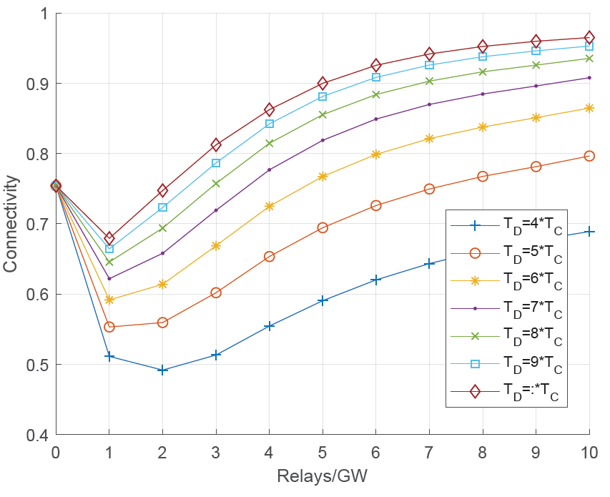
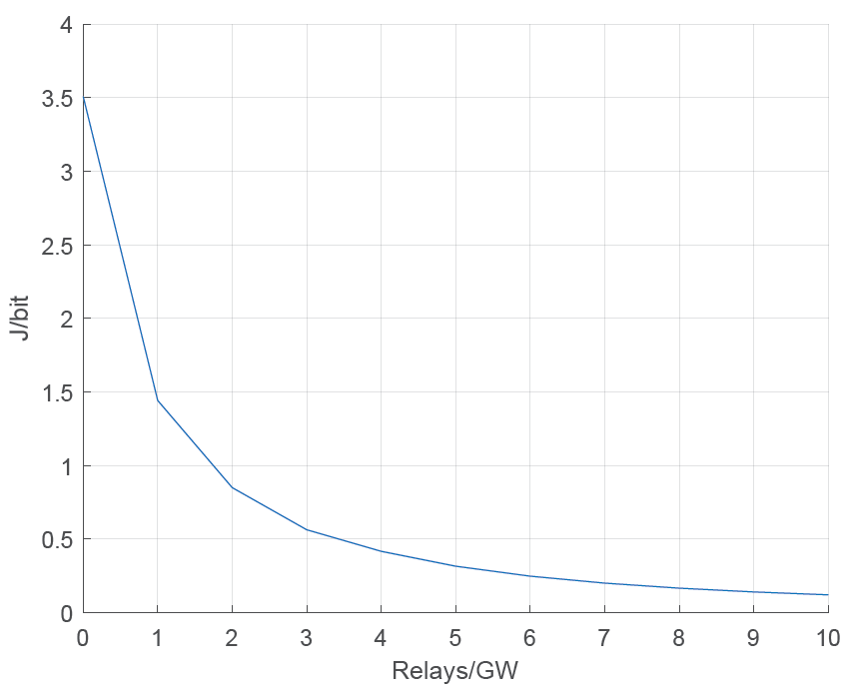
Expected performance
* These graphs have been extracted from the paper for LoRa system to be submitted soon. (Relay=FFD)
Connectivity = Probability for randomly chosen RFD to satisfy ‘successfully arrived at GW’ condition AND ‘arrived at GW within its APP’s boundary’ condition
Energy/bit = Transmission energy consumption per bit for randomly chosen RFD
Jin-Taek Lim, Kunmin Yeo, Youngnam Han, KAIST
Notes:
We performed a simple simulation to simulate the performance of the proposed system.
We have seen performance with two metrics, one is connectivity and the other is energy / bit.
Connectivity is defined as the probability that the packet of arbitrarily selected RFD in topology arrives at the GW successfully and arrives at the same time within the latency limit.
Energy / bit is the total average energy consumed by this packets for transmission.

Slide 11
Expected performance
* These graphs have been extracted from the paper for LoRa system to be submitted soon. (Relay=FFD)
$T_{D}$ : APP’s delay boundary
$T_{C}$ : Beacon period (60 sec)
Simulation environment
Coverage of GW : 20 km
Path loss exponent : 2.7
Carrier frequency : 867 MHz
1000 RFDs per GW
Modulation
Chirp Spread Spectrum (CSS)
Jin-Taek Lim, Kunmin Yeo, Youngnam Han, KAIST
Notes:
The average coverage of GW was set at 20 km and there were 1000 RFDs per GW.
At this time, the simulation was performed by changing FFD per GW.
In the graphs, T_D denotes the latency boundary of the packet, and T_C denotes the beacon interval. We set it to 60 seconds.
In each T_D value setting, the division of CF period and CB period was performed optimally.
Here, when there is no relay per GW, the network structure is equal to the conventional network without relays.
We have shown that if the T_D is not equal to T_C in the connectivity graph, the connectivity can be improved by increasing the relay.
However, if there are not enough relays, there are some places where connectivity is deteriorated.
This is because the RFD sends power adjusted to the nearest receiver, so that if the number of FFDs is small, the number of RFDs per EFD is too large to use the CF transmission protocol stably within T_D.
It can be seen that the energy consumed in transmission decreases exponentially with increasing FFD.

Slide 12
Vision
Under limited resources, achieving massive connectivity and reducing energy consumption are very important issues for the market.
These requirements cannot be met by only using the energy-saving protocol, because there exit devices that are full of energy.
So, we propose a MAC scheme that supports:
Increase of the lifetime of energy-constrained devices by utilizing devices that are full of energy
Increase of connectivity by a harmonious control of contention-based and contention-free protocols
We find that the contention-free FFD-assisted approach can save the energy of RFDs and increase connectivity.
Jin-Taek Lim, Kunmin Yeo, Youngnam Han, KAIST
Notes:
On this page we summarize our suggestions.
As you know, IEEE standards must be consistent with industry and market trends.
It is very important to meet the requirements of massive connectivity and low energy consumption under limited resources.
Using energy-saving transmission protocols simply can not be a good solution because there are also energy-rich devices.
Therefore, we propose a harmonious coexistence of CB and CF protocols that can increase the lifetime of non-energy-intensive devices and increase connectivity at the same time using FFDs.
A solution is needed and we believe that our proposed method will be a good solution.
Thank you for your attention.
And, if you have any questions, I would like to ask you to make it a bit slow.

