Slide 1
Project: IEEE P802.15 Working Group for Wireless Personal Area Networks (WPANs)
Submission Title: [OFDM extension to lower data rates]
Date Submitted: [8 MAY 2018]
Source: [Ruben Salazar, Chris Calvert] Company [Landis + Gyr]
Address [30000 mill creek av, Alpharetta GA 30022]
Voice:[+1678 258 3165], FAX: [+1 866 219 4410], E-Mail:[ruben.salazar@landisgyr.com]
Re: []
[If this is a response to a Call for Contributions, cite the name and date of the Call for Contributions to which this document responds, as well as the relevant item number in the Call for Contributions.]
[Note: Contributions that are not responsive to this section of the template, and contributions which do
not address the topic under which they are submitted, may be refused or consigned to the “General Contributions” area.]
Abstract: [Proposed extending OFDM in SUN specification to lower data rates.]
Purpose: [Discussion.]
Notice: This document has been prepared to assist the IEEE P802.15. It is offered as a basis for discussion and is not binding on the contributing individual(s) or organization(s). The material in this document is subject to change in form and content after further study. The contributor(s) reserve(s) the right to add, amend or withdraw material contained herein.
Release: The contributor acknowledges and accepts that this contribution becomes the property of IEEE and may be made publicly available by P802.15.
NOTE: Update all red fields replacing with your information; they are required. This is a manual update in appropriate
fields. All Blue fields are informational and are to be deleted. Black stays. After updating delete this box/paragraph.

Slide 2
Overview – 802.15.4x PAR
“This amendment defines enhancements to the IEEE Std 802.15.4 SUN Orthogonal Frequency-Division Multiplexing (OFDM) PHYs enabling the support for data rates up to 2.4Mb/s. This amendment also defines additional channel plans, as needed, to support emerging applications.”
Slide 2
Notes:
May 18
Page 2

Slide 3
Overview of proposal
Proposed addition
Define lower data rates in OFDM SUN PHY
Complete the OFDM modulation table in SUN PHY specification
Rationale
Lower data rates are a very important and needed feature and component for the SUN PHY.
Provides another option to increase range and/or penetration for SUN PHYs
It is convenient to change data rates without changing modulation schemes
Slide 3
Notes:
May 18
Page 3

Slide 4
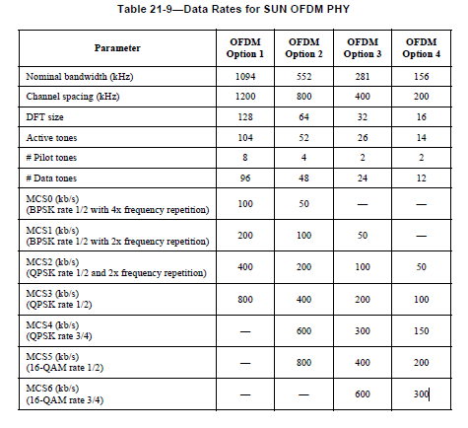
Current OFDM Data Rates in SUN
Slide 4
Notes:
May 18
Page 4

Slide 5
Extension proposal
OFDM Option 3 and OFDM Option 4 to support MCS0
OFDM Option 4 to support MCS1
Slide 5
Notes:
May 18
Page 5

Slide 6
Proposed OFDM Data Rates extension
25
12.5
25
Slide 6
Notes:
May 18
Page 6

Slide 7
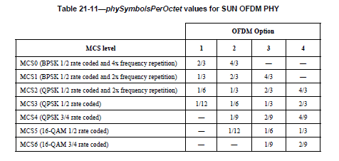
Other tables impacted – symbols/octet
8/3
16/3
8/3
Slide 7
Notes:
May 18
Page 7

Slide 8
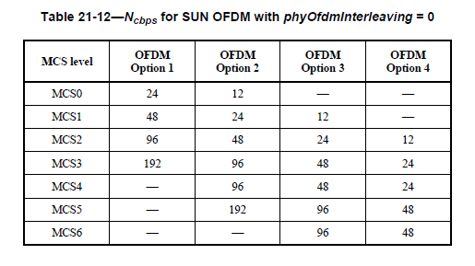
Other tables impacted – Interleaving
6
3
6
Slide 8
Notes:
May 18
Page 8

Slide 9
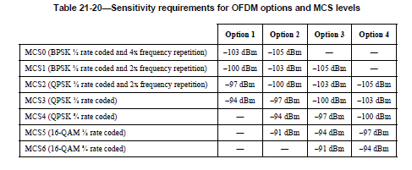
Other tables impacted – Sensitivity
-108dBm
-111dBm
-108dBm
Slide 9
Notes:
May 18
Page 9

Slide 10
Comments
The added data rates would be natural extensions of the current data rates
Current silicon has already the elements necessary to cover these, it require at most testing for their performance
The OFDM table will now be complete with additions at the higher data rates and at the lower data rates both of which have found immediate need in the SUN deployments.
Sensitivity for the added rates would be significantly better: from current experience one can expect ~10dB better than the above specification
It is easier to implement the changes of Operating modes (speed) rather than Modulation schemes.
Slide 10
Notes:
May 18
Page 10

