Slide 1
Project: IEEE P802.15 Working Group for Wireless Personal Area Networks (WPANs)
Submission Title: Graphic Data Dictionary Based Automatic Traffic Sign Recognition Using CamCom Technology
Date Submitted: January 2018
Source: Jaesang Cha, Deokgun Woo, Mariappan Vinayagam, Seonhee Lee (SNUST), Sooyoung Chang(CSUS) , SangWoon Lee (Namseoul Univ.)
Address: Contact Information: +82-2-970-6431, FAX: +82-2-970-6123, E-Mail: chajs@seoultech.ac.kr
Re:
Abstract: This documents introduce the V2I CAMCOM Link design consideration for VAT. The proposed Graphic Data dictionary based automatic traffic sign recognition used for autonomous vehicle control using CAMCOM technology. This VAT to operate on the application services like ITS, ADAS, etc. on road condition, Bio-Plant / Manufacturing Industry Safety AIDS using Sign boards / Lighting / Display based infrastructure. Also this can be used for IoT/IoL, LEDIT, Digital Signage with Advertisement Information etc.
Purpose: To Provided Concept models of See-Through Display based Vehicle CamCom for Vehicular Assistant Technology (VAT) Interest Group
Notice: This document has been prepared to assist the IEEE P802.15. It is offered as a basis for discussion and is not binding on the contributing individual(s) or organization(s). The material in this document is subject to change in form and content after further study. The contributor(s) reserve(s) the right to add, amend or withdraw material contained herein.
Release: The contributor acknowledges and accepts that this contribution becomes the property of IEEE and may be made publicly available by P802.15.
Slide 1

Slide 2
Contents
Needs for Automatic Traffic Sign Recognition
Graphic Data Dictionary (GDD)
GDD based Automatic Traffic Sign Recognition Using CamCom Technology
Conclusion
References
Slide 2

Slide 3
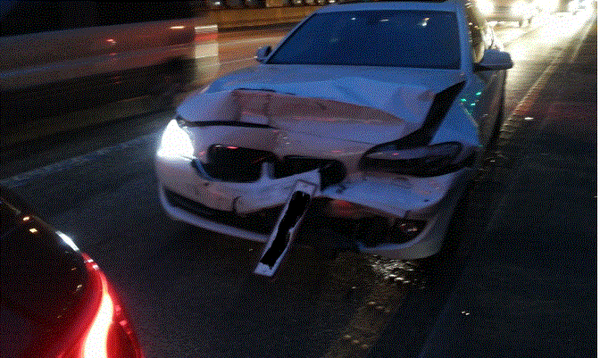
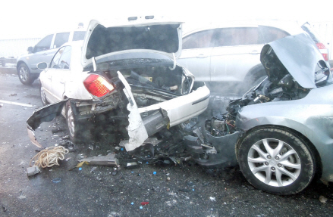
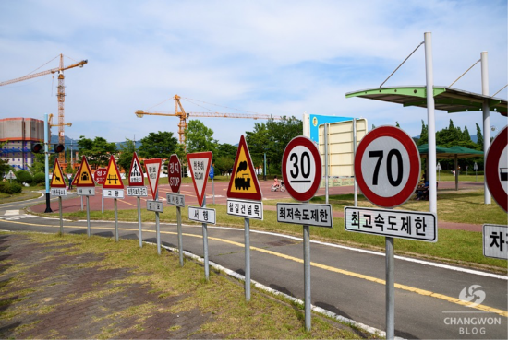
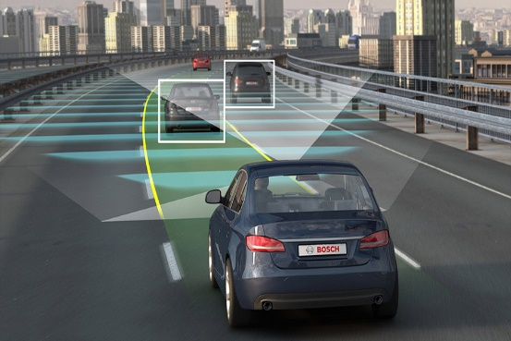
Needs for Automatic Traffic Sign Recognition
Needs
Frequent occurrence of vehicle accidents
Requires easily solution about data transmission while driving
Innovation
The role of traffic signs and direct transportation information is possible
Applicable in various transportation fields
Get a traffic information from signage
< Vehicle Collision Accident>
< Background Techniques >
Slide 3

Slide 4
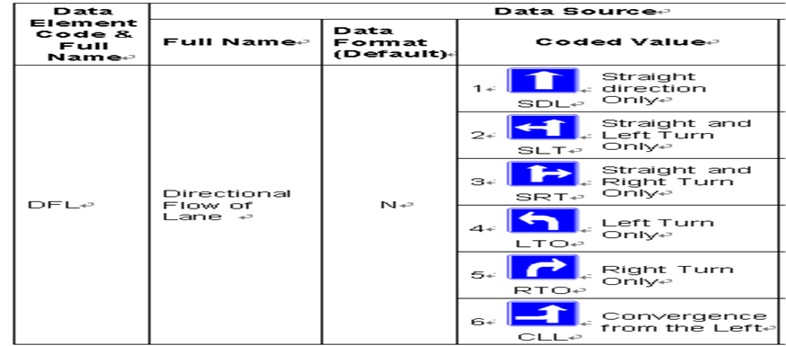
Graphic Data Dictionary (GDD)
Graphic Data Dictionary
System of standardized codes for existing road traffic signs and pictograms used to deliver Traffic and Traveller Information (TTI)
Coding system can be used in the formation of messages within intelligent transport systems
ISO14823:2017 specifies a GDD
Graphic Data Dictionary (GDD) has been developed with the intent of creating a common basis for transmitting encoded information for existing road traffic signs and pictograms by ISO TC204
< Example Road Signs Using Graphic Data Dictionary >
Slide 4

Slide 5
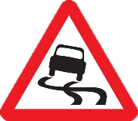
GDD based Automatic Traffic Sign Recognition Using CamCom Technology
• • •
Graphic Data Dictionary based CamCom Link
Tx : LED based Signage
Rx : CMOS Image Sensor in Camera
Day-Night Communication Mode
Data Rate : 1K ~ 1Mb/s
Supported LoS(Line of Sight)
Available Distance : 1m ~ 15m
LED Tx.
Autonomous
Vehicle With Rx.
Transmit Signal
Traffic Sign
0 0 1 0 0 1 0 1 1 …
< Graphic Data Dictionary based OCC >
※Get a variety of information
Slide 5

Slide 6
Conclusion
Proposed the GDD based Automatic traffic sign recognition method using CamCom Technology for automatic vehicle control and driver assistance
The existing LED-based signage can be utilized to make cost effective and easy to apply the technology in a wide range.
Slide 6

Slide 7
References
Sangwoon Lee, Minwoo Lee, Jaesang Cha, “Automatic Traffic Sign Recognition Method for Autonomous Vehicles using Optical Camera Communication and Graphic Data Dictionary, The 3rd International Conference on Next Generation Computing 2017, Dec. 2017
http://www.bobaedream.co.kr/board/bulletin/view.php?code=accident&No=318952
http://www.kama.or.kr/jsp/webzine/201611/pages/report_02.jsp
http://imnews.imbc.com/news/2013/society/3387789_11202.html
Slide 7

