Slide 1
Project: IEEE P802.15 Working Group for Wireless Personal Area Networks (WPANs)
Submission Title: [Recent 5G Mobility Demonstrations by Companies]
Date Submitted: [13 March, 2017]
Source: [Junhyeong Kim, Hee-Sang Chung and Il Gyu Kim] Company [ETRI]
Address [218 Gajeong-ro, Yuseong-gu, Daejeon, 34129, KOREA]
Voice:[+82-42-860-6239], FAX: [+82-42-861-1966], E-Mail:[jhkim41jf@etri.re.kr]
Abstract: [This document presents recent 5G mobility demonstrations conducted by global companies]
Purpose: [For discussion]
Notice: This document has been prepared to assist the IEEE P802.15. It is offered as a basis for discussion and is not binding on the contributing individual(s) or organization(s). The material in this document is subject to change in form and content after further study. The contributor(s) reserve(s) the right to add, amend or withdraw material contained herein.
Release: The contributor acknowledges and accepts that this contribution becomes the property of IEEE and may be made publicly available by P802.15.

Slide 2
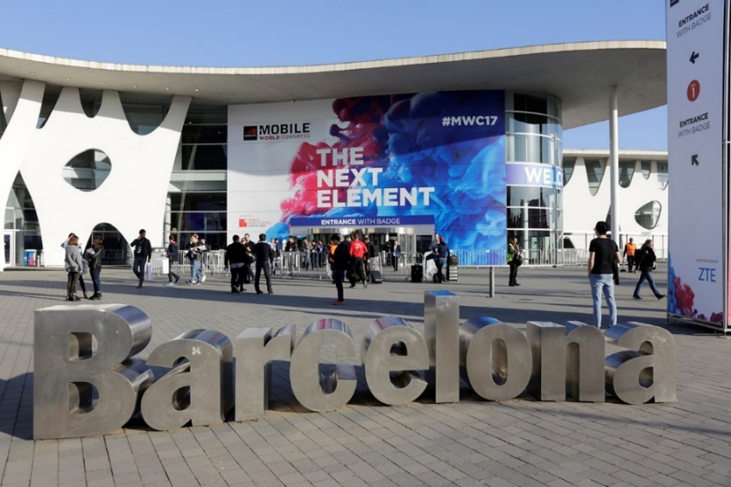
MWC 2017
5G mobility demonstrations at Mobile World Congress (MWC) 2017 held in Barcelona, Spain, 27 February ~ 2 March 2017
  MWC is one of the world’s largest gathering for the mobile industry organized by the GSMA
  Slogan of MWC2017 : THE NEXT ELEMENT
  5G moves from concept to reality at MWC 2017
  Companies like Ericsson, Samsung, and Qualcomm talked about 5G NR and are working closely with operators to demonstrate 5G technologies

Slide 3

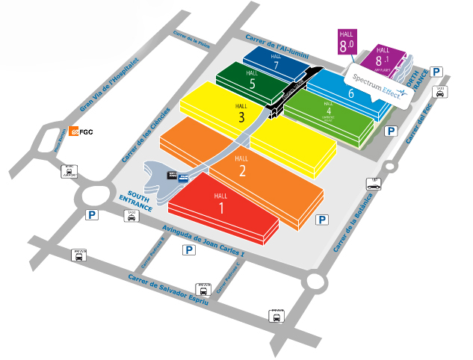

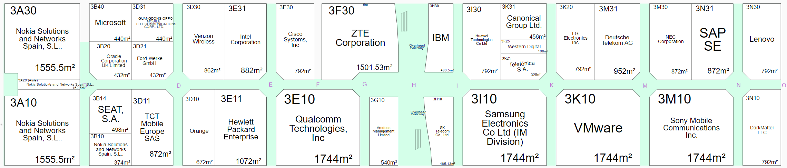
MWC 2017
Hall2:
Ericsson, LG,
Samsung Networks
Hall8: NEXTech
Entrance
Hall4: GSMA Innovation City
KT, Huawei, AT&T
Hall1:
Huawei,
NTT Docomo,
Major companies are at Hall 1~3
A new Pavilion, “NEXTech(Hall 8)”
exhibiting AI Robotics, AR/VR, Drone, was added
Hall3:
Samsung, LG, Nokia, Microsoft, Oracle, HP, Verizon, Orange, ZTE Qualcomm, IBM, Sony
Hall 3

Slide 4
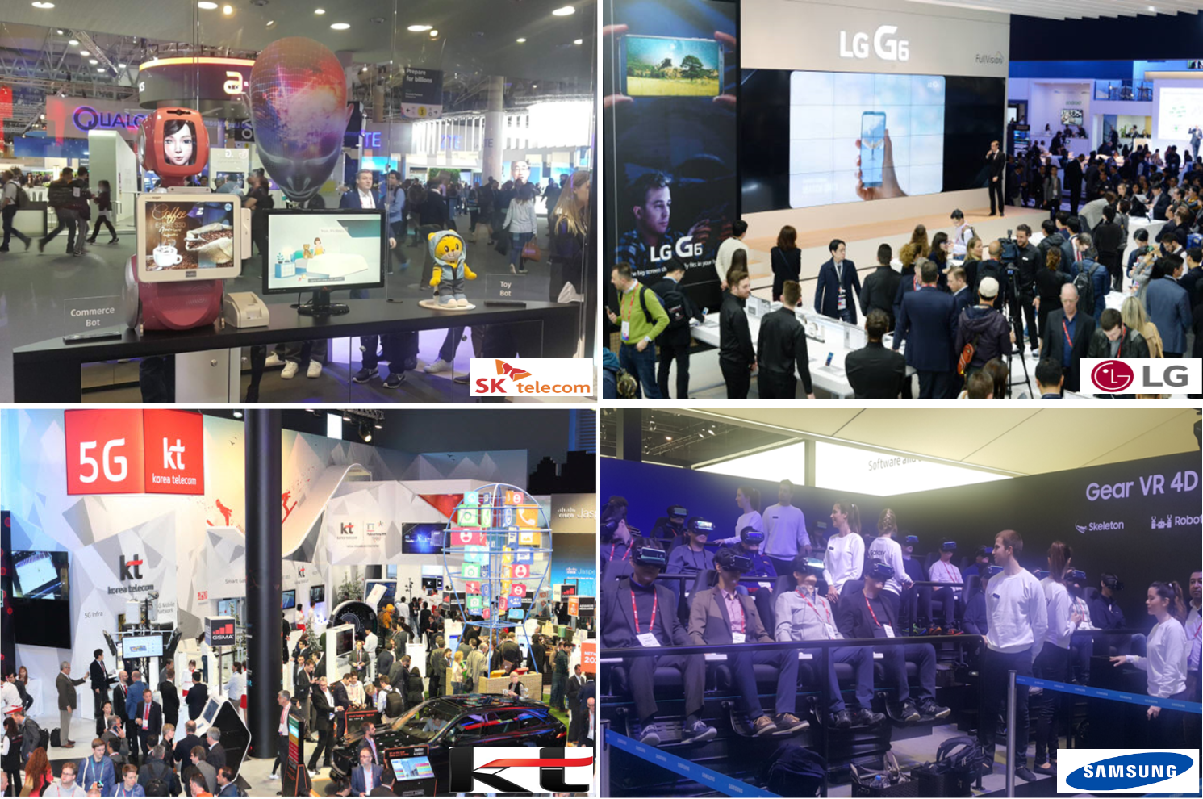
MWC 2017

Slide 5
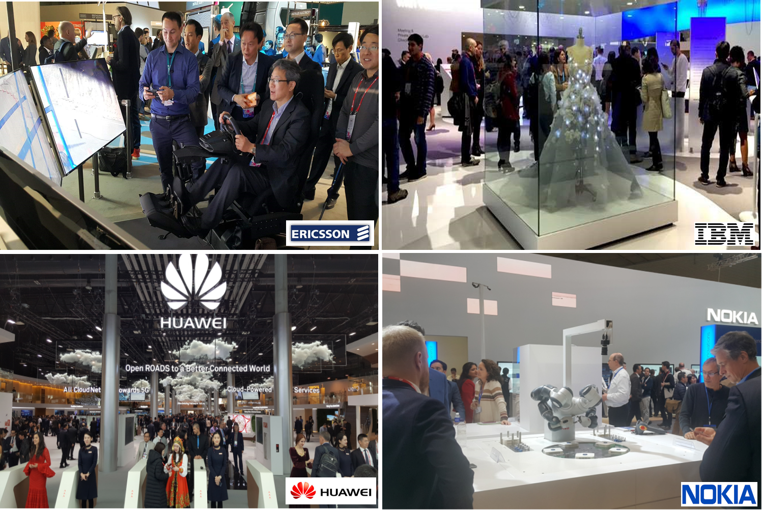
MWC 2017

Slide 6
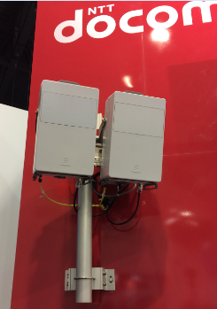
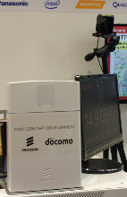
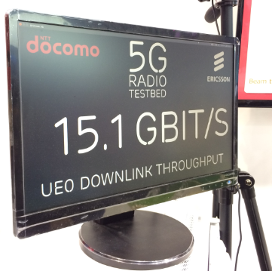
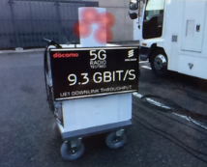
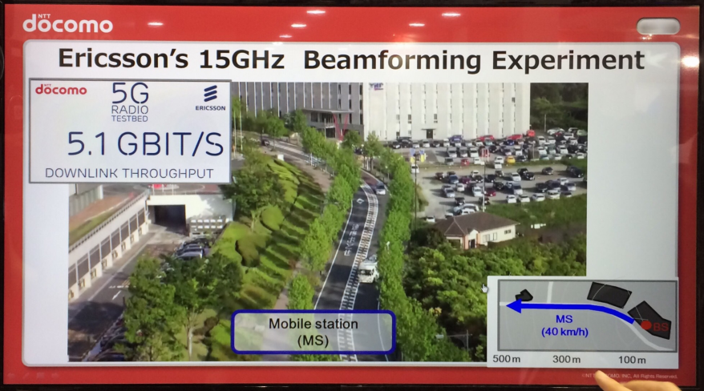
5G Mobility Demonstrations
Ericsson & NTT docomo
  Demonstration of 15GHz system in both stationary and dynamic environments
    BW of 800MHz, 4 stream MIMO transmission, 256QAM
    Real time demonstration of 15Gbps was shown in the booth
    In the outdoor stationary environment, 10Gbps can be achieved
    Beamforming experiment
      Over 5Gbps can be achieved
      Support Adaptive Modulation and Coding (AMC)
      Sometimes, the system was able to transmit 256-QAM

Slide 7
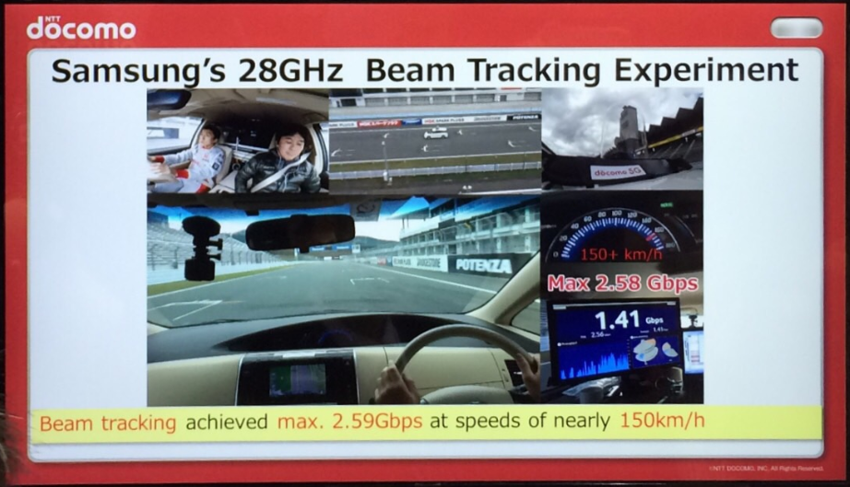
5G Mobility Demonstrations
Samsung & NTT docomo
  Demonstrated 28GHz system
    Mobile terminal was installed on a moving car
    Peak date rate of up to 2.59Gbps was achieved at speeds of nearly 150km/h
    Bandwidth of 800MHz, Beam tracking, 2 stream MIMO, 64QAM

Slide 8
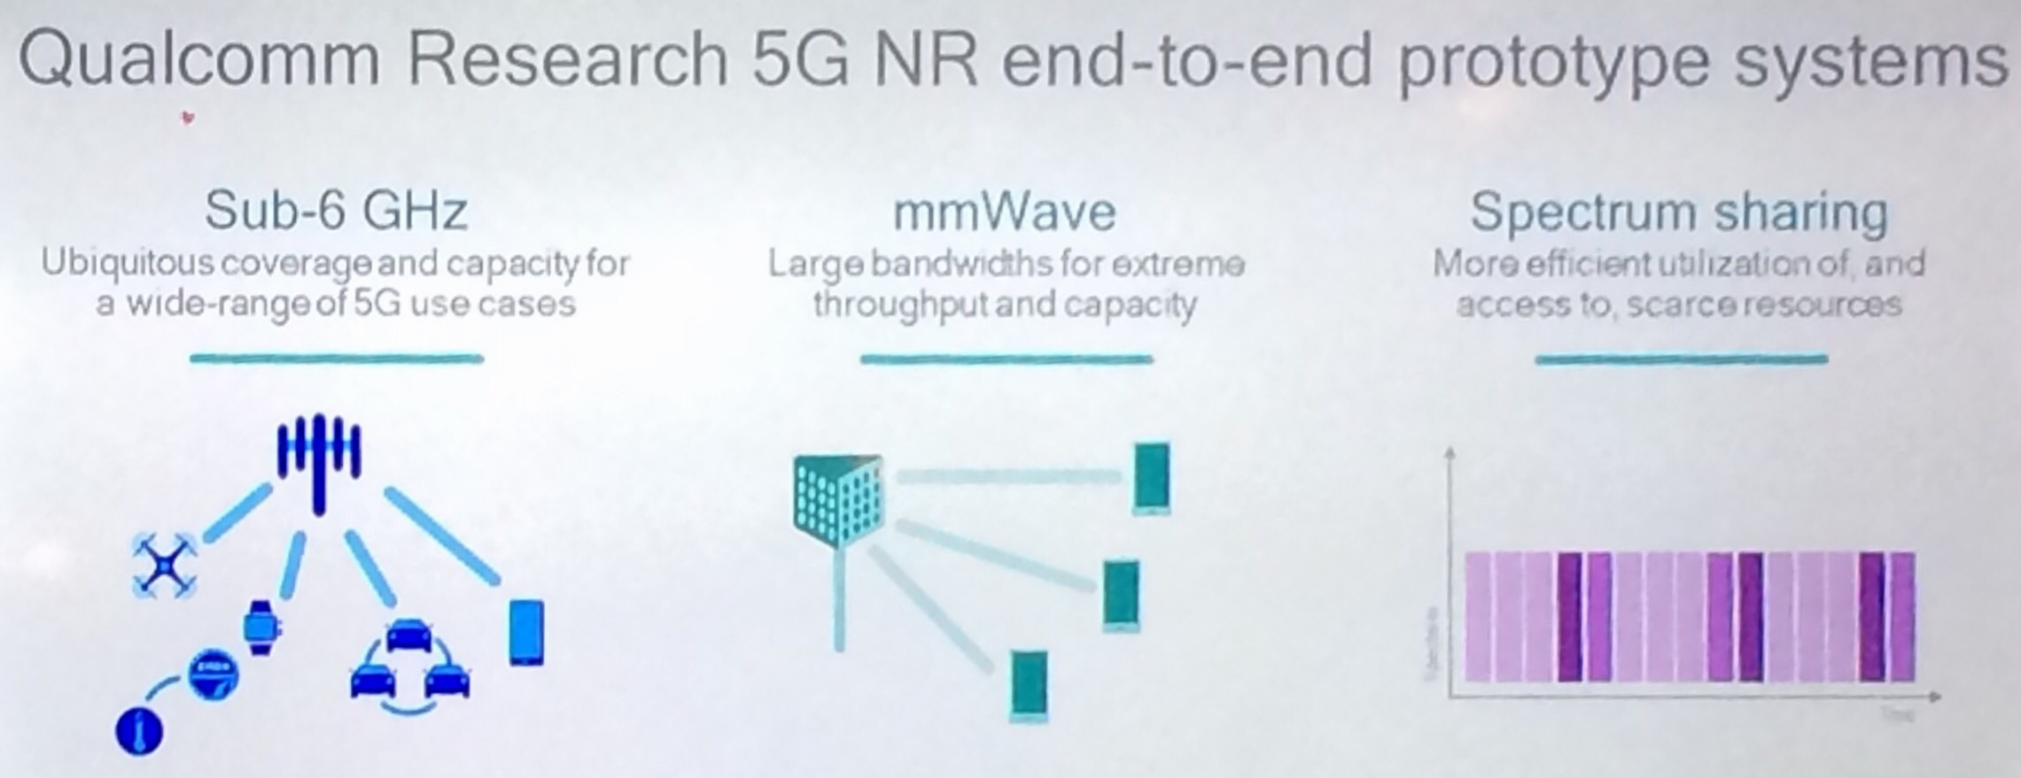
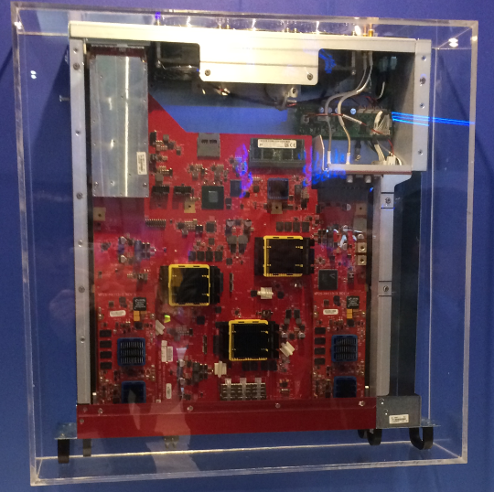
5G Mobility Demonstrations
Qualcomm Research 5G NR end-to-end prototype systmes
  Sub-6GHz, mmWave, Spectrum sharing
Qualcomm’s sub-6GHz 5G NR prototype
  Capable of operating at mid-band spectrum from 3.3GHz to 5.0 GHz initially
  Features wide RF BW (100+ MHz) to achieve multi-Gbps data rates
  Flexibly built to closely track 3GPP progress

Slide 9
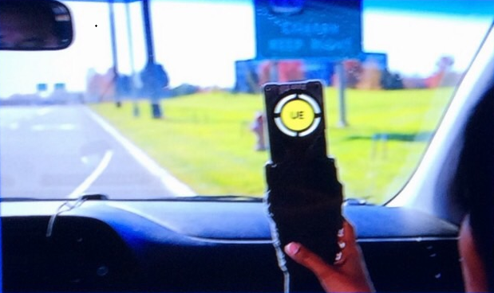
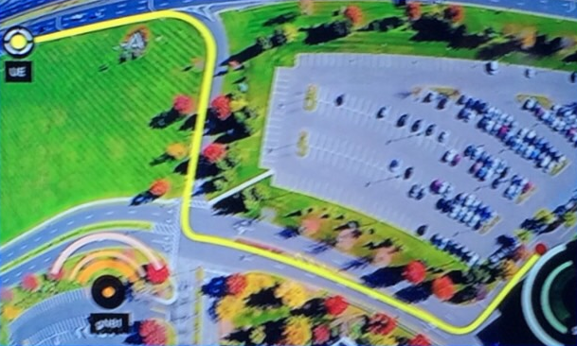
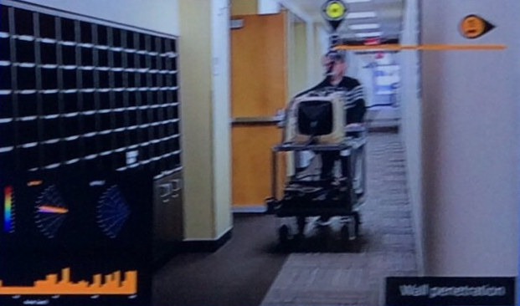
5G Mobility Demonstrations
Qualcomm’s 5G mmWave (28GHz) demonstrations
  Outdoor and indoor demonstrations featuring a TDD system operating in the 28GHz band
    Outdoor mobility up to 30mph with seamless handover
    Indoor mobility with penetration and dynamic blockage
  Advanced antenna techniques for robust and sustained mobile broadband communications
  Features multiple gNodeBs with handheld and in-vehicle devices

Slide 10
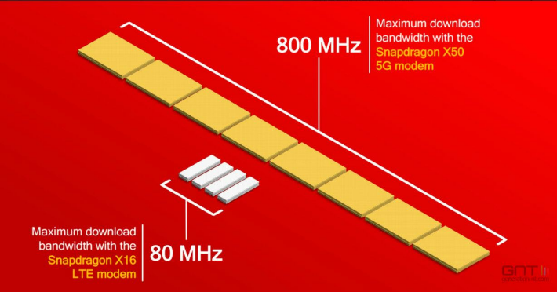
5G Mobility Demonstrations
Snapdragon X50 5G NR Modem will
  Initially support operation in the 28 GHz millimeter wave band
    800 MHz of bandwidth via 8x100 MHz carrier aggregation
    Advanced MIMO techniques such as
      adaptive beamforming, beam tracking
  Support multi-mode 2G/3G/4G/5G functionality on a single chip
  Provide multi-mode 4G/5G capability via dual connectivity
  Support 5G NR dual-band
  Composed of the modem and the SDR051 mmWave transceiver
    The next-gen RF companion to the modem, supporting 28 GHz mmWave and advanced features such as adaptive beamforming and antenna switch diversity
The first commercial products featuring Snapdragon X50 5G NR modems are expected to be available in 2019

Slide 11
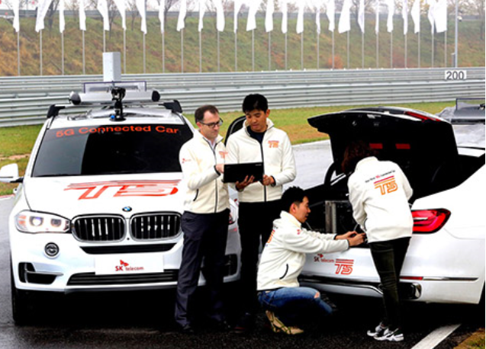
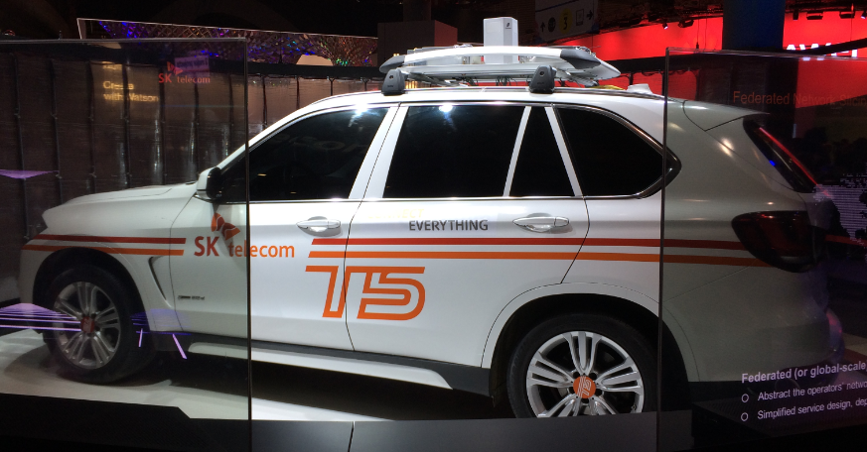
5G Mobility Demonstrations
SK Telecom’s 5G connected car, “T5”
  Deployed world’s largest mmWave 5G trial network with Ericsson at BMW driving center located in Incheon, Korea, and demonstrated ‘T5’, the world’s first 5G connected car in November last year
    Supported by Gbps throughput and ultra-low latency of 5G
    The system supports beam-tracking and handover
    Peak data rate of 3.6Gbps in mobility of 170km/h in November last year
  Also “T5” was showcased in the booth

Slide 12
5G Mobility Demonstrations
SK Telecom’s 5G-based bus
  Along with 5G connected car, SK Telecom also demonstrated an immersive experience service in a moving vehicle with Samsung in Gangnam, Seoul (urban area)
    28GHz system (UE is located in the vehicle)
    The maximum data rate of 1Gbps
    5G-based bus with large-screen displays, an audio system and video cameras which provided the virtual and augmented reality multimedia, meaning passengers can have an immersive reality experience while on the move

Slide 13
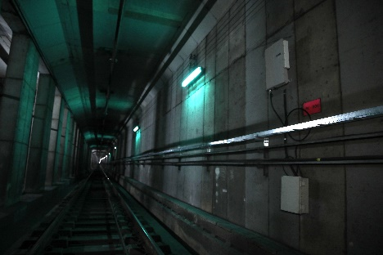
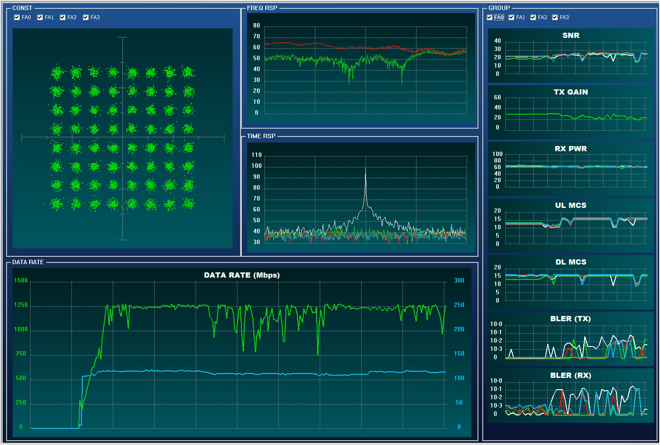

5G Mobility Demonstrations
ETRI’s demonstration of MHN system
  Meanwhile, ETRI successfully demonstrated an upgraded version of MHN system at Seoul subway line 8 in Feb.
    Peak data rate of over 1.2Gbps was achieved
      Much higher than the previous system^{[1][2]}

Slide 14
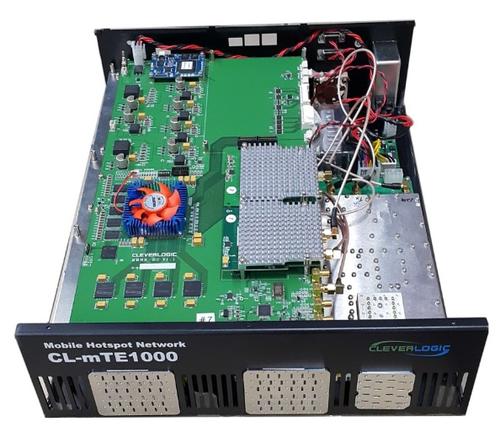
5G Mobility Demonstrations
ETRI’s demonstration of MHN system
  Antenna module configuration
    mNB(or mRU): 2T2R, mTE: 1T2R
    Maximum transmit power of 20 dBm
  EIRP requirement in 25~26GHz (FACS)
    EIRP ≤ 36dBm
Size | TX : 4x4 patch antenna RX : 8x8 patch antenna (66.6 mm x 62.3 mm)
Antenna gain | TX : 16 dBi RX : 22 dBi
Beam-width@3dB | TX: 12°@Vertical, 12°@Horizontal RX: 8°@Vertical, 8°@Horizontal
<mRU>
<mTE>

Slide 15

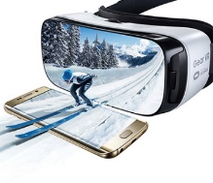
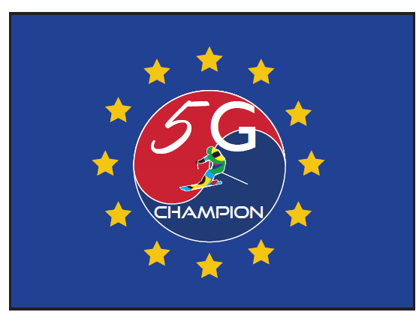

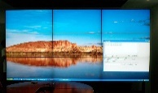
Plan for MHN-E Demonstration
Plan for MHN-E Demonstration
  Phase 1: indoor test (in the lab)
    Underway, to be completed soon
  Phase 2: outdoor test (with very low mobility)
    Expected to be completed by the end of this year
Inside vehicle
mRU of mNB
mmWave moving wireless backhaul
(data rate exceeding 2.5 Gbps)
Broadband Internet service via
Giga Wi-Fi AP deployed in the vehicle
mTE
Immersive experience
(VR/AR)
Multiple UHD
video streaming

Slide 16
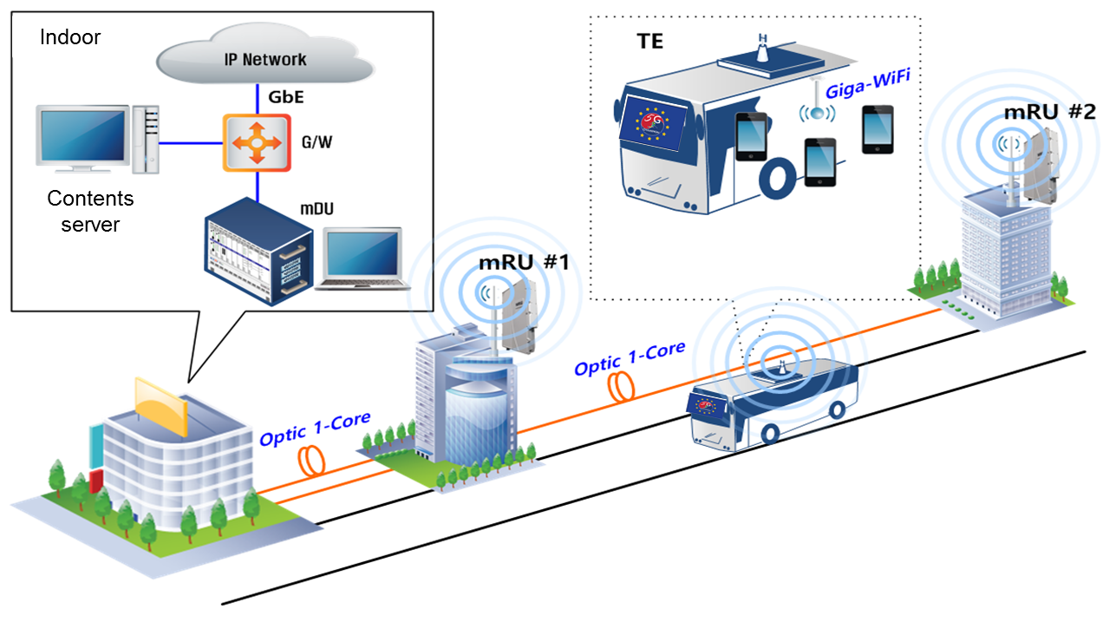
Plan for MHN-E Demonstration
Plan for MHN-E Demonstration
  Phase 3: field trial using a bus running at a speed of up to 60km/h
  Phase 4: demonstration using subway train (TBD)
MHN-E technologies^{[3]}
  Antenna configurations of mRU and mTE
Source from HFR

Slide 17
References
[1] | S. W. Choi et al., “Performance Evaluation of Millimeter-wave-based Communication System in Subway Tunnels”, IEEE 802.15-16-0185-01-hrrc, Mar. 2016
[2] | S. W. Choi, H. Chung, J. Kim, J. Ahn, and I. Kim, "Mobile Hotspot Network System for High-Speed Railway Communications Using Millimeter Waves," ETRI Journal, vol. 38, no. 6, pp. 1042-1051, December 2016.
[3] | J. Kim, H. S. Chung, S. W. Choi, I. G. Kim and Y. Han, "Mobile Hotspot Network Enhancement System for High-Speed Railway Communication," EuCAP 2017, March 2017.

Slide 18
Thank you

