Slide 1
Project: IEEE P802.15 Working Group for Wireless Personal Area Networks (WPANs)
Submission Title: Ethernet convergence for 802.15.3d
Date Submitted: 2016-09-13
Source: Max Riegel, Company Nokia Bell Labs
Address -
E-Mail: maximilian.riegel@nokia.com
Abstract: Document discusses the possibility to transfer Ethernet frames over 802.15.3
Purpose: Contribution of various aspects to conclude and decide about further steps necessary to enhance the FCSL for transfer of Ethernet frames over 802.15.3
Notice: This document has been prepared to assist the IEEE P802.15. It is offered as a basis for discussion and is not binding on the contributing individual(s) or organization(s). The material in this document is subject to change in form and content after further study. The contributor(s) reserve(s) the right to add, amend or withdraw material contained herein.
Release: The contributor acknowledges and accepts that this contribution becomes the property of IEEE and may be made publicly available by P802.15.

Slide 2
Ethernet convergence for 802.15.3d
Max Riegel
(Nokia Bell Labs)

Slide 3
Prolog
This presentation was triggered by OmniRAN.
  OmniRAN works on “Network Reference Model and Functional Description of IEEE 802 Access Network (P802.1CF)”
  Generic specification for all IEEE 802 technologies
  Requires support of Ethernet transport in the data path
  Currently no 802.15 technology supports Ethernet transport over the air
    … but we would like to show applicability for 802.15.
Please treat this presentation more as observations than a proposal for going forward.

Slide 4
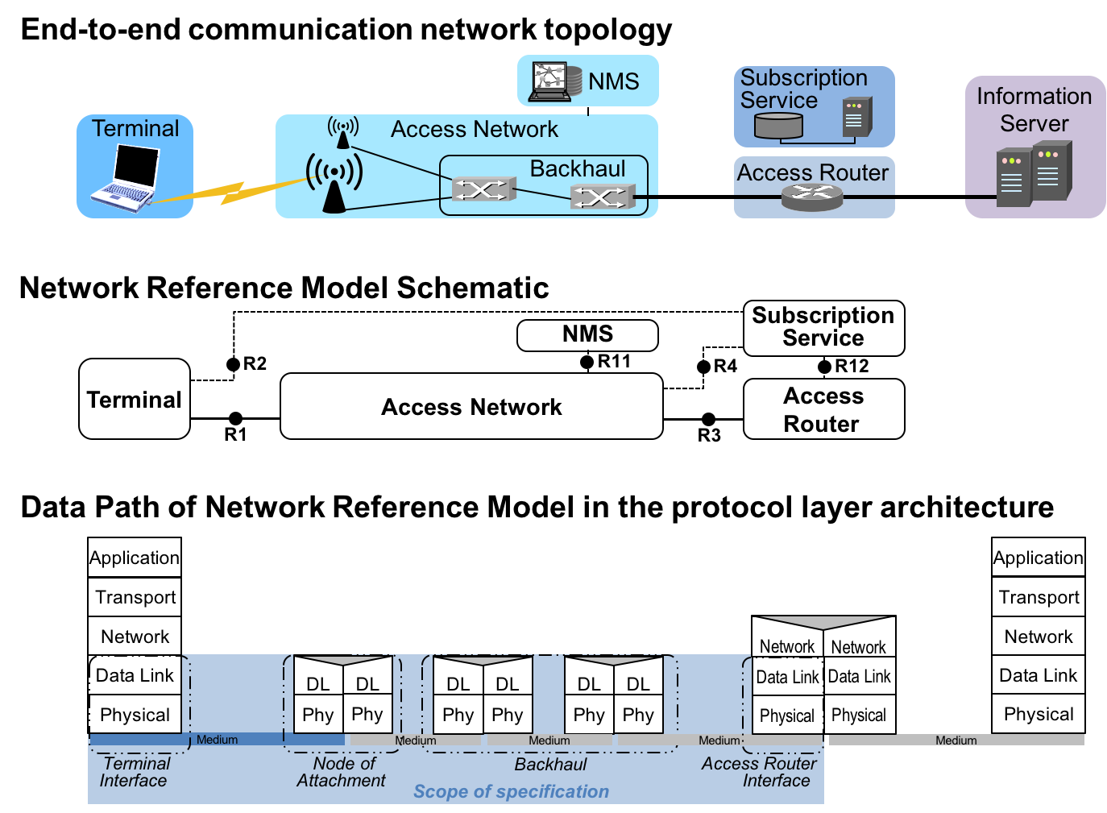
What is OmniRAN P802.1CF?
Scope of P802.1CF is limited to the specification domain of IEEE 802
  PHY, Data Link layer and forwarding in the data link layer (bridging).

Slide 5
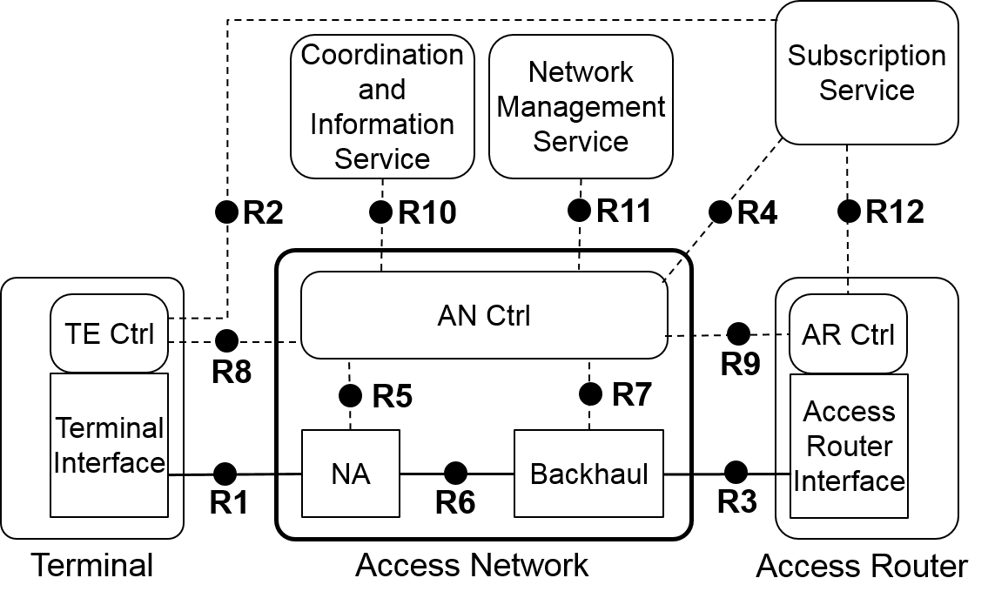
What does OmniRAN P802.1CF provide?
A functional model of an IEEE 802 access network
An standardized functional end2end model is prerequisite for many advanced networking topics, e.g. access network management, network virtualization, end2end SDN.

Slide 6
What is 802.15.3d – in my observation
802.15.3 defines direct communication within a pico-net (small distances of << 10m)
802.15.3 was initially aimed for operation in 2.4 GHz
802.15.3c added an additional PHY for 60 Ghz
P802.15.3d is on a PHY for 100 Gbps in the THz range
  E.g. addressing deployments of wireless links in data centers

Slide 7
802.15.3 protocol architecture
802.15.3 provides direct communication links between devices (DEVs)
Forwarding of MAC frames across DEVs is not supported
  Assumed to be peer2peer or to be done on higher layer

Slide 8
802.15.3 MSAP frame format
MSAP frame is limited to 8bit addresses for source and destination
MSDU can handle payloads up to 2044 bytes.
It supports 7 different QoS classes according to 802.1D.

Slide 9
Payload over 802.15.3
802.15.3 allows for a number of convergence sublayers
802.2 FCSL SAP is aimed for carrying higher layer protocol (e.g. IP) packets

Slide 10
Frame convergence sublayer (FCSL)
FCSL replaces 64bit DEV identifiers by 8bit addresses
  Classifiers in FCSL provide mappings
802.15.3 is currently not able to transfer Ethernet frames
  802.2 frames are carried with 8bit addresses
  Only higher layer protocols, e.g. IP, are aimed for payload
  Ethernet is not specified as payload in 802.2
  With bridging, DestAddr of Ethernet frame may be different from DestAddr of MAC frame.

Slide 11
Thoughts for going forward
Is Ethernet transport really required for 802.15.3d?
If yes, there might be an easy solution by tunneling Ethernet frames over the point2point links established by 802.15.3
  Either by amending current 802.2 FCSL by an Ethertype for Ethernet payload,
    Maintaining depreciated 802.2 LLC
  Or by defining a new EPD FCSL for native transport of Ethernet frames
    Moving forward to EPD, like 802.11 through .11ak

