Slide 1
Project: IEEE P802.15 Working Group for Wireless Personal Area Networks (WPANs)
Submission Title: [TG12 ULI Report for July 2016 Session]
Date Submitted: [25 July 2016]
Source: [Patrick Kinney] Company [Kinney Consulting LLC]
Address [Chicago area, IL, USA]
Voice:[+1.847.960.3715], E-Mail:[pat.kinney@ieee.org]
Re: [TG12 Report for July 2016 Session.]
Abstract: [Report for the July Session]
Purpose: []
Notice: This document has been prepared to assist the IEEE P802.15. It is offered as a basis for discussion and is not binding on the contributing individual(s) or organization(s). The material in this document is subject to change in form and content after further study. The contributor(s) reserve(s) the right to add, amend or withdraw material contained herein.
Release: The contributor acknowledges and accepts that this contribution becomes the property of IEEE and may be made publicly available by P802.15.

Slide 2
Instructions for the WG Chair
The IEEE-SA strongly recommends that at each WG meeting the chair or a designee:
  Show slides #1 through #4 of this presentation
  Advise the WG attendees that:
    The IEEE’s patent policy is described in Clause 6 of the IEEE-SA Standards Board Bylaws;
    Early identification of patent claims which may be essential for the use of standards under development is strongly encouraged;
    There may be Essential Patent Claims of which the IEEE is not aware. Additionally, neither the IEEE, the WG, nor the WG chair can ensure the accuracy or completeness of any assurance or whether any such assurance is, in fact, of a Patent Claim that is essential for the use of the standard under development.
  Instruct the WG Secretary to record in the minutes of the relevant WG meeting:
    That the foregoing information was provided and that slides 1 through 4 (and this slide 0, if applicable) were shown;
    That the chair or designee provided an opportunity for participants to identify patent claim(s)/patent application claim(s) and/or the holder of patent claim(s)/patent application claim(s) of which the participant is personally aware and that may be essential for the use of that standard
    Any responses that were given, specifically the patent claim(s)/patent application claim(s) and/or the holder of the patent claim(s)/patent application claim(s) that were identified (if any) and by whom.
  The WG Chair shall ensure that a request is made to any identified holders of potential essential patent claim(s) to complete and submit a Letter of Assurance.
  It is recommended that the WG chair review the guidance in IEEE-SA Standards Board Operations Manual 6.3.5 and in FAQs 14 and 15 on inclusion of potential Essential Patent Claims by incorporation or by reference.
  Note: WG includes Working Groups, Task Groups, and other standards-developing committees with a PAR approved by the IEEE-SA Standards Board.

Slide 3
Participants, Patents, and Duty to Inform
All participants in this meeting have certain obligations under the IEEE-SA Patent Policy.
  Participants [Note: Quoted text excerpted from IEEE-SA Standards Board Bylaws subclause 6.2]:
    “Shall inform the IEEE (or cause the IEEE to be informed)” of the identity of each “holder of any potential Essential Patent Claims of which they are personally aware” if the claims are owned or controlled by the participant or the entity the participant is from, employed by, or otherwise represents
    “Should inform the IEEE (or cause the IEEE to be informed)” of the identity of “any other holders of potential Essential Patent Claims” (that is, third parties that are not affiliated with the participant, with the participant’s employer, or with anyone else that the participant is from or otherwise represents)
  The above does not apply if the patent claim is already the subject of an Accepted Letter of Assurance that applies to the proposed standard(s) under consideration by this group
  Early identification of holders of potential Essential Patent Claims is strongly encouraged
  No duty to perform a patent search
Slide #1

Slide 4
Patent Related Links
  All participants should be familiar with their obligations under the IEEE-SA Policies & Procedures for standards development.
  Patent Policy is stated in these sources:
  IEEE-SA Standards Boards Bylaws
  http://standards.ieee.org/develop/policies/bylaws/sect6-7.html#6
  IEEE-SA Standards Board Operations Manual
  http://standards.ieee.org/develop/policies/opman/sect6.html#6.3
  Material about the patent policy is available at
  http://standards.ieee.org/about/sasb/patcom/materials.html
If you have questions, contact the IEEE-SA Standards Board Patent Committee Administrator at patcom@ieee.org or visit http://standards.ieee.org/about/sasb/patcom/index.html
This slide set is available at https://development.standards.ieee.org/myproject/Public/mytools/mob/slideset.ppt
Slide #2

Slide 5
Call for Potentially Essential Patents
If anyone in this meeting is personally aware of the holder of any patent claims that are potentially essential to implementation of the proposed standard(s) under consideration by this group and that are not already the subject of an Accepted Letter of Assurance:
  Either speak up now or
  Provide the chair of this group with the identity of the holder(s) of any and all such claims as soon as possible or
  Cause an LOA to be submitted
Slide #3

Slide 6
TG12 Officers
Chair Pat Kinney
Vice Chair Charlie Perkins
Slide 6
Notes:
July 16
Page 6

Slide 7
TG12 Meeting Goals
Monday 25 July, PM1: Opening report, Agenda, Functional decomposition review
Tuesday 26 July, AM2: Joint meeting with 802.15.4s – discussion on common elements
Tuesday 26 July, PM2: Discussion on Higher Layer Protocol Discrimination Entity
Wednesday 27 July, AM1: Discussion on Multiplexed MAC interface
Wednesday 27 July, PM1: Discussion on PHY and MAC configuration using Multiplexed MAC interface
Wednesday 27 July, PM2: Discussion on how KMP should work within 15.12
Thursday 28 July, AM1: Discussion on how 6LoWPAN should work within 15.12
Slide 7
Notes:
July 16
Page 7

Slide 8
TG12 Meeting
Monday 25 July, PM1: Opening report, Agenda, Functional decomposition review
  Approve Agenda 15-16-0456-01
  Approve Minutes from previous session 15-16-0403-00
  Functional Decomposition Review
Slide 8
Notes:
July 16
Page 8

Slide 9
Strategy for moving forward
Next Steps
Define how KMP should work within 15.12
  What does Link SAP look like?
  Expand the Multiplexed data service into the Multiplexed MAC interface
Define how 6LoWPAN should work within 15.12
  Define the Link SAP using IPv6, et al as examples
Define PHY configuration using management protocols function
Define MAC Configuration using management protocols function
Define the Higher Layer Protocol Discrimination Entity (HLPDE)
Define ULI header
  Unique identification of ULI presence
  Compression of higher layer stack and EtherType
  Other components?
Slide 9
Notes:
July 16
Page 9

Slide 10
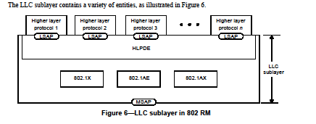
802-2014 Reference Model
Slide 10
Notes:
July 16
Page 10

Slide 11
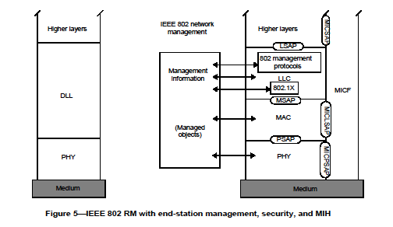
802-2014 Reference Model
Slide 11
Notes:
July 16
Page 11

Slide 12
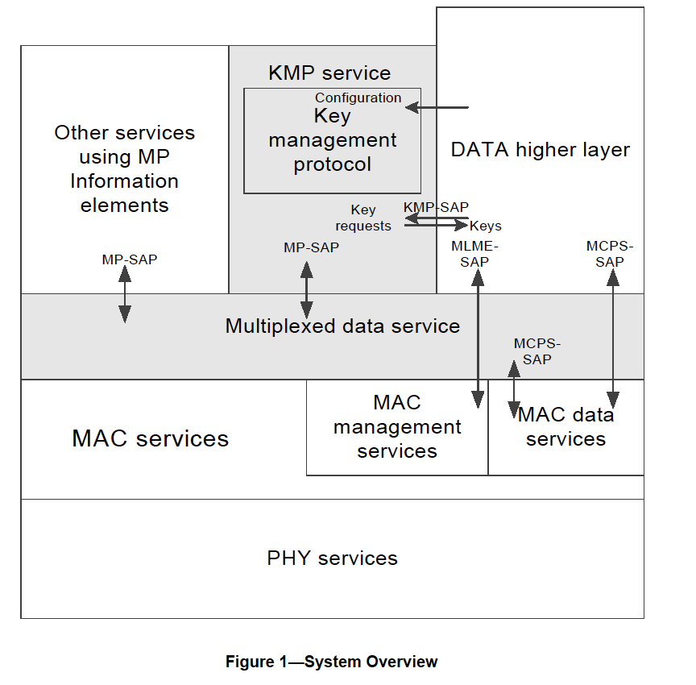
802.15.9 Functional Decomposition

Slide 13
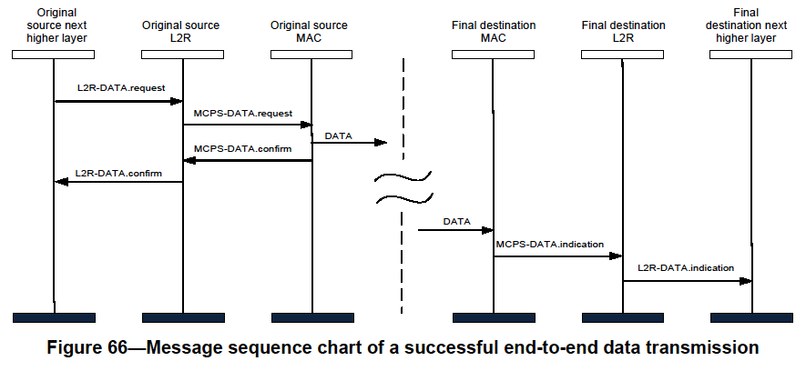
802.15.10 Functional Decomposition
The Data SAP and the MCPS-SAP are used for Multicast as indicated in Figure 19 and Figure 66
The MGMT SAP and the MLME-SAP are used as indicated in Figures 3 through 13

Slide 14
802.15.12 Functional Decomposition
Slide 14
Notes:
July 16
Page 14

Slide 15
802.15.12 Functional Description
Higher Layer Protocol Discrimination Entity (HLPDE)
  Directs and optionally modifies information from Functional SAP to the appropriate higher layer protocol SAP or another Functional SAP
Multiplexed MAC Interface (MMI)
  Directs and optionally modifies information from Functional SAP to the appropriate MAC SAP or another Functional SAP

Slide 16
802.15.12 Higher Layer Protocol Discrimination Entity (HLPDE)
  HLPDE will be dependent upon configuration of device (via Mgmt Protocol entity).
  For frames going to the higher layer, the HLPDE removes the ULI header (if present), and directs the frame to the proper SAP identified by the ULI header information.
  For datagrams coming from a higher layer, the HLPDE prepends the datagram with a ULI header and forwards it to the appropriate SAP defined by the configuration setting.
    Note: review how CoMI and CoAP send their management information to the correct device/SAP. Note: ask RAC for EtherType assignment for 802.15.12.

Slide 17
802.15.12 Multiplexed MAC interface
Multiplexed MAC Interface (MMI)
  Provides multiplex and fragmentation service to the packets sent by the ULI functions and send them to either the MCPS-SAP, the MLME-SAP, or to another function within the ULI.
  The interface between the MMI and the ULI functions includes the Multiplex ID and the payload to be sent or the payload received.
  The mechanism for the MMI, i.e. the ability to send the data to the proper SAP, will be an extension of the mechanism defined in IEEE 802.15.9 for the multiplexed data service

Slide 18
802.15.12 Functional Description
802.1X provides authentication, authorization, and cryptographic key agreement mechanisms to support secure communication between end stations connected to 802 networks.
802.15.9 (KMP) provides a methodology to enable key management by providing a transport for key management protocols outside the application layers. Additionally, provides a fragmentation and multiplexing layer for those packets so they can be delivered over smaller MAC layer frames and multiplexed on the recipient end to the right processing service.
6LoWPAN provides the function of MAC frame modification into a frame format for transmission of IPv6 packets and the method of forming IPv6 link-local addresses and statelessly autoconfigured addresses on IEEE 802.15.4 networks. Additional functions include a header compression scheme using shared context and provisions for packet delivery in IEEE 802.15.4 meshes.

Slide 19
802.15.12 Functional Description
6tisch functions as an abstraction of an IP link over the TSCH mode of the MAC sublayer by providing network formation and maintenance, multi-hop topology, assign time source neighbor, resource management, dataflow control, scheduling mechanisms, and security.
802.15.10 (L2R) provides the following functions: topology construction, L2R mesh discovery/join/update/recovery, hop-by-hop retransmission, unicast/multicast/broadcast routing, data concatenation, short address assignment, and security
Management protocols provides a Yang modeling interface via the HLPDE-SAP to upper layer applications such as CoAP, CoMI. Additionally, it provides configuration parameters to the MAC and PHY via the MMI-SAP, and may provide configuration parameters to other protocol entities in the ULI.

Slide 20
 | Management Protocol Configuration Parameters via MGMT SAP
ULI Protocol entity | MAC Mode (incl. IEs) | PHY Parameters | PHY Parameters cont’d
 | TSCH | Channel | Number/Frequency/Band
 | DSME | Bandwidth
 | RIT | Modulation
 | CSL | Preamble | Code/repetition
 | SUN | FCS size
 | TVWS | Packet Length
 | RFID | Data Rate
 | RCC | Transmit power level
 | LECIM | CCA | Mode/duration
 | PAN discovery | FEC | Rate/code/interleaving
 | PAN set-up | SFD | Size/value
 | Security | ED threshold
 | Association | Spreading factor
 | Promiscuous | DSSS code
 | Ranging | Data whitening
 | Spectrum Tracking | Common signaling mode
Slide 20
Notes:
July 16
Page 20

Slide 21
    Frame Composition
Slide 21
Notes:
July 16
Page 21

Slide 22
    Joint Meeting with TG4s
Dynamic 802.15.4 Management
  MAC
  PHY
    Spectrum resource measurement
    Desired signal strength and non-desired signal strength
      Regulatory
      Transmit power level set
      CCA threshold
    Transmit power level
      Set maximum to comply to regulatory
Slide 22
Notes:
July 16
Page 22

Slide 23
    Deliverables
Deliverables
Management SAP
  Configuration Management
    Dynamic PHY management
      B Rolfe to provide
    Network
      Set-Up
    MAC
      Set-Up
    PHY
      Set-Up
    Security
      Set-Up
    TSCH set-up
      P Kinney to provide
    Channel Hopping
  Yang Modeling
  L2 Routing
    C Perkins to provide
Data SAP
  Protocol Differentiation
    EtherType
  Security
    KMP (802.15.9)
      ETSI TS102887-2
      802.1x
      Internet Key Exchange (IKE)
      Dragonfly
      PANA
      Vendor specific
  MAC Resource Management
    Priority
    GTS management
  TSCH Operation
    P Kinney to provide
  Fragmentation
    Adaptive
    PHY (PSDU)
    UpperLayer
      802.15.9
      6LoWPAN
  Location awareness
    Ranging
    B Verso to provide
Slide 23
Notes:
July 16
Page 23

Slide 24
    Deliverables
Management SAP
  Configuration Management
    PHY
      Set-Up
        Channel
          Center frequency
          Channel number
          Regional band
        Bandwidth
        Modulation
          Channel page
        Preamble
          Code
          Repetition
        FCS size
        Packet Length
        Data Rate
        Transmit Power level
        Data Whitening
        Common Signalling Mode
        ED Threshold
        Spreading Factor
        DSSS code
        CCA
          Mode
          duration
        FEC?
          Rate
          Coding
          Interleaving
        SFD
          Size
          value
Slide 24
Notes:
July 16
Page 24

Slide 25
    Deliverables
Management SAP
  Configuration Management
    MAC
      Set-Up
        FFD?
        Beacon-enabled?
          DSME?
            Seong-Soon Joo to provide
          Superframe parameters
        Low Energy?
          Parameters
        Channel Hopping?
          parameters
        Association?
          Fast?
        Synchronization
          Superframe
          TSCH
        ACK required?
        Promiscuous mode?
          Ask Packet Sniffer vendors or chipset vendors
        Device Announcement
        UL IEs?
          parameters
Slide 25
Notes:
July 16
Page 25

Slide 26
    Deliverables
Management SAP
  Configuration Management
    Network
      Set-Up
        PAN Coordinator?
          Beacon-enabled?
          Low Energy?
          Association?
            Fast?
            Permit to Join?
              Criteria to accept
          Short Address?
            Assignment
        Channel Scan
Slide 26
Notes:
July 16
Page 26

Slide 27
Strategy for moving forward
Next Steps
Define the Higher Layer Protocol Discrimination Entity (HLPDE).
Define how the Multiplexed MAC interface (MMI) works using the Multiplexed data service as a baseline.
Define how the management protocols work
  PHY configuration
  MAC configuration
  TG4s coordination efforts
Define how KMP should work within 15.12.
  Define the KMP SAPs using 802.1X as an example
Define how 6LoWPAN should work within 15.12.
  Define the 6LO SAPs using IPv6 as an example
Define how L2R should work within 15.12.
  Define the L2R SAPs using both an endpoint and router as examples
Define how Ranging should work within 15.12
  Define the RNG SAPs using RFID as example
Define ULI frame mechanism (ULI IE/Payload).
  Unique identification of ULI presence
  Compression of higher layer stack and EtherType
  Other components?
Slide 27
Notes:
July 16
Page 27

Slide 28
    Future Efforts
Functional Blocks
HLPDE P Kinney
MMI P Kinney
Management Protocol H Yokota
6LoWPAN
KMP
802.1X
L2R C Perkins
6tisch
Ranging B Verso
Functional Block Overview
How do they work?
What functions do they include?
How do the SAPs work?
What primitives are required?
What parameters are required?
Slide 28
Notes:
July 16
Page 28

Slide 29
Meeting Accomplishments
Discussion on the concepts necessary for 802.15.12
  Use of an IE assigned to 15.12 for any ULI message
  Use of an IE assigned to 15.12 for ULI 6LoWPAN message
  Use of the frame payload for ULI message (note: requires the devices to have security and use a well-known key for discovery)
Discussion on the architecture for 802.15.12
  Agreement on extensible and scalable architecture
Discussion with TG4s on common efforts
  Agreement on common efforts and methods to work together
Slide 29
Notes:
July 16
Page 29

Slide 30
802.15.12 Functional Decomposition
Slide 30
Notes:
July 16
Page 30

Slide 31
    Frame Composition
Slide 31
Notes:
July 16
Page 31

Slide 32
    Schedule
TASK | Start | Completed
TG12 | May, 2016 | November, 2018
Concept and Architecture | May, 2016 | July, 2016
Baseline definition | July, 2016 | Nov, 2016
Draft | Nov, 2016 | March, 2017
TG Comment Collection | April, 2017 | May, 2017
WG Letter Ballot | June, 2017 | January, 2018
Sponsor Ballot | January, 2018 | July, 2018
NesCom | July, 2018 | September, 2018
IEEE-SA Publication | September, 2018 | November, 2018
Slide 32
Notes:
July 16
Page 32

