Slide 1
Project: IEEE P802.15 Working Group for Wireless Personal Area Networks (WPANs)
Submission Title: [Proposed resolution for cid#9]
Date Submitted: [14 April 2016]
Source: [Ken Hiraga⁽¹⁾, Keiji Akiyama, Jae Seung Lee, Itaru Maekawa, Makoto Noda, Ko Togashi, (representative contributors), all contributors are listed in “Contributors” slide]
Company: [ETRI, JRC, NTT¹, Sony, Toshiba]
Address¹: [Hirarinooka 1-1, Yokosuka Japan]
E-Mail¹: [hiraga.ken@lab.ntt.co.jp (all contributors are listed in “Contributors” slide)]
Re:[15-16-0292-00-003e]
Abstract: A proposed resolution to CID#9
Purpose: For a comment resolution to CID#9, we propose to add a MLME primitive that indicates the MCS that the DEV uses to the upper layer.
Notice: This document has been prepared to assist the IEEE P802.15. It is offered as a basis for discussion and is not binding on the contributing individual(s) or organization(s). The material in this document is subject to change in form and content after further study. The contributor(s) reserve(s) the right to add, amend or withdraw material contained herein.
Release: The contributors acknowledge and accept that this contribution becomes the property of IEEE and may be made publicly available by P802.15.

Slide 2
Contributors
Name | Affiliation | Email
Jae Seung Lee | ETRI | jasonlee@etri.re.kr
Moon-Sik Lee | ETRI | moonsiklee@etri.re.kr
Itaru Maekawa | Japan Radio Co., Ltd. | maekawa.itaru@jrc.co.jp
Doohwan Lee | NTT Corporation | lee.doohwan@lab.ntt.co.jp
Ken Hiraga | NTT Corporation | hiraga.ken@lab.ntt.co.jp
Hideki Toshinaga | NTT Corporation | toshinaga.hideki@lab.ntt.co.jp
Keitarou Kondou | Sony Corporation | Keitarou.Kondou@jp.sony.com
Hiroyuki Matsumura | Sony Corporation | Hiroyuki.Matsumura@jp.sony.com
Makoto Noda | Sony Corporation | MakotoB.Noda at jp.sony.com
Masashi Shinagawa | Sony Corporation | Masashi.Shinagawa@jp.sony.com
Ko Togashi | Toshiba Corporation | ko.togashi@toshiba.co.jp
Kiyoshi Toshimitsu | Toshiba Corporation | kiyoshi.toshimitsu@toshiba.co.jp

Slide 3
Comment to be resolved
CID | Page | Sub-clause | Line # | Comment | Proposed Change | E/T | Must Be Satisfied? | Resolution Stats
9 |  | n/a | n/a | Define method to send MCS info to the upper layer | Confirm why MLME channel status request has disappeared (6.3.18) | T | Yes | See document 15-16-0292-00, still pending, may want to know the MCS

Slide 4
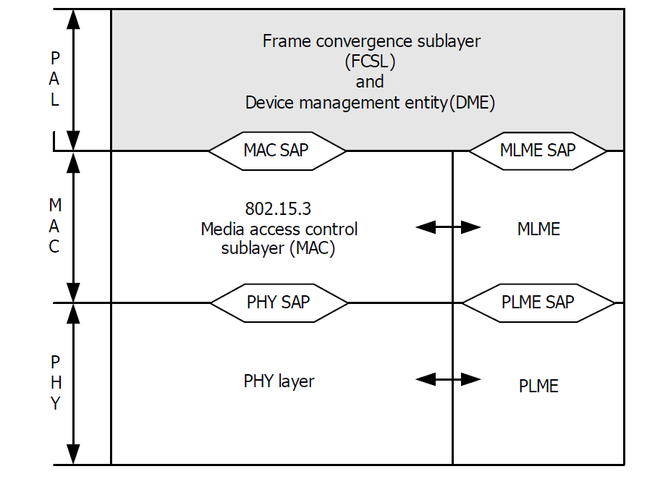
A new MLME primitive
We propose to add a new MLME primitive that indicates the current MCS identifier used in the frame to the upper layer.
This should be only used in the PPC. (Not used in non-PPC)
Hence it is not an over-air command.
HRCP-DEV #1 (PPC)
MLME-MCS.request
Ask the current MCS
HRCP-DEV #2 (non-PPC)
MLME-MCS.confirm
Information of the MCS identifier A
Used frequency channel P and Q
PHY frame( MCS identifier = A
at frequency channel P and Q)

Slide 5
Proposed text
Insert the following subclause, after subclause 5.3.18.
5.3.19 MCS indication to the upper layer
This function is only applicable for HRCP. These primitives are used to indicate the current MCS identifier and frequency channel used in the transmitted frame to the upper layer.

Slide 6
Proposed text (continued)
5.3.19.1 MLME-MCS.request
This primitive requests reports of MCS identifier to MLME.
The semantics of this primitive are:
MLME-MCS.request (
Timeout
)
The primitive has no parameters.
5.3.19.2 MLME-MCS.confirm
This primitive indicates the MCS identifier and frequency channel where the frame will be transmitted.
The semantics of this primitive are:
MLME-MCS.confirm (
MCSIdentifier
ChIdentifier
ResultCode
)
The primitive parameters are defined in Table 5-27a.

Slide 7
Proposed text (continued)
Table 5-27a. MLME-MCS primitive parameters
Name | Type | Valid range | Description
MCSIdentifier | Enumeration | Any valid MCS identifier, as defined in Table 11a-6. | MCS used in the transmitted PHY frame.
ChIdentifier | Enumeration | Any valid combinations of channel, as defined in figure 6-88c | The frequency channel used in the transmitted PHY frame.
Result Code | Enumeration | SUCCESS, FAILURE | Indicates the result of the MLME request.

