Slide 1
doc.: IEEE 802.15-16- 0283-03-007a
Project: IEEE P802.15 Working Group for Wireless Personal Area Networks (WPANs)
Submission Title: Invisible code for 2D-sequential code
Date Submitted: March 2016
Source: Mohammad Arif Hossain, Nam Tuan Le, Trang Nguyen, Yeong Min Jang [Kookmin University], Sung-Hee Lee, Nam-Kyung Lee [ETRI], and Jaesang Cha(SNUST).
Contact: +82-2-910-5068 E-Mail: yjang@kookmin.ac.kr
Re:
Abstract: This is a proposal for Invisible-Watermarking Image Sensor Communication (IISC) Scheme based on the Intensity Modulation technique of a image pixel. The proposed scheme is asynchronous and supportive for frame rate variation. This scheme is feasible for different kind of digital signage application, smart advertising, device-to-device communication and so on.
Purpose: Call for Proposal Response
Notice: This document has been prepared to assist the IEEE P802.15. It is offered as a basis for discussion and is not binding on the contributing individual(s) or organization(s). The material in this document is subject to change in form and content after further study. The contributor(s) reserve(s) the right to add, amend or withdraw material contained herein.
Release: The contributor acknowledges and accepts that this contribution becomes the property of IEEE and may be made publicly available by P802.15.
Submission

Slide 2
doc.: IEEE 802.15-16- 0283-03-007a
Contributed Modulation Schemes for ISC
Intel |  | Kookmin
 | UFSOOK |  | S2-PSK
 | Twinkle VPPM |  | S2 + DMS-PSK
Panasonic |  |  | FSK
 | PWM/PPM (3 modes) |  | OOK (2 modes)
 |  |  | 2D-sequential color code
SNUST |  | China Telecom
 | Offset-VPWM |  | PAPM
 | VCAM | SYCA
 | Invisible (2 modes) |  | CSM
NTU
 | RS-FSK

Slide 3
doc.: IEEE 802.15-16- 0283-03-007a
Contributed Modulation Schemes for ISC
Intel |  | Kookmin
 | UFSOOK |  | S2-PSK
 | Twinkle VPPM |  | S2 + DMS-PSK
Panasonic |  |  | FSK
 | PWM/PPM (3 modes) |  | OOK (2 modes)
 |  |  | 2D-sequential color code +… + (Invisible interface)
SNUST |  | China Telecom
 | Offset-VPWM |  | PAPM
 | VCAM | SYCA
 | Invisible (2 modes) |  | CSM
NTU
 | RS-FSK

Slide 4
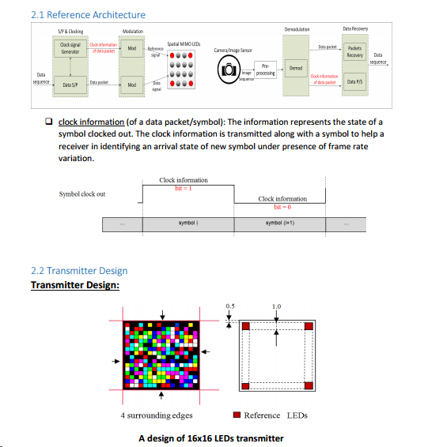
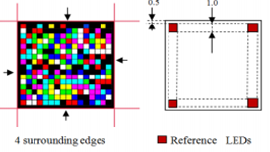
doc.: IEEE 802.15-16- 0283-03-007a
Kookmin PHY 6 modes: 2D-sequential color code for ISC
(IEEE P802.15-16-0241-00-007a)
Presented…
(Visible Interface)
Presenting…
(Invisible Interface)

Slide 5
doc.: IEEE 802.15-16- 0283-03-007a
Topology
Communication between any image senor such as camera and imaging device, for instance, display, monitor, digital signage etc.
Fields of Application:
Display to Camera Communication
Device-to-device communication
Display-User Interaction
Augmented Reality
Smart Advertising
Online payment
Online map viewing
Indoor navigation
Location based services
Figure 1: Illustration of Invisible-Watermarking Image Sensor Communication
Submission

Slide 6

doc.: IEEE 802.15-16- 0283-03-007a
Working Principle
Steps:
During video transmission, one image frame is made as reference image and the sequential image frame is modulated to transmit data i.e. the frame #i is the reference frame and the #(i+1) is the data frame.
The image is divided into NxM block where each block contains group of pixel. If the image frame contains PxQ pixel (P=row of pixel, Q= column of pixel), then every block will contain approximately (PxQ)/(NxM)= R pixels.
The data can be embedded real-time or prior to data transmission.
The data bit ‘1’ interprets changing in the average intensity or less intensity YCbCr elements of the pixel block; while the ‘0’ indicates no variation in the intensity of the pixels in the block.
The reference image and the data image is compared to extract the data.
Image Frame
Submission

Slide 7
doc.: IEEE 802.15-16- 0283-03-007a
Data embedding Mechanism
Submission

Slide 8
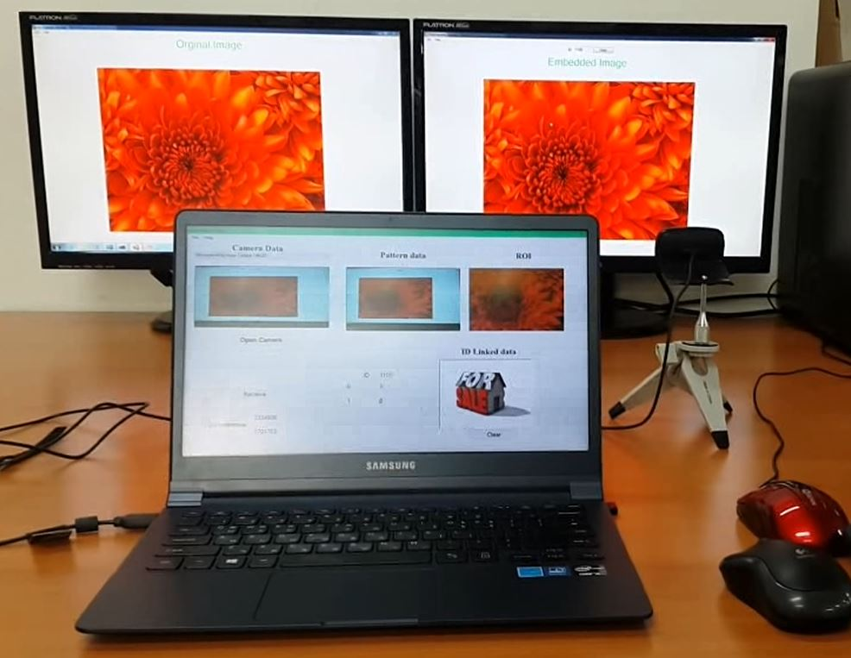
doc.: IEEE 802.15-16- 0283-03-007a
Illustration of the Implementation work
Figure: Demonstration of the implemented invisible embedded data for smart digital signage system. (Right side display contains an original video image while the left one includes the embedded data inside the image of the video)
Submission

