Slide 1
Project: IEEE P802.15 Working Group for Wireless Personal Area Networks (WPANs)
Submission Title: [Hybrid VLC and RF heterogeneous network for indoor applications]
Date Submitted: [7 March, 2016]
Source: [Dong Chen, Li Qiang, Jiang Tong] Company [Huawei]
Address [Huawei Building, No.3 Xinxi Road, Haidian, Beijing, China]
Voice:[86-15801539749], FAX: [+86-10-82882144], E-Mail:[john.liqiang@huawei.com]
Re: []
Abstract: [In this contribution, we analyze the benefits of joint operation of RF and VLC. The potential standard impacts are further presented.]
Purpose: [Contribution to IEEE 802.15.7r1 Optical Wireless Communication]
Notice: This document has been prepared to assist the IEEE P802.15. It is offered as a basis for discussion and is not binding on the contributing individual(s) or organization(s). The material in this document is subject to change in form and content after further study. The contributor(s) reserve(s) the right to add, amend or withdraw material contained herein.
Release: The contributor acknowledges and accepts that this contribution becomes the property of IEEE and may be made publicly available by P802.15.

Slide 2
Hybrid VLC and RF heterogeneous network for indoor applications
Dong Chen, Li Qiang, Jiang Tong
Huawei

Slide 3
Motivations for Hybrid RF + VLC system
Integration of VLC and RF systems is expected to significantly improve the user experience
VLC link: high data rates & limited coverage
RF link: moderate data rates & wide coverage
RF systems such as WIFI are already widely deployed
Crucial for commercial success

Slide 4
Network architecture
Coordinated network similar to the one proposed by [1]
RF connectivity is provided by a RF access point, which is co-located with the global controller
VLC connectivity is provided by coordinators
Global controller : Provides support for interference management and mobility control. RF connectivity is provided by a RF AP co-located with the global controller.
Coordinator : manages the operation of a corresponding VPAN
Device: support RF + VLC operations

Slide 5
Joint operation of RF and VLC
A device maintains the RF connectivity.
Once the device is associated with a VLC VPAN, the global controller may jointly use RF link and VLC link for data transmissions.
The global controller and the associated coordinator assist the device to handover to another VLC coordinator or fall back to RF link once it leaves the VPAN.

Slide 6
Device implementation
Device type | RF downlink | RF uplink | VLC downlink | VLC uplink
Type 1 |  |  | √ | √
Type 2 | √ | √ |  | √
Type 3 | √ | √ | √ | √
Type 2 is equipped with RF downlink and uplink. Yet only VLC downlink is implemented.
Compare to type 3, the cost is expected to be lower. Besides, the impacts to the design of smart phone will be less significant.

Slide 7
Uplink traffic handling for device type2
For device type2, uplink data is transmitted via RF link.
VLC MAC commands, such as association request, and ACK frames, are first transmitted to global controller via RF link. The global controller then forward them to the coordinator.
See Annex for detailed analysis.

Slide 8
Conclusions
In this contribution, we analyze the benefits of joint operation of RF and VLC. It is proposed that,
Proposal 1: A network architecture is proposed. RF connectivity is provided by a RF AP collocated with global controller while VLC connectivity is provided by a coordinator.
Proposal 2: specify procedures to support joint operation of RF and VLC
Proposal 3: specify procedures to support devices that only capable of VLC downlink receptions.

Slide 9
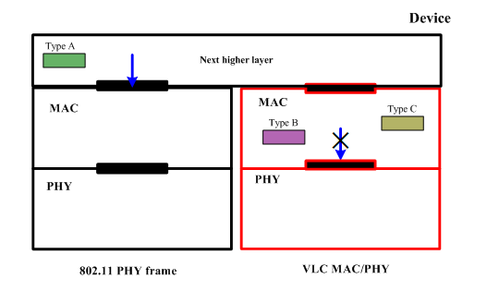
Annex: Uplink traffic handling for device type2
In the Annex, we demonstrate how the uplink traffic can be rerouted to RF link
Uplink traffic
Type A: data (can be directly send via RF link)
Type B: ACK frames for downlink data frame
Type C: other command frames (association request, GTS request, VPAN ID conflict notification, etc.)
Type B & C are generated by VLC MAC and should be reroute to RF link

Slide 10
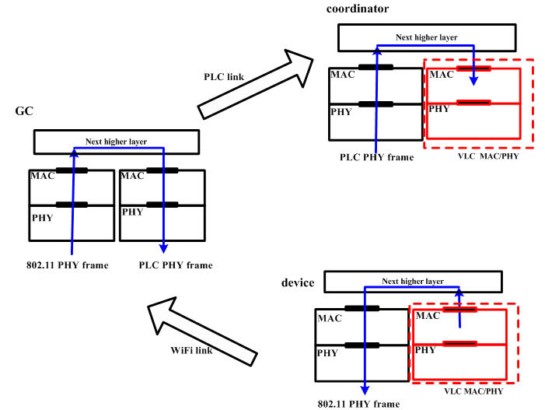
Annex: Uplink traffic handling for device type2
Assume the backhaul is PLC (Power line communication) based, an uplink transmission, such as an association request command or an ACK frame, shall be first transmitted to global controller and then rerouted to the coordinator through the PLC link.

Slide 11
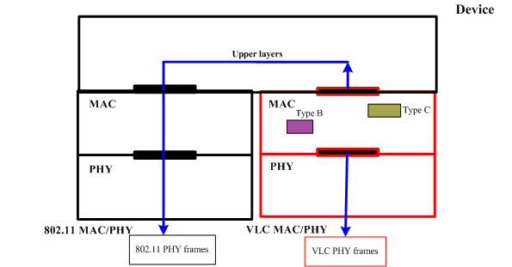
Annex: Uplink traffic handling for device type2
Specification support is needed
A set of primitives may need to be specified
Using RF link to transmit a uplink command frame
Original procedure for a device to transmit a uplink command frame

Slide 12
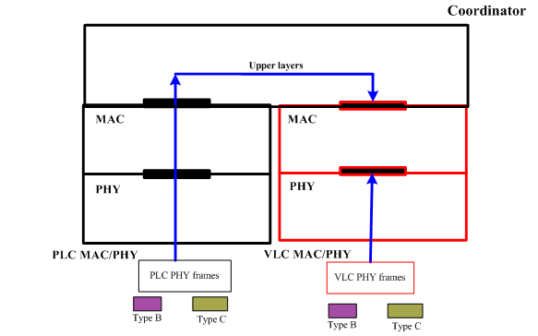
Annex: Uplink traffic handling for device type2
Specification support is needed
A set of primitives may need to be specified
Receive command frames forwarded from the global controller via PLC backhaul
Original procedure for a coordinator to receive a uplink command frame

Slide 13
Reference
Volker Jungnickel, Pablo Wilke Berenguer, Dominic Schulz, Zabih Ghassemlooy, Stanislav Zvánovec, “IEEE 15-16-0016-01-007a, Proposal for TG7r1 High-rate PD Communications”, IEEE 802 Wireless Interim Session (Atlanta), Jan 2016

