Slide 1
Project: IEEE P802.15 Working Group for Wireless Personal Area Networks (WPANs)
Submission Title: [A method for generating realistic wireless traffic through analysis of smartphone operation logs]
Date Submitted: [16 Feb, 2016]
Source: [Yuko Hirabe, Yutaka Arakawa, Keiichi Yasumoto] Company [Nara Institute of Science and Technology (NAIST)]
Address [Takayama-cho 8916-5, Ikoma, Nara 630–0192, Japan ]
Voice:[+81-743-72-5392], FAX: [+81-743-72-5976], E-Mail:[hirabe.yuko.ho2@is.naist.jp, ara@is.naist.jp, yasumoto@is.naist.jp]
Re: []
Abstract: [For development of a realistic performance eveluation model of IEEE 802.15, this document introduces an investigated result of the influence that IEEE 802.11 interference gives to IEEE 802.15 communication, taking account of users’ operation on smartphone applications. This is informative to discuss significance of performance analysis in IEEE802.15 TG4s.]
Purpose: [For discussion]
Notice: This document has been prepared to assist the IEEE P802.15. It is offered as a basis for discussion and is not binding on the contributing individual(s) or organization(s). The material in this document is subject to change in form and content after further study. The contributor(s) reserve(s) the right to add, amend or withdraw material contained herein.
Release: The contributor acknowledges and accepts that this contribution becomes the property of IEEE and may be made publicly available by P802.15.

Slide 2
A method for generating realistic wireless traffic through analysis of smartphone operation logs
Investigating influence of Wifi-interference to ZigBee communication and understanding Wifi traffic patterns by real smartphone applications
Authors:
Name | Company | Address | Phone | email
Yuko Hirabe, Yutaka Arakawa, Keiichi Yasumoto | Nara Institute of Science and Technology (NAIST) | Takayama-cho 8916-5, Ikoma, Nara 630–0192, Japan | +81-743-72-5392 | hirabe.yuko.ho2@is.naist.jp ara@is.naist.jp yasumoto@is.naist.jp

Slide 3






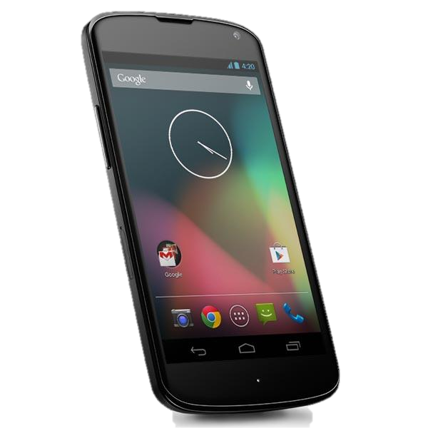

Background
802.11: Wifi 802.15: ZigBee
Sensors’ data
IoT + Smart Home
Popularization of the Internet of Things (IoT)
  Increase of networked home appliances
  Sensors for smart home
  ex) wattmeter, sensors of temperature, humidity, and location
Send sensor data by ZigBee
Many ZigBee and Wifi devices coexist in the home
→Heavy Wifi traffic may hamper ZigBee communication
Internet
Gateway
server
Send
Power
sensor
Wifi interference
Temperature,
humidity sensor
Location sensor
Current: realistic performance evaluation of 802.15 (ZigBee) base system is difficult due to Wifi interference.
Demand for performance evaluation of 802.15 (ZigBee) base system considering Wifi interference

Slide 4
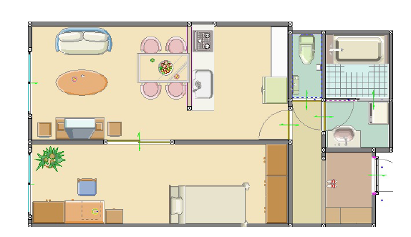
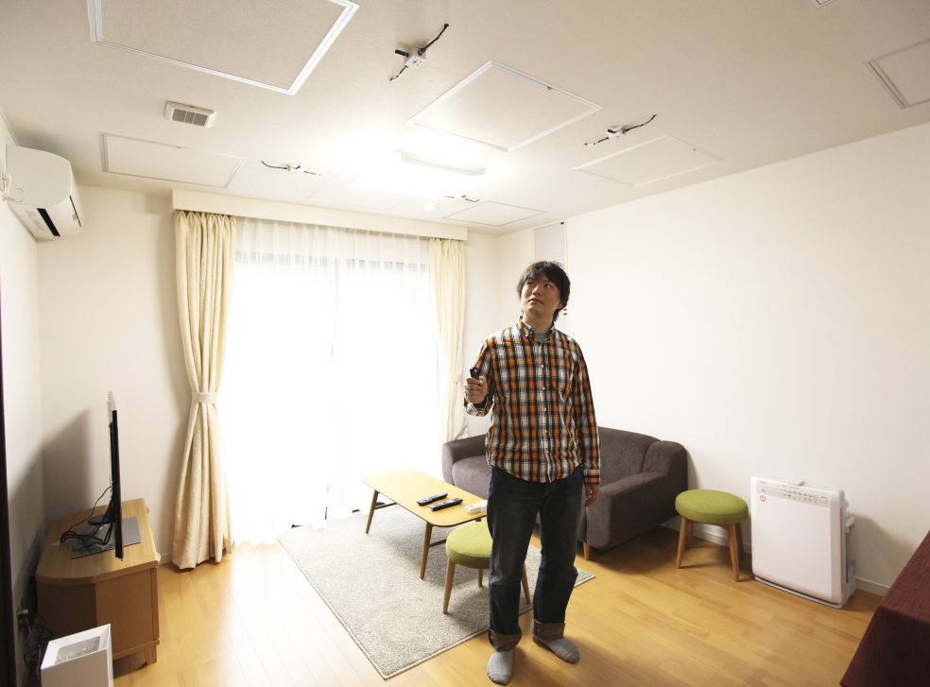
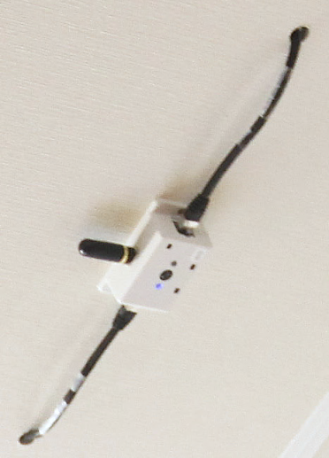
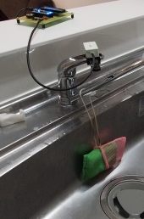
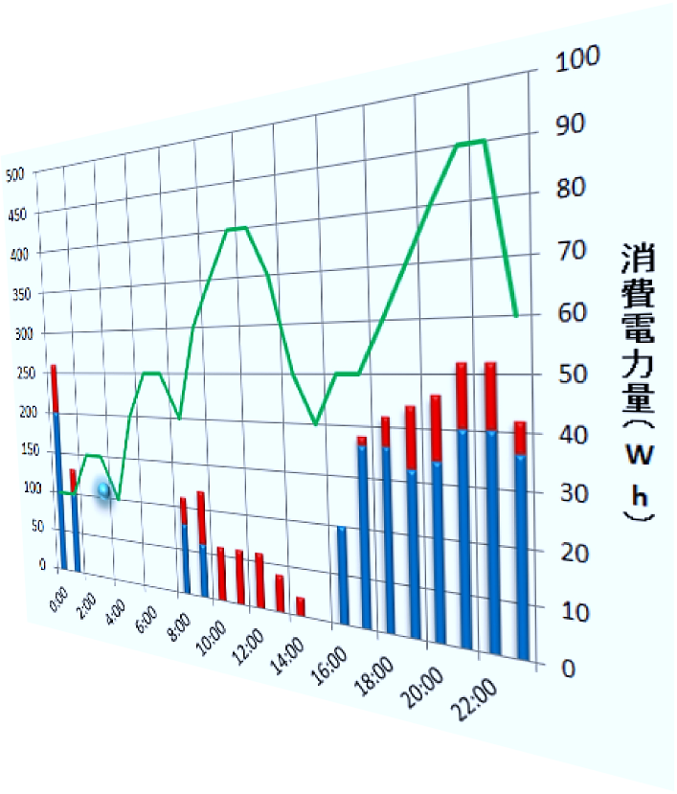
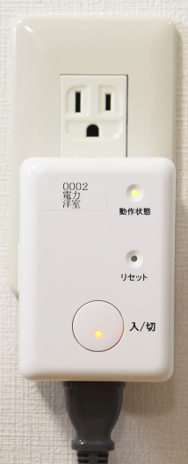
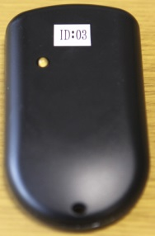
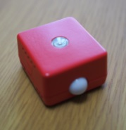
Smart home environment
Smart home in our lab
Continuously record sensor data 24 hours, 365 days
Sensors
  Sensors using ZigBee:
    Power sensor × 28
    Environment sensor × 24
    Door sensor × 15
  Sensors using Bluetooth:
    Power sensor × 10
  Sensors using EnOcean:
    Door sensor × 8
    CO2 × 4
    Illuminance × 4
    Button× 3
  Etc...
Location
(Ultrasonic receiver）
Location
(Ultrasonic sender）
Environment
sensor
Power
consumption

Slide 5











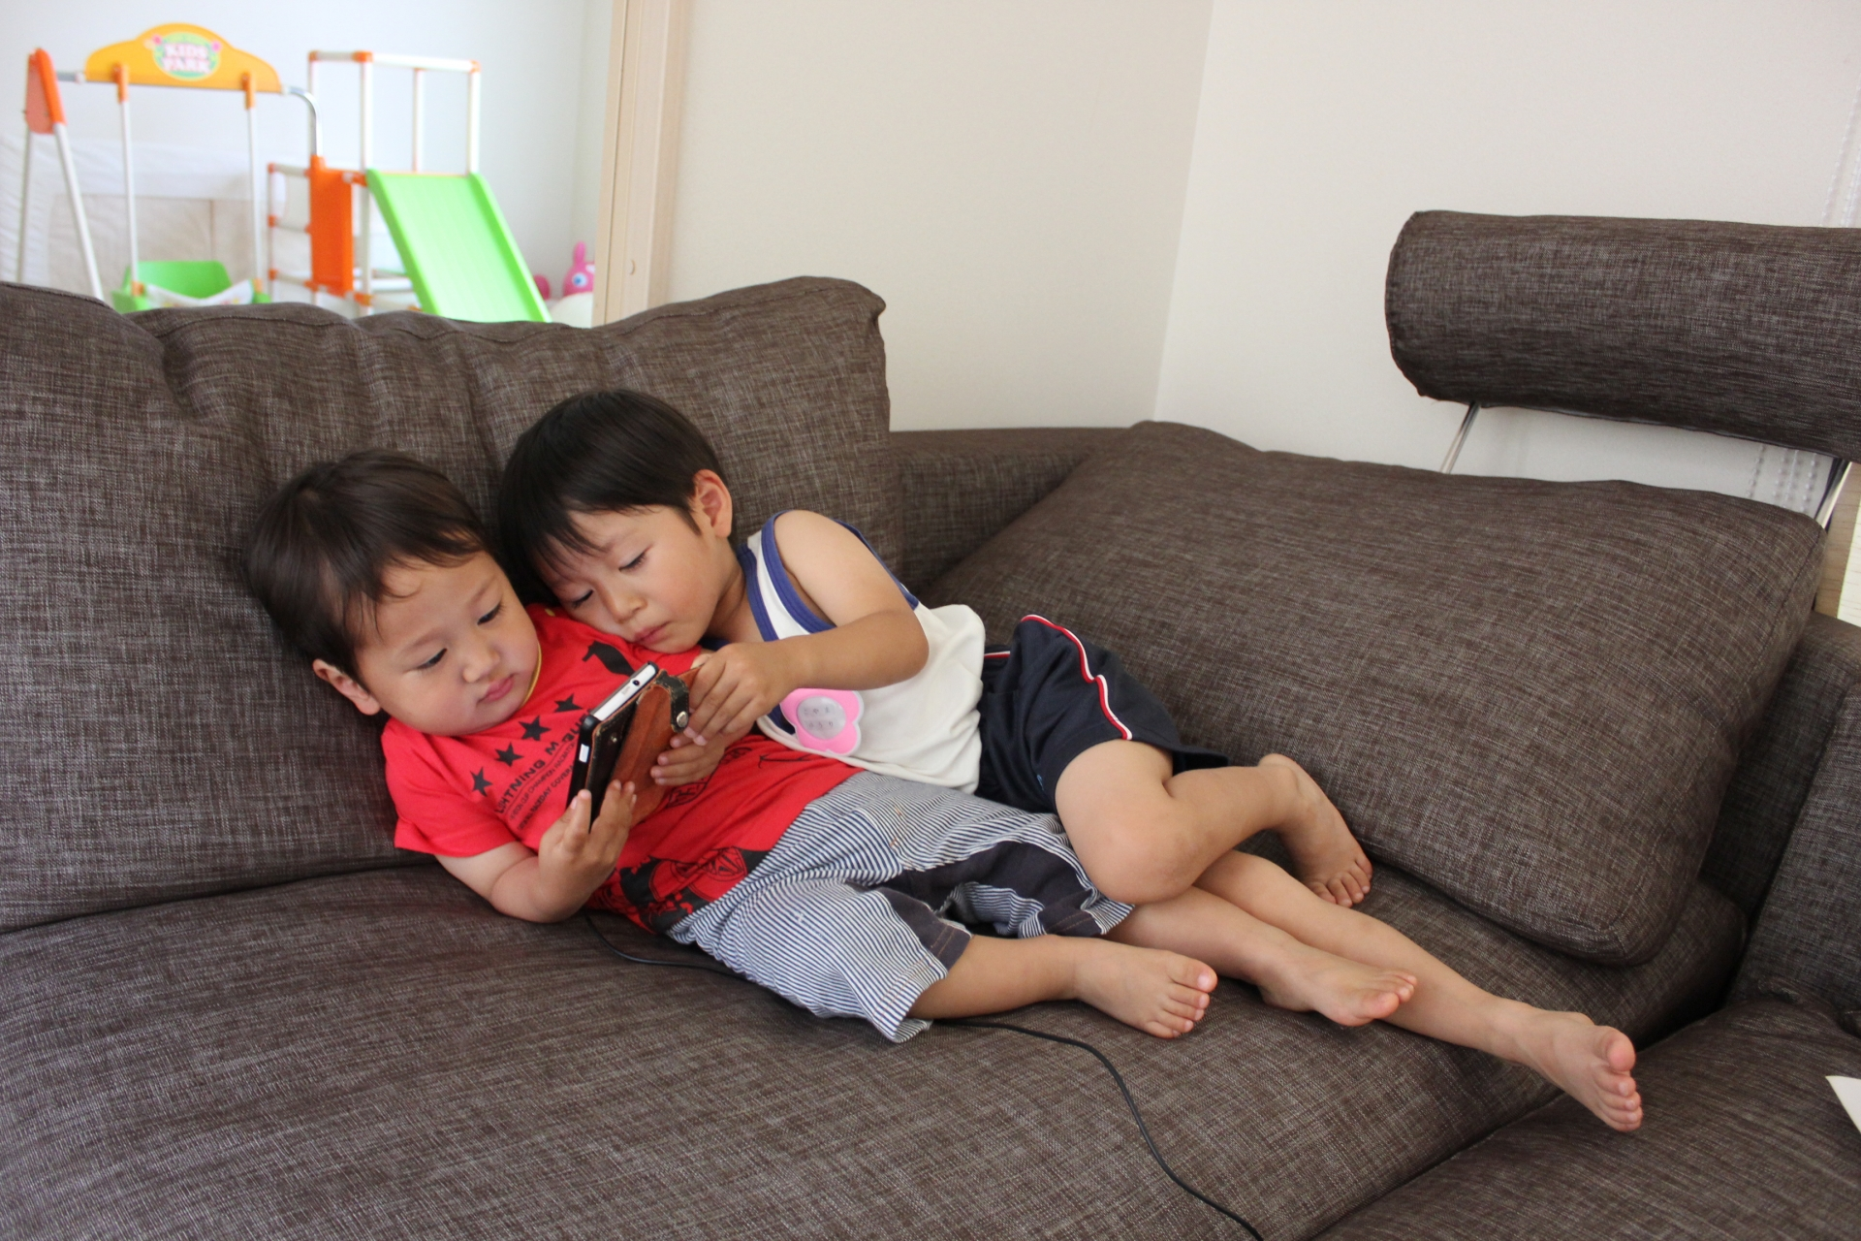

Users produce Wifi data traffic in smart home
① Bathroom
② Bedroom
②Bedroom
③ Kitchen
①Bathroom
③Kitchen
④Living room
④ Living room

Slide 6
How to consider the Wifi interference?
Performance evaluation of wireless communication system
  Wireless traffic generation by random/probabilistic traffic model ^{[1]}
Wifi coexists with 802.15 in a smart home environment.
  Wifi traffic may disturb ZigBee data communication.
  Current main traffic source is a smartphone.
For realistic performance evaluation of 802.15 base systems, we need to clarify and consider Wifi traffic from smartphones
1. H. Zhai et al., Performance analysis of IEEE 802.11 MAC protocols in wireless LANs, Wireless Communications and Mobile Computing 4.8, 2004.

Slide 7
Wifi traffic pattern depends on the type of apps.
Various mobile apps generate different traffic
  SNS: Facebook, Twitter, Instagram
    Text, Photo, Movie
  Multimedia: YouTube, Youku, iCloud, Google Photo
    Movie, photo （huge traffic [2]）
  Map: Google Maps, Apple map
    map tile data
  File: Dropbox, Box, Google drive
    Every types
Usage pattern also affects to the generated traffic.
  preload, play a video, input text, share photo
2. Chart by BI Intelligence, used in Business Insider event, IGNITION

Slide 8
Goal and approach
Goal:
Clarify how 802.11(Wifi) affects the performance of 802.15 (ZigBee)
Propose a method to construct a realistic wireless traffic generation model for realistic performance evaluation of 802.15 base systems
Approach:
Step1: Investigate how the interference with ZigBee-traffic happens while using Wifi
Step2: Investigate how users' operation on the applications affects Wifi traffic
Step3: Propose a method to construct a realistic WiFi traffic generation model for reproducing interference with 802.15

Slide 9
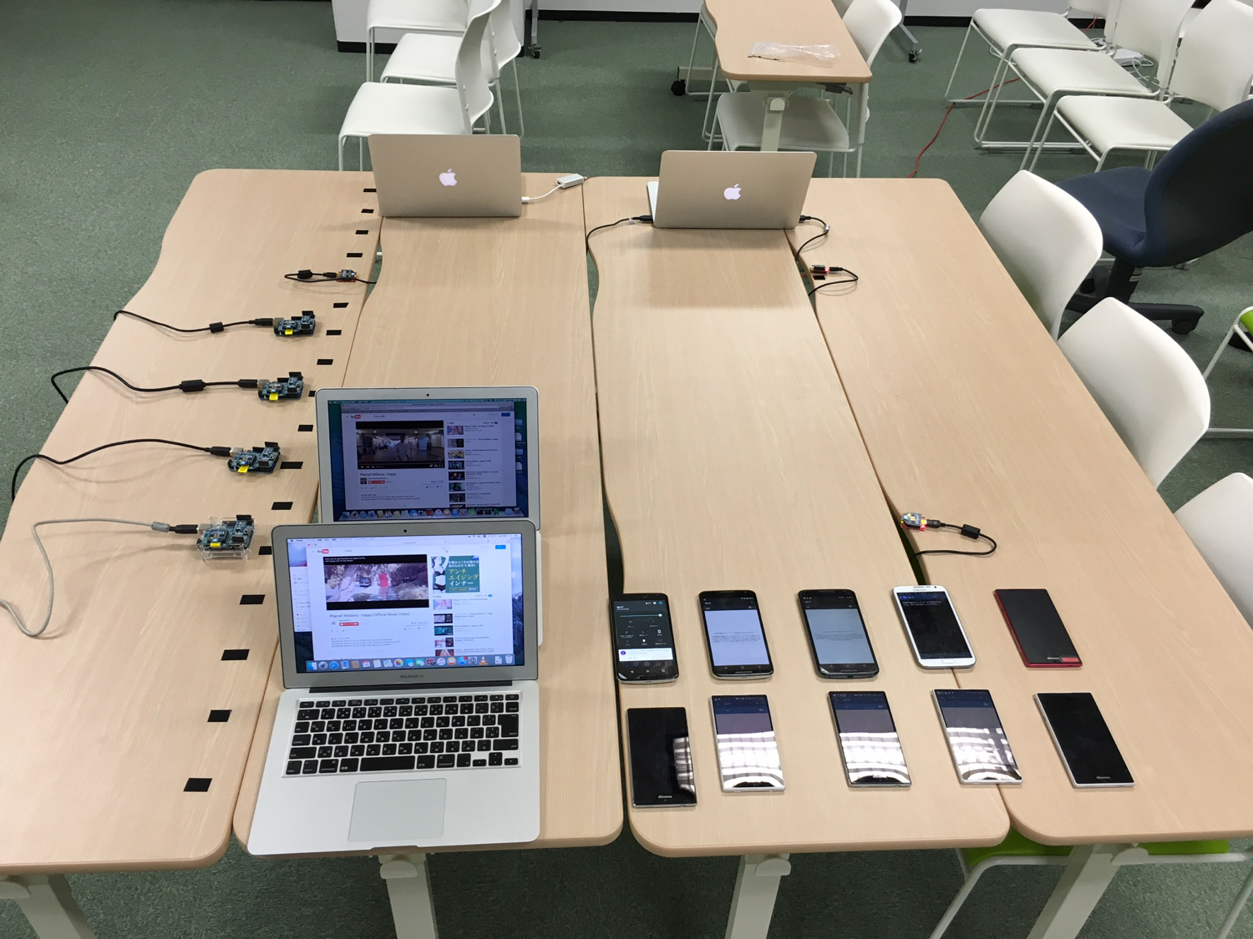
Step1: Investigate how interference with ZigBee-traffic happens while using Wifi (1/3)
Experiment environment
  802.15
  CH: 22 (2460MHz)
  7 Xbees
  （Sender: 5 Xbees, Receiver: 2 Xbees）
  One Macbook Air: 1
  802.11
  CH: 11 (2462MHz)
  Connection side
    Android: 10
    Macbook Air: 2
  Access point
    Macbook Pro
Actual environment
802.15
802.11

Slide 10
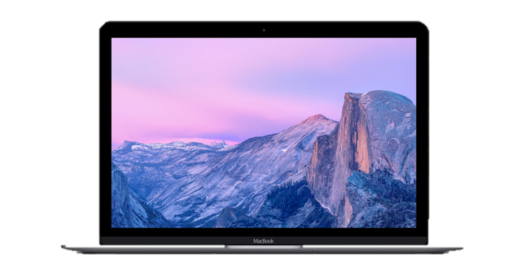
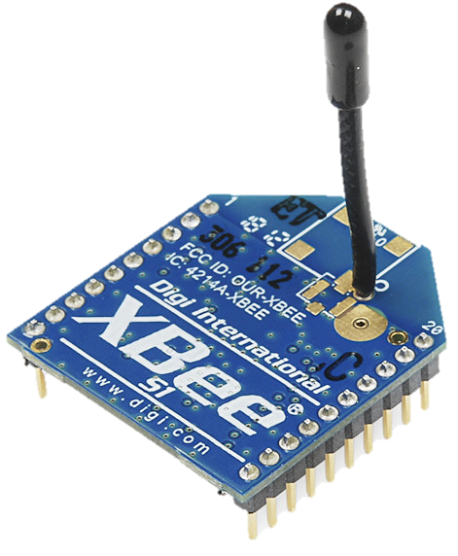
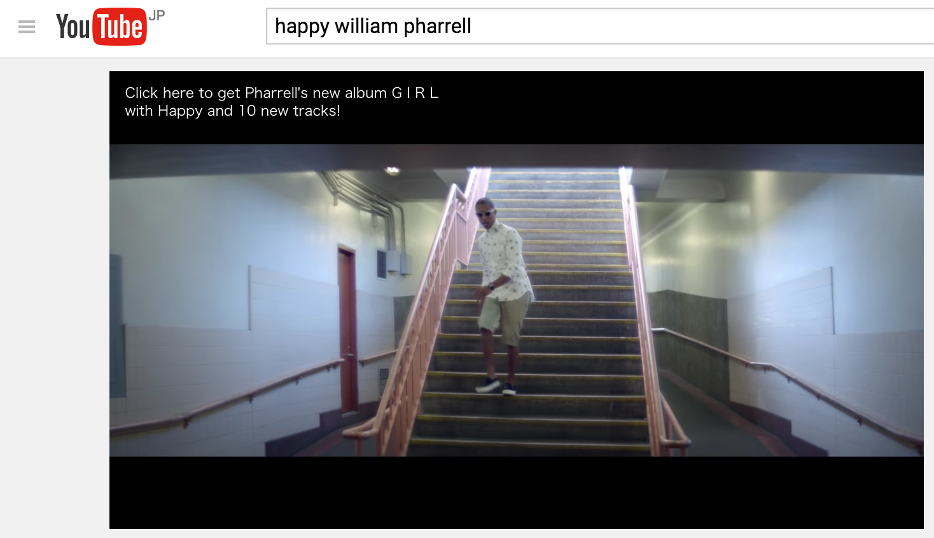
Step1: Investigate how interference with ZigBee-traffic happens while using Wifi (2/3)
Set the environment as the Wifi interferences happens to ZigBee
Wifi access point
Data sending side
10 times / 1s
Total 1200 times
× 5
Macbook Pro
Wifi connection
Interference
1.5 m
Data receiving side
ZigBee data transmission
1.0 m
Android × 10
Play the movie (1080p) with each devices
Macbook Air
Macbook Air × 2
Xbee

Slide 11
Step1: Investigate how interference with ZigBee-traffic happens while using Wifi (3/3)
We observe the following with ZigBee communication
  Transmission time between send and receive
  The number of retry
We changed the environment as follows:
  Increased ZigBee data traffic when WiFi is not used
  Changed the distance between ZigBee receiver and Wifi access point with Wifi connection
  Increased the number of WiFi devices connecting to Wifi access point

Slide 12
1. Increase ZigBee data traffic without WiFi （1/2）
Result : Transmission time between send and receive
80 byte
The more data transmission volume increases, the longer ZigBee takes a transmission time.
2 byte
Transmission time between send and receive (s)
80 byte
2 byte
The number of data transmission time (times)

Slide 13
1. Increase ZigBee data traffic without WiFi （2/2）
Result : The number of retry
Total times of data transmission: 1200
The number of retry increases when data transmission volume is small.
The number of retry (times)
When data transmission volume increased, data transmission time grows and also the number of retry decreases.
→In rest investigations, we set data transmission volume 80 byte.

Slide 14
  2. Change the distance between ZigBee receiver and Wifi access point (with Wifi)
  Result: The number of retry
Total times of data transmission: 1200
** Transmission time between send and receive didn’t change
When the distance between ZigBee receiver and Wifi access point is zero, the number of retry decreased.
d: distance between ZigBee receiver and Wifi access point
  d = 0.0 or 1.0 (m)
One device is connected to Wifi access point
d = 0.0
d = 1.0
The number of retry (times)
The distance between ZigBee receiver and Wifi access point don't affect ZigBee interference.

Slide 15
  3. Increase the number of WiFi devices connecting to Wifi access point (with Wifi)
  Result: The number of retry
Total times of data transmission: 1200
** Transmission time between send and receive didn’t change
The number of retry (times)
The more the number of device increases, the more the number of retry grows.
The number of retry is up to six times, compared when Wifi wasn't connected.
0
1
2
3
4
5
6
7
8
9
10
11
12
6
The number of Wifi devices connecting to Wifi access point
When many devices connected to Wifi access point, the number of retry grew → the effect of the interference

Slide 16
Goal and approach
Goal:
Clarify how 802.11(Wifi) affects the performance of 802.15 (ZigBee)
Propose a method to construct a realistic wireless traffic generation model for realistic performance evaluation of 802.15 base systems
Approach:
Step1: Investigate how the interference with Zigbee-traffic happens while using Wifi
Step2: Investigate how users' operation on the applications affects Wifi traffic
Step3: Propose a method to construct a realistic WiFi traffic generation model for reproducing interference with 802.15

Slide 17
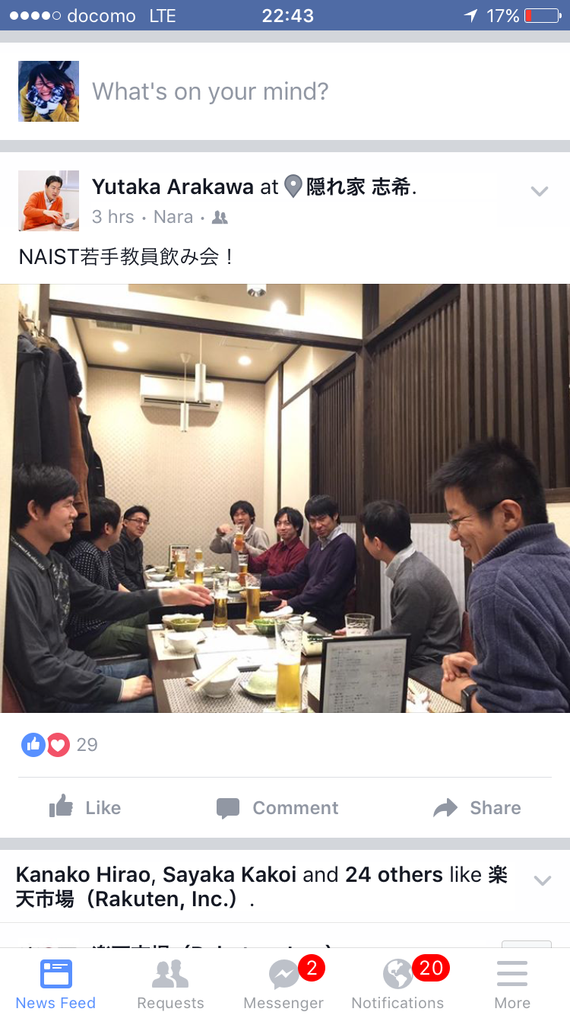
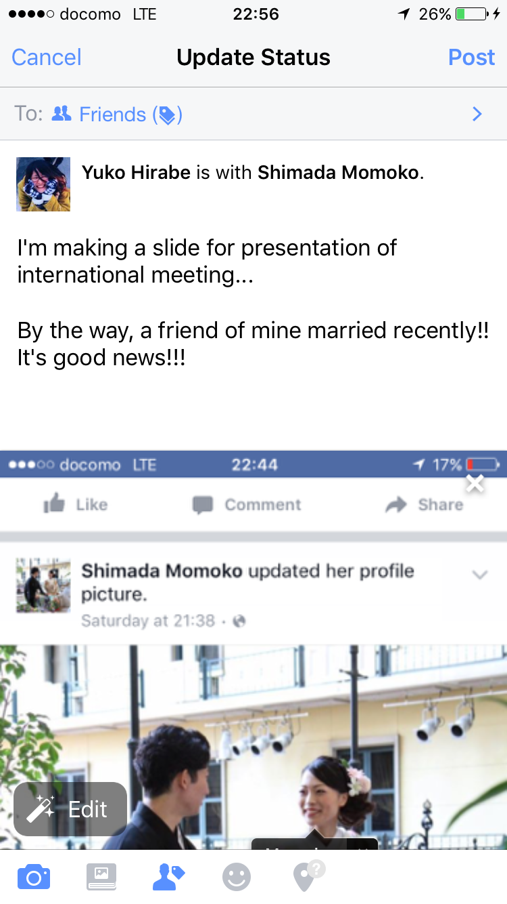
Step2: Investigate how users’ operation on the applications affects Wifi traffic (1/3)
Different traffic for different usage pattern
View posts by others
(Download)
Post items
（Upload）
Scrolling
→preload & increase of traffic
Contents
Text, picture, movie
Comments：Like, text
Posts: text, picture, movie, share
→larger traffic
DL happens in only displayed range

Slide 18
Step2: Investigate how users’ operation on the applications affects Wifi traffic (2/3)
Traffic generation pattern on Facebook
Facebook
Investigating targets
View：Download
Posts: Upload
Operations of 4 types
With scrolling
Without scrolling
Comments
Posts
Traffic
Big (DL)
Small (DL)
Small (UL)
Big (UL)

Slide 19
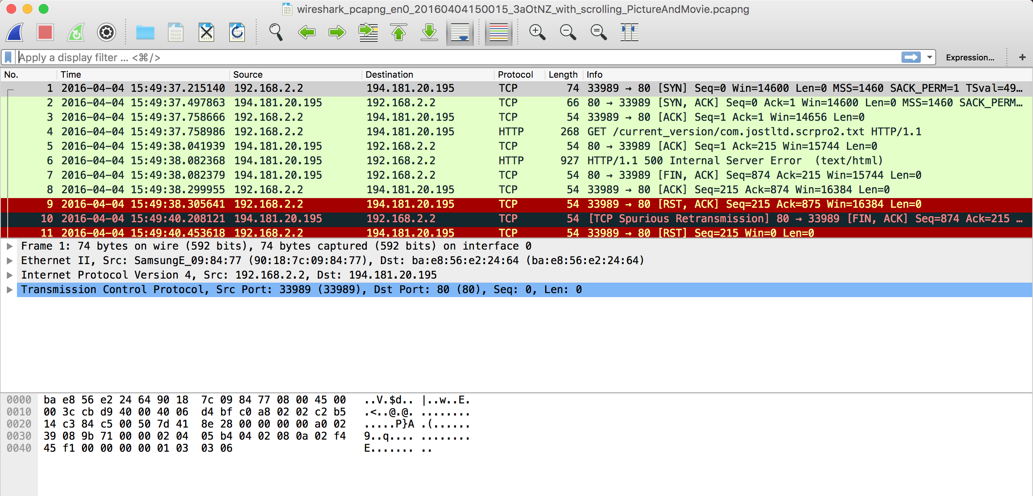
Step2: Investigate how users’ operation on the applications affects Wifi traffic (3/3)
Experiment environment
Target app: Facebook
Ethernet
Wifi connection
Obtain the packets with Wireshark
GALAXY Note II
Access point
Macbook Pro
Investigate apps’ traffic by showing the obtained packet as I/O graphs

Slide 20


Result
App’s window is just slid
Packets increased depending on users’ operation
Pictures and movies are selected, while sliding app's window

Slide 21
Goal and approach
Goal:
Clarify how 802.11(Wifi) affects the performance of 802.15 (ZigBee)
Propose a method to construct a realistic wireless traffic generation model for realistic performance evaluation of 802.15 base systems
Approach:
Step1: Investigate how the interference with Zigbee-traffic happens while using Wifi
Step2: Investigate how users' operation on the applications affects Wifi traffic
Step3: Propose a method to construct a realistic WiFi traffic generation model for reproducing interference with 802.15

Slide 22
Step3: Propose a method to construct a realistic WiFi traffic generation model for reproducing interference with 802.15
Approach:
Recognize a user’s operations on each app.
Measure a generated traffic for each operation
Construct a statistical traffic generation model by associating each operation with the measured traffic
Clarify the interference of 802.11 (Wifi) to 802.15 (ZigBee) by using a spectrum analyzer or packet loss evaluation.
View w/o scroll
Traffic distribution
Traffic generation model of each mobile user
Comment
View w. scroll
Post

Slide 23
Summary and discussion
Investigated how the interference with Zigbee traffic happens while using Wifi
Investigated how users' operation on the applications affects Wifi traffic
Proposed a method to construct a realistic WiFi traffic generation model for reproducing interference with 802.15
Future work
Investigate WiFi interference with ZigBee communication when user operations on smartphone apps are changed
Actually develop classification algorithm of users' app.
  target apps: Instagram, Facebook, LINE
Construct the model, and incorporate it into network simulators
Notes:
読む。

